Slide 1
Real-time and NoSQL Databases: Firebase
Dr. Samer zein

Slide 2
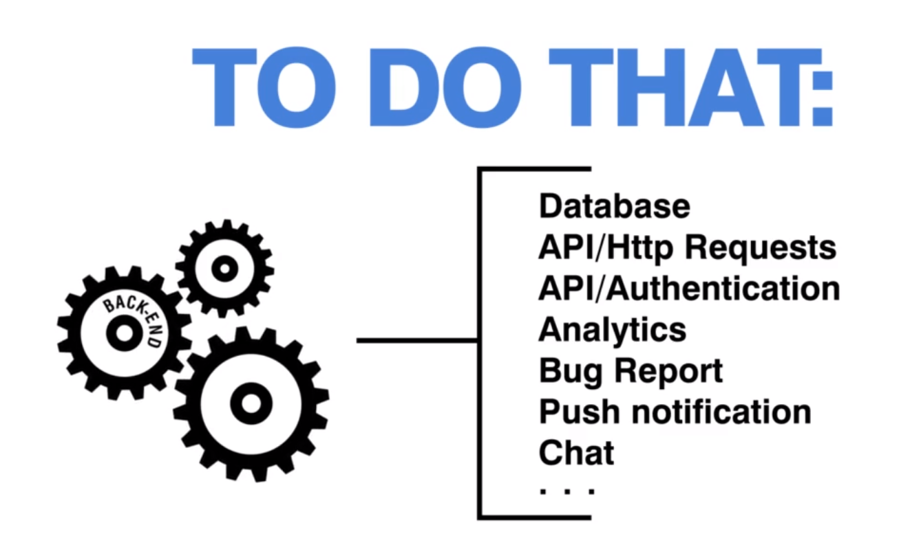
Why we need Firebase?
Suppose you want to develop a real-time app, something like chat app, you will need to create:

Slide 3
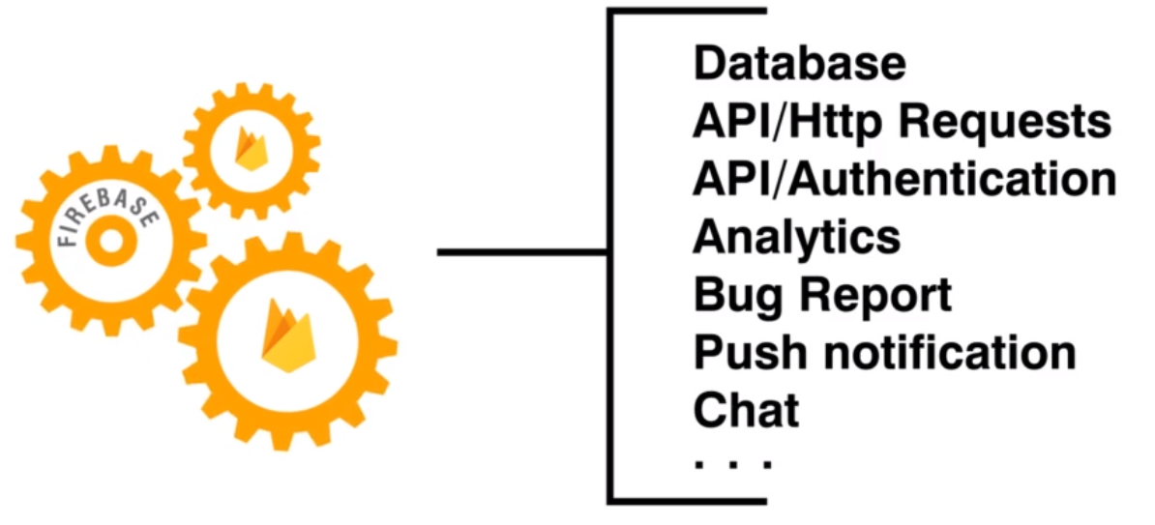
That is what Firebase already provides!

Slide 4
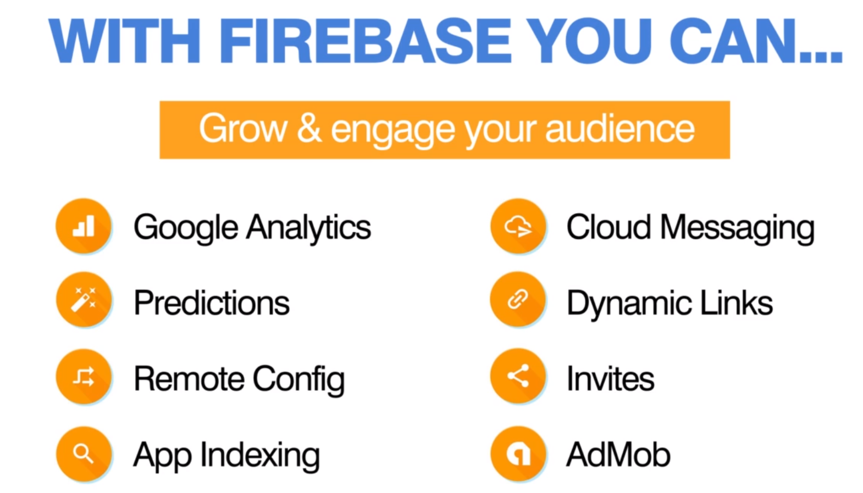
Customize this Template

Slide 5
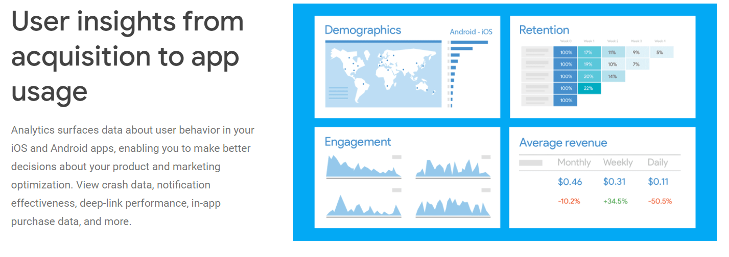
Firebase Analytics

Slide 6
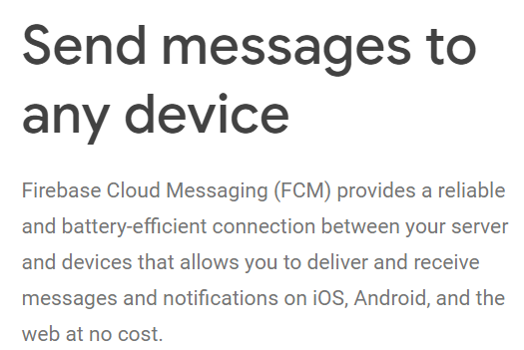
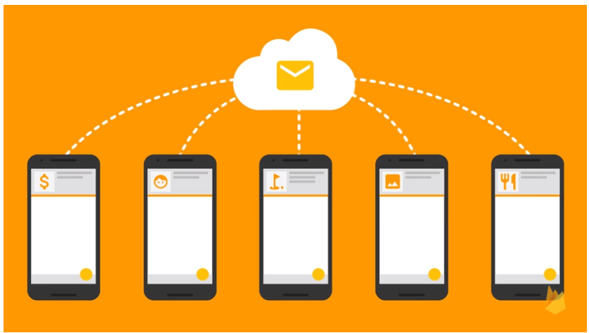
Firebase Cloud Messeging

Slide 7
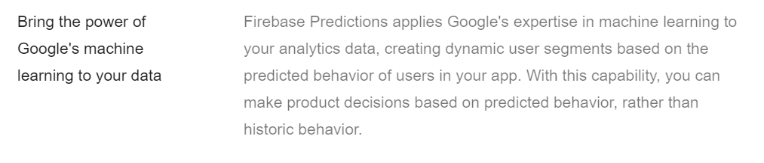
Firebase Predictions

Slide 8
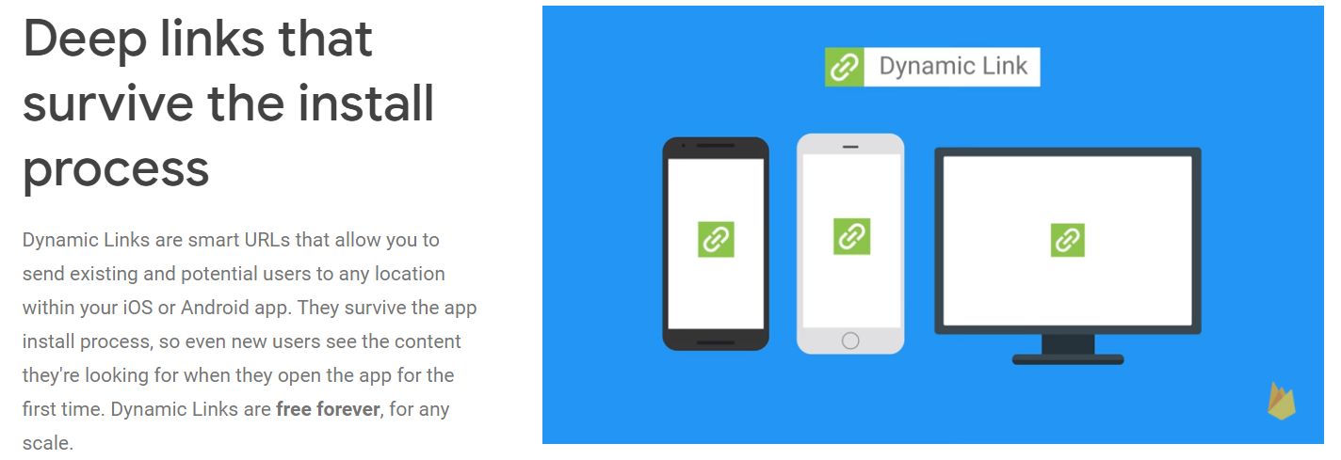
Firebase Dynamic Links

Slide 9
Firebase AdMob
Is a mobile advertising platform that you can use to generate revenue from your app.
Using AdMob with Firebase provides you with additional app usage data and analytics capabilities.
Show ads from millions of Google advertisers in real time or use AdMob mediation to earn from over 40 premium networks.
Simplify your ad operations, improve competition, and earn more, for free.

Slide 10
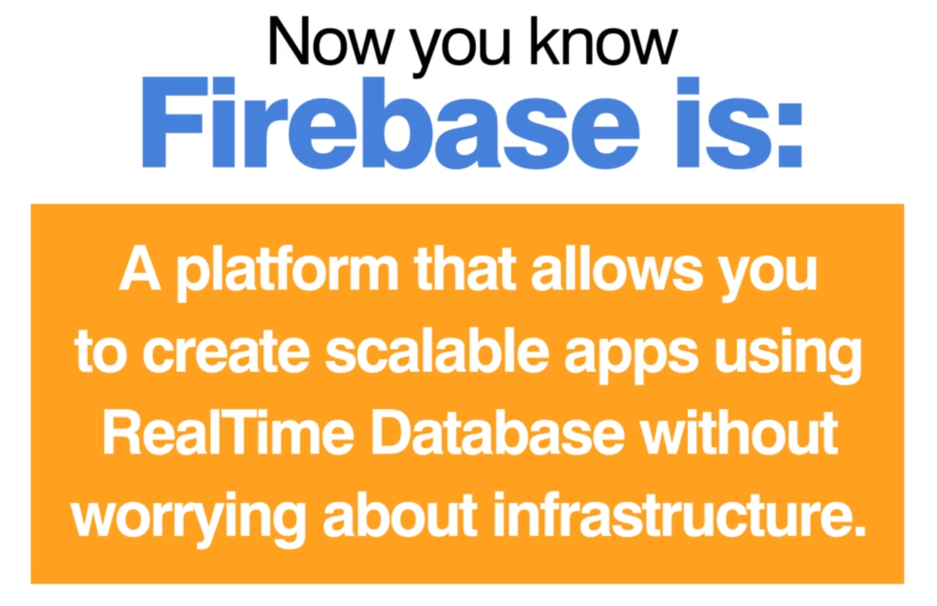
Definition of Firebase

Slide 11
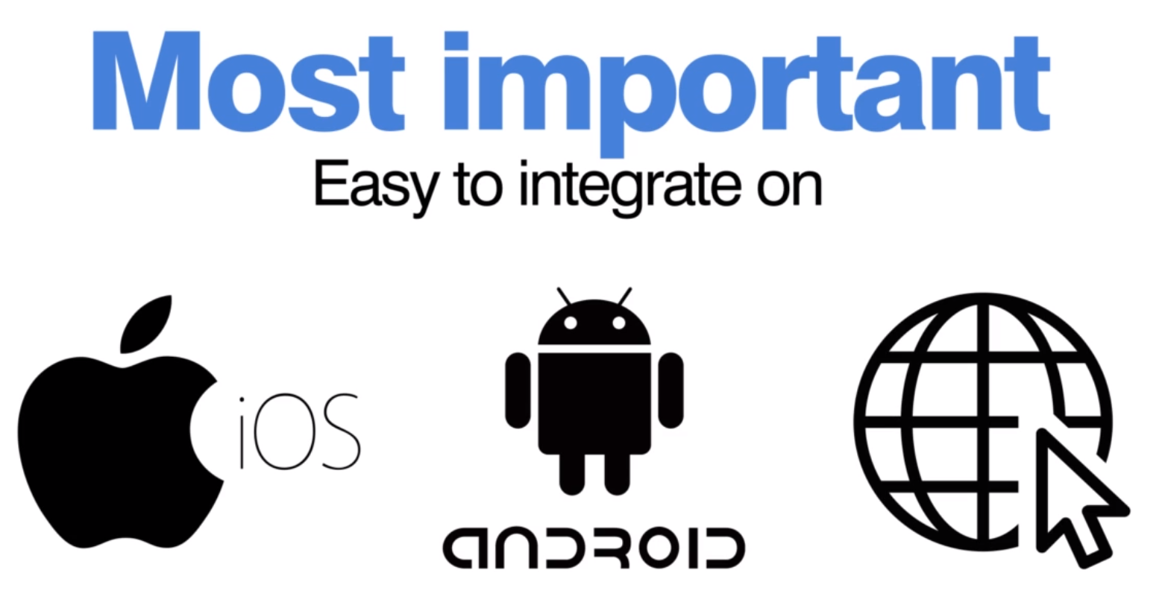

Slide 12
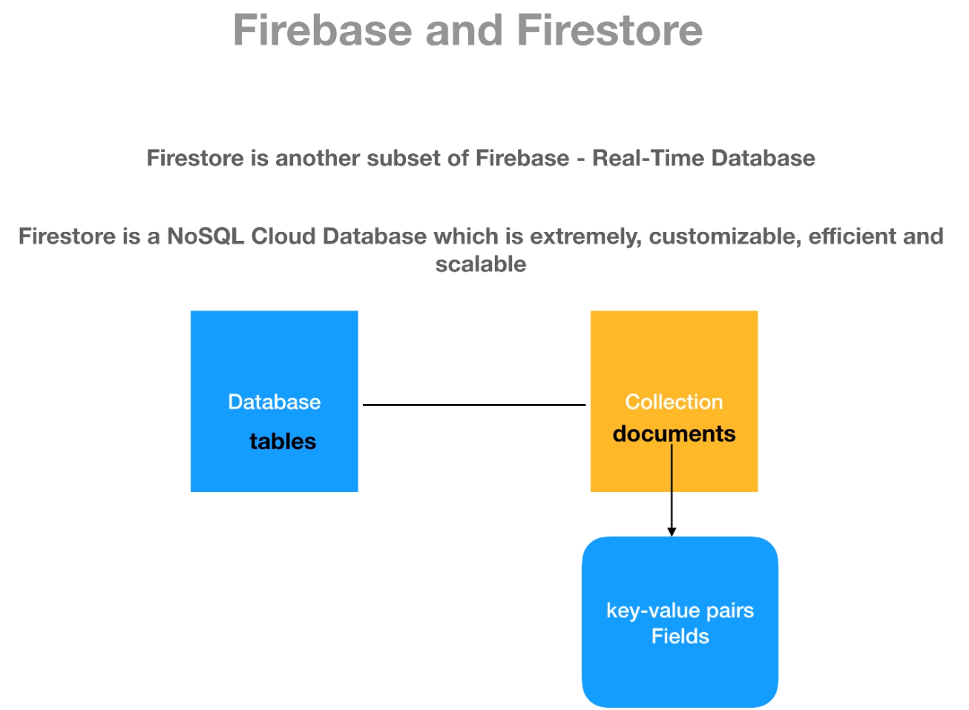
Firestore

Slide 13
