Slide 1

Chapter 1
Remembering General Chemistry:
Electronic Structure
and Bonding
Paula Yurkanis Bruice
University of California,
Santa Barbara

Slide 2
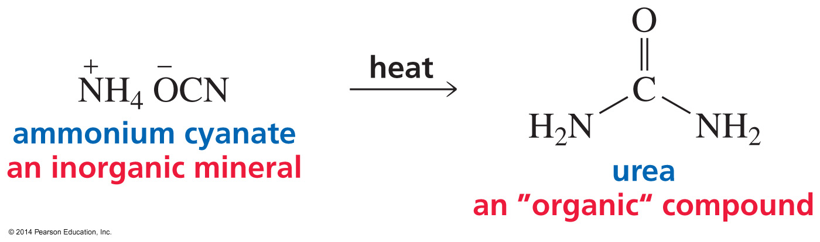
What is Organic Chemistry?
Organic compounds: from living organisms (with a vital force)
Inorganic compounds: from minerals
(with a vital force)
organic chemistry = compounds that contain carbon

Slide 3
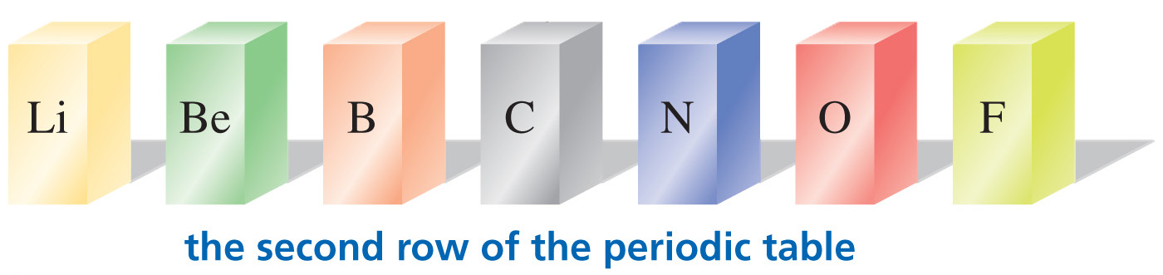
What Makes Carbon So Special?
Atoms to the left of carbon give up electrons.
Atoms to the right of carbon accept electrons.
Carbon shares electrons.

Slide 4
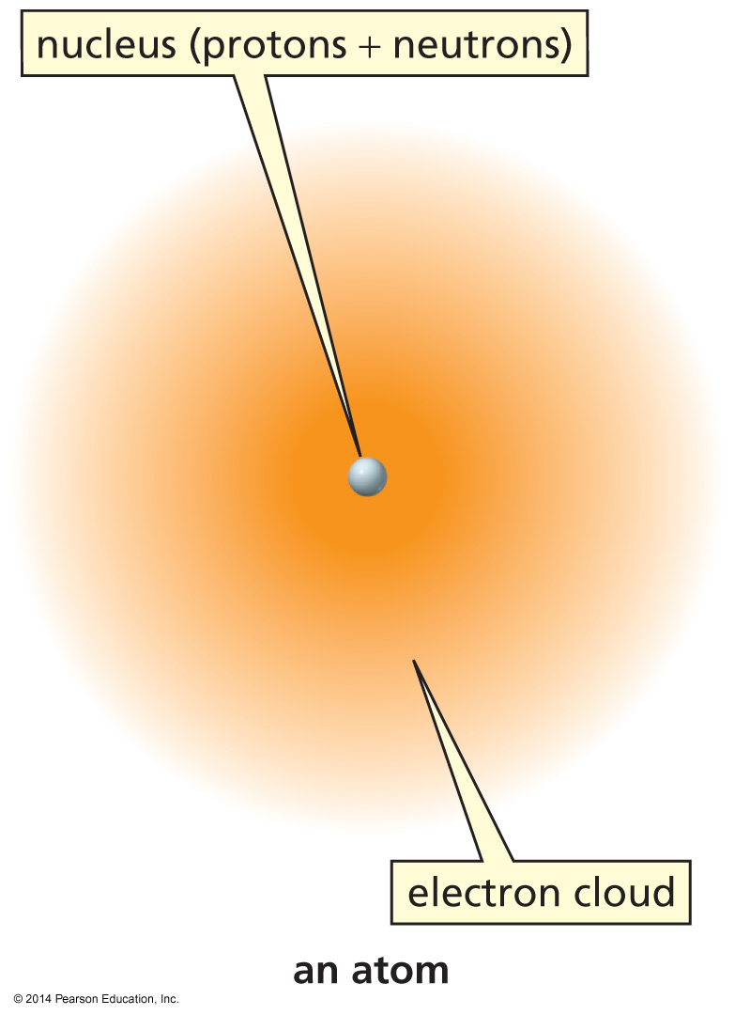
The Structure of an Atom
Protons are positively charged.
Neutrons have no charge.
Electrons are negatively charged.
Atomic number = # of protons
Atomic number of carbon = 6
Neutral carbon has six protons
and six electrons.

Slide 5
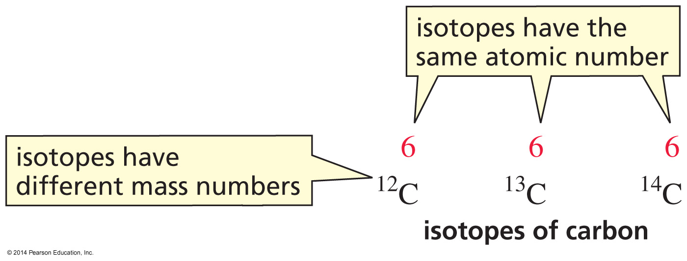
Isotopes

Slide 6
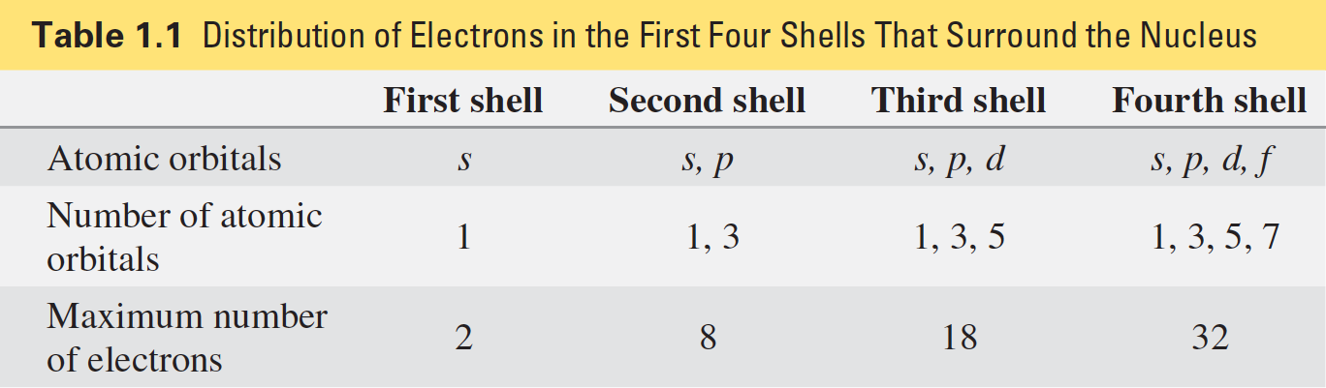
The Distribution of Electrons in an Atom
The first shell is closest to the nucleus.
The closer the atomic orbital is to the nucleus, the lower its energy.
Within a shell, s is lower in energy than p.

Slide 7
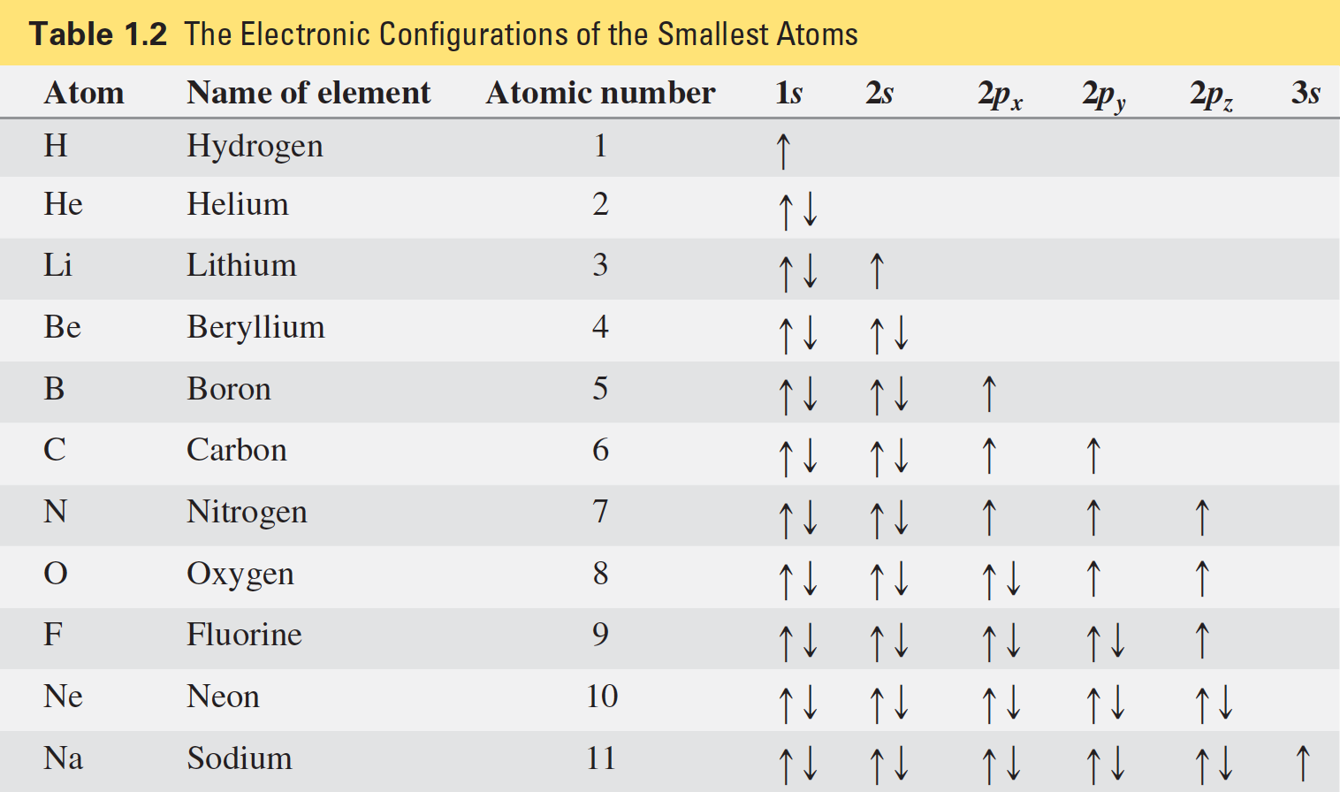
-Aufbau principle: An electron goes into the atomic orbital with the lowest energy.
-Pauli exclusion principle: No more than two electrons can be in an atomic orbital.
-Hund’s rule: An electron goes into an empty degenerate orbital rather than pairing up.

Slide 8
Relative Energies of the Atomic Orbitals

Slide 9
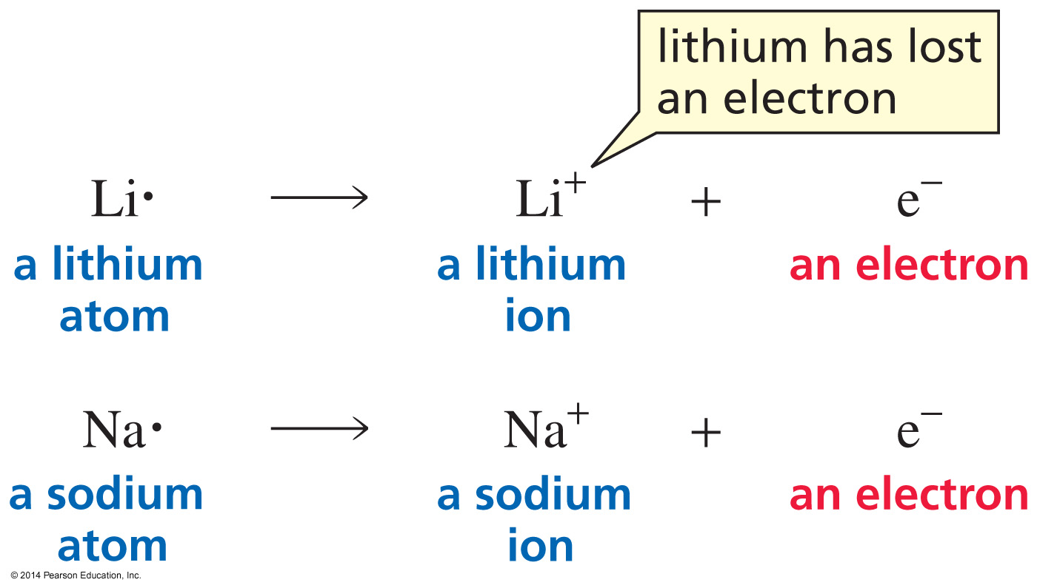
Atoms on the Left Side of the
Periodic Table Easily Lose an Electron

Slide 10
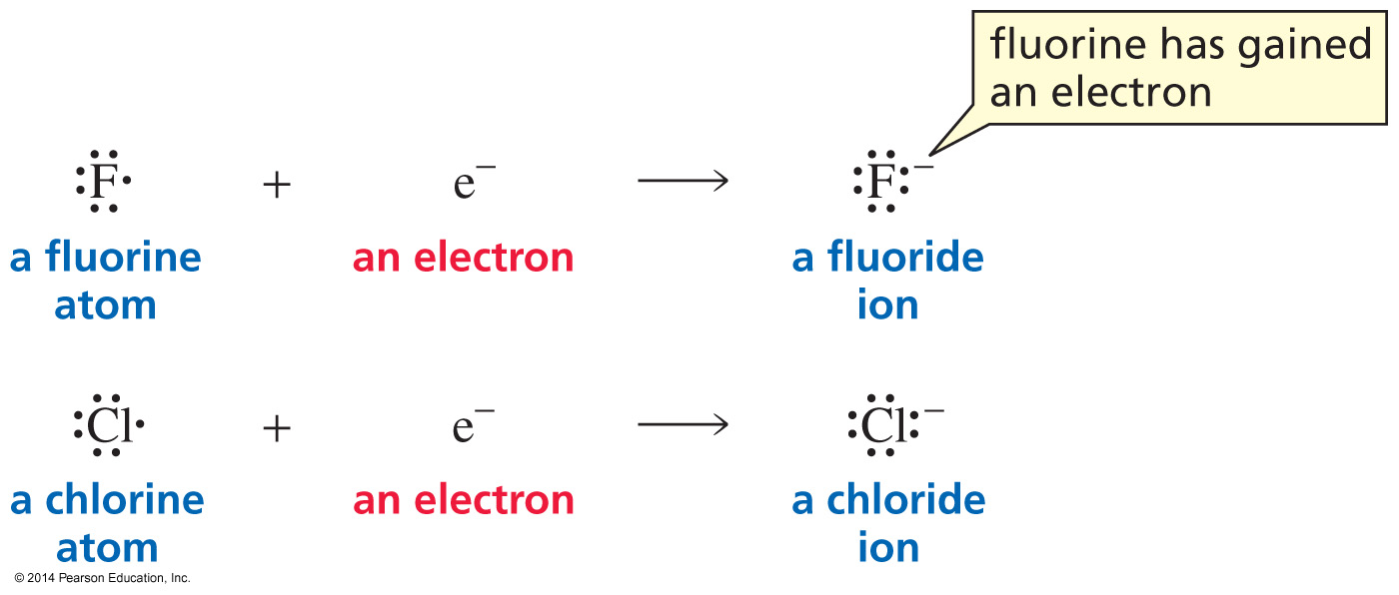
Atoms on the Right Side of the
Periodic Table Easily Gain an Electron

Slide 11
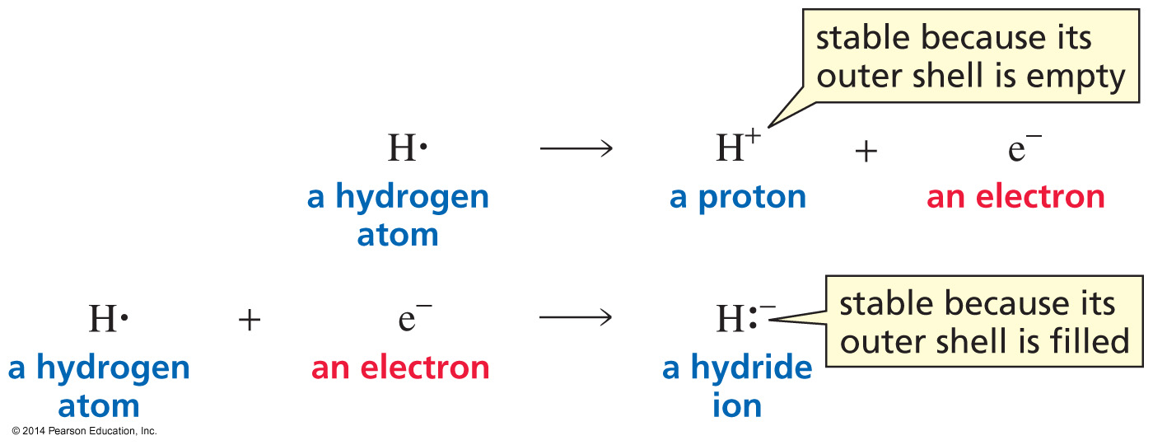
A Hydrogen Atom can Easily
Lose or Gain an Electron

Slide 12
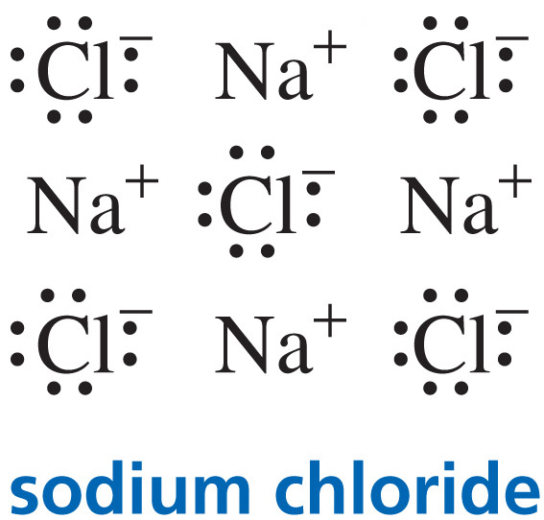
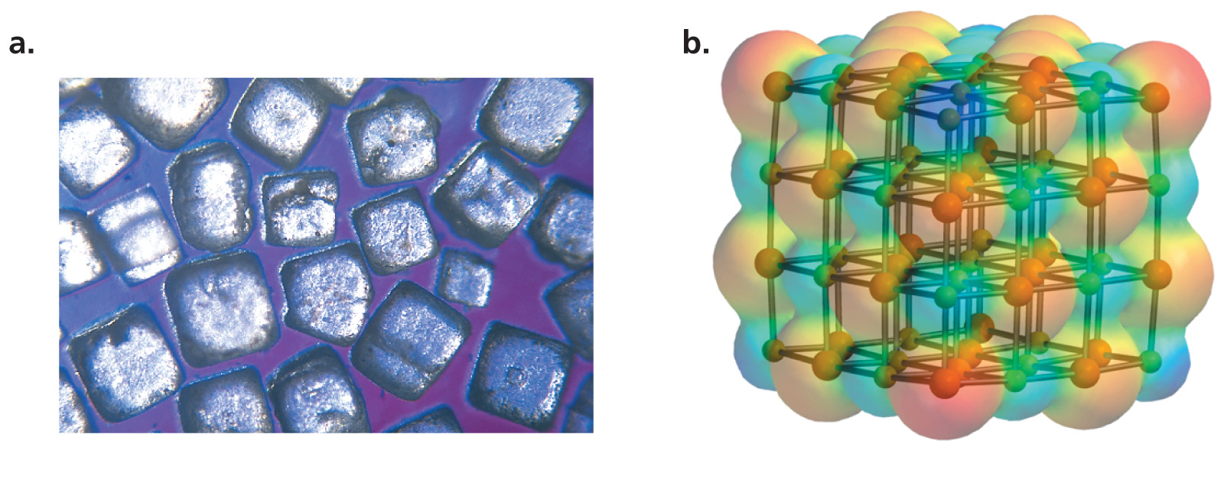
An Ionic Compound is Formed by the Attraction Between Ions of Opposite Charge

Slide 13


Covalent Bonds are Formed by
Sharing Electrons
Nonpolar covalent bond = bonded atoms are the same'
Polar covalent bond = bonded atoms are different

Slide 14
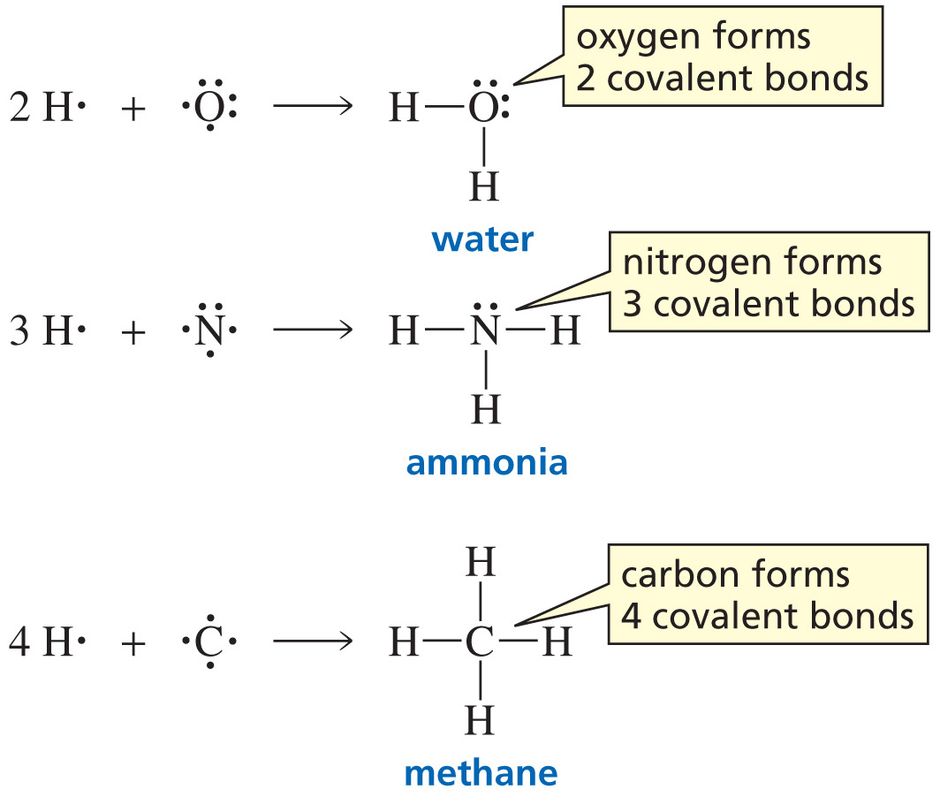
How Many Bonds Does
an Atom Form?

Slide 15
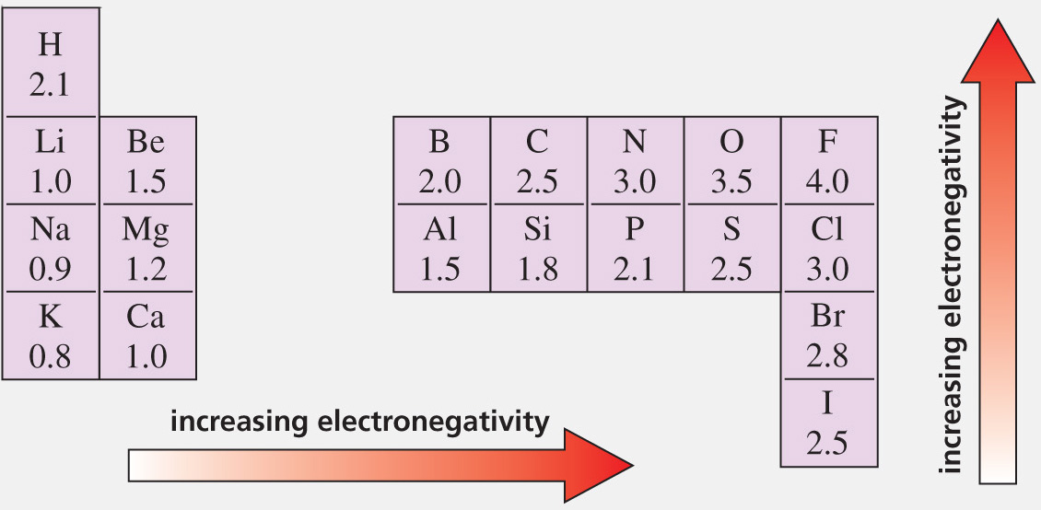
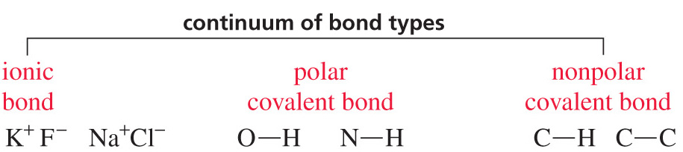
Bond Polarity Depends on
Electronegativity Differences

Slide 16
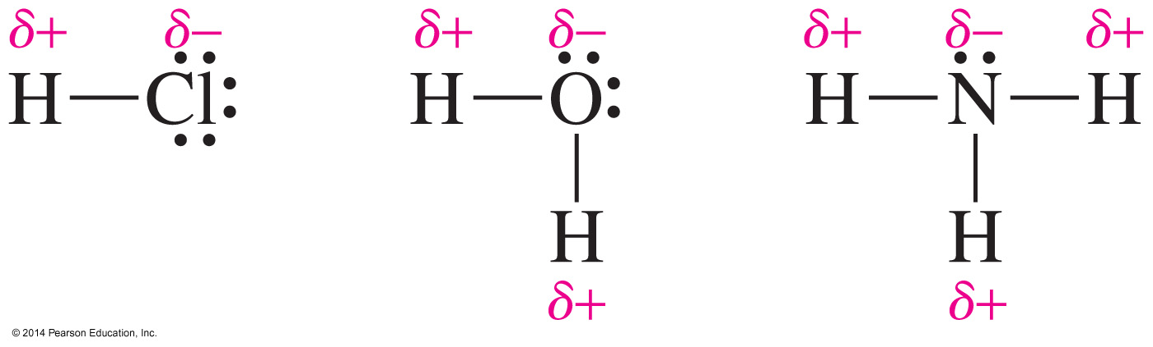
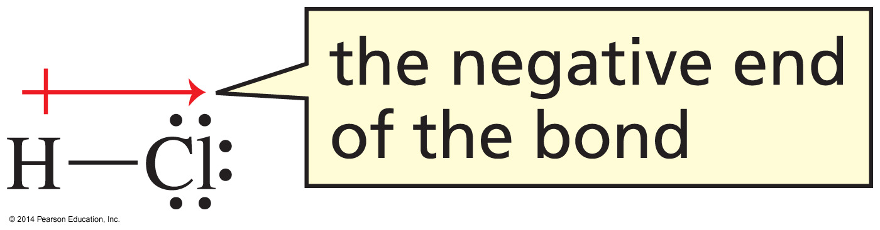
Polar Covalent Bonds

Slide 17
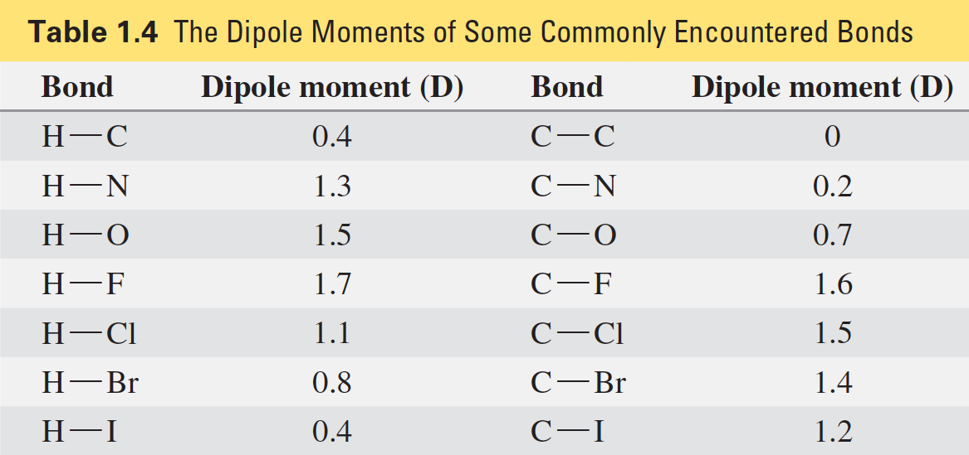
Dipole Moments
the greater the difference in electronegativity,
the greater the dipole moment, and the more polar the bond

Slide 18
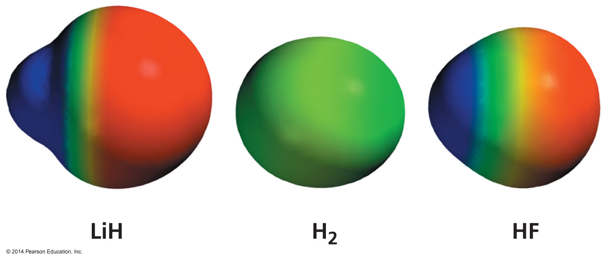
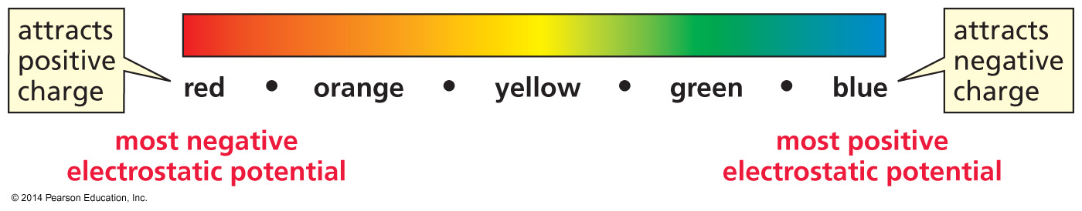
Electrostatic Potential Maps

Slide 19
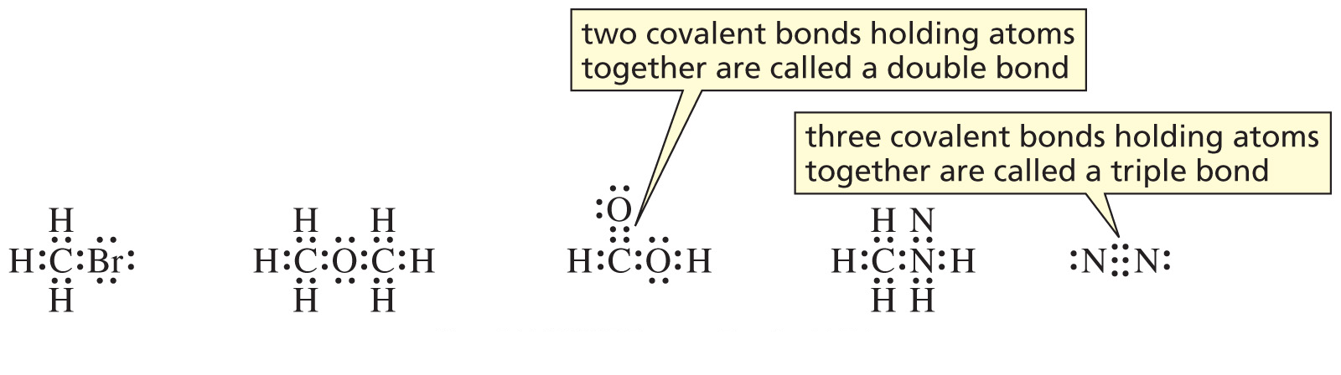
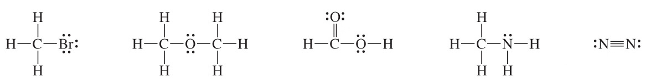
Lewis Structures

Slide 20
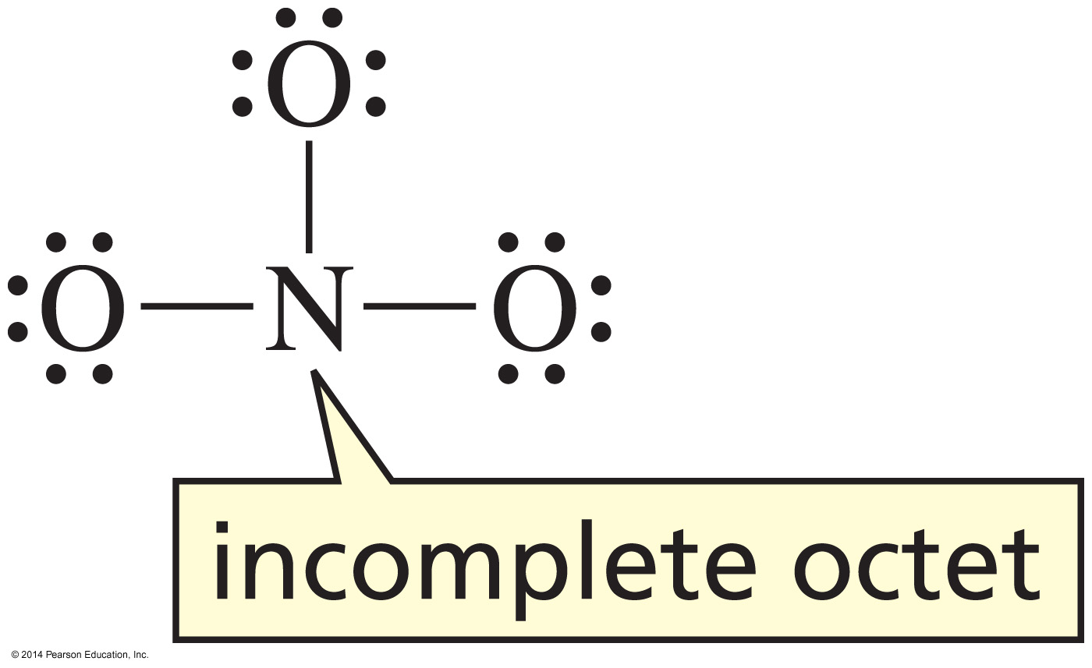

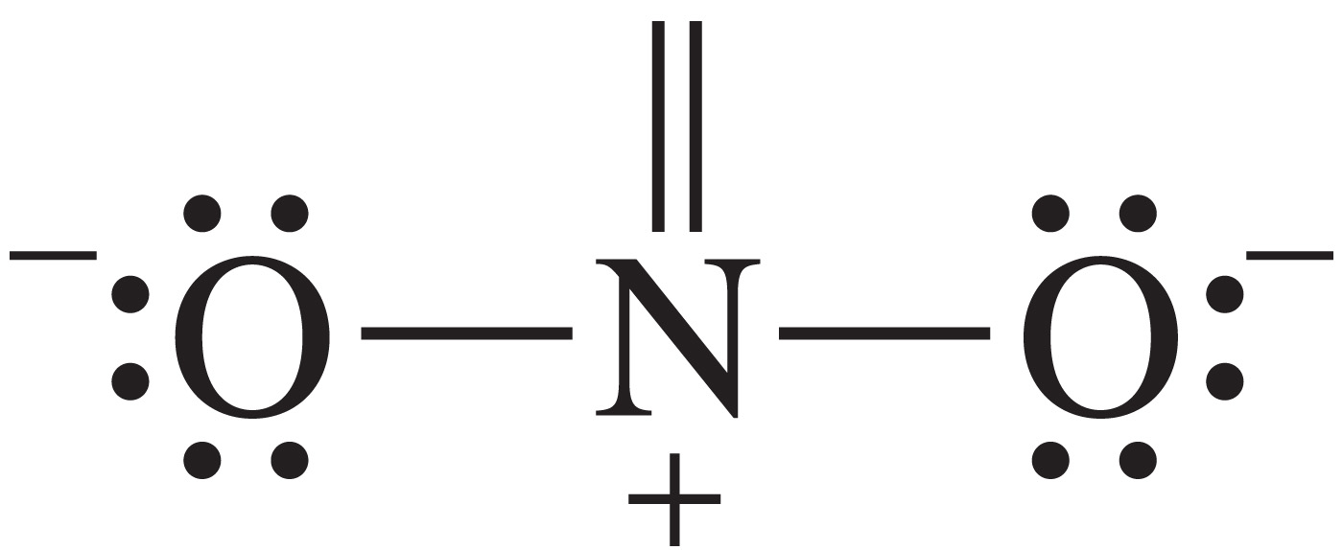
How to Draw a Lewis Structure
NO₃–
Determine the total number of valence electrons (5 + 6 + 6 + 6 = 23).
Because they are negatively charged, add another electron = 24.
^{Avoid O–O bonds.}
^{Check for formal charges.}

Slide 21
Formal Charge
Formal Charge = the number or valence electrons
– the number of bonds

Slide 22
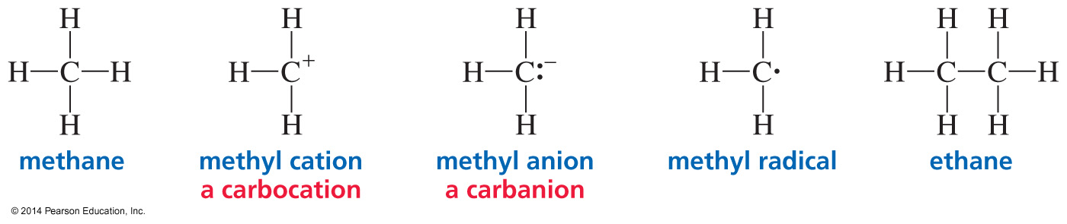
Neutral Carbon Forms Four Bonds
if carbon does not form four bonds, it has a charge
(or it is a radical)
Formal Charge: +1 –1 0

Slide 23
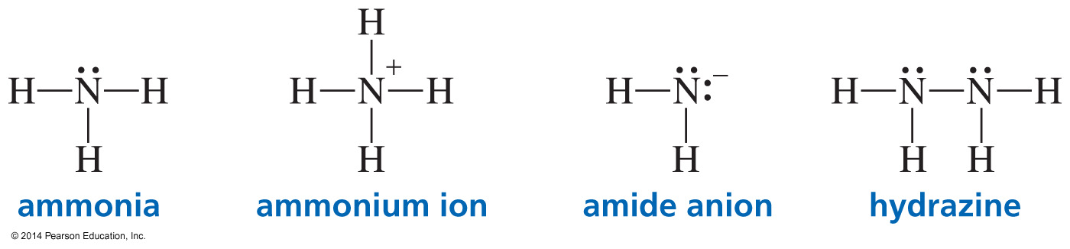
Neutral Nitrogen Forms Three Bonds
Nitrogen has one lone pair.
If nitrogen does not form three bonds, it is charged.

Slide 24
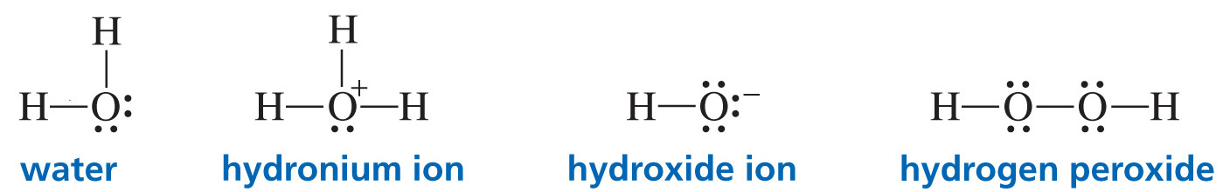
Neutral Oxygen Forms Two Bonds
Oxygen has two lone pairs.
If oxygen does not form two bonds, it is charged.

Slide 25
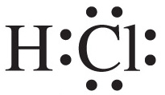
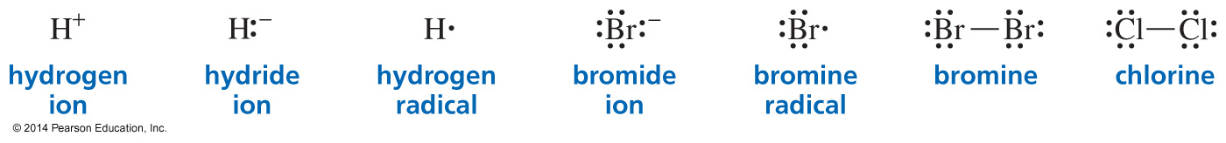
Hydrogen and the Halogens
Form One Bond
A halogen has three lone pairs.
if hydrogen or halogen does not form one bond, it has a charge
(or it is a radical)

Slide 26
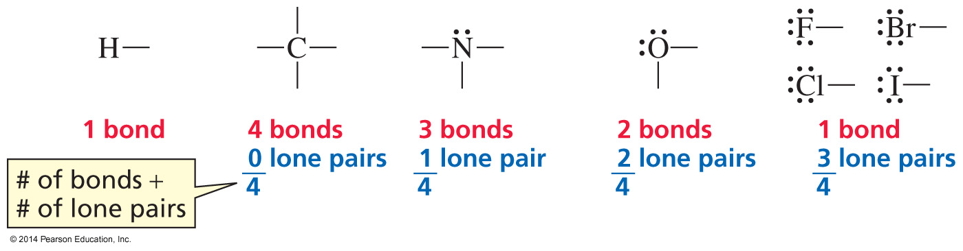
The Number of Bonds and Lone Pairs
Halogen = 3 lone pairs
Oxygen = 2 lone pairs
Nitrogen = 1 lone pair

Slide 27
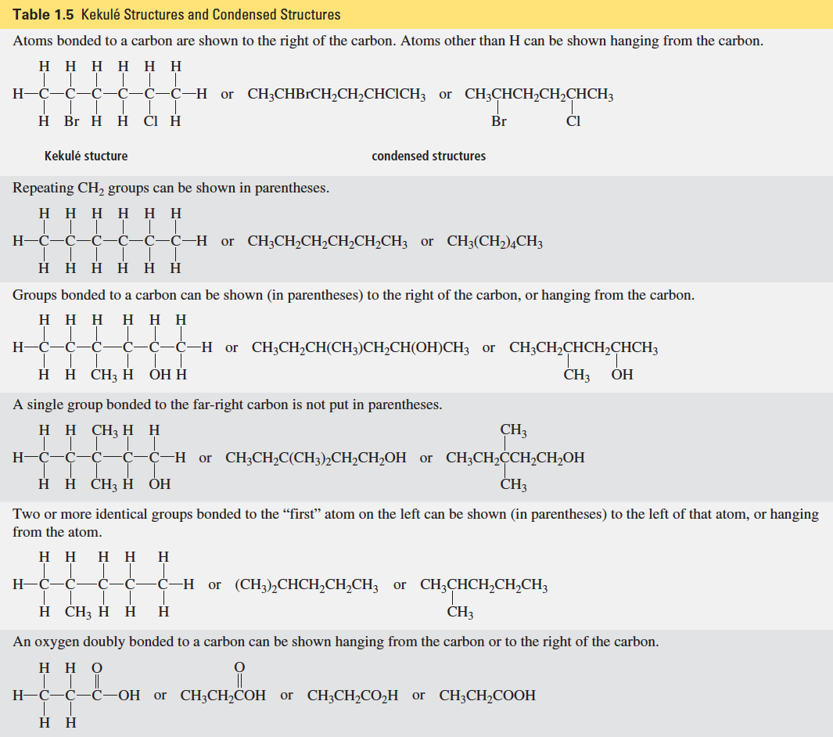

Slide 28
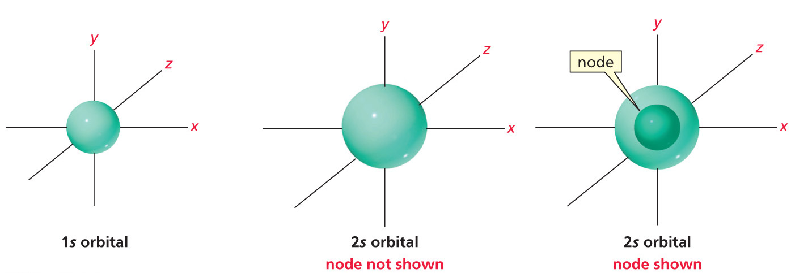
What is an Atomic Orbital?

Slide 29
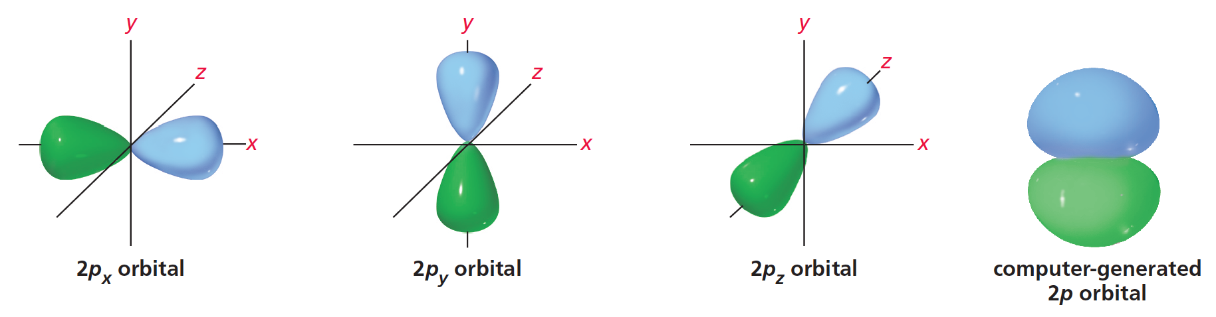
The Three p Orbitals

Slide 30
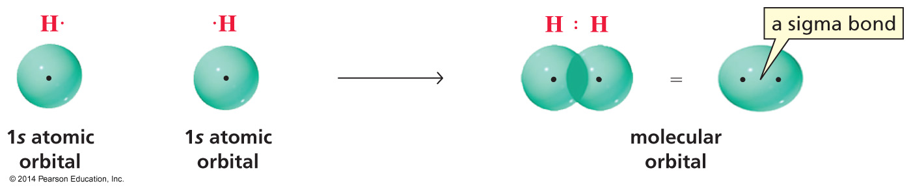
The Bonding in H₂

Slide 31
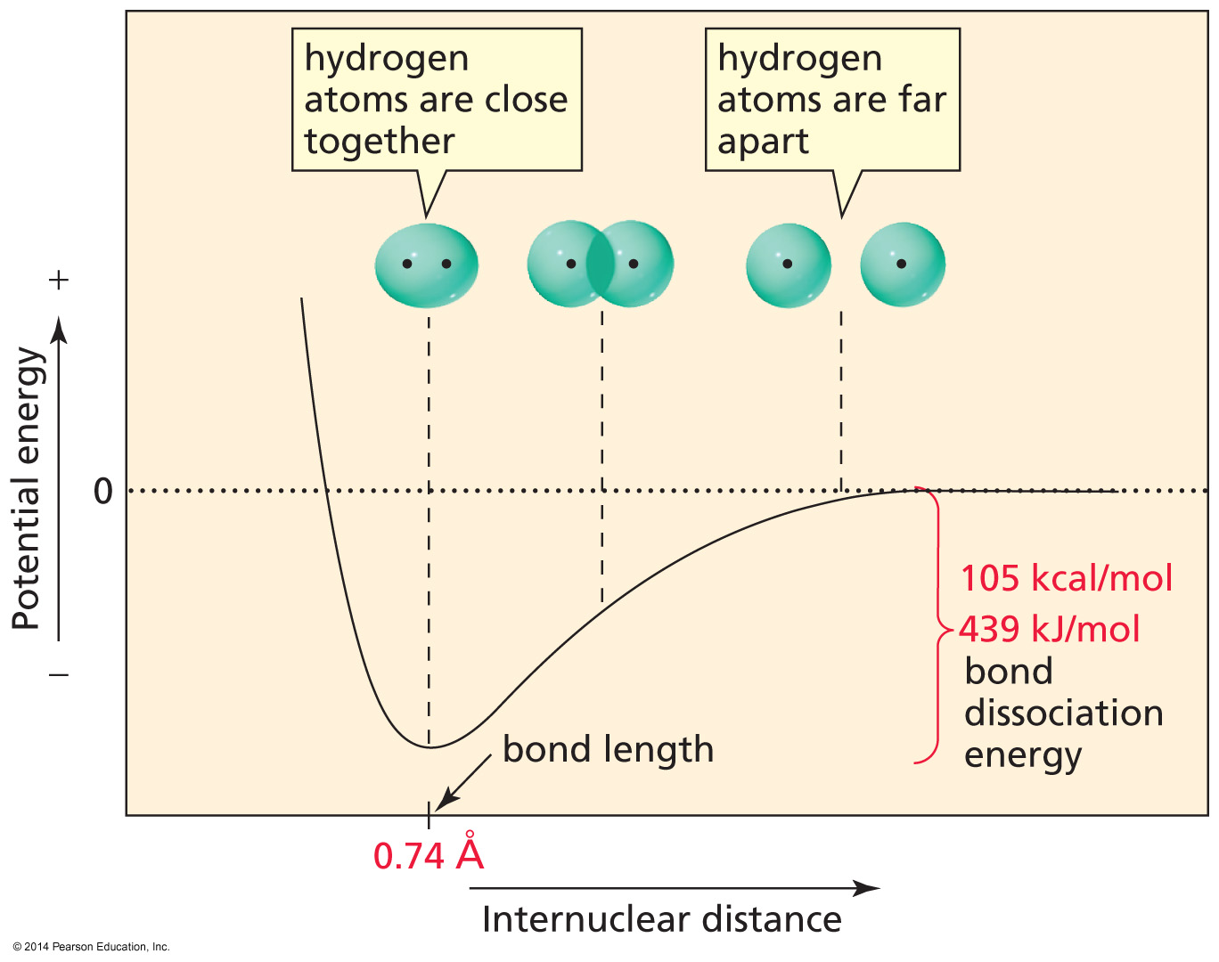

Slide 32
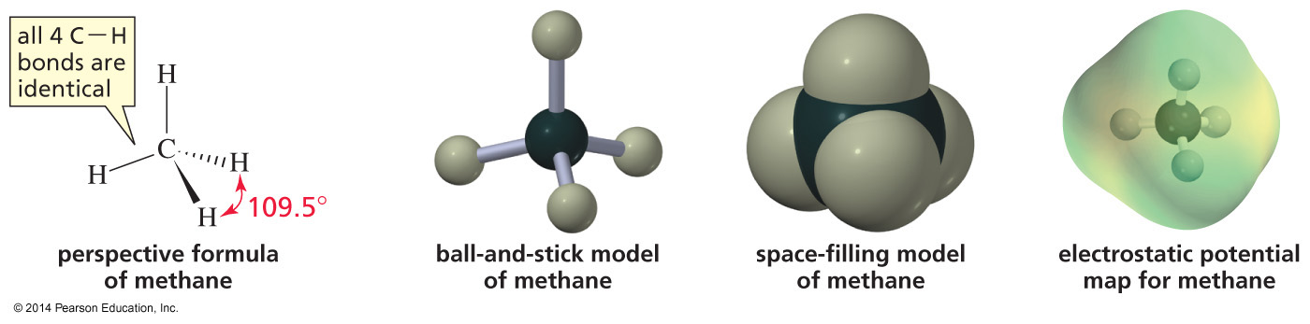
Representations of Methane

Slide 33
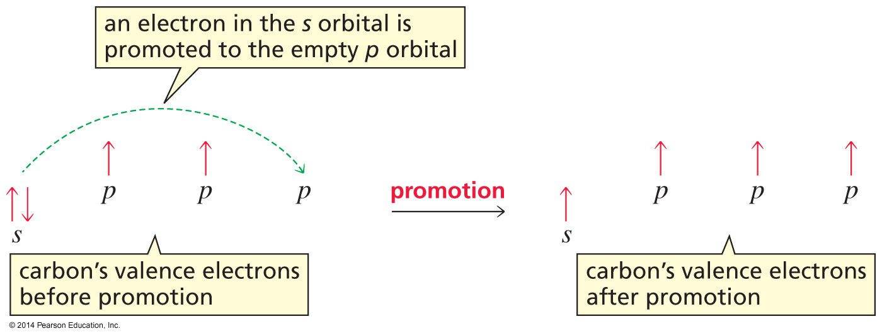
In Order to Form Four Bonds,
Carbon Must Promote an Electron

Slide 34
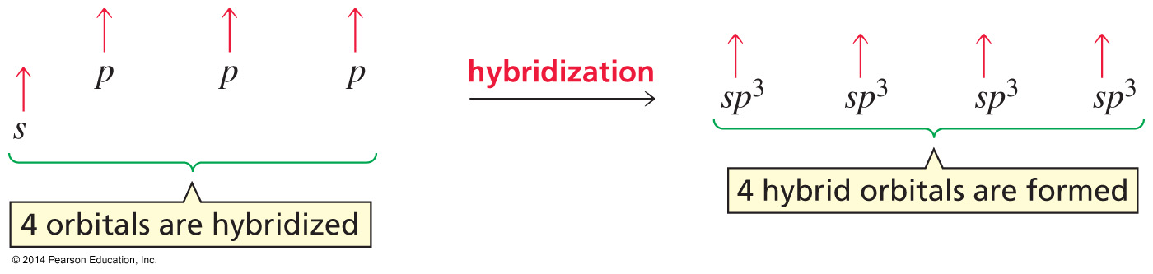
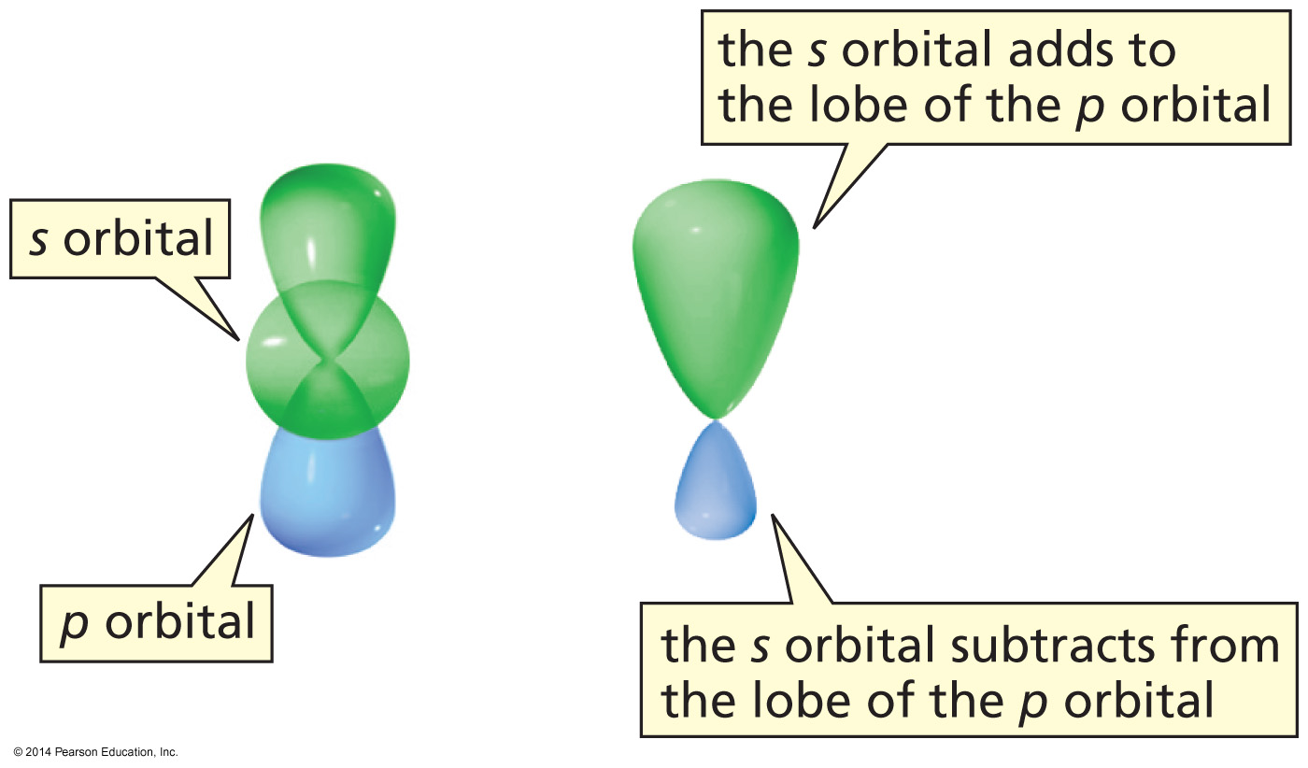
Four Orbitals are Mixed to Form
Four Hybrid Orbitals
An sp³ orbital has a large lobe and a small lobe.

Slide 35
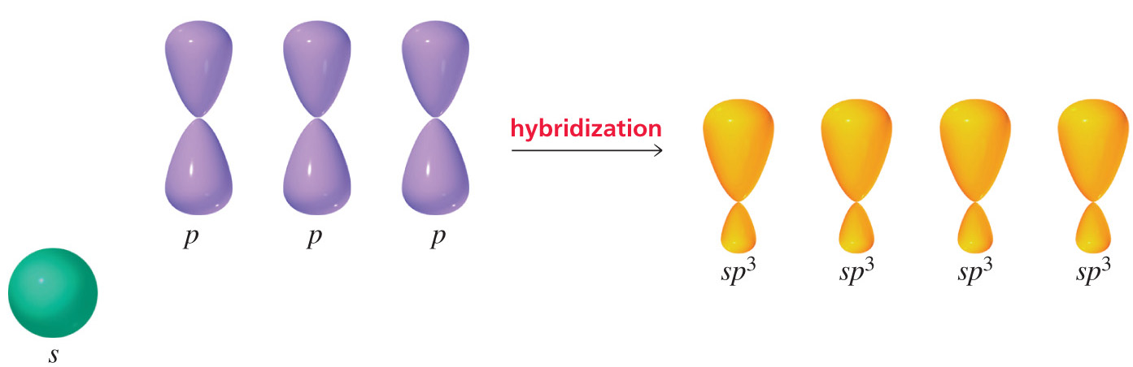
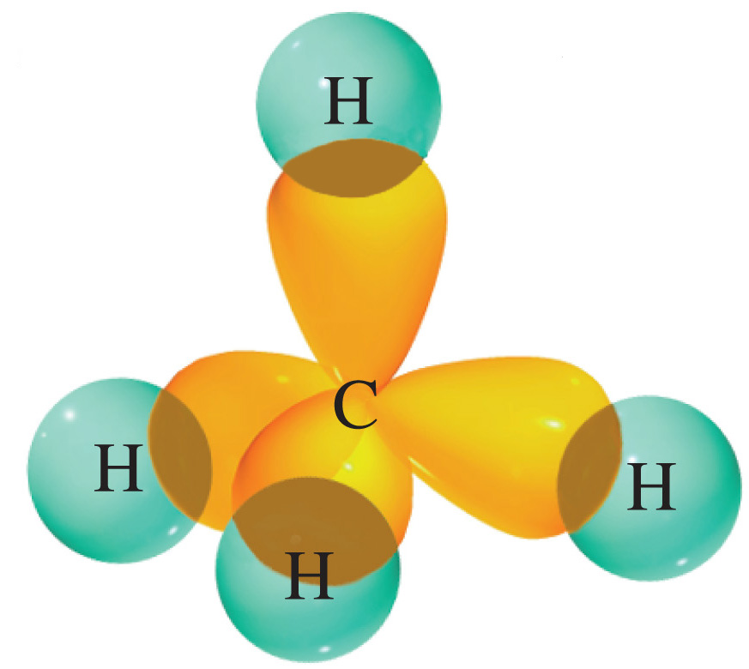

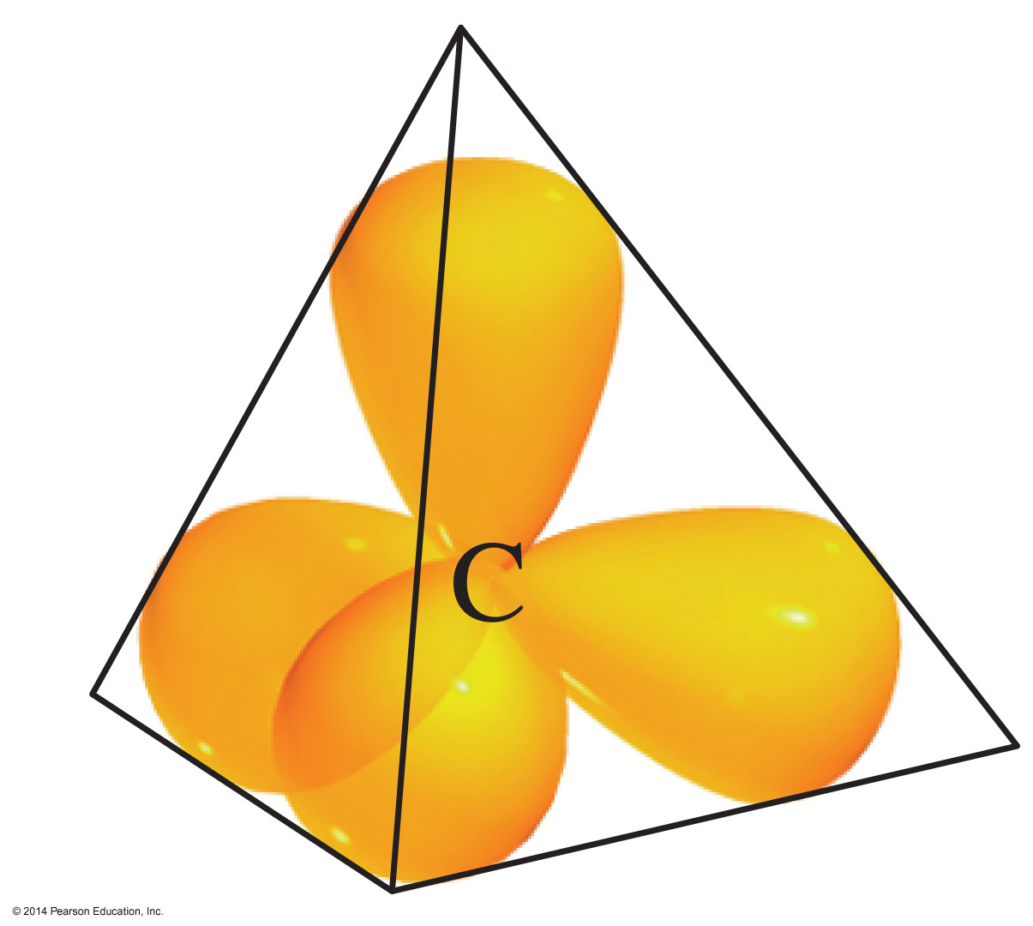
The Carbon in Methane is sp³
Carbon is tetrahedral.
The tetrahedral bond angle is 109.5°.

Slide 36
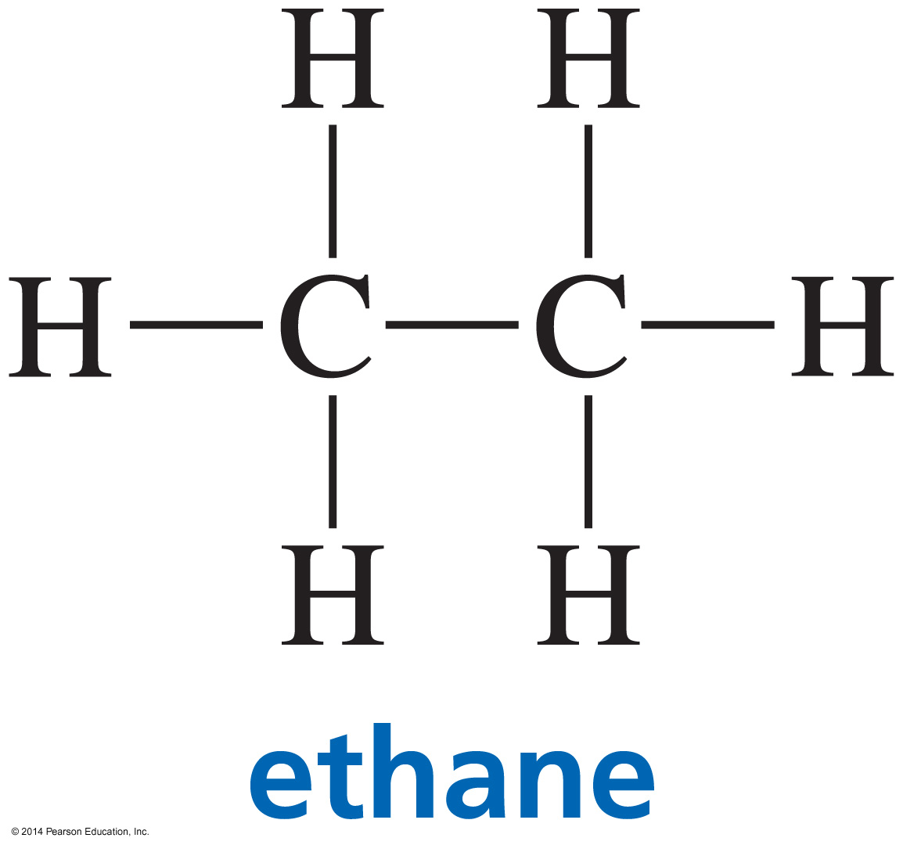
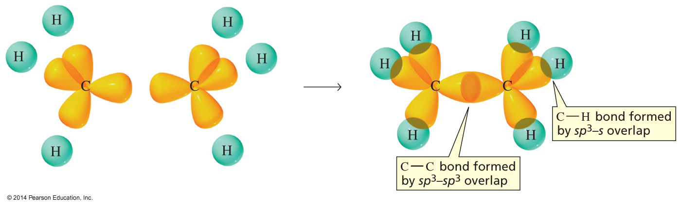
The Bonding in Ethane

Slide 37
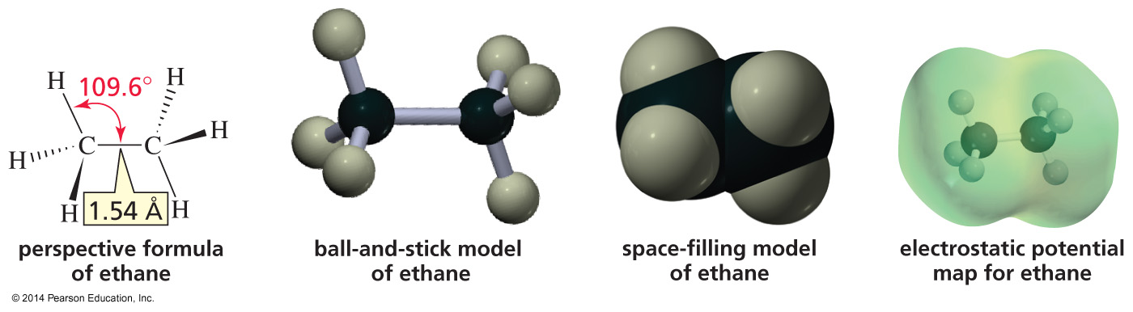
Representations of Ethane

Slide 38
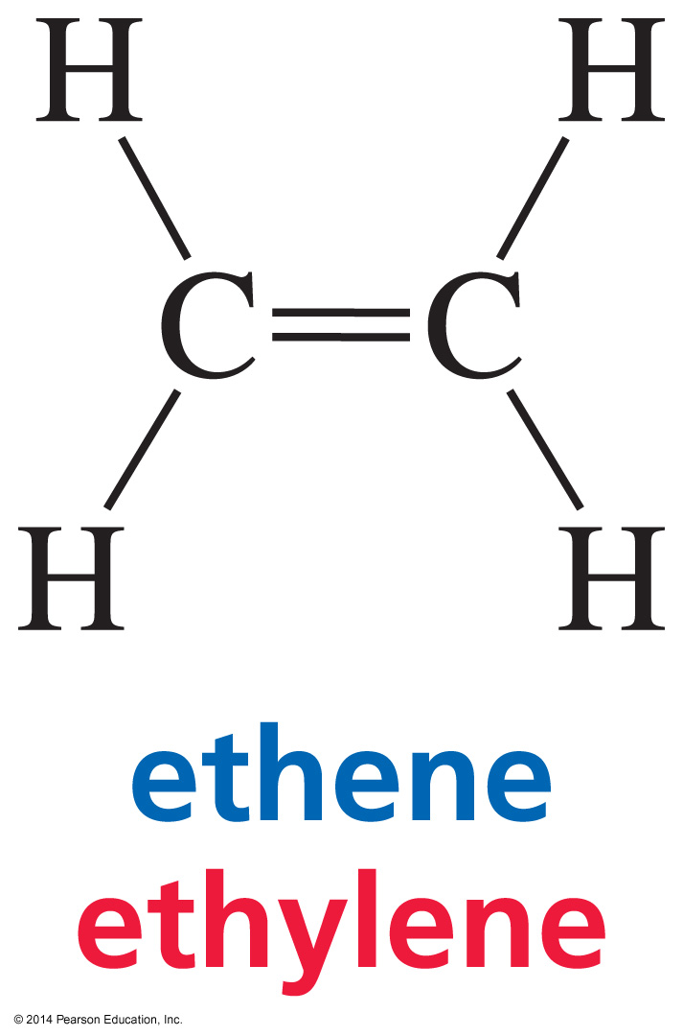
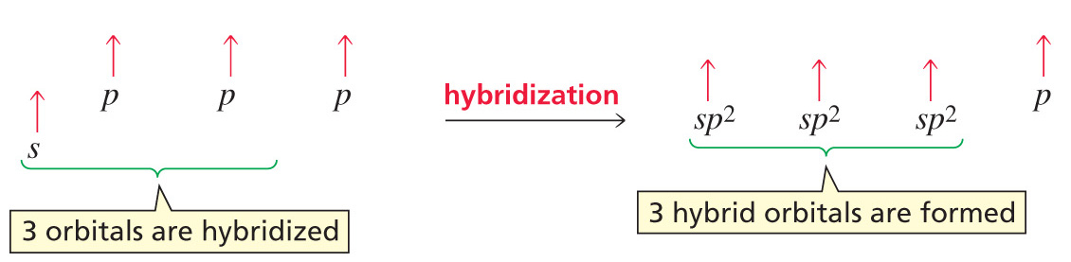
Bonding in Ethene

Slide 39
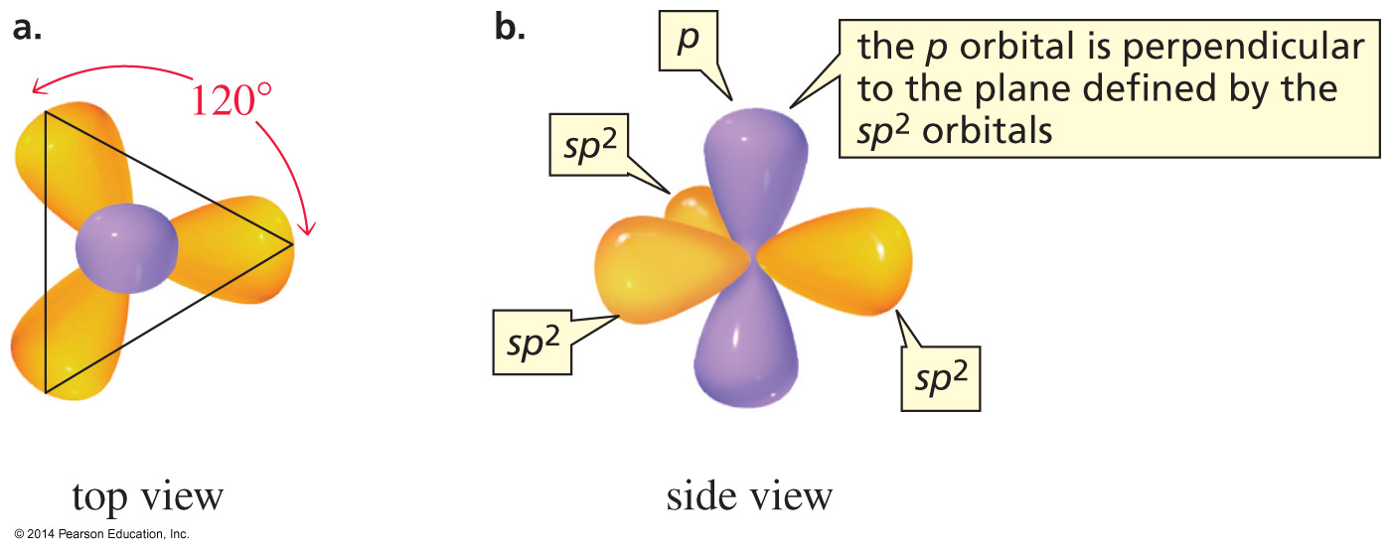
An sp² Carbon Has Three sp² Orbitals
and One p Orbital

Slide 40
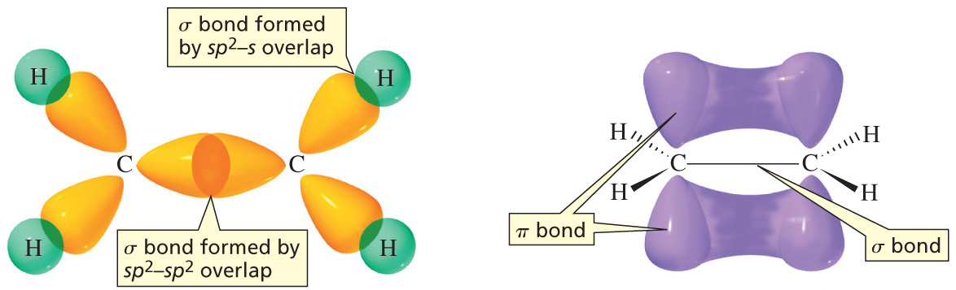
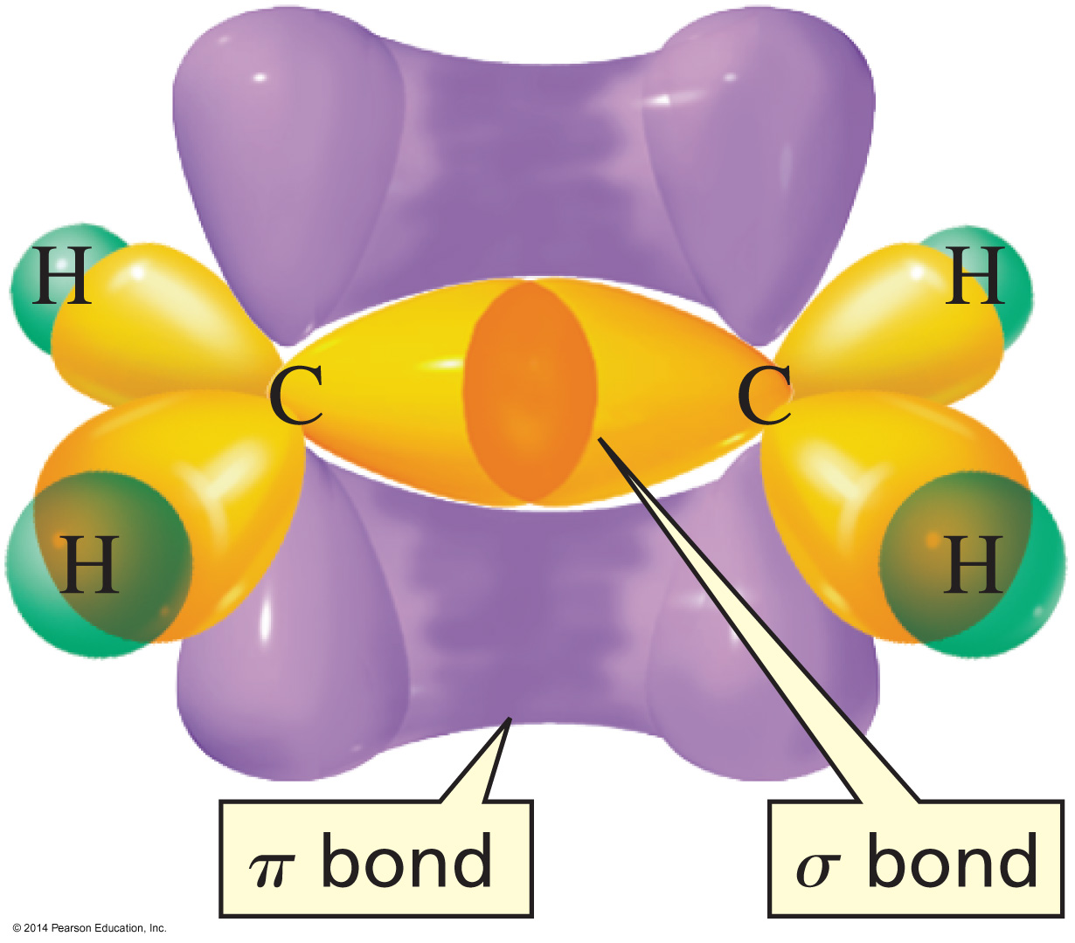
The Carbons in Ethene are sp²

Slide 41
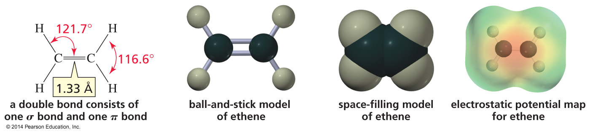
Representations of Ethene

Slide 42


Bonding in Ethyne

Slide 43

The Two sp Orbitals Point in Opposite Directions The Two p Orbitals are Perpendicular

Slide 44


The Carbons in Ethyne are sp

Slide 45

Representations of Ethyne

Slide 46


Methyl Cation and
Methyl Radical are sp²

Slide 47

Methyl Anion is sp³

Slide 48

Nitrogen Has Three Unpaired Valence Electrons and Forms Three Bonds in NH₃
Nitrogen does not have to promote an electron.

Slide 49


The Bonds in Ammonia (NH₃)

Slide 50

The Ammonium Ion (⁺NH₄)

Slide 51

Oxygen Has Two Unpaired Valence
Electrons and Forms Two Bonds in H₂O
Oxygen does not have to promote an electron.

Slide 52


The Bonds in Water (H₂O)

Slide 53






The Bond in a Hydrogen Halide

Slide 54

Overlap of an s Orbital with
an sp³ Orbital

Slide 55

The Length and Strength of a
Hydrogen Halide Bond

Slide 56

Summary of Hybridization
The orbitals used in bond formation determine the bond angle.

Slide 57

Single Bond: 1 σ Double bond: 1 σ + 1 π
Triple Bond: 1 σ + 2 π

Slide 58

Hybridization of C, N, and O

Slide 59

Bond Strength and Bond Length
The shorter the bond, the stronger it is.

Slide 60

A π Bond is Weaker Than a σ Bond

Slide 61

Hybridization, Bond Angle,
Bond Length, Bond Strength

Slide 62

Dipole Moments of Molecules

Slide 63

Dipole Moments of Molecules

