Slide 1
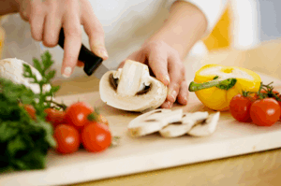
Principles of Food Preparation NUTD233
Chapter 5
Basics in Food Preparation
Afaf Jaqaman

Slide 2
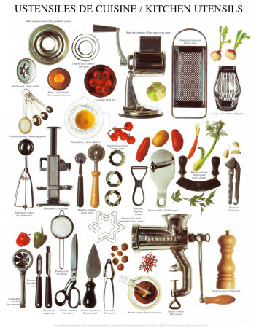

Slide 3
Introduction
Small Equipment
Weights and Measures
Metric vs US weights and measures
Recipes and recipe standardization

Slide 4
Small Equipment
Knives: are very important in food preparation.
Knife parts include:
Handle: Should be easy to use
Wood
Polypropylene (hard plastic)
Blade
1: Made of carbon steel: an alloy of iron with 1% carbon
Easier to sharpen than stainless steel
Holds its edge longer
But it rusts and stains

Slide 5
Small Equipment Cont’d.
Knife parts Cont’d.
Blade
2: Stainless steel: Made of iron + 10-15% chromium or other metals + only little carbon
Sharpens less than carbon steel
Resists rust and stains
Inexpensive
But there are expensive types that sharpen well, even better than carbon steel (mostly from Japan)
3: High carbon stainless steel:
Maintain a sharp edge
Do not discolor

Slide 6
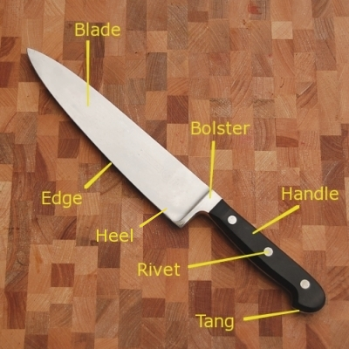
Parts of a Knife

Slide 7
Sharpening
Sharp knives are safer
Cut easier
Are less slippery
Cause less injury
Therefore sharpen knives regularly using sharpening tools

Slide 8
Sharpening Tools
1: Sharpening Stone or Whetstone
2: Sharpening Steel

Slide 9
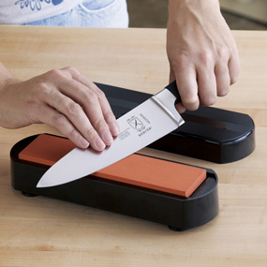
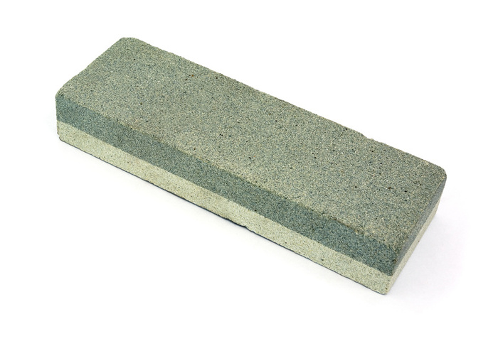
Sharpening Stones
Whetstone
Sharpens by friction.
Sharpen at 20 degrees angle.
Lubricate the stone with water or mineral oil and not vegetable oil because Veg oil becomes gummy.

Slide 10
Sharpening Steel
Long thin cylindrical metal tool
Sharpen at 20 degrees angle.

Slide 11
Types of Knives
French or Chef’s knife: an all purpose knife for chopping, slicing, and mincing.
Utility knife: used for cutting fruits, vegetables, and poultry
Rigid Boning knife: used to separate meat from bone.
Paring knife: for paring fruits and vegetable .
Cleaver : used for chopping through bones

Slide 12
Types of Knives Cont’d.
Flexible Slicer: primarily used for cutting cooked meat, carving cooked meat.
Serrated Slicer : used primarily for cutting bread or pastry.
Butcher’s knife: Used to prepare raw meat.
Oyster knife: used to effectively open oyster shells
Clam knife: used to effectively open clam shells.

Slide 13
Types of Knives

Slide 14
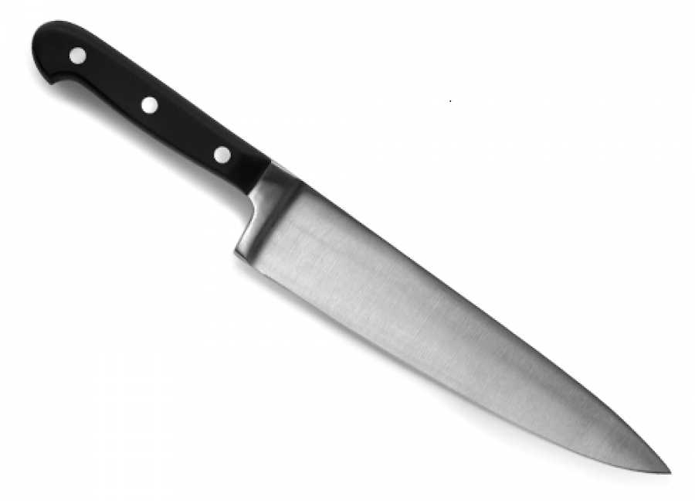
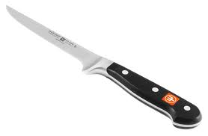
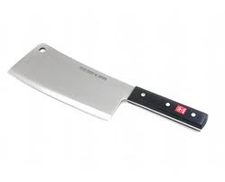
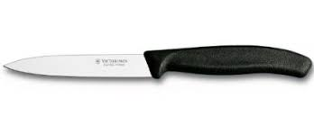
Boning Knife
French or Chef’s Knife
Paring Knife
Cleaver

Slide 15
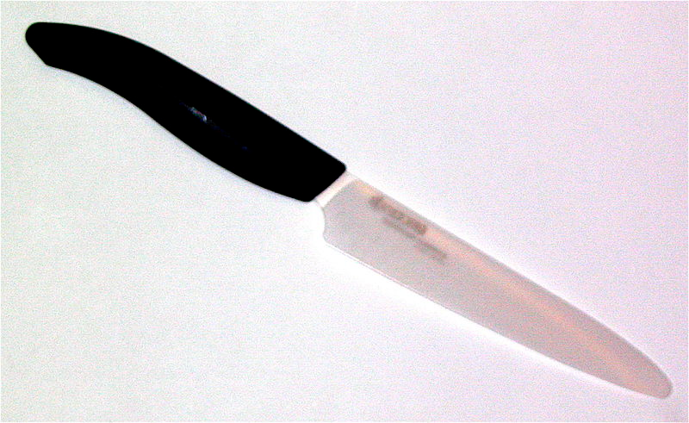
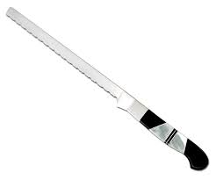
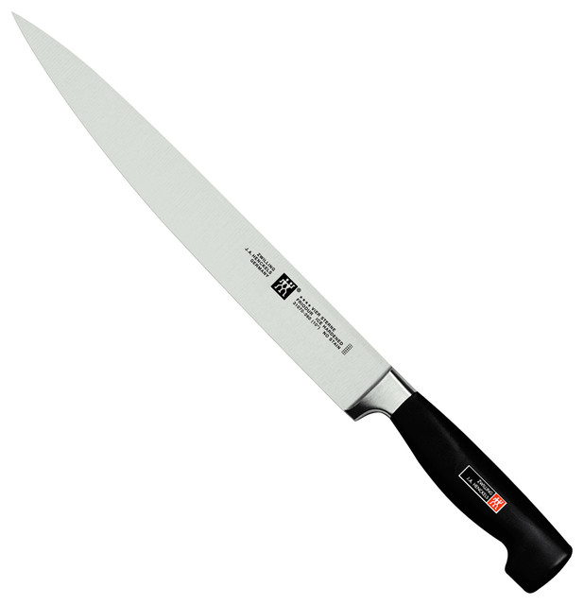
Utility Knife
Flexible Slicer
Serrated Slicer

Slide 16
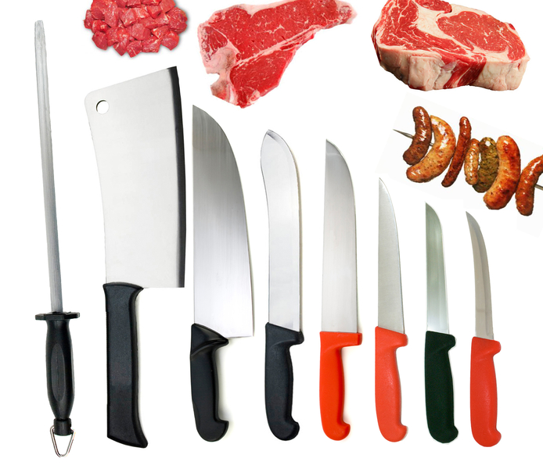
Sharpening Steel, Cleaver, Butcher’s Knives

Slide 17
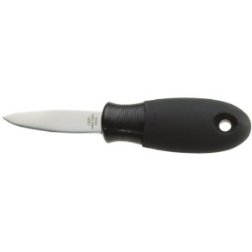
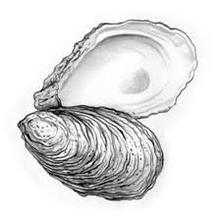
Oyster Knife

Slide 18
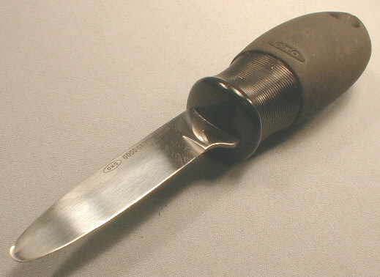
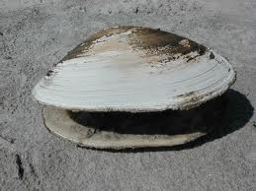
Clam Knife

Slide 19
Hand Tools Used for stirring, whipping, etc.

Slide 20
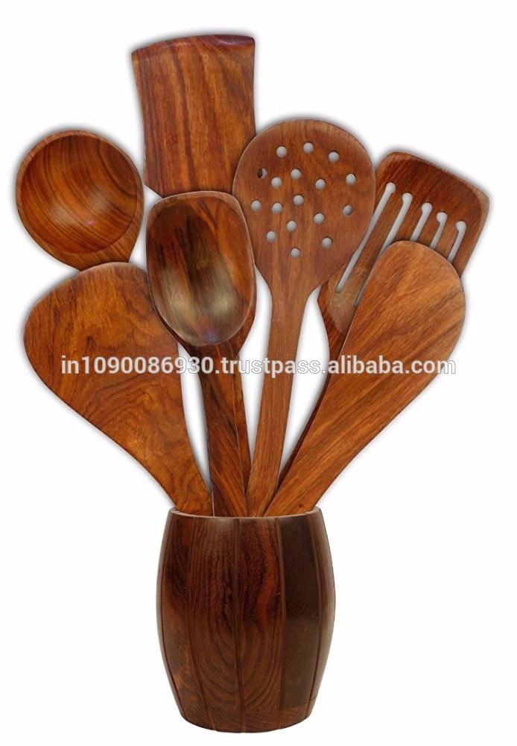
1. Wooden Spoons a) solid b) perforated c) slotted.

Slide 21
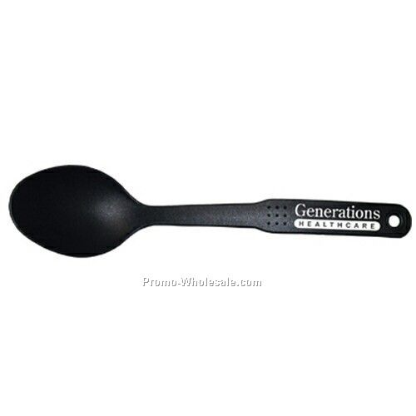
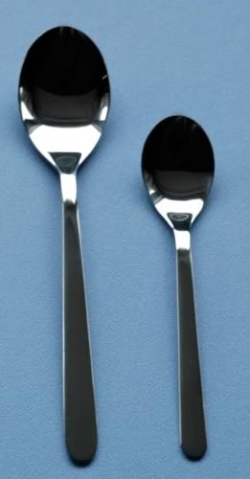
2. Solid Spoons

Slide 22
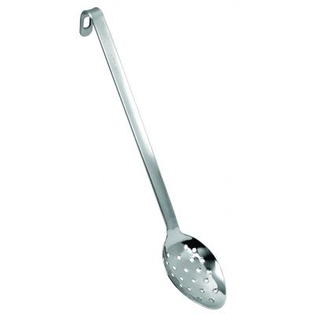
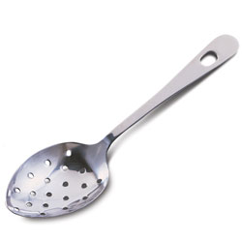
3. Perforated Spoons

Slide 23
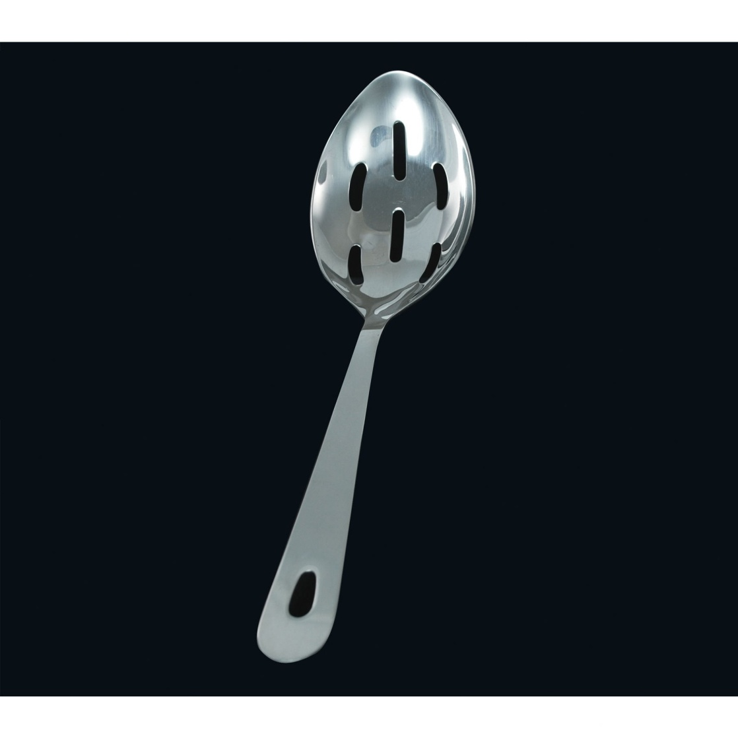
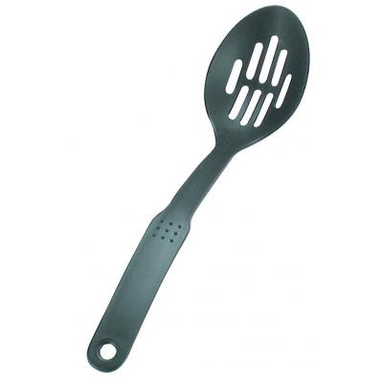
4. Slotted Spoons

Slide 24
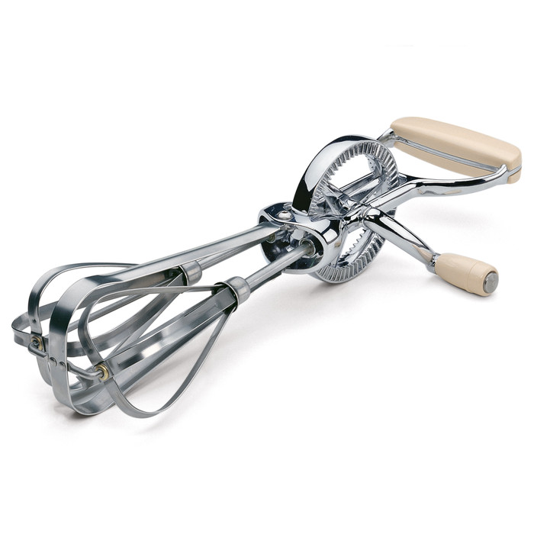
5. Whisks: used for whipping for example eggs, mixing flour mixtures.
6. Egg Beater

Slide 25
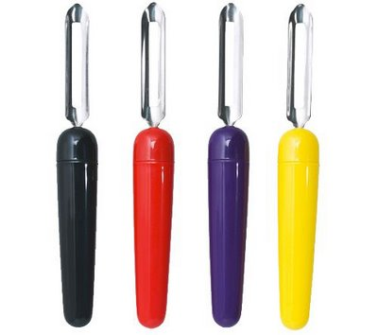
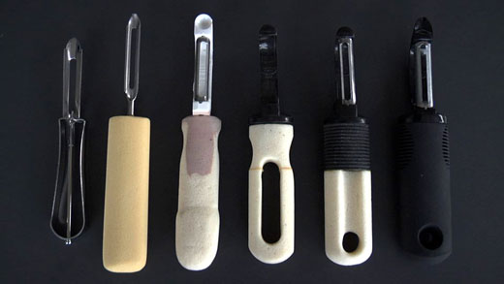
7. Peelers

Slide 26
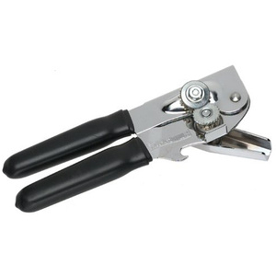
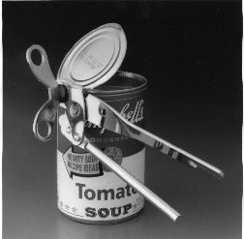
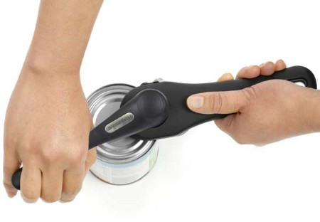
8. Can Openers

Slide 27
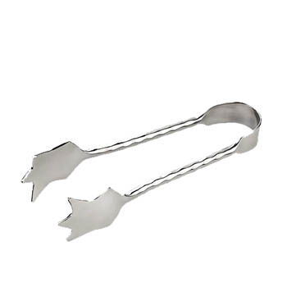
9. Tongs

Slide 28
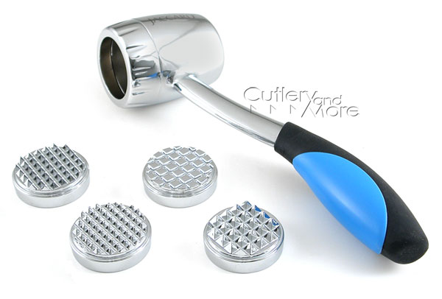
10. Meat Mallet

Slide 29
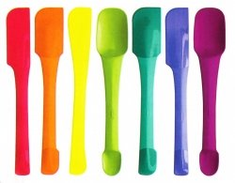
11. Rubber Spatulas

Slide 30
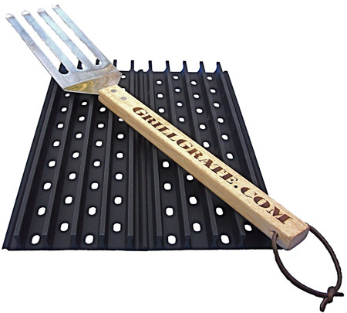
12. Grill Spatulas

Slide 31
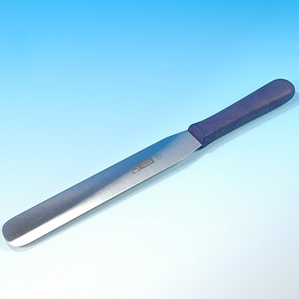
13. Straight Spatulas (cake spatula)

Slide 32
Measuring and Portioning Tools

Slide 33
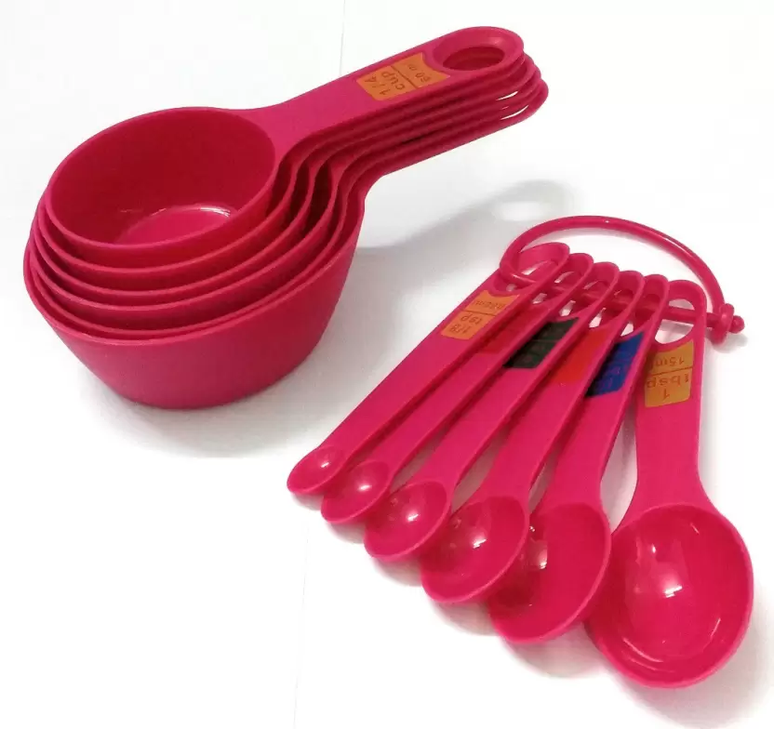
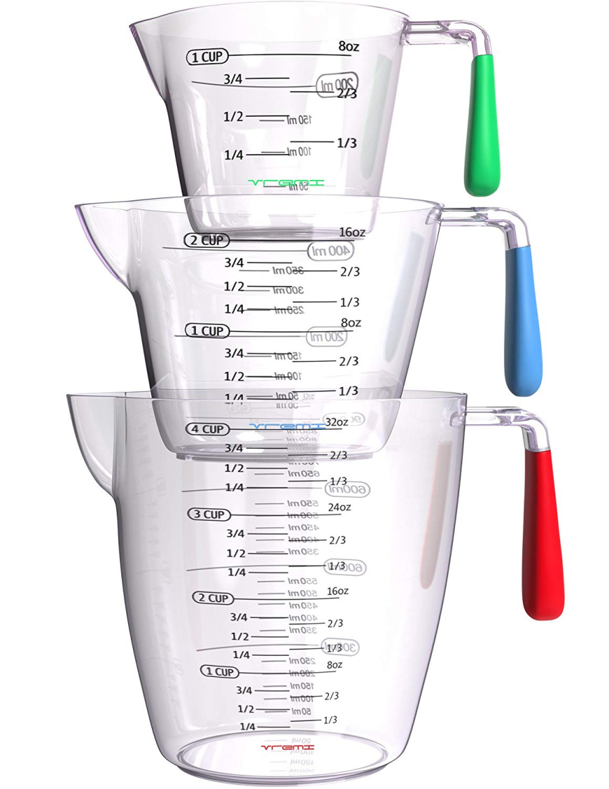
1. Measuring Cups and Spoons

Slide 34
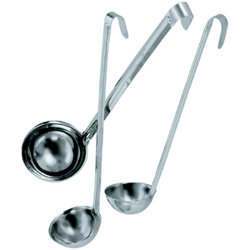
2. Ladles for liquids

Slide 35
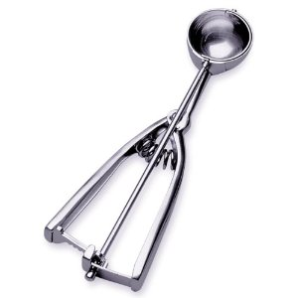
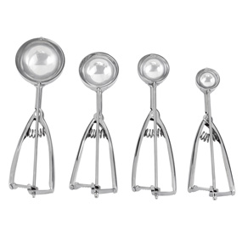
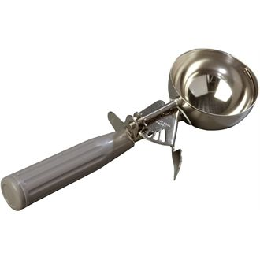
3. Portion Scoops

Slide 36
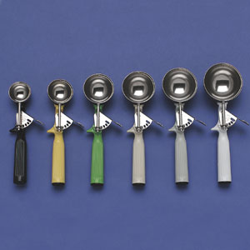
4. Ice Cream Scoops

Slide 37
Portion Scoops Numbering
Portion scoops: for dishing cookies and or ice cream.
Scoops are numbered according to the number of scoops in a quart which = 4 cups, e.g.
A 1/3 c scoop is numbered 12 because there are 12 (1/3s) in a quart which is equal to 4 cups. (12 scoops per quart)
A ½ c scoop is numbered 8 because there are 8 (1/2s ) in a quart = 8 scoops per quart

Slide 38
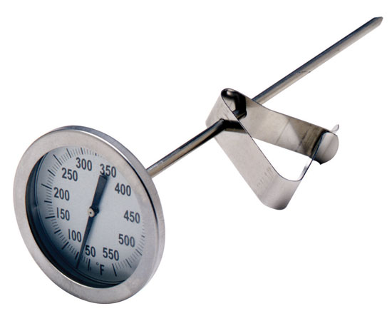
Thermometers
Thermometers: to measure
End point cooking temperatures
Deep fat frying
Oven temperature

Slide 39
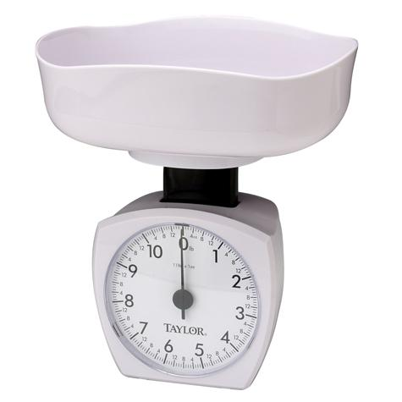
Scales or Balances Should be oiled and calibrated periodically.
Dial Weighing Scale
Digital Weighing Scale

Slide 40
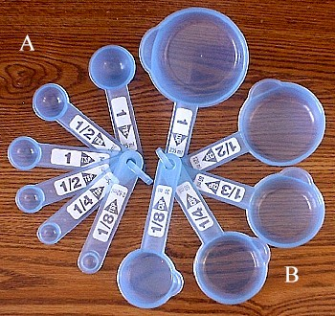
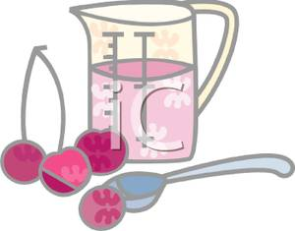
Weights and Measures

Slide 41
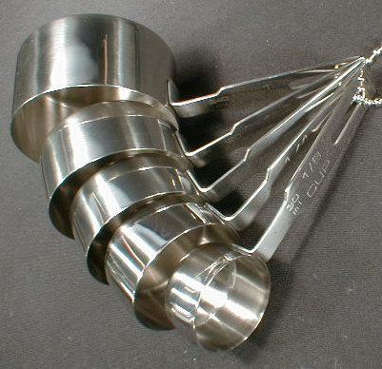
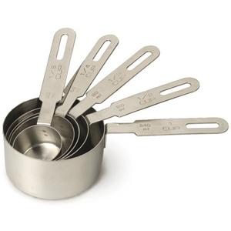
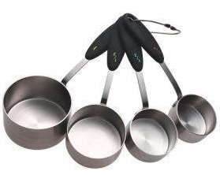
1. Dry Measuring Cups
Should always use standard measuring cups and spoons in recipes.
Fill to top and level with a straight spatula.
Come in different sizes: 1 c, 1/2 c, 1/3 c, 1/4 c.

Slide 42
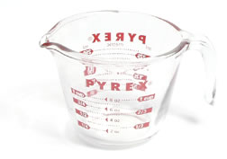
2. Liquid Measuring Cups
Are either glass or plastic
Usually have extra space on top to prevent spillage.
1 liquid cup = 8 fl. oz. ; these are used in small recipes (family size recipes)

Slide 43
3. Measuring Spoons

Slide 44
Weights and Measures
Recipes : Generally call for volume measures, especially in small size recipes
Accuracy is very important in quantity cooking especially in baked goods.
In quantity cooking it is preferable to use weights because weighing gives more accurate amounts of ingredients.
Also dry ingredients do not have the same density (weights are varied for the same volume) e.g.
1 c of flour = 4 oz. = ≈ 115 gm
1 c of dry mint = 1 oz. = ≈ 30 gm

Slide 45
Other Tools

Slide 46
Round Mesh Strainers

Slide 47
Colander:
all metal, usually has bigger holes than mesh strainer.
Chinois: (French word means Chinese); is a conical sieve with very fine mesh.
China Cap: Asian style Conical sieve with larger holes to remove coarser matter.

Slide 48
Whip
Mixer: usually have attachments like:
Flat paddle: good for muffin making.
Whip
Dough hook
Dough Hook
Flat Paddle

Slide 49
Food Processors

Slide 50
Food Blenders

Slide 51
Food Choppers

Slide 52
The Metric System
Adopted by most countries of the world.
Based on multiples of 10.
Meter is the basic unit; it is slightly longer than the yard (.914 m)
E.g.
Length 1 m = (1000 mm) = (100 cm)= (10 dm [decimeters])
1 inch = 2.54 cm = ≈ 2.5 cm
Same thing with units of mass or weight:
Weight: 1Kg = (1000 g) = (1000 mg) = (100 cg) = (10 dg)
Volume: L = (1000 ml = 100 cl = 10 dl)

Slide 53
Temperature Conversions
Fahrenheit vs Celsius
Formulas:
°C = (°F -32) x 5/9 or divide by 1.8
e.g 350-32=318/1.8=176.666
°F = (°C x 9/5) + 32 e.g (20°C x 9/5) + 32 = 68°F or multiply by 1.8

Slide 54
Common measurements used in food preparation and their symbols:
1 Tbsp= 3 tsp |  | 8 fl. Oz = 1 c
16 Tbsp = 1 c |  | 2 c = 1 pt
5 &1/3 Tbsp = 1/3 c |  | 4 c = 1 qt
2 Tbsp = 1 fl.oz. or 1/8 c |  | 4 qt = 1 gal = 16 c

Slide 55
Conversions (Liquids)
Liquids | Exact | Approximate
1 tsp = | 4.9 ml | 5 ml
1 Tbsp = | 14.8 ml | 15 ml
1 c | 237 ml | 240 ml
1 qt = 4 c | 946 ml | .95 L
1.06 qt = | 1000ml | 1 L
1 fl. oz. = |  | 30 ml

Slide 56
Conversions (Weights)
Weights | Exact | Approximate
1 oz = | 28.35 g | 30 g
8 oz = | 226.8 g | 250 g
1 lb = | 454 g | 450 g
1 kg = | 2.2 lb

Slide 57
Recipe Styles 1. Standard Style: ingredients in order of use followed by method.
Ingredients: 1c sifted flour 2 Tbsp granulated sugar 1 tsp B.P. ¼ tsp salt ¼ c shortening Method of preparation or instructions: Preheat oven to 350 degrees F = 177 degrees C Sift dry ingredients together into mixing bowl Add shortening etc

Slide 58
2. Action Style: action followed by ingredients of concern
Measure and sift together in a mixing bowl 1 c sifted flour, 2 Tbsp sugar, 1 tsp BP, ¼ tsp salt. Add ¼ c shortening Etc.

Slide 59
3. Descriptive Style: Ingredients, quantities and method in 3 separate columns.
Ingredients Flour sifted Sugar granulated BP Salt Shortening | Quantities 1 c 2 Tbsp 1 tsp ¼ tsp ¼ c | Method Sift dry ingredients together into a mixing bowl. Add to dry ingredients

Slide 60
4. Narrative style: is best suited for recipes that have few ingredients (simple) like
Sift all purpose flour Measure 1 c sifted flour, 2 Tbsp gr sugar, 1 tsp BP, and ¼ tsp salt Sift all dry ingredients together into a mixing bowl Measure ¼ c shortening and add to dry ingredients Etc.

Slide 61
Regardless of style, recipes must be written as follows:
Ingredients in order of preparation
Clear and specific e.g. 1 lb cooked or raw meat
Provide food safety instructions e.g. Internal temperature of meat
Provide recipe yield e.g. 4 (½ c) servings
Provide pan size, oven temp, time, etc.

Slide 62
Standardization of Recipes
A recipe is considered standardized only after it has been:
Tried
Tested and
Evaluated for quality
Recipes in cookbooks are standardized for using:
Large eggs
Measuring c and spoons, and
Sifted flour

