Slide 1
Chapter 15 Event-Driven Programming and Animations

Slide 2
Procedural vs. Event-Driven Programming
Procedural programming is executed in procedural order.
In event-driven programming, code is executed upon activation of events.

Slide 3
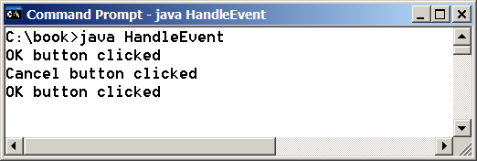
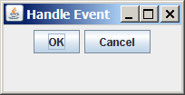
Taste of Event-Driven Programming
The example displays a button in the frame. A message is displayed on the console when a button is clicked.
HandleEvent
Run

Slide 4
Handling GUI Events
Source object (e.g., button)
Listener object contains a method for processing the event.
4

Slide 5
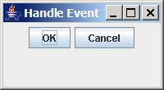
Trace Execution
animation
public class HandleEvent extends Application {
public void start(Stage primaryStage) {
…
OKHandlerClass handler1 = new OKHandlerClass();
btOK.setOnAction(handler1);
CancelHandlerClass handler2 = new CancelHandlerClass();
btCancel.setOnAction(handler2);
…
primaryStage.show(); // Display the stage
}
}
class OKHandlerClass implements EventHandler<ActionEvent> {
@Override
public void handle(ActionEvent e) {
System.out.println("OK button clicked");
}
}
1. Start from the main method to create a window and display it
5

Slide 6
Trace Execution
animation
public class HandleEvent extends Application {
public void start(Stage primaryStage) {
…
OKHandlerClass handler1 = new OKHandlerClass();
btOK.setOnAction(handler1);
CancelHandlerClass handler2 = new CancelHandlerClass();
btCancel.setOnAction(handler2);
…
primaryStage.show(); // Display the stage
}
}
class OKHandlerClass implements EventHandler<ActionEvent> {
@Override
public void handle(ActionEvent e) {
System.out.println("OK button clicked");
}
}
2. Click OK
6

Slide 7
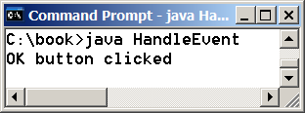
Trace Execution
animation
public class HandleEvent extends Application {
public void start(Stage primaryStage) {
…
OKHandlerClass handler1 = new OKHandlerClass();
btOK.setOnAction(handler1);
CancelHandlerClass handler2 = new CancelHandlerClass();
btCancel.setOnAction(handler2);
…
primaryStage.show(); // Display the stage
}
}
class OKHandlerClass implements EventHandler<ActionEvent> {
@Override
public void handle(ActionEvent e) {
System.out.println("OK button clicked");
}
}
3. The JVM invokes the listener’s handle method
7

Slide 8
Events
An event can be defined as a type of signal to the program that something has happened.
The event is generated by external user actions such as mouse movements, mouse clicks, or keystrokes.

Slide 9
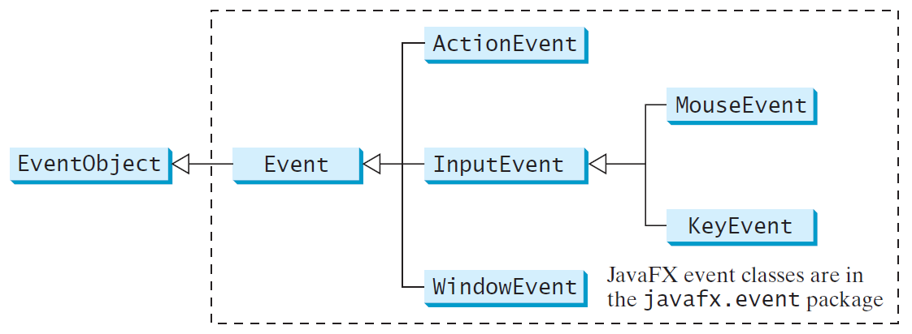
Event Classes

Slide 10
Event Information
An event object contains whatever properties are pertinent to the event. You can identify the source object of the event using the getSource() instance method in the EventObject class. The subclasses of EventObject deal with special types of events, such as button actions, window events, mouse movements, and keystrokes. Table 15.1 lists external user actions, source objects, and event types generated.

Slide 11
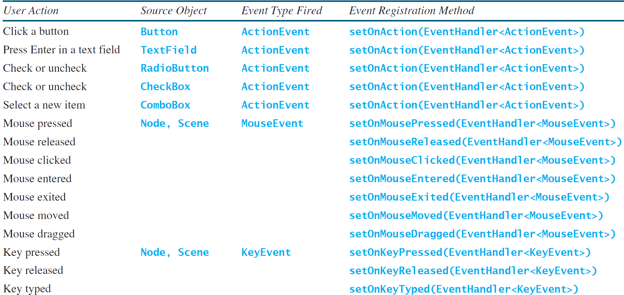
Selected User Actions and Handlers

Slide 12
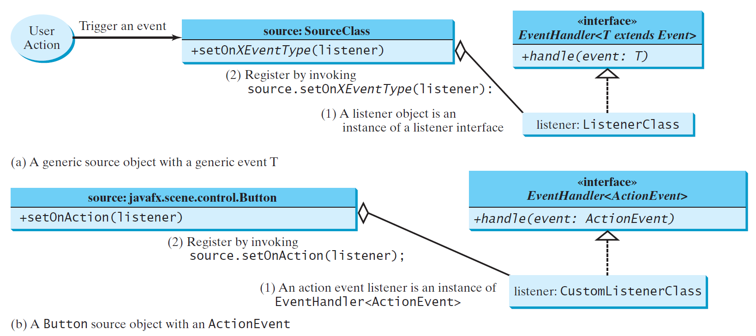
The Delegation Model

Slide 13
The Delegation Model: Example
Button btOK = new Button("OK");
OKHandlerClass handler = new OKHandlerClass();
btOK.setOnAction(handler);

Slide 14
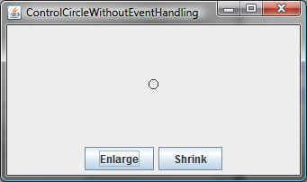
Example: First Version for ControlCircle (no listeners)
Now let us consider to write a program that uses two buttons to control the size of a circle.
ControlCircleWithoutEventHandling
Run

Slide 15
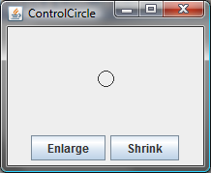
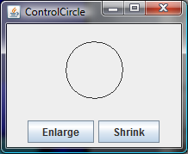
Example: Second Version for ControlCircle (with listener for Enlarge)
Now let us consider to write a program that uses two buttons to control the size of a circle.
ControlCircle
Run

Slide 16
Inner Class Listeners
A listener class is designed specifically to create a listener object for a GUI component (e.g., a button). It will not be shared by other applications. So, it is appropriate to define the listener class inside the frame class as an inner class.

Slide 17
Inner Classes
Inner class: A class is a member of another class.
Advantages: In some applications, you can use an inner class to make programs simple.
An inner class can reference the data and methods defined in the outer class in which it nests, so you do not need to pass the reference of the outer class to the constructor of the inner class.
ShowInnerClass

Slide 18
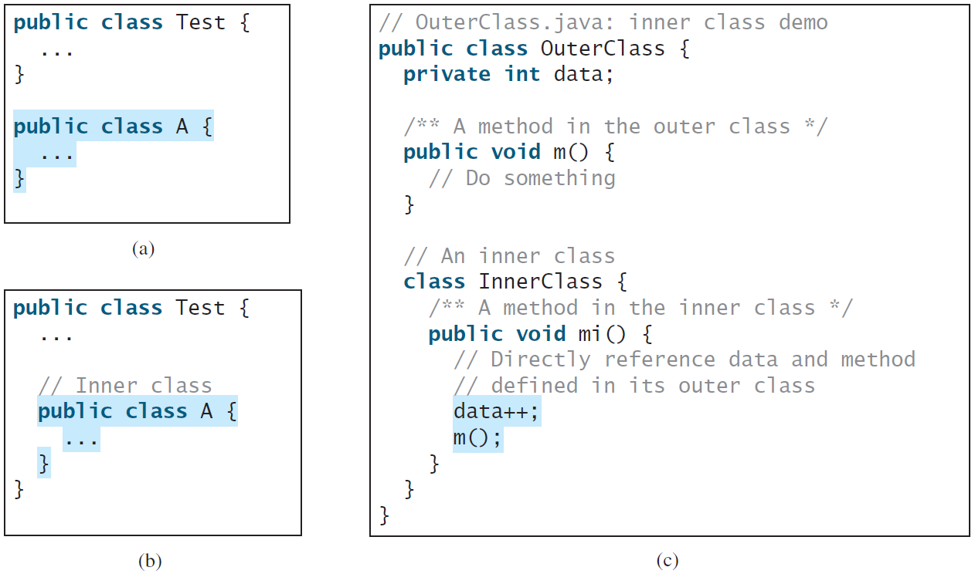
Inner Classes, cont.

Slide 19
Inner Classes (cont.)
Inner classes can make programs simple and concise.
An inner class supports the work of its containing outer class and is compiled into a class named OuterClassName$InnerClassName.class. For example, the inner class InnerClass in OuterClass is compiled into OuterClass$InnerClass.class.

Slide 20
Inner Classes (cont.)
An inner class can be declared public, protected, or private subject to the same visibility rules applied to a member of the class.
An inner class can be declared static. A static inner class can be accessed using the outer class name. A static inner class cannot access nonstatic members of the outer class

Slide 21
Anonymous Inner Classes
An anonymous inner class must always extend a superclass or implement an interface, but it cannot have an explicit extends or implements clause.
An anonymous inner class must implement all the abstract methods in the superclass or in the interface.
An anonymous inner class always uses the no-arg constructor from its superclass to create an instance. If an anonymous inner class implements an interface, the constructor is Object().
An anonymous inner class is compiled into a class named OuterClassName$n.class. For example, if the outer class Test has two anonymous inner classes, these two classes are compiled into Test$1.class and Test$2.class.

Slide 22
Anonymous Inner Classes (cont.)
Inner class listeners can be shortened using anonymous inner classes. An anonymous inner class is an inner class without a name. It combines declaring an inner class and creating an instance of the class in one step. An anonymous inner class is declared as follows:
new SuperClassName/InterfaceName() {
// Implement or override methods in superclass or interface
// Other methods if necessary
}

Slide 23
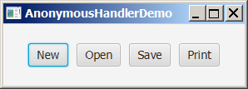
Anonymous Inner Classes (cont.)
AnonymousHandlerDemo
Run

Slide 24
Simplifying Event Handing Using Lambda Expressions
Lambda expression is a new feature in Java 8. Lambda expressions can be viewed as an anonymous method with a concise syntax. For example, the following code in (a) can be greatly simplified using a lambda expression in (b) in three lines.

Slide 25
Basic Syntax for a Lambda Expression
The basic syntax for a lambda expression is either
(type1 param1, type2 param2, ...) -> expression
or
(type1 param1, type2 param2, ...) -> { statements; }
The data type for a parameter may be explicitly declared or implicitly inferred by the compiler. The parentheses can be omitted if there is only one parameter without an explicit data type.

Slide 26
Single Abstract Method Interface (SAM)
The statements in the lambda expression is all for that method. If it contains multiple methods, the compiler will not be able to compile the lambda expression. So, for the compiler to understand lambda expressions, the interface must contain exactly one abstract method. Such an interface is known as a functional interface, or a Single Abstract Method (SAM) interface.
AnonymousHandlerDemo
Run

Slide 27
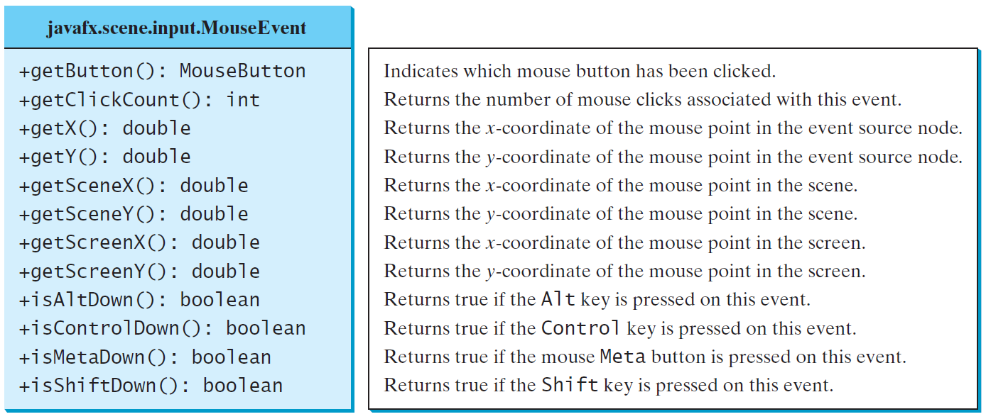
The MouseEvent Class
MouseEventDemo
Run

Slide 28
The KeyEvent Class
KeyEventDemo
Run

Slide 29
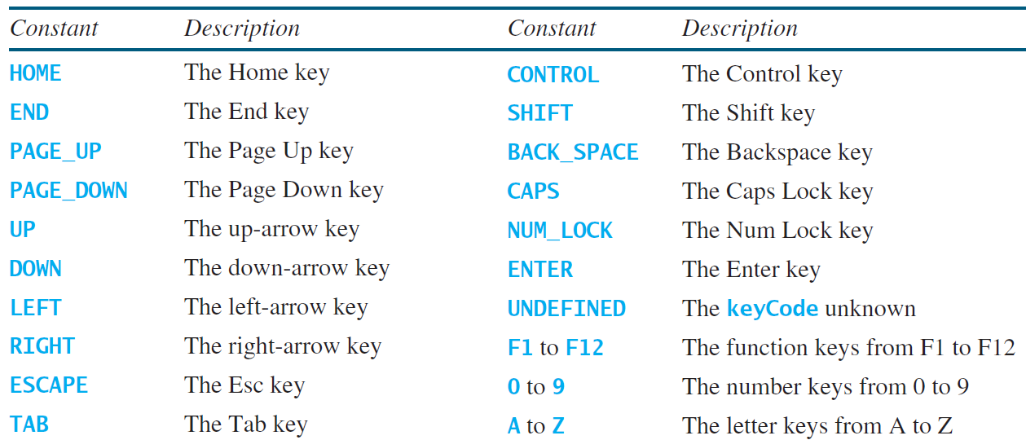
The KeyCode Constants

Slide 30
Example: Control Circle with Mouse and Key
ControlCircleWithMouseAndKey
Run

Slide 31
Listeners for Observable Objects
You can add a listener to process a value change in an observable object.
An instance of Observable is known as an observable object, which contains the addListener(InvalidationListener listener) method for adding a listener. Once the value is changed in the property, a listener is notified. The listener class should implement the InvalidationListener interface, which uses the invalidated(Observable o) method to handle the property value change. Every binding property is an instance of Observable.
ObservablePropertyDemo
Run
DisplayResizableClock
Run

Slide 32
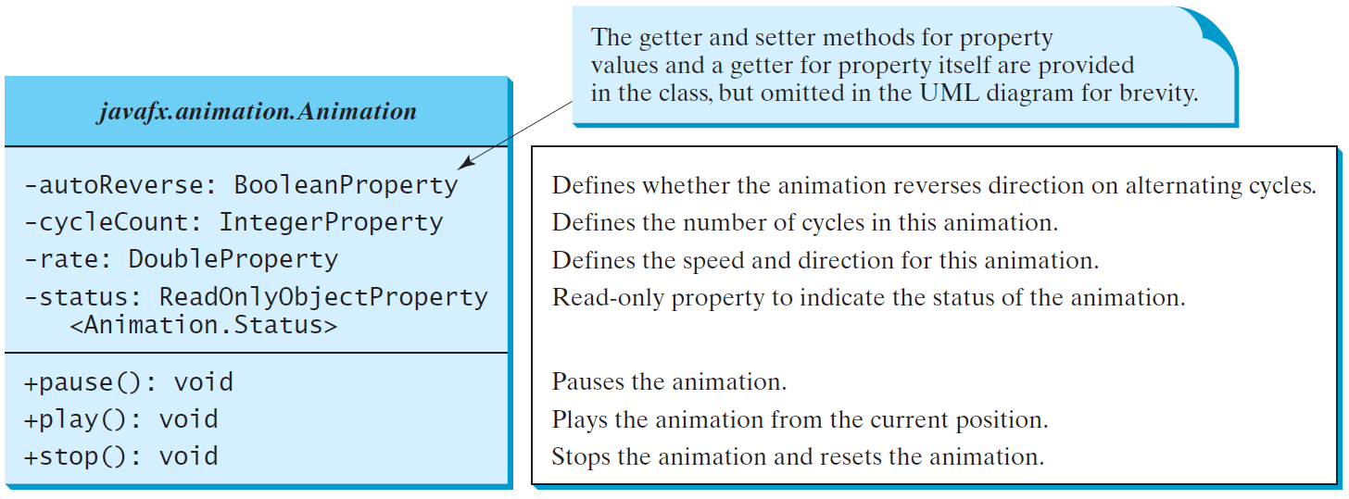
Animation
JavaFX provides the Animation class with the core functionality for all animations.

Slide 33
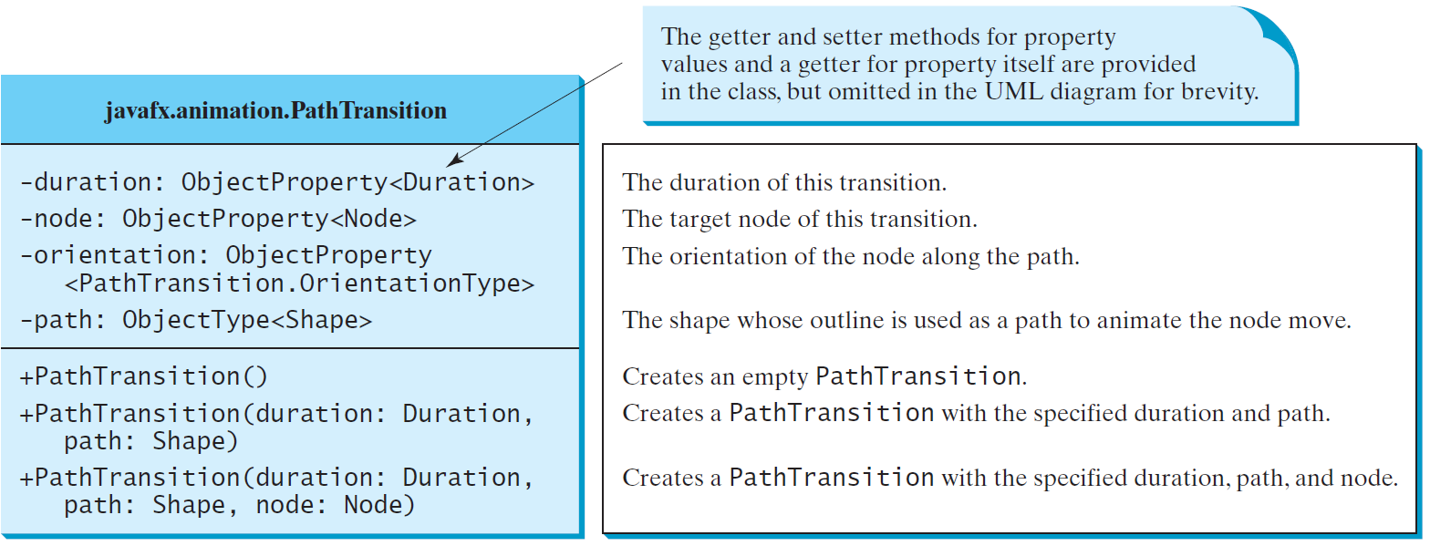
PathTransition
PathTransitionDemo
Run
FlagRisingAnimation
Run

Slide 34
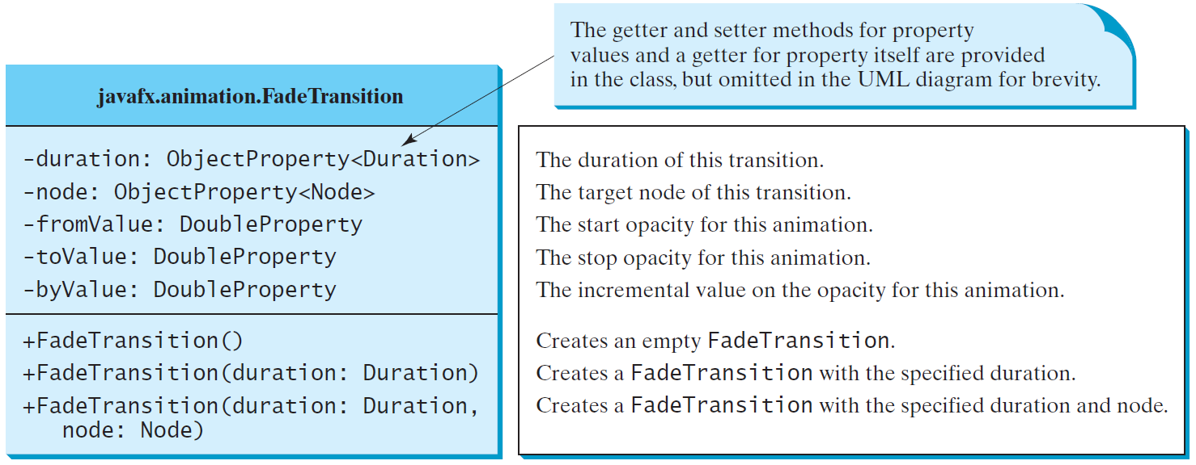
FadeTransition
The FadeTransition class animates the change of the opacity in a node over a given time.
FadeTransitionDemo
Run

Slide 35
Timeline
PathTransition and FadeTransition define specialized animations. The Timeline class can be used to program any animation using one or more KeyFrames. Each KeyFrame is executed sequentially at a specified time interval. Timeline inherits from Animation.
TimelineDemo
Run

Slide 36
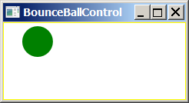
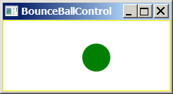
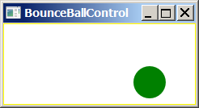
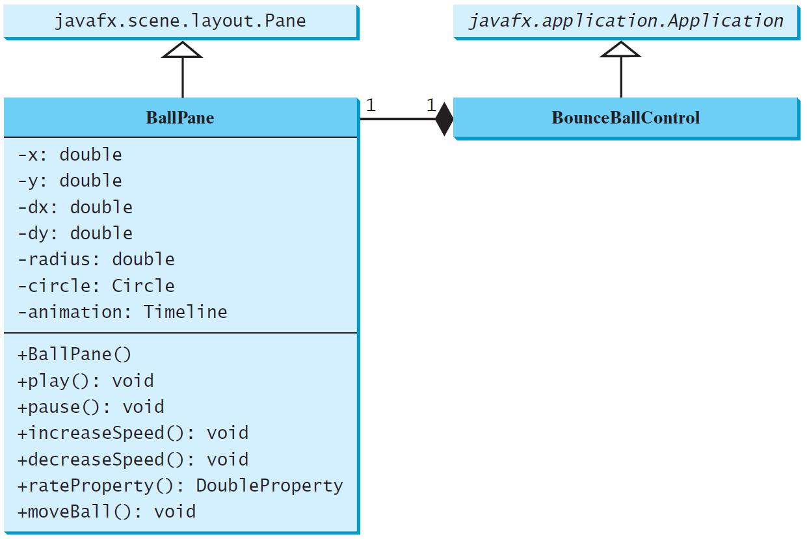
Case Study: Bouncing Ball
BallPane
BounceBallControl
Run

