Slide 1
Thermal Fluid Engineering ENMC4411 Psychrometric Applications
(Chapter 10 Moran et.al.2003)
Afif Hasan
Mechanical & Mechatronics Engineering Department
Birzeit University

Slide 2
Outline
Air vapor mixture
Properties of mixtures
Dry bulb & wet bulb temperatures
Psychrometric chart
Air conditioning processes

Slide 3
Psychrometrics
The objective of this chapter is to study systems involving mixtures of dry air and water vapor. A liquid water phase also may be present.
Knowledge of the behavior of such systems is essential for the analysis and design of air-conditioning devices, cooling towers, and industrial processes requiring close control of the vapor content in air.
The study of systems involving dry air and water is known as psychrometrics.

Slide 4
Moist air mixture
Consider a system consisting of moist air occupying a volume V at mixture pressure P and mixture temperature T.
The overall mixture and each mixture component behave as ideal gases at the states under present consideration.
The overall mixture is assumed to obey the ideal gas equation of state.

Slide 5
Partial pressure
Each mixture component is considered to act as if it existed alone in the volume V at the mixture temperature T while exerting a part of the pressure. This is known as the Dalton model.
It follows that the mixture pressure is the sum of the partial pressures of the dry air and the water vapor: P = Pa + Pv.
Partial pressure is the pressure of each component as if it occupies the total volume of mixture at temperature of the mixture.
Using the ideal gas equation of state, the partial pressures pa and pv of the dry air and water vapor are, respectively.

Slide 6
Partial pressure
The partial pressures can be evaluated alternatively as follows;
Similarly,
where ya is the mole fraction of the dry air in the mixture

Slide 7
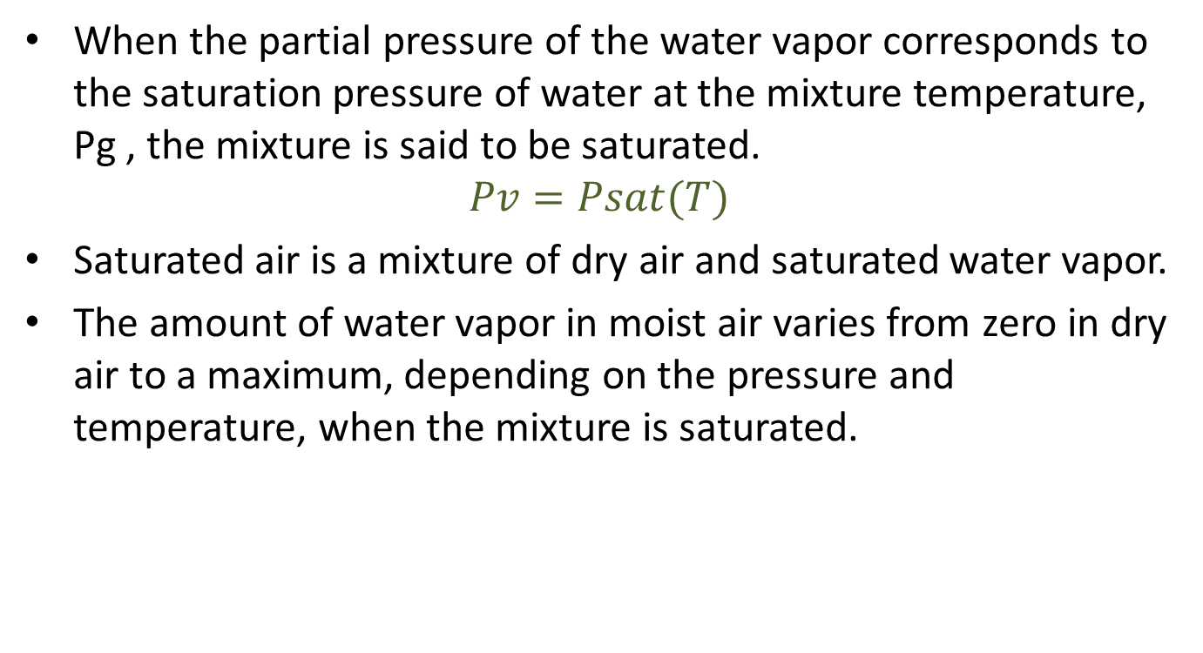
Saturated mixture
When the partial pressure of the water vapor corresponds to the saturation pressure of water at the mixture temperature, Pg , the mixture is said to be saturated.
$$Pv=Psat(T)$$
Saturated air is a mixture of dry air and saturated water vapor.
The amount of water vapor in moist air varies from zero in dry air to a maximum, depending on the pressure and temperature, when the mixture is saturated.

Slide 8
Humidity Ratio
humidity ratio ω, defined as the ratio of the mass of the water vapor to the mass of dry air.
The humidity ratio is sometimes referred to as the specific humidity.
The humidity ratio can be expressed in terms of partial pressures and molecular weights
Introducing Pa =P- Pv and noting that the ratio of the molecular weight of water to that of dry air is approximately 0.622, this expression can be written as

Slide 9



Relative Humidity: "Ф"
It’s the ratio of mole fraction of the vapor in the mixture to the mole fraction of vapor in saturated mixture at the same temperature and total pressure.
Where "Pg" is at the same temperature of mixture.

Slide 10
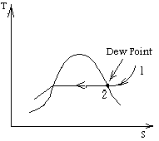
Dew point of a gas – vapor mixture
Dew point of a gas – vapor mixture: it’s the temperature at which the vapor condenses or solidifies when cooled at constant pressure.
Constant pressure cooling starting at "1" to "2"
Condensation starts at "2".
From
Since total pressure P is constant then Pi = constant
State "2" is the dew point of mixture, where Pv=Pg , and from Pg the saturation temperature of the vapor is found from tables and is known as dew point of the mixture.

Slide 11
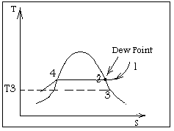
Isobaric cooling of gas – vapor mixture
Starting at "1" , Partial pressure of vapor remains constant
Until dew point at "2",
Condensate liquid at "4",
yv changes as nv change due to condensation hence, will change but it remain at saturation depending on temperature (e.g) at "3" if T = T3

Slide 12
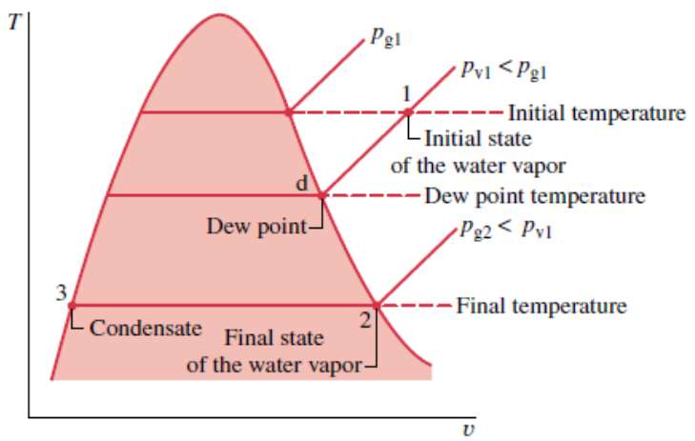
Isobaric cooling of gas – vapor mixture
Once the system is cooled below the dew point temperature and some of the water vapor initially present would condense.
At the final state, the system would consist of a gas phase of dry air and water vapor in equilibrium with a liquid water phase.
The vapor that remains can be regarded as saturated at the final temperature, state 2 of above figure with a partial pressure equal to the saturation pressure pg2 corresponding to this temperature.
The condensate would be a saturated liquid at the final temperature, state 3 of above figure.

Slide 13
Example

Slide 14
Example

Slide 15
Evaluating H and U
The values of H and U for moist air modeled as an ideal gas mixture can be found by adding the contribution of each component at the condition at which the component exists in the mixture. For example, the enthalpy H of a given moist air sample is
Dividing by ma and introducing the humidity ratio gives the mixture enthalpy per unit mass of dry air
The enthalpies of the dry air and water vapor appearing are evaluated at the mixture temperature. Or hv in above equation can be taken as hg at the mixture temperature. Enthalpy of dry air, ha, can be obtained from the appropriate ideal gas table.
An approach similar to that for enthalpy also applies to the evaluation of the internal energy of moist air, u.

Slide 16
Psychrometers
Dry – bulb temperature is temperature of air as measured by ordinary thermometer placed in air.
Wet – bulb temperature is temperature as measured by a thermometer when its bulb is covered by a moistened cotton wick.
Psychrometer is a device which uses air flow past dry and wet – bulb thermometer to determine humidity of air – water vapor mixture.
Sling Psychrometers

Slide 17
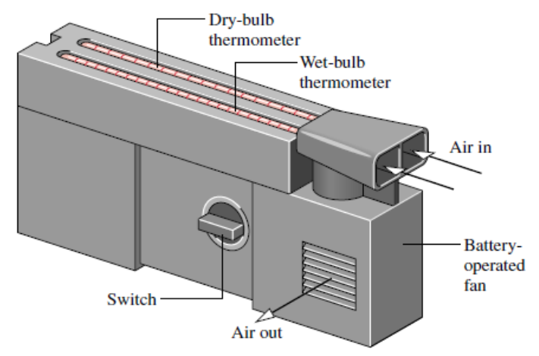
Psychrometers

Slide 18
Outline
Air vapor mixture
Properties of mixtures
Dry bulb & wet bulb temperatures
Psychrometric chart
Air conditioning processes

Slide 19
Psychometric chart
Psychometric chart is a graphical presentation of air – water vapor mixture properties.
Three independent properties will describe the state of the mixture e.g. T, P, and composition.
Psychometric is a plot of humidity ratio “ ω “y- axis” versus dry – bulb temperature “x – axis” with relative humidity , wet – bulb temperature, and mixture enthalpy per mass of dray air, at fixed pressure usually 0.1 MP or 1 atm.

Slide 20
Psychometric chart
Curves of constant relative humidity are shown on psychrometric charts.
Since the dew point is the state where the mixture becomes saturated when cooled at constant vapor pressure, the dew point temperature corresponding to a given moist air state can be determined by following a line of constant ω (constant pv) to the saturation line, φ=100%.
The dew point temperature and dry-bulb temperature are identical for states on the saturation curve.

Slide 22

Psychrometric charts
Psychrometric charts also give values of the mixture enthalpy per unit mass of dry air in the mixture: ha + ωhv the mixture enthalpy has units of kJ per kg of dry air.
The enthalpy of the dry air ha is determined relative to a zero value at 0ºC, and not 0 K.
The enthalpy of the water vapor hv is evaluated as hg at the dry-bulb temperature of the mixture.
For charts in SI, the temperature is in ºC and ω is expressed in kg, or g, of water vapor per kg of dry air.

Slide 23
Psychrometric charts
Wet bulb temperature Twb lines run from the upper left to the lower right of the chart. Lines of constant wet-bulb temperature are approximately lines of constant mixture enthalpy per unit mass of dry air.

Slide 24
Psychrometric charts
Psychrometric charts also provide lines representing volume per unit mass of dry air, V/ma. These specific volume lines can be interpreted as giving the volume of dry air or of water vapor, per unit mass of dry air, since each mixture component is considered to fill the entire volume.

Slide 25
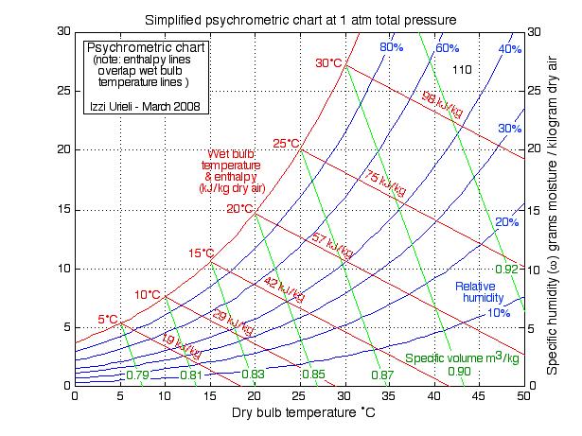

Slide 26
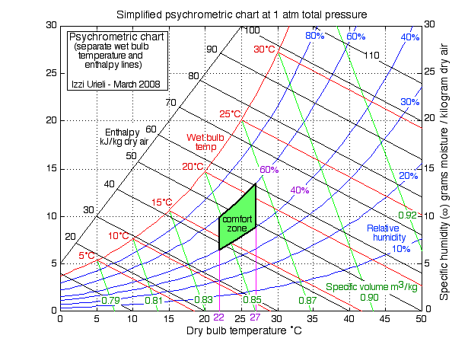
Psychrometric charts
Also note Human comfort zone range of condition most agreeable to human well being.
Comfort of human body depends primarily on three factures:
1. temperature (Dry – bulb) 20 – 27 C
2. Relative humidity 40% ≤ ≤ 60%.
3. Air motion. V = 15

Slide 31

Example
If dry – bulb temperature is 23 ºC, and wet bulb temperature is 16 º C, Determine:
a)Humidity ratio.
b)Relative Humidity.
c)Vapor Partial Pressure.
d)Dew point.
e)Enthalpy of mixture.
From psychometric chart at TWb = 16, Tdp = 23 º C.
a) ω = 0.0087kg water/ kg dry air
b) Φ = 50%
Pv = Φ Pg @23 º C
or, from ω=

Slide 32
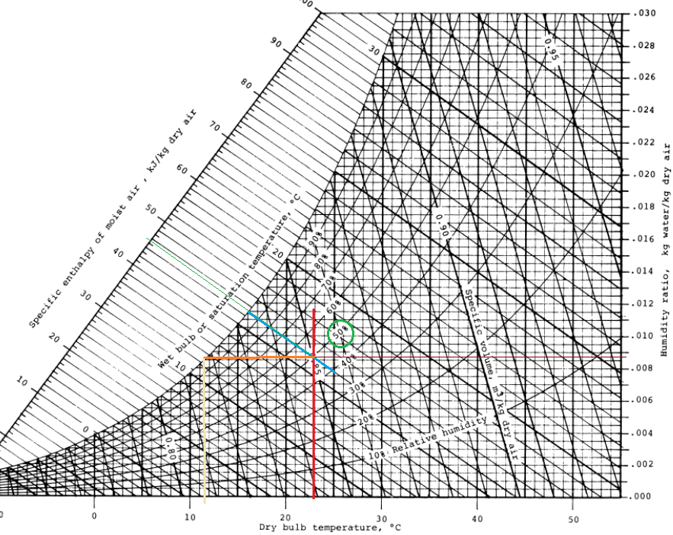

Slide 33

Example
d) Enthalpy =65 kJ/ kg dry air
e) Dew point.
Cooling at constant ω, since ω = =fixed.
Move along ω = 0.0087 = constant until condensation takes place or Φ = 100% (saturated mixture) then need the dry- bulb temperature as the dew point.
Tdew = 12 º C.
Repeat e.g for Tw = 23 º C Td = 42 º C

Slide 34
Outline
Air vapor mixture
Properties of mixtures
Dry bulb & wet bulb temperatures
Psychrometric chart
Air conditioning processes

Slide 35
Air conditioning processes
Heating and cooling at constant “ω”.
Heating with humidification when φ low, pass air through heating section then humidifying section e.g. spry water
Cooling with dehumidification e.g. T1 = 30C ; φ1 = 80% to T1 = 14C ; φ2 = 100% and water T1=T2=14C
Evaporative cooling identical to adiabatic sat process if follow a constant wet – bulb temperature line.

Slide 36
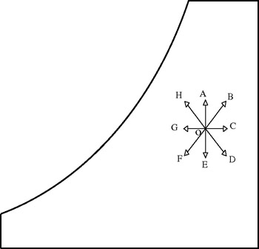
Air conditioning processes
Process | Direction
Simple heating | O to C
Simple cooling | O to G
Humidification | O to A
Dehumidification | O to E
Evaporative cooling | O to H
Evaporative heating | O to D
Heating and humidification | O to B
Cooling and dehumidification | O to F

Slide 37
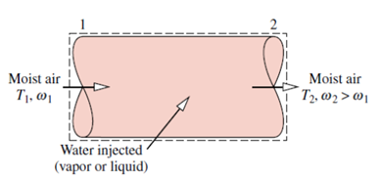



Applying Mass and Energy Balances to Air-Conditioning Systems
Mass balance
At steady state for each component individually it is necessary for the total incoming and outgoing mass flow rates to be equal.
The mass flow rates of the water vapor can be expressed conveniently in terms of humidity ratios as
With these expressions, the mass balance for water becomes

Slide 38


Energy Balance
Assuming and ignoring all kinetic and potential energy effects, the energy rate balance reduces at steady state to
The enthalpies of the entering and exiting water vapor can be evaluated as the saturated vapor enthalpies corresponding to the temperatures T1 and T2, respectively, giving
Finally the energy rate balance becomes

Slide 45
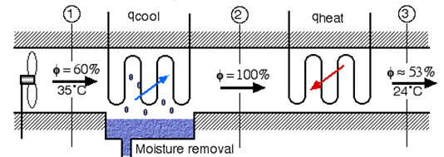
Dehumidification
When a moist air stream is cooled at constant mixture pressure to a temperature below its dew point temperature, some condensation of the water vapor initially present would occur.
Moist air enters at state 1 and flows across a cooling coil through which a refrigerant or chilled water circulates. Some of the water vapor initially present in the moist air condenses, and a saturated moist air mixture exits the dehumidifier section at state 2.
Since the moist air leaving the humidifier is saturated at a temperature lower than the temperature of the moist air entering, the moist air stream might be unsuitable for direct use in occupied spaces.
However, by passing the stream through a following heating section, it can be brought to a condition most occupants would regard as comfortable.

Slide 46
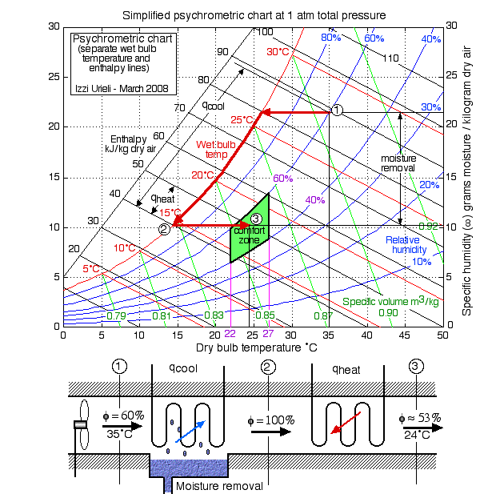
Dehumidification

Slide 47
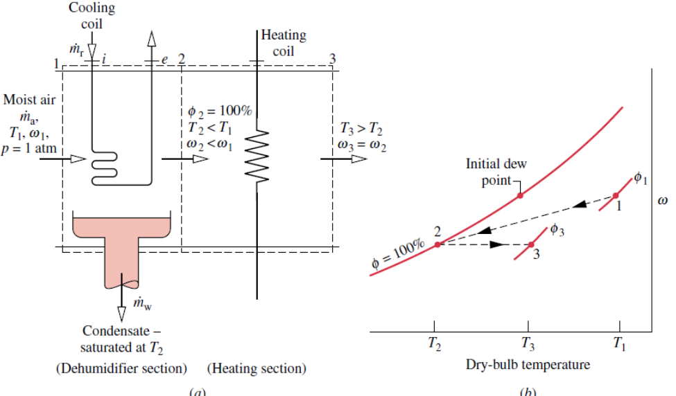
Dehumidification

Slide 48
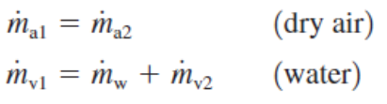

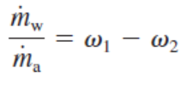
Mass balance then
Rewrite as
For steady state energy balance with no work gives and heat transfer to surroundings,
and
where the specific enthalpies of the water vapor at 1 and 2 are evaluated at the saturated vapor values corresponding to T1 and T2, respectively. Since the condensate is assumed to exit as a saturated liquid at T2, hw = hf2

Slide 52
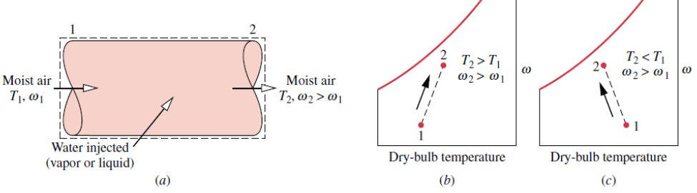
Humidification
It is often necessary to increase the moisture content of the air circulated through occupied spaces. One way to accomplish this is to inject steam. Alternatively, liquid water can be sprayed into the air.

Slide 55
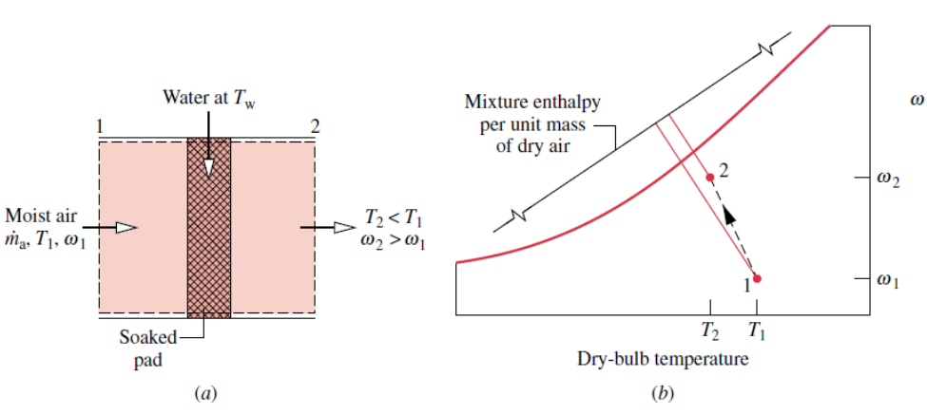

Evaporative Cooling
Cooling in hot, relatively dry climates can be accomplished by evaporative cooling. This involves either spraying liquid water into air or forcing air through a soaked pad that is kept replenished with water.
The steady-state forms of the mass and energy rate balances reduce for the control volume to,

Slide 56
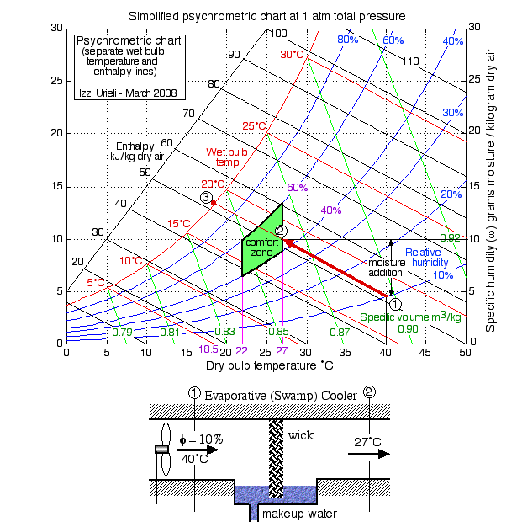
Evaporative Cooling

Slide 57
Evaporative cooling: Example
Air at state point 1 (65°C dry bulb temperature and 57°C wet bulb temperature) experiences a temperature drop of 3°C as it passes
through the soaked water pad.
Determine the properties of the air at state point 2 and compare them with those at state point 1.
Given: T1 = 65°C; Tw1 = 57°C
Adiabatic cooling to T2 = 62°C
Air flow rate = 2 m/s
Find Properties of the air at state point 2
Analysis
Constant enthalpy process
h2=h1

Slide 58
(a) At state point 1: T1 = 65°C
Tw1 = 57°C
Tdp1 = 56.3°C
RH1 = 66.9%
HR1 ω= 123.1 g/kg of dry air
v1 = 1.15 m3/kg of dry air
h1 = 387.7 kJ/kg of dry air
At state point 2: T2 = 62°C and h2=h1= 387.7
Tw2 = 57°C
Tdp2 = 56.5°C
RH2 = 77.3%
HR2 ω= 124.5 g/kg of dry air
v2 = 1.14 m3/kg of dry air

Slide 59
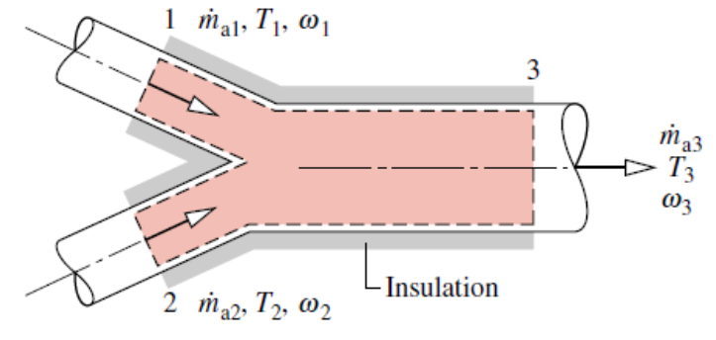
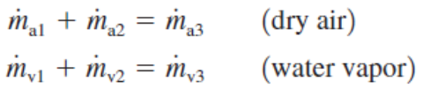
Adiabatic Mixing of Two Moist Air Streams
Consider the adiabatic mixing of two streams shown in figure below,
The mass rate balances for the dry air and water vapor at steady state are, respectively
the energy rate balance reduces at steady state to

Slide 63
End of psychrometry

