Slide 1
Intervention for fluency

Slide 2
Fluency
the major type of fluency disorder exhibited by children and adults is stuttering. Stuttering is characterized by an abnormally high frequency and/or duration of stoppages in the forward flow of speech.
Studies indicate that prevalence under age 6 is considerably higher than in later periods in life and that stuttering occurs in approximately 0.72% to 1% of the population. It occurs in males more than females.
Cause of stuttering:
Many theories have been proposed regarding the cause of stuttering, ranging from genetic and other organic explanations to learned, environmental, or linguistic accounts. Certain theories emphasize differences in cerebral dominance, disruptions of speech motor timing , or anticipatory struggle to avoid communicative failure.

Slide 3
The covert repair hypothesis suggests that stutterers may be prone to errors in phonological planning; their attempts to edit these errors before producing the utterance are considered as disfluencies.
Several multifactorial theories have emphasized the interaction between stuttering and a variety of intrinsic/extrinsic factors. The capacities and demands model; suggests that stuttering results from demands for performance that exceed the speaker’s capacities in one or more domains.
The three-factor hypothesis claims that a combination of psycholinguistic, psychosocial, and physiological factors are involved in the phenomenon of stuttering. The Packman (2012) is multifactorial and includes:
(1) Deficit in neural processing of spoken language
(2) External triggers inherent in spoken language such as variable syllable stress and linguistic complexity.
(3) Modulation factors according to each individual (such as emotional reactivity) and environmental stressors( such as levels of physiological arousal)

Slide 4
Some identified specific gene mutations correlated with stuttering which involve metabolic deficiencies in the body’s ability to process certain enzymes.
Others suggests that stuttering includes consideration of a neurobiological lack of integration of the processes of planning and producing language/speech that leads to interruptions in the acoustic speech signal and physical struggle (e.g., tension). Which may lead to surface behaviors (e.g., repetitions, prolongations, blocks) and emotional and cognitive reactions.
The specific interactions among linguistic, motor, cognitive, genetic, emotional, and social factors are not definitely determined.

Slide 5
-Onset of stuttering: 2 - 5 years
-80% Spontaneous recovery before the age of puberty
-Some suggests that spontaneous recovery is a gradual process that may begin within the first year of stuttering and not reach completion until 3 or 4 years post-onset .
-50% to 80% of children who stutter will recover with or without treatment
-Several viewpoints regarding the development of stuttering
Bloodstein (1960) describes a four-phase model that progresses from mild episodic disfluencies to severe, chronic stuttering accompanied by fear and avoidance reactions.
Van Riper (1982) suggests a three-stage progression that includes primary, transitional, and secondary phases.
Starkweather (1987); development of stuttering fluctuates as a result of individual’s changing capacity to accommodate environmental demands for communication.
Recent data suggest that severity of stuttering may remain unchanged up to 3 years post-onset

Slide 6
Categories of stuttering behaviors
Core Behaviors
Are beyond the voluntary control of the stutterer and include:
Repetitions of sounds, syllables, or whole words (e.g., c-c-cat; ba-ba-balloon; we-we-we are going)
Prolongations of single sounds (e.g., sssssoap; fffffishing)
Blocks of airflow/voicing during speech (inappropriate stoppage of air or voice at any level of the vocal tract)

Slide 7
Secondary Behaviors
Develop over time as learned reactions to core behaviors and are categorized as escape or avoidance behaviors.
Escape behaviors occur during a stuttering moment and are attempts to break out of the stutter; head nods, eye blinks, foot taps, and jaw tremors.
In the more advanced stages of stuttering, these behaviors may be accompanied by visible struggle and muscular tension.
Avoidance behaviors occur in anticipation of a stuttering moment and are attempts to refrain from stuttering at all; Circumlocutions (substitutions of less feared vocabulary words), unfilled pauses (without tension/struggle) within or between words, and use of “um” or other interjections to postpone speaking.

Slide 8
Developmental Disfluencies Versus Stuttering
Most developing children 2 -4 years display some effortless disfluencies during the normal course of language acquisition:
Hesitations (silent pauses)
Interjections of sounds, syllables, or words (e.g., “Um, I went to school”; “Did you you know find her?”)
Revisions/repetitions of words, phrases, or sentences (e.g., “You have to touch,no, turn it”; “I have some . . . I want you to look at these baseball cards”)
Normal rhythm and stress patterns
No tension or tremors noted

Slide 9
To differentiate between normal disfluencies and atypical disfluencies.
Early signs of stuttering:
Three or more within-word disfluencies per 100 words (especially fragmentation of syllables)
Disfluencies on more than 10% of syllables spoken
Predominant use of prolongations, blocks, and part-word repetitions (as opposed to interjections and whole-word or phrase repetitions)
Presence of secondary behaviors/increased tension
Vowel neutralization (schwa) during repetitions (e.g., buh-buh-beat)
Duration of single instance of disfluency that exceeds two seconds
Uncontrolled or abrupt changes in pitch or loudness

Slide 10
Ambrose and Yairi’s (1999) suggest a basis of three main characteristics to differentiate :
(1) part-word repetition
(2) single-syllable word repetition
(3) dysrhythmic phonation (i.e., prolongations, blocks, and broken words).
CWS produced 2.5 – 4 times as many total disfluencies as the CWNS. Also, CWS produce an average of 2.0 extra repetition units.
Decision-making regarding intervention is influenced by factors associated with high probability of recovery:
18 months to 3 years of age at onset, no family history of stuttering or a small number of affected relatives who recovered in childhood, female, few to no associated behaviors and no coexisting phonological or cognitive problems

Slide 11
Treatment for fluency disorders
Fluency can be described as consisting of four primary components: rate, continuity, rhythm, and effort.
Fluent speech is smooth, relatively rapid, and melodic (as opposed to monotonous), and without any physical or mental effort.
For people with severe stuttering behavior, spontaneous fluency is not a realistic goal. Controlled fluency or acceptable levels of stuttering may be identified as the ultimate goal of treatment, depending on the nature of stuttering and the client’s cultural and linguistic background as well as preferences and priorities.
People who stutter frequently experience disfluency after treatment has been terminated. Therefore, periodic follow-up sessions are important.
For example, Blood (1995) advocates a cognitive-behavioral relapse management program for adolescents after treatment. Providing training in five basic areas: problem solving, general communication skills, assertiveness, coping strategies, and establishment of realistic expectations.

Slide 12
Stuttering can occur with other communication problems such as language or phonology disorders, particularly in preschool and school-age children.
There are at least four programming alternatives for treating coexisting impairments :
Discrete: A certain amount of therapy time is allotted to treat each disorder in isolation. For example, in a 1-hour therapy session, a clinician may devote 20 minutes to fluency goals and the remaining 40 minutes to articulation goals. Alternatively, a twice-weekly therapy schedule can be divided to spend one session on each disorder area.
Modified cycles: Treatment for one disorder is implemented for a specified block of time (e.g., 6 weeks) and then discontinued. An equivalent time period is then devoted to treatment of the other communicative impairment. This cycle is alternated until long-term goals are achieved for each disorder.

Slide 13
3. Blended: Therapy goals for one disorder are incorporated into the therapy activities for a second disorder. For example, during articulation activities, the clinician can encourage fluency-enhancing behaviors such as slower speaking rate and increased pause time between conversational turns.
4. Lagged: This is a modified form of the blended approach that incorporates an initial time delay. Specifically, a period of initial therapy focuses on attaining a predetermined level of mastery in the concomitant disorder area (e.g., phonological or linguistic). Once the child has reached this level of mastery, fluency therapy can begin using the recently mastered phonological/linguistic forms as the basis for practice. Fluency therapy continues to be programmed at comfortable levels of phonological/linguistic demand as the child progressively masters new objectives in the concomitant disorder area.

Slide 14
Treatment efficacy/ EBP
Efficacy in the area of stuttering therapy is particularly difficult to measure because its definition must incorporate three interrelated factors:
(1) objective measures of frequency and duration of stuttered moments.
(2) client emotions and attitudes.
(3) the client’s amenability to participate in communicative interactions with a variety of partners
(WHO) presented a multidimensional classification scheme for describing health status and the experience of disability;
The International Classification of Functioning, Disability, and Health (ICF) to describe the experience of stuttering. That involve negative affective, behavioral, cognitive reactions (both from the speaker and the listener), limitations in the ability to participate in daily activities and a negative impact on quality of life.
-ICF is used for measuring treatment outcomes for persons who stutter.

Slide 15
Several Studies showed that:
-Preschool children benefit from initiation of therapy in the early stages of stuttering.
-Response-contingent intervention is the most well-documented approach for preschoolers who stutter.
-Studies of adults indicate that prolonged speech, gentle onsets, self-monitoring, and modeling are among the most effective treatment strategies for remediating stuttering
What is critical for successful treatment outcomes may not be the intervention itself, but rather the knowledge and skill of the clinician.
Frequently, the client’s age is a critical factor in determining how intervention will be implemented.

Slide 16
Intervention techniques
Fluency Shaping: is based on the assumption that stuttering is a learned behavior. The primary goal of fluency shaping is to eliminate disfluencies and gradually change the speaker’s habitual speaking pattern to one of fluent speech. This is accomplished through the use of several fluency enhancing techniques:
Easy onset/prevoice exhalation: The speaker is taught to exhale slightly before beginning phonation and reach conversational loudness gradually.
Decreased speaking rate (prolonged speech): The speaker is trained to stretch out the sounds (primarily vowels) in his speech and produce words at a slower-than-normal speaking rate while maintaining normal stress and intonation.
Light articulatory contacts: The speaker is taught to move the articulators in a loose and relaxed manner.
Continuous phonation: The speaker is trained to reduce all breaks between words by maintaining voicing continuously until he naturally needs to take a breath.

Slide 17
The ultimate aim of programs based on a fluency-shaping philosophy is to completely change speech behavior by teaching clients to use these techniques at all times, not just during disfluent moments. These techniques are designed to interfere with the stuttering behaviors, thus reducing them. Therapy sessions focus solely on acquisition of fluency-enhancing behaviors and generally do not address a client’s secondary behaviors or the negative feelings and attitudes that may be associated with the stuttering.

Slide 18
Delayed auditory feedback (DAF):
This fluency-shaping technique has been widely used in the treatment of stuttering. A speaker’s own words are returned through headphones after an imposed electronic delay of a few milliseconds. For normal speakers, the use of DAF disrupts the smooth flow of speech and results in a significant breakdown in fluency. DAF has the opposite effect on the speech of many individuals who stutter; it decreases their speech rate and reduces the number of notable disfluencies. As a general rule, therapy is initiated at a delay time of approximately 250 ms. The time delay is then reduced in 50-ms intervals (i.e., 200 ms, 150 ms, 100 ms, and so on) as the client stabilizes fluency skills at each level.
This technique tends to generate increased fluency in the early stages of therapy and to enhance the speaker’s ability to monitor oral-sensory feedback cues from his own speech mechanism. Finally, it facilitates a slower speaking rate by increasing a client’s syllable duration and phonation time.

Slide 19
Among disadvantages are difficulty in weaning clients from the DAF equipment and the development of a “DAF voice” (slow, labored, lacking in inflection and stress variation).
Recently, assistive devices have been developed to treat stuttering from a fluency-shaping perspective. Such as SpeechEasy, use frequency-altered feedback (FAF) as well as DAF to promote fluent speech. In FAF, digital technology allows speech signal frequencies to be adjusted without changing a client’s speech rate. Other portable devices, such as the Edinborough Masker, permit clients to turn on masking noise in anticipation of a disfluency.

Slide 20
Stuttering Modification/Management : is based on the premise that stuttering may involve a physiological predisposition. The primary goals of stuttering management are to modify each disfluent moment by stuttering more easily and to eliminate struggle and avoidance behaviors. Some called this the “stutter more fluently” approach. The strategy is to minimize a client’s reaction to loss of speech control rather than to eliminate the disfluencies themselves. Through the use of these techniques:
Self-analysis: Increase the client’s awareness of the type, severity, and loci of disfluencies as well as any accompanying secondary behaviors. Attention also may be given to increase the client’s self-awareness of the characteristics of his non-stuttered speech and monitoring his proprioceptive awareness of the oral musculature.
Relaxation: Reduce the client’s anxiety and muscle tension through relaxation training .
Desensitization: Reduce negative emotions associated with stuttering (e.g., fear, frustration, embarrassment) by decreasing sensitivity to core behaviors and listener reactions through activities such as voluntary stuttering or voluntary exaggeration of a stuttered moment

Slide 21
Therapy outcomes are not defined strictly by decreases in stuttering frequency counts. Rather, progress is measured along a qualitative continuum as the nature of stuttering shifts from high-struggle speech with syllable fragmentations to less effortful, forward-moving speech.
Clinicians who employ a stuttering modification approach work with clients to identify hierarchies of feared speaking situations (See Table 9-1 next slide)
These hierarchies are valuable tools for a variety of therapeutic purposes: (1) developing clients’ self-awareness and ability to analyze their behavior
(2) recognizing variations in clients’ stuttering patterns across different settings
(3) facilitating development of sequential behavioral objectives and collection of data وبيتدرج بالصعوبة من حيث المكان والاوضاع اللي بتأتئ فيهم والاشخاص اللي تعود عليهم

Slide 22
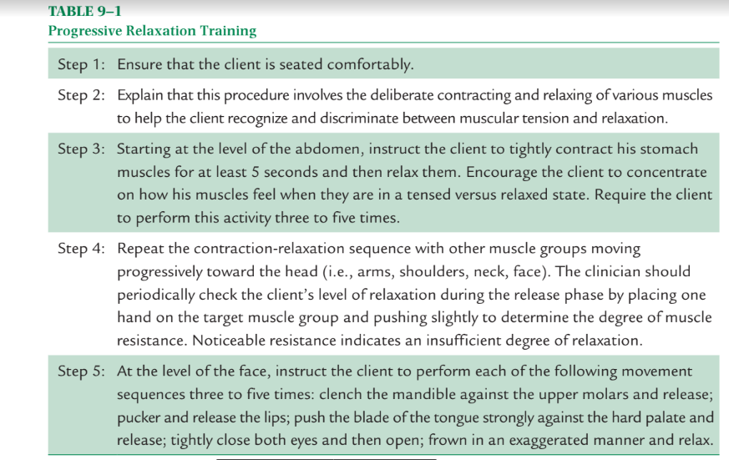

Slide 23
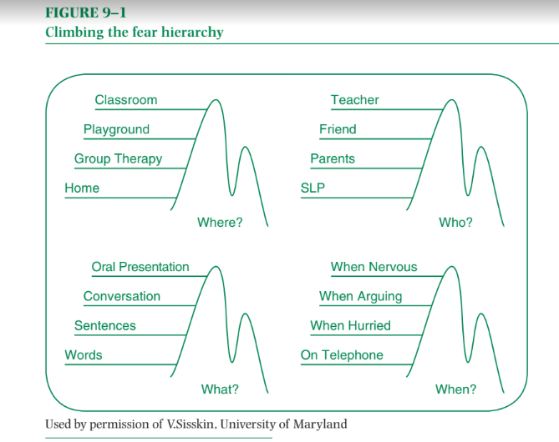

Slide 24
The following stuttering modification techniques are generally intended to be used as a three-part sequence in the following order:
Cancellations: When experiencing a disfluency, the speaker is encouraged to complete the intended word without attempting to break out of the disfluency. After the disfluency has been produced, the speaker is instructed to pause and mentally rehearse a technique for producing the word more fluently (or with an easier stutter) and then repeat the word.
Pull-outs: When experiencing a disfluency, the speaker is taught to stop in the middle of the stuttering moment, mentally rehearse the intended word using a fluency- enhancing technique (or easier stuttering pattern), and then reproduce it.
Preparatory sets: The speaker is encouraged to anticipate an imminent disfluency and pause briefly to mentally rehearse fluent (or gentle stuttering) production before the word is attempted.

Slide 25
The ultimate aim of programs based on a stuttering modification/management philosophy is to modify stuttering behaviors to an acceptable level rather than eliminate them entirely. The client’s negative attitudes and feelings toward his or her stuttering are typically identified and monitored over time through the administration of attitudinal scales.
Therapy sessions also give considerable attention to the reduction of speech fears and secondary behaviors as a means of minimizing the impact of stuttering. Elementary school-age children and adolescents are particularly vulnerable to teasing and negative self-image. Effective therapy programs incorporate activities such as role playing and brainstorming to proactively address these issues.

Slide 26
Guitar (2013) suggests that long-term fluency goals and clinical methods are two important treatment issues that differentiate fluency-shaping and stuttering modification/ management approaches. With regard to fluency goals, the three possible outcomes of therapy are spontaneous fluency, controlled fluency, and acceptable stuttering. The outcome of choice for both therapy approaches is spontaneous fluency, with a secondary goal of controlled fluency.
Yairi and Seery (2014) suggest that therapists consider three major alternatives when designing long-term treatment for people who stutter: increased fluency, reduced stuttering, and improved cognitive-emotional adjustment.
Guitar (20013) and others advocate the integration of fluency shaping and stuttering modification/management techniques in the treatment of stuttering. They believe that stuttering results from an interaction of physiologic factors and learned behaviors.

Slide 27
Example Profiles from
(385-396)
Taima Kokaly.

