Slide 1
Acute Kidney Injury and
Chronic Kidney Disease

Slide 2
Introduction
Acute kidney injury is abrupt in onset and often is reversible if recognized early and treated appropriately.
In contrast, chronic kidney disease is the end result of irreparable damage to the kidneys. It develops slowly, usually over the course of a number of years and often requires dialysis therapy or transplantation.

Slide 3
Acute Kidney Injury
Acute kidney injury (AKI), formerly known as acute renal failure, represents an abrupt decline in kidney function, resulting in an inability to maintain fluid and electrolyte balance and excrete nitrogenous wastes.
Acute kidney injury is a common threat to seriously ill persons, in whom it is associated with a high rate of adverse outcomes, with mortality rates ranging between 25% and 80% depending on the cause and clinical status of the patient. This high mortality rate probably reflects the facts that AKI is often seen in elderly persons and that it is frequently superimposed on other life-threatening conditions, such as trauma, shock, and sepsis.

Slide 4
Acute Kidney Injury
Acute renal injury is commonly defined as an abrupt (within 48 hours) reduction in kidney function based on an increase in serum creatinine level, a reduction in urine output, and the need for dialysis, or a combination of these factors.
The range of clinical manifestations can vary from mild to severe, based on the degree of rise in creatinine levels and decrease in urine output.

Slide 5
Types of Acute Kidney Injury
Acute kidney injury can be caused by several types of conditions, including a decrease in blood flow without ischemic injury; ischemic, toxic, or obstructive tubular injury; and obstruction of urinary tract out flow.
The causes of AKI commonly are categorized as prerenal, intrarenal, and postrenal. Collectively, prerenal and intrarenal causes account for 80% to 95% of AKI cases.

Slide 6
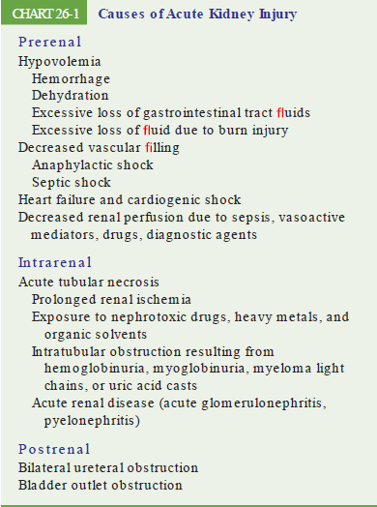

Slide 7
Acute Tubular Necrosis
Acute tubular necrosis (ATN) is characterized by the destruction of tubular epithelial cells with acute suppression of renal function. It can be caused by a number of conditions, including acute tubular damage due to ischemia, sepsis, nephrotoxic effects of drugs, tubular obstruction, and toxins from a massive infection.
Tubular epithelial cells are particularly sensitive to ischemia and toxins. The tubular injury that occurs in ATN frequently is reversible. The process depends on recovery of the injured cells, removal of the necrotic cells and intratubular casts, and regeneration of tubular cells to restore the normal continuity of the tubular epithelium.

Slide 8
Clinical Manifestations: The onset phase
The onset or initiating phase, which lasts hours or days, is the time from the onset of the precipitating event (e.g., ischemic phase of prerenal failure or toxin exposure) until tubular injury occurs.

Slide 9
The Maintenance Phase
The maintenance phase can involve either an oliguric or nonoliguric phase.
Nonoliguric ATN has a better outcome. Conversion from a nonoliguric to an oliguric state is characterized by a marked decrease in the GFR, accompanied by retention of metabolic wastes such creatinine, urea, and sulfate, which normally are cleared by the kidneys.
The urine output usually is lowest at this point. Fluid retention gives rise to edema, water intoxication, and pulmonary congestion. If the period of oliguria is prolonged, hypertension develops and with it signs of uremia (accumulation of nitrogenous wastes in the blood). When untreated, the neurologic manifestations of uremia progress from neuromuscular irritability to seizures, somnolence, coma, and death.

Slide 10
The Recovery Phase
The recovery phase is the period during which repair of renal tissue takes place. Its onset usually is heralded by a gradual increase in urine output and a fall in serum creatinine, indicating that the nephrons have recovered to the point at which urine excretion is possible.
Diuresis often occurs before renal function has fully returned to normal. Consequently, BUN and serum creatinine, potassium, and phosphate levels may remain elevated or continue to rise even though urine output is increased.
In some cases, the diuresis may result from impaired nephron function and may cause excessive loss of water and electrolytes. Eventually, renal tubular function is restored with improvement in concentrating ability. At about the same time, the creatinine and BUN begin to return to normal. In some cases, mild to moderate kidney damage persists.

Slide 11
Diagnosis and Treatment
Prevention and early diagnosis.
Careful observation of urine output.
U/A.
Blood tests.
A major concern in the treatment of AKI is identifying and correcting the cause.
Hemodialysis.

Slide 12
Chronic Kidney Disease
Chronic kidney disease (CKD) is a pathophysiologic process that results in the loss of nephrons and a decline in renal function as determined by a measured or estimated decrease in the GFR that has persisted for more than 3 months.
Chronic kidney disease can result from a number of conditions including diabetes, hypertension, glomerulonephritis, systemic lupus erythematosus, and polycystic kidney disease.
The prevalence and incidence of the CKD continues to grow, reflecting the growing elderly population and the increasing number of people with diabetes and hypertension.

Slide 13
Chronic Kidney Disease
The rate of nephron destruction differs from case to case, ranging from several months to many years. Typically, the signs and symptoms of CKD occur gradually and do not become evident until the disease is far advanced. This is because of the amazing compensatory ability of the kidneys.
As kidney structures are destroyed, the remaining nephrons undergo structural and functional hypertrophy, each increasing its function as a means of compensating for those that have been lost. In the process, each of the remaining nephrons must filter more solute particles from the blood. It is only when the few remaining nephrons are destroyed that the manifestations of kidney failure become evident.

Slide 14
Diagnostic Measures
Blood tests.
U/ A.
Serum albumin levels.
Plasma electrolytes.

Slide 15
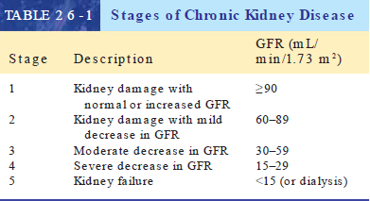
Clinical Stages

Slide 16
Clinical Manifestations
Elevated levels of nitrogenous wastes in the blood, or azotemia, is often an early sign of kidney failure, occurring before other signs and symptoms become evident.
Uremia, which literally means “urine in the blood,” is the term used to describe the clinical manifestations of kidney failure that are due to an accumulation of nitrogenous waste products in the blood. The uremic state is characterized by signs and symptoms of altered neuromuscular function (e.g., fatigue, peripheral neuropathy, restless leg syndrome, sleep disturbances, uremic encephalopathy); gastrointestinal disturbances such as anorexia and nausea; and immune dysfunction; amenorrhea and sexual dysfunction; and dermatologic manifestations such as pruritus.

Slide 17
Clinical Manifestations
Fluid, Electrolyte , and Acid–Base Disorders.
Sodium and Water Balance.
Potassium Balance.
Acid–base Balance.
Cardiovascular Complications.
Hypertension.
Heart Disease.
Gastrointestinal Disorders.

Slide 18
Clinical Manifestations
Disorders of Mineral Metabolism.
Calcium, Phosphorous, PTH, and Vitamin D Levels.
Metastatic Calcifications.
Bone Disease.
Hematologic Complications.
Anemia.
Coagulation Disorders.
Immunologic Disorders.
Neuromuscular Complications.
Sexual Dysfunction.
Skin Disorders.

Slide 19
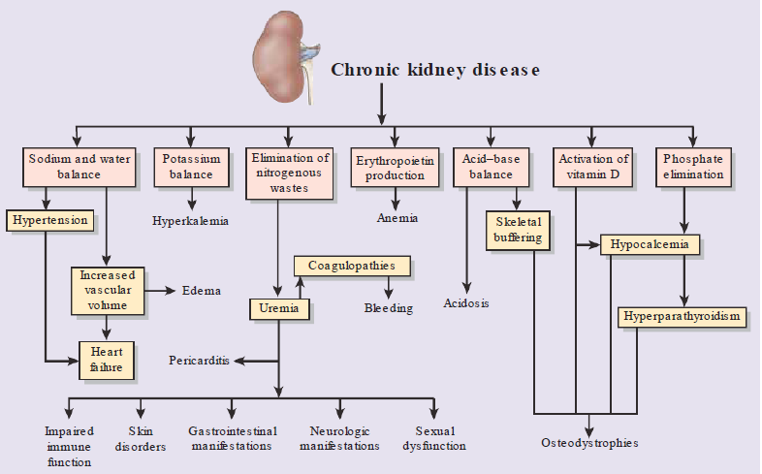
Mechanisms and manifestations of chronic kidney disease.

Slide 20
Treatment
Conservative Medical Management.
Dietary Management.
Medication Management.
Dialysis and Transplantation.

