Slide 1
Sports Nutrition and the Immune System
NUTD 337

Slide 2
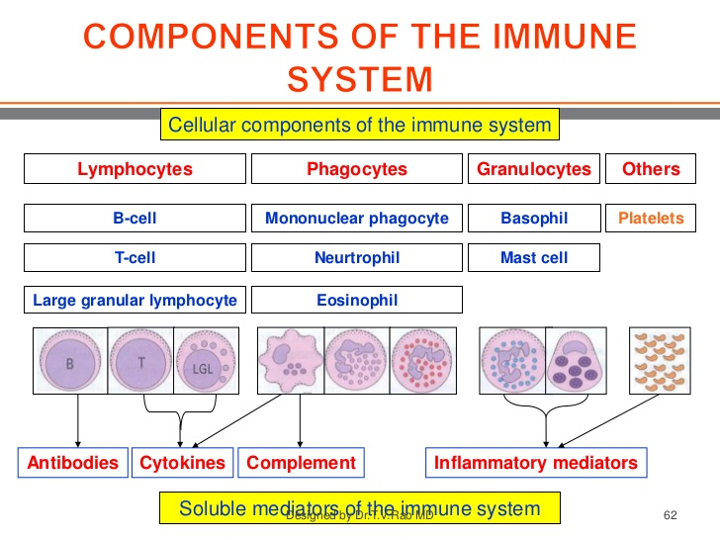
The immune system

Slide 3
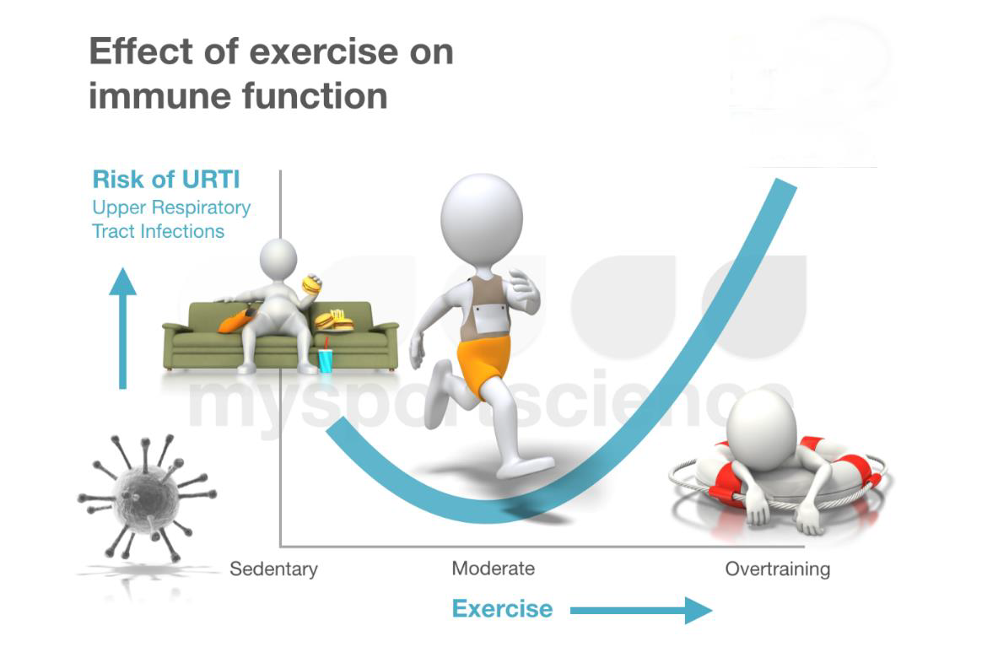
Exercise and immunity

Slide 4
CHO and immune function
Carbohydrates
Fuel for white blood cells
WBCs high metabolic rate
10 fold more usage than glutamine
Athletes on low CHO diet
Higher rates of URTI
Cortisol immunosuppressive
Application
Hydrating glucose beverage
Keep saliva secretion
Beta amylase
Lysozyme
IgA
Antimicrobial capacity

Slide 5
Proteins and Fat
Protein
Fat
20 g ingestion post exercise
MPS increases
Immune function enhanced
High Protein intake
Reduces glutamine
Oxidized by WBCs
Acidosis
High fat diet
Detrimental?
Lack of CHO or high fat?
In general
Fat does not seem to provide any benefit for immune function

Slide 6
Vitamins
Beta carotene, Vitamin C and E
Beneficial to reduce ROS post exercise
ROS less mean better recovery
Can reduce adaptations of innate defensive mechanism (supplement)
Vitamin B12 and Folic acid
Nucleic acid synthesis hence WBCs synthesis
Vitamin D in deficient athletes
Reduced cytokine production
Lower salivary cathlicidin & IgA

Slide 7
Minerals
Zinc
Proliferation of lymphocytes
Cofactor- terminal deoxynucleiotidyl transferase
Deficiency
lymphoid atrophy
Reduced IL-2 (interleukin, cytokine signaling molecule) & NKCA natural killer cells activation production
Delayed cutaneous (skin) hypersensitivity
Reduced Superoxide production by macrophages
Supplementation
Exercise induced immunosuppression time
Reduce Cu absorption
Increase HDL cholesterol

Slide 8
Mineral Continued
Magnesium & selenium
Glutathione peroxidase: exercise increases expression& sensitivity. neutralizing ROS
Copper deficiency (may be caused from zinc supp.
Reduced NKCA stimulation
Impaired antibody formation
Delayed inflammatory response
Manganese
Superoxide dismutase
Cobalt
WBCs & RBCs formation

Slide 9
General Guidelines
So what are the guidelines to reduce athlete infection
Lets put them together

