Slide 1
Exp #2
Android Layouts
SLIDES BY: Tarek Zidan and Mohamad Balawi

Slide 2


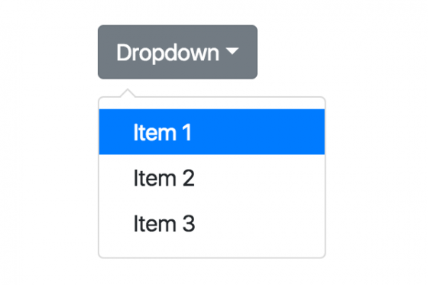
Widgets vs Layouts
Widget
Layout
UI elements, such as buttons, text fields, spinners...etc.
UI containers that can hold widgets and other layouts, their primary goal is to arrange the UI elements in a certain way. Ex: Linear, Relative..etc
TextView

Slide 3
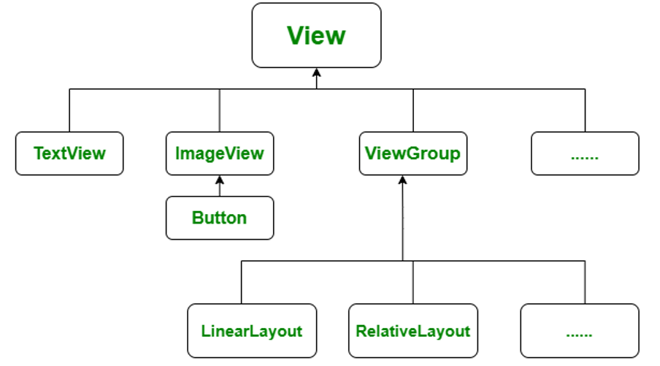
View inheritance hierarchy
Widgets directly inherit from View, while Layouts inherit ViewGroup which in turn inherits View.

Slide 4
Static vs Dynamic layouts
Layouts can be created in two ways:
Statically: Using XML design files to determine the layout (compile time).
Dynamically: Using code to design the layout (runtime).
  Which approach is more performant, and why?
  Why can’t we just use the more performant approach?
  Can we use both approaches at the same time?

Slide 5
Static vs Dynamic layouts
Layouts can be created in two ways:
Statically: Using XML design files to determine the layout (compile time).
Dynamically: Using code to design the layout (runtime).
  Which approach is more performant, and why?
  Static XML layouts are generally more performant than dynamic layouts created in code. This is because XML layouts are parsed and compiled at compile time, meaning the structure of the UI is already known, and the system can optimize resources during the build process.

Slide 6
Static vs Dynamic layouts
Layouts can be created in two ways:
Statically: Using XML design files to determine the layout (compile time).
Dynamically: Using code to design the layout (runtime).
  Why can’t we just use the more performant approach?
  While XML layouts are more performant, they lack the flexibility that dynamic layouts offer. You must dynamically modify or generate layouts in specific scenarios based on user interaction, device orientation, or other runtime conditions.

Slide 7
Static vs Dynamic layouts
Layouts can be created in two ways:
Statically: Using XML design files to determine the layout (compile time).
Dynamically: Using code to design the layout (runtime).
  Can we use both approaches at the same time?
  Yes, you can definitely use both approaches at the same time. It’s common to define a base layout statically in XML and then modify or add views dynamically in the code.

Slide 8
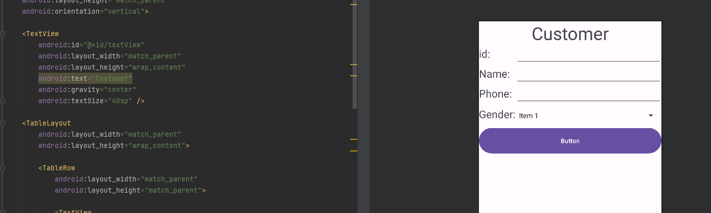
Static vs Dynamic layouts
LinearLayout firstLinearLayout = new LinearLayout(this);
Button addButton = new Button(this);
firstLinearLayout.addView(addButton);
setContentView(firstLinearLayout);

Slide 9
Webview
In Android, a WebView is a component that displays web content within a mobile app, enabling the incorporation of web-based functionality.
Not recommended since it has little to no support.

Slide 10
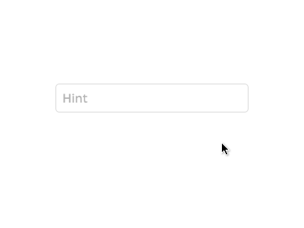
Hints
Hint is a gray text visible inside the text field, it disappears automatically when the user starts typing.

Slide 11
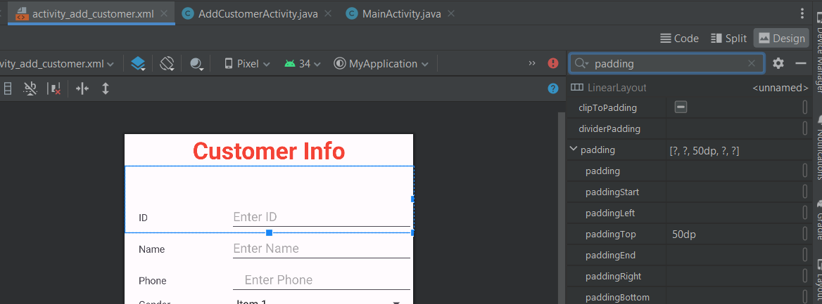
Padding
Padding is an amount of space that can be added to layouts to have a space around it (top, bottom, right, left) for better visualization.

Slide 12
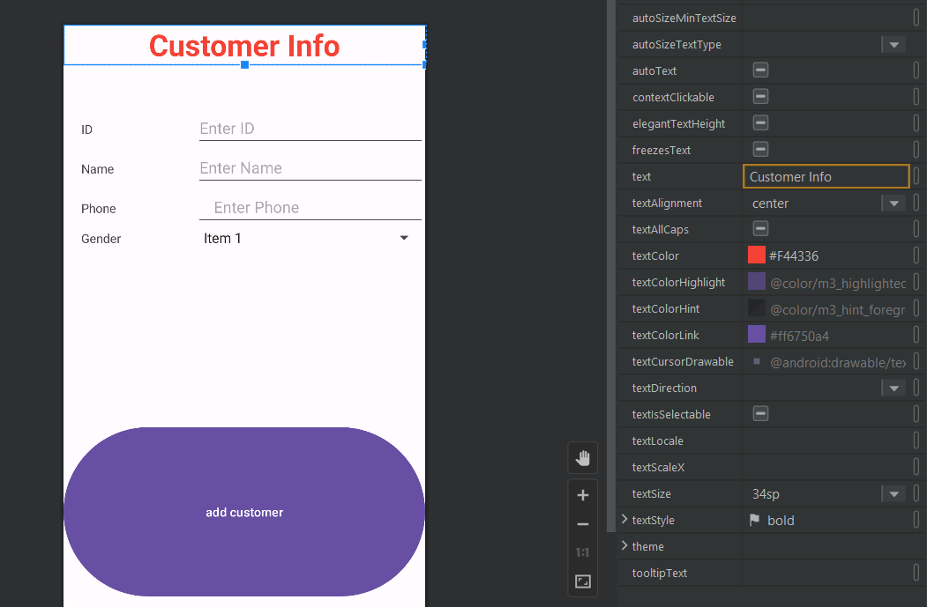
Some text settings
textcolor: changes the text color.
textAlignment: sets the text at the start of the line, center, or end of the line.
textsize: changes the size of the text, measured in dp unit, which is similar to pixels.
textStyle: can change the text to Bold, Italic…etc

Slide 13
Intents
An Intent is a messaging object you can use to request an action from another app component. Although intents facilitate communication between components in several ways, there are three fundamental use cases:
Navigating among various activities within the same application
Starting Activities
Broadcasting and Receiving Messages

Slide 14
Consider the following
Linear layout vs Constraint layout.
You can nest layouts but remember that wide nested are better than deep nested.
Custom text fields (password, number, ...).
Width/height (match_parent vs wrap_content).

Slide 15
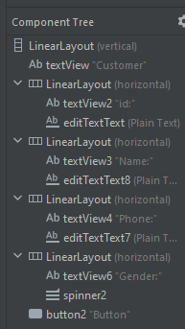
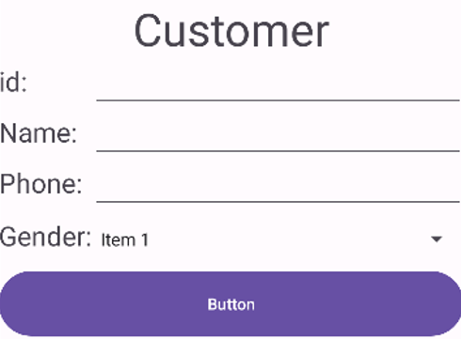
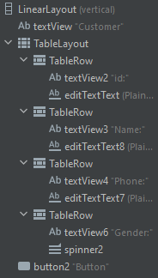
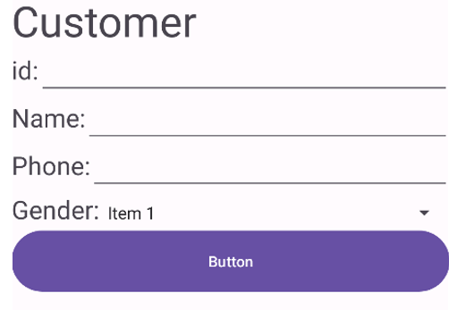
Nested Linear Layouts
Table Layout

Slide 16
Customer class

Slide 17
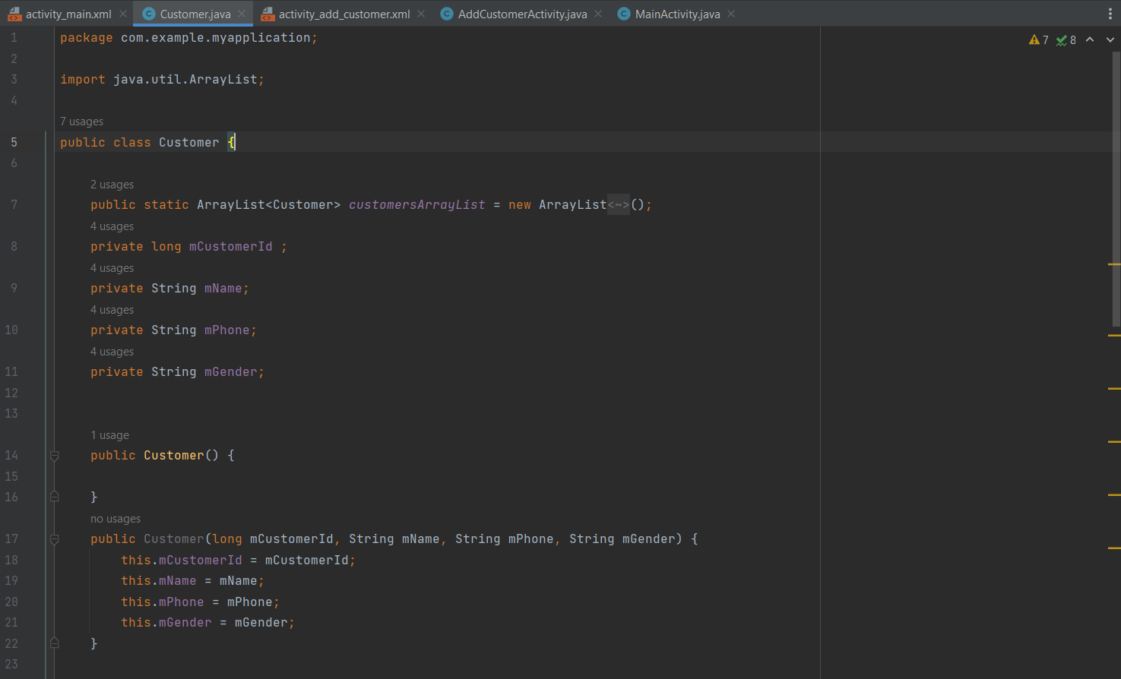

Slide 18
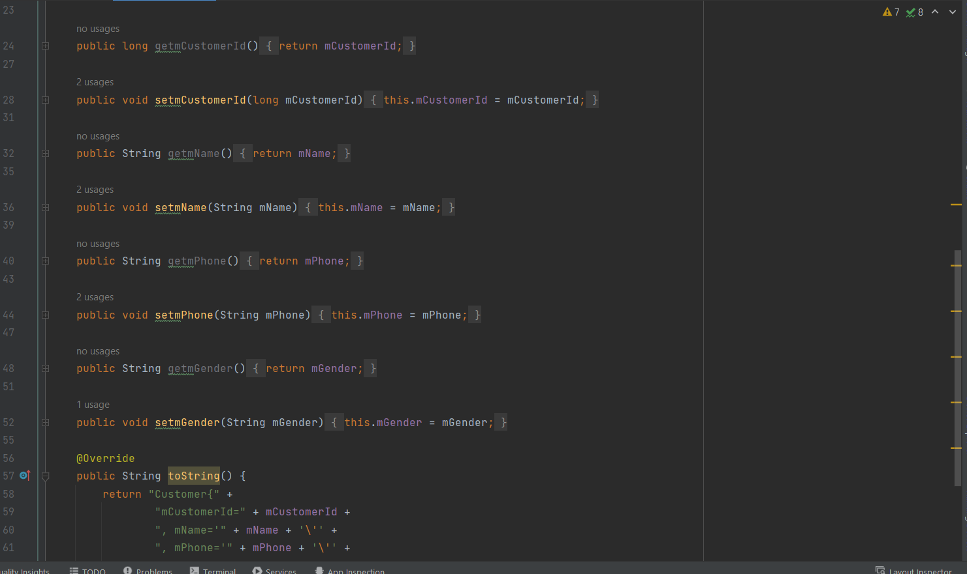

Slide 19
Add Customer Activity

Slide 20
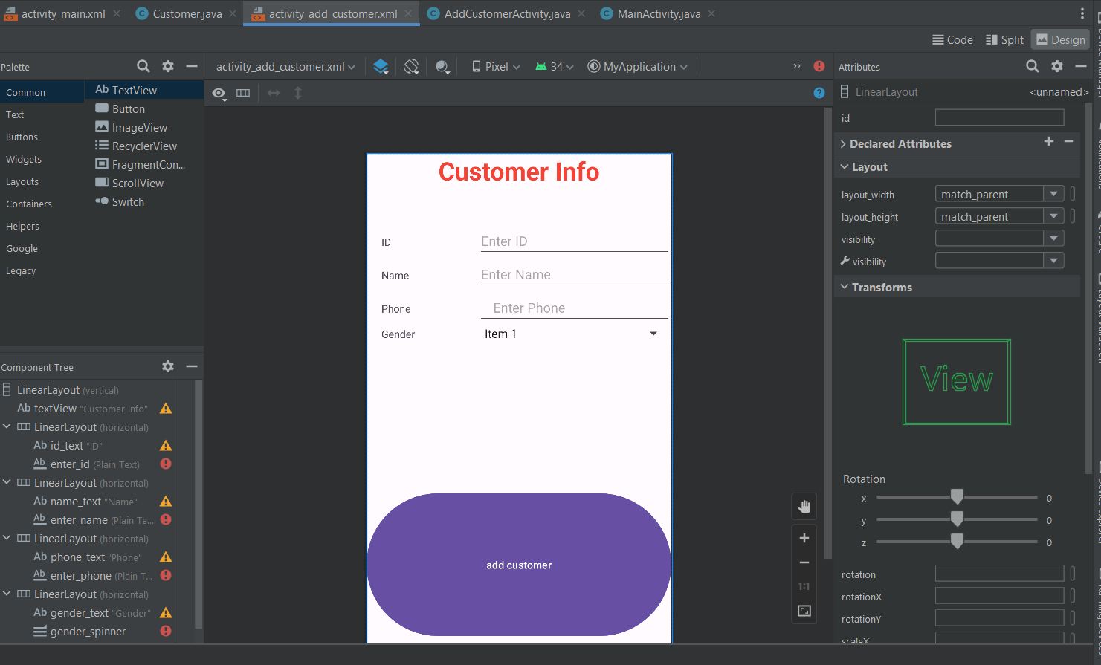

Slide 21
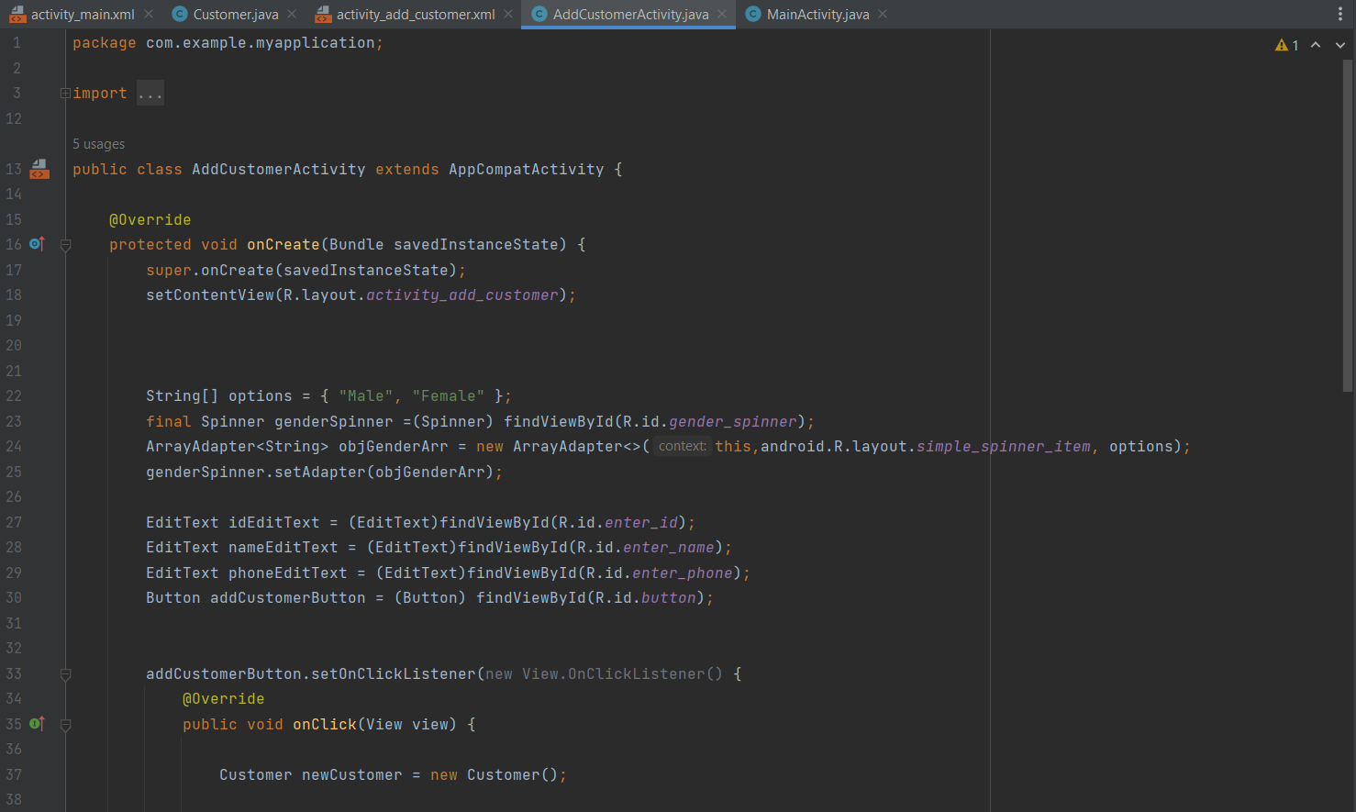

Slide 22
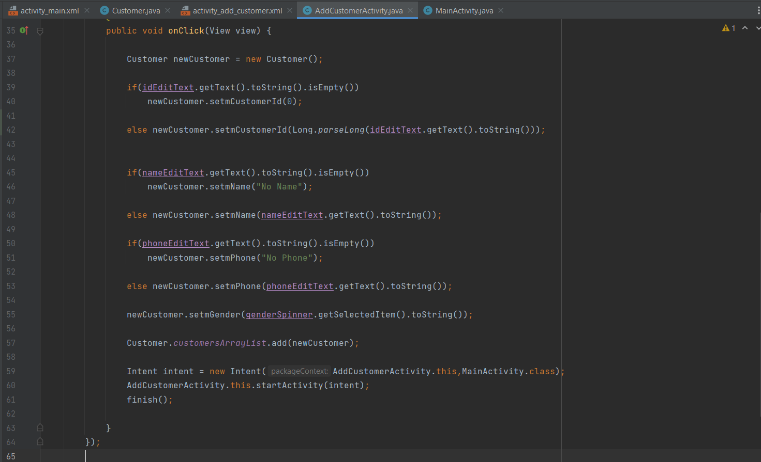

Slide 23
Main Activity

Slide 24
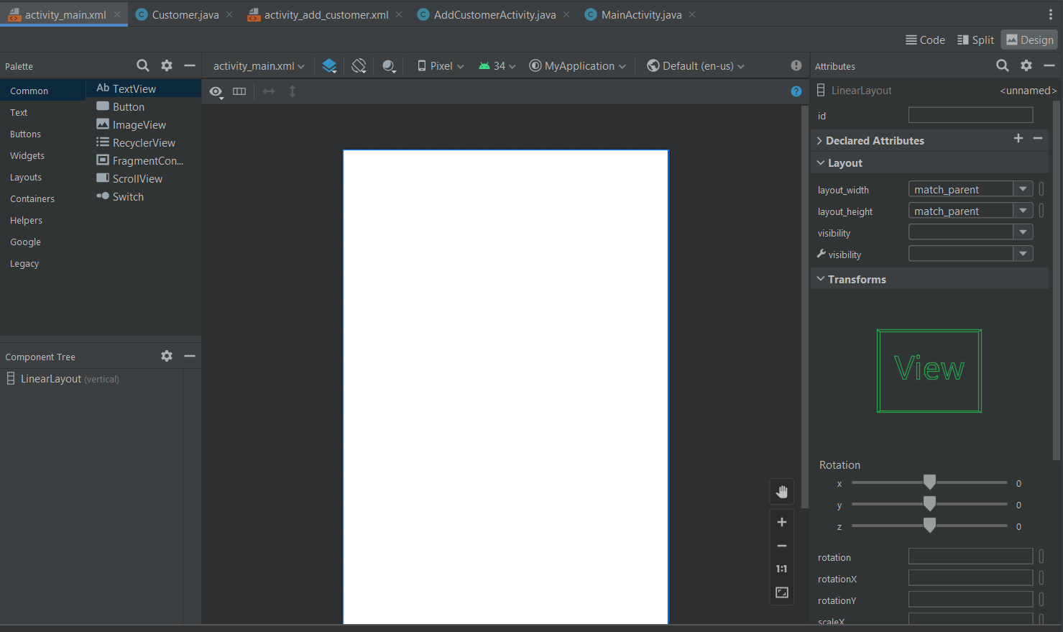

Slide 25
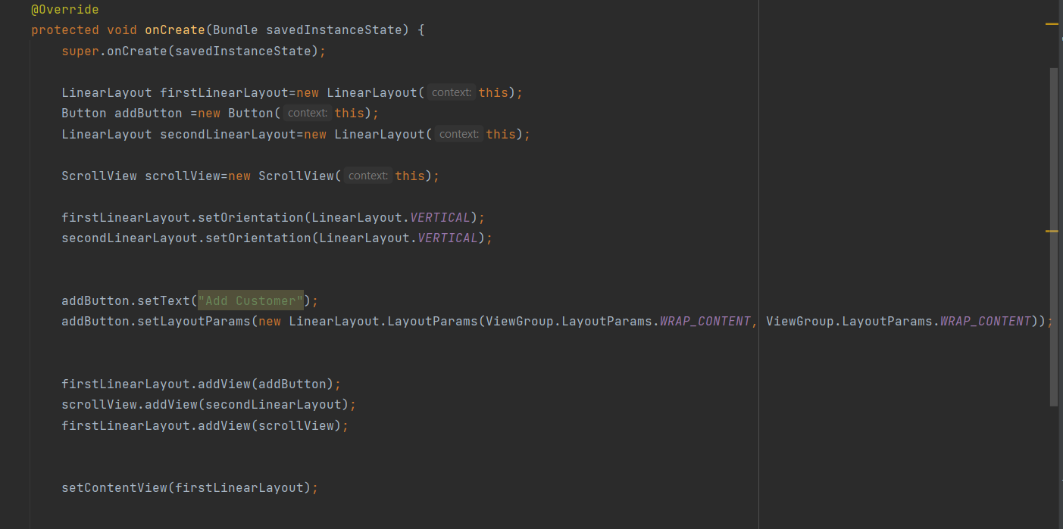

Slide 26
