Slide 1
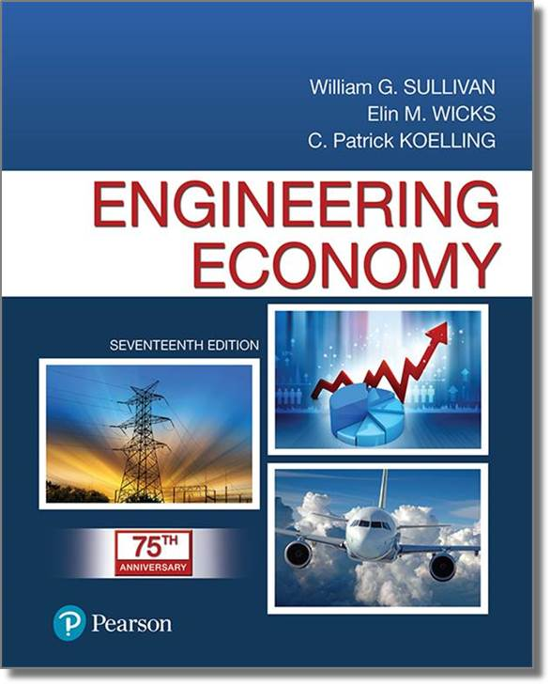
Engineering Economy
Seventeenth Edition
Chapter 07
Depreciation and Income Taxes
Copyright © 2019, 2016, 2013 Pearson Education, Inc. All Rights Reserved

Slide 2
Objective
The objective of Chapter 7 is to explain:
(a) how depreciation affects income taxes, and
(b) how income taxes affect economic decision making.
Notes:
Slide 2 is list of textbook LO numbers and statements

Slide 3
Income Taxes
Income taxes usually represent a significant cash outflow.
In this chapter we describe how after-tax liabilities and after-tax cash flows result in the after-tax cash flow (ATCF) procedure.
Depreciation is an important element in finding after-tax cash flows.
Notes:
Slide 2 is list of textbook LO numbers and statements

Slide 4
Depreciation is the Decrease in Value of Physical Properties with the Passage of Time
It is an accounting concept, a non-cash cost, that establishes an annual deduction against before-tax income.
It is intended to approximate the yearly fraction of an asset’s value used in the production of income.
Notes:
Slide 2 is list of textbook LO numbers and statements

Slide 5
Property is Depreciable if
it is used in business or held to produce income.
it has a determinable useful life, longer than one year.
it is something that wears out, decays, gets used up, becomes obsolete, or loses value from natural causes.
it is not inventory, stock in trade, or investment property.
Notes:
Slide 2 is list of textbook LO numbers and statements

Slide 6
Depreciable Property is
tangible (can be seen or touched; personal or real) or intangible (such as copyrights, patents, or franchises).
depreciated, according to a depreciation schedule, when it is put in service (when it is ready and available for its specific use).
Notes:
Slide 2 is list of textbook LO numbers and statements

Slide 7
Straight Line (SL): Constant Amount of Depreciation Each Year Over the Depreciable Life of the Asset
N = depreciable life
B = cost basis
d_{k} = depreciation in k
BV_{k} = book value at end of k
SV_{N} = salvage value
Notes:
Slide 2 is list of textbook LO numbers and statements

Slide 8
Pause and Solve (1 of 3)
Acme purchased a coordinate measurement machine (CMM). The cost basis is $120,000 and it has a seven-year depreciable life. Acme estimates a salvage value of $22,000 at the end of seven years.
Determine the annual depreciation amounts using SL depreciation. Tabulate the annual depreciation amounts and book value of the CMM at the end of each year.
Notes:
Slide 2 is list of textbook LO numbers and statements

Slide 9
Solution (1 of 2)
(1) Year | (2) Value at the Beginning of the Period | (3) Depreciation | (4) Ending Book Value = (2) – (3)
1 | $120,000 | $14,000 | $106,000
2 | $106,000 | $14,000 | $92,000
3 | $92,000 | $14,000 | $78,000
4 | $78,000 | $14,000 | $64,000
5 | $64,000 | $14,000 | $50,000
6 | $50,000 | $14,000 | $36,000
7 | $36,000 | $14,000 | $22,000
Notes:
Slide 2 is list of textbook LO numbers and statements

Slide 10
Or Solution (1 of 2)
Ending Book Value (BV_{k}) = B – Accumulated Depreciation
BV_{k} = 120,000 – Accumulated Depreciation
Year | Annual Depreciation | Accumulated Depreciation | Ending Book Value
1 | 14,000 | 14,000 | 106,000
2 | 14,000 | 28,000 | 92,000
3 | 14,000 | 42,000 | 78,000
4 | 14,000 | 56,000 | 66,000
5 | 14,000 | 70,000 | 50,000
6 | 14,000 | 84,000 | 36,000
7 | 14,000 | 98,000 | 22,000

Slide 11
Declining-Balance (DB): a Constant- Percentage of the Remaining BV is Depreciated Each Year (1 of 3)
The constant percentage is determined by R, where:
R = 2/N when 200% declining balance is being used,
R = 1.5/N when 150% declining balance is being used.
Notes:
Slide 2 is list of textbook LO numbers and statements

Slide 12

Declining-Balance (DB): a Constant- Percentage of the Remaining BV is Depreciated Each Year (2 of 3)
The units-of-production method can be used when the decrease in value of the asset is mostly a function of use, instead of time. The cost basis is allocated equally over the number of units produced over the asset’s life. The depreciation per unit of production is found from the formula below.
$$\frac{B − {SV}_{N}}{Estimated life production units}$$
Notes:
Slide 2 is list of textbook LO numbers and statements

Slide 13
Declining-Balance (DB): a Constant- Percentage of the Remaining BV is Depreciated Each Year (3 of 3)
The Modified Accelerated Cost Recovery System (MACRS) is the principal method for computing depreciation for property in engineering projects.
It consists of two systems:
(a) the General Depreciation System (GDS) which is the main system, and
(b) the Alternative Depreciation System (ADS).
Notes:
Slide 2 is list of textbook LO numbers and statements

Slide 14
When an Asset is Depreciated Using MACRS, the Following Information is Needed to Calculate Deductions
Cost basis, B
Date the property was placed into service
The property class and recovery period
The MACRS depreciation method (GDS or ADS).
The time convention that applies (half year)
Notes:
Slide 2 is list of textbook LO numbers and statements

Slide 15
Using MACRS is Easy!
Determine the asset’s recovery period (Table 7-2).
Use the appropriate column from Table 7-3 that matches the recovery period to find the recovery rate, r_{k}, and compute the depreciation for each year as
Notes:
Slide 2 is list of textbook LO numbers and statements

Slide 16
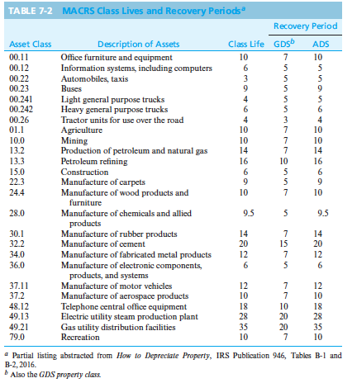

Slide 17
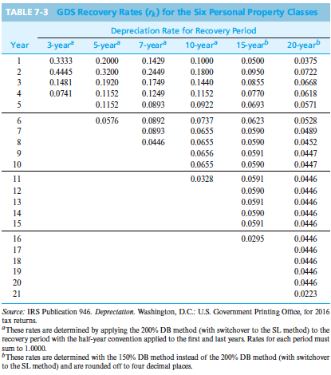

Slide 18
There are Many Different Types of Taxes
Income taxes are assessed as a function of gross revenues minus allowable expenses, usually a percentage.
Property taxes are assessed as a function of the value of property owned, usually a percentage.
Sales taxes are assessed on the basis of purchase of goods or services, usually a percentage.
Excise taxes are federal taxes assessed as a function of the sale of certain goods or services often considered non-necessities, usually a lump sum.
We will focus on income taxes.
Notes:
Slide 2 is list of textbook LO numbers and statements

Slide 19

Taking Taxes into Account Changes Our Expectations of Returns on Projects, So Our MARR (After-Tax) is Lower
Before-Tax-MARR $≈ \frac{After−tax MARR}{1 −effective income tax rate}$
Notes:
Slide 2 is list of textbook LO numbers and statements

Slide 20
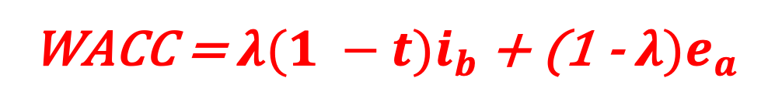
The After-Tax MARR Should be at Least the Tax-Adjusted Weighted Average Cost of Capital (WACC)
WACC = $λ(1 −t)i_{b}$ + (1 - $λ)e_{a}$
λ = fraction of a firm’s pool of capital borrowed from lenders
t = effective income tax rate as a decimal
i_{b} = before-tax interest paid on borrowed capital
e_{a} = after-tax cost of equity capital
Notes:
Slide 2 is list of textbook LO numbers and statements

Slide 21
Depreciation is Not a Cash Flow, but it Affects a Corporation’s Taxable Income, and Therefore the Taxes a Corporation Pays
Taxable income = TI
TI = gross income minus all expenses except capital invested minus depreciation deductions.
Notes:
Slide 2 is list of textbook LO numbers and statements

Slide 22
Federal Taxes are Calculated Using a Set of Income Brackets, Each Applying a Different Tax Rate on the Marginal Value of Income. State Taxes Vary Widely
Tax rates are found in Table 7-5.
Corporations need to know their effective tax rate, which is a combination of federal and state taxes according to either formula below.
Notes:
Slide 2 is list of textbook LO numbers and statements

Slide 23
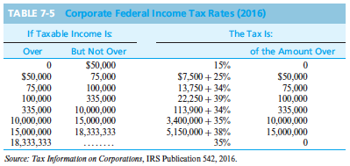

Slide 24
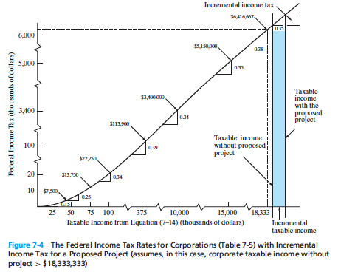
$3,332,000

Slide 25
Pause and Solve (2 of 3)
Last year Acme, Inc. had $16.4 million in revenue, $1.2 million of operating expenses, and depreciation expenses of $5.4 million. Using the corporate federal tax rates from the table provided in the text, what is the approximate federal tax this corporation will have to pay for this tax year?
Notes:
Slide 2 is list of textbook LO numbers and statements

Slide 26
Solution (2 of 2)
Last year Acme, Inc. had $16.4 million in revenue, $1.2 million of operating expenses, and depreciation expenses of $5.4 million. Using the corporate federal tax rates from the table provided in the text, what is the approximate federal tax this corporation will have to pay for this tax year?
Taxable income = $16.4 - $1.2 - $5.4 = $9.8
Tax = $9,800,000 * 0.34
Tax = $3,332,000
Notes:
Slide 2 is list of textbook LO numbers and statements

Slide 27
The Disposal of a Depreciable Asset can Result in a Gain or Loss Based on the Sale Price (Market Value) and the Current Book Value
A gain is often referred to as depreciation recapture, and it is generally taxed as the same as ordinary income. An asset sold for more than its cost basis results in a capital gain.
A loss is a capital loss.
Notes:
Slide 2 is list of textbook LO numbers and statements

Slide 28
Pause and Solve (3 of 3)
Acme Casting and Molding sold a piece of equipment during the current tax year for $67,000. This equipment had a cost basis of $210,000 and the accumulated depreciation was $153,000. Assume the effective income tax rate is 25%. Based on this information, what is
the gain (loss) on disposal,
the tax liability (or credit) resulting from this sale, and
the tax liability (or credit) if the accumulated depreciation was $125,000 instead of $153,000?
Notes:
Slide 2 is list of textbook LO numbers and statements

Slide 29
Solution—Part A
Acme Casting and Molding sold a piece of equipment during the current tax year for $67,000. This equipment had a cost basis of $210,000 and the accumulated depreciation was $153,000. Assume the effective income tax rate is 25%. Based on this information, what is
a. the gain (loss) on disposal,
Notes:
Slide 2 is list of textbook LO numbers and statements

Slide 30
Solution—Part B
Acme Casting and Molding sold a piece of equipment during the current tax year for $67,000. This equipment had a cost basis of $210,000 and the accumulated depreciation was $153,000. Assume the effective income tax rate is 25%. Based on this information, what is
b. the tax liability (or credit) resulting from this sale
Notes:
Slide 2 is list of textbook LO numbers and statements

Slide 31
Solution—Part C
Acme Casting and Molding sold a piece of equipment during the current tax year for $67,000. This equipment had a cost basis of $210,000 and the accumulated depreciation was $153,000. Assume the effective income tax rate is 25%. Based on this information, what is
c. the tax liability (or credit) if the accumulated depreciation was $125,000 instead of $153,000?
Book Value (BV) = 210,000 - 125,000 = $85,000
Notes:
Slide 2 is list of textbook LO numbers and statements

Slide 32
After-Tax Economic Analysis
After-tax economic analysis is generally the same as before-tax analysis, just using after-tax cash flows (ATCF) instead of before-tax cash flows (BTCF).
The analysis is conducted using the after-tax MARR.
Notes:
Slide 2 is list of textbook LO numbers and statements

Slide 33
Cash Flows are Typically Determined for Each Year Using the Notation Below
R_{k} = revenues (and savings) from the project during period k
E_{k} = cash outflows during k for deductible expenses
d_{k} = sum of all noncash, or book, costs during k, such as depreciation
t = effective income tax rate on ordinary income
T_{k} = income tax consequence during year k ATCF_{k} = ATCF from the project during year k
Notes:
Slide 2 is list of textbook LO numbers and statements

Slide 34
Some Important Cash Flow Formulas
(1 of 3)
−Taxable income = R_{k} − E_{k} − d_{k}
Ordinary income tax consequences
T_{k} = − t(R_{k} − E_{k} − d_{k})
BTCF_{k} = R_{k} − E_{k}
ATCF_{k} = BTCF_{k} + T_{k}
ATCF_{k} = (1 − t)(R_{k} − E_{k}) +td_{k}
Notes:
Slide 2 is list of textbook LO numbers and statements

Slide 35
Some Important Cash Flow Formulas
(2 of 3)
Acme purchased a pump for $250,000 and expended $20,000 for shipping and installation. The addition of this pump will result in an increase in revenue of $80,000, with associated increased expenses of $10,000, each year. The pump has a general depreciation system (GDS) recovery period of five years, and Acme’s effective tax rate is 21%.
What is the ATCF for this project for the fourth year of service of the asset?
Notes:
Slide 2 is list of textbook LO numbers and statements

Slide 36
Some Important Cash Flow Formulas (3 of 3)
B = $250,000 + $20,000 = $270,000
BTCF₄ = R₄ − E₄ = $80,000 − $10,000 = $70,000
d₄ = 0.1152 ($270,000) = $31,104
T₄ = − 0.21($80,000 − $10,000 − $31,104) = − $8,168
ATCF₄ = BTCF₄ + T₄
ATCF₄ = $70,000 − $8,168 = $61,832
Notes:
Slide 2 is list of textbook LO numbers and statements

Slide 37
Economic Value Added, EVA (1 of 2)
Economic value added, EVA, is an estimate of the profit-earning potential of proposed capital investments in engineering projects.
It is the difference between a company’s adjusted net operating profit after taxes (NOPAT) in a particular year and its after-tax cost of capital during that year.
Notes:
Slide 2 is list of textbook LO numbers and statements

Slide 38
Economic Value Added, EVA (2 of 2)
EVA_{k} = (Net Operating Profit After Taxes)_{k} - (Cost of Capital)_{k}
EVA_{k} = NOPAT_{k} – (i · BV_{k})
where,
k = an index for the year
i = after-tax MARR based on the cost of capital
And
NOPAT_{k} = (R_{k} + E_{k} -d_{k})(1 -t)
NOPAT_{k} = ATCF_{k} -d_{k}
Notes:
Slide 2 is list of textbook LO numbers and statements

Slide 39
For Acme, What is the EVA for Year 4 if Their After-Tax MARR is 8%?
(pertaining to the last example)
NOPAT₄ = ATCF₄ − d₄
NOPAT₄ = $61,832 − $31,104 = $30,728
EVA₄ = NOPAT₄ − i * BV₃
EVA₄ = $30,728 − (0.08)($77,760) = $24,507
Notes:
Slide 2 is list of textbook LO numbers and statements

Slide 40

Copyright
Notes:
If this slide was not included in the original PPT, it should be added.

