Slide 1
ENERGY

Slide 2
Energy is the primary currency of nutrition
require energy to stay warm and to drive all the processes of life
How do we get energy ?
Chemical combustion of food
We eat to maintain an adequate supply of energy

Slide 3
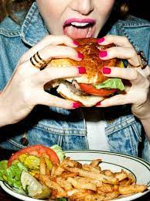
Plants do photosynthesis to produce glucose for energy
Glucose gives plant energy to produce proteins, fats and other carbohydrates
In humans, dietary energy is derived from four major food types:
Carbohydrate
Fat
Protein
Alcohol

Slide 4
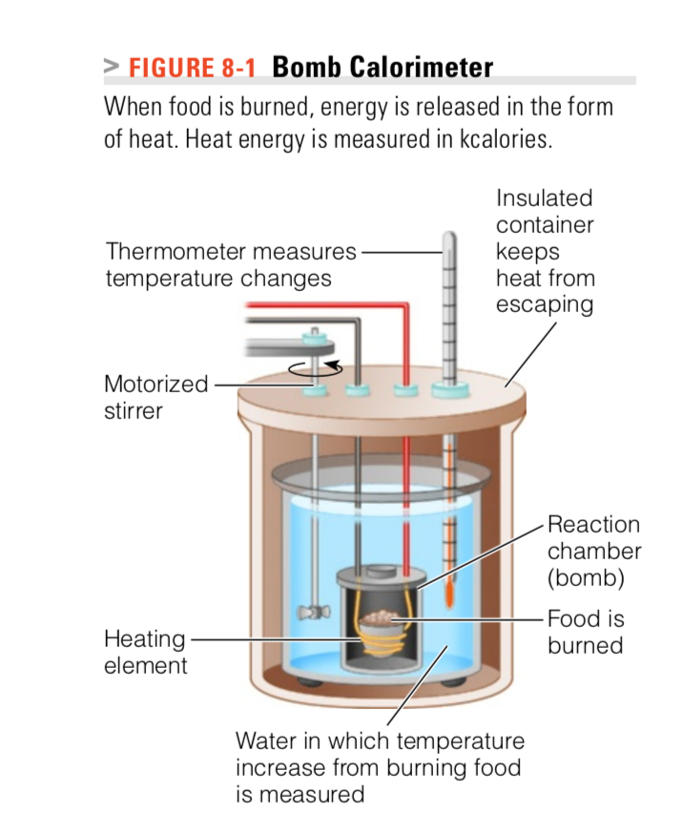
The energy value of food
The chemical energy of food is simply the total amount of energy that would be liberated by the food if it were combusted in oxygen (i.e. its heat of combustion)
How Is it measured?
directly in a bomb calorimeter
By measuring the heat liberated when burning a small sample of a certain food
The body is less efficient than a calorimeter and cannot metabolize all of the energy-yielding nutrients in a food completely for example the body can’t digest and get energy from fiber
Measurements are corrected to account for the undigestible portion of food and to estimate how much energy the body will receive from eating a specific food

Slide 5
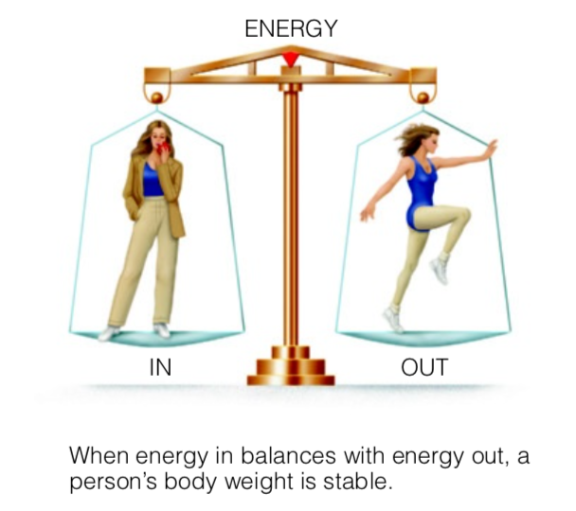
energy Balance
People expend energy continuously and eat to refuel
When a person is maintaining weight
  Energy in =Energy out
Foods and beverages provide the “Energy In”
  Excess energy in is stored as glycogen and fat
“Energy out” =Energy Expenditure

Slide 6
A classic rule states that for each 3500 \calories eaten in excess = a pound of body fat is stored
many diet plans recommend lowering energy intake by 500 calories a day to result in a weight loss of 1 pound per week.
several limitations
Quick changes in body weight are not simple changes in fat stores
Weight gained or lost rapidly includes some fat, large amounts of fluid, and some lean tissues such as muscle proteins and bone minerals.
Water is 60% of body weight

Slide 7
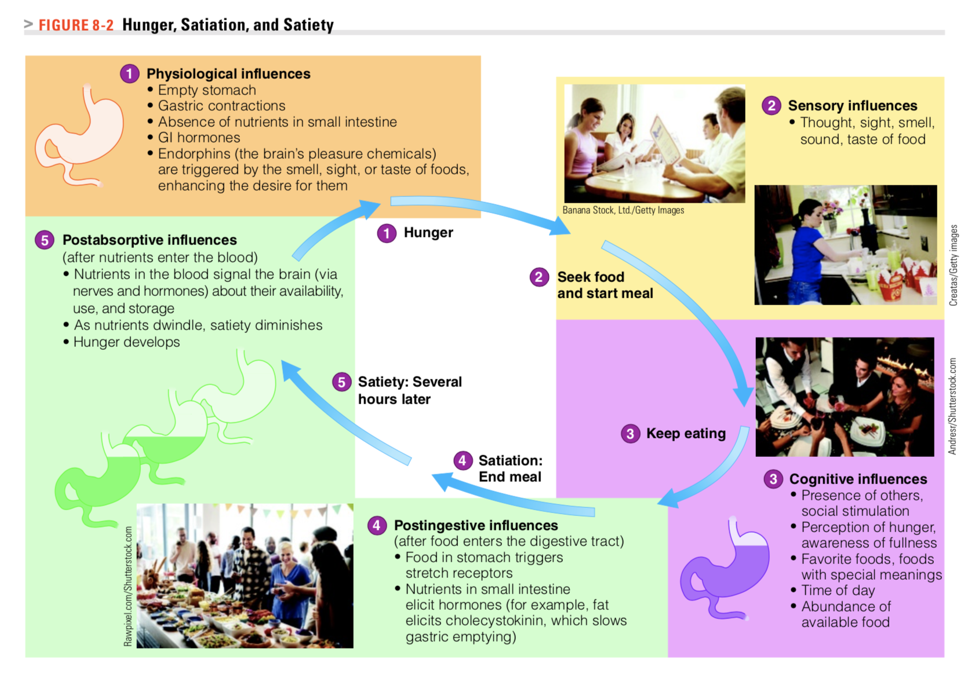

Slide 8
Components of Energy Expenditure
Energy expended for basal metabolism 60-70%
Energy expended for physical activity
Energy expended for food consumption

Slide 9
Basal metabolism
Represents the energy required to sustain the basic processes of life such as
  Breathing
  Circulation
  Tissue repair and renewal
  Waste removal
  Heart beat

Slide 10
Measurement OF Basal metabolism
The basal metabolic rate (BMR) is the rate at which the body expends energy to sustain processes in the body
The rate may vary from person to person
BMR : a specific term that describes energy expenditure measured under the following highly standardized conditions
  Subjects should be lying completely still after a restful sleep
  Fasted for the previous 12–14 hours
  No heavy physical activity on the previous day
  Healthy subjects, free from fever
  Measurement must be made at thermoneutral temperature

Slide 11
  Resting metabolic rate (RMR)— is slightly higher than the BMR because its criteria for recent food intake and physical activity are not as strict
If any of the conditions of BMR are not met, the term Resting energy Expenditure REE is used

Slide 12
Factors affecting basal metabolism
An individual’s BMR is determined by
Body size and body composition
BMR is MOSTLY effected by the amount of lean tissue or lean body mass (LBM) ( fat-free mass)
Lean mass is more metabolically active than adipose tissue( fat tissue)
Muscle is the major contributor to lean tissue, and even in resting basal state it has a moderately high energy expenditure
Visceral organs (internal organs ) especially the heart and liver, have a high metabolic rate

Slide 13
Women have a lower proportion of lean tissue than men and have lower BMR
Older people have a lower BMR; Aging is associated with a gradual substitution of lean tissue by fat
BMR is high in children because they have a higher proportion of visceral organ mass to total mass
BMR is highest in people who are growing (children, adolescents, and pregnant women)
Fever increases BMR
Hormone- thyroid hormones- menstrual cycle ( Up to 360 kcal/day differences over cycle
BMR DECREASES in negative energy balance ( energy sparing + low LBM)
  How can I increase MY BMR???
Notes:
One way to increase the BMR, participate in endurance and strength-training activities regularly to maximize lean body mass

Slide 14
Physical Activity (pa)
Voluntary movement of the skeletal muscles and support systems
Physical activity is the most variable component of energy expenditure
During physical activity, the muscles need extra energy to move, and the heart and lungs need extra energy to deliver nutrients and oxygen and dispose of wastes

Slide 15
The amount of energy expended on PA
The intensity and duration of the activity
Weight of the person performing the activity
Heavier people, who have more weight to move, use more energy than lighter people to perform the SAME activity
The more intense and longer the activity, the greater the amount of calories burned

Slide 16
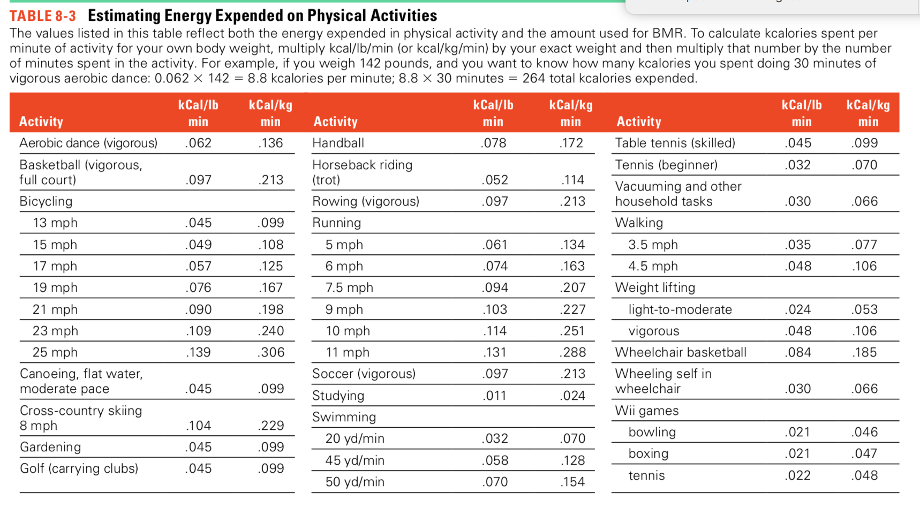
For any activity to calculate how many kcal burned per minute of activity for your body weight
Kcal/kg/min * kg of body weight * min of activity

Slide 17
Thermic effect of Food (tef)
Energy required to absorb, digest, transport, interconvert, and store the nutrients in a meal
When a person eats, the GI tract muscles speed up contractions
The cells that manufacture and secrete digestive juices become active
Some nutrients require energy to be absorbed.
This is wasted energy that must be lost because no physiological process can be 100% efficient
The TEF accounts for approximately 10% of the TEE ( Total Energy Expenditure)

Slide 18
Factors affecting Thermic effect of Food
Composition of Diet and frequency of meals
Protein tends to cause a higher DIT than fat and carbohydrate
Protein produces more waste
Spicy foods enhance TEF
TEF is higher if we eat one big meal rather than smaller spaced out meals
Over all the TEF is not a significant part of TEE

Slide 19
Additional energy is expended when circumstances in the body are dramatically changed
A body challenged to physical conditioning such as
extreme cold, overfeeding, starvation, trauma, or other types of stress that it must adapt to
The body will have extra work to do and uses extra energy to build the tissues and produce the enzymes and hormones necessary to cope with the demand. This energy is known as adaptive thermogenesis
Not included when estimating energy requirements for most healthy people.

Slide 20
estimating energy requirements
The DRI Committee developed equations based on research to estimate total energy expenditure BY CONSIDERING THE FOLLOWING FACTORS
Gender
Growth: The BMR is high in people who are growing. For this reason, pregnant and lactating women, infants, children, and adolescents have their own sets of energy equations.
Age
Physical activity
Body composition and body size
  Taller people, more SA HIGHER BMR
  More weight, higher BMI

Slide 21
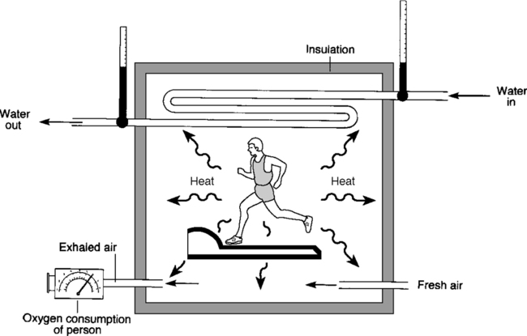
Measurement of energy expenditure
Direct calorimetry
Subject confined within a small-to- moderately sized chamber.
Measures heat loss.
It is a measure of energy expended, not the type of fuel being used.

Slide 22
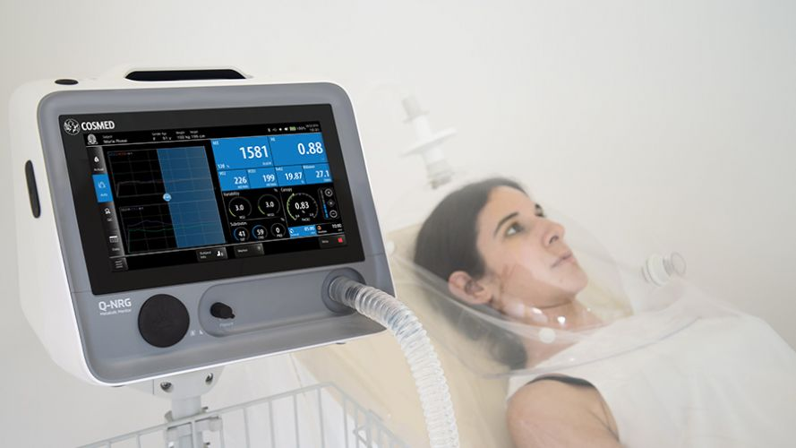
Indirect Calorimetry
Estimation of energy expenditure by measuring oxygen consumption and CO₂ production.
Equipment is commonly a mouthpiece or a ventilated hood. Most accurate in measuring RMR

Slide 23
Doubly labelled water
Assesses CO2 turnover from differential rate of disappearance of ²H and ¹⁸O
Gold standard method for assessing EE in free-living subjects
This method provides information on the total energy expended by a free-living individual for a period of 4–20 days
The individual takes an oral dose of water containing a known amount of stable (non radioactive) isotopes of both hydrogen and oxygen
The isotopes, ²H (deuterium) and ¹⁸O, mix with the normal hydrogen and oxygen in the body water within a few hours
(²H) leaves the body as water, while ¹⁸O leaves as water (H₂O) and carbon dioxide (CO₂)
CO₂ production can be calculated by subtracting ²H elimination from ¹⁸O elimination.

Slide 24
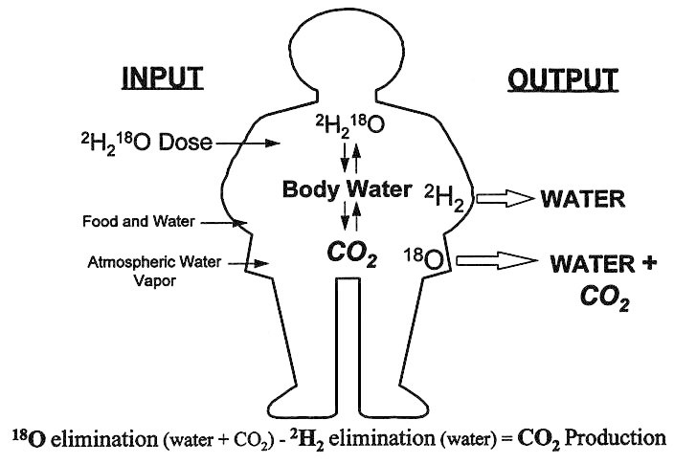
Emerging Technologies for Nutrition Research: Potential for Assessing Military Performance Capability.
Institute of Medicine (US) Committee on Military Nutrition Research; Carlson-Newberry SJ, Costello RB, editors.
Washington (DC): National Academies Press (US); 1997.

Slide 25
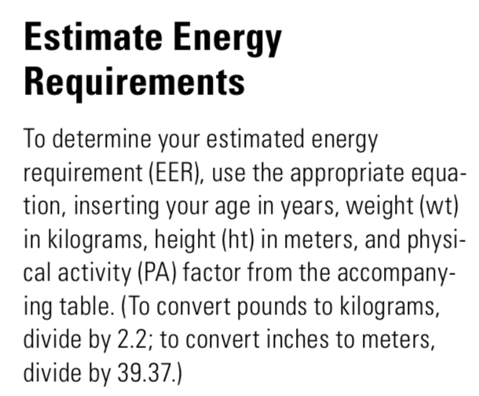
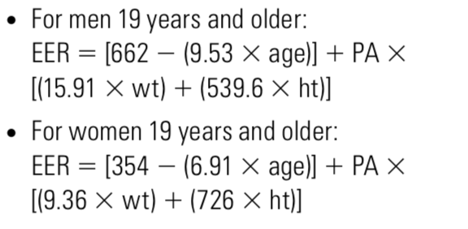
Estimating Energy Requirement

Slide 26
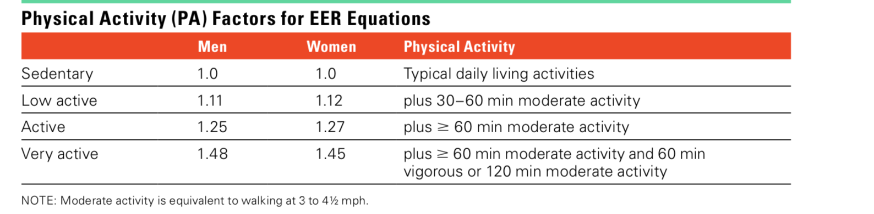

Slide 27
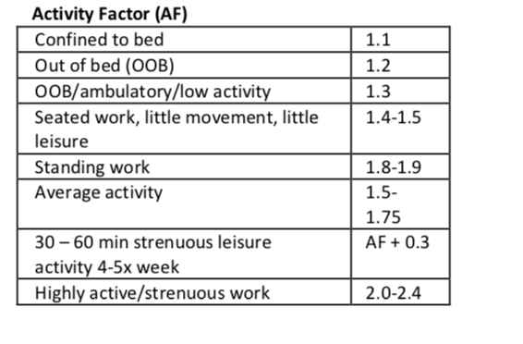
Estimating Energy Requirement
MIFFLIN-ST. JOER equation (MSJ) * AF
Men: (10*wt.[kg]) + (6.25*ht.[cm]) – (5 × age) + 5
Women: (10*wt.[kg]) + (6.25*ht.[cm]) – (5 × age) -161

Slide 28
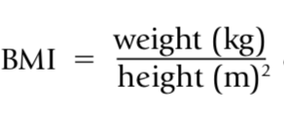
Body weight
Body weight= fat + lean tissue (including water)
Weight gains and losses tell us nothing about how the body’s composition may have changed
Body Mass index The body mass index (BMI) describes relative weight for height:

Slide 29
Bmi Classification
Underweight BMI below 18.5
Healthy weight BMI >18.4 - < 25
Overweight BMI 25 – 29.9
Obese BMI 30-40
BMI says little about body composition

Slide 30
Health-care professionals commonly use BMI and waist circumference measurements because they are relatively easy and inexpensive. Together, these two measurements prove most valuable in assessing a person’s health risks and monitoring changes over time

Slide 31
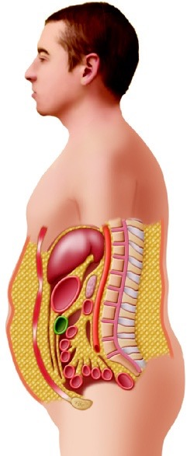
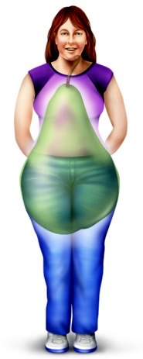
The location of fat on the body may influence health as much, or more than, total fat alone.
Visceral fat is stored around the organs of the abdomen is referred to as central obesity or upper-body fat ( more common in men)
Subcutaneous fat around the hips and thighs, sometimes referred to as lower-body fat, is most common in women during their reproductive years, and is associated with lower heart disease risks.
In healthy-weight people, some fat is stored around the organs of the abdomen. BUT EXCESS abdominal fat increases the risks of diseases

Slide 32
Waist Circumference
A person’s waist circumference is a good indicator of central obesity and its associated health risks
Criteria for risk of central obesity and associated problems
Women -waist circumference >35 inches (88 centimeters)
Men -waist circumference > 40 inches (102 centimeters)
Waist-to-hip ratio as an indicator of disease risks

Slide 33
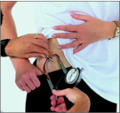

Anthropometric measurements to determine body fat and muscle mass
Skinfold Measurements: Skinfold measures estimate body fat by using a caliper to gauge the thickness of a fold of skin on the back of the arm (over the triceps), below the shoulder blade (subscapular), and in other places (including lower-body sites), and then comparing these measurements with standards.

Slide 34
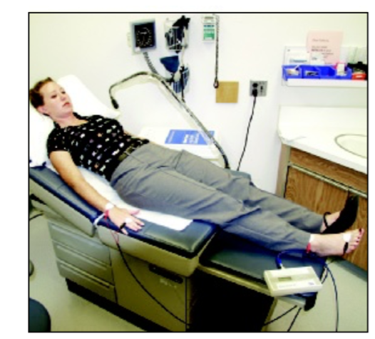
Bioelectrical impedance
Measures body fat by using a low-intensity electrical current
Difference in electrical conductive properties of different tissues.
Lean body mass such as muscle contains MORE water and electrolytes than adipose Tissue ( fat tissue only 20% water)
Lean mass conducts more current

