Slide 1


Slide 2
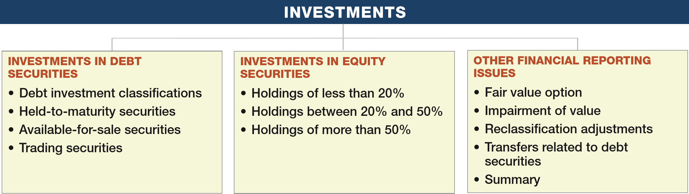
PREVIEW OF CHAPTER 17
Intermediate Accounting
16th Edition
Kieso ● Weygandt ● Warfield

Slide 3
LEARNING OBJECTIVES
17
Investments
After studying this chapter, you should be able to:
Understand the accounting for investments in debt securities.
Understand the accounting for investments in equity securities.
Explain the equity and consolidation methods of accounting.
Evaluate other major issues related to investments in debt and equity securities.
LO 1

Slide 4
INVESTMENT IN DEBT SECURITIES
Different motivations for investing:
  To earn a high rate of return.
  To secure certain operating or financing arrangements with another company.
LO 1

Slide 5
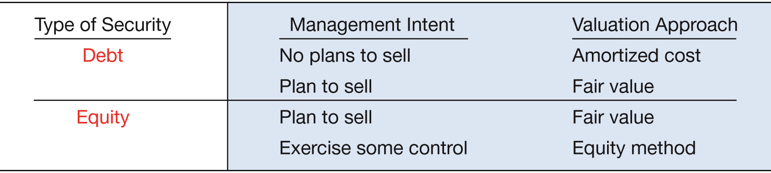
INVESTMENT IN DEBT SECURITIES
Companies account for investments based on
  the type of security (debt or equity) and
  their intent with respect to the investment.
ILLUSTRATION 17-1
Summary of Investment Accounting Approaches
LO 1

Slide 6
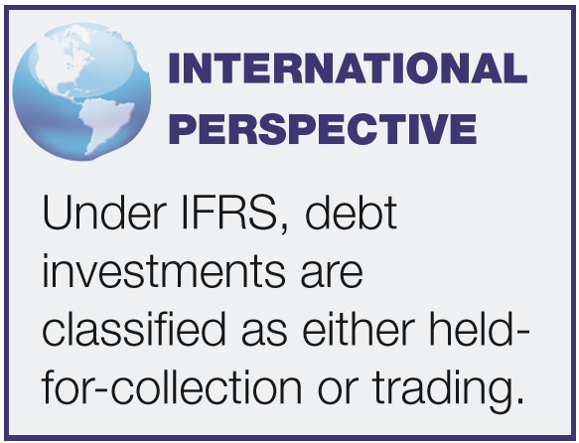
Debt Investment Classiﬁcations
Debt securities represent a creditor relationship:
Type
Accounting Category
  U.S. government securities
  Municipal securities
  Corporate bonds
  Convertible debt
  Commercial paper
  Held-to-maturity
  Trading
  Available-for-sale
LO 1

Slide 7
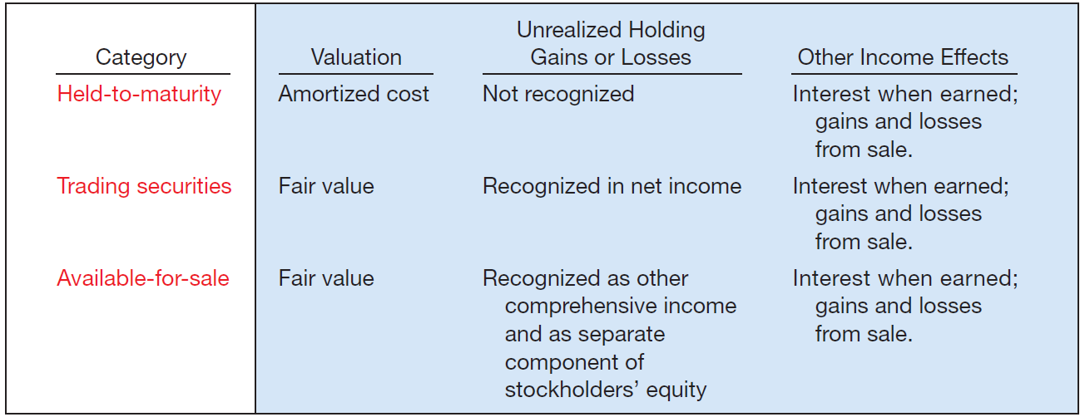
Debt Investment Classiﬁcations
ILLUSTRATION 17-2
Accounting for Debt
Securities by Category
Amortized cost is the acquisition cost adjusted for the amortization of discount or premium, if appropriate.
LO 1

Slide 8
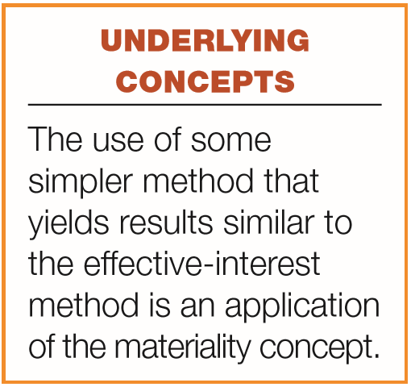
INVESTMENT IN DEBT SECURITIES
Held-to-Maturity Securities (Amortized Cost)
Classify a debt security as held-to-maturity only if it has both
  the positive intent and
  the ability to hold securities to maturity.
Accounted for at amortized cost, not fair value.
Amortize premium or discount using the effective-interest method unless the straight-line method yields a similar result.
LO 1

Slide 9
Held-to-Maturity Securities (Amortized Cost)
Illustration: Z-Smith Company purchased $100,000 of 8 percent bonds of Bush Corporation on January 1, 2016, at a discount, paying $92,278. The bonds mature January 1, 2021 and yield 10%; interest is payable each July 1 and January 1. Z-Smith records the investment as follows:
January 1, 2016
Debt Investments 92,278
Cash 92,278
LO 1

Slide 10
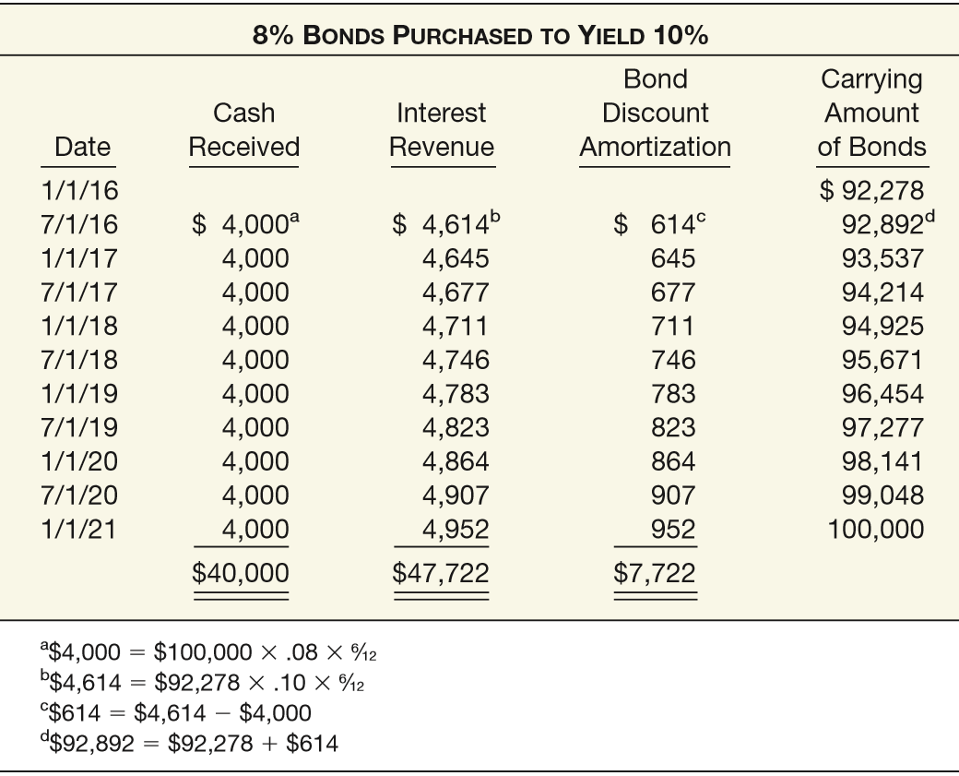
ILLUSTRATION 17-3
Schedule of Interest Revenue and Bond Discount Amortization— Effective-Interest Method
LO 1

Slide 11
ILLUSTRATION 17-3
Illustration: Z-Smith Company records the receipt of the first semiannual interest payment on July 1, 2016, as follows:
Cash 4,000
Debt Investments 614
Interest Revenue 4,614
LO 1

Slide 12
ILLUSTRATION 17-3
Illustration: Z-Smith is on a calendar-year basis, it accrues interest and amortizes the discount at December 31, 2016, as follows:
Interest Receivable 4,000
Debt Investments 645
Interest Revenue 4,645
LO 1

Slide 13
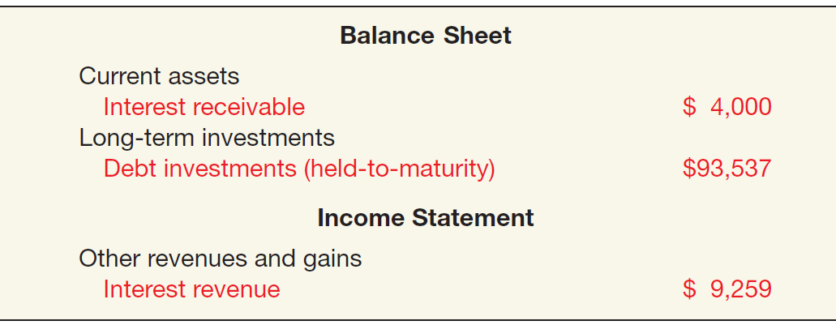
Held-to-Maturity Securities (Amortized Cost)
Reporting of Held-to-Maturity Securities
ILLUSTRATION 17-4
Reporting of Held-to-Maturity Securities
LO 1

Slide 14

Held-to-Maturity Securities (Amortized Cost)
Illustration:
Assume Z-Smith sells its investment in Bush bonds on November 1, 2020, at 99¾ plus accrued interest. Z-Smith records discount amortization as follows:
ILLUSTRATION 17-3
Calculation of amortization =
$952 x 4/6 = $635
Debt Investments 635
Interest Revenue 635
LO 1

Slide 15
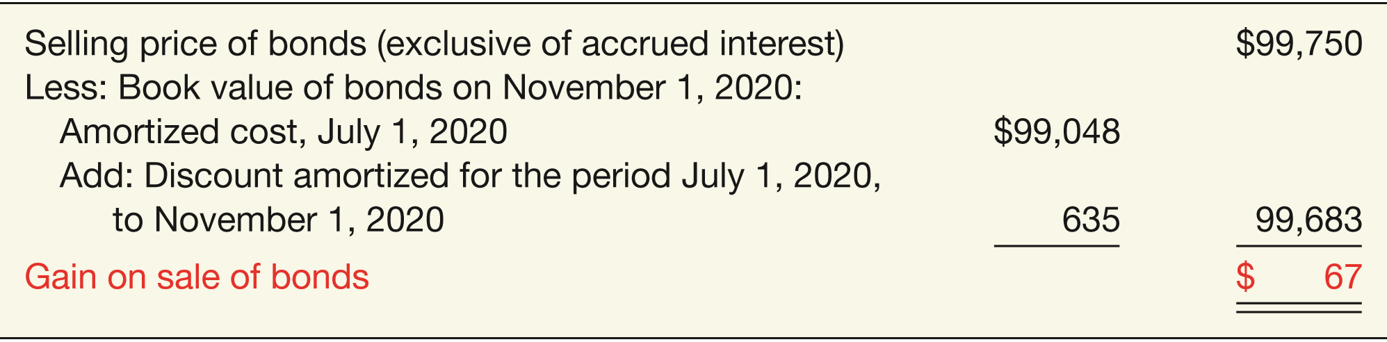
Held-to-Maturity Securities (Amortized Cost)
Computation of Gain on Sale of Bonds
ILLUSTRATION 17-5
Cash 102,417
Interest Revenue (4/6 x $4,000) 2,667
Debt Investments 99,683
Gain on Sale of Securities 67
LO 1

Slide 16
INVESTMENT IN DEBT SECURITIES
Available-for-Sale Securities
Companies report available-for-sale securities at
  fair value, with
  unrealized holding gains and losses reported as other comprehensive income, a separate component of stockholder’s equity, until realized.
Any discount or premium is amortized.
LO 1

Slide 17
Available-for-Sale Securities
Debt Securities
Illustration (Single Security): Graffeo Corporation purchases $100,000, 10 percent, five-year bonds on January 1, 2016, with interest payable on July 1 and January 1. The bonds sell for $108,111, which results in a bond premium of $8,111 and an effective interest rate of 8 percent. Graffeo records the purchase of the bonds on January 1, 2016, as follows.
Debt Investments 108,111
Cash 108,111
LO 1

Slide 18
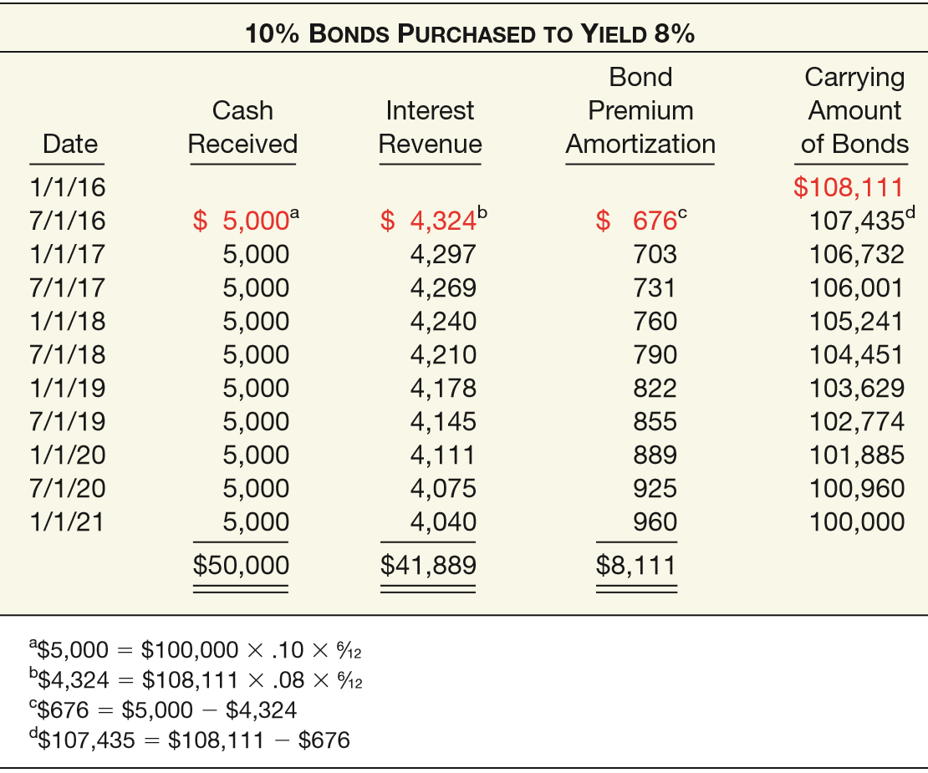
ILLUSTRATION 17-6
Schedule of Interest Revenue and Bond Premium Amortization— Effective-Interest Method
LO 1

Slide 19
ILLUSTRATION 17-6
Illustration (Single Security): The entry to record interest revenue on July 1, 2016, is as follows.
Cash 5,000
Debt Investments 676
Interest Revenue 4,324
LO 1

Slide 20
Available-for-Sale Securities
Debt Securities
Interest Revenue for 2016 = $8,621
ILLUSTRATION 17-6
Illustration (Single Security): At December 31, 2016, Graffeo makes the following entry to recognize interest revenue.
Interest Receivable 5,000
Debt Investments 703
Interest Revenue 4,297
LO 1

Slide 21
Available-for-Sale Securities
Debt Securities
ILLUSTRATION 17-6
Illustration (Single Security): To apply the fair value method to these debt securities, assume that at December 31, 2016 the fair value of the bonds is $105,000. Graffeo makes the following entry.
Unrealized Holding Gain or Loss—Equity 1,732
Fair Value Adjustment 1,732
LO 1

Slide 22
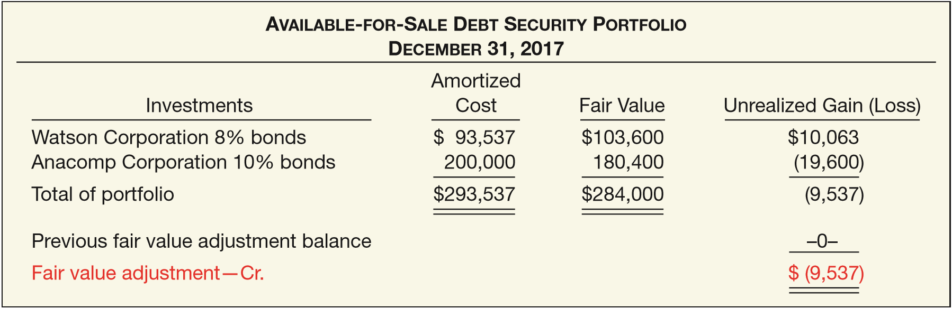
Available-for-Sale Securities
Debt Securities
Illustration (Portfolio of Securities): Herringshaw Corporation has two debt securities classified as available-for-sale. The following illustration identifies the amortized cost, fair value, and the amount of the unrealized gain or loss.
ILLUSTRATION 17-7
Computation of Fair Value Adjustment—Available-for-Sale Securities (2017)
LO 1

Slide 23
Available-for-Sale Securities
Debt Securities
ILLUSTRATION 17-7
Prepare the adjusting entry Herringshaw would make on December 31, 2017 to record the loss.
Unrealized Holding Gain or Loss—Equity 9,537
Fair Value Adjustment 9,537
LO 1

Slide 24
Available-for-Sale Securities
Debt Securities
Sale of Available-for-Sale Securities
If company sells bonds before maturity date:
  It must make entries to remove from the Debt Investments account the amortized cost of bonds sold.
  Any realized gain or loss on sale is reported in the “Other” section of the income statement.
LO 1

Slide 25
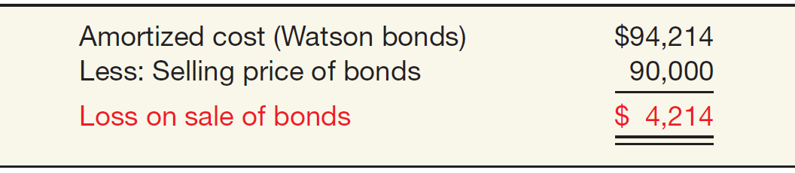
Sale of Available-for-Sale Securities
Illustration: Herringshaw Corporation sold the Watson bonds (from Illustration 17-7) on July 1, 2018, for $90,000, at which time it had an amortized cost of $94,214.
ILLUSTRATION 17-8
Computation of Loss on Sale of Bonds
Cash 90,000
Loss on Sale of Investments 4,214
Debt Investments 94,214
LO 1

Slide 26
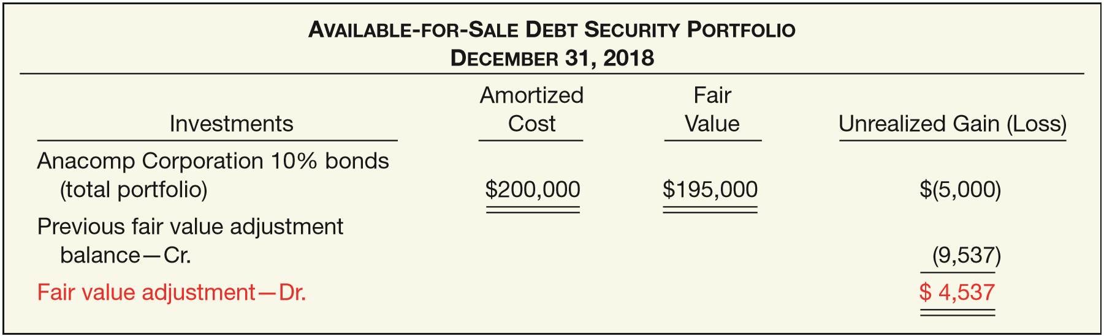
Sale of Available-for-Sale Securities
Illustration: Herringshaw reports this realized loss in the “Other expenses and losses” section of the income statement. Assuming no other purchases and sales of bonds in 2018, Herringshaw on December 31, 2018, prepares the information:
ILLUSTRATION 17-9
Computation of Fair Value Adjustment—Available-for-Sale Securities (2018)
LO 1

Slide 27
Sale of Available-for-Sale Securities
Illustration: Herringshaw records the following at December 31, 2018.
ILLUSTRATION 17-9
Fair Value Adjustment 4,537
Unrealized Holding Gain or Loss—Equity 4,537
LO 1

Slide 28
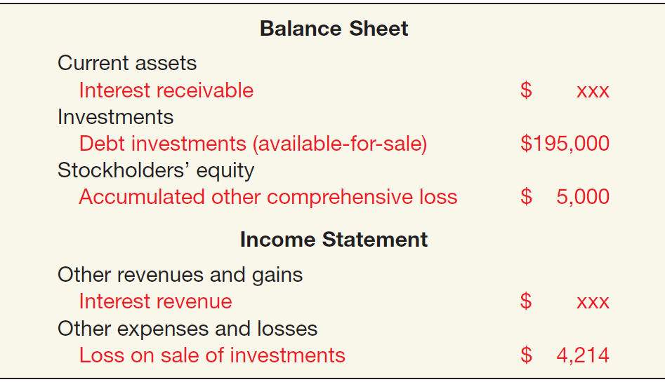
Available-for-Sale Securities
Debt Securities
Financial Statement Presentation
ILLUSTRATION 17-10
Reporting of Available-for-Sale Securities
LO 1

Slide 29
INVESTMENT IN DEBT SECURITIES
Trading Securities (Fair Value Through Net Income)
Companies report trading securities at
  fair value, with
  unrealized holding gains and losses reported as part of net income.
Any discount or premium is amortized.
A holding gain or loss is the net change in the fair value of a security from one period to another, exclusive of dividend or interest revenue recognized but not received.
LO 1

Slide 30
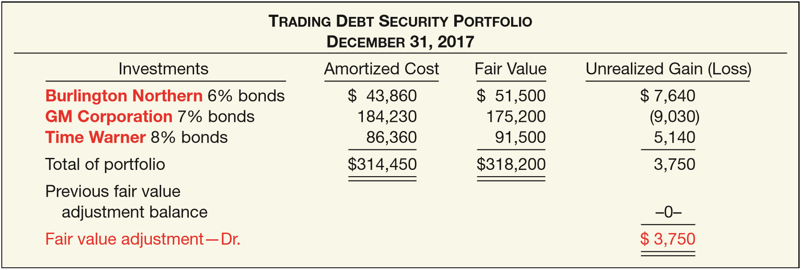
Trading Securities
Debt Securities
Illustration: On December 31, 2017, Koopmans Publishing Corporation determined its trading securities portfolio to be as follows:
ILLUSTRATION 17-11
Computation of Fair Value Adjustment—Trading Securities Portfolio (2017)
LO 1

Slide 31
Trading Securities
Debt Securities
Illustration: At December 31, Koopmans Publishing makes an adjusting entry:
ILLUSTRATION 17-11
Fair Value Adjustment 3,750
Unrealized Holding Gain or Loss—Income 3,750
LO 1

Slide 32
Trading Securities
Debt Securities
Illustration: (Trading Securities) Hendricks Corporation purchased trading investment bonds for $50,000 at par. At December 31, Hendricks received annual interest of $2,000, and the fair value of the bonds was $47,400.
Instructions:
  Prepare the journal entry for the purchase of the investment.
  Prepare the journal entry for the interest received.
  Prepare the journal entry for the fair value adjustment.
LO 1

Slide 33
Trading Securities
Debt Securities
Illustration: (Trading Securities) Hendricks Corporation purchased trading investment bonds for $50,000 at par. At December 31, Hendricks received annual interest of $2,000, and the fair value of the bonds was $47,400. Prepare the journal entry for the purchase of the investment.
Debt Investments 50,000
  Cash 50,000
LO 1

Slide 34
Trading Securities
Debt Securities
Illustration: (Trading Securities) Hendricks Corporation purchased trading investment bonds for $50,000 at par. At December 31, Hendricks received annual interest of $2,000, and the fair value of the bonds was $47,400. Prepare the journal entry for the interest received.
Cash 2,000
  Interest Revenue 2,000
LO 1

Slide 35
Trading Securities
Debt Securities
Illustration: (Trading Securities) Hendricks Corporation purchased trading investment bonds for $50,000 at par. At December 31, Hendricks received annual interest of $2,000, and the fair value of the bonds was $47,400. Prepare the journal entry for the fair value adjustment.
Unrealized Holding Loss – Income 2,600
  Fair Value Adjustment 2,600
LO 1

Slide 36
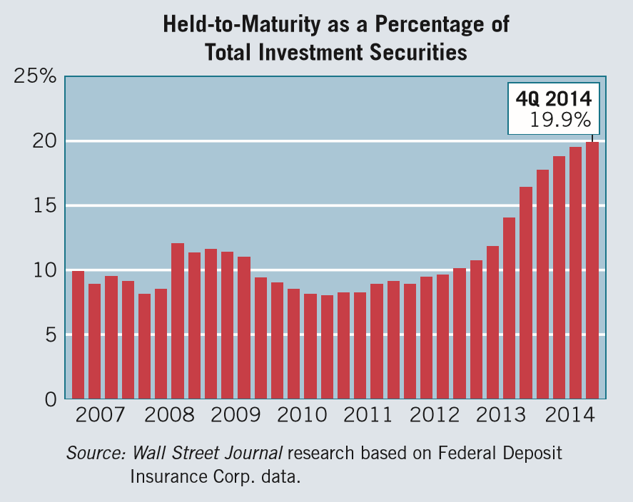
WHAT DO THE NUMBERS MEAN? TO HAVE AND TO HOLD
WHAT’S YOUR PRINCIPLE
Wall Street is a romantic place these days. Recently, many banks, especially big ones, entered into long-term relationships with their securities portfolios, promising that hundreds of billions of dollars of assets will be “held-to-maturity.” As a result, the banks may appear to have higher book values and be better capitalized in the eyes of regulators even if the value of these securities declines.
In fact, many banks, especially the large ones, have recently shifted their debt investments portfolios into the “held-to-maturity” category from trading or available-for-sale. For example, in a recent 18-month period, banks have moved $293 billion of their investments to the held-to-maturity category. That means that about $640 billion, or one in ﬁve dollars in the banks’ portfolios, cannot be sold easily, as shown in the chart to the right.
(continued)
LO 1

Slide 37
WHAT DO THE NUMBERS MEAN? TO HAVE AND TO HOLD
WHAT’S YOUR PRINCIPLE
Why the shift? One major reason is that banks recognize when securities are classiﬁed as held-to-maturity, they are carried at their original cost, typically face value. As you have learned, declines in market values hit neither book value nor earnings. Their value is written down only if they are considered to be permanently impaired. If long-term interest rates are expected to rise (which appears to be the consensus today), then bond prices will drop. And if bond prices drop, banks that hold trading or available-for-sale securities will have their earnings and capital drop. As a result, the shift to held-to-maturity portfolios provides protection from this level of volatility.
But banks should be careful. For example, if the bank has liquidity problems, it may have to sell these held-to-maturity securities for a large loss at inopportune times. And given the ﬁnancial crisis of 2008, the process of trying to hype capital and maintain less volatile earnings may backﬁre if investors believe that shenanigans are taking place in the ﬁnancial institution area.
Sources: John Carney, “Accounting Trick Can Help Banks Dodge Some Capital Pain,” Wall Street Journal (March 28, 2014); and Michael Rapoport, “Banks Shift Bond Portfolios,” Wall Street Journal (March 23, 2015).
LO 1

Slide 38
LEARNING OBJECTIVES
17
Investments
After studying this chapter, you should be able to:
Understand the accounting for investments in debt securities.
Understand the accounting for investments in equity securities.
Explain the equity and consolidation methods of accounting.
Evaluate other major issues related to investments in debt and equity securities.
LO 2

Slide 39
INVESTMENTS IN EQUITY SECURITIES
Represent ownership of capital stock.
Cost includes:
  price of the security, plus
  broker’s commissions and fees related to purchase.
The degree to which one corporation (investor) acquires an interest in the common stock of another corporation (investee) generally determines the accounting treatment for the investment subsequent to acquisition.
LO 2

Slide 40
INVESTMENTS IN EQUITY SECURITIES
Ownership Percentages
0 ------------------20% ---------------- 50% ---------------- 100%
Investor has passive interest
Investor has significant influence
Investor has controlling interest
Investment valued using Fair Value Method
Investment valued using Equity Method
Investment valued on parent’s books using Cost Method or Equity Method (investment eliminated in Consolidation)
LO 2

Slide 41
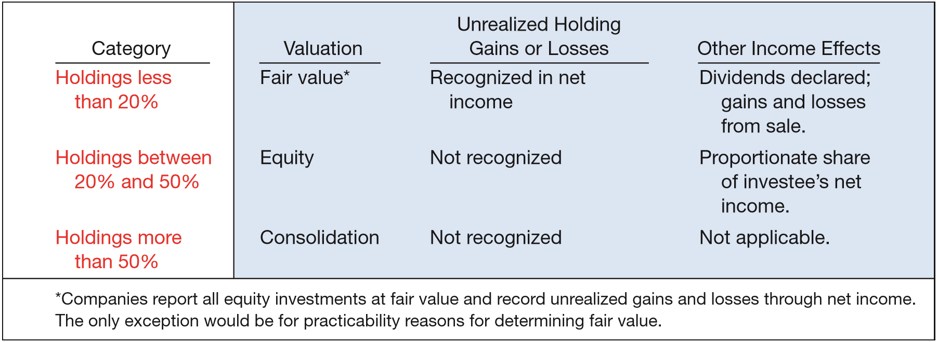
INVESTMENTS IN EQUITY SECURITIES
Accounting and Reporting for Equity Securities by Category
ILLUSTRATION 17-13
LO 2

Slide 42
INVESTMENTS IN EQUITY SECURITIES
Holding of Less Than 20%
Accounting Subsequent to Acquisition
With
Readily Determinable Fair Value
Without
Readily Determinable Fair Value
Value and report the investment using the
fair value method.
Value and report the investment using a practicability exception.*
* Entities report equity investments at cost adjusted for changes in observable prices minus impairment. Entities recognize dividends when received and generally recognize gains or losses when selling the securities.
LO 2

Slide 43
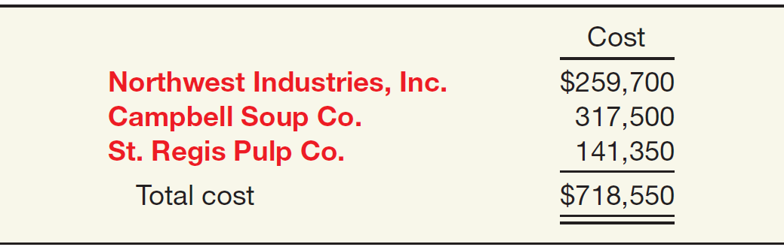
Holdings of Less Than 20%
Upon acquisition, companies record equity securities at cost.
Illustration: On November 3, 2017, Republic Corporation purchased common stock of three companies, each investment representing less than a 20 percent interest.
LO 2

Slide 44
Holdings of Less Than 20%
Illustration: Republic records these investments on November 3, as follows.
Equity Investments 718,550
Cash 718,550
LO 2

Slide 45
Holdings of Less Than 20%
Illustration: On December 6, 2017, Republic receives a cash dividend of $4,200 from Campbell Soup Co.
Cash 4,200
Dividend Revenue 4,200
LO 2

Slide 46
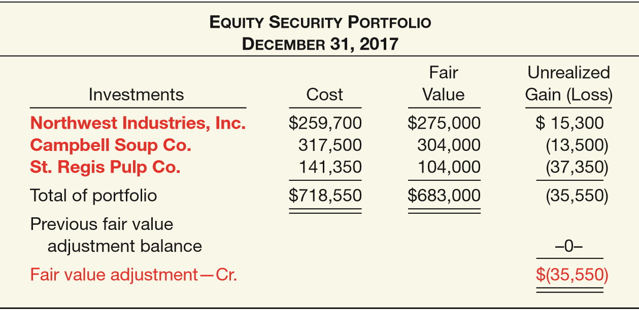
Holdings of Less Than 20%
Illustration: Republic’s available-for-sale equity security portfolio on December 31, 2017:
ILLUSTRATION 17-14
Computation of Fair Value Adjustment—Equity Security Portfolio (2017)
LO 2

Slide 47
Holdings of Less Than 20%
ILLUSTRATION 17-14
Illustration: Prepare the entry Republic would make on December 31, 2017, to record the net unrealized gains and losses.
Unrealized Holding Gain or Loss—Income 35,550
Fair Value Adjustment 35,550
LO 2

Slide 48
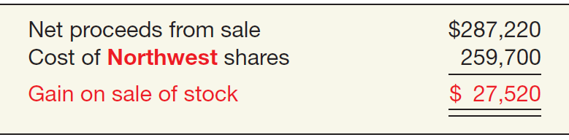
Holdings of Less Than 20%
Illustration: On January 23, 2018, Republic sold all of its Northwest Industries, Inc. common stock receiving net proceeds of $287,220. Prepare the entry to record the sale.
ILLUSTRATION 17-15
Computation of Gain on Sale of Stock
Cash 287,220
Equity Investments 259,700
Gain on Sale of Investments 27,520
LO 2

Slide 49
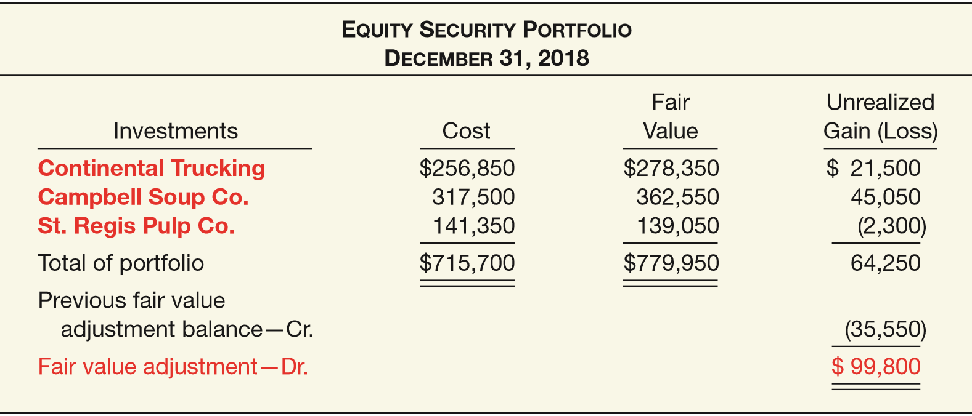
Holdings of Less Than 20%
Illustration: On February 10, 2018, Republic purchased 20,000 shares of Continental Trucking at a price of $12.75 per share plus brokerage commissions of $1,850 (total cost, $256,850).
ILLUSTRATION 17-16
Computation of Fair Value Adjustment—Equity Security Portfolio (2018)
LO 2

Slide 50
Holdings of Less Than 20%
ILLUSTRATION 17-16
Illustration:
Prepare the entry that Republic would make at December 31, 2018, to adjust its portfolio to fair value.
Fair Value Adjustment 99,800
Unrealized Holding Gain or Loss—Income 99,800
LO 2

Slide 51
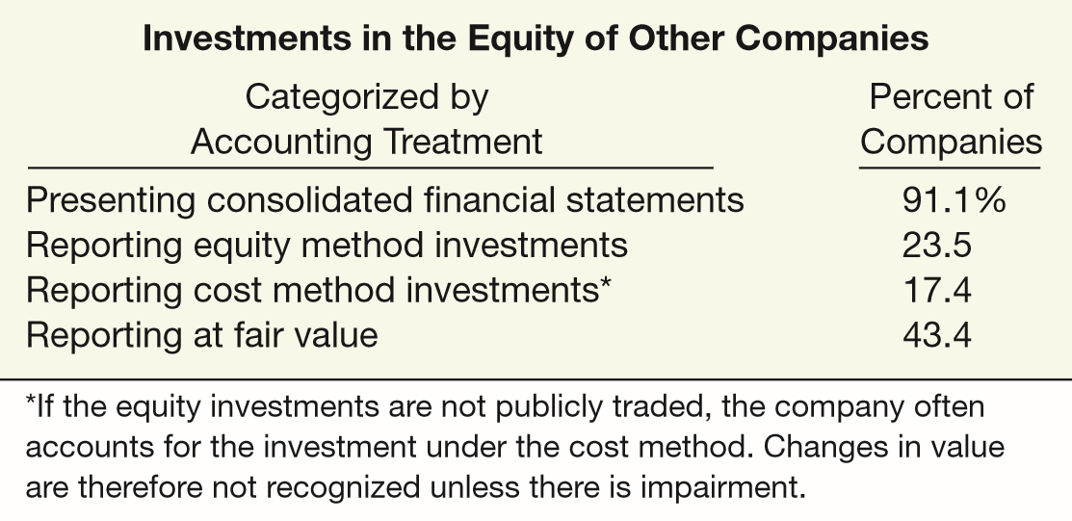
WHAT DO THE NUMBERS MEAN? MORE DISCLOSURE, PLEASE
WHAT’S YOUR PRINCIPLE
How to account for investment securities is a particularly sensitive area, given the large amounts of equity investments involved. And presently companies could report investments in equity securities at cost, equity, fair value, and full consolidation, depending on the circumstances. As an SEC study noted, “there are so many different accounting treatments for investments that it raises the question of whether they are all needed.” Presented in the right-hand column is an estimate of the percentage of companies on the major exchanges that have investments in the equity of other entities. As the table indicates, many companies have equity investments of some type. These investments can be substantial. For example, the
total amount of equity-method investments appearing on company balance sheets is approximately $403 billion, and the amount shown in the income statements in any one year for all companies is approximately $38 billion.
Source: “Report and Recommendations Pursuant to Section 401(c) of the Sarbanes-Oxley Act of 2002 on Arrangements with Off-Balance Sheet Implications, Special Purpose Entities, and Transparency of Filings by Issuers,” United States Securities and Exchange Commission—Office of Chief Accountant, Office of Economic Analyses, Division of Corporation Finance (June 2005), pp. 36–39.
LO 2

Slide 52
LEARNING OBJECTIVES
17
Investments
After studying this chapter, you should be able to:
Understand the accounting for investments in debt securities.
Understand the accounting for investments in equity securities.
Explain the equity and consolidation methods of accounting.
Evaluate other major issues related to investments in debt and equity securities.
LO 3

Slide 53
INVESTMENTS IN EQUITY SECURITIES
Holding Between 20% and 50% (Equity Method)
An investment (direct or indirect) of 20 percent or more of the voting stock of an investee should lead to a presumption that in the absence of evidence to the contrary, an investor has the ability to exercise significant influence over an investee.
In instances of “significant influence,” the investor must account for the investment using the equity method.
LO 3

Slide 54
Holdings Between 20% and 50%
Comparison of Equity Method to Fair Value
Record the investment at cost and subsequently adjust the amount each period for
  the investor’s proportionate share of the earnings (losses) and
  dividends received by the investor.
If investor’s share of investee’s losses exceeds the carrying amount of the investment, the investor ordinarily should discontinue applying the equity method and not recognize additional losses.
LO 3

Slide 55
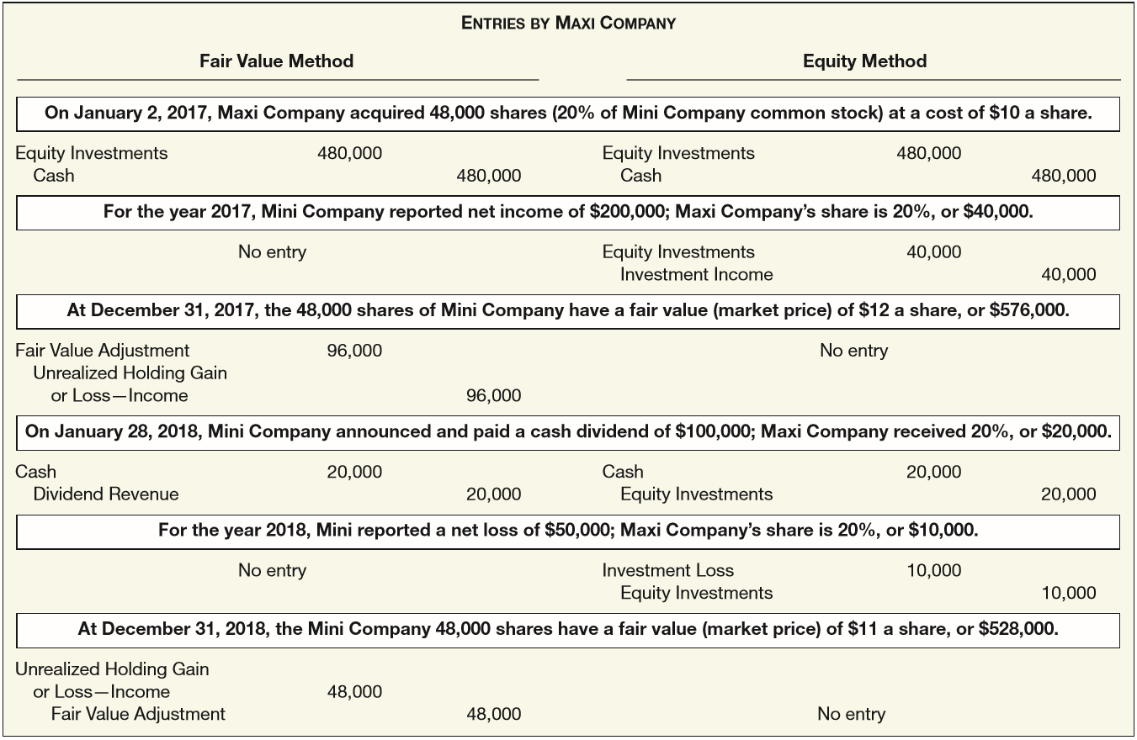

ILLUSTRATION 17-17
Comparison of Fair Value Method and Equity Method
LO 3

Slide 56
INVESTMENTS IN EQUITY SECURITIES
Holding of More Than 50% (Consolidation)
Controlling Interest - When one corporation acquires a voting interest of more than 50 percent in another corporation
  Investor corporation is referred to as the parent.
  Investee corporation is referred to as the subsidiary.
  Investment in the subsidiary is reported on the parent’s balance sheet as a long-term investment.
  Parent generally prepares consolidated financial statements.
LO 3

Slide 57
WHAT DO THE NUMBERS MEAN? WHO’S IN CONTROL HERE?
WHAT’S YOUR PRINCIPLE
Molson Coors Brewing Company owns 42 percent of the MillerCoors’ brewing venture operating in the United States and Puerto Rico. As part of the agreement, Molson helps the MillerCoors unit produce and sell its products in the U.S. and Puerto Rican markets. Lenovo Group owns a signiﬁcant percentage (45 percent) of the shares of Beijing Lenovo Parasaga Information Technology Co. (which develops and distributes computer software). Beijing Lenovo is important to Lenovo because it develops and sells the software that is used with Lenovo computers. In return, Beijing Lenovo depends on Lenovo to provide the products that make its software and services valuable, as well as perform signiﬁcant customer and market support. Indeed, it can be said that to some extent Lenovo controls Beijing Lenovo, which would likely not exist without the support of Lenovo.
As you have learned, because a company like Lenovo owns less than 50 percent of the shares, it does not consolidate Beijing Lenovo but instead accounts for its investment using the equity method. Under the equity method, Lenovo reports a single income item for its proﬁts from Beijing Lenovo and only the net amount of its investment in the statement of ﬁnancial position.
(continued)
LO 3

Slide 58
WHAT DO THE NUMBERS MEAN? WHO’S IN CONTROL HERE?
WHAT’S YOUR PRINCIPLE
Equity method accounting gives Lenovo a pristine statement of ﬁnancial position and income statement, by separating the assets and liabilities and the profit margins of the related companies from its laptop-computer businesses.
Some are critical of equity method accounting. They argue that some investees, like Beijing Lenovo, should be consolidated. The FASB has issued rules to consider other factors, in addition to voting interests, when determining whether an entity should be consolidated. The FASB has tightened up
consolidation rules, so that companies will be more likely to consolidate more of their 20–50-percent-owned investments. Consolidation of entities, such as MillerCoors and Beijing Lenovo, is warranted if Molson and Lenovo effectively control their equity method investments.
LO 3

Slide 59
LEARNING OBJECTIVES
17
Investments
After studying this chapter, you should be able to:
Understand the accounting for investments in debt securities.
Understand the accounting for investments in equity securities.
Explain the equity and consolidation methods of accounting.
Evaluate other major issues related to investments in debt and equity securities.
LO 4

Slide 60
OTHER FINANCIAL REPORTING ISSUES
Fair Value Option
Companies have the option to report most financial instruments at fair value, with all gains and losses related to changes in fair value reported in the income statement.
  Applied on an instrument-by-instrument basis.
  Generally available only at the time a company first purchases the financial asset or incurs a financial liability.
  Company must measure this instrument at fair value until the company no longer has ownership.
LO 4

Slide 61
Fair Value Option
Available-for-Sale Debt Securities
Illustration: McCollum Company purchases stock in Fielder Company during 2017 that it classifies as available-for-sale. At December 31, 2017, the cost of this security is $100,000; its fair value at December 31, 2017, is $125,000. If McCollum chooses the fair value option to account for the Fielder Company stock, it makes the following entry at December 31, 2017.
Equity Investments 25,000
Unrealized Holding Gain or Loss—Income 25,000
LO 4

Slide 62
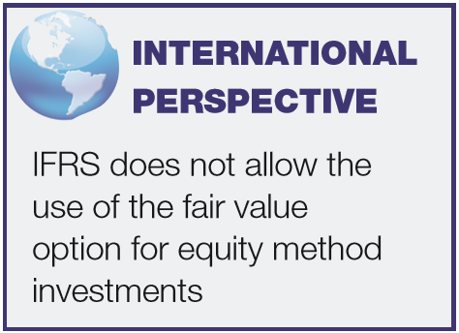
Fair Value Option
Equity Method Investments
Illustration: Sullivan Company holds a 28 percent stake in Suppan Inc. Sullivan purchased the investment in 2017 for $930,000. At December 31, 2017, the fair value of the investment is $900,000. Sullivan elects to report the investment in Suppan using the fair value option. The entry to record this investment is as follows.
Unrealized Holding Gain or Loss—Income 30,000
Equity Investments 30,000
LO 4

Slide 63
EVOLVING ISSUE FAIR VALUE CONTROVERSY
WHAT’S YOUR PRINCIPLE
As discussed in the opening story, the reporting of investment securities is controversial. Some believe that all securities should be reported at fair value with the unrealized gain or loss reported in net income. Others believe the unrealized gain or loss should be reported in other comprehensive income. A third group believes all debt securities should be stated at amortized cost, and still others favor the present approach. Here are some of the major unresolved issues:
• Measurement based on intent. Companies classify debt securities as held-to-maturity, available-for-sale, or trading. As a result, companies can report three identical debt securities in three different ways in the ﬁnancial statements. Some argue such treatment is confusing. Furthermore, the held-to-maturity category relies on intent, a subjective evaluation. What is not subjective is the fair value of the debt instrument. In other words, the three classiﬁcations are subjective, resulting in arbitrary classiﬁcations.
• Gains trading. Companies can classify certain debt securities as held-to-maturity and therefore report them at amortized cost. Companies can classify other debt securities as available-for-sale and report them at fair
(continued)
LO 4

Slide 64
EVOLVING ISSUE FAIR VALUE CONTROVERSY
WHAT’S YOUR PRINCIPLE
value, with the unrealized gain or loss reported as other comprehensive income. In either case, a company can become involved in “gains trading” (also referred to as “cherry picking,” “snacking,” or “sell the best and keep the rest”). In gains trading, companies sell their “winners,” reporting the gains in income, and hold on to the losers.
• Liabilities not fairly valued. Many argue that if companies report investment securities at fair value, they also should report liabilities at fair value. Why? By recognizing changes in value on only one side of the balance sheet (the asset side), a high degree of volatility can occur in the income and stockholders’ equity amounts. Further, ﬁnancial institutions are involved in asset and liability management (not just asset management). Viewing only one side may lead managers to make uneconomic decisions as a result of the accounting. The fair value option may address this concern to some extent. However, there is debate on the usefulness of fair value estimates for liabilities.
LO 4

Slide 65
OTHER FINANCIAL REPORTING ISSUES
Impairment of Value
The rules for debt investments (debt securities and loans) reported at amortized cost follow the same approach as discussed in Chapter 7. That is, companies should use the current expected credit loss model to record the impairment of debt investments similar to receivables.
LO 4

Slide 66
Impairment of Value
Illustration: Strickler Company holds held-to-maturity bond securities with a par value and amortized cost of $1 million. The fair value of these securities is $800,000. In evaluating the securities, Strickler now determines that it is probable that it will not collect all amounts due. In this case, it reports a Loss on Impairment of $200,000. Strickler includes this amount in income and records the impairment as follows.
Loss on Impairment 200,000
Debt Investments 200,000
LO 4

Slide 67
OTHER FINANCIAL REPORTING ISSUES
Impairment of Value
Companies that have debt securities that are classified as available-for-sale use a different impairment model. Under this model, if the fair value is greater than amortized cost, no expected credit loss is recognized.
Impairment losses on debt securities that are available-for-sale are limited to the difference between fair value and amortized cost.
LO 4

Slide 68
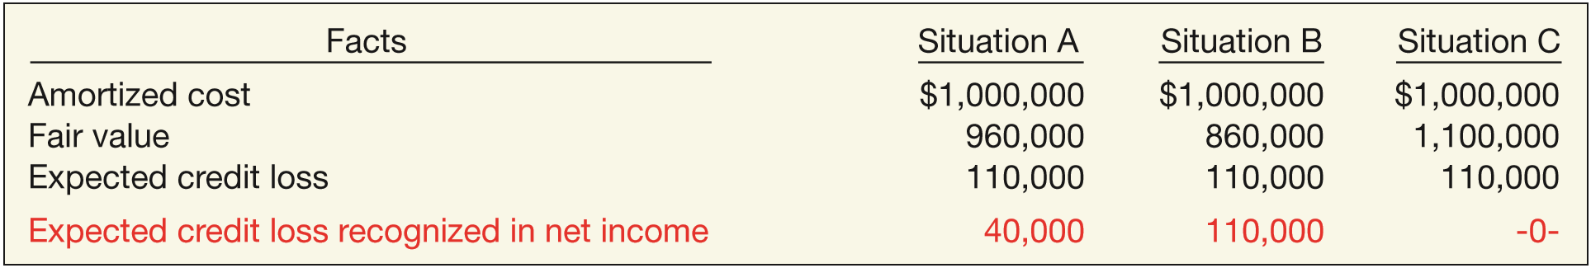
Impairment of Value
For example, Illustration 17-18 provides an impairment analysis based on these impairment guidelines for Alexander Company.
In Situation A, Alexander recognizes an impairment of $40,000 ($1,000,000 − $960,000) even though the expected credit loss is $110,000, why?
ILLUSTRATION 17-18
Impairment Analysis Available-for-Sale Investments
The reason is that the difference between the fair value and amortized cost is less than the expected credit loss.
LO 4

Slide 69
Impairment of Value
For example, Illustration 17-18 provides an impairment analysis based on these impairment guidelines for Alexander Company.
ILLUSTRATION 17-18
In Situation B, Alexander recognizes an impairment
of $110,000 because the difference between fair value and amortized cost is greater than the expected credit loss.
Loss on Impairment 110,000
Allowance for Impaired Debt Investments 110,000
LO 4

Slide 70
Impairment of Value
For example, Illustration 17-18 provides an impairment analysis based on these impairment guidelines for Alexander Company.
ILLUSTRATION 17-18
In Situation C, Alexander does not recognize an
impairment because the fair value is higher than amortized cost.
LO 4

Slide 71
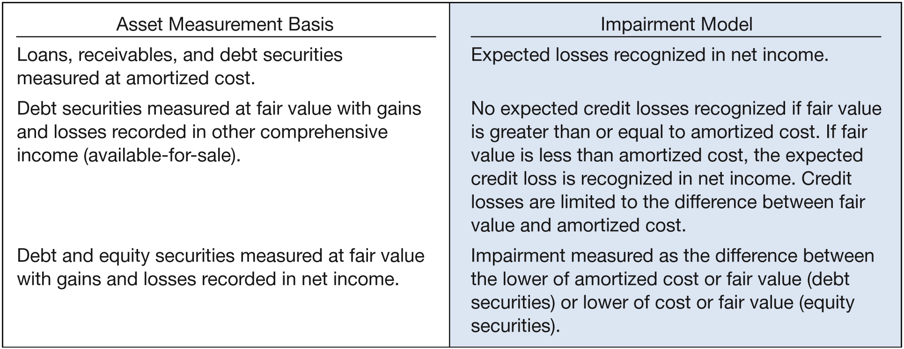
Impairment of Value
ILLUSTRATION 17-19
Impairment Model Summary
LO 4

Slide 72
OTHER FINANCIAL REPORTING ISSUES
Reclassification Adjustments
The reporting of changes in unrealized gains or losses in comprehensive income is straightforward unless a company sells securities during the year.
In that case, double counting results when the company reports realized gains or losses as part of net income but also shows the amounts as part of other comprehensive income in the current
period or in previous periods.
To ensure that gains and losses are not counted twice when a sale occurs, a reclassification adjustment is necessary.
LO 4

Slide 73
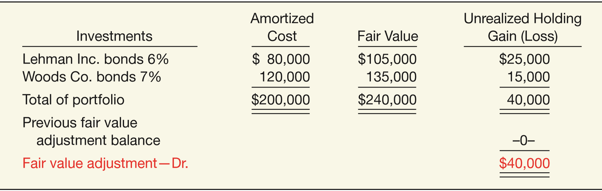
Reclassification Adjustments
Illustration: Open Company has the following two available-for-sale securities in its portfolio at the end of 2016 (its first year of operations).
ILLUSTRATION 17-26
Available-for-Sale Security Portfolio (2016)
LO 4

Slide 74
Reclassification Adjustments
ILLUSTRATION 17-26
Available-for-Sale Security Portfolio (2016)
The entry to record the unrealized holding gain in 2016 is as follows.
Fair Value Adjustment 40,000
Unrealized Holding Gain or Loss—Equity 40,000
LO 4

Slide 75
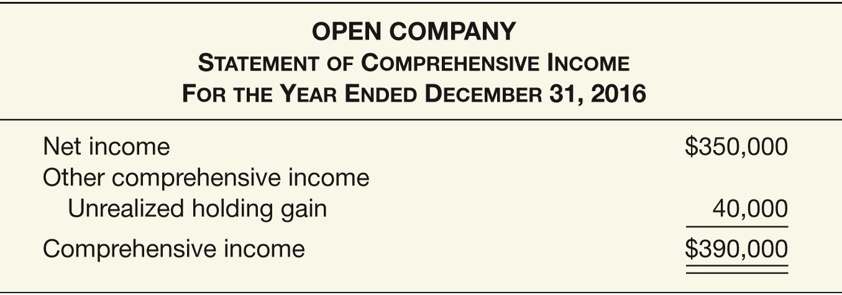
Reclassification Adjustments
Illustration: If Open Company reports net income in 2016 of $350,000, it presents a statement of comprehensive income as follows.
ILLUSTRATION 17-27
Statement of Comprehensive Income (2016)
LO 4

Slide 76
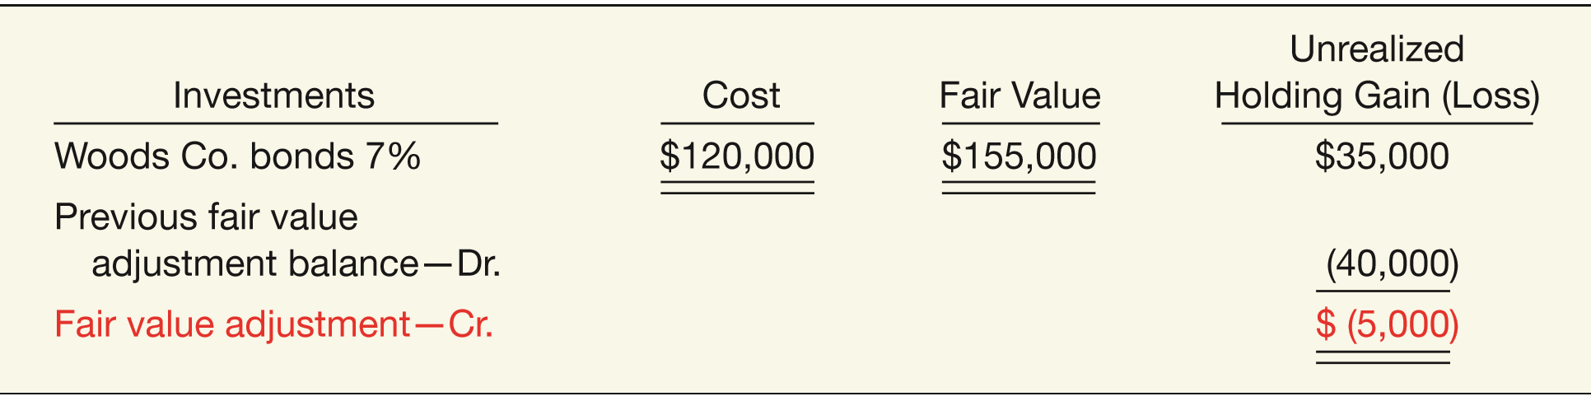
Reclassification Adjustments
Illustration: During 2017, Open Company sold the Lehman Inc. bonds for $105,000 and realizes a gain on the sale of $25,000 ($105,000 – $80,000). At the end of 2017, the fair value of the Woods Co. bonds increased an additional $20,000, to $155,000.
ILLUSTRATION 17-28
Available-for-Sale Security Portfolio (2017)
LO 4

Slide 77
Reclassification Adjustments
ILLUSTRATION 17-28
Available-for-Sale Security Portfolio (2017)
The entry to record the unrealized holding gain or loss in 2017 is as follows.
Unrealized Holding Gain or Loss—Equity 5,000
Fair Value Adjustment 5,000
LO 4

Slide 78
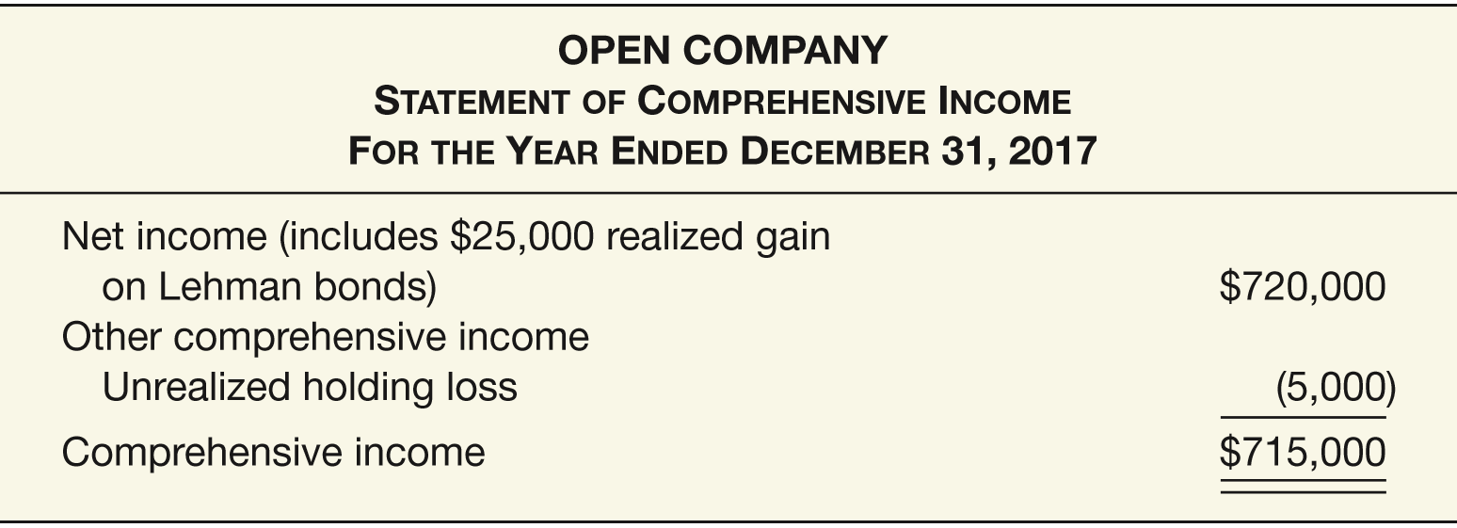
Reclassification Adjustments
Illustration: If we assume that Open Company reports net income of $720,000 in 2017, including the realized loss on the Lehman bonds, its statement of comprehensive income is presented as shown in Illustration 17-29.
ILLUSTRATION 17-29
Statement of Comprehensive Income (2017)
LO 4

Slide 79
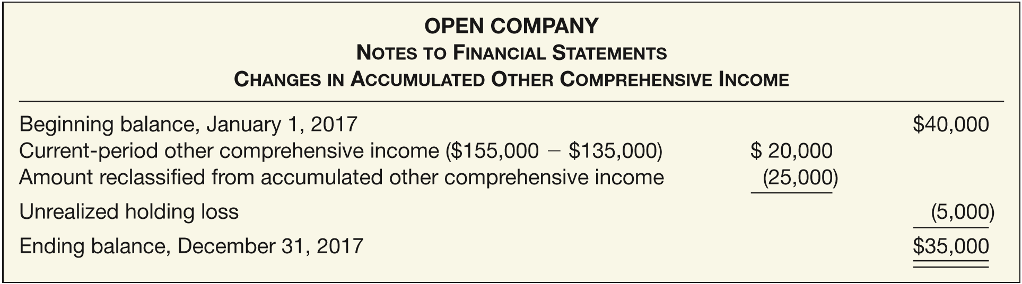
Reclassification Adjustments
Reclassification adjustment may be made in the income statement, in accumulated other comprehensive income or in a note to the financial statements. The FASB prefers to show the reclassification amount in accumulated other comprehensive income in the notes to the financial statements. For Open Company, this presentation is as shown in Illustration 17-30.
ILLUSTRATION 17-30
Note Disclosure of Reclassiﬁcation Adjustments
LO 4

Slide 80
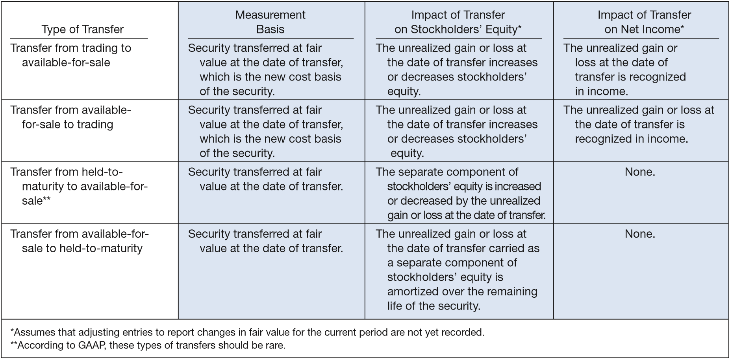
OTHER FINANCIAL REPORTING ISSUES
Transfers Related to Debt Securities
ILLUSTRATION 17-31
Accounting for Transfers
LO 4

Slide 81
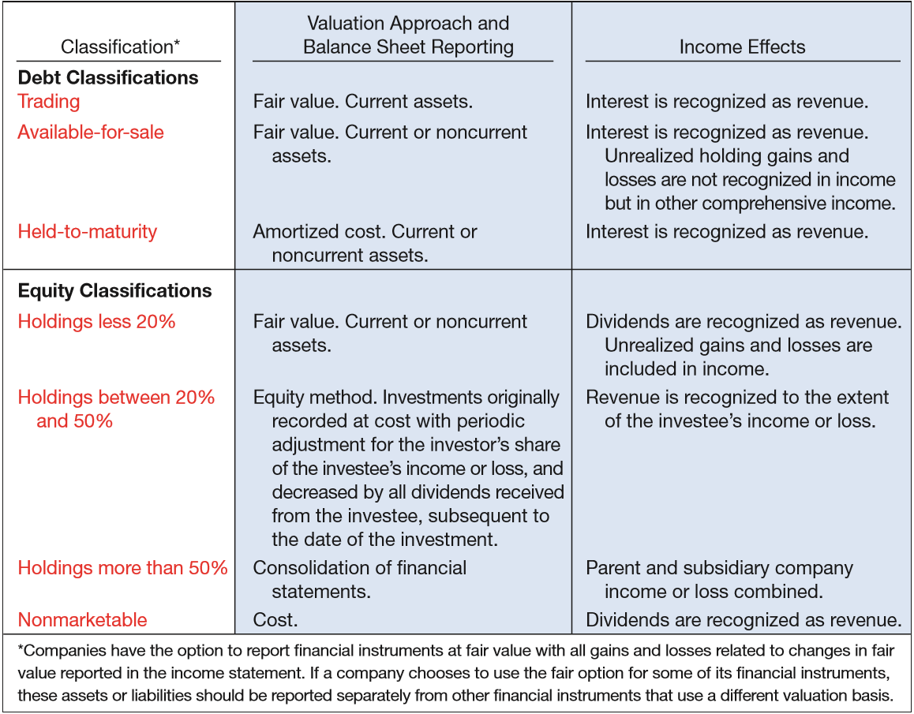
ILLUSTRATION 17-32
Summary of Treatment of Major Debt and Equity Securities
LO 4

Slide 82
APPENDIX 17A
ACCOUNTING FOR DIRIVATIVE INSTRUMENTS
DEFINING DERIVATIVES
Financial instruments that derive their value from values of other assets (e.g., stocks, bonds, or commodities).
Three different types of derivatives:
  Financial forwards or financial futures.
  Options.
  Swaps.
LO 5 Describe the uses of and accounting for derivatives.

Slide 83
APPENDIX 17A
ACCOUNTING FOR DIRIVATIVE INSTRUMENTS
WHO USES DERIVATIVES, AND WHY?
  Producers and Consumers
  Commodity prices are volatile.
  They depend on weather, crop production, and general economic conditions.
  To plan effectively, it makes good sense to lock in specific future revenues or costs in order to run their businesses successfully.
LO 5

Slide 84
APPENDIX 17A
ACCOUNTING FOR DIRIVATIVE INSTRUMENTS
WHO USES DERIVATIVES, AND WHY?
  Speculators and Arbitrageurs
  The speculator who may be in the market for only a few hours, will then sell the forward contract to another speculator or to a company.
  Arbitrageurs attempt to exploit inefficiencies in markets. They seek to lock in profits by simultaneously entering into transactions in two or more markets.
LO 5

Slide 85
APPENDIX 17A
ACCOUNTING FOR DIRIVATIVE INSTRUMENTS
BASIC PRINCIPLES IN ACCOUNTING FOR DERIVATIVES
  Recognize derivatives in the financial statements as assets and liabilities.
  Report derivatives at fair value.
  Recognize gains and losses resulting from speculation in derivatives immediately in income.
  Report gains and losses resulting from hedge transactions differently, depending on the type of hedge.
LO 5

Slide 86
APPENDIX 17A
ACCOUNTING FOR DIRIVATIVE INSTRUMENTS
Example of Derivative Financial Instrument-Speculation
Illustration: Assume that a company purchases a call option contract from Baird Investment Co. on January 2, 2017, when Laredo shares are trading at $100 per share. The contract gives it the option to purchase 1,000 shares (referred to as the notional amount) of Laredo stock at an option price of $100 per share. The option expires on April 30, 2017. The company purchases the call option for $400 and makes the following entry on January 2, 2017.
Call Option 400
Cash 400
Option Premium
LO 5

Slide 87
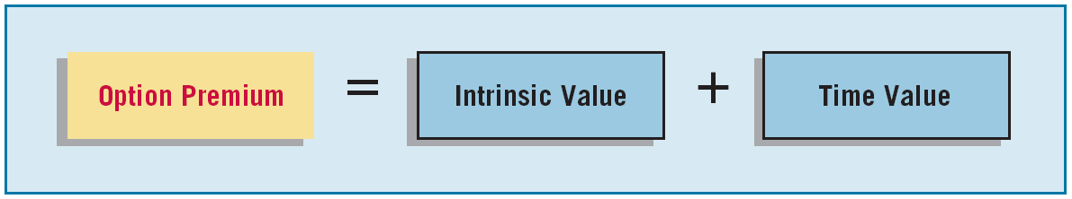
APPENDIX 17A
ACCOUNTING FOR DIRIVATIVE INSTRUMENTS
Example of Derivative Financial Instrument-Speculation
The option premium consists of two amounts.
ILLUSTRATION 17A-1
Option Premium Formula
Intrinsic value is the difference between the market price and the preset strike price at any point in time. It represents the amount realized by the option holder, if exercising the option immediately. On January 2, 2017, the intrinsic value is zero because the market price equals the preset strike price.
LO 5

Slide 88
APPENDIX 17A
ACCOUNTING FOR DIRIVATIVE INSTRUMENTS
Example of Derivative Financial Instrument-Speculation
The option premium consists of two amounts.
ILLUSTRATION 17A-1
Option Premium Formula
Time value refers to the option’s value over and above its intrinsic value. Time value reflects the possibility that the option has a fair value greater than zero. How? Because there is some expectation that the price of Laredo shares will increase above the strike price during the option term. As indicated, the time value for the option is $400.
LO 5

Slide 89

APPENDIX 17A
ACCOUNTING FOR DIRIVATIVE INSTRUMENTS
Additional data available with respect to the call option:
On March 31, 2017, the price of Laredo shares increases to $120 per share. The intrinsic value of the call option contract is now $20,000. That is, the company can exercise the call option and purchase 1,000 shares from Baird Investment for $100 per share. It can then sell the shares in the market for $120 per share. This gives the company a gain on the option contract of ________.
$20,000
($120,000 - $100,000)
LO 5

Slide 90
APPENDIX 17A
ACCOUNTING FOR DIRIVATIVE INSTRUMENTS
On March 31, 2017, it records the increase in the intrinsic value of the option as follows.
Call Option 20,000
Unrealized Holding Gain or Loss—Income 20,000
A market appraisal indicates that the time value of the option at March 31, 2017, is $100. The company records this change in value of the option as follows.
Unrealized Holding Gain or Loss—Income 300
Call Option ($400 - $100) 300
LO 5

Slide 91
APPENDIX 17A
ACCOUNTING FOR DIRIVATIVE INSTRUMENTS
At March 31, 2017, the company reports the
  call option in its balance sheet at fair value of $20,100.
  unrealized holding gain which increases net income.
  loss on the time value of the option which decreases net income.
LO 5

Slide 92
APPENDIX 17A
ACCOUNTING FOR DIRIVATIVE INSTRUMENTS
On April 16, 2017, the company settles the option before it expires. To properly record the settlement, it updates the value of the option for the decrease in the intrinsic value of $5,000 ([$20 - $15]) x 1,000) as follows.
Unrealized Holding Gain or Loss—Income 5,000
Call option 5,000
The decrease in the time value of the option of $40 ($100 - $60) is recorded as follows.
Unrealized Holding Gain or Loss—Income 40
Call Option 40
LO 5

Slide 93
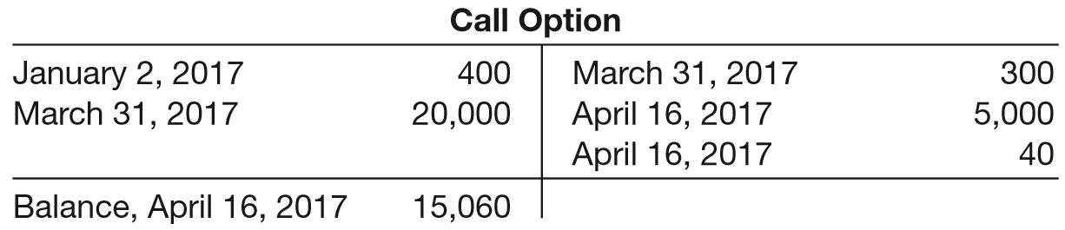
APPENDIX 17A
ACCOUNTING FOR DIRIVATIVE INSTRUMENTS
At the time of the settlement, the call option’s carrying value is as follows.
Settlement of the option contract is recorded as follows.
Cash 15,000
Loss on Settlement of Call Option 60
Call Option 15,060
LO 5

Slide 94
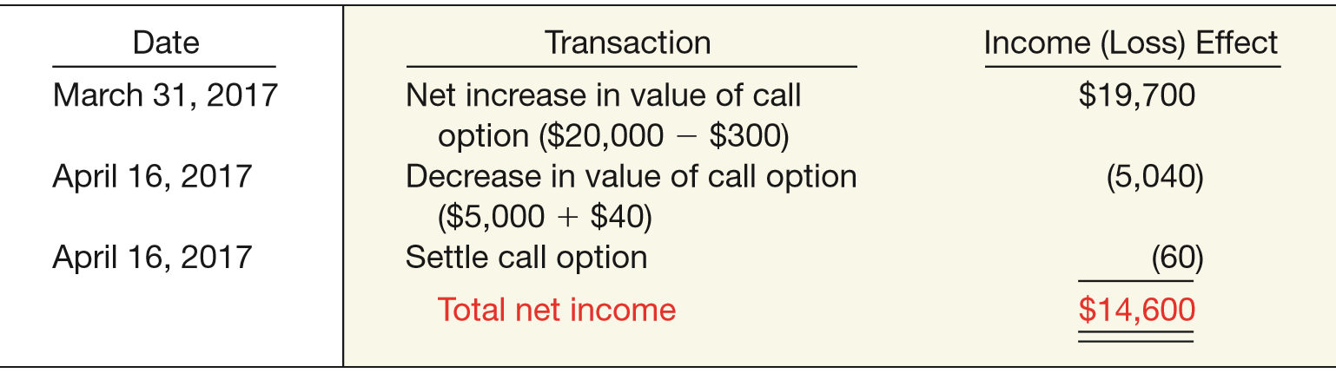
APPENDIX 17A
ACCOUNTING FOR DIRIVATIVE INSTRUMENTS
Summary effects of the call option contract on net income.
ILLUSTRATION 17A-2
Effect on Income— Derivative Financial Instrument
Because the call option meets the definition of an asset, the company records it in the balance sheet on March 31, 2017. It also reports the call option at fair value, with any gains or losses reported in income.
LO 5

Slide 95
APPENDIX 17A
ACCOUNTING FOR DIRIVATIVE INSTRUMENTS
Differences between Traditional and Derivative Financial Instruments
A derivative financial instrument has the following three basic characteristics.
  The instrument has (1) one or more underlyings and (2) an identified payment provision.
  The instrument requires little or no investment at the inception of the contract.
  The instrument requires or permits net settlement.
LO 5

Slide 96
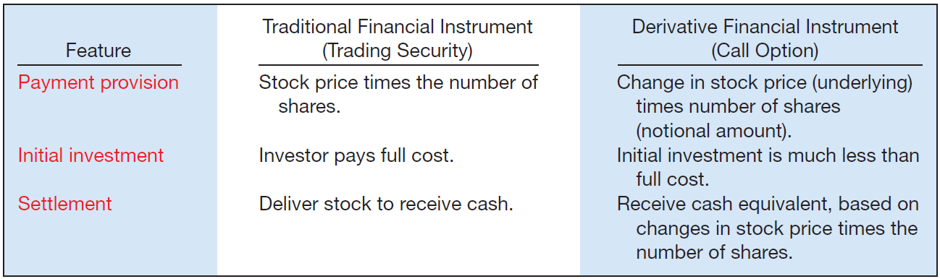
APPENDIX 17A
ACCOUNTING FOR DIRIVATIVE INSTRUMENTS
Features of Traditional and Derivative Financial Instruments
ILLUSTRATION 17A-3
LO 5

Slide 97
APPENDIX 17A
ACCOUNTING FOR DIRIVATIVE INSTRUMENTS
DERIVATIVES USED FOR HEDGING
Hedging: The use of derivatives to offset the negative impacts of changes in interest rates or foreign currency exchange rates.
FASB allows special accounting for two types of hedges—
  fair value and
  cash flow hedges.
LO 6 Explain how to account for a fair value hedge.

Slide 98
APPENDIX 17A
ACCOUNTING FOR DIRIVATIVE INSTRUMENTS
Fair Value Hedge
A company uses a derivative to hedge (offset) the exposure to changes in the fair value of a recognized asset or liability or of an unrecognized commitment.
Companies commonly use several types of fair value hedges.
  Interest rate swaps
  put options
LO 6

Slide 99
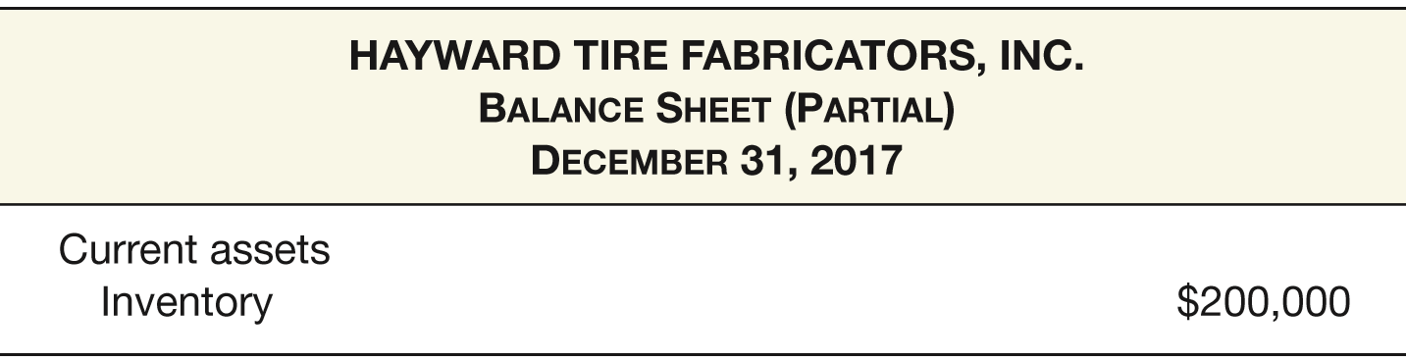
APPENDIX 17A
ACCOUNTING FOR DIRIVATIVE INSTRUMENTS
Illustration: On December 31, 2017, Hayward Tire Fabricators, Inc. holds an inventory of 1,000 tractor tires, with a cost of $200 per tire.
ILLUSTRATION 17A-4
Balance Sheet Presentation of Inventory
Hayward wishes to hedge its exposure to fair value declines for its tire inventory (the inventory is pledged as collateral for one of its bank loans).
LO 6

Slide 100
APPENDIX 17A
ACCOUNTING FOR DIRIVATIVE INSTRUMENTS
To hedge this risk, Hayward locks in the value of its tire inventory on January 2, 2018, by purchasing a put option to sell rubber at a fixed price. Hayward designates the option as a fair value hedge of the tire inventory. This put option (which expires in two years) gives Hayward the option to sell 4,000 pounds of rubber at a price of $50 per pound, which is the current spot price for rubber in the market. Since the exercise price equals the current market price, no entry is necessary at inception of the put option.
LO 6

Slide 101
APPENDIX 17A
ACCOUNTING FOR DIRIVATIVE INSTRUMENTS
At March 31, 2018, the fair value of the inventory has declined by 10 percent. Hayward records the following entry for the tire inventory.
Unrealized Holding Gain or Loss—Income 20,000
Allowance to Reduce Inventory to Fair Value 20,000
The following journal entry records the increase in value of the put option to sell rubber, assuming that the spot price for rubber declined by 10 percent.
Put Option 20,000
Unrealized Holding Gain or Loss—Income 20,000
LO 6

Slide 102
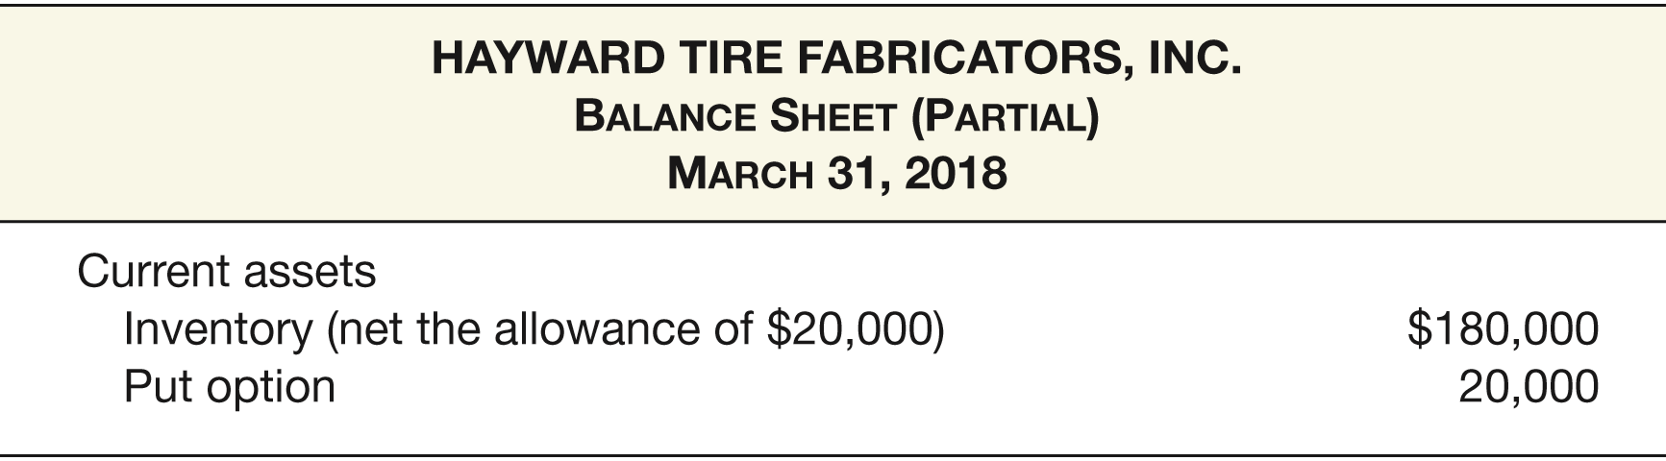
APPENDIX 17A
ACCOUNTING FOR DIRIVATIVE INSTRUMENTS
Hayward reports the amounts related to the Inventory and the put option.
ILLUSTRATION 17A-5
Balance Sheet Presentation of Fair Value Hedge
LO 6

Slide 103
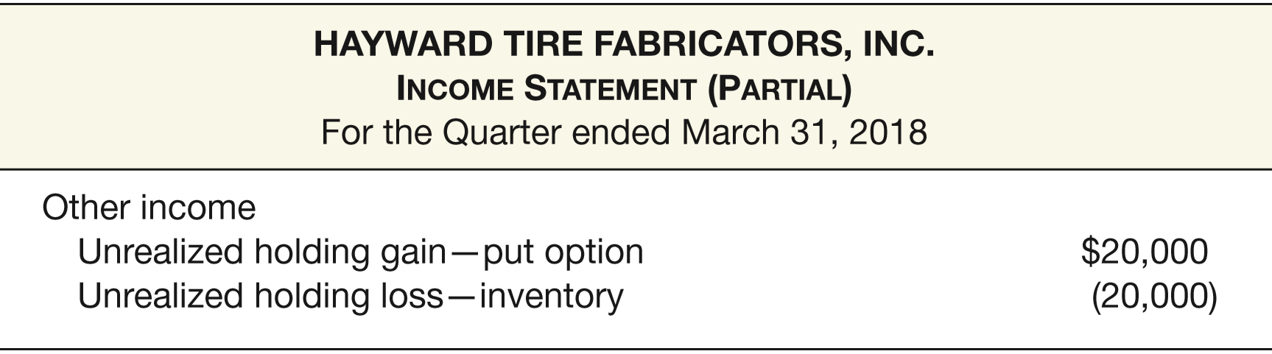
APPENDIX 17A
ACCOUNTING FOR DIRIVATIVE INSTRUMENTS
Hayward reports the effects of the hedging transaction on income for the year ended December 31, 2018.
ILLUSTRATION 17A-6
Income Statement Presentation of Fair Value Hedge
LO 6

Slide 104
APPENDIX 17A
ACCOUNTING FOR DIRIVATIVE INSTRUMENTS
Cash Flow Hedge
Used to hedge exposures to cash flow risk, which results from the variability in cash flows.
Reporting:
  Fair value on the balance sheet
  Gains or losses in equity, as part of other comprehensive income.
LO 6

Slide 105
APPENDIX 17A
ACCOUNTING FOR DIRIVATIVE INSTRUMENTS
Illustration: In September 2017 Allied Can Co. anticipates purchasing 1,000 metric tons of aluminum in January 2018. As a result, Allied enters into an aluminum futures contract. In this case, the aluminum futures contract gives Allied the right and the obligation to purchase 1,000 metric tons of aluminum for $1,550 per ton. This contract price is good until the contract expires in January 2018. The underlying for this derivative is the price of aluminum.
Allied enters into the futures contract on September 1, 2017. Assume that the price to be paid today for inventory to be delivered in January—the spot price—equals the contract price. With the two prices equal, the futures contract has no value. Therefore no entry is necessary.
LO 6

Slide 106
APPENDIX 17A
ACCOUNTING FOR DIRIVATIVE INSTRUMENTS
Illustration: At December 31, 2017, the price for January delivery of aluminum increases to $1,575 per metric ton. Allied makes the following entry to record the increase in the value of the futures contract.
Futures Contract 25,000
Unrealized Holding Gain or Loss—Equity 25,000
([$1,575 - $1,550] x 1,000 tons)
Allied reports the futures contract in the balance sheet as a current asset and the gain as part of other comprehensive income.
LO 6

Slide 107
APPENDIX 17A
ACCOUNTING FOR DIRIVATIVE INSTRUMENTS
Illustration: In January 2018, Allied purchases 1,000 metric tons of aluminum for $1,575 and makes the following entry.
Aluminum Inventory 1,575,000
Cash ($1,575 x 1,000 tons) 1,575,000
At the same time, Allied makes final settlement on the futures contract. It records the following entry.
Cash 25,000
Futures Contract ($1,575,000 - $1,550,000) 25,000
LO 6

Slide 108
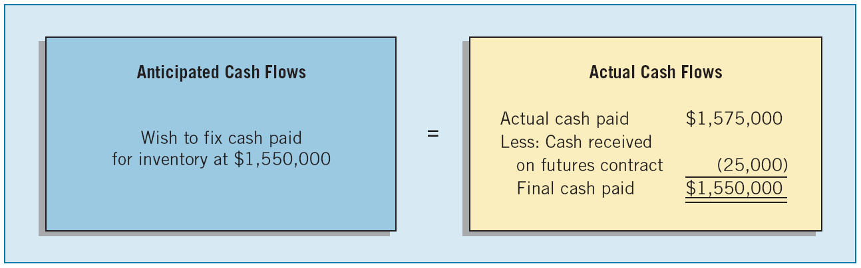
APPENDIX 17A
ACCOUNTING FOR DIRIVATIVE INSTRUMENTS
Effect of Hedge on Cash Flows
ILLUSTRATION 17A-7
There are no income effects at this point. Allied accumulates in equity the gain on the futures contract as part of other comprehensive income until the period when it sells the inventory.
LO 6

Slide 109
APPENDIX 17A
ACCOUNTING FOR DIRIVATIVE INSTRUMENTS
Illustration: Assume that Allied processes the aluminum into finished goods (cans). The total cost of the cans (including the aluminum purchases in January 2018) is $1,700,000. Allied sells the cans in July 2018 for $2,000,000, and records this sale as follows.
Cash 2,000,000
Sales Revenue 2,000,000
Cost of Goods Sold 1,700,000
Inventory (cans) 1,700,000
LO 6

Slide 110
APPENDIX 17A
ACCOUNTING FOR DIRIVATIVE INSTRUMENTS
Illustration: Since the effect of the anticipated transaction has now affected earnings, Allied makes the following entry related to the hedging transaction.
Unrealized Holding Gain or Loss—Equity 25,000
Cost of Goods Sold 25,000
The gain on the futures contract, which Allied reported as part of other comprehensive income, now reduces cost of goods sold. As a result, the cost of aluminum included in the overall cost of goods sold is $1,550,000.
LO 6

Slide 111
APPENDIX 17A
ACCOUNTING FOR DIRIVATIVE INSTRUMENTS
OTHER REPORTING ISSUES
Embedded Derivatives
Convertible bond is a hybrid instrument. Two parts:
  a debt security, referred to as the host security, and
  an option to convert the bond to shares of common stock, the embedded derivative.
To account for an embedded derivative, a company should separate it from the host security and then account for it using the accounting for derivatives. This separation process is referred to as bifurcation.
LO 7 Identify special reporting issues related to derivative financial instruments that cause unique accounting problems.

Slide 112
APPENDIX 17A
ACCOUNTING FOR DIRIVATIVE INSTRUMENTS
Qualifying Hedge Criteria
Criteria that hedging transactions must meet before requiring the special accounting for hedges.
  Documentation, risk management, and designation.
  Effectiveness of the hedging relationship.
  Effect on reported earnings of changes in fair values or cash flows.
LO 7

Slide 113
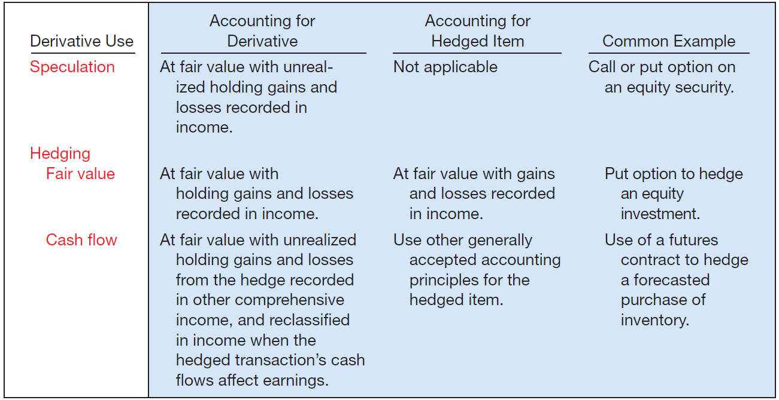
APPENDIX 17A
ACCOUNTING FOR DIRIVATIVE INSTRUMENTS
Summary of Derivative Accounting under GAAP
ILLUSTRATION 17A-8
LO 7

Slide 114
APPENDIX 17B
FAIR VALUE DISCLOSURES
FASB believes that fair value information is relevant for making effective business decisions. Others express concern about fair value measurements for two reasons:
  the lack of reliability related to the fair value measurement in certain cases, and
  the ability to manipulate fair value measurements.
LO 8 Describe required fair value disclosures.

Slide 115
APPENDIX 17B
FAIR VALUE DISCLOSURES
DISCLOSURE OF FAIR VALUE INFORMATION: FINANCIAL INSTRUMENTS—NO FAIR VALUE OPTION
Both the cost and the fair value of all financial instruments are to be reported in the notes to the financial statements.
FASB also decided that companies should disclose information that enables users to determine the extent of usage of fair value and the inputs used to implement fair value measurement.
LO 8

Slide 116
APPENDIX 17B
FAIR VALUE DISCLOSURES
DISCLOSURE OF FAIR VALUE INFORMATION: FINANCIAL INSTRUMENTS—NO FAIR VALUE OPTION
Two reasons for additional disclosure beyond the simple itemization of fair values are:
  Differing levels of reliability exist in the measurement of fair value information.
  Changes in the fair value of financial instruments are reported differently in the financial statements, depending upon the type of financial instrument involved and whether the fair value option is employed.
LO 8

Slide 117
APPENDIX 17B
FAIR VALUE DISCLOSURES
Levels of reliability fair value hierarchy.
  Level 1 is the most reliable measurement because fair value is based on quoted prices in active markets for identical assets or liabilities.
  Level 2 is less reliable; it is not based on quoted market prices for identical assets and liabilities but instead may be based on similar assets or liabilities.
  Level 3 is least reliable; it uses unobservable inputs that reflect the company’s assumption as to the value of the financial instrument.
LO 8

Slide 118
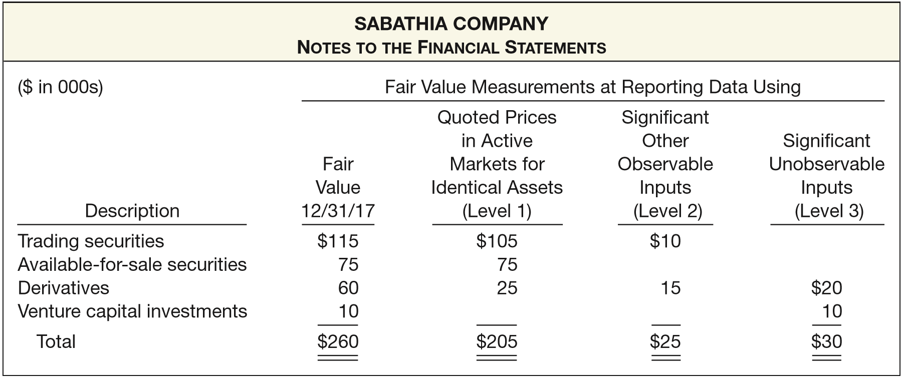
APPENDIX 17B
FAIR VALUE DISCLOSURES
Example of Fair Value Hierarchy
ILLUSTRATION 17B-1
LO 8

Slide 119
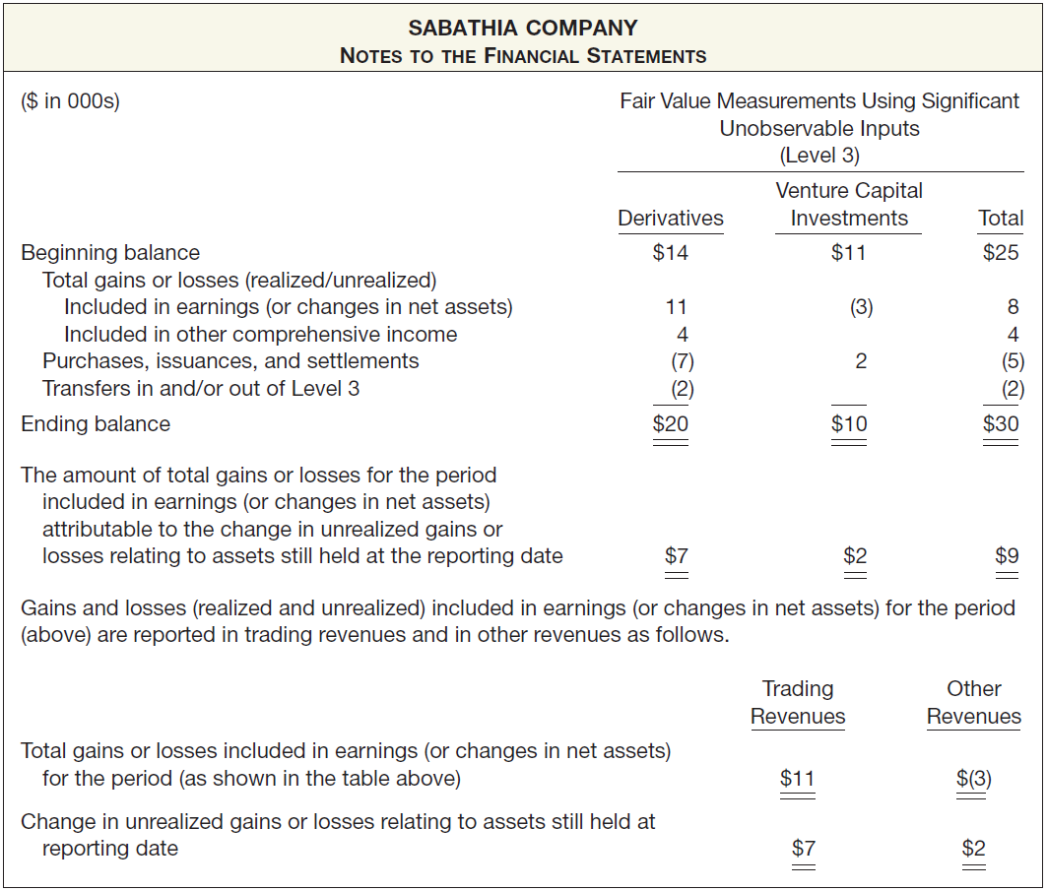
ILLUSTRATION 17B-2
Reconciliation of Level 3 Inputs

Slide 120
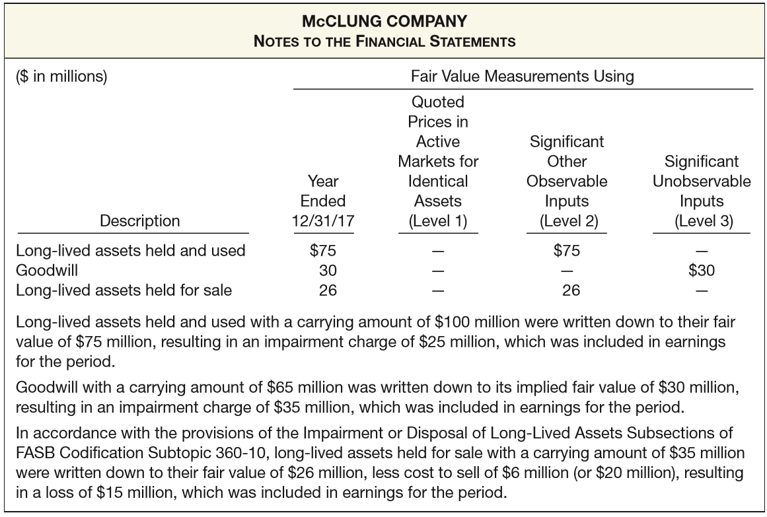
APPENDIX 17B
FAIR VALUE DISCLOSURES
DISCLOSURE OF FAIR VALUES: IMPAIRED ASSETS OR LIABILITIES
ILLUSTRATION 17B-4
Disclosure of Fair Value with Impairment

Slide 121

RELEVANT FACTS - Similarities
  GAAP and IFRS use similar classifications for financial assets: cash, loans and receivables, investments, and derivatives.
  Both IFRS and GAAP require that financial assets be sorted into specific categories for measurement and classification purposes.
  Held-to-maturity (GAAP) and held-for-collection (IFRS) investments are accounted for at amortized cost. Gains and losses on some investments are reported in other comprehensive income.
  Amortized cost or fair value is used depending upon the classification of the financial instrument.
  The definition of amortized cost and fair value are the same.
LO 9 Compare the accounting for investments under GAAP and IFRS.

Slide 122
RELEVANT FACTS - Similarities
  Both GAAP and IFRS use the same test to determine whether the equity method of accounting should be used, that is, significant influence with a general guideline of over 20 percent ownership.
  GAAP and IFRS are similar in the accounting for the fair value option. That is, the option to use the fair value method must be made at initial recognition, the selection is irrevocable, and gains and losses are reported as part of income.
LO 9

Slide 123
RELEVANT FACTS - Differences
  While GAAP classifies debt investments as trading, available-for-sale, and held-to-maturity, IFRS classifies debt investments as held-for-collection (debt investments) and trading.
  GAAP requires that all changes in fair value for equity securities be reported as part of income. IFRS requires that changes in fair value for non-trading equity securities be reported as part of other comprehensive income.
  While the measurement of impairments is similar under GAAP and IFRS, GAAP does not permit the reversal of an impairment charge related to held-to-maturity debt investments and equity investments. IFRS allows reversals of impairments of held-for-collection investments.
LO 9

Slide 124
RELEVANT FACTS - Differences
  While GAAP and IFRS are similar in the accounting for the fair value option, one difference is that GAAP permits the fair value option for equity method investments; IFRS does not.
ON THE HORIZON
At one time, both the FASB and IASB have indicated that they believe that all financial instruments should be reported at fair value and that changes in fair value should be reported as part of net income. Under the Boards’ recent standards in this area, GAAP and IFRS are substantially converged, except for non-trading equity investments.
LO 9

Slide 125
IFRS SELF-TEST QUESTION
All of the following are key similarities between GAAP and IFRS with respect to accounting for investments except:
  IFRS and GAAP require the same accounting for equity securities.
  IFRS and GAAP apply the equity method to significant influence equity investments.
  IFRS and GAAP have a fair value option for financial instruments.
  the accounting for impairment of investments is similar, although IFRS allows recovery of impairment losses.
LO 9

Slide 126
IFRS SELF-TEST QUESTION
Which of the following statements is correct?
  IFRS permits the fair value option for the equity method of accounting. (b)
  GAAP permits recovery of impairment losses. (c)
  Under IFRS, non-trading equity investments are accounted for at amortized cost. (d)
  IFRS and GAAP both have a trading investment classification.
LO 9

Slide 127
IFRS SELF-TEST QUESTION
IFRS requires companies to measure their financial assets at fair value except when based on:
  whether the equity method of accounting is used.
  whether the financial asset is a debt investment.
  whether the financial asset is an equity investment.
  whether an investment is classified as trading.
LO 9

Slide 128
COPYRIGHT
“Copyright © 2016 John Wiley & Sons, Inc. All rights reserved. Reproduction or translation of this work beyond that permitted in Section 117 of the 1976 United States Copyright Act without the express written permission of the copyright owner is unlawful. Request for further information should be addressed to the Permissions Department, John Wiley & Sons, Inc. The purchaser may make back-up copies for his/her own use only and not for distribution or resale. The Publisher assumes no responsibility for errors, omissions, or damages, caused by the use of these programs or from the use of the information contained herein.”

