Slide 1
Lecture 13
NUTD 343
Dr. Emilia Rappocciolo

Slide 2
Food Preservation
Purpose of Preservation
to extend shelf life
protect from changes that could lead to spoilage
To ensure safety
Microbiological changes – prevented by eliminating spoilage microorganisms or suppressing their metabolic activity and to ensure safety.
Physical methods are the most commonly used
Heat (thermal processing) inactivates pathogens, spoilage-initiating microorganisms, enzymes and may destroy heat-labile toxins
Refrigeration or freezing- suppresses microbial metabolism and multiplication, may inactivate some of food microbiota.

Slide 3
Food Preservation
Decreasing water availability- preserving through drying or by addition of water activity (aw) modifiers (humectants):
Aw reduction achieved by adding humectants to food- they enhance stability, maintain texture/flavor, reduce microbial activity.
Humectants: as salt, sugar, glycerol and propylene glycol
Preserve food effectively and minimize deterioration
Alternative methods:
gamma radiation
Use of ultra-high pressure to preserve prepackaged food

Slide 4
Food Preservation
Emerging preservation approaches
pulsed electric fields
UV light
Ultrasound
Introduced with the aim of ensuring food safety while minimizing adverse effects of processing on product quality

Slide 5
Preservation by High Temperature
Above the optimum temp, growth of a microorganism and cell multiplication slows and eventually ceases
Additional increase in temperature causes cell injury or death
Mild high temp (55 to 90°C) inactivate psychrotrophs and mesophils by damaging cell membranes, proteins, ribosomes leading to cell death
Example: Thermal pasteurization

Slide 6
Preservation by High Temperature
Higher dry heat:
inactivate bacterial spores by altering DNA
Inactivate key components of spore germination system (important thermal inactivation of spores by heat)
High enough temp inactivate bacterial spores - used in thermal sterilization of food.

Slide 7
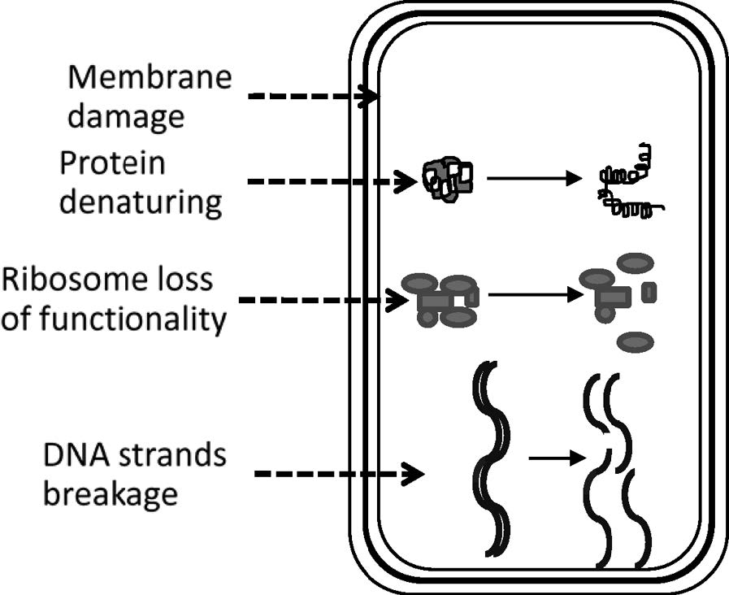
Microbial cell components altered or damaged during heat treatment.

Slide 8
Pathogens of Concern and Biological Indicators
Food preservation by thermal processing at high temp is a reliable process- can be lethal to all forms of life in food
Heat treatment can eliminate any microbial target, including spoilage and pathogenic microorganisms.
Commercial thermal processes are made just severe enough to protect product from spoilage and consumers from pathogens, excessive heat is avoided to minimize product quality damage

Slide 9
Pathogens of Concern and Biological Indicators
Examples of current pathogens of concern:
Enterohemorrhagic E. coli in fruit juices
Salmonella enterica serovar- Enteritidis in liquid eggs
Listeria monocytogenes in milk and ready-to-eat meat
Products are thermally pasteurized to eliminate pathogens

Slide 10
Pathogens of Concern and Biological Indicators
Thermal commercial sterilization
Heat-intensive treatment that targets Clostridium botulinum spores
Spores of C. botulinum represent the pathogen of concern in most sterilization processes
Adequate processing should eliminate the most resistant spores

Slide 11
Pathogens of Concern and Biological Indicators
Biological indicators
Microorganisms with relatively high and stable thermal resistance that make them suitable for thermal process validation – Examples of biological indicators:
Spores of Geobacillus stearothermophilus
Bacillus subtilis
Clostridium sporogenes

Slide 12
Kinetics of Microbial Death by Heat
Kinetics of microbial inactivation, at a given temp are determined by observing the decline in survivors during heating time - best described in survivor semi-log plots
Linearity of survivor plots allows to measure the death rate
Instead of death rate, decimal reduction time (D value) is more practical to determine
D value (DT) is the time (t) required for 10-fold (1-log) reduction in the number of survivors of an microorganism at specified temp (T)
The greater the D value at a given temp, the more resistant is the microorganism to heat.
The D value decreases as the processing temp increases.

Slide 13
D value and z value
The D value is the time (in minutes) it takes at a given temperature to decrease viability by a factor of 10.
The z value is the number of degrees it takes to change the D value by a factor of 10.
The heat resistances (D values) and how they change with temperature (z value) are influenced by many factors (e.g., pH and aw) and differ among microbial species. Bacterial spores are more heat resistant than vegetative cells of the same species. Some spores survive for minutes at 120°C or for hours at 100°C. Less heat-resistant spores have D100°C values of <1 min.

Slide 14
D value and z value
Vegetative cells of bacteria, yeasts, and molds can have D values of <0.1 min at 70 to 80°C.
The age of the cells, their growth phase, the growth temperature, growth medium composition, exposure to prior stressors, and the heating environment also affect heat resistance. For example, one would expect the D value of a Salmonella sp. to be different in chocolate than it is in milk because chocolate has a higher fat content and lower aw.
Unlike chemical constants such as pKa or molecular mass, D and z values depend on the situation of use. Since they depend on so many factors, great caution should be used in applying values obtained in one environment to some other food environment.

Slide 15
log₁₀ DT vs. Temp is linear, “thermal resistance” plot – useful to compare heat resistance at different temps (Z plot)
z value (thermal resistance constant) is equal to the negative reciprocal of the slope
z value is the change in temperature required to change the DT values of a microorganism by an order of magnitude (10-fold).

Slide 16
Calculations of D value
D = decimal reduction time
Time required to kill 90% of organisms at a certain temperature
How to determine the D value for B. cereus spores at 90 °C
Heat the food containing the spores or spore suspension in a buffer – or milk to 90°C
Take 1 ml aliquots at 0, 1, 2, 3, 5, 10 minutes
Make dilutions – 10 dilutions
Plate the dilution in duplicates
Count and make a table
Determine the number of organisms for each dilution, calculate the log₁₀ for each count
Plot the results

Slide 17
Resistance of Microorganisms to Heat
High temperature injures or kills living cells by denaturing vital proteins, disrupting membrane integrity, and damaging DNA.
Some bacteria have greater innate protective mechanisms against heat than others
These mechanisms include:
Protein cross-linking
DNA structural changes
For example - thermophiles express genes involved in disulfide bonding which contributes to heat resistance

Slide 18
Resistance of Microorganisms to Heat
Other responses to heat
Expression of heat shock proteins which prevent misfolding of newly synthesized proteins
Lack of expression of the genes encoding these proteins decreases heat tolerance of bacteria to heat
Stage of growth and dormancy affect the heat resistance of microorganisms. Bacteria in stationary phase of growth are more heat resistant than those in active log phase

Slide 19
Resistance of Microorganisms to Heat
Spore formation increases the heat resistance of bacteria (require heating at 99 – 115o C )
The heat sensitivity of fungal mycelia and conidia is similar to vegetative bacteria, but ascospores of some fungi are more resistant to heat
The aw , pH, gross composition, and antimicrobial constituents of a food have significant influence on the heat resistance of its microbiota

Slide 20
Ohmic Heating
Ohmic heating – electric current is passed through food,
Electric energy becomes heat, that rapidly/uniformly heat the food
Electricity for Ohmic heaters can be obtained from a normal electrical source
Electrical conductivity of food materials determines how efficiently the electric current passes through the food
Electrical conductivity of food is influenced by ionic (salt) content
The advantages of Ohmic heating is its capacity for rapid and volumetric (size) heating of food.
It is assumed that the microbial inactivation that occurs during Ohmic heating is primarily due to thermal effects

Slide 21
Microwave Heating
Microwaves are found electromagnetic spectrum, covering the frequency range of 300 to 300,000 MHz
Microwave energy causes rotation of dipolar molecules in food - water molecules.
These rotations create intermolecular friction, which causes rapid production of heat
Penetration of microwaves in food produces a volumetrically distributed heat
Distribution of energy and associated heat in a microwave field is uneven, leads to thermal nonuniformity and uneven lethality of microorganisms

Slide 22
Low Temperature Preservation
Addition of heat to food causes microbial destruction
Heat removal (chilling or freezing) suppresses microbial growth
Freezing stops the metabolic activity of most foodborne microorganisms - product deterioration is prevented
Freezing and thawing cycles may cause physical damage and kill living cells
Toxins in food are not affected by the freezing process.
Chilling suppresses the growth and metabolic activity of most food microbiota except for psychrophilic and psychrotrophic organisms that grow at these temperatures

Slide 23
Low Temperature Preservation
Low temperatures preserve food by
Suppressing microbial growth and metabolism and
Retarding chemical and biochemical deterioration
In general, lowering the temp by 10 ºC decreases reaction rates by 50%
Reactions that cause product deterioration that are suppressed during chilling and freezing include
Lipid oxidation
Enzymatic browning
Proteolysis
Lipolysis

Slide 24
Chilling
Chill storage - holding food below ambient temperature and above freezing generally from –2 to ~16 °C
Chilling is accomplished by removing heat energy from the product by mechanical refrigeration
Fresh fruits/vegetables are chilled by evaporative or vacuum cooling to remove field heat from the product.
Foods as raw milk/poultry are rapidly chilled after harvest
If chilled slowly, they may spoil - growth of pathogen occur
Fresh fruits and vegetables, may have chilling injury if held below critical temperatures

Slide 25
Chilling
After processing or cooking, many foods are chilled and kept refrigerated during storage and retailing
chilled foods must be protected from psychrotrophs
Foods receiving minimal preservation (pasteurization, acidification, fermentation) are promptly refrigerated to prevent growth of microorganisms that survive processing

Slide 26
Chilling
Chilling is a secondary barrier to microbial growth.
Cook-Chill products- as roast meat precooked meals are chilled after the cooking treatment.
It is important that chilled foods are protected against psychrotrophic pathogens, which are capable of growing at low temps (Bacillus, Pseudomonas, Aeromonas, Listeria)

Slide 27
Chilling
Low temp decreases metabolic reactions that contribute to microbial growth and metabolism
Response to low temps
Depends on psychrotrophs membrane: phospholipids must remain in a liquid-crystalline state to maintain membrane fluidity, which enables their growth at low temperature.

Slide 28
Chilling
Composition of lipid bilayer in L. monocytogenes contain >95% branched-chain fatty acids (C15)
Reduction in long aliphatic chains (C17:0 ) and increase in asymmetric branching reduce van der Waals bonds -This reduces tight packing of membrane phospholipids at low temperature, which helps maintain membrane fluidity.

Slide 29
Freezing
Freezing of food, which contains large amount of water is accomplished by decreasing its temp to at least –18 °C and maintain the food at this temperature
Food may be frozen by
direct contact with a chilling agent
freezing medium (– 30 to – 40 °C)
dry ice, or liquid refrigerant (liquid N₂ at –196 °C).
heat is first removed from the product then the food temp decreases below the freezing point of water, and the liquid component reaches the “supercooling” stage
Freezing (conversion of water to ice) - Gradual formation of ice crystals increases

Slide 30
Freezing
As food temp decreases during freezing, aw decreases
The cold-tolerant and xerotolerant organisms (and some fungi) can grow on frozen products such as meat and butter
Other organisms experience cold shock, osmotic shock, or both, which may injure their cells.
The concentration of intracellular liquids changes the pH and ionic strength which affect enzymes activity, denature proteins, and hamper many biological functions.
Mechanical injury occurs when large crystals form inside microbial cells.

Slide 31
freezing
Gram-positive are more resistant to freezing than Gram negative
Parasites are destroyed easily by subzero freezing -Trichinella is eliminated when meat held at –23.3 °C
Composition of medium affects survival of microorganisms
Presence of NaCl reduces freezing point and prolonged cells exposure to high salt concentration before freezing can be deleterious to some microorganisms.

Slide 32
freezing
Presence of glycerol has cryoprotective effect
Rapid freezing (in liquid nitrogen) - better than slow freezing which produce larger ice crystals and expose microbial cells to osmotic shock for longer period of time
Under these conditions, microbial cells are more susceptible to injury and death

Slide 33
Preservation by Decreasing Water availability
Water is a major constituent of food that exists in bound or unbound form.
The presence of unbound water is essential for microbial growth.
Removing or restricting the availability of water can preserve the food by suppressing microbial metabolism and multiplication, and extend shelf life and enhance food safety.
Approaches to modify water availability in food
Drying - most commonly used to remove water from food.
Adding humectants (additives used mainly to help retain moisture in food) such as glycerol or chemical binding agents as salt is used to limit water availability for microbial growth in food

Slide 34
Drying
Drying - a process of mobilizing water present in the internal food matrix to its surface and then removing it by evaporation.
Drying operations convert water in the food (by heat) to vapor and remove it by passing hot air over the product
During drying, heat is transferred from external heating medium to the food by:
Conduction: transfer heat within the food
Convection: heat transfer mechanism at the surface
Dehydration achieve the following goals:
preserve food by preventing proliferation of spoilage and pathogenic microorganisms
reduce weight and bulkiness of the food by removing water

Slide 35
Freeze-Drying
Freeze-drying: product is frozen first then moisture is removed by sublimation
Sublimation converts frozen moisture (solid) to vapor (gas) without going through liquid state
Freeze-drying includes the steps:
prefreezing, freezing, and primary and secondary drying.

Slide 36
Freeze-Drying
Food is pretreated then frozen to convert all moisture in the product into ice.
Freezing technique (liquid nitrogen -196 ºC or dry ice -78 ºC) should promote the formation of small ice crystals in the food
In the primary drying stage - moisture is removed from food by sublimation via vacuum in freeze-dryer and through heat input
Freeze-drying has minimal impact on structure/flavor of food; the product has superior quality

