Slide 1
Chapter 6 Methods

Slide 2
Opening Problem
Find the sum of integers from 1 to 10, from 20 to 30, and from 35 to 45, respectively.

Slide 3
Problem
int sum = 0;
for (int i = 1; i <= 10; i++)
sum += i;
System.out.println("Sum from 1 to 10 is " + sum);
sum = 0;
for (int i = 20; i <= 30; i++)
sum += i;
System.out.println("Sum from 20 to 30 is " + sum);
sum = 0;
for (int i = 35; i <= 45; i++)
sum += i;
System.out.println("Sum from 35 to 45 is " + sum);

Slide 4
Problem
int sum = 0;
for (int i = 1; i <= 10; i++)
sum += i;
System.out.println("Sum from 1 to 10 is " + sum);
sum = 0;
for (int i = 20; i <= 30; i++)
sum += i;
System.out.println("Sum from 20 to 30 is " + sum);
sum = 0;
for (int i = 35; i <= 45; i++)
sum += i;
System.out.println("Sum from 35 to 45 is " + sum);

Slide 5
Solution
public static int sum(int i1, int i2) {
int sum = 0;
for (int i = i1; i <= i2; i++)
sum += i;
return sum;
}
public static void main(String[] args) {
System.out.println("Sum from 1 to 10 is " + sum(1, 10));
System.out.println("Sum from 20 to 30 is " + sum(20, 30));
System.out.println("Sum from 35 to 45 is " + sum(35, 45));
}
MethodDemo
Run

Slide 6
Defining Methods
A method is a collection of statements that are grouped together to perform an operation.

Slide 7
Defining Methods
A method is a collection of statements that are grouped together to perform an operation.

Slide 8
Method Signature
Method signature is the combination of the method name and the parameter list.

Slide 9
Calling Methods, cont.
animation

Slide 10
Trace Method Invocation
animation
i is now 5

Slide 11
CAUTION
A return statement is required for a value-returning method. The method shown below in (a) is logically correct, but it has a compilation error because the Java compiler thinks it possible that this method does not return any value.
To fix this problem, delete if (n < 0) in (a), so that the compiler will see a return statement to be reached regardless of how the if statement is evaluated.

Slide 12
Trace Call Stack
animation
i is declared and initialized

Slide 13
Trace Call Stack
animation
pass the values of i and j to num1 and num2

Slide 14
Trace Call Stack
animation
Return result and assign it to k

Slide 15
Trace Call Stack
animation
Execute print statement

Slide 16
Passing Parameters
public static void nPrintln(String message, int n) {
for (int i = 0; i < n; i++)
System.out.println(message);
}
Suppose you invoke the method using
nPrintln(“Welcome to Java”, 5);
What is the output?
Suppose you invoke the method using
nPrintln(“Computer Science”, 15);
What is the output?
Can you invoke the method using
nPrintln(15, “Computer Science”);

Slide 17
Pass by Value
This program demonstrates passing values to the methods.
public static void swap(int n1, int n2) {
System.out.println("\tInside the swap method");
System.out.println("\t\tBefore swapping, n1 is " + n1 +
" and n2 is " + n2);
// Swap n1 with n2
int temp = n1; n1 = n2;
n2 = temp;
System.out.println("\t\tAfter swapping, n1 is " + n1 + " and n2 is " + n2);
}
Run
TestPassByValue

Slide 18
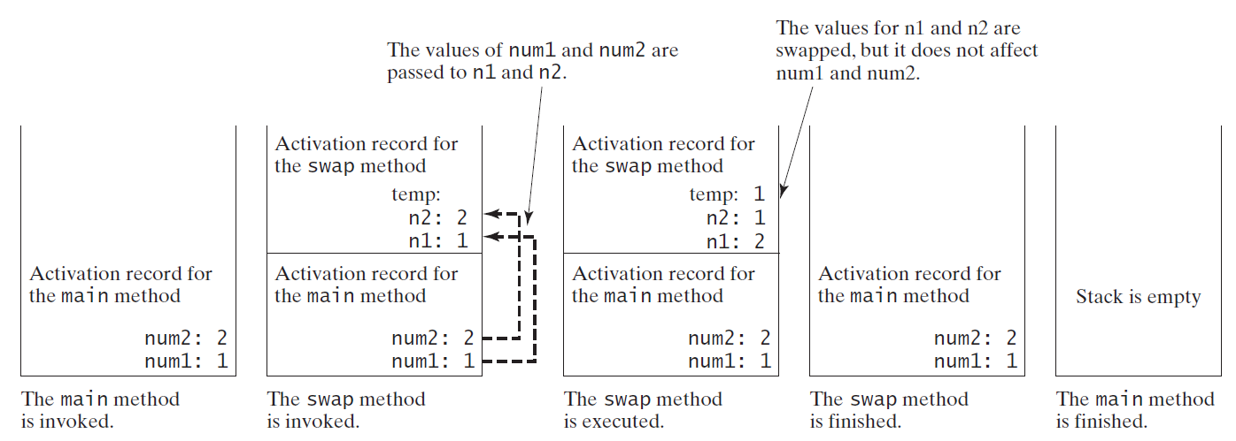
Pass by Value, cont.

Slide 19
Modularizing Code
Methods can be used to reduce redundant coding and enable code reuse. Methods can also be used to modularize code and improve the quality of the program.
public static int gcd(int n1, int n2) {
int gcd = 1; // Initial gcd is 1
int k = 1; // Possible gcd
while (k <= n1 && k <= n2) {
if (n1 % k == 0 && n2 % k == 0)
gcd = k; // Update gcd k++;
}
return gcd; // Return gcd
}
public static boolean isPrime(int number) {
for (int divisor = 2; divisor <= number / 2; divisor++) { if (number % divisor == 0) {
return false;
}
}
return true; // number is prime
}

Slide 20
Overloading Methods
public static int max(int num1, int num2) {
if (num1 > num2)
return num1;
else
return num2;
}
public static double max(double num1, double num2) {
if (num1 > num2)
return num1;
else
return num2;
}
public static double max(double num1, double num2, double num3) {
return max(max(num1, num2), num3);
}
TestMethodOverloading

Slide 21
Ambiguous Invocation: Error
public class AmbiguousOverloading {
public static void main(String[] args) {
System.out.println(max(1, 2));
}
public static double max(int num1, double num2) {
if (num1 > num2)
return num1;
else
return num2;
}
public static double max(double num1, int num2) {
if (num1 > num2)
return num1;
else
return num2;
}
}

Slide 22
Scope of Local Variables
A local variable: a variable defined inside a method.
Scope: the part of the program where the variable can be referenced.
The scope of a local variable starts from its declaration and continues to the end of the block that contains the variable. A local variable must be declared before it can be used.
You can declare a local variable with the same name multiple times in different non-nesting blocks in a method, but you cannot declare a local variable twice in nested blocks.

Slide 23
Scope of Local Variables, cont.

Slide 24
Scope of Local Variables, cont.
// Fine with no errors
public static void correctMethod() {
int x = 1;
int y = 1;
// i is declared
for (int i = 1; i < 10; i++) {
x += i;
}
// i is declared again
for (int i = 1; i < 10; i++) {
y += i;
}
}

Slide 25
Scope of Local Variables, cont.
// With errors
public static void incorrectMethod() {
int x = 1;
int y = 1;
for (int i = 1; i < 10; i++) {
int x = 0;
x += i;
}
}

Slide 26
Method Abstraction
You can think of the method body as a black box that contains the detailed implementation for the method.

Slide 27
Case Study: Generating Random Characters, cont.
To generalize the foregoing discussion, a random character between any two characters ch1 and ch2 with ch1 < ch2 can be generated as follows:
(char)(ch1 + Math.random() * (ch2 – ch1 + 1))

Slide 28
The RandomCharacter Class
// RandomCharacter.java: Generate random characters
public class RandomCharacter {
/** Generate a random character between ch1 and ch2 */
public static char getRandomCharacter(char ch1, char ch2) {
return (char)(ch1 + Math.random() * (ch2 - ch1 + 1));
}
/** Generate a random lowercase letter */
public static char getRandomLowerCaseLetter() {
return getRandomCharacter('a', 'z');
}
/** Generate a random uppercase letter */
public static char getRandomUpperCaseLetter() {
return getRandomCharacter('A', 'Z');
}
/** Generate a random digit character */
public static char getRandomDigitCharacter() {
return getRandomCharacter('0', '9');
}
/** Generate a random character */
public static char getRandomCharacter() {
return getRandomCharacter('\u0000', '\uFFFF');
}
}
RandomCharacter
TestRandomCharacter
Run

Slide 29
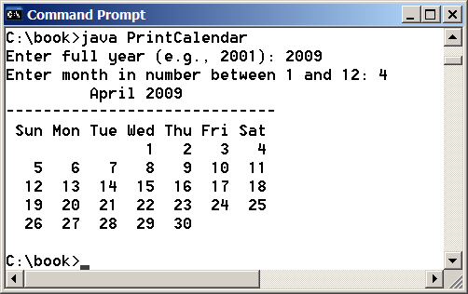
PrintCalender Case Study
Let us use the PrintCalendar example to demonstrate the stepwise refinement approach.
PrintCalendar
Run

Slide 30
Design Diagram

Slide 31
public static boolean isLeapYear(int year) {
return year % 400 == 0 || (year % 4 == 0 && year % 100 != 0);
}
public static int getNumberOfDaysInMonth(int year, int month) {
if (month == 1 || month == 3 || month == 5 || month == 7 ||
month == 8 || month == 10 || month == 12)
return 31;
if (month == 4 || month == 6 || month == 9 || month == 11)
return 30;
if (month == 2)
return isLeapYear(year) ? 29 : 28; return 0;
}

Slide 32
public static int getTotalNumberOfDays(int year, int month) {
int total = 0; // Get the total days from 1800 to 1/1/year
for (int i = 1800; i < year; i++)
if (isLeapYear(i))
total = total + 366;
else total = total + 365;
// Add days from Jan to the month prior to the calendar month for (int i = 1; i < month; i++)
total = total + getNumberOfDaysInMonth(year, i);
return total;
}

Slide 33
public static int getStartDay(int year, int month) {
final int START_DAY_FOR_JAN_1_1800 = 3;
// Get total number of days from 1/1/1800 to month/1/year
int totalNumberOfDays = getTotalNumberOfDays(year, month);
// Return the start day for month/1/year
return (totalNumberOfDays + START_DAY_FOR_JAN_1_1800) % 7;
}

Slide 34
/** Print month body */
public static void printMonthBody(int year, int month) {
// Get start day of the week for the first date in the month
int startDay = getStartDay(year, month);
// Get number of days in the month
int numberOfDaysInMonth = getNumberOfDaysInMonth(year, month);
// Pad space before the first day of the month
int i = 0;
for (i = 0; i < startDay; i++)
System.out.print(" ");
for (i = 1; i <= numberOfDaysInMonth; i++) {
System.out.printf("%4d", i);
if ((i + startDay) % 7 == 0) System.out.println();
}
System.out.println();
}

Slide 35
public static String getMonthName(int month) {
String monthName = "";
switch (month) {
case 1: monthName = "January"; break;
case 2: monthName = "February"; break;
case 3: monthName = "March"; break;
case 4: monthName = "April"; break;
case 5: monthName = "May"; break;
case 6: monthName = "June"; break;
case 7: monthName = "July"; break;
case 8: monthName = "August"; break;
case 9: monthName = "September"; break;
case 10: monthName = "October"; break;
case 11: monthName = "November"; break;
case 12: monthName = "December"; }
return monthName;
}

Slide 36
public static void printMonth(int year, int month) {
// Print the headings of the calendar
printMonthTitle(year, month);
// Print the body of the calendar
printMonthBody(year, month);
}
/** Print the month title, e.g., May, 1999 */
public static void printMonthTitle(int year, int month) {
System.out.println(" " + getMonthName(month) + " " + year);
System.out.println("-----------------------------");
System.out.println(" Sun Mon Tue Wed Thu Fri Sat");
}

