Slide 1
Food insecurity and the food assistance program

Slide 2
Food security Access by all people at all times to sufficient food for an active and healthy life.
Food security includes at a minimum
the ready availability of nutritionally adequate and safe foods and the ability to acquire them in socially acceptable ways (without resorting to emergency food sources, scavenging, stealing, or other coping strategies to meet basic food needs).

Slide 3
Food insecurity Limited or uncertain ability to acquire or consume an adequate quality or sufficient quantity of food in socially acceptable ways
(for example, not knowing where one’s next meal is coming from constitutes food insecurity).

Slide 4
The concept of food security includes five components
Quantity: Is there access to a sufficient quantity of food?
Quality: Is food nutritionally adequate?
Suitability: acceptable, appropriate for circumstances
Psychological: Do the type and quantity of food alleviate anxiety, lack of choice, and feelings of deprivation?
Social: Are the methods of acquiring food socially acceptable?

Slide 5
Causes of Hunger?
Poverty
High housing costs
Unemployment
Medical costs
Mental health issues
Health problems, chronic disease, alcoholism, or substance abuse
Poor management of limited family resources may contribute to food insecurity. A lack of education and employment skills can make it difficult for individuals to exit poverty.
Families and individuals rely on emergency food assistance facilities both in emergencies and as a steady source of food over long periods of time. However, insufficient community food resources are available to the hungry.
Reluctance of some people, including older adults, to accept what they perceive as “welfare” or “charity”
Transportation costs

Slide 6
2013 trends
“Food insecurity affects 57 percent of households in the Gaza Strip, and 19 percent in the West Bank”
“1.6 million food-insecure Palestinians”
2017
“An estimated 1.6 million Palestinians across the occupied Palestinian and 31.5 % of households, are food insecure”
Food assistance for the Food-Insecure population in the West bank and Gaza Strip. (n.d.). Retrieved March 29, 2021, from https://www.wfp.org/operations/200709-food-assistance-food-insecure-population-west-bank-and-gaza-strip
Food security. (n.d.). Retrieved March 29, 2021, from https://www.ochaopt.org/theme/food-security
Notes:
Restrictions imposed on trade and access to resources in the West Bank and in the Gaza Strip – where the blockade is now entering its eighth year – continue to prevent sustainable recovery and growth of the Palestinian economy.

Slide 7
Determinants and components of food insecurity ?
Outcomes and consequences of food insecurity ?
Notes:
high unemployment, low household incomes and a high cost of living
repeated shocks and continued restrictions on freedom of movement, constrained productive capacities and a lack of economic opportunities. Although food is available, it is priced out of reach for many.

Slide 8
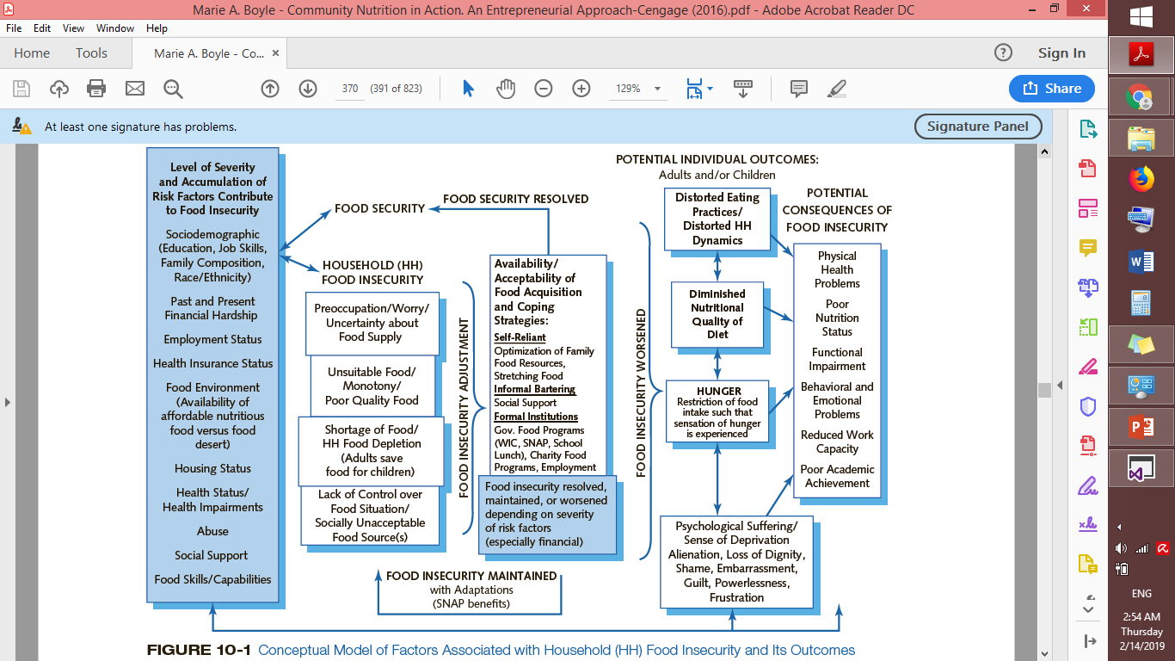
determinants and components of food insecurity

Slide 9
Poverty
Poverty The state of having too little money to meet minimum needs for food, clothing, and shelter. As of 2012, the U.S. Department of Health and Human Services defined a poverty-level income as $23,050 annually for a family of four

Slide 10
Poverty
In Palestine
“Overall poverty incidence in 2016/2017 was 24%.
“There a large difference between the West Bank (11%) and Gaza Strip (45%) in terms of incidence of multidimensional poverty. Poverty in the Gaza Strip is four times as prevalent than in the West Bank.”
“The results show that poverty is more severe in refugee camps than urban and rural places. Incidence of poverty is 39% in refugee camps as compared to 14% in rural areas and 24% in urban places”
PCBS: Multi-Dimensional Poverty Profile in Palestine, 2017

Slide 11
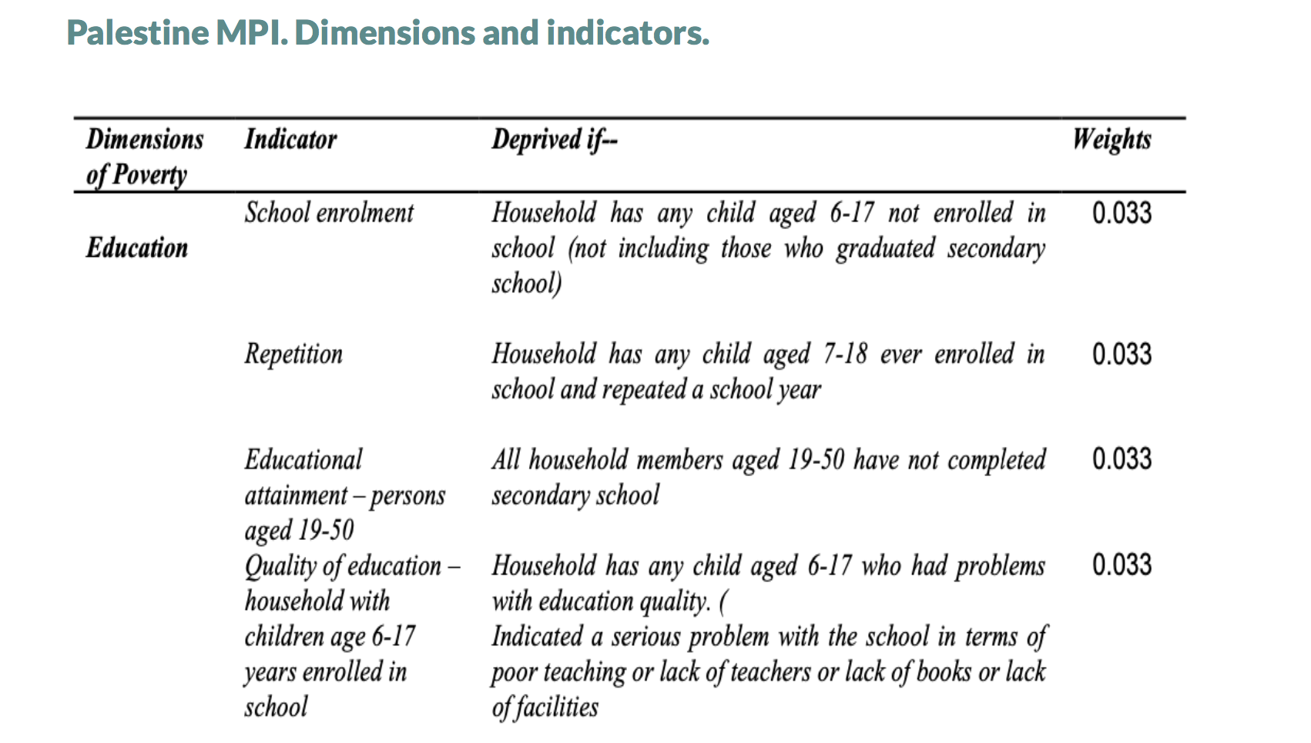
PCBS: Multi-Dimensional Poverty Profile in Palestine, 2017

Slide 12
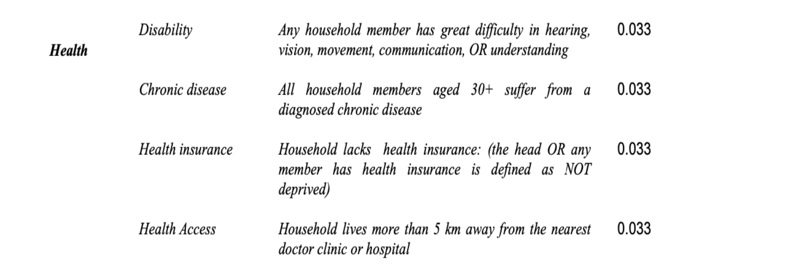
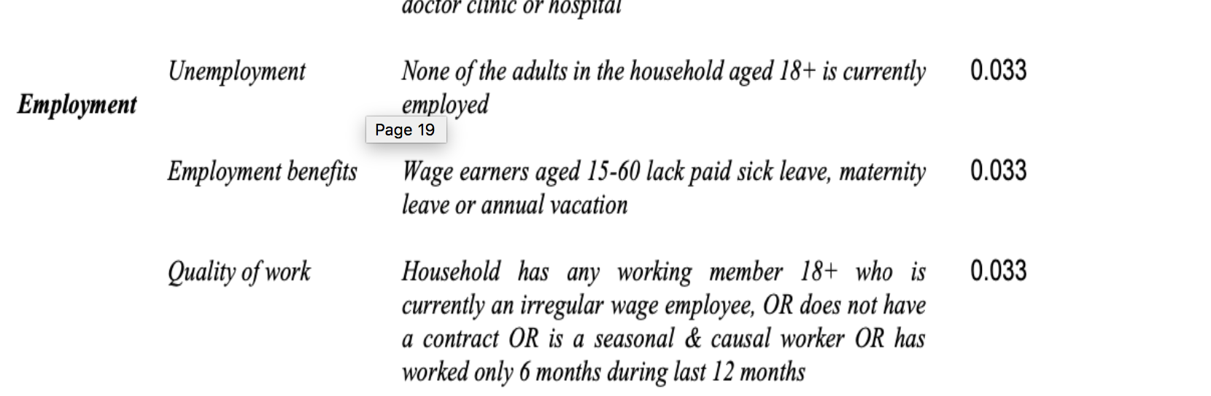
PCBS: Multi-Dimensional Poverty Profile in Palestine, 2017

Slide 13
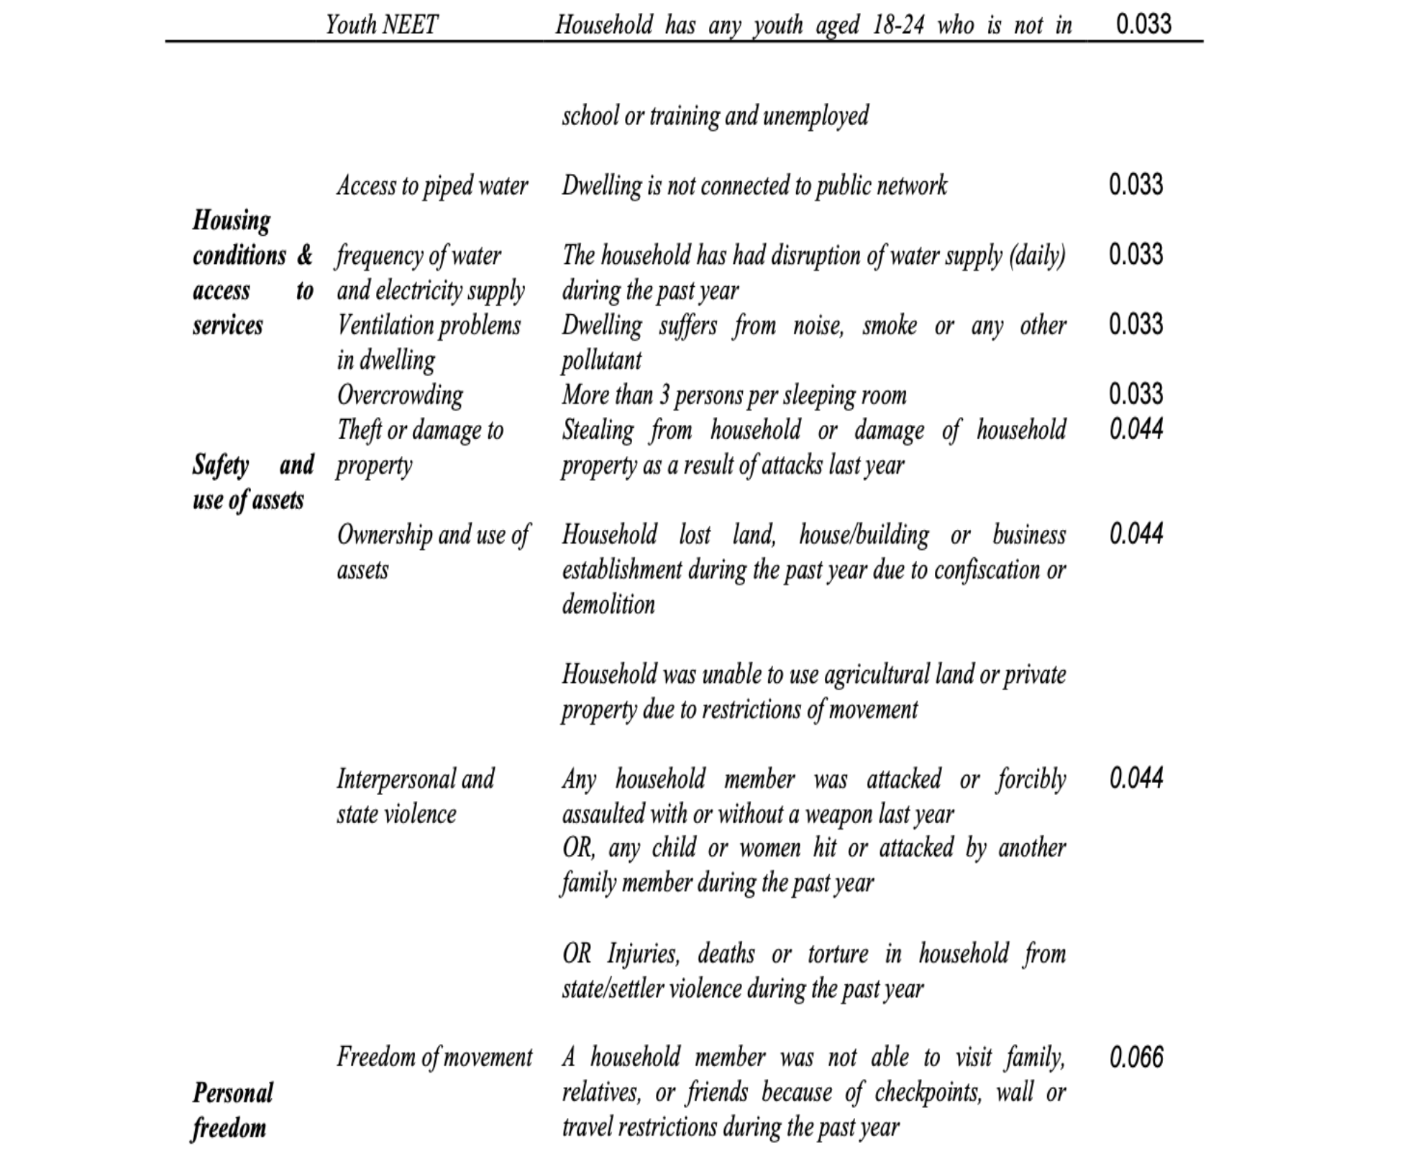
PCBS: Multi-Dimensional Poverty Profile in Palestine, 2017

Slide 14
“In 2017, the poverty line and deep poverty line for a reference household of five individuals (2 adults and 3 children) were, respectively, NIS (New Israeli Shekels) 2,470 and NIS 1,974.”
“Deep poverty line,” reflects a budget for food, clothing and housing
The poverty line line adds other necessities including health care, education, transportation, personal care, and housekeeping supplies
Palestinian Central Bureau of Statistics Poverty Profile in Palestine, 2017

Slide 15
Assessment
Can be interviews
Four components
Diet quality
Amount of food
Lack of choice
Disrupted food patterns

Slide 16
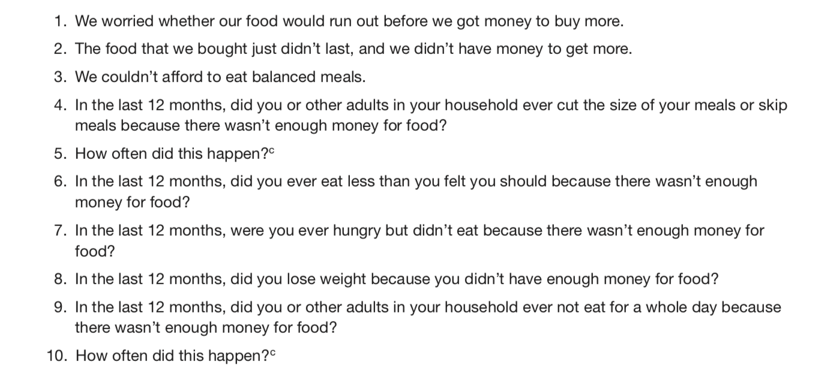
Measuring Food Security: Questions from the Food Security Survey Module

Slide 17
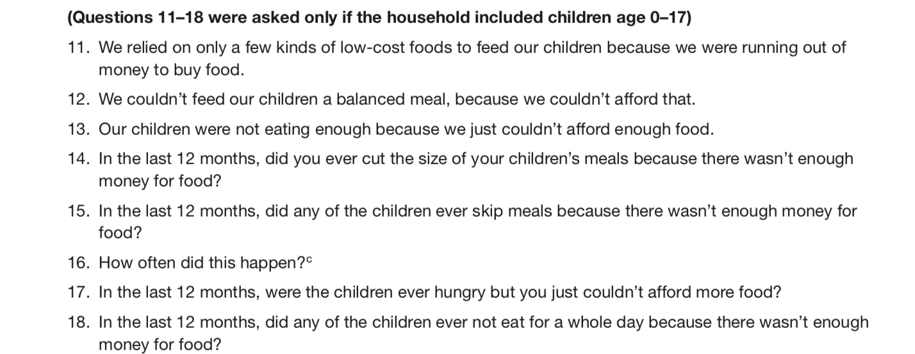
The score for a household with children
a “yes” response to 0 items is considered high food security
a “yes” response to any 1 to 2 items is marginal food security
3 to 7 items, low food security
8 to 18 items, very low food security

Slide 18
Questions address:
Fear and anxiety related to the insufficiency of the food budget to meet basic needs
Experiencing food shortages without having the money to purchase more
Perceived quality and quantity of food eaten by household members
Atypical food usage (substituting fewer or cheaper foods)
Episodes of reduced food intake, hunger, or weight loss by household members
These questions reflect the different stages that households go through as food insecurity worsens—from worrying about running out of food to children missing meals for a whole day.
The food security status of each household lies somewhere along a continuum
high food security to very low food security
Placement on this continuum is determined by the household’s responses to a series of questions about behaviors and experiences associated with difficulty in meeting food needs

Slide 19
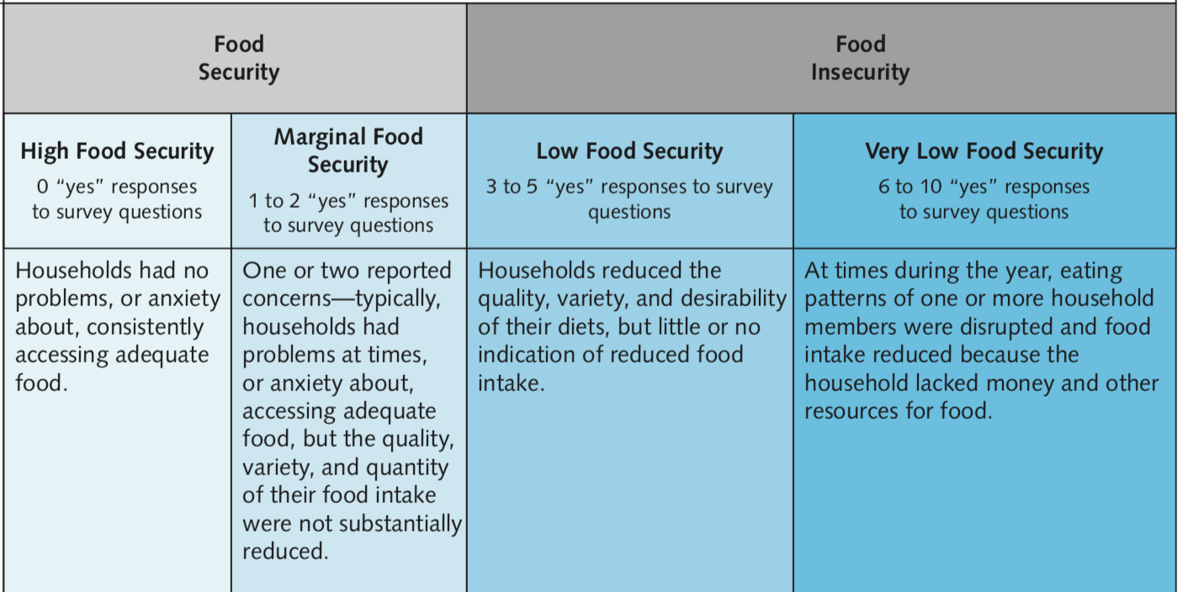

Slide 20
Sample of a continuum
Mild: We were worried whether our food would run out before we got money to buy more: often true, sometimes true, or never true
Moderate: Were you ever hungry but didn’t eat because you couldn’t afford enough food?: yes, no
Severe: Did your child ever skip meals because there wasn’t enough money for food?: yes, no

Slide 21
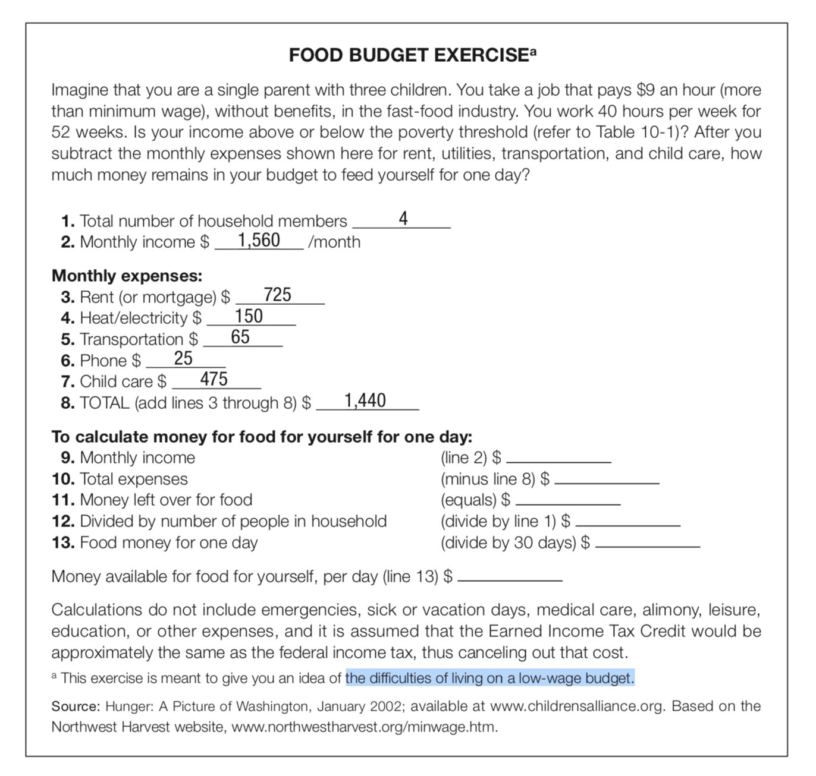

Slide 22
Food insecurity in the U.S. is associated with:
Food insecurity in the U.S. is associated with:
Lower nutrient intakes/dietary quality—especially in adult women
Psychosocial problems in children and youth
Disordered eating patterns in women
Self-reported “poor or fair” health
Poor mental health/ depressive symptoms
Obesity in adults
At-risk of overweight in children

Slide 23
poverty and food insecurity perfectly correlated?
Poverty/income measures do not account for price differences in housing, food, and health care
Recent economic changes (loss of job, divorce, unexpected expenses) affect household food insecurity
Food assistance buffer the effects of low income but not all the needy are reached
Access to family, friends’ resources may buffer the effects of poverty (at least short term)

Slide 24
Double burden of malnutrition
The double burden of malnutrition
The coexistence of undernutrition along with overweight and obesity, or diet-related noncommunicable diseases, within individuals, households and populations, and across the lifecourse.
Individual level :
obesity with deficiency of one or various vitamins and minerals, or overweight in an adult who was stunted during childhood
Household level – For example: mother may be overweight or anaemic and a child or grandparent is underweight
Population level
prevalence of both undernutrition and overweight in the same community, nation or region.
www.who.int

Slide 25
The food insecurity- obesity link
The need to maximize caloric intake
Without adequate resources for food, families must make decisions to stretch their food money as far as possible and maximize the number of calories they can buy so that their members do not suffer from frequent hunger.
Low-income families therefore may consume lower-cost foods with relatively higher levels of calories per dollar to stave off hunger when they lack the money to purchase a more healthful balance of more nutritious foods.

Slide 26
The trade-off between food quantity and quality
Research on coping strategies among food-insecure households shows that, along the continuum of typical coping strategies, food quality is generally affected before the quantity of intake.
As a result, although families may get enough food to avoid feeling hungry, they also may be poorly nourished because they cannot afford a consistently adequate diet that promotes health and averts obesity. In the short term, the stomach registers that it is full, not whether a meal was nutritious.

Slide 27
Overeating when food is available.
In addition, obesity can be an adaptive response to periods when people are unable to get enough to eat.
Research indicates that chronic ups and downs in food availability can cause people to eat more when food is available than they normally would.
Over time, this cycle can result in weight gain.
Research among food-insecure families also shows that low-income mothers first sacrifice their own nutrition by restricting their food intake during periods of food insufficiency in order to protect their children from hunger. This practice may result in eating more than is desirable when food is available, thereby contributing to obesity among poor women

Slide 28
Food insecure eat cheaper energy-dense foods
Periods without enough food cause overeating when food is available
Fluctuations in eating habits result in greater efficiency in use of energy
Food insecurity lowers dietary quality ( more sat fat, energy /sugar dense snacks/ less fruits and vegetables)
How can it affect children?
Adults?
Increased stress, chronic inflammation, blood pressure, decreased memory functioning ?

Slide 29
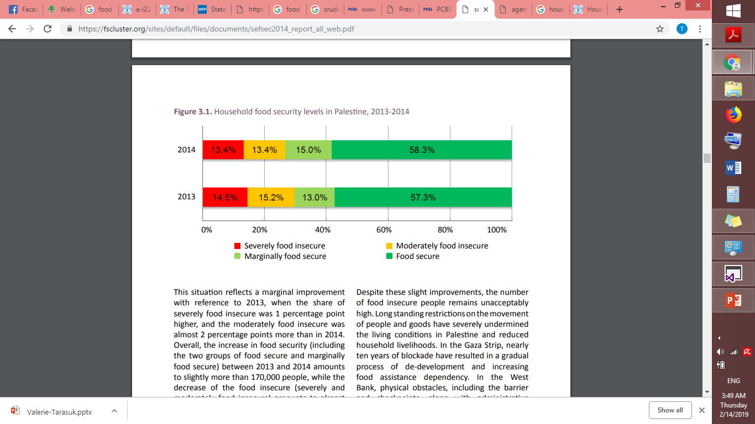
Results From the Socio-Economic & Food Security Survey 2014 - Palestine
fscluster.org

Slide 30
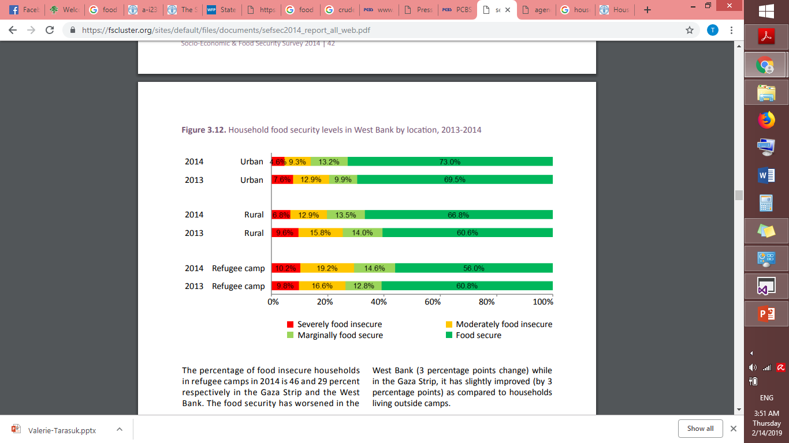
fscluster.org

Slide 31
Food assistance programs
Examples
SNAP: Direct payments in the form of electronic benefits transfer (EBT) redeemable at most retail food stores.
SNAP Nutrition Education : Increase the likelihood that those eligible for SNAP benefits will make healthful choices on a limited budget and choose active lifestyles consistent with the Dietary Guidelines for Americans.
Commodity Supplemental Food Program: Provides food and administrative funds to states.
The Emergency Food Assistance Program : Provides commodity foods to state distributing agencies, which are typically food banks, that then distribute foods to the public through soup kitchens and food pantries.
Commodity Foods :Support American agricultural producers by providing cash reimbursements for meals served in schools

Slide 32
Food bank A nonprofit community organization that collects surplus commodities from the government and edible but often unmarketable foods from private industry for use by nonprofit charities, institutions, and feeding programs at nominal cost.
Soup kitchen A small feeding operation attached to an existing organization, such as a church, civic group, or nonprofit agency, that serves prepared meals that are consumed on-site. Soup kitchens generally do not require clients to prove need or show identification.

Slide 33
National School Lunch Program : Assist states in providing nutritious free or reduced-price lunches to eligible children.
School Breakfast Program
Summer Food Service Program : Ensure that children in lower- income areas continue to receive nutritious meals during long school vacations, when they do not have access to school lunch or breakfast. All meals are served free to eligible children.
Older Americans Act (OAA)Nutrition Program : home-delivered meals
and other nutrition services. Nutrition screening, assessment, education, and counseling to identify older adults’ general and special nutritional needs; provided in a variety of settings, such as senior centers, schools, and individual homes

