Slide 1
Pentose Phosphate Pathway And Lipids
Book: Chapter 3 and 5
Pentose phosphate pathway The production of five-carbon monosaccharides (pentoses) and nicotinamide adenine dinucleotide phosphate (NADPH)

Slide 2
Glucose 6-phosphate → glycolysis
Has other catabolic fates→ oxidation to pentose phosphates in the pentose phosphate pathway
Through the pentose phosphate pathway , glucose in the cytosol generates important intermediates not produced in other pathways
  Pentose phosphatases
  NADPH Generation

Slide 3
Rapidly dividing cells, such as those of bone marrow, skin, and intestinal mucosa, use the pentoses to make
  RNA, DNA
  coenzymes as ATP, NADH, FADH2, and coenzyme A.
Other cells will utilize NADPH, needed for reductive biosynthesis
NADPH also used to combat the damaging effects of oxygen radicals ( Erythrocytes and cornea cells)- directly exposed to oxygen
Tissues that carry out extensive fatty acid synthesis (liver, adipose, lactating mammary gland) or very active synthesis of cholesterol and steroid hormones (liver, adrenal gland, gonads) require the NADPH provided by the pathway
These tissues engage the entire pentose phosphate pathway, recycling pentose phosphates back to glucose-6-phosphate to repeat the cycle and ensure a supply of NADPH

Slide 4
The pathway reactions that include the dehydrogenase reactions and therefore the formation of NADPH from NADP+ are called the oxidative reactions of the pathway.
The pentose phosphate pathway also synthesizes three-, four-, five-, six-, and seven-carbon sugars.

Slide 5
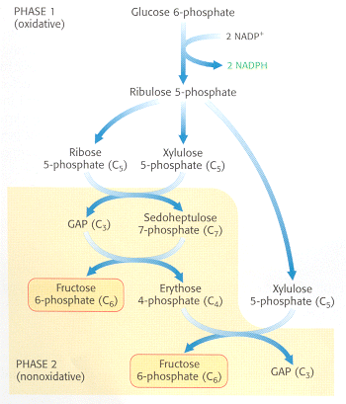
This pathway begins by oxidizing glucose-6-phosphate in two consecutive reactions catalyzed by glucose-6- phosphate dehydrogenase and 6-phosphogluconate dehydrogenase. Both reactions require NADP+ as cosubstrate

Slide 6
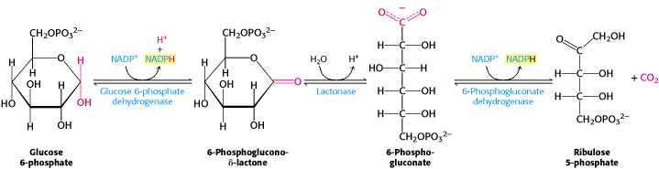
The Rate of the Pentose Phosphate Pathway Is Controlled by the Level of NADP+ It is strongly inhibited by NADPH and fatty acid CoAs.

Slide 7
The pathway’s activity is low in skeletal muscle because of the limited demand for NADPH (fatty acid synthesis) in this tissue and also because of muscle’s reliance on glucose and fatty acids for energy metabolism.

Slide 8
LIPIDS
Chapter 5

Slide 9
The property that sets lipids apart from other major nutrients is their solubility in organic solvents such as ether, chloroform, and acetone
Many diverse molecules fit the criteria and are thus considered lipids
The lipids discussed- limited to those most relevant to human nutrition
  Fatty acids
  Triacylglycerols, diacylglycerols, and monoacylglycerols
  Phospholipids
  Sphingolipids
  Sterols (cholesterol, bile acids, and phytosterols).

Slide 10
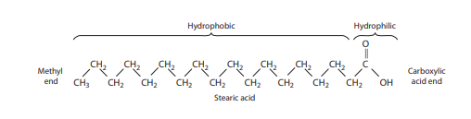
Fatty acids are composed of a hydrocarbon chain with a methyl group at one end and a carboxylic acid group at the other
Polar, hydrophilic end and a nonpolar, hydrophobic end that is insoluble in water
lengths of the hydrocarbon chains: 4-24 Carbons
most common fatty acids in nature are 18 carbons.
They are of vital importance as an energy
Saturated (SFA)
◦ Monounsaturated (MUFA)
◦ Polyunsaturated (PUFA). Notre: may contain as many as 6 double bonds.

Slide 11
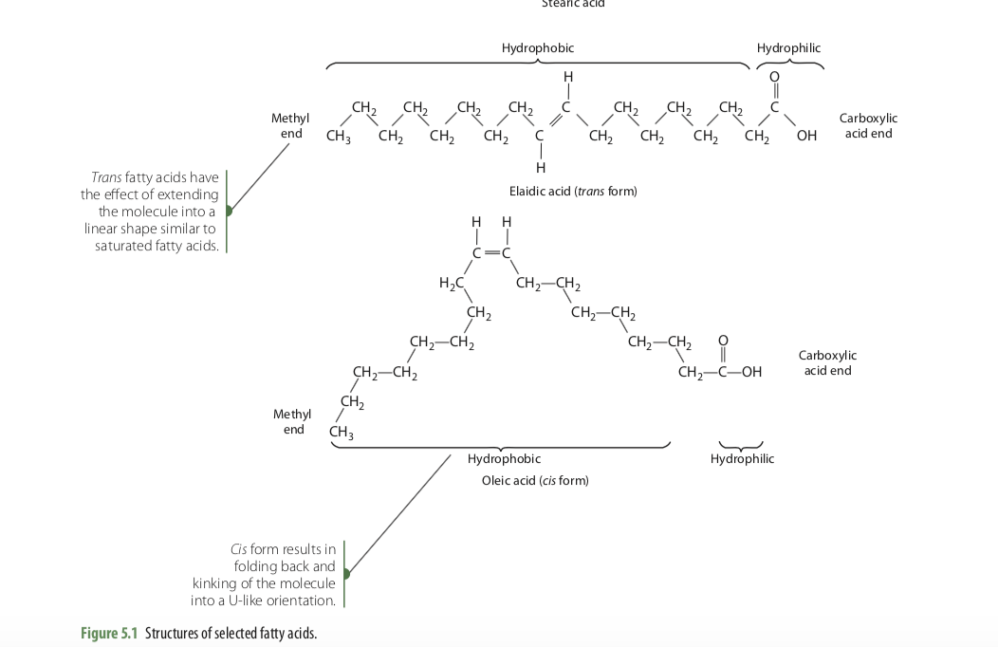
The cis isomer →bending of the molecule into a U-like orientation
Trans → linear shape
Naturally occurring unsaturated fatty acids are of the cis configuration

Slide 12
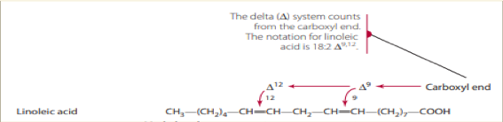
Fatty Acid Nomenclature
The delta (Δ) system of notation has been established to denote the chain length of the fatty acids and the number and position of any double bonds that may be present.
For example, the notation 18:2 Δ9,12 describes linoleic acid.
18: number of carbon atoms
2: total number of double bonds present
9,12: designate the carbon atoms at which the double bonds begin, counting from the carboxyl end of the fatty acid.

Slide 13
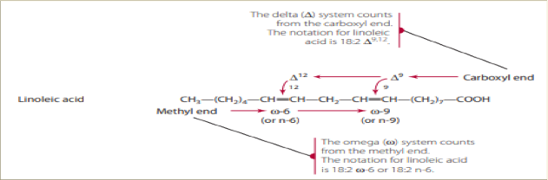
A second commonly used system of notation locates the position of double bonds on carbon atoms counted from the methyl, or omega (ω), end of the hydrocarbon chain.
Linoleic acid: would 18:2 ω-6. Substitution of the omega symbol with the letter n has been

Slide 14
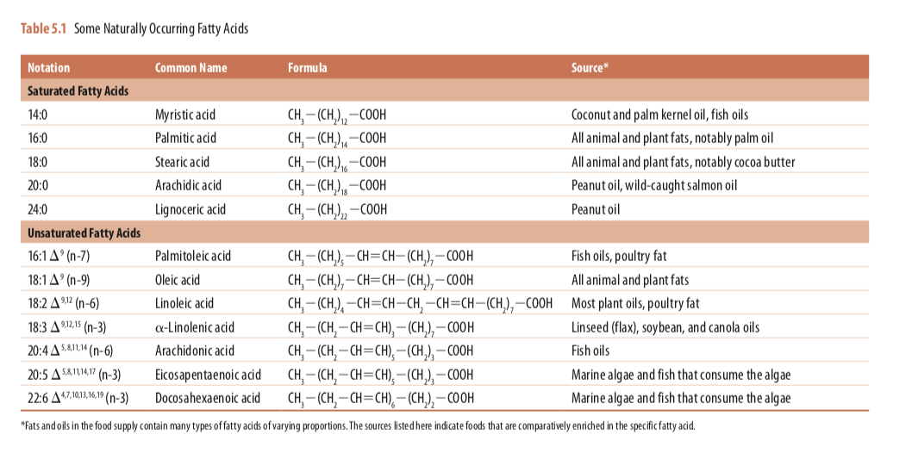

Slide 15
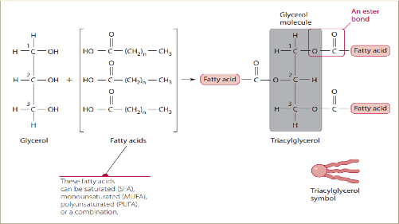
Triacylglycerols (Triglycerides)
Most adipose tissue is composed of triacylglycerols, which represent a highly concentrated form of stored energy
Accounts for nearly 95% of dietary fat
Acylglycerols
Diacylglycerol

Slide 16
Two unsaturated fatty acids cannot be synthesized in the body and must be acquired in the diet
The two essential fatty acids are
linoleic acid (18:2 n-6 or 18:2D9,12) ]
alpha-linolenic acid (18:3 n-3 or 18:3D9,12,15)
It is estimated that our human ancestors consumed foods that provided equal amounts of n-6 and n-3 fatty acids. Today, the intake of n-3 fatty acids is quite low and over- whelmed by n-6 fatty acids in the diet, with linoleic acid providing 80–90% of all PUFA
wide- spread use of plant oils, such as soybean oil, in the production of manufactured food products and in foodservice frying oils, coupled with the relatively low intake of fish and other n-3 fatty acid sources in Western diets

Slide 17
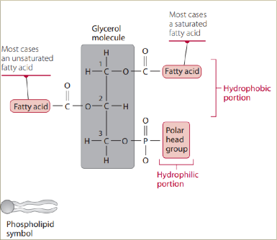
Phospholipids
phosphate- containing lipids that form the structural basis of all cell membranes
Glycerol forms the structural backbone of phospholipids. Fatty acids are esterified to the hydroxyl groups at the sn-1 and sn-2 positions of glycerol; a phosphate group is esterified at the sn-3 position and, in turn, a polar “head group” is esterified to the phosphate.

Slide 18
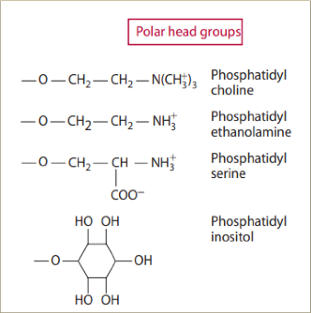
Phospholipids are named according to the specific head group.
Common head group molecules are choline, ethanolamine, serine, and inositol, each possessing an alcohol group through which esterification to the phosphate takes place
Phosphatidylcholine: The most common in mammal tissue. Followed by Phosphatidylethanolamine.

Slide 19
Amphipathic nature: phospholipids form the foundational structure of lipid bilayers that comprise cell membranes that serve as a selective barrier for the passage of water-soluble and fat-soluble materials across the membrane
Phospholipids also form a monolayer on the surface of bloodborne lipoprotein particles, thereby stabilizing the particles in the aqueous medium.
Phospholipids are physiologically active compounds
phosphatidylinositol plays a significant role in cell signaling

Slide 20
Phosphatidylinositol in the plasma membrane can be doubly phosphorylated by ATP → phosphatidylinositol-4,5-bisphosphate (PIP2)
Phosphorylated forms of phosphatidylinositol (PI) are called phosphoinositides and play important roles in lipid signaling, cell signaling
The reversible phosphorylation and dephosphorylation reactions are catalyzed by phosphoinositide kinases and phosphatases in response to extracellular stimuli
Phosphoinositides exert their physiological role by attracting regulatory proteins to the membrane
  endocytosis, membrane fusion, and ion channels.
Example: PIP3 and its role in insulin signaling pathways
The binding of insulin to its receptor triggers phosphatidylinositol-3-kinase to synthesize PIP3 (by phosphorylating PIP2), which then recruits other protein kinases to the cell membrane that regulate enzymes involved in CHO, protein and lipid metabolism

Slide 21
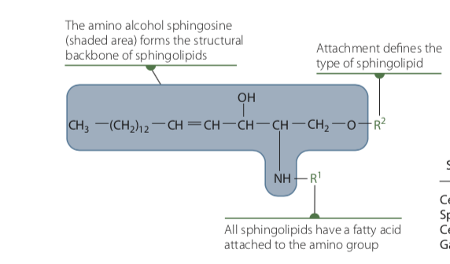
Sphingolipids
found in the plasma membrane of all cells, although their concentration is highest in cells of the central nervous system
Sphingolipids are built on the amino alcohol sphingosine (not glycerol) as the structural backbone

Slide 22
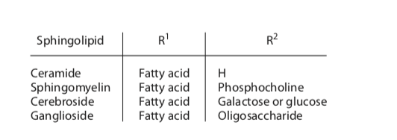
Sphingomyelin: formed when phosphocholine is added to ceramide. Abundant in the myelin sheath of nerve tissues
Cerebrosides: A single sugar molecule, either galactose (myelin sheath) or glucose (spleen and RBCs), attaches to the terminal hydroxyl group of ceramide.
Gangliosides: have multiple sugar units. Located on the outer surface of membranes mainly in nerve tissue

Slide 23
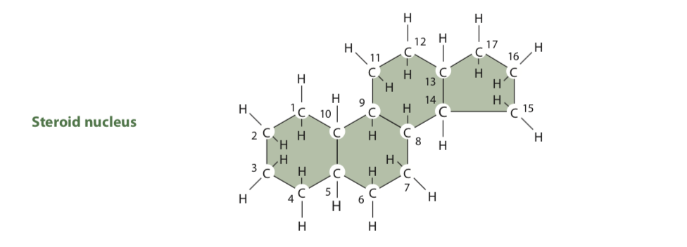
Sterols
Characterized by having a four-ring steroid nucleus and at least one hydroxyl group, hence the name sterol (steroid alcohol).
Three categories of sterols important to human nutrition
Cholesterol
Bile acids and salts
Phytosterols

Slide 24
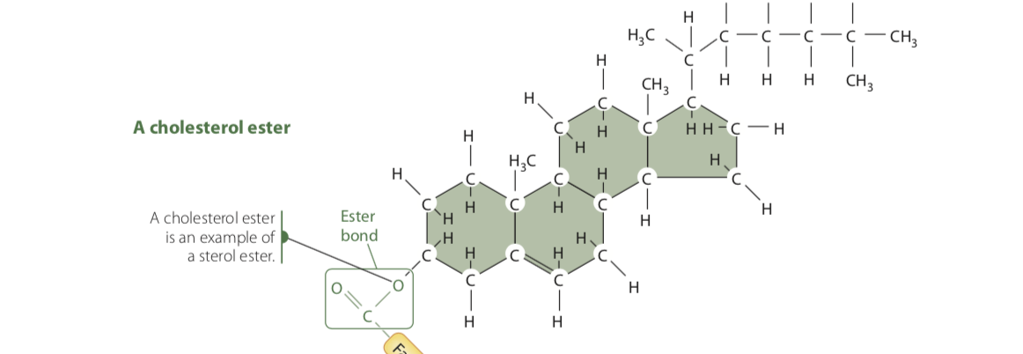
Cholesterol
Most common sterol in humans
Free form or the hydroxyl group at C-3 can be esterified with a fatty acid
Amphipathic nature→ Important for membrane structure
Cholesterol is an important constituent of plasma membranes. (nearly 25% of the lipids in plasma membranes of some nerve cells, but may be absent in intracellular membranes)

Slide 25
Cells can regulate the amount of cholesterol in membranes by esterifying “excess” cholesterol with a fatty acid and storing the cholesterol esters in vesicles within the cytosol.
When unesterified (free) cholesterol is needed, the cholesterol esters are hydrolyzed and free cholesterol is transported back to the membrane.
Cholesterol serves as the precursor for many important steroids in the body, including the bile acids; steroid sex hormones such as estrogens, androgens, and progesterone; the adrenocortical hormones; and vitamin D

Slide 26
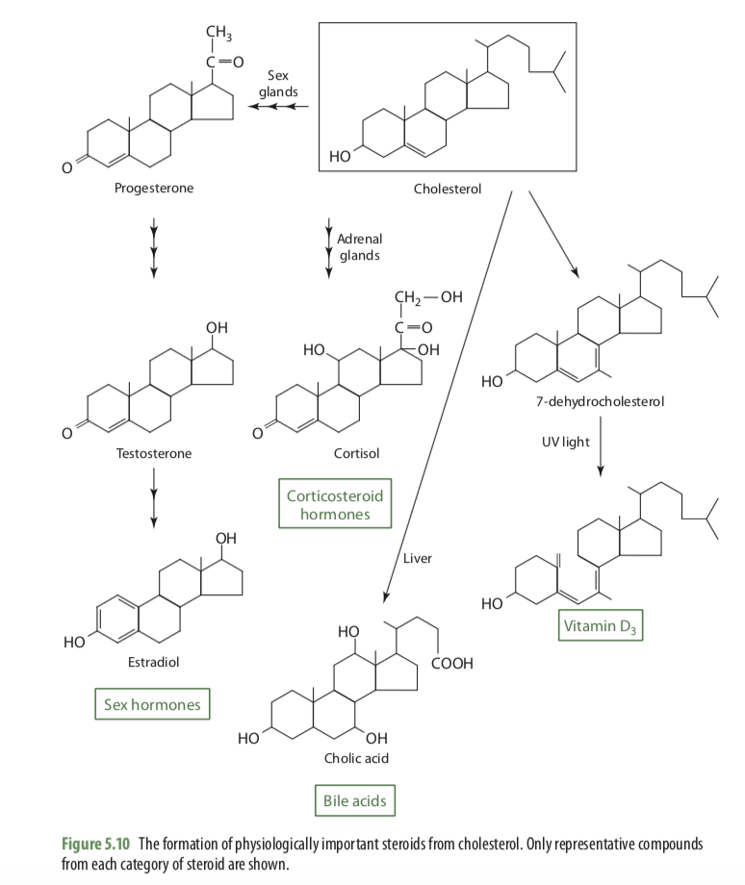
The major derivatives of cholesterol

Slide 27
These steroids differ structurally from one another in the arrangement of double bonds in the ring system, the presence of carbonyl or hydroxyl groups, and the nature of the side chain at C-17. All of these structural modifications are mediated by enzymes that function as dehydrogenases, isomerases, hydroxylases, or desmolases. Desmolases remove or shorten the length of side chains on the steroid nucleus.

Slide 28
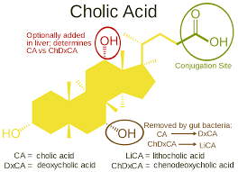
Bile Acids and Bile Salts
Bile act as detergents in the small intestine to emulsify dietary lipids for digestion and absorption
The liver synthesizes two bile acids
Get conjugated with either glycine or taurine, resulting in four different primary bile salts (bile acids are conjugated with the amino acids taurine or glycine for micelle formation which is necessary for the absorption of lipids)
Enter the small intestine via bile secretion

Slide 29
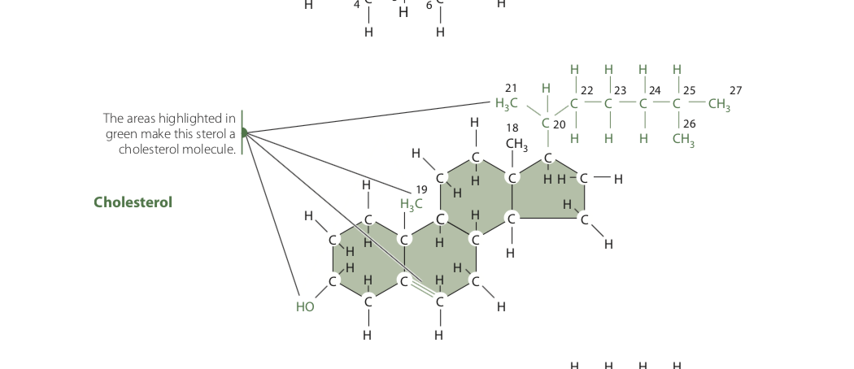
Phytosterols
Plant cell membranes contain structural sterols similar to cholesterol in animal cells. (structurally similar to cholesterol, with only slight differences in the side chain)
According to their structure, they can be divided into sterols and Stanols→ Stanols , a saturated subgroup of sterols (the double bond between carbons 5 and 6 is eliminated by saturating the molecule with hydrogen atoms)

Slide 30
Phytosterols are found throughout the food supply. Plant oils, legumes, nuts, and seeds have relatively high concentrations of phytosterols
Fruits and vegetables→ Low concentration
cereal grains have only modest concentrations
Intake of total phytosterols from natural food sources is about 200–300 mg/day
The manufacture of foods and supplements enriched with phytosterols has increased in recent years because of their cholesterol-lowering properties.
Phytosterol intake of 2 g/day results in blood cholesterol reductions of 10% or more
Displace cholesterol from micelles that form during digestion, reducing the amount of cholesterol available for intestinal absorption

Slide 31
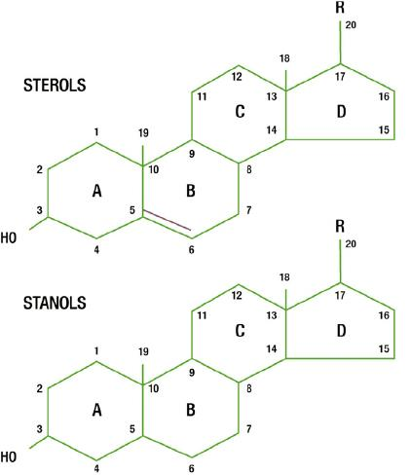

Slide 32
Digestion
Dietary lipids are hydrophobic → problem for digestive enzymes.
Proteins, digestive enzymes are hydrophilic and normally function in an aqueous environment.
The dietary lipid targeted for digestion is emulsified by an efficient process, mediated mainly by bile salts. This emulsification greatly increases the surface area of the dietary lipid, consequently increasing the accessibility of the fat to digestive enzymes.

Slide 33
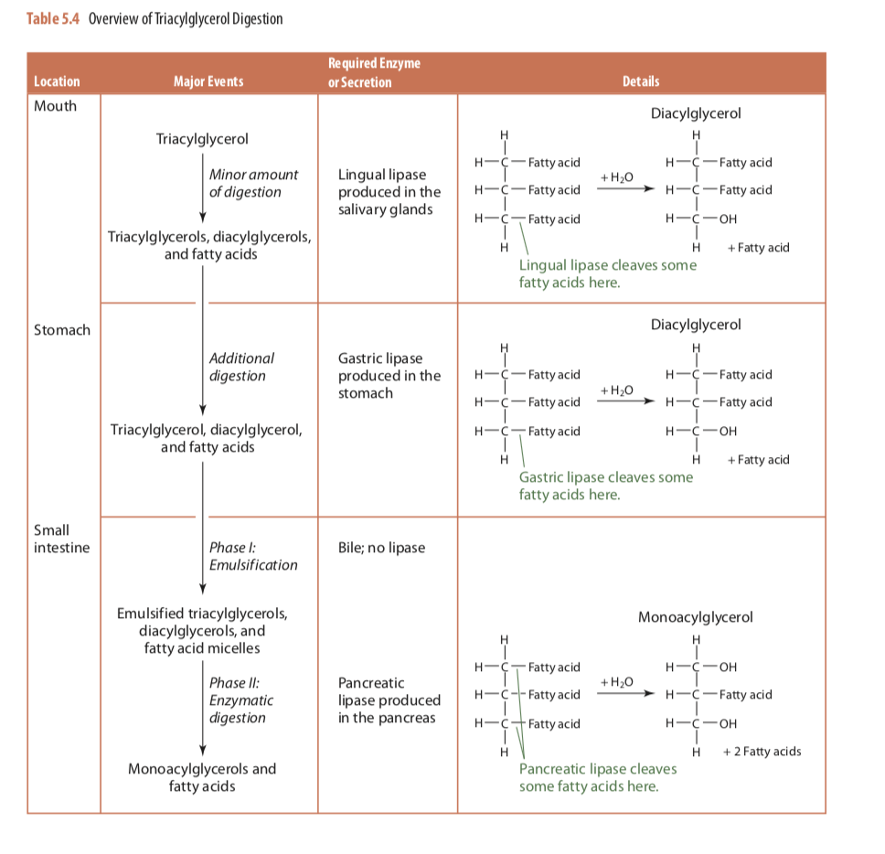

Slide 34
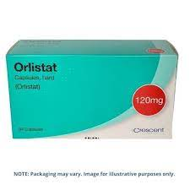
An inhibitor of gastric and pancreatic lipase, orlistat, has been developed to reduce the absorption of dietary triacylglycerols.
When you take the drug with a meal, about 25 percent of the fat you consume isn't broken down and is eliminated through bowel movements.
The most frequently reported side effects of orlistat are gastrointestinal discomfort, fecal incontinence, and steatorrhea (presence of fat in feces).

Slide 35
Some of the cholesterol present in food is esterified with a fatty acid
10% of the cholesterol in egg yolks is esterified, whereas about 50% in meat and poultry is esterified.
Cholesterol esters cannot be absorbed and therefore must be hydrolyzed to free cholesterol and free fatty acid to be incorporated into micelles for delivery to intestinal cells.
Free cholesterol from the diet (and from bile) requires no digestion and can directly incorporate in micelles.

Slide 36
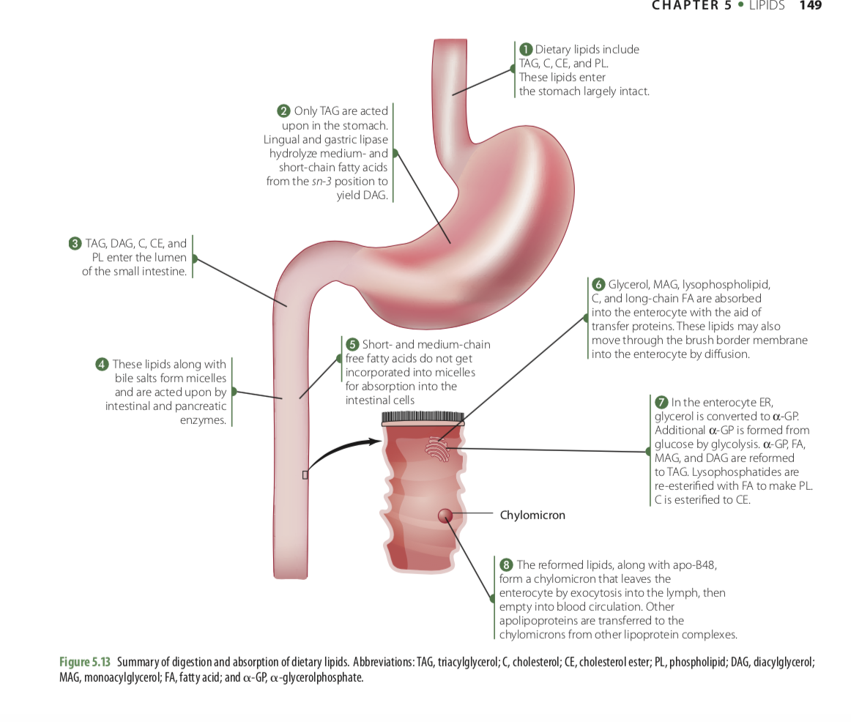

Slide 37
Cholesterol Absorption
Cholesterol that enters the small intestine comes from two sources: the diet and bile.
Dietary intake of cholesterol is about 300 mg/day
Bile contributes 800–1,400 mg/day.
Efficiency of absorption can affect how much cholesterol is retained in the body
Cholesterol not absorbed is excreted in the feces

Slide 38
The uptake of cholesterol by intestinal epithelial cells is mediated through the brush border protein, NPC1L1
Once in cytosol, Cholesterol has two fates
  Incorporate into enterocyte membranes
  Esterification in preparation for transport out of the cell as a component of chylomicrons
Phytosterols are also transported into the intestinal cell by NPC1L1.
HOWEVER NO phytosterols incorporate into chylomicrons or enter the circulation→ presence of two additional proteins→ABCG5 and ABCG8 → redirect phytosterols back into the intestinal lumen immediately after being taken into the cell. ABCG5 and ABCG8 also redirect some cholesterol back into the intestinal lumen, so that the overall efficiency of cholesterol absorption is about 50–60%

Slide 39
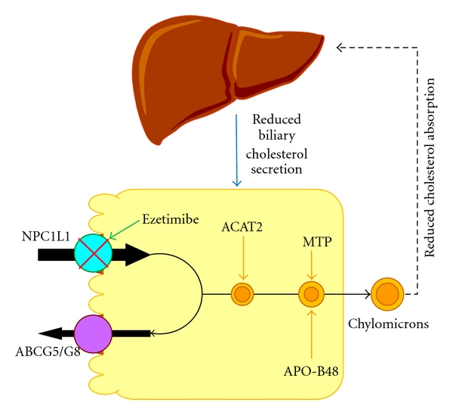
de Bari et al (2012). Journal of lipids.302847. 10.1155/2012/302847.

Slide 40
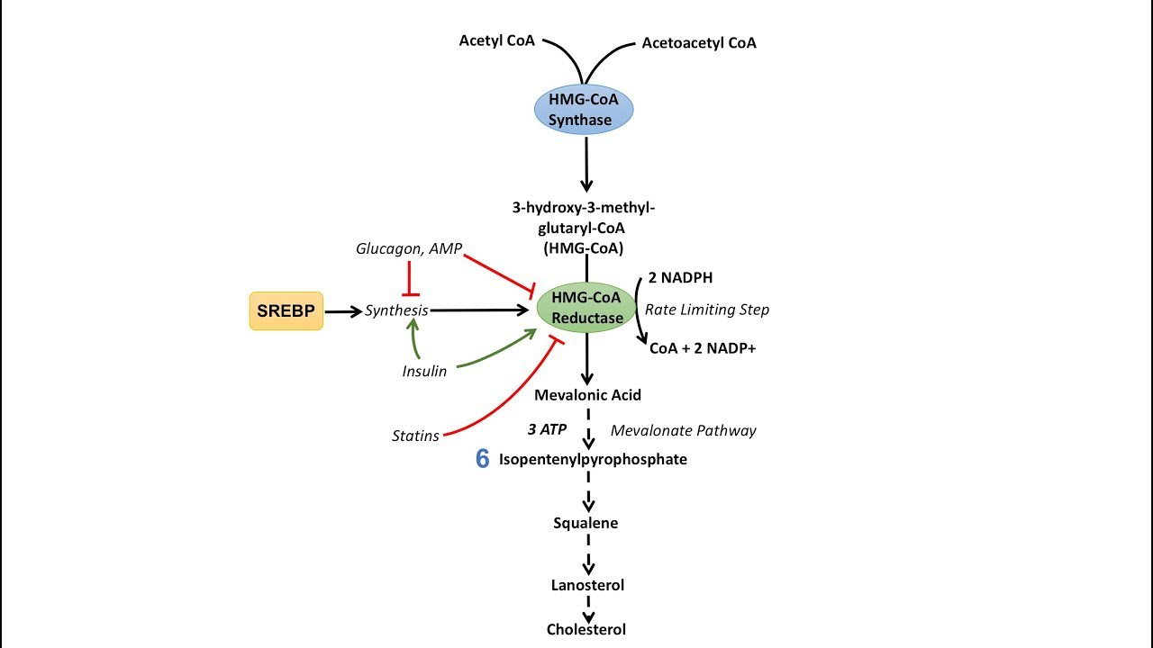

Slide 41
Cholesterol synthesis
The formation of mevalonate by HMG-CoA Reductase is strictly regulated because it is the key reaction in the pathway leading to cholesterol
Glucagon (and thus cAMP) induces HMG-CoA Reductase Kinase to phosphorylate HMG-CoA→ inhibiting the enzyme→ HMG-CoA will be shuttled to the mitochondria to produce ketone bodies instead.
During glucose intake, insulin activates HMG-CoA Reductase Phosphatase → dephosphorylate the enzyme→ Mevalonate synthesis → cholesterol

Slide 42
The transcription of HMG-CoA reductase Enzyme is another point of regulation so synthesis of cholesterol only takes place when the cell has adequate precursors to do so.
When the cell needs to produce cholesterol, and there are plenty of precursors, sterol regulatory element-binding protein (SREBP) is released from the ER and translocate to the nucleus, where it binds the sterol regulatory element (SRE). This increases the rate of HMG-CoA reductase transcription.

Slide 43
Lipid Release into Circulation
For dietary lipids to be fully absorbed into the circulation, they must first be packaged in a form that allows for transport in the aqueous bloodstream.
Chylomicrons are a class of lipoproteins.
The other classes are
  Very-low-density lipoproteins (VLDL)
  Intermediate-density lipoproteins (IDL)
  Low-density lipoproteins (LDL)
  High-density lipoproteins (HDL)

Slide 44
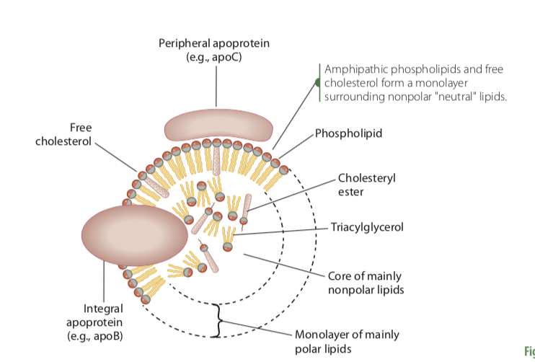
Lipoprotein typical structure:
Hydrophobic, nonpolar lipids (triacylglycerols and cholesterol esters) reside in the spherical core
Monolayer of amphipathic phospholipids and free cholesterol
On the surface are proteins (called apolipoproteins or apoproteins)

Slide 45
Chylomicrons
Mostly triacylglycerols and some cholesterol esters in the core
The main protein added to the chylomicron surface is called apolipoprotein B-48 (apoB-48) that helps stabilize the triacylglycerol-rich chylomicron.
Enter lymphatic system blood circulation
Deliver their triacylglycerol cargo to other tissues such as muscle and adipose tissue

Slide 46
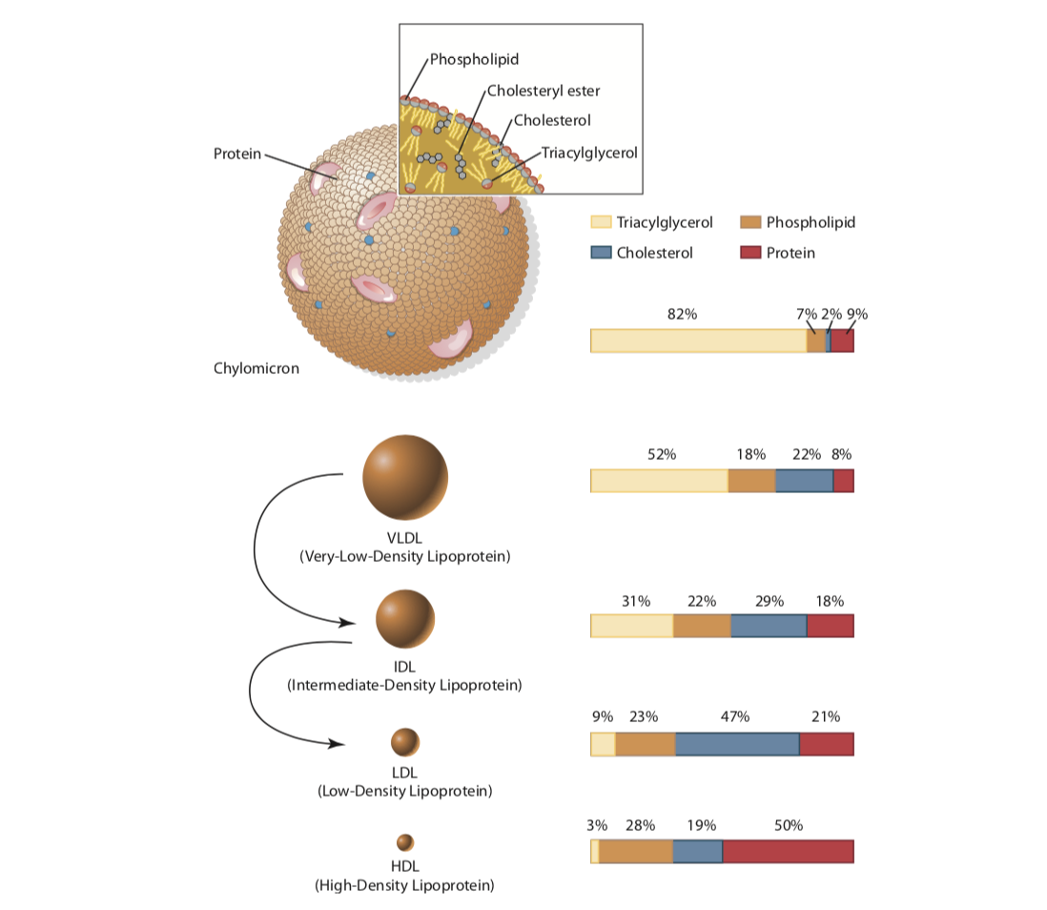

Slide 47
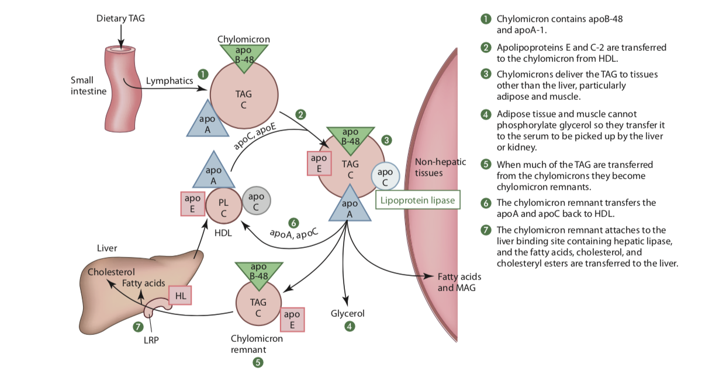
Circulating chylomicrons interact with tissues that express the enzyme lipoprotein lipase, primarily skeletal muscle, heart muscle, and adipose tissue (but not liver). This interaction occurs due to the presence of apoC-2, which activates the enzyme

Slide 48
Exogenous lipid transport system
Exogenous lipid transport system involves chylomicrons and refers to the transport of dietary lipids, primarily triacylglycerols, from the intestine to peripheral tissues for storage or energy utilization.
Mainly after a high fat meal
How insulin influences exogenous transport ?
Insulin increases the uptake of free fatty acids and monoacylglycerols in adipocytes by stimulating lipoprotein lipase. Insulin also accelerates the entry of glucose into adipocytes and its conversion to fatty acids.
Inhibiting hormone-sensitive lipase, which hydrolyzes stored triacylglycerols, thus favoring triacylglycerol synthesis.

Slide 49
Endogenous Lipid Transport
Hepatic triacylglycerols are packaged in VLDL and delivered to peripheral tissues , similar to chylomicrons.
After delivery, the left- over particles, referred to as LDL, are depleted of triacylglycerol but relatively enriched in cholesterol.
LDL are removed from the circulation for catabolism by specific receptors on the plasma membrane of cell
If the LDL receptors are in short supply, LDL can accumulate in the blood, causing the concentration of LDL-associated cholesterol to rise
The liver is capable of synthesizing new fatty acids and triacylglycerols from nonlipid precursors such as glucose, fructose, and amino acids
Notes:
Excess glucose and fructose not used for energy via the TCA cycle results in an accumulation of acetyl-CoA, which can be used to synthesize fatty acids
The glycerol needed for triacylglycerols is made from triose phosphates such as glycerol-3-phosphate.
AA→ Acetyl COA or pyruvate

Slide 50
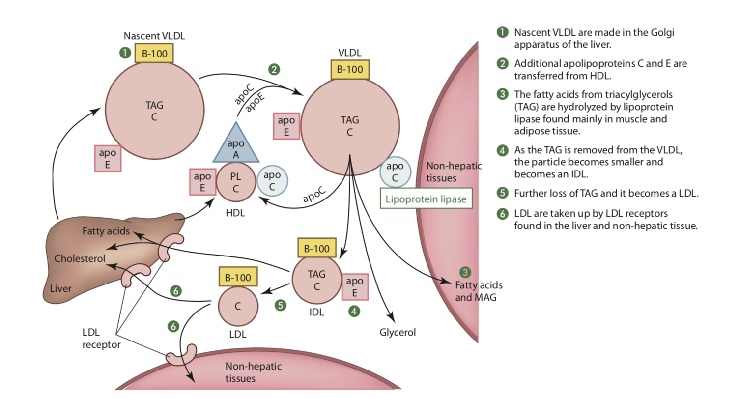

Slide 51
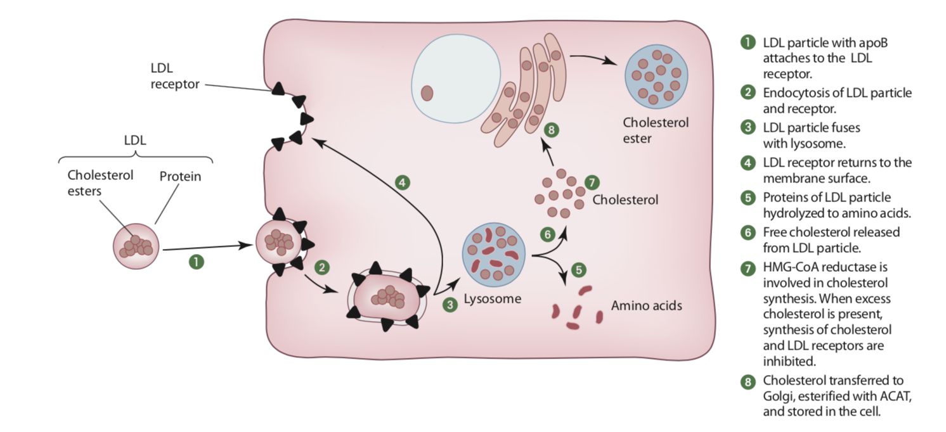
Primary carrier of cholesterol in the bloodstream
ApoB-100 apoprotein Remaining on LDL
Notes:
In the lysosome, the apoprotein and cholesterol ester com- ponents are hydrolyzed by lysosomal enzymes into amino acids, free fatty acids, and free cholesterol

Slide 52
The synthesis of LDL receptors is suppressed through decreased transcription of the receptor gene, thereby preventing further entry of LDL into the cell.
Dietary components are known to strongly influence the number of LDL receptors. Saturated and trans fatty acids decrease receptors, whereas soluble fiber and phytosterols increase receptors. In addition, obesity reduces the number of LDL receptors; therefore, obese individuals are less responsive to dietary interventions that normally improve serum cholesterol profiles

Slide 53
When high influx of free cholesterol
HMG- CoA reductase is suppressed
The enzyme-regulating cholesterol esterification, acyl- CoA:cholesterol acyltransferase (ACAT), is activated→ promoting cholesterol ester storage
LDL receptors synthesis is suppressed

Slide 54
Reverse Cholesterol Transport
Circulating HDL pick up excess cholesterol from peripheral tissues and deliver it to the liver for excretion from the body via bile, as either free cholesterol or bile acids
Mammals lack the oxidative enzymes necessary to degrade cholesterol
Transport of cholesterol from peripheral cells to the liver for excretion →important pathway for maintaining cholesterol homeostasis
Binding of HDL to the surface of hepatocytes
  cholesterol esters deposited in the liver cells
  cholesterol can be secreted directly into bile or converted to bile salts and secreted (excretion of cholesterol)
  high proportion of large HDL are thought to be an indicator of lower ASCVD risk

Slide 55
INTEGRATED METABOLISM IN TISSUES
  In times of energy need ( exercise, low-calorie diets, sleeping )the stored triacylglycerols hydrolyzed →released into the circulation as free fatty acid
  Triacylglycerols stored in adipose tissue are mobilized by a hormone-sensitive triacylglycerol lipase. The released fatty acids bind to serum albumin and are carried in the blood to the heart, skeletal muscle, and other tissues that use fatty acids for fuel.
  Only adipocytes have the ability to release free fatty acids into the blood- stream
  FFA oxidized via the TCA cycle for ATP production.
  Adipose tissue is constantly taking up and releasing fatty acids throughout the day
  In high energy intake: excess nutrients such as monosaccharides and amino acids can be converted to fatty acids for storage in adipose tissue
  In low energy intake: fatty acids to be converted to ketone bodies ( Impt for brain and red blood cells

Slide 56
Catabolism of Triacylglycerols and Fatty Acids
Activators of lipolysis:
Epinephrine, natriuretic peptides (circulating hormones of cardiac origin), thyroid-stimulating hormone, growth hormone, glucocorticoids
Glycerol : used for energy by the liver and other tissues that have the enzyme glycerokinase, which converts glycerol to glycerol phosphate.
Glycerol phosphate can enter the glycolytic pathway at the level of dihydroxyacetone phosphate→ energy oxidation or gluconeogenesis

Slide 57
Mitochondrial oxidation of fatty acids takes place in 3 stages
  Stage 1 : Fatty acids undergo oxidative removal of successive two-carbon units in the form of acetyl-CoA, starting from the carboxyl end of the fatty acyl chain.
  Stage 2 : Fatty acid oxidation, the acetyl groups of acetyl-CoA are oxidized to CO2 in the citric acid cycle, which also takes place in the mitochondrial matrix
  Stage 3 electrons move to the mitochondrial respiratory chain, through which the electrons pass to oxygen and phosphorylation of ADP to ATP

Slide 58
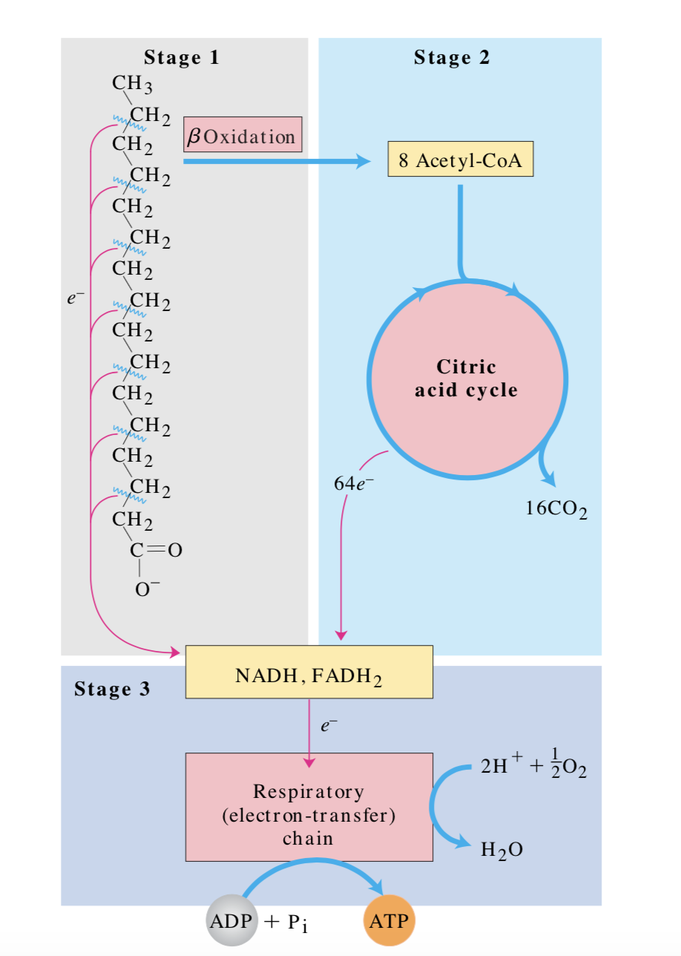

Slide 59
The enzymes of fatty acid oxidation in animal cells are located in the mitochondrial matrix BUT fatty acids of 14 or more carbons (which constitute the majority of the FFA obtained in the diet or released from adipose tissue ) CANNOT pass directly through the mitochondrial membranes—they must first undergo the three enzymatic reactions of the carnitine shuttle.

Slide 60
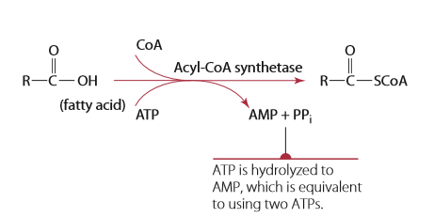
ACTIVATION STEP
When the fatty acid enters the cell, it is first activated by coenzyme A to acyl-CoA.
The reaction consumes two high-energy phosphate bonds to yield AMP.

Slide 61
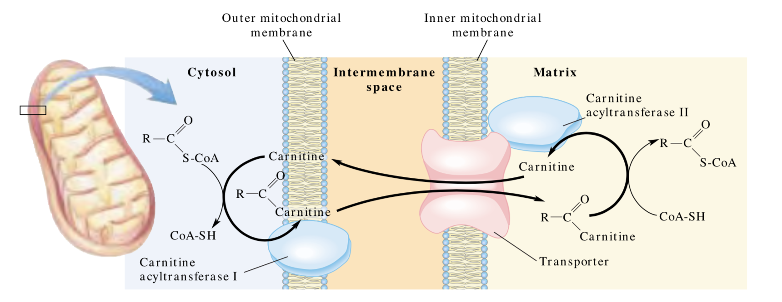
Fatty acyl–CoA esters formed at the cytosolic side of the outer mitochondrial membrane can be trans- ported into the mitochondrion and oxidized to produce ATP, or they can be used in the cytosol to synthesize membrane lipids.

Slide 62
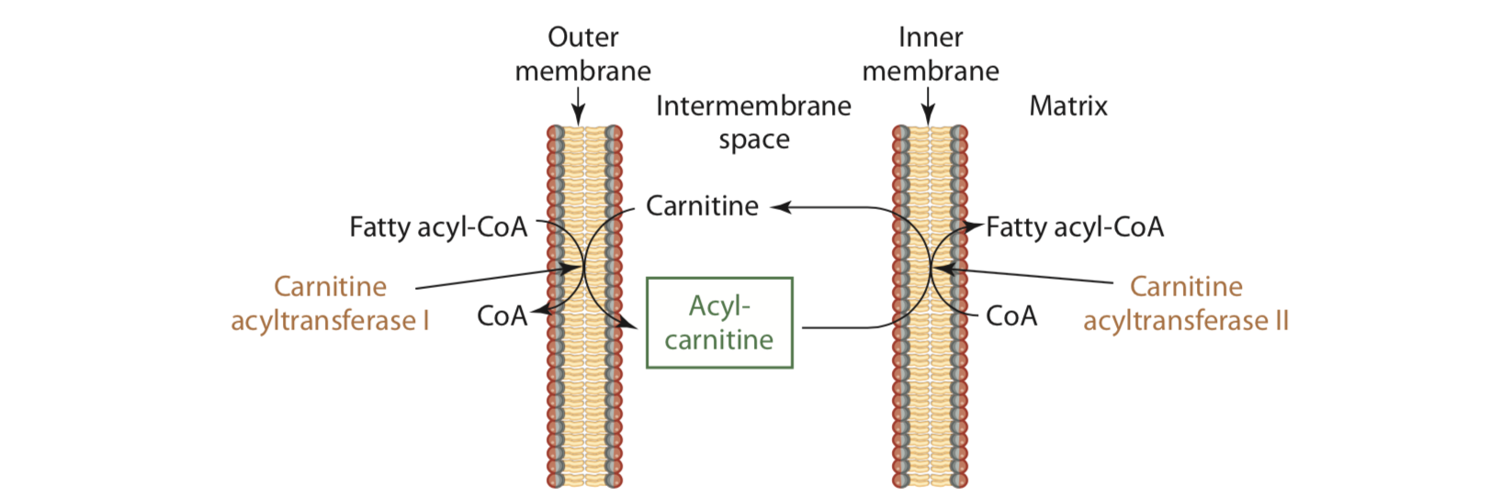
β-Oxidation of Fatty Acids
Short-chain fatty acids can pass directly into the mitochondrial matrix
Long-chain fatty acids and their CoA derivatives are incapable of crossing the inner mitochondrial membrane→ require carnitine membrane transport system

Slide 63
The oxidation of activated fatty acids occurs primarily in mitochondria through a degradative pathway called beta-oxidation.
Enzymatic reactions cleaves two carbons at a time—in the form of acetyl-CoA—with each passage through the pathway. Cleavage of each acetyl-CoA occurs at the carboxyl end of the fatty acid.

Slide 64
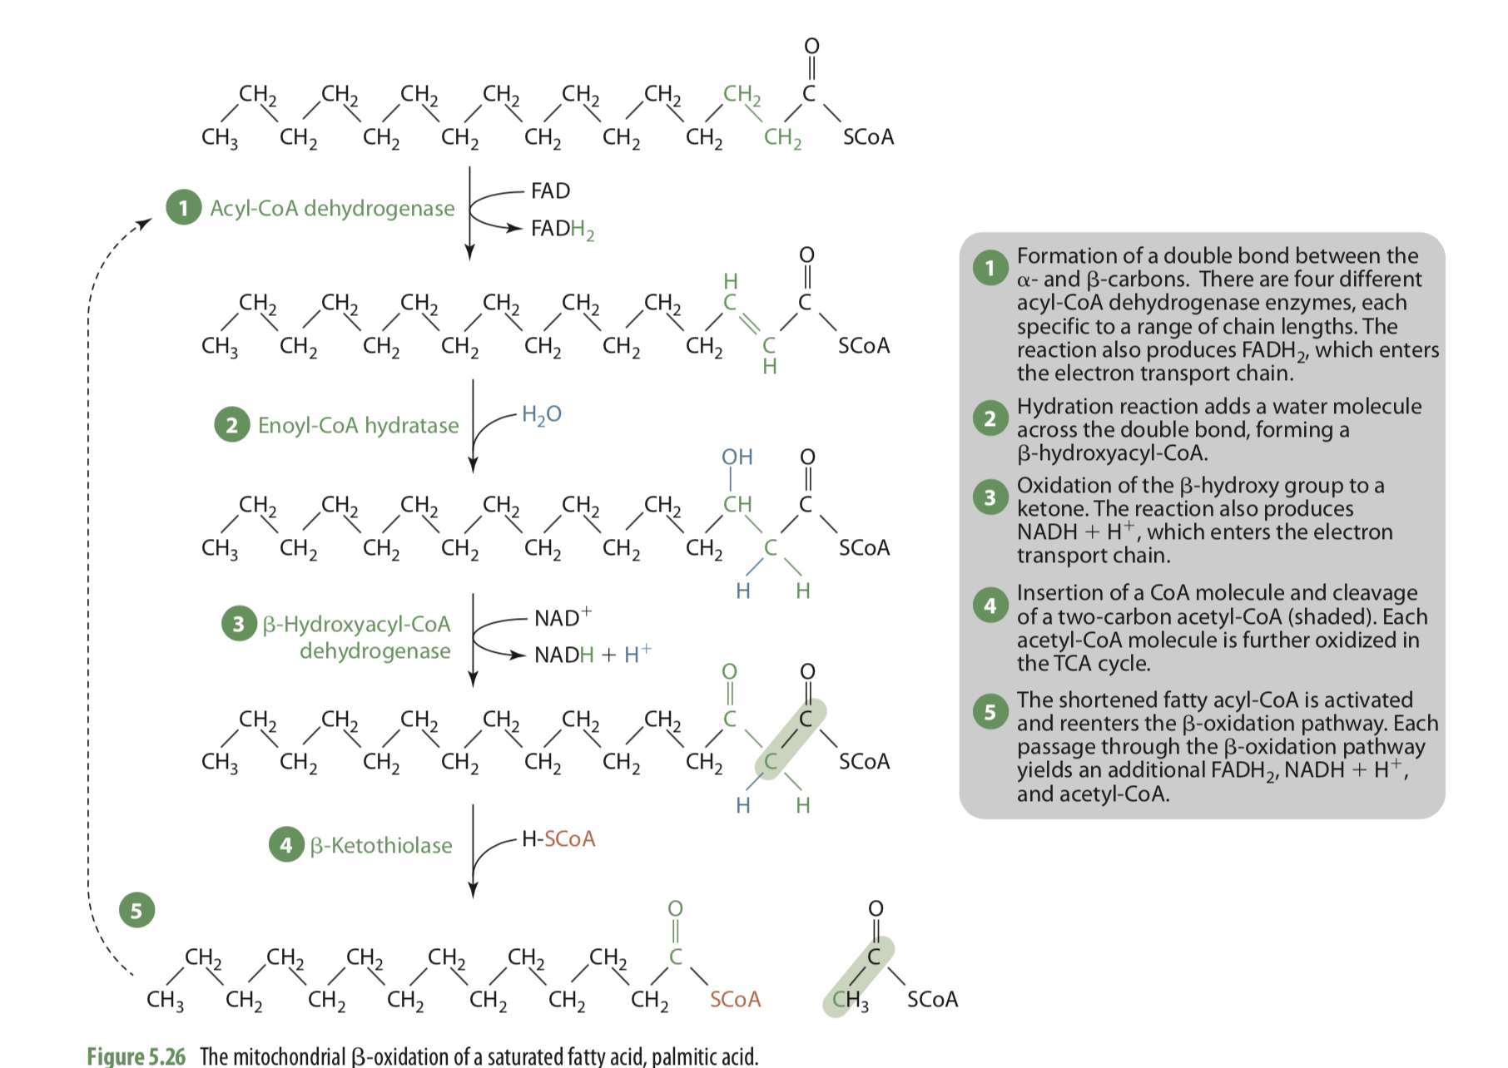
Acyl-CoA dehydrogenase
introduces a double bond between C2 and C3 (the a- and b-carbons, respectively).

Slide 65
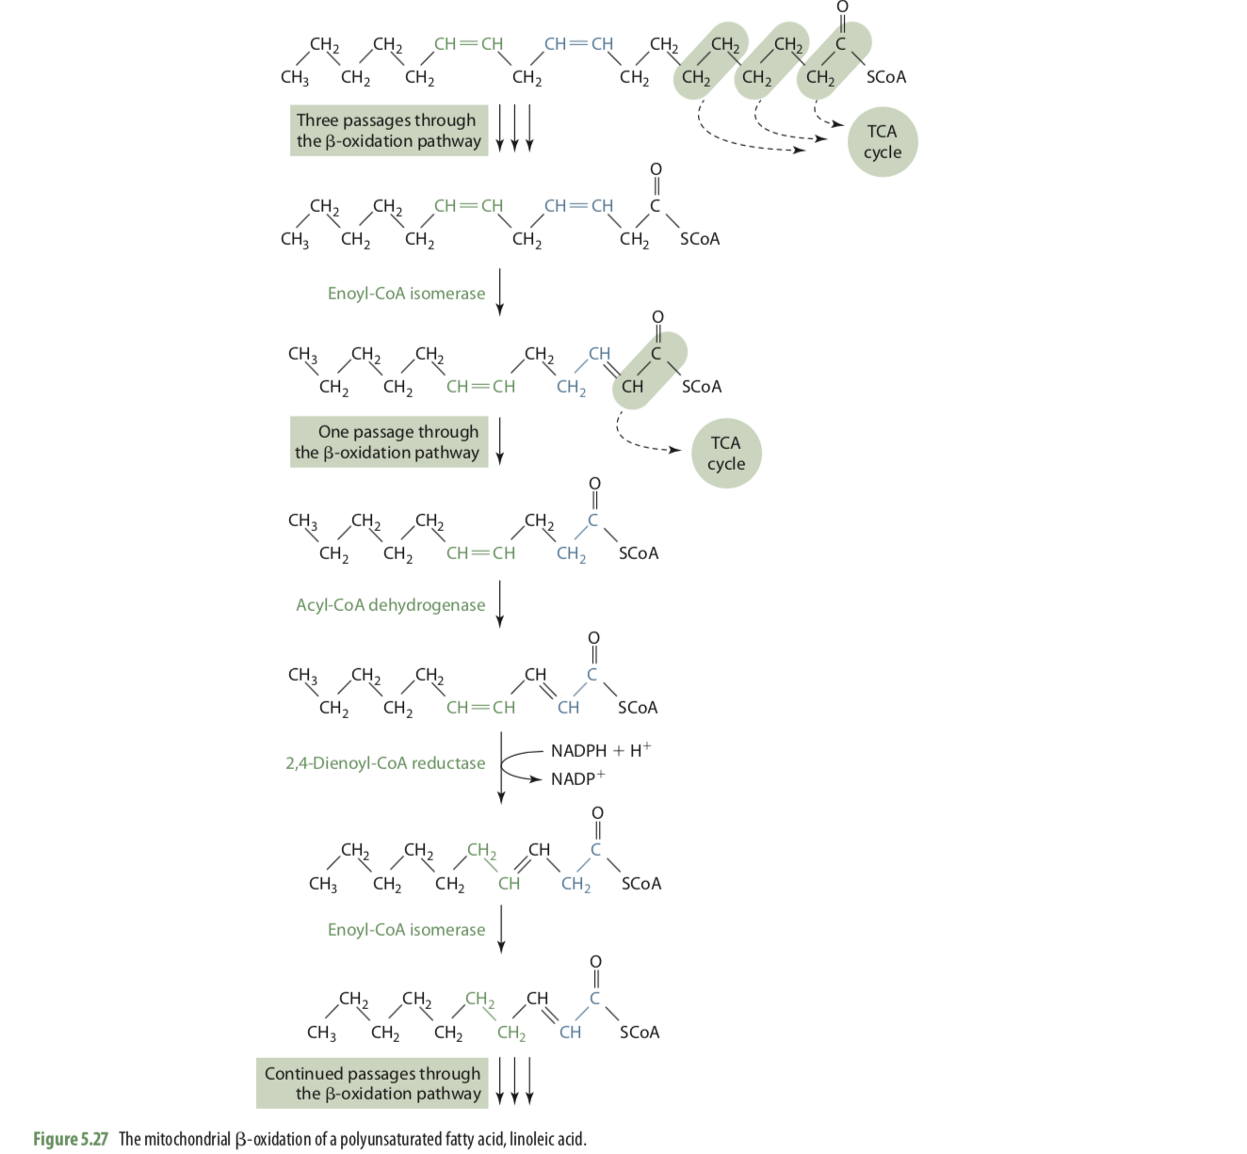
PUFA
After removal of an acetyl-CoA, the remaining double bond is now between C3 and C4
The action of acyl-CoA dehydrogenase proceeds normally with the creation of a new double bond between C2 and C3. BUT proximity of the two double bonds prevents b-oxidation from continuing, so another enzyme called 2,4-dienoyl-CoA reductase is needed to reduce the two double bonds to one.

Slide 66
Energy Yield in Fatty Acid Oxidation
The complete b-oxidation of one 16-carbon palmitic acid molecule requires seven passages through the pathway
  8 acetyl-CoA
  7 FADH2
  7 NADH molecules
  The FADH2 and NADH directly enter the electron transport chain and yield on average 1.5 ATP/mole FADH2 and 2.5 ATP/mole NADH
  The acetyl-CoAs are completely oxidized to CO2 and H2O by the TCA cycle and oxidative phosphorylation, with an average yield of 10 ATP/mole acetyl-CoA

Slide 67
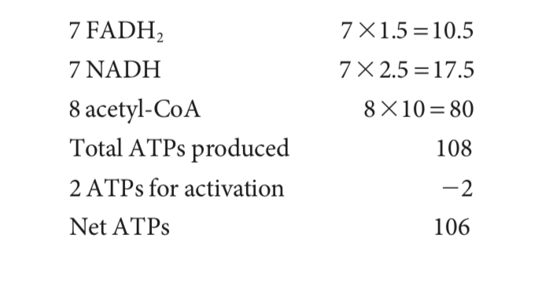
Unsaturated fatty acids : beta-oxidation of unsaturated fatty acids releases slightly less energy because of the preexisting double bonds
Each time the acyl-CoA dehydrogenase reaction is skipped, one less molecule of FADH2 is produced

Slide 68
Fatty Acid Oxidation Is Tightly Regulated
In the liver, fatty acyl–CoA formed in the cytosol has two major pathways open to it:
Oxidation by enzymes in mitochondria
Conversion into triacylglycerols and phospholipids by enzymes in the cytosol.
The pathway taken depends on the rate of transfer of long-chain fatty acyl–CoA into mitochondria.

Slide 69
Ketone body formation
Under normal condition: Ketone body formation is low
When free fatty acids are released by adipocytes into the circulation in an amount greater than what the body is able to oxidize → ketone body formation ( e.g.: low CHO , low energy, T1DM)
Glucose-requiring tissues, including the brain and red blood cells, cannot use fatty acids for energy and their need for alternative fuels increases.
Fatty acids can’t access through BBB
Ketogenesis primarily occurs in liver

Slide 70
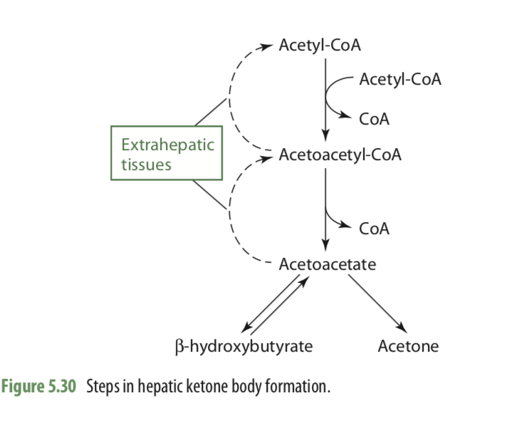
ketogenesis
Excess free fatty acids → ketone bodies
Following b-oxidation, the liver converts the excess acetyl-CoA
Acetoacetate
b-hydroxybutyrate
Acetone
Three types of ketone bodies
Ketone bodies are
Water soluble
Can move in blood w/o transport protein
In target cell, ketone bodies broken down to acetyl coA→ enter TCA cycle→ ATP generation

Slide 71
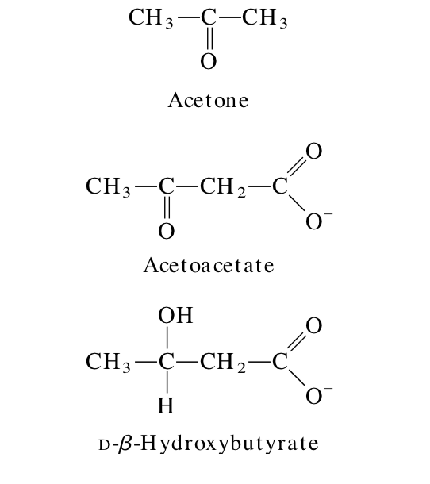
The production and export of ketone bodies from the liver to extrahepatic tissues allow continued oxidation of fatty acids in the liver when acetyl-CoA is not being oxidized in the citric acid cycle

Slide 72
For Acetyl coA to feed into the TCA cycle → ATP generation, there must be an adequate supply of oxaloacetate
When the supply of carbohydrate is inadequate, there is insufficient glucose for glycolysis→ less pyruvate is produced
Intermediates of the citric acid cycle are being siphoned off for glucose to carry out gluconeogenesis--> TCA cycle slows, less oxidation of acetyl coA
Additionally, the pool of oxaloacetate (made directly from pyruvate), with which the acetyl-CoA normally combines for oxidation in the TCA cycle, is reduced
With inadequate oxaloacetate→ Acetyl coA participates less in TCA and enters ketogenesis

Slide 73
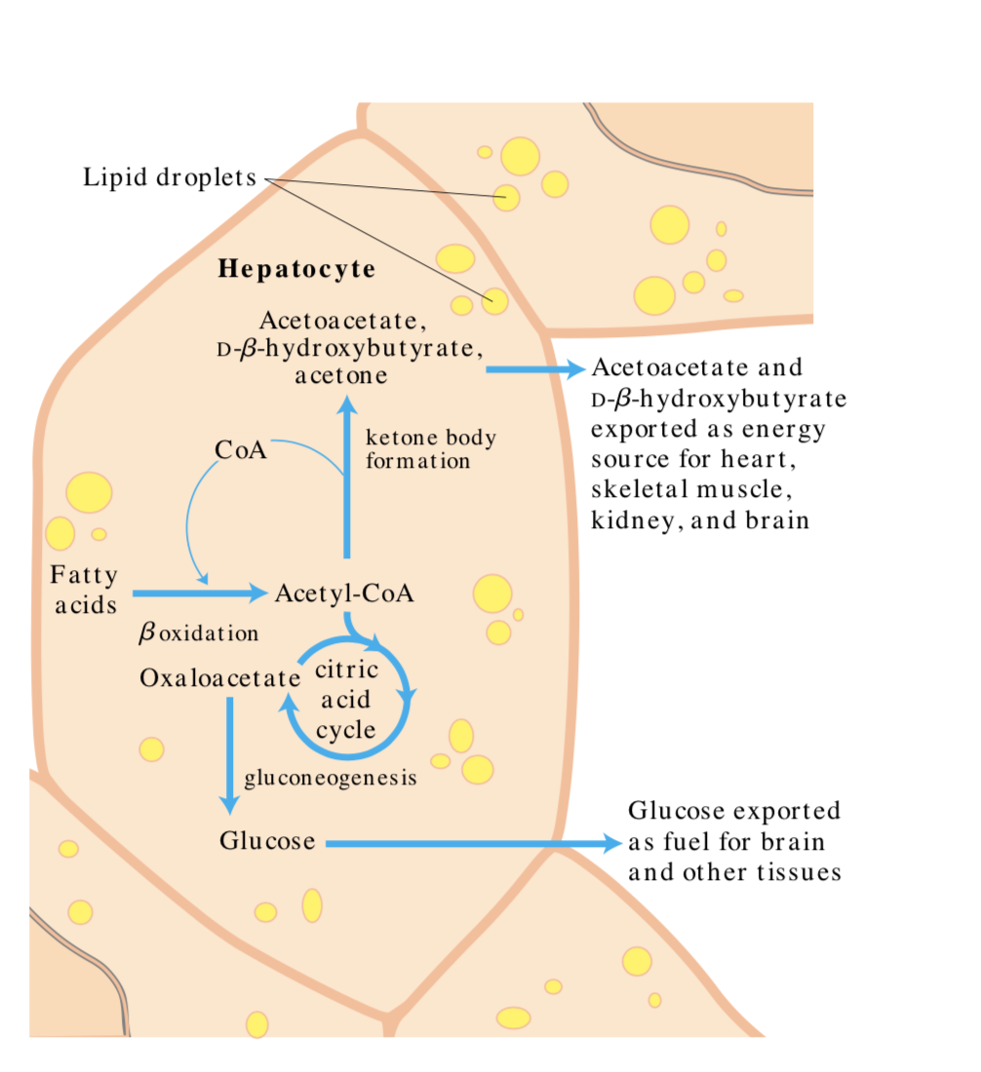

Slide 74
Acetyl coA generated from b-oxidation of fatty acids will be used to generate ATP if there is enough oxaloacetate present
During times of fasting or in diabetics, low levels of oxaloacetate will drive the formation of ketone bodies from acetyl CoA.
Acetyl CoA can be transformed into one of three ketone bodies - acetone, acetoacetate and D-3-hydroxybutyrate. Acetone is released in our breath while the other two can be metabolized by peripheral cells
In starvation, or prolonged intake of very low-carbohydrate diet, ketone bodies can rise to dangerous levels that lower the pH of the blood, resulting in ketoacidosis
Untreated ketoacidosis can lead to low blood pressure, dehydration, coma, and death.

Slide 75
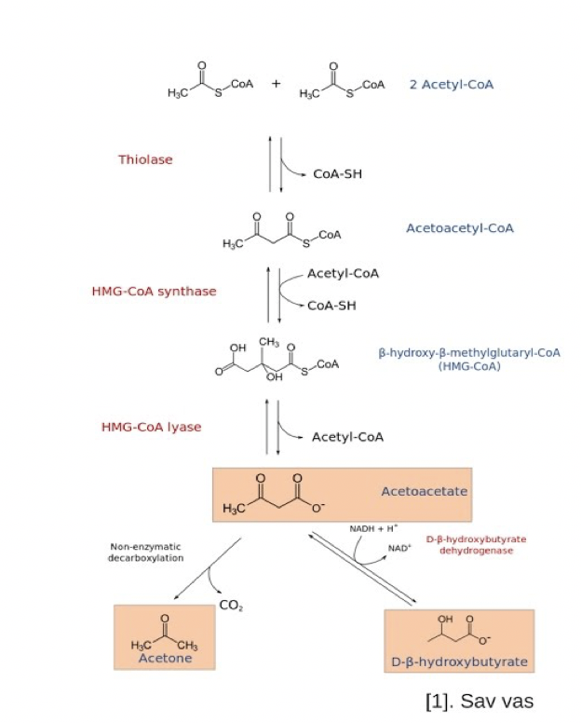
Formation of ketone bodies occurs in liver Hepatocytes mitochondria
Can be used to synthesize cholesterol In cytosol

Slide 76
During starvation, gluconeogenesis depletes citric acid cycle intermediates, diverting acetyl-CoA to ketone body production
In untreated diabetes → insulin level is insufficient, extrahepatic tissues cannot take up glucose efficiently from the blood
Under these conditions, levels of malonyl- CoA (the starting material for fatty acid synthesis) fall, inhibition of carnitine acyltransferase I is relieved, and fatty acids enter mitochondria to be degraded to acetyl- CoA—which cannot pass through the citric acid cycle because cycle intermediates have been drawn off for use as substrates in gluconeogenesis. The resulting accumulation of acetyl-CoA accelerates the formation of ketone bodies beyond the capacity of extrahepatic tissues to oxidize them.

Slide 77
The increased blood levels of acetoacetate and B-hydroxybutyrate lower the blood pH→ Acidosis
Extreme acidosis can lead to coma and in some cases death. Ketone bodies in the blood and urine of untreated diabetics can reach extraordinary levels
blood concentration of 90 mg/100 mL (compared with a normal level of < 3 mg/100 mL)
Urinary excretion of 5,000 mg/24 hr (compared with a normal rate of < 125 mg/ 24 hr)
Individuals on very low-calorie diets, using the fats stored in adipose tissue as their major energy source, also have increased levels of ketone bodies in their blood and urine. These levels must be monitored to avoid the dangers of acidosis and ketosis (ketoacidosis

Slide 78
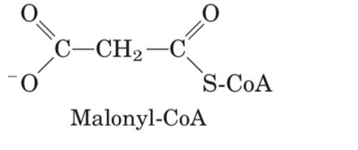
Synthesis of Fatty Acids
Most human cells are capable of synthesizing fatty acids from acetyl-CoA
Exception: Essential fatty acids linoleic acid and a-linolenic acid,
Location: Liver, lungs, adipose tissue, lactating mammary glands, brain, and kidneys
biosynthesis requires the participation of a three-carbon intermediate, malonyl-CoA, that is not involved in fatty acid breakdown.

Slide 79
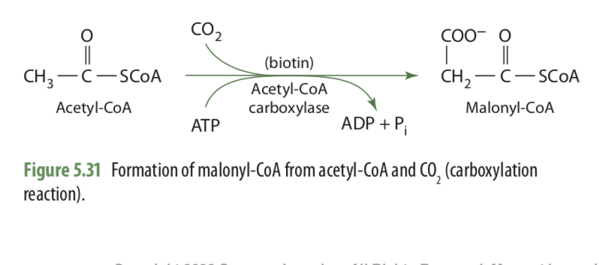
The formation of malonyl-CoA from acetyl-CoA is an irreversible process, catalyzed by acetyl-CoA carboxylase.
The enzymes involved in fatty acid synthesis are arranged in a complex called the fatty acid synthase system, located in the cytosol.

Slide 80
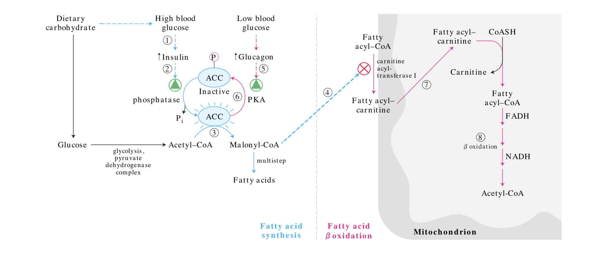
Regulation of fatty acid synthesis and breakdown

