Slide 1


•Sensor classification
•Mechanical sensors
•Thermal sensors
•Chemical sensors

Slide 2
🞂 Sensors can be classified, among others,
according to one of the following criteria
Power supply requirements
  Passive and active
Nature of the output signal
  Digital and analog
Measurement operational mode
  Deflection and null modes
Input/output dynamic relationships
  Zero, first, second order, etc.
Measurand
  Mechanical, thermal, magnetic, radiant, chemical
Physical measurement variable
  Resistance, inductance, capacitance, etc

Slide 3
🞂 Passive or self-generating
Directly generate an electrical signal in response to an external stimuli without the need for an external power supply
  Output signal power comes from the stimulus
Examples
  Thermocouple
  Piezoelectric sensors
🞂 Active or modulating
These sensors require external power supply or an excitation signal for their operation
  Output signal power comes from the power supply
Examples
  Thermistors
  Chemo-resistors

Slide 4

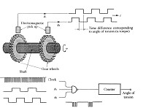
🞂 Analog sensors
Provide a signal that is
continuous in both its magnitude and temporal or spatial content
  Most of the physical measurands are analog in nature
Examples: Temperature,
displacement, light intensity
🞂 Digital sensors
Their output takes the form of discretesteps or states
Digital signals are more repeatable, reliable and easier to transmit
Examples: Shaft encoder, contact switch

Slide 5


🞂 Deflection mode
The sensor or instrument generates a response that is a deflection or a deviation from the initial condition of the instrument
The deflection is proportional to the measurand of interest
🞂 Null mode
The sensor or instrument exerts an influence on the measured system so as to oppose the effect of the measurand
  The influence and measurand are balanced (typically through feedback) until they are equal but opposite in value, yielding a null measurement
🞂 Null mode instrumentation can produce very accurate measurements, but are not as fast as deflection instruments

Slide 6
🞂 Displacement
Resistive sensors
Capacitive sensors
Inductive sensors
🞂 Force and acceleration
Strain gauges
Cantilever beam-based sensors

Slide 7
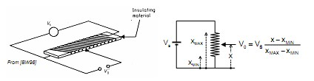
🞂 A resistance with a movable contact (a potentiometer) may
be used to measure linear or rotational displacements
A known voltage is applied to the resistor ends
The contact is attached to the moving object of interest
The output voltage at the contact is proportional to the
displacement
🞂 Notes
Non-linearities as a result of loading effects
Resolution due to limited number of turns per unit distance
Contact wear as a result of frictions

Slide 8


🞂 The capacitance of a parallel plate capacitor is
Capacitive Sensors
d is the separation between the plates, A is the area of the plates, ε0 is
the permittivity of air and εr is the relative permitivity of the dielectric
🞂 A moving object is attached to the dielectric or the plates to generate capacitance changes
🞂 Notes
Variable distance (d) sensors operate over a range of a few millimeters
Cross-sensitivity to temperature and humidity (specially if the dielectric is
air)
Capacitive sensors are also commonly used to measure pressure
  “Condenser” microphones measure changes in air pressure of incoming sound waves
Example on Capacitive Sensors

Slide 9
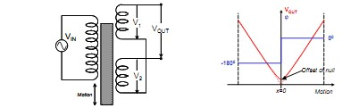
🞂 Linear Variable Differential Transformer (LVDT)
Motion of a magnetic core changes the mutual inductance of two
secondary coils relative to a primary coil
Primary coil voltage: VSsin(ωt)
Secondary coil induced emf: V1=k1sin(ωt+ϕ) and V2=k2sin(ωt+ϕ)
  k1 and k2 depend on the amount of coupling between the primary and the
  secondary coils, which is proportional to the position of the coil
    When the coil is in the central position, k1=k2 ⇒ VOUT=V1-V2=0
    When the coil is is displaced x units, k1≠k2 ⇒ VOUT=(k1-k2)sin(ωt+ϕ)
    Positive or negative displacements are determined from the phase of VOUT
https://www.elprocus.com/lvdt-working-principle-construction-types-applications-advantages-and-disadvantages/
https://www.fierceelectronics.com/components/modern-lvdts-new-applications-air-ground-and-sea

Slide 10
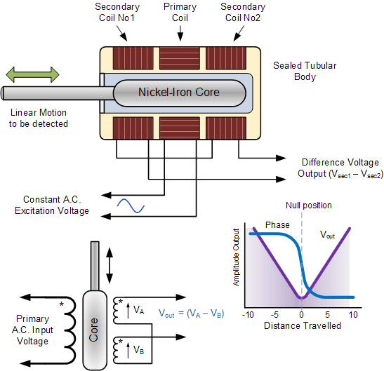
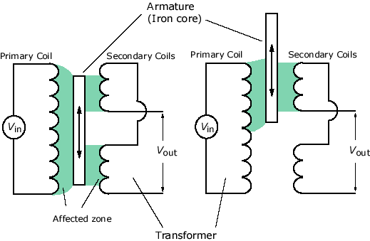

Slide 11

🞂 LVDT Characteristics
Typical LVDTs run at 5V, 2kHz
LVDTs can measure from mm down to µm
Due to small variations in the windings, a small residual voltage appears at the output when the coil is in the central position
🞂 Advantages of the LVDT over other
displacement sensors
No mechanical wear ensures a long life
Complete electrical isolation
DC versions with integrated oscillators are available

Slide 12
What is a Strain Gauge ?
Strain Gauge is a device used to measure deformation (strain) of an object.
Strain gauges have been developed for the accurate measurement of strain
Fundamentally, all strain gauges are designed to convert mechanical motion into an electronic signal.
The piezoresistive effect is a change in the electrical resistivity of a semiconductor or metal when mechanical strain is applied. In contrast to the piezoelectric effect, the piezoresistive effect causes a change only in electrical resistance, not in electric potential.

Slide 13
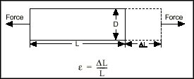
What is Strain ?
Strain is the amount of deformation of a body due to an applied force. More specifically, strain (e) is defined as the fractional change in length.
Strain can be positive (tensile) or negative (compressive). Although dimensionless, strain is sometimes expressed in units such as in./in. or mm/mm.
In practice, the magnitude of measured strain is very small. Therefore, strain is often expressed as microstrain (me), which is e x 10⁻⁶.

Slide 14



🞂 Strain gauges are devices whose resistance
changes with stress (piezo-resistive effect)
Strain is a fractional change (∆L/L) in the dimensions of an object as a result of mechanical stress (force/area)
The resistance R of a strip of material of length L, cross-
section A and resistivity ρ is R=ρL/A
Differentiating, the gauge factor G becomes
•Where ν is the Poisson’s ratio (ν≅0.3), which determines the strain in directions normal to L
•In metal foil gauges, the geometric term dominates (G≅2)
In semiconductor gauges, the piezo-resistive term dominates
(G≅100)

Slide 16
Schematic View Of Strain Gauge
The gauge shown here is primarily sensitive to strain in the X direction, as the majority of the wire length is parallel to the X axis.
Insulated backing
Solder Tags - for attachment of wires.
Y
Gauge, wire / foil approx. 0.025 mm thick
X

Slide 17
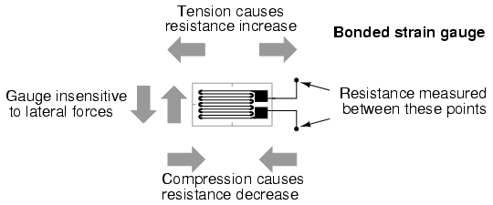
Strain Gauge
The name "bonded gauge" is given to strain gauges that are glued to a larger structure under stress (called the test specimen).

Slide 18
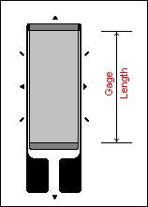
Gage Length
Gage length is an important consideration in strain gage selection
The gage length is the dimension of the active grid as measured inside the grid end loops.
The gage length (GGG ) ranges from 0.008 in (0.2 mm) to 4 in (100 mm).

Slide 19
Strain Gauge Operation
This schematic shows how the strain gauge resistance varies with strain (deformation).
On applying a force a change in resistance takes place.
Tension causes resistance increase.
Compression causes resistance decrease.
+
-
Ω
Ω
Ω

Slide 20

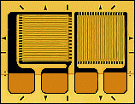
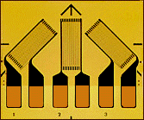

Grid Pattern
(a) (b) (c) (d)
Uniaxial Gage with a single grid for measuring strain in the grid direction .
Biaxial Rosettes Gage with two perpendicular grids used to determine principal strains when their directions are known.
Three-Element Rosettes Gage with three independent grids in three directions for ascertaining the principal strains and their directions.
Shear Patterns Gage having two chevron grids used in half-bridge circuits for direct indication of shear strains (difference in normal strains) .

Slide 21
Strain Gauge Installation
The Strain Gauge is bonded to the specimen under test, only after the following:
  cleaning the surface using a degreaser
  cleaning it again with a conditioner solution (mild acid that accelerates the cleaning process)
  neutralizing by applying a base (neutralizes any chemical reaction introduced by the Conditioner)
  finally bonding it with a super glue.
The Strain Gauge has 2 leads which exhibit variation in resistance when strain is applied.

Slide 22
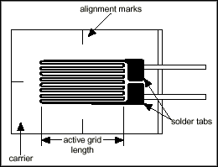

The bonded metallic strain gauge
The metallic strain gauge consists of a very fine wire or metallic foil arranged in a grid pattern.
The grid pattern maximizes the amount of metallic wire or foil subject to strain in the parallel direction.
The grid is bonded to a thin backing, called the carrier, which is attached directly to the test specimen.
The strain experienced by the test specimen is transferred directly to the strain gauge, which responds with a linear change in electrical resistance.
Gauge factor is defined as:

Slide 23
Measuring Circuits
In order to measure strain with a bonded resistance strain gauge, it must be connected to an electric circuit that is capable of measuring the minute changes in resistance corresponding to strain
Strain gauge is connected in a Wheatstone bridge circuit
A strain gauge bridge circuit indicates measured strain by the degree of imbalance
It provides an accurate measurement of that imbalance

Slide 24
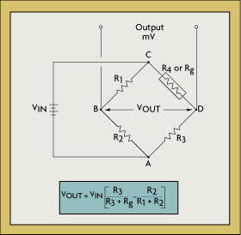
Wheatstone Bridge
In Figure, if R1, R2, R3, and Strain gauge are equal, and a voltage, VIN, is applied between points A and C, then the output between points B and D will show no potential difference.
However, if R4 is changed to some value which does not equal R1, R2, and R3, the bridge will become unbalanced and a voltage will exist at the output terminals.
The variable strain sensor has resistance Rg, while the other arms are fixed value resistors.

Slide 25
Wheatstone Bridge
The sensor, however, can occupy one, two, or four arms of the bridge, depending on the application.
The total strain, or output voltage of the circuit (V_{out}) is equivalent to the difference between the voltage drop across R1 and R4, or Rg.
It is given by V_{out} = V_{cd} – V_{cb}

Slide 26

Wheatstone Bridge Working
The bridge is considered balanced when R1/R2 = Rg/R3 and, therefore, V_{OUT} equals zero.
Any small change in the resistance of the sensing grid will throw the bridge out of balance, making it suitable for the detection of strain.
A small change in Rg will result in an output voltage from the bridge.
If the gage factor is GF, the strain measurement is related to the change in Rg as follows:

Slide 27
Solution
Shielding: Most electric interference and noise problems can be solved by shielding.
A shield around the measurement lead wires will intercept interferences and may also reduce any errors caused by insulation degradation.
Shielding also will guard the measurement from capacitive coupling.
If the measurement leads are routed near electromagnetic interference sources such as transformers, twisting the leads will minimize signal degradation due to magnetic induction.
By twisting the wire, the flux-induced current is inverted and the areas that the flux crosses cancel out.
For industrial process applications, twisted and shielded lead wires are used almost without exception.

Slide 28
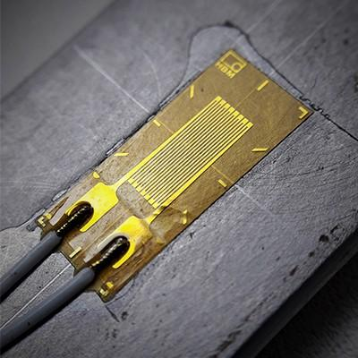
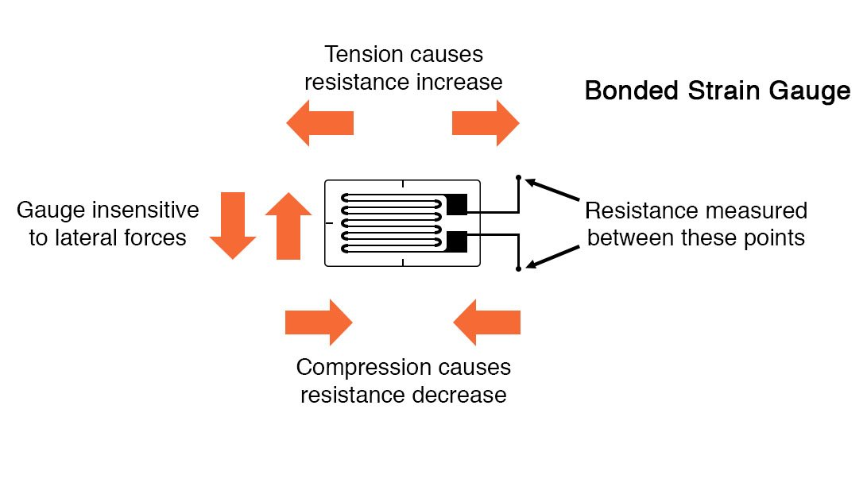
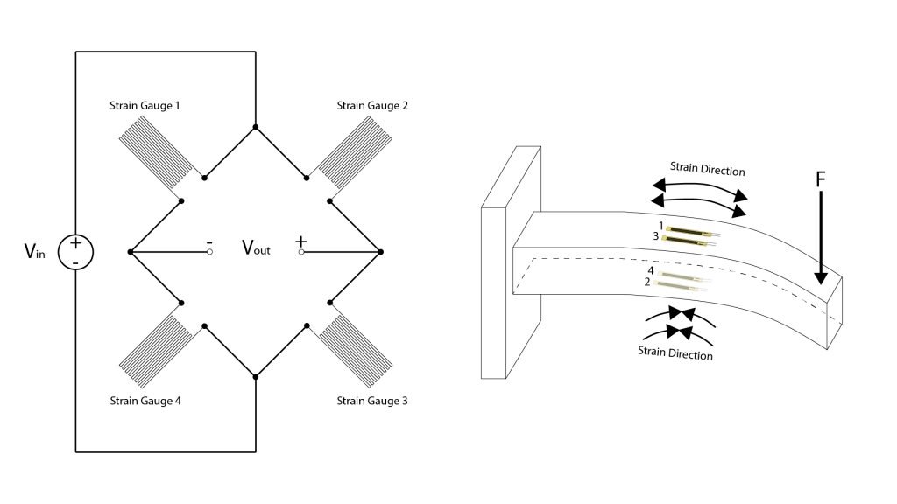
How Strain Gauges Work?
https://www.youtube.com/watch?v=BH8hAWRDTkA&ab_channel=OMEGAEngineering
https://www.allaboutcircuits.com/textbook/direct-current/chpt-9/strain-gauges/
Notes:
How Strain Gauges Work?

Slide 29
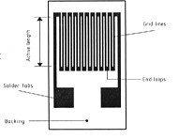
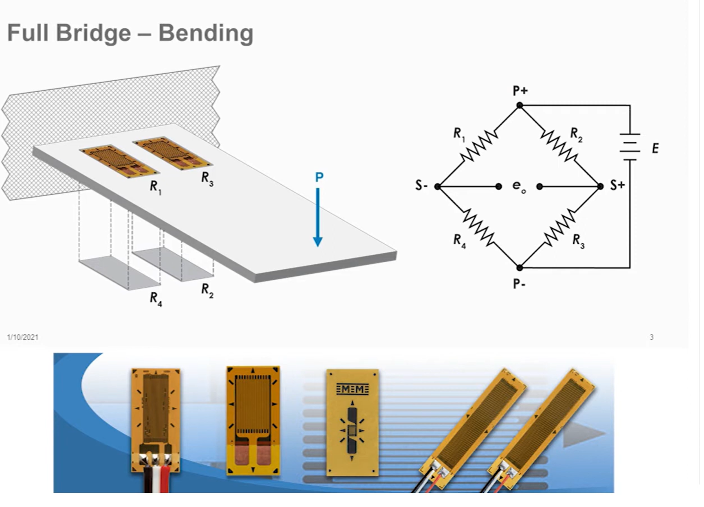
🞂 Fabrication and use
Typical strain gauges consist of a foil or wire grid covered by two sheets of insulation (polyimide)
The gauge is attached to the desired object with an adhesive
Longitudinal segments are aligned with
the direction of stress
Sensitivity to traverse stress can be neglected
🞂 Notes
Temperature effects are quite pronounced in semiconductor gauges
To compensate it is common to place “dummy” gauges that are subject to the same temperature changes but no mechanical stress
Resistance changes are typically very small
Strain gauges are almost invariable used in a Wheatstone bridge

Slide 30
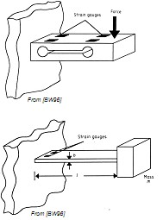
🞂 Force
The coupled-double-beam load cell
Dumb-bell cut-out provides areas
◦
of maximum strain for the gauges
Cantilever beam bends in an S-
shape
This induces both compressive and tensile strains that can be easily measured in a bridge arrangement
🞂 Acceleration sensors
Spring-mass-damper
Covered in the previous lecture
Cantilever-beam with strain gauges
A seismic mass is attached to the
◦
end of the cantilever
Dampening is usually performed
with viscous fluids or permanent magnets
https://www.youtube.com/watch?v=ykBn4IxStrU&ab_channel=AutodataTraining
https://www.avnet.com/wps/portal/abacus/solutions/technologies/sensors/pressure-sensors/core-technologies/capacitive-vs-piezoresistive-vs-piezoelectric/

Slide 31




Applications of Strain gauge
In load cells for weighbridges, scales, vehicles and in medical and educational applications.
For monitoring structures such as bridges and buildings.
In research and development applications, including automotive, aerospace, medical, process, oil and gas, and power generation.
Virtually every other sector of industry.

Slide 32
Temperature Sensors

Slide 33
🞂 Thermoresistive sensors
Resistive Temperature Devices (RTD)
Thermistors
🞂 Thermoelectric sensors
The Seebeck effect
The Peltier effect
Thermocouples
🞂 p-n junction sensors

Slide 34
Introduction
Temperature is an important parameter in many control systems
Several distinctly different transduction mechanisms are employed
These include non electrical as well as electrical methods
A thermometer is the most common non electrical sensor
Common electrical sensors include thermocouples, thermistors and resistance thermometers

Slide 35
Sensors Covered
Thermocouple
Thermistor
Resistance Temperature Detectors (RTD)
Semiconductor temperature sensor
Liquid in glass
Bimetallic

Slide 37

🞂 The Seebeck effect
When a pair of dissimilar metals are joined at one end, and there is a temperature difference between the joined ends and the open ends, thermal emfis generated, which can be measured in the open ends
🞂 The Peltier effect
When a current passes through the junction of two different conductors, heat can be either absorbed or released depending on the direction of current flow
🞂 Thermocouples
Based on the Seebeck effect
Open ends must be kept at a constant reference temperature TREF
A number of standard TCs are used
  These are denominated with different letter codes: T, J, K, S, R…
    i..e, type J (the most popular) is made of Iron and Constantan (Cu/Ni alloy: 57/43)

Slide 38
Thermocouples
Based on the Seebeck effect
When any conductor is subjected to a thermal gradient, it will generate a voltage
The magnitude of the effect depends on the metal in use

Slide 39
To measure the generated voltage we need to connect another conductor
This conductor also experiences the Seebeck effect and its voltage tends to oppose the original
So the conductor used to measure the voltage must be different
A small difference voltage can be made available by use of dissimilar metals
Difference increases with temperature, and can typically be between 1 and 70 µV/°C

Slide 40

Thermocouples measure the temperature difference between two points and not the absolute temperature
●
●
The relationship between the temperature difference and the output voltage of a thermocouple is nonlinear and is approximated by polynomial:
●
To achieve accurate measurements the equation is usually implemented in a digital controller or stored in a look-up table
https://srdata.nist.gov/its90/download/download.html
https://www.ti.com/lit/an/sbaa274/sbaa274.pdf?ts=1602672527665&ref_url=https%253A%252F%252Fwww.google.com%252F

Slide 41
Types
A variety of thermocouples are available, suitable for different measuring applications
They are usually selected based on the temperature range and sensitivity needed
Thermocouples with low sensitivities (B, R, and S types) have correspondingly lower resolutions

Slide 42
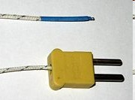
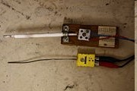
K Type
S and K Type

Slide 43
Advantages and Disadvantages
They are simple, rugged, need no batteries, measure over very wide temperature ranges
The main limitation is accuracy; System errors of less than 1°C can be difficult to achieve

Slide 44
Applications
Thermocouples are most suitable for measuring over a large temperature range, up to 1800 °C
These are widely used in the steel industry, heating appliances, manufacturing of electrical equipments like switch gears etc

Slide 45
Thermistor
A thermistor is a type of resistor with resistance varying according to its temperature. The resistance is measured by passing a small, measured direct current through it and measuring the voltage drop produced.
There are basically two broad types
  NTC-Negative Temperature Coefficient:
used mostly in temperature sensing
  PTC-Positive Temperature Coefficient: used mostly in electric current control.

Slide 46

Types
A NTC thermistor is one in which the zero-power resistance decreases with an increase in temperature
Thermistors (“thermally sensitive resistor”)
The material is a semiconductor
  A composite of a ceramic and a metallic oxide (Mn, Co, Cu or Fe)
A PTC thermistor is one in which the zero-power resistance increases with an increase in temperature

Slide 47
Assuming, as a first-order approximation, that the relationship between resistance and temperature is linear, then:
ΔR = kΔT
where
ΔR = change in resistance ΔT = change in temperature
k = first-order temperature coefficient of resistance For PTC k is positive while negative for NTC

Slide 48
Advantages and Disadvantages
Thermistors, since they can be very small, are used inside many other devices as temperature sensing and correction devices
Thermistors typically work over a relatively small temperature range, compared to other temperature sensors, and can be very accurate and precise within that range

Slide 49
Applications
PTC thermistors can be used as current-limiting devices for circuit protection, as replacements for fuses. Current through the device causes a small amount of resistive heating. This creates a self-reinforcing effect that drives the resistance upwards
PTC thermistors can be used as heating elements in small temperature-controlled ovens. As the temperature rises, resistance increases, decreasing the current and the heating, resulting in a steady state
NTC thermistors are used as resistance thermometers in low- temperature measurements of the order of 10 K.
NTC thermistors can be used as inrush-current limiting devices in power supply circuits. They present a higher resistance initially which prevents large currents from flowing at turn-on, and then heat up and become much lower resistance to allow higher current flow during normal operation.
NTC thermistors are regularly used in automotive applications.
Thermistors are also commonly used in modern digital thermostats and to monitor the temperature of battery packs while charging.
●
●
●
●
●

Slide 50
RTD
Resistance Temperature Detectors (RTDs)
Resistance Temperature Detectors (RTD), as the name implies, are sensors used to measure temperature by correlating the resistance of the RTD element with temperature
As they are almost invariably made of platinum, they are often called platinum resistance thermometers (PRTs)

Slide 51
🞂 Based on materials whose resistance changes in
accordance with temperature
Resistance Temperature Detectors (RTDs)
  The material is a metal
    Platinum, Nickel, Copper are typically used
Positive temperature coefficients
🞂

Slide 52
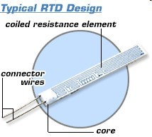
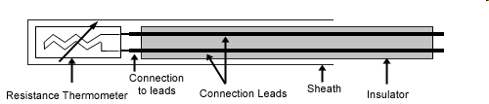
Construction
Common Resistance Materials for RTDs:
Platinum (most popular and accurate) Nickel
Copper Tungsten (rare)
Image obtained from www.omega.com

Slide 53
Construction
RTD elements consist of a length of fine coiled wire wrapped around a ceramic or glass core
The element is usually quite fragile, so it is often placed inside a sheathed probe to protect it
The RTD element is made from a pure material whose resistance at various temperatures has been documented. The material has a predictable change in resistance as the temperature changes; it is this predictable change that is used to determine temperature

Slide 54
Types
There are two broad categories, "film" and "wire-wound" types.
Film thermometers have a layer of platinum on a substrate; the layer may be extremely thin, perhaps 1 micrometer.
Wire-wound thermometers can have greater accuracy, especially for wide temperature ranges.

Slide 55
Advantages
High accuracy
Low drift
Wide operating range
Suitability for precision applications

Slide 56
Limitations
RTDs in industrial applications are rarely used above 660 °C. Difficult to maintain the purity of Platinum at high temperatures
At low temperatures the resistance is independent of temperature as there are a very few phonons and resistance is determined by impurities
Compared to thermistors, platinum RTDs are less sensitive to small temperature changes and have a slower response time. However, thermistors have a smaller temperature range and stability.

Slide 57
Liquid in Glass
These are the most commonly used sensors. The most common liquid is Mercury
The commonly used thermometer falls under this category
Basically consist of a glass cylinder with a bulb at one end, a capillary hole down the axis, connected to the reservoir in the bulb filled with silvery mercury or perhaps a red-colored fluid

Slide 58
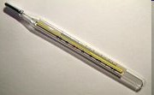
Due to the health reasons mercury is being replaced by galinstan, a liquid alloy of gallium, indium, and tin

Slide 59
Bimetallic Sensors
A bi-metallic strip is used to convert a temperature change into mechanical displacement and thus acts as a temperature sensor
The strip consists of two strips of different metals which expand at different rates as they are heated, usually steel and copper

Slide 60

The different expansions force the flat strip to bend one way if heated, and in the opposite direction if cooled below its normal temperature. The metal with the higher expansion is on the outer side of the curve when the strip is heated and on the inner side when cooled.

Slide 61
Applications
Mechanical clock mechanisms are sensitive to temperature changes which lead to errors in time keeping. A bimetallic strip is used to compensate for this in some mechanisms
In the regulation of heating and cooling, thermostats that operate over a wide range of temperatures the bi-metal strip is mechanically fixed and attached to an electrical power source while the other (moving) end carries an electrical contact.

Slide 62
A direct indicating dial thermometer uses a bi-metallic strip wrapped into a coil. One end of the coil is fixed to the housing of the device and the other drives an indicating needle

Slide 63
Semiconductor Thermometer Devices
Semiconductor thermometers are usually produced in the form of ICs, Integrated Circuits
These devices have temperature measurement ranges that are small compared to thermocouples and RTD, but, they can be quite accurate and inexpensive and very easy to interface with other electronics for display and control.

Slide 64
The major uses are where the temperature range is limited to within a minimum temperature of about -25°C to a maximum of about 200°C
Also the recent advances in electronics and telemetry have resulted in non contact thermometers
These include IR thermometers, IR imagers and optical pyrometers

Slide 65
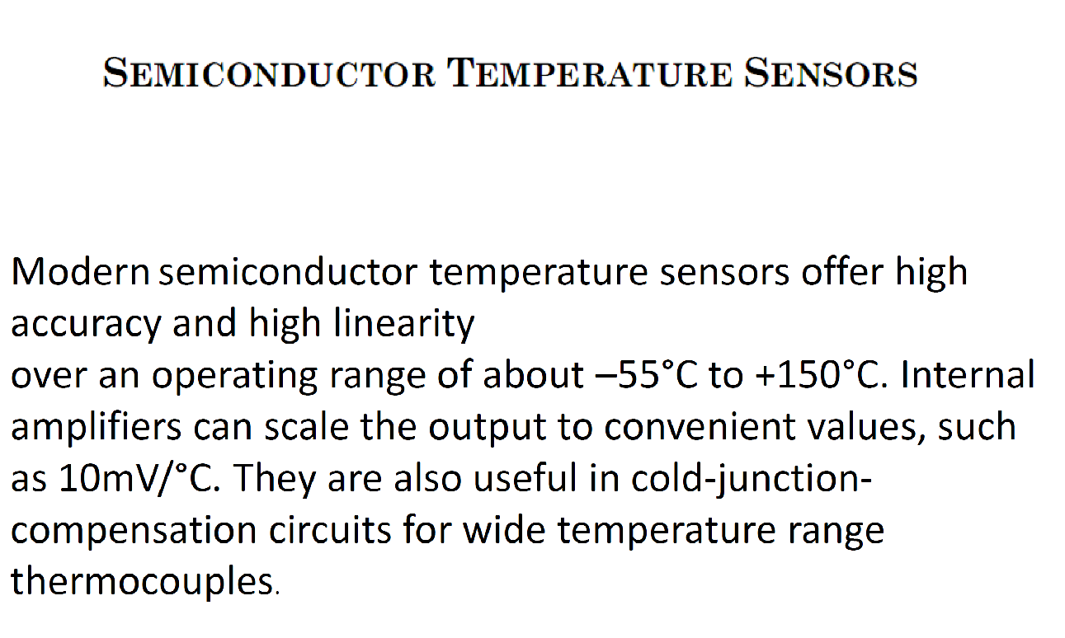

Slide 66
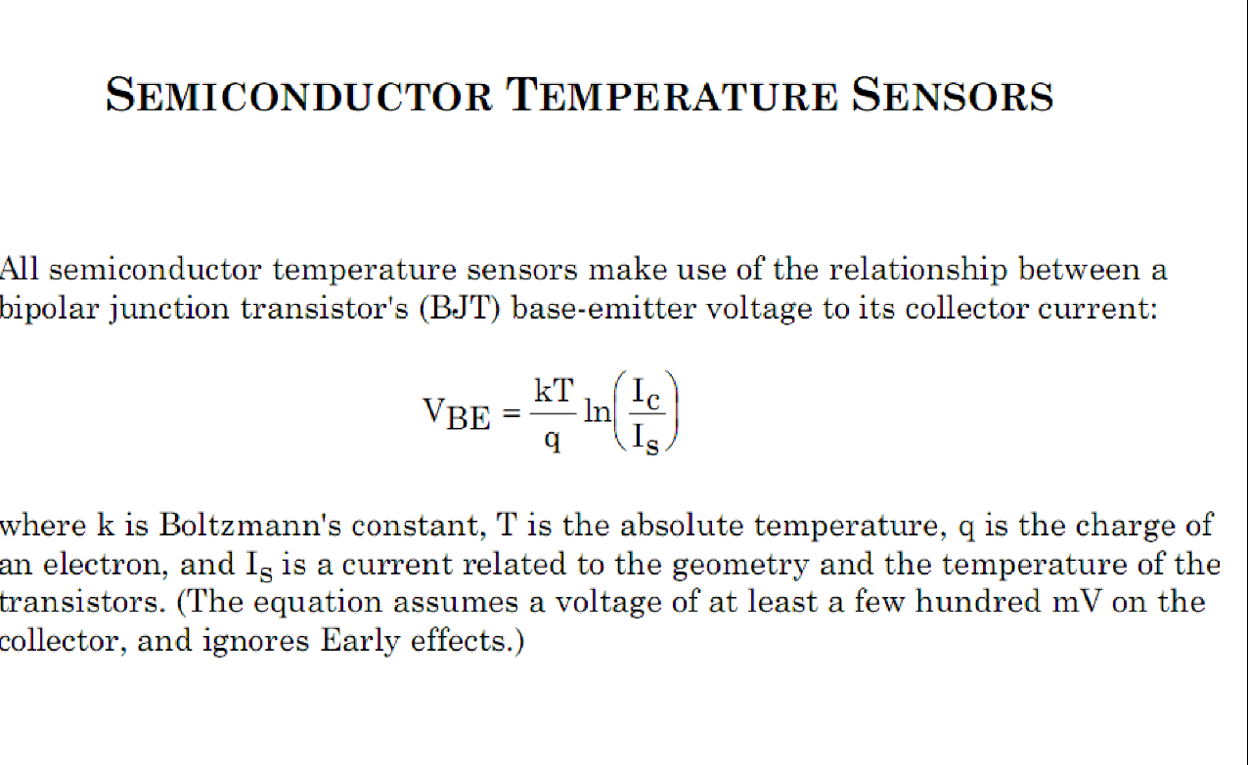

Slide 67
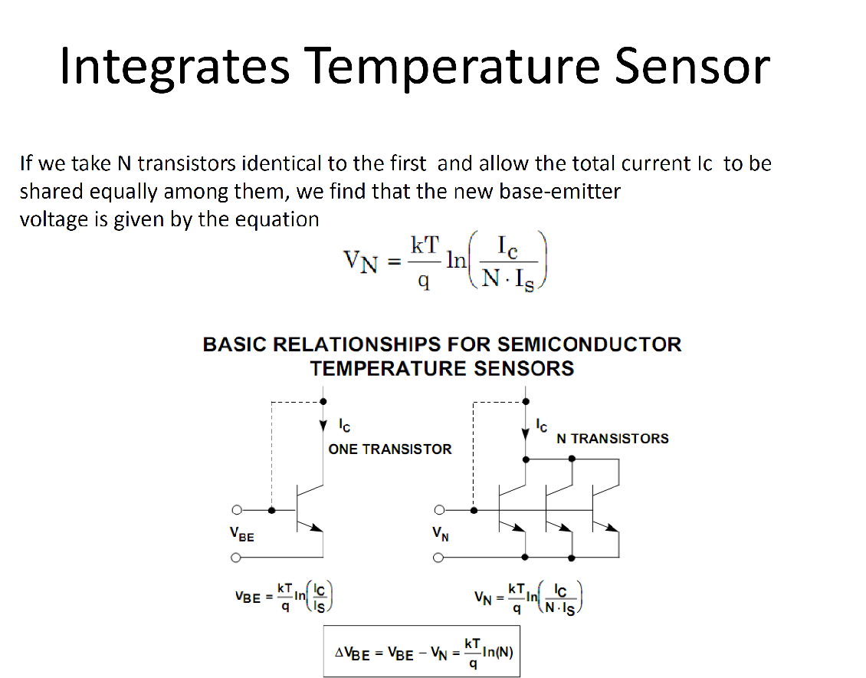

Slide 68
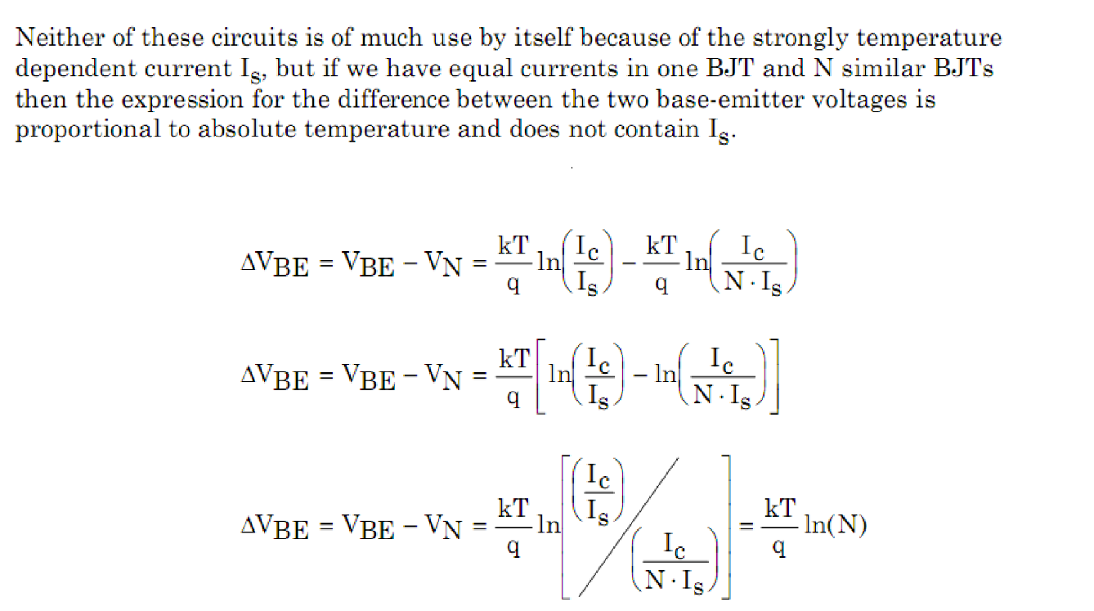

Slide 69
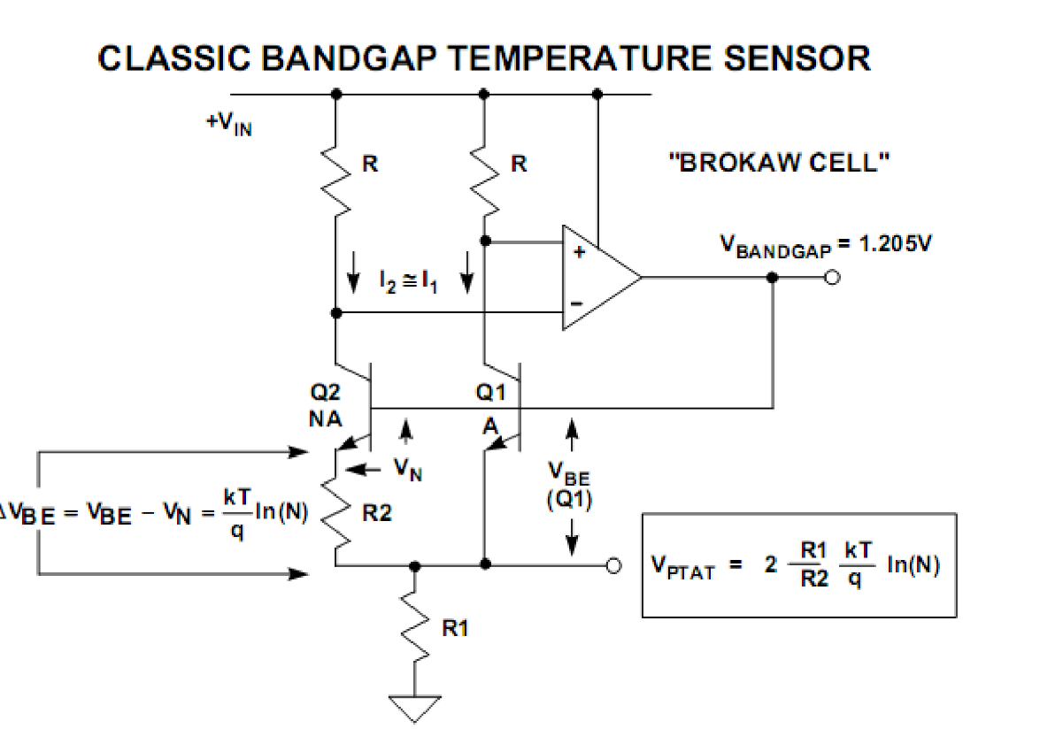

Slide 70
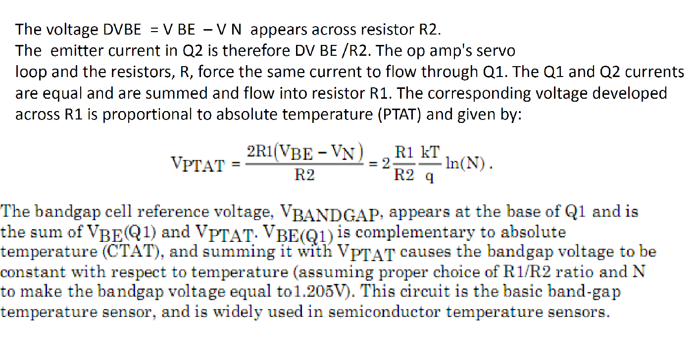

Slide 71
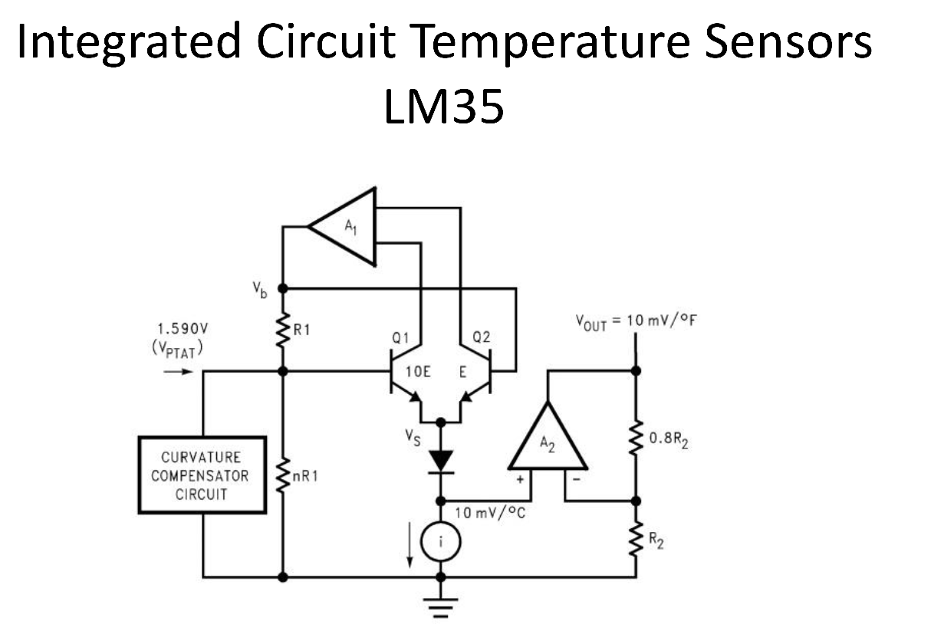

Slide 72
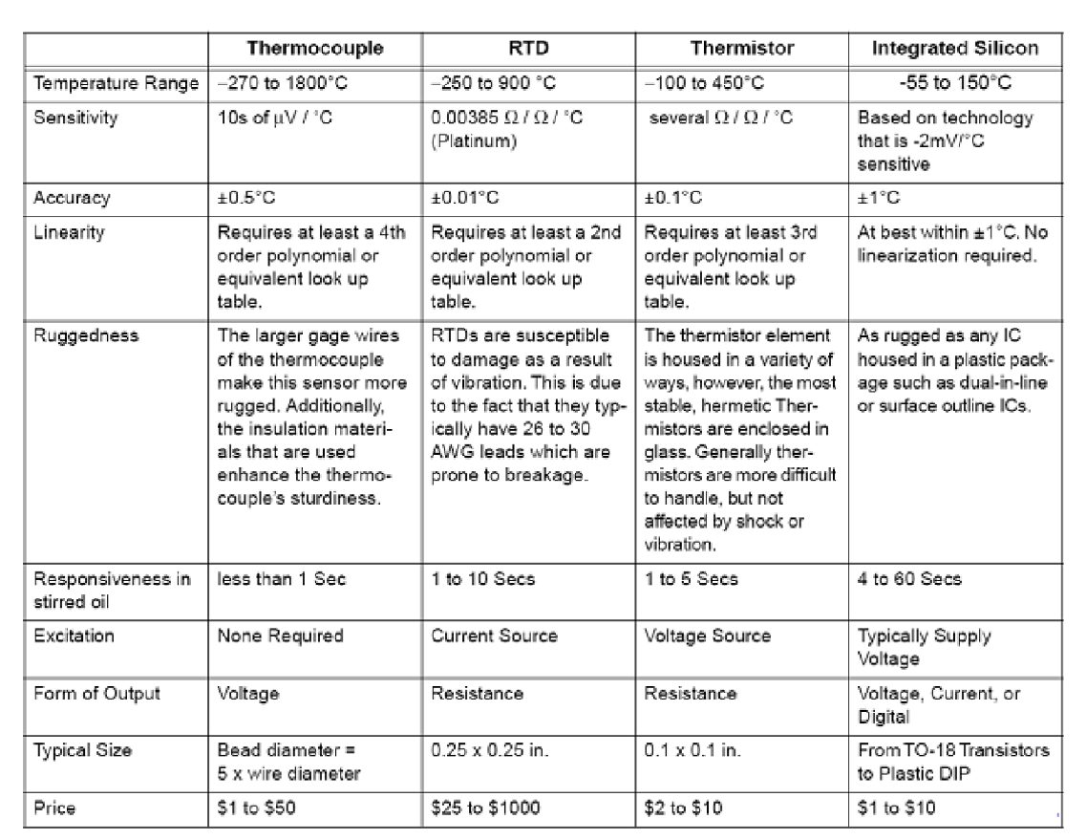

Slide 73

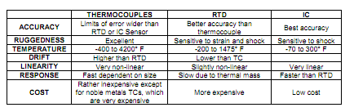

Slide 74

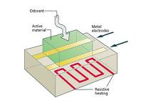
🞂 Absorption of gases modifies the conductivity of sensing layer
🞂 Sensing layer types
Metal Oxide
  Typically SnO2 doped with Pt or Pd
  Operate a high temperatures (300-5000C)
    Temperature-selectivity dependency
  Broad selectivity
    Particularly suitable for combustible gases
Conducting Polymers
  Based on pyrrole, aniline or thiophene
  Operate at room temperature
CPs vs MOXs
  CP advantages
    Large number of polymers available with various selectivities
    Sensitivity* to wide number of VOCs
    Low power consumption
    Faster response and recovery times
  CP Limitations
    Cross-sensitivity* to humidity
    Lower sensitivity* than MOXs
🞂 *By sensitivity here we mean the ability to detect certain Volatile Organic Compound (VOCs), not the slope of the calibration curve

Slide 75
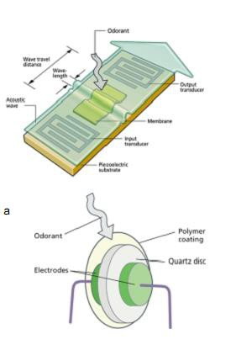
🞂 Piezo-electric effect
The generation of an electric charge by a crystalline material upon subjecting it to stress (or the opposite)
  A typical piezo-electric material is Quartz (SiO2)
Piezo-electric sensors
  Thin, rubbery polymer layer on a piezo-electric substrate
  Sensing principle: mass and viscosity changes in the
sensing membrane with sorption of VOCs
🞂 Surface Acoustic Wave (SAW)
AC signal (30-300MHz) applied to interdigitated input electrode generates a surface (Rayleigh) wave
Propagation delays to output electrode are affected by
changes in the surface properties
◦
Phase shifts of the output electrode signal are used as a
response
🞂 Quartz Crystal Microbalance (QMB)
Also known as Bulk Acoustic Wave (BAW) devices
Device is operated in an oscillator circuit
Changes in the sensing membrane affect the resonant
frequency (5-20MHz) of the device

