Slide 1
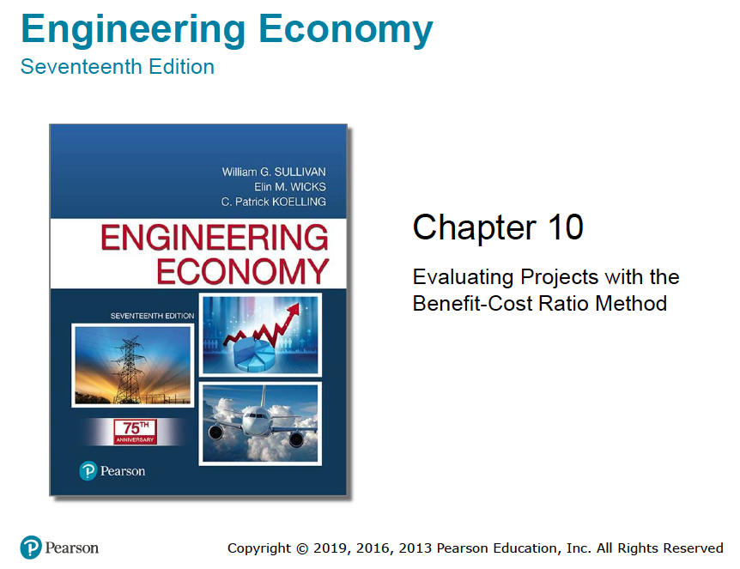

Slide 2
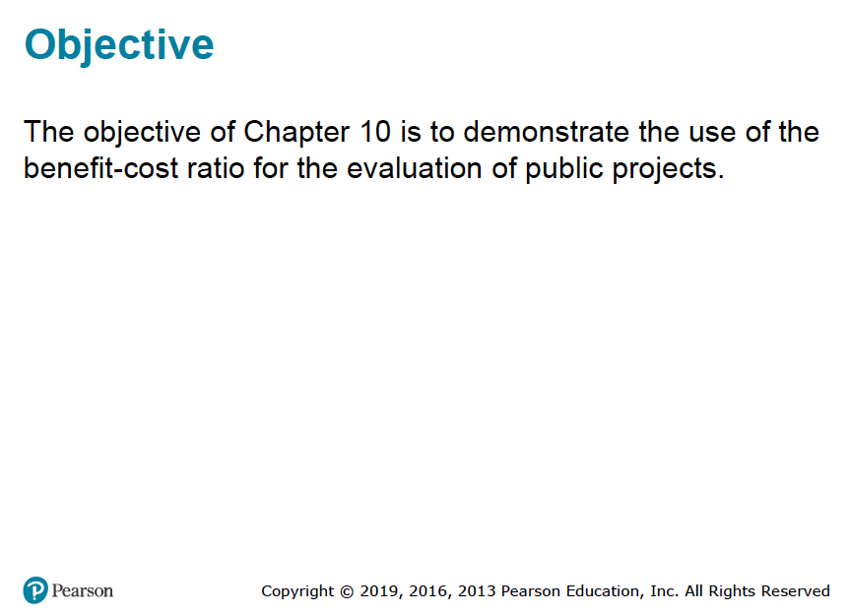

Slide 3
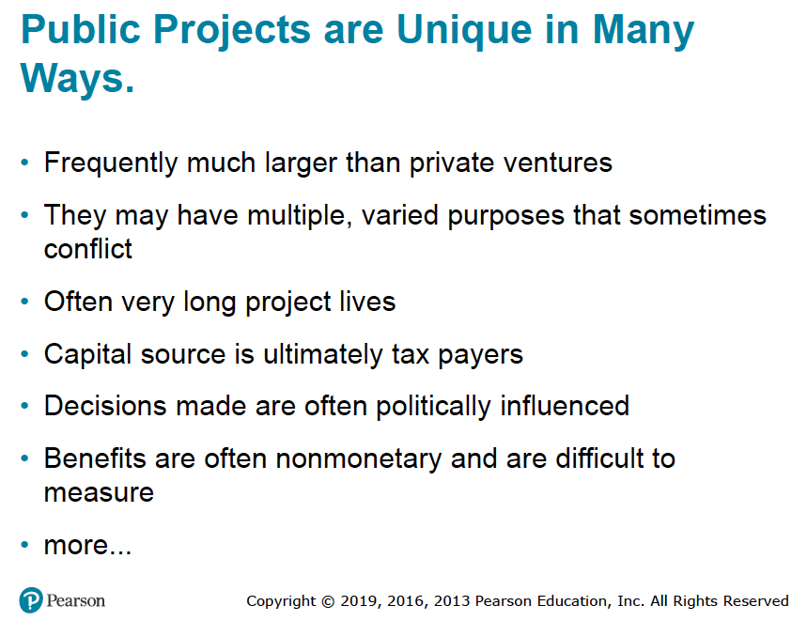

Slide 4
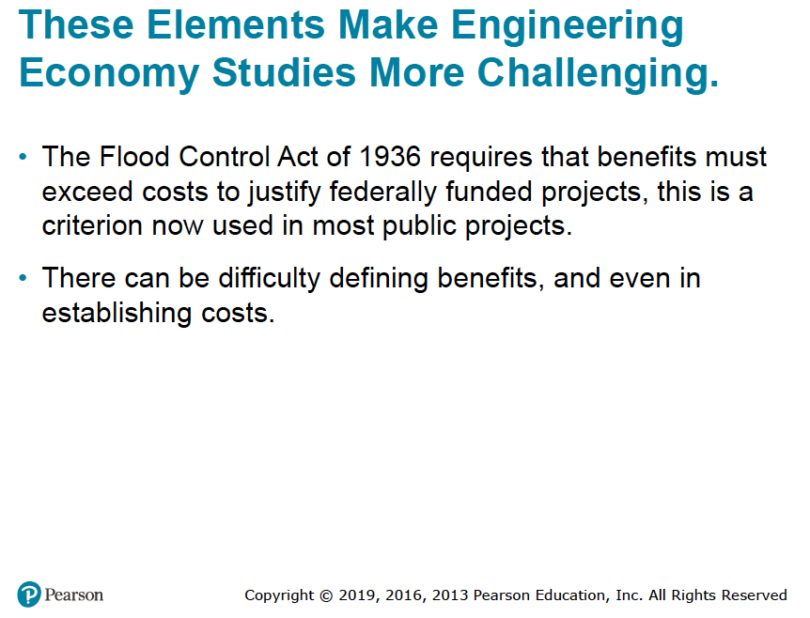

Slide 5
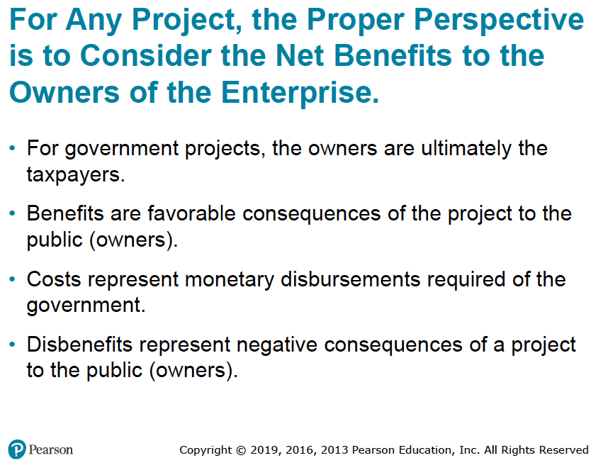

Slide 6
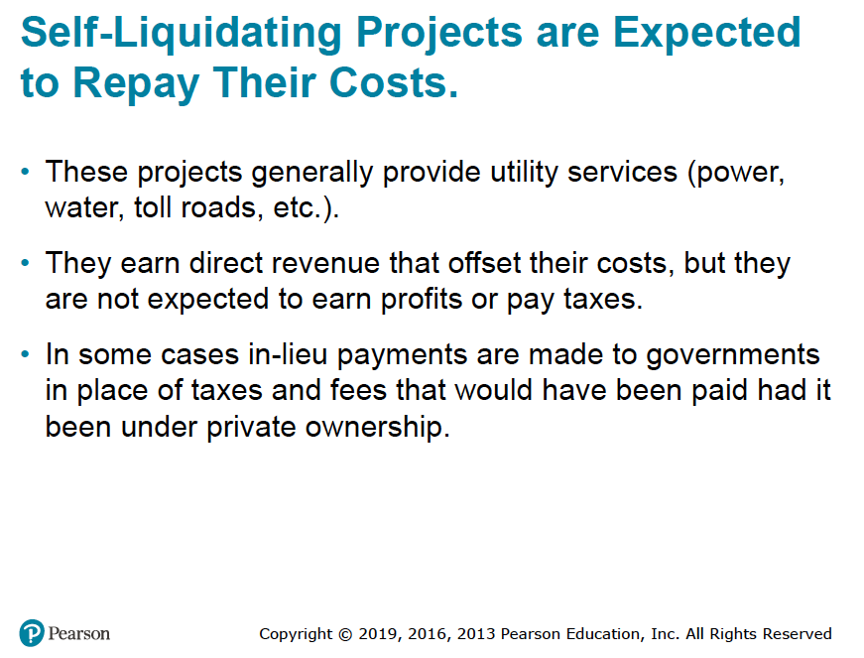

Slide 7
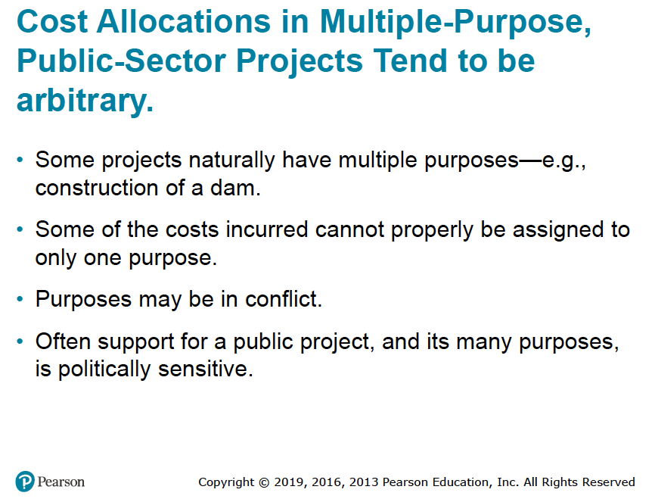

Slide 8
Difficulties Inherent in Project Evaluation Studies in the Public Sector (1 of 2)
1. There is no profit standard to be used as a measure of financial effectiveness. Most public projects are intended to be nonprofit.
2. The monetary impact of many of the benefits of public projects is difficult to quantify.
3. There may be little or no connection between the project and the public, which is the owner of the project.
4. There is often strong political influence whenever public funds are used. When decisions regarding public projects are made by elected officials who will soon be seeking reelection, the immediate benefits and costs are stressed, often with little or no consideration for the more important long-term consequences.

Slide 9
Difficulties Inherent in Project Evaluation Studies in the Public Sector (2 of 2)
5. Public projects are usually much more subject to legal restrictions than are private projects. For example, the area of operations for a municipally owned power company may be restricted such that power can be sold only within the city limits, regardless of whether a market for any excess capacity exists outside the city.
6. The ability of governmental bodies to obtain capital is much more restricted than that of private enterprises.
7. The appropriate interest rate for discounting the benefits and costs of public projects is often controversially and politically sensitive.
Clearly, lower interest rates favor long-term projects having major social or monetary benefits in the future.
Higher interest rates promote a short-term outlook whereby decisions are based mostly on initial investments and immediate benefits.

Slide 10
What Interest Rate Should Be Used for Public Projects?
The choice of an interest rate in the private sector is intended to lead directly to a selection of projects to maximize profit or minimize cost.
In the public sector, on the other hand, projects are not usually intended as profit-making ventures.
Instead, the goal is the maximization of social benefits, assuming that these have been appropriately measured.
The choice of an interest rate in the public sector is intended to determine how available funds should best be allocated among competing projects to achieve social goals.
The relative differences in magnitude of interest rates between governmental agencies, regulated monopolies, and private enterprises are illustrated in Figure 10-2.

Slide 11
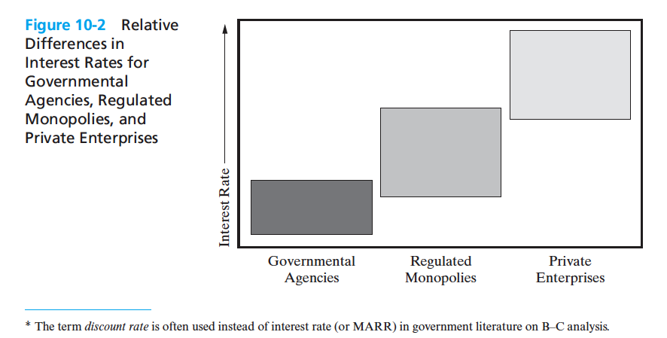

Slide 12
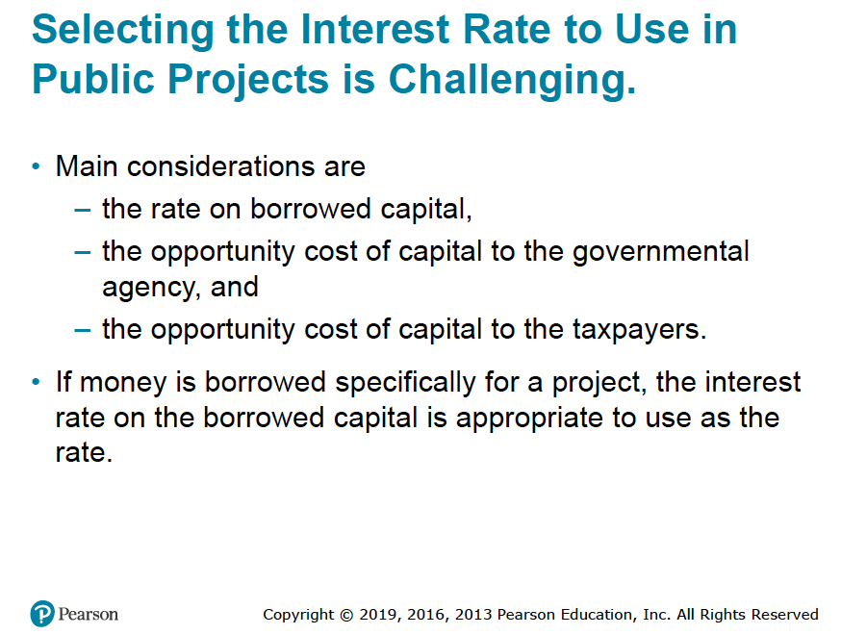

Slide 13
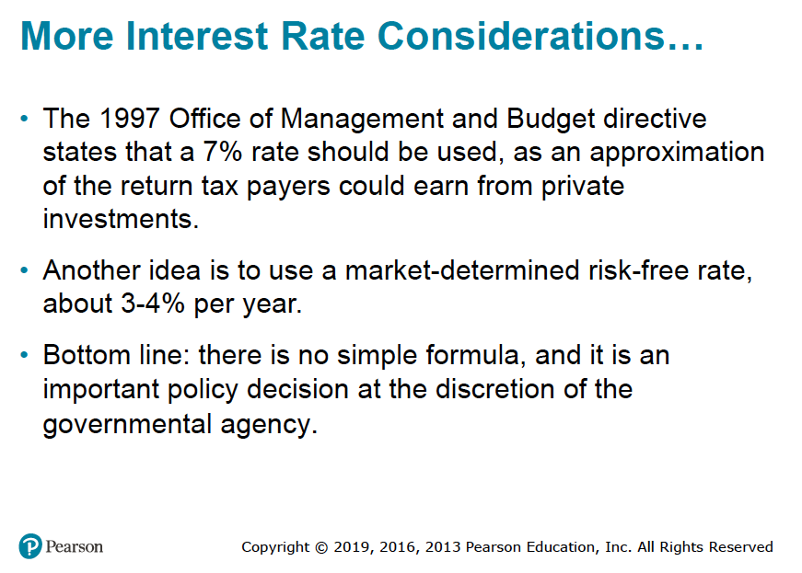

Slide 14
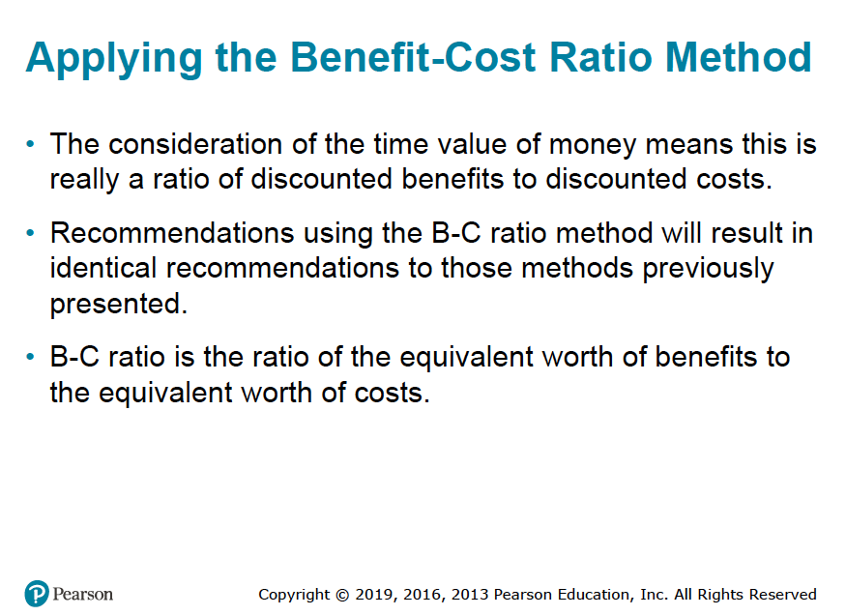

Slide 15
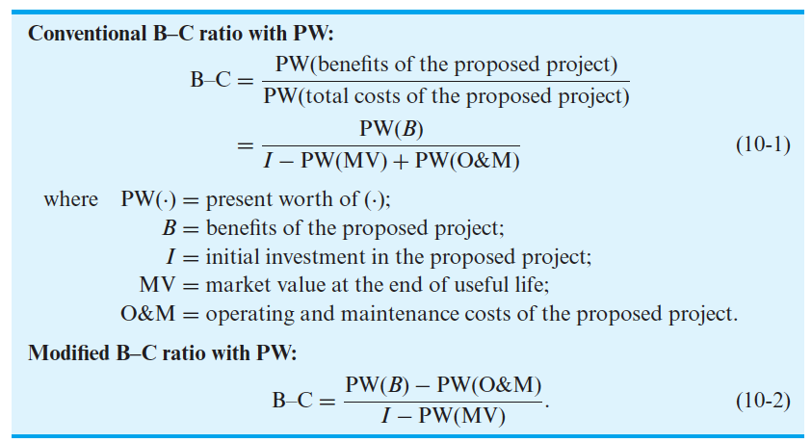
A project is acceptable when the B-C ratio is equal to or greater than 1.

Slide 16
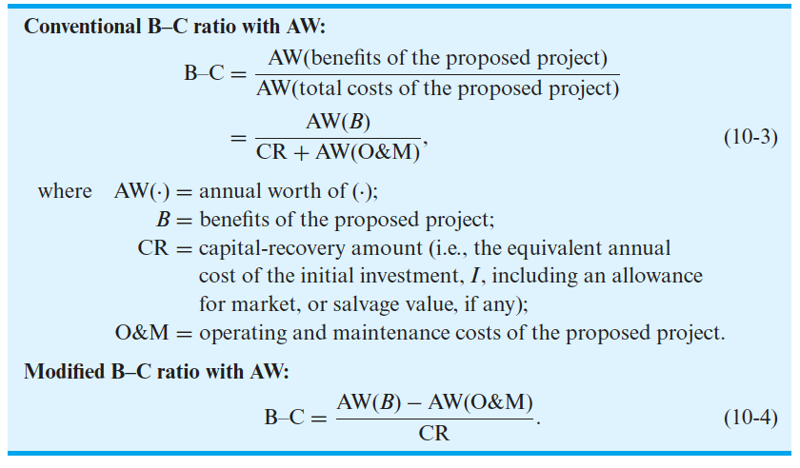
Equations (10-1) and (10-2) can be rewritten in terms of equivalent annual worth as follows:

Slide 17
The Benefit−Cost Ratio Method
The resulting B–C ratios for all the previous formulations will give identical results in determining the acceptability of a project (i.e., either B–C ≥ 1.0 or B–C < 1.0).
The conventional B–C ratio will give identical numerical results for both PW and AW formulations; similarly, the modified B–C ratio gives identical numerical results whether PW or AW is used.
Although the magnitude of the B–C ratio will differ between conventional and modified B–C ratios, go/no-go decisions are not affected by the choice of approach.

Slide 18
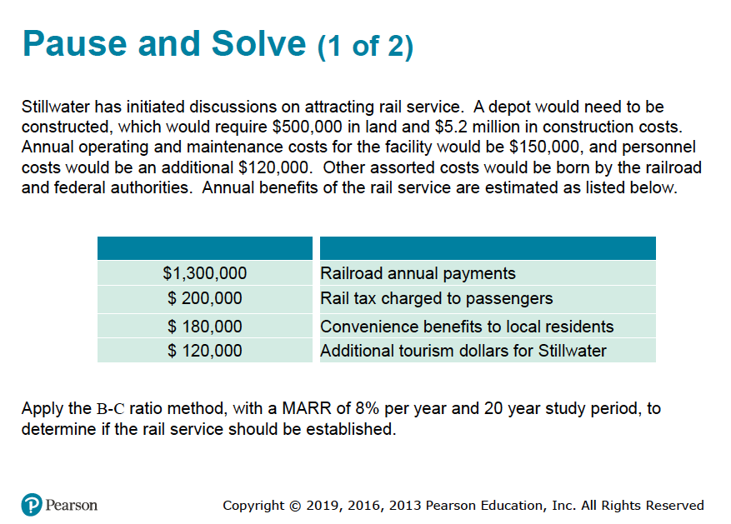

Slide 19
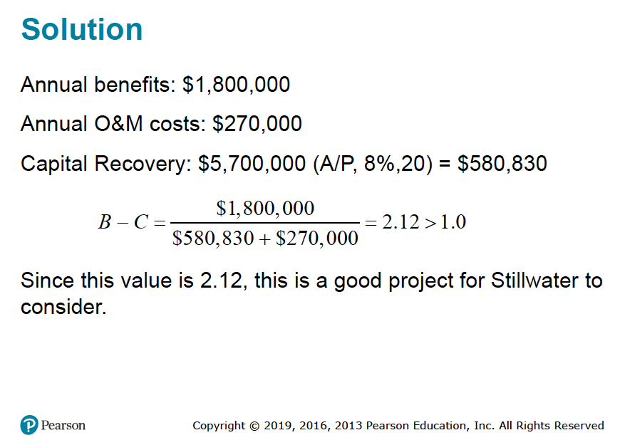

Slide 20
The city of Columbia is considering extending the runways of its municipal airport so that commercial jets can use the facility. The land necessary for the runway extension is currently a farmland that can be purchased for $350,000. Construction costs for the runway extension are projected to be $600,000, and the additional annual maintenance costs for the extension are estimated to be $22,500. If the runways are extended, a small terminal will be constructed at a cost of $250,000. The annual operating and maintenance costs for the terminal are estimated at $75,000. Finally, the projected increase in flights will require the addition of two air traffic controllers at an annual cost of $100,000. Annual benefits of the runway extension have been estimated as follows:
$325,000 | Rental receipts from airlines leasing space at the facility
$65,000 | Airport tax charged to passengers
$50,000 | Convenience benefit for residents of Columbia
$50,000 | Additional tourism dollars for Columbia
Apply the B–C ratio method with a study period of 20 years and a MARR of 10% per year to determine whether the runways at Columbia Municipal Airport should be extended.

Slide 21
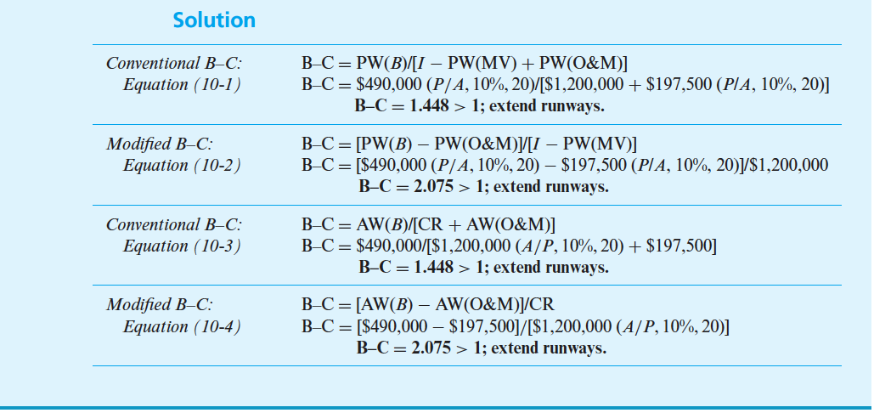

Slide 22
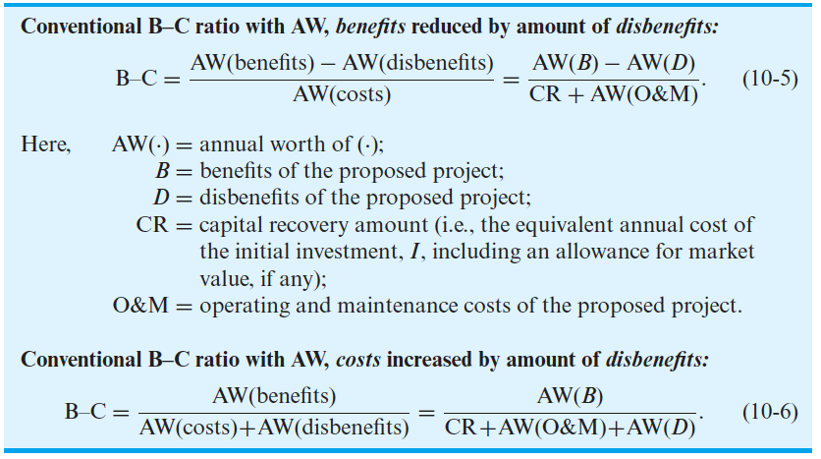
Disbenefits (D) can be included in the B-C Ratio in either the Numerator or Denominator, as shawn with AW below:

Slide 23
Disbenefits (D) can be included in the B-C Ratio in either the Numerator or Denominator, as shawn with AW below:
As in the case of conventional and modified B–C ratios, the treatment of disbenefits may affect the magnitude of the B–C ratio, but it has no effect on project desirability in go/no-go decisions.

Slide 24
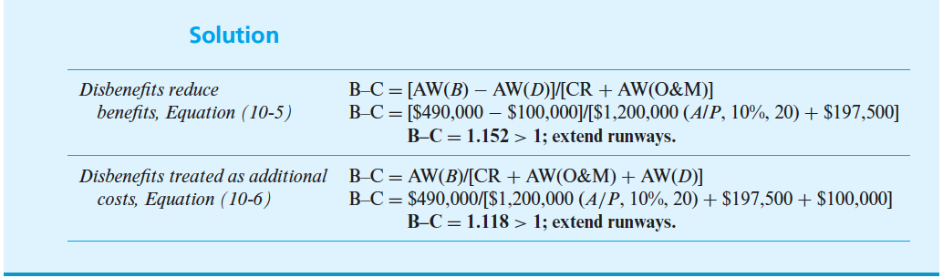
Refer back to Example 10-2. In addition to the benefits and costs, suppose that there are disbenefits associated with the runway extension project. Specifically, the increased noise level from commercial jet traffic will be a serious nuisance to homeowners living along the approach path to the Columbia Municipal Airport. The annual disbenefit to citizens of Columbia caused by this noise pollution is estimated to be $100,000. Given this additional information, reapply the conventional B–C ratio, with equivalent annual worth, to determine whether this disbenefit affects your recommendation on the desirability of this project.

Slide 25
🔹 As can be seen in the preceding example, the difference between conventional and modified B–C ratios is essentially due to subtracting the equivalent-worth measure of operating and maintenance costs from both the numerator and the denominator of the B–C ratio.
🔹 In order for the B–C ratio to be greater than 1.0, the numerator must be greater than the denominator.
🔹 Similarly, the numerator must be less than the denominator for the B–C ratio to be less than 1.0.
🔹 Subtracting a constant (the equivalent worth of operating and maintenance costs) from both numerator and denominator does not alter the relative magnitudes of the numerator and denominator. Thus, project acceptability is not affected by the choice of conventional versus modified B–C ratio. This information is stated mathematically as follows for the case of B–C > 1.0:

Slide 26
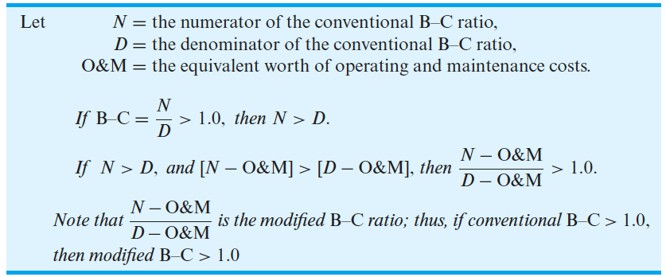

Slide 27

In this example, we will evaluate the bypass described in the beginning of the chapter. The construction cost of the bypass is $20 million, and $500,000 would be required each year for annual maintenance. The annual benefits to the public have been estimated to be $2 million. If the study period is 50 years and the state’s interest rate is 8% per year, should the bypass be constructed? What impact does a social interest rate of 4% per year have on the B–C ratio of the project?
Solution
At an interest rate of 8% per year, the conventional B–C ratio of the proposed bypass is
Because this ratio is less than one, the bypass is not economically acceptable at 8% interest.
If a social interest rate of 4% per year was used, the B–C ratio would be 1.40 and the bypass would be acceptable.

Slide 28
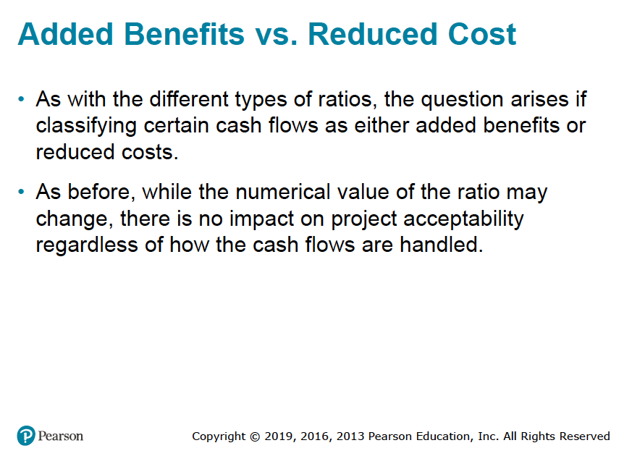

Slide 29
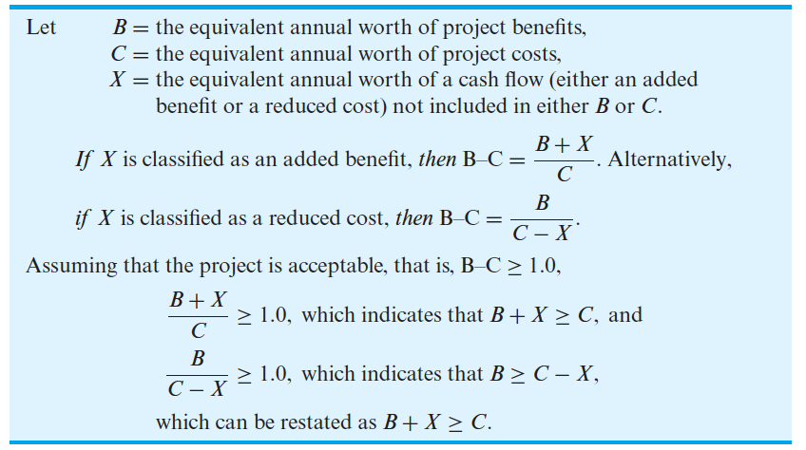

Slide 30
A project is being considered by the Tennessee Department of Transportation to replace an aging bridge across the Cumberland River on a state highway. The existing two-lane bridge is expensive to maintain and creates a traffic bottleneck because the state highway is four lanes wide on either side of the bridge. The new bridge can be constructed at a cost of $300,000, and estimated annual maintenance costs are $10,000. The existing bridge has annual maintenance costs of $18,500. The annual benefit of the new four-lane bridge to motorists, due to the removal of the traffic bottleneck, has been estimated to be $25,000. Conduct a B–C analysis, using a MARR of 8% and a study period of 25 years, to determine whether the new bridge should be constructed.
Solution
Treating the reduction in annual maintenance costs as a reduced cost:
B–C = $25,000/[$300,000(A/P, 8%, 25) − ($18,500 − $10,000)]
B–C = 1.275 > 1; construct new bridge.
Treating the reduction in annual maintenance costs as an increased benefit:
B–C = [$25,000 + ($18,500 − $10,000)]/[$300,000(A/P, 8%, 25)]
B–C = 1.192 > 1; construct new bridge.
Therefore, the decision to classify a cash-flow item as an additional benefit or as a reduced cost will affect the magnitude of the calculated B–C ratio, but it will have no effect on project acceptability.

Slide 31
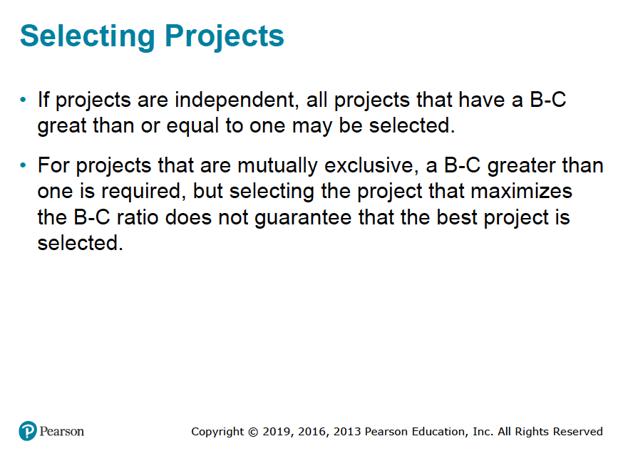

Slide 32
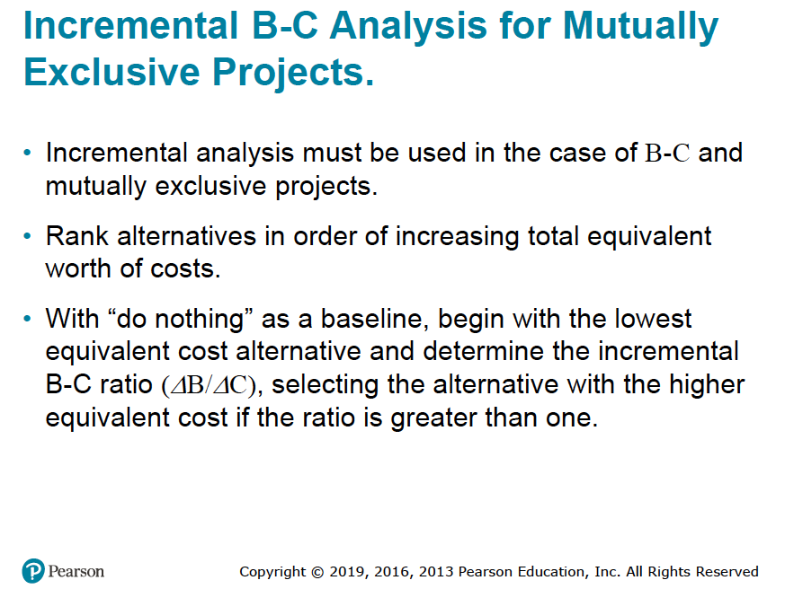

Slide 33
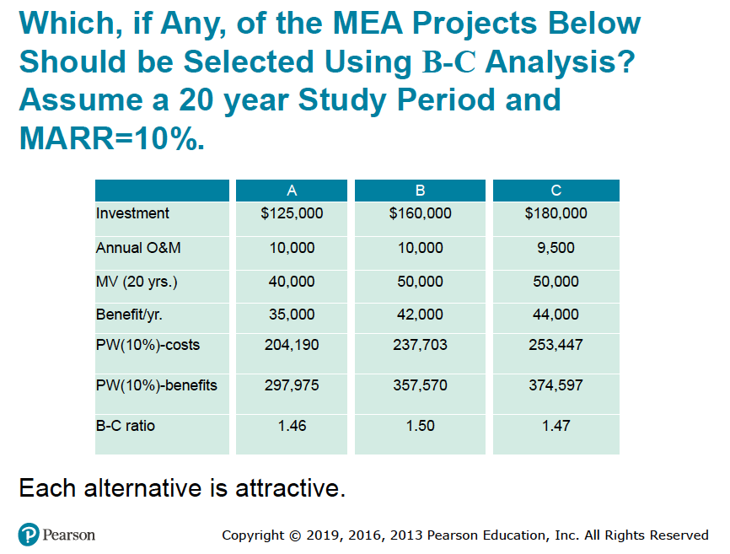

Slide 34
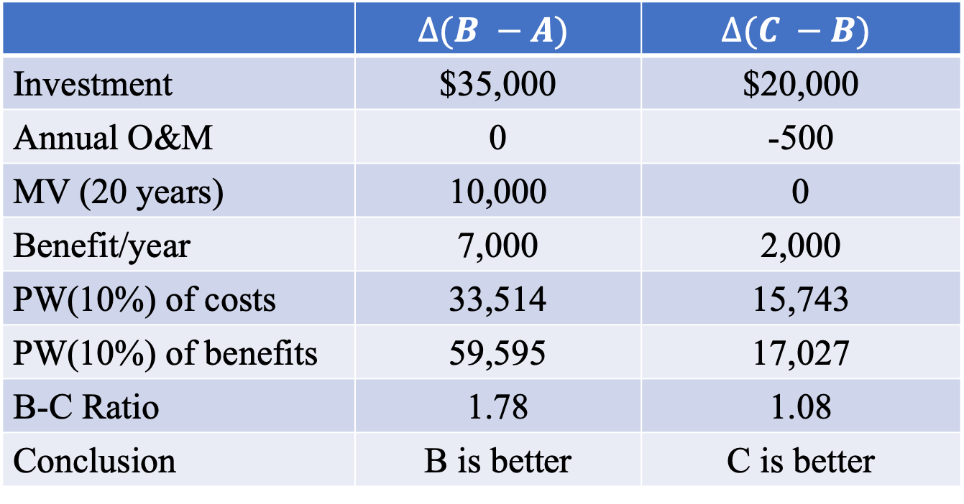
Incremental Analysis
 | $$∆(B −A)$$ | $$∆(C −B)$$
Investment | $35,000 | $20,000
Annual O&M | 0 | -500
MV (20 years) | 10,000 | 0
Benefit/year | 7,000 | 2,000
PW(10%) of costs | 33,514 | 15,743
PW(10%) of benefits | 59,595 | 17,027
B-C Ratio | 1.78 | 1.08
Conclusion | B is better | C is better
Choose alternative C.

Slide 35
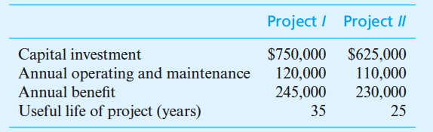
Two mutually exclusive alternative public-works projects are under consideration. Their respective costs and benefits are included in the table that follows. Project I has an anticipated life of 35 years, and the useful life of Project II has been estimated to be 25 years. If the MARR is 9% per year, which, if either, of these projects should be selected? The effect of inflation is negligible.

Slide 36
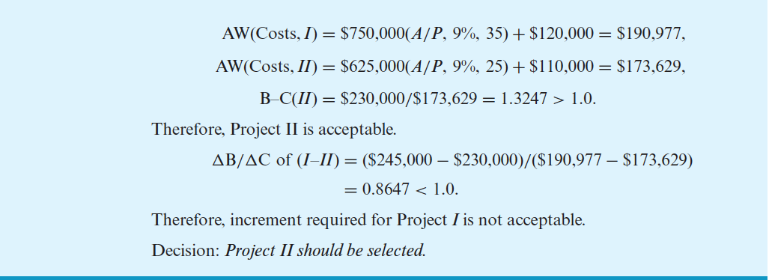

Solution
B-C ratio (Project I = 245,000/190,977 = 1.2829 > 1. Therefore, based on its own merit,
Project I is acceptable. But let’s check the differences to choose one of them

Slide 37
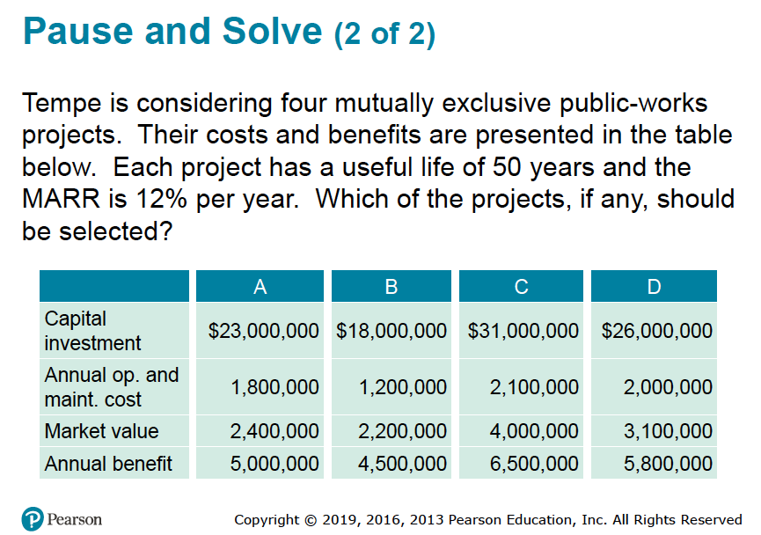
Work this problem on your own!

Slide 38
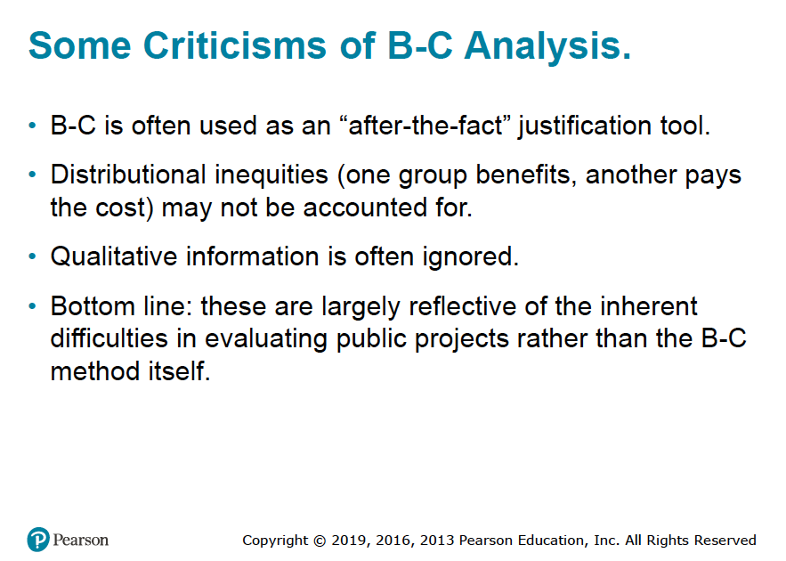

Slide 39
