Slide 1
Epidemiological studies

Slide 2
Types of epidemiological studies
Descriptive studies
Ecological studies.
Case reports or case series
Cross-sectional surveys
Etiologic studies
Case- control studies
Observational
Prospective cohort studies
Experiments
Notes:
The different types of epidemiologic studies that are used to study the relationship between diet and disease are divided into two main categories- descriptive studies, which are used in describing patterns and in generating hypothesis but not in testing them: and these include ecological studies, special exposure groups and migrant studies and secular trends. And etiological studies, in which data is collected from individuals and so they are used to test hypothesis concening the etiology of the disease. And these include case-control and prospective studies ( which are obervational studies) and randomized trials. A discription of each study type with strengths and weaknesses follows.

Slide 3
Study designs
The relative strengths of studies for identifying risk factors
Establishing cause
Experiments
High
Cohort studies
Case-control
Source of hypothesis
Cross sectional
Case series
Case report
Low
Ecological
strength

Slide 4
Types of epidemiological studies Descriptive studies
Used to formulate hypothesis not to test them.
Less-expensive since they use readily available data.
Describe patterns of disease occurrence.

Slide 5
Descriptive studies Ecological studies
Study the pattern of disease among populations.
Concerned with measurements that represent characteristics of entire populations as a whole.
Correlation coefficient r is the descriptive measure of association in ecological studies.

Slide 6
Ecological studies
50
NZ
USA
30
CAN
COLON CANCER INCIDENCE
100,000 WOMEN / YEAR
DEN
UK
SWE
NET
NOR
ISR
FDR
10
JAM
ICE
JAP
YUG
FIN
DDR
CHI
ROM
PR
POL
NIG
COL
HUN
40
80
120
160
200
240
280
320
PER CAPITA DAILY MEAT CONSUMPTION- GRAMS
Figure adapted from W. Willett, nutritional epidemiology 2nd ed. 1998
Notes:
Ecological studies basically offer a comparison of disease rates in populations with the population per capita consumption of specific dietary factors. Usually the dietary information in such studies is based on ”disappearance data”, which means the national figures for food produced and imported minus the food that is exported, fed to animals or otherwise not available to humans.
Many of the correlations based on such information are remarkably strong. Here we see for example the relationship between meat intake and the incidence of colon cancer in different countries. This association can be however confounded, for example most of the countries here with low incidence of colon cancer tend to be economically underdeveloped, so any variable associated with industrialization will be similary corrlated.

Slide 7
Ecological studies
Strengths
Quick and inexpensive since readily available records are used.
Weaknesses
Inability to link exposure with disease in particular individuals. ” NO CAUSE-EFFECT relationship can be established”.
Other determinants of disease may vary between areas compared ( cannot control for confounding variables).
Data represents average exposure levels rather than actual individual values.
Notes:
So the strengths of correlational studies are-
The contrasts in dietary intake are typically very large.
The average of diets for persons living in a country are likely to be more stable over time than are diets of individual persons within the country.
large populations- small random error
And the weaknesses are-
Other determinants of disease (other than diet) may vary between areas with a high and a low incidence of disease(confounding factors like genetic predisposition, lifestyle factors, environmental factors) as we have seen in the example with colon cancer and meat consumption.
Importance of temporal relation in correlational studies. For at least some diseases rates may be most appropriatly related to dietary data many years earlier.
Limited by use of food disappearence data indirectly related to intake and are
likely to be of variable quality. like in the previous example the dissapearence in calories per capita might be due in some countries to wasted food in addition to higher actual intake.
another example- alcohol and breast cancer- in some cultures alcohol is consumed by men only.

Slide 8
Case reports and case series
Describe the experience of a single patient or a group of patients with a similar diagnosis.
Case reports
Document unusual medical occurrences.
Represent the first clues in the identification of new diseases or adverse effects of exposures.
Case series
Collections of individual case reports which may occur within a fairly short period of time.
Historically has often been used as an early means to identify the begining or the presence of an epidemic.

Slide 9
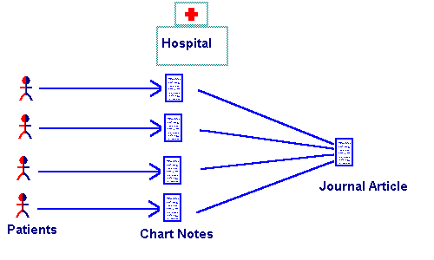
Schematic design of a Case report & Case series studies

Slide 10
Case reports and case series
Strengths
Useful to recognize new diseases and the formulation of hypothesis concerning possible risk factors
Limitations
Cannot be used to test for the presence of a valid statistical association.
Based on the experience of only one person (case-report).
Lack of a comparison group. ” this can either obscure a relationship or suggest an association where non actually exists.”

Slide 11
Cross sectional studies
In this design, measurements are made on a population at one point in time ( snapshot ).
For example, a survey done in a village to identify the number of individuals with hypertension. Here the villagers are screened with blood pressure measurement at one point in time.
Cross sectional studies measure the prevalence of disease and are also called prevalence studies.
Cross sectional studies yield useful data on prevalence of diseases and this is often good enough to assess the health situation a population.

Slide 12
Cross sectional studies
Strengths:
Cheap and simple
Ethically safe
Weaknesses:
Establishes association at most, not causality.
Problem in temporality

Slide 13
Etiologic studies Case-control studies
Exposure Disease Investigator
(dietary intake)

?
?
Odds of exposure among cases
OR =
Odds of exposure among controls
Notes:
Analytic studies – in these studies dietary information is obtained for the individuals actually affected by disease rather than using the average intake in the population as a whole,as is the case with descriptive studies..
Case-control studies-here the criteria for entering a study is the disease status. The investigator selects patients and controls and the information about previous diet is obtained from diseased patients and compared with that from subjects without the disease.
the relationship between exposure and disease is presented in case control studies by the ODDs Ratio which is basically the odds of exposure among cases divided by the odds of exposure among controls.

Slide 14
Case-control studies
Strengths
Information obtained for the individuals actually affected by disease- information is efficient and rapid.
Can adjust for confounding factors either in the design or in the analysis.
Weaknesses
Bias (recall).
Selection of control group is problematic
- patients with other diseases
- sample from general population
Temporal relationship
Notes:
Strengths-
Information obtained for the individuals actually affected by disease- information is efficient and rapid.
Can adjust for known confounding factors either in the design or in the analysis of the study.
Weaknesses
Valid results maybe difficult to obain from case-control studies because of the limited range of variation in diet within most populations and some inevitable error in measuring intake due to the method of dietary assessment itself so realistic RR is likely to be modest.
Recall bias is a specially important problem in case-control studies since cases will systematically over or under report past dietary practices compared to controls.
Also the selection of control group can be problematic-
patients with another disease with the assuming that the exposure under study is unrelated to the condition of this control group. However because diet may effect many diseases, it is often difficult to identify disease groups that are definitely urelated to the aspect of diet under investigation.
The other alternative is to have a sample from the general population as the control group, but then the participation rate will be low... And also diet is related with the level of general health consciousness, so diets of those who participate may differ from those who don’t.
The third weakness has to do with the temporal relationship.... Since in these studies the exposure (dietary intake) is assessed after the occurance of disease, this is especially important when biochemical indicators are used as surrogates for diet, since you cannot exclude the possibility that the difference in the level of nutrient is not due to the disease itself or to treatment.

Slide 15
Case-control studies
The purpose of the control group is to determine the relative size of the exposed and unexposed components of the source population.
So control group is used to estimate the distribution of exposure in the source population, so controls should be sampled independently of exposure status.

Slide 16
Nested case-control studies
The Population within which the study is conducted is a well defined cohort.
Almost any case-control study can be thought of as nested within a source population , and a description of this population corresponds to eligibility criteria for both cases and controls.

Slide 17
Control selection
Population controls
Neighborhood controls
Random-digit dialing
Hospital or clinic based controls
Dead people-

Slide 18
Control selection
Hospital or clinic based controls
problem- possibility that they are not selected independently of exposure in the source population.
Using a variety of diagnosis has the advantage of diluting any bias that might result from including a specific diagnostic group that is in fact related to the exposure.

Slide 19
Control selection
Dead people- not members of source population!!ok if have same exposure distribution as source population.(but sometimes exposure is the cause of death).

Slide 20
Prospective cohort studies
Etiologic studies
Exposure Investigator Disease

?
?
Risk of disease in exposed
RR =
Risk of disease in non-exposed
Notes:
Prospective cohort study- in this study exposure is the criteria for intering the study- information on diet is obtained from disease-free subjects who are then followed to determine disease rates according to levels of dietary factors.
The relative risk which is the the ratio between the risk of disease in exposed to the risk of disease in the non-exposed is the measurement of association used in these studies.

Slide 21
Prospective cohort studies
Strengths
Information on exposure is collected before the disease occurs
so illness cannot affect the recall of exposure or the biochemical indicators of exposure.
The opportunity to obtain repeated information on the exposure over time.
The opportunity to examine the effect of exposure on a wide variety of diseases simultaneously.
Weaknesses
The necessity of enrolling tens of thousands of subjects (use of self
admininstered questionnaires has made studies of this size possible).
Not good for rare diseases even if study includes a large number of people.
Expensive/time consuming- many years.
Notes:
Strengths-
Information on exposure (diet) is collected before the disease occurs
so illness cannot affect the recall of diet or the biochemical indicators of diet.
The oprtunity to obtain repeated information on diet over time, so cahnges in diet can be assessed...
The opportunity to examine the effect of diet on a wide variety of diseases simultaneously.
Weaknesses-
The necessity of enrolling tens of thousands of subjects (use of self
admininstered questionnaires has made studies of this size possible.
not good for rare diseases even if study includes a large number of people.
Cohort studies are expensive and time consuming and can go on for many years.

Slide 22
Cohort studies
Complications
Who is eligible to be followed?
What should count as an instance of disease?
measure risk or incidence rates?
How to define exposure?

Slide 23
Cohort studies
Who can belong to a cohort?- basic requirments
Cohort members must be at risk of getting the disease. (often called population at risk).(e.g alive)
Everyone should be free of the disease being measured at the onset of follow-up

Slide 24
Cohort studies
Who can belong to a cohort?- basic requirments
not as simple as it seems.
- if outcome is development of measles should people with measles vaccination be included?
- disease occurs only once (diabetes, death, MS) or does it reoccur?

Slide 25
Cohort studies
Being part of a population at risk is a dynamic process. People may enter or leave a population at risk depending on their health and other possible eligibility criteria ( age, geography).

Slide 26
Cohort studies
2 types of cohorts
1. Closed cohort (e.g randomized experiments)
2. Open cohort- dynamic cohort- can take new members as time passes and people who leave geographic boundaries will not be counted. (e.g school population)

Slide 27
Cohort studies
Counting disease events- Incidence rate, risk.
New cases of disease are counted- BUT- some disease onsets are excluded:
1. If not the first occurrence of the disease in that person.
- difficult to distinguish between a new case and a recurrence of an earlier case.
- recurrent disease may have a different set of causes from the primary occurrence.

Slide 28
Cohort studies
2. There was insufficient time for the disease to be related to an exposure –induction time.
There are two reasonable options for dealing with this time: ignore it or combine it with the follow-up time of people who were never exposed.

Slide 29
Example
*
12
exposed
20
15
*
2
*
10
20
18
unexposed
20
*
11
20
0
5
10
15
20
years

Slide 30
Cohort vs. Case-control
Cohort study | Case-control study
Complete source population | Sampling from source population
Can calculate incidence rates or risks | Can only calculate the ratio of incidence rates or risks.
expensive | Less expensive
Convenient for studying many diseases | Convenient for studying many exposures

Slide 31
Causation
RISK FACTOR
DISEASE
Observational study
Results that show an association
Is the association due to chance?
Is the association due to Bias?
Is the association due to confounding?
Is the association a cause-effect relationship?

Slide 32
Cohort studies- experiments
Experiments are the golden standard!!!
All experiments are cohort studies but not all cohort studies are experiments!!!
1. Randomization
2. control and intervention group.

Slide 33
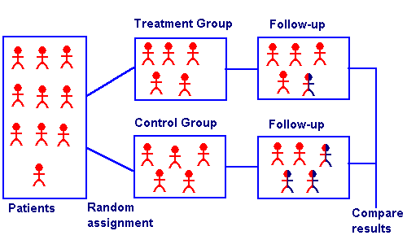
Schematic design of a Experimental clinical study

Slide 34
Randomized controlled trials
Strengths
Potential and unknown confounders are distributed at random between the treatment and control groups (minimizing possibility of confounding by known and unknown factors).
Possibility of creating a larger contrast between the groups being compared.
Unique information on the latent period between change in an exposure and change in disease.
Notes:
Stregnths
The principle strength of a randomized trial is that potential and unknown confounders should be distributed at random between the treatment and the control group., thus minimizing the possibility of confounding by these extraneous factors.
Possibility of creating a larger contrast between the groups being compared.
Particulary practical for evaluating hypothesis concerning minor components of diet, such as trace elements or vitamins.
Because it is easy to put the nutrient in a form of capsule.
Unique information on the latent period between change in an exposure and change in disease.

Slide 35
Randomized controlled trials
Weaknesses
Time between change in level of exposure and disease is uncertain (trials should have long duration).
Compliance with treatment is likely to decrease during an extended trial.
Participants who enroll are usually health conscious and are motivated, so people with highest risk are seriously underrepresented.
Some trials are impossible due to ethical or practical reasons.
Notes:
Weaknesses
Time between change in level of exposure and disease is uncertain (trials should have long duration). But even then RCT might not yield any results because from some disease perhaps exposure early in childhood may determine the disease in adulthood.
Compliance with treatment diet is likely to decrease during an extended trial specially if treatment involves a real change in food intake.
Participants who enroll are usually health conscious and are motivated, so people with highest risk (on the basis of their dietary intake) are seriously underrepresented.
Some trials are impossible due to ethical or practical reasons.

Slide 36
Cohort studies- experiments
Randomization tends to produce comparability between the cohorts with respect to factors that might affect the rate of complications (clinical trials).
1. clinical trials- aims to study complication of disease.
2. field trials- participants are not patients and the goal is to study the primary prevention of disease (e.g- salk vaccine-1954)
3. community intervention trial- exposure assigned to a group of people rather than singly.(e.g- community flouridation trials in 1940’s and 1950s)

Slide 37
Experimental studies Crossover Clinical trials
In this type of studies the patient receives both treatment and non-treatment (Drug & placebo).
Here the comparison is made “within” patients and not “between” patients.

Slide 38
Experimental studies Crossover Clinical trials Conditions
Patient should complete both arms.
Drugs must be short acting.
Outcome must be reversible.

Slide 39
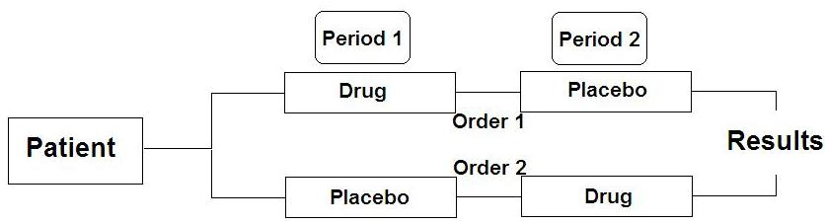
Crossover clinical study
Schematic design of a Crossover clinical study

Slide 40
Experimental studies Crossover Clinical trials
Strengths
Reducing sample size.
Allow preference question
“when do you like to receive treatment, at first or second period ?”
Weaknesses
Possible carry-over effect (drug).
Possible period effect (time).
- Unstable disease process.
- Cancer patients deteriorate over time.

Slide 41
STUDY DESIGNS IN EPIDEMIOLOGY
Considerations in choosing a study design
Nature of the disease
Type of exposure
Available resources
Logistic of time
Availability documentation
Results of previous studies
Gaps in knowledge that remained to be filled

Slide 42
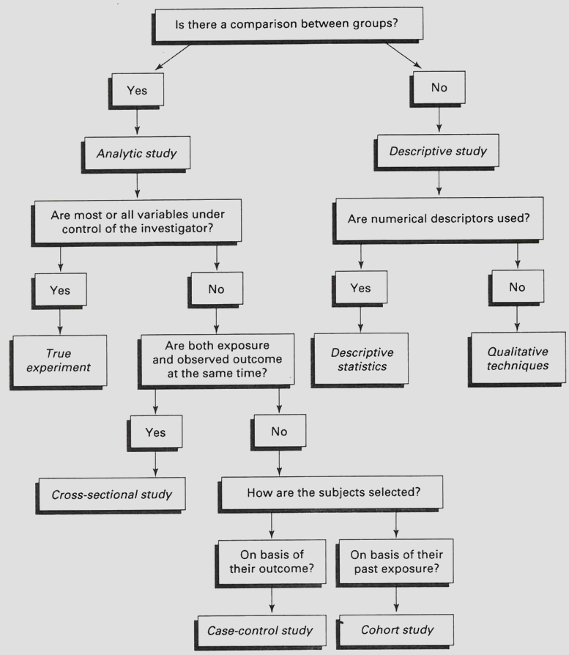
STUDY DESIGNS IN EPIDEMIOLOGY A scheme of selecting or identifying a study design

Slide 43
STUDY DESIGNS IN EPIDEMIOLOGY
Generally, in epidemiology, the observational analytic studies are the most common performed by epidemiologists because they are cheaper than the clinical trials, and also they give much more information than the descriptive studies.

Slide 44
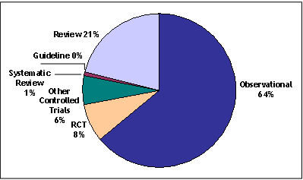
STUDY DESIGNS IN EPIDEMIOLOGY

Slide 45
Principles of causation and Interpretation of results

Slide 46
Causation
RISK FACTOR
DISEASE
Observational study
Results that show an association
Is the association due to chance?
Is the association due to Bias?
Is the association due to confounding?
Is the association a cause-effect relationship?

Slide 47
Chance?
Precision!!
No random errors in the study result.
Hypothesis testing- statistical significance!!!! Rules out chance as a possible explanation of the results!!!!

Slide 48
Is the association due to bias?
Validity No systematic errors (bias) in the study result.
SELECTION BIAS
INFORMATION BIAS

Slide 49
Systematic vs. Random errors
ERROR
Systematic error
Random error
Study Size

Slide 50
Selection Bias
Definition: is a systematic error in a study caused by the procedures used to select subjects or from factors that influence study participation. It occurs when the association between exposure and disease differ between those who participate and those who do not participate in the study.
Examples
Self selection (ill individuaks may participate at a higher rate than non ill individuals)
Healthy worker effect (death rates among workers are generally lower than the general population)

Slide 51
Information bias
Definition: is a systematic error that can occur because the information collected about or from study subjects is not exact.
Example
- Recall bias (individuals with a disease/condition may remember prior events better than others)
- Diagnostic bias (disease)

Slide 52
Is the association due to confounding?
Confounding: when the estimate of the effect of the exposure of interest is mixed with the effect of an extraneous factor.
Confounding factor: A factor that is associated both with the disease (as a risk factor) and with the exposure under study, but which is not an intermediate variable between that exposure and the disease.

Slide 53
A confounder must…
Be a risk factor for disease among the unexposed.
Be associated with the exposure variable.
Should not be a factor in the pathophysiological pathway between an exposure and an outcome

Slide 54
A confounder must…
Be unequally distributed in the study groups to cause confounding.

Slide 55
Example
Example: A study shows an association between high consumption of alcohol and lung cancer.
Possible explanations?

Slide 56
Is the association due to confounding?
Exposure
(Alcohol)
Confounder
(Smoking)
~
Disease
Lung cancer

Slide 57
Is the association due to confounding?
Exposure
(Tea)
Confounder
(calcium, vitD, smoking(
~
Bone mineral density

Slide 58
A confounder is not an intermediate!
High fat diet
High level of blood cholesterol
Myocardial infarction
High level of blood cholesterol is not a confounder

Slide 59
Examples positive confounding
Oral contraceptive use
Myocardial infarction
+
OC users smoke more heavily than non users
+
Smokers, irrespective of OC use, have a higher risk of MI than nonsmokers
Smoking
(confounder)

Slide 60
Positive confounding
Observed estimate of the association is more extreme..than the true association.

Slide 61
Examples negative confounding
Oral contraceptive use
Myocardial infarction
-
OC users are less obese than non-users
+
Obesity increases the risk of MI
Obesity
(confounder)

Slide 62
Negative confounding
A negative confounder underestimates the true association.

Slide 63
Control of confounding
In the study design
restriction
randomization
In the analysis
Stratification
Multivariate regression analysis

Slide 64
Control for confounding (Randomization)
+
-
Control for known and unknown confounders if sample size is sufficient
Only applicable to intervention (experimental trials

Slide 65
Control for confounding (Restriction)
+
-
Simple
inexpensive
Reduces number of subjects
No evaluation of different levels of the confounder
Limits generaizability

Slide 66
Control for confounding (stratification)
+
-
Easy and easily understood.
Flexible and reversible
Inability to control simultaneously for a moderate number of confounders.

Slide 67
Control for confounding (multivariate analysis)
+
-
Allows controlling for a number of confounding factors simultaneously
”black box” strategy, its difficult to understand intuitively.

Slide 68
Bias vs. confounding
Introduced by the investigator /study participant.
Problems in study design.
The result of an inherent and complex relationship between various exposures and the outcome.
The observed association is due to a mixing of effects between exposure, the disease and a third factor.

Slide 69
Causality
There is an Association between a risk factor and a certain disease!!
Is it a true cause and effect relationship?
Hill’s Criteria for causality-
Strength Consistency Biologic plausibility
Temporality Dose-response Analogy
Specificity
Notes:
Causality-
There is an association between a dietary factor and a certain disease! Now the question is is it a true cause and effect relationship??
Bradford Hill suggested certain factors that can be considered for determining causality. It is worth notng that hill has not intended to offer a check list of necessary conditions for proving causality but rather as a guildline...
An association is causal if it is strong, if there are consisitent findings from different types of studies, if there is a biologic mechanism behind the association, temporality- exposure have to proceed the outcome, for a relation to be causal there should be a dose –response relationship, and another criteria is analogy- the association had been demonstarted in other species- for example in animals! Specificity is another criteria which means that for a factor to be causal it must lead to a single effect not to multiple effects.

Slide 70
Problems with Hill’s ”criteria”
Strength of association- weak associations can be causal.
Biologic plausibility- pathophysiology of most cancers and other chronic diseases is poorly understood-so lack of a well defined mechanism should not be used as evidence against causality.
Specificity – a dietary factor maybe associated with many diseases and therefore this criteria is irrelevent.
Notes:
Strength of association- in studies relating diet to disease, true associations are not likely to be strong because of low variation in diet between people.
Consistency- abosolute consistency is not realistic because of the complexity of nutrient-nutrient interactions and low variation in diet within populations
Biologic plausibility- pathophysiology of most cancers and other chronic diseases is poorly understood-so lack of a well defined mechanism should not be used as evidence against causality.
Specificity – diet maybe associated with many diseases and therefore this criteria is irrelevent. For example low folate is associated with neural tube defects and with increasing the risk of CVD.

Slide 71
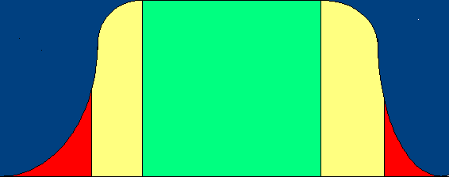
Causality
Dose –response- not all relationships are linear.
Optimal
100%
Marginal
Marginal
Biological Function
Deficiency
Toxicity
Concentration or intake of nutrient
Figure adapted from W. Willett, nutritional epidemiology 2nd ed. 1998
Notes:
As for dose-response relationships- relationship between the dietary factor and disease are likely to be non linear, and therefore the dose response relationship depends on the levels you are comparing and their location on the curve.
For example if 2 points on the ascending part of the curve are compared, it might be concluded that the nutrient was beneficial. If points on the horizontal portion are compared, it might be concluded that the nutrient had no effect. If points on the descending segment were contrasted, it might be reported that the nutrient was harmful.
Therefore the health effects of the nutrient can only be fully appreciated by an examination of the dose-response relationship over a full range of exposures, which may not be possible within any single study.
Also clear dose-response relationships can be the result of bias or confounding.

Slide 72
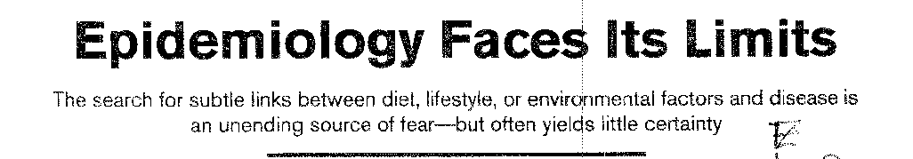
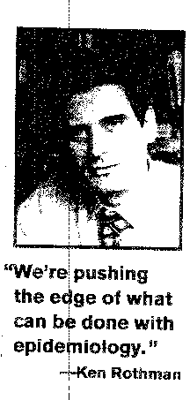
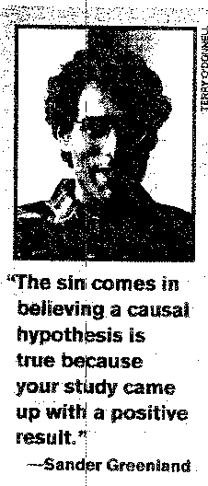
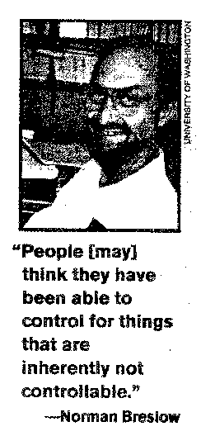
SCIENCE VOL 296 14 JULY 1995
Notes:
And in the July 1995 issue of Science an article regarding the limitations and diffculties in epidemiology in establishing a causal relationship between diet, lifestyle or environmental factors with disease has been published. In this article famous epidemiologists were asked about the reason for the contraversial findings in epidemiology. ken rothman for example said- we are pushing the edge of what can be done with epidemiology, and norman breslow said that people may think they have been able to control for things that are inherently not controlable.
And sander greenland said the sin comes in believing a causal hypothesis is true because your study came up with a positive answer.

Slide 73
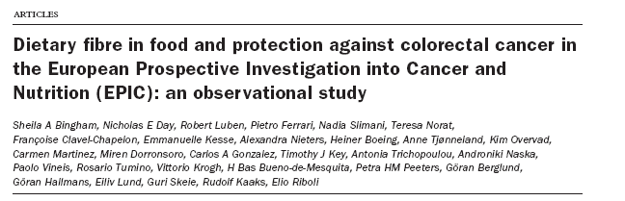
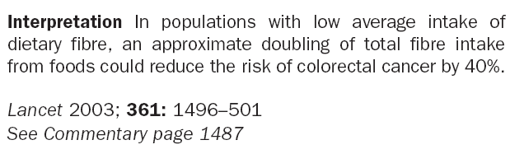
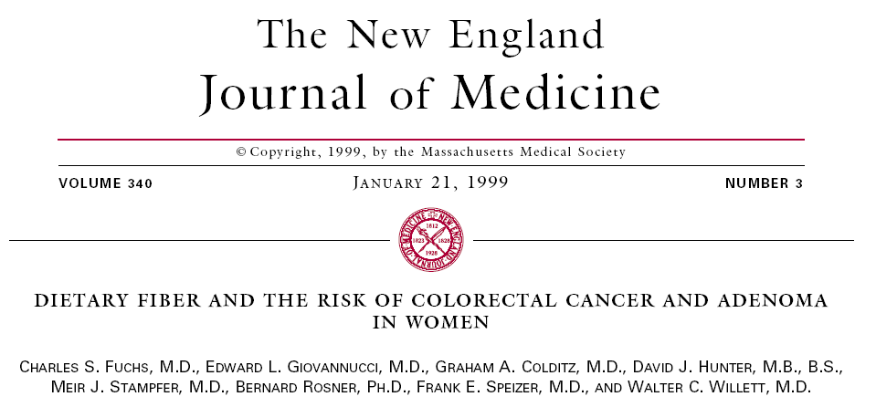
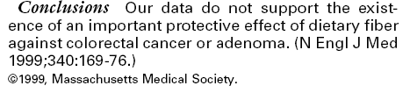
Notes:
however…..There are contraversial findings in epidemiology…… for example does dietary fiber in food protects against colorectal cancer?
Results from 2 large cohorts studies looked at this. The Epic study which is a cohort on 478,021 individuals from 10 European countries. Showed that the intake of fibre reduces the risk of colorectal cancer by 40%.
While another cohort: Nurses’s health study which has dietary data on 77 283 women showed that there was no protective effect of dietary fiber against colorectal cancer.

Slide 74
[Fat consumption and breast cancer: preliminary results from the E3N-Epic cohort]
CONCLUSION: There was no detectable association between fatty acids or food items contributing to fat intake and breast cancer risk. These analyses suggest there is a need for longer follow-up time to increase statistical power and confirm these tendencies.
Bull Cancer. 2001 Oct;88(10):954-8
Premenopausal fat intake and risk of breast cancer
CONCLUSIONS: Intake of animal fat, mainly from red meat and high-fat dairy foods, during premenopausal years is associated with an increased risk of breast cancer.
J Natl Cancer Inst. 2003 Jul 16;95(14):1079-85.
Notes:
Another example
Does fat consumption increase the risk of breast cancer?
The Epic study reported no detectable association between fat intake and breast cancer, while the large nurse’s health study reported an increased risk.
The literature is full of such contraversial findings….

Slide 75
Vitamin A and lung cancer Vitamin A: function and forms
Vitamin A functions in the regulation of cell differentiation. Loss of differentiation is a basic feature of malignancy so vitamin A maybe related to cancer incidence.
Vitamin A – diversity of sources
Animal sources - vitamin A pre-formed - retinol
Plant sources - Carotenoids – Beta-carotene retinol
Notes:
Vitamin A and lung cancer-
Vitamin A functions in the regulation of cell differentiation. Loss of differentiation is a basic feature of malignancy so vitamin A maybe related to cancer incidence.
vitamin A comes from 2 sources- animal sources –contain the natural preformed vitamin A , usually referred to as retinol.
And plant sources which don’t have the preformed vitamin A but have a group of carotenoids , some of which can be metabolized to form retinol, the physiologically active form of vitamin A. Beta carotene is the most plentiful carotenoid with potential vitamin A activity.because it can be cleaved after absorption to form 2 molecules of retinol.

Slide 76
Vitamin A and lung cancer
Animal studies
Animal studies showed that Vitamin A inhibited the occurence of induced tumors.
Epidemilogic studies
Case-control – diet
Cohort –diet
serum
Notes:
Animal studies showed that vitamin a inhibited the occurence of induced tumers.
The relationship between vitamin a and lung cancer was also evaluated in epidemiologic studies.
In cohort studies both dietary intake and serum levels of pre-formed vitamin A abd beta carotene were studied as the dietary exposure.
In case control studiies only dietary intake was used as a dietary exposure since the levels of the vitamin A can be affected by disease or treatment in cases and so is not a valid estimate.

Slide 77
Vitamin A and lung cancer
Cohort studies of vitamin A intake and lung cancer
RR for High vs. Low intake categories
Total pre-formed carotenoid
Bjelke (1975)- 8278 Norwegian men 0.4
Kvåle 1983- extended follow-up of the same cohort.
0.5
Shekelle et al 1981 NS 0.1
Notes:
Prospective studies on vitamin A intake and lung cancer –
The fisrt study was conducted by Bjelke in 1975 and it was a follow-up study on 8278 norwegian men. The RR for total vitamin intake estimated from the intake of fruits and vegetables was 0.4 for men who took above average levels of vitamin A than those who’s intake of vitamin A was below average, ie there was a 60% decrease in risk.
In an extended follow up of same cohort Kvåle found that the protective effects were attributable to carrots and other vegetables, so this study provided stronger evidence for a beneficial effect of carotenoids than from preformed vitamin A.
The first epidemiologic study in which the independent effects of carotenoids and preformed vitamin A were formally examined was reported by Shekelle et al in 1981, and he found that preformed vitamin A was not related to the incidence of lung cancer, but in a striking contrast vitamin A from carotenoids was strongly associated with lower risk of this disease.
After that more prospective studies were done and most of them found an inverse relationship between vitamin A carotenoids and the risk of lung cancer. It is worth noting that stronger inverse relationships were observed for fruits and vegetables intake , suggesting that factors in those foods, other than or in addition to beta carotene might be protective against lung cancer.

Slide 78
Vitamin A and lung cancer
Case-control studies of vitamin A intake and lung cancer
RR for high vs. Low intake categories
Total preformed carotenoid
MacLennan et al 1977
0.6-0.7
Zigler et al 1984
1.1 1.3 0.8
Le Marchand et al 1989 Men 0.6 1.1 0.5
Women 0.4 1.0 0.4
Notes:
Around 20 case control studies were done to study the relationship between the intake of vitamin A and lung cancer all studies had consistent findings. Preformed vitamin A had no relationship with with the incidence of lung cancer while carotenoids sources of vitamin A were protective against lung cancer. And in this table we see few examples of these studies.
However these studies didnot distingish between the various carotenoids including those without potental vitamin A activity.

Slide 79
Vitamin A and lung cancer
Serum beta-carotene and lung cancer
RR for
High vs. Low category
Nomura et al (1985) 0.5
Menkes et al (1986) 0.5
Notes:
As for beta caroten nested case control studies showed consistently that serum beta caroten was inversely associated with lung cancer.

Slide 80
Vitamin A and lung cancer
Causality
Is this relationship CAUSAL?
Hill’s Criteria for causality-
Strength Consistency Biologic plausibility
Temporality Dose-response Analogy
Specificity
✓
✓
✓
✓
✓
Consistency of the association between carotenoid intake and lung cancer as seen in case-control and cohort studies as well as those based on biochemical measurments
Notes:
Now what about causality? Is this relationship causal?
If we go through Hill’s criteria for causality we can say that the relationship between beta carotene and lung cancer was moderately strong, there was Consistency in the association between carotenoid intake and lung cancer as seen in case-control and cohort studies as well as those based on biochemical measurments. The biological plausibility exisits in the fact that Vitamin A functions in the regulation of cell differentiation. Loss of differentiation is a basic feature of malignancy so vitamin A maybe related to cancer incidence. Temporality was demonstated in the cohort studies. And as for analogy animal studies have previously shown that Vitamin A inhibited the occurence of induced tumers. However it is worth mentioning that beta carotene was not extensively studied in animals and the studies showed that alpha carotene seems more promising! As for specificity well there is no specificity since vitamin a has been see to reduce the risk of different types of cancer.
now is the relationship due to confounding?

Slide 81
Vitamin A and lung cancer
Randomized Trials
3 large Randomized Trials
The Alpha-Tocopherol Beta-Carotene Cancer Prevention Study, 1994
- Conducted among smoking men in Finland
STOPPED after 6 Years
Incidence of lung cancer was 18% higher in the treatment group
Notes:
The best way to resolve confounding is by doing a randomized controlled trial.’
Relatively easy to implement- active agent can be formulated in a capsule.
and in fact 3 large randomized controlled trials were conducted.
First the The Alpha-Tocopherol Beta-Carotene Cancer Prevention Study, 1994
And it was conducted among smoking men in finland
an unexpected result happened and the trial was stopped after 6 years because the incidence of lung cancer was 18% higher in the treatment group!

Slide 82
Vitamin A and lung cancer
Randomized Trials
Carotene and Retinol Efficacy Trial, CARET Study, 1996
conducted among men who were at high risk due to smoking or asbestos exposure.
A combination of beta-carotene and preformed vitamin A was compared with placebo
Stopped prematurely
28% increase in the incidence of lung cancer among men receiving the supplements
Notes:
The second study was the Caret study, 1996
conducted among men who were at high risk due to smoking or asbestos exposure.
A combination of beta-carotene and preformed vitamin A was compared with placebo
This trial was also Stopped prematurely- because there was a 28% increase in the incidence of lung cancer among men recieving the suppplements.

Slide 83
Vitamin A and lung cancer
Randomized Trials
The physicians health study, 1996
-Conducted among US physicians who received beta-carotene supplements for 12 years.
No increase or decrease in lung cancer (relative risk= 0.93)
Notes:
The third study was the physicians health study- 1996
Conducted among US physicians who recieved beta-carotene supplements for 12 years.
and in this study there was No increase no decrease in lung cancer (relative risk= 0.93)
These RT collectievely provide strong evidence against the hypothesis that high doses of beta-carotene supplementation can reduce the risk of lung cancer
The lack of any protective effect in the Physician’s Health Study decreases the probability that an important protective effect was missed due to unsufficient follow-up time.
The lack of an adverse (or beneficial) effect of beta-carotene in the 3rd Trial could possibly be related to the higher levels of blood carotenoids at baseline .

Slide 84
Vitamin A and lung cancer
Conclusions
The inverse relationship between intake of vegetables and fruits and the risk of lung cancer, represents one of the best established associations in the field of nutritional epidemiology.
Randomized trials indicate that this is unlikely to be due to a protective effect of beta carotene. It is more likely that other carotenoids or chemically unrelated, but correlated constituents are the active agents.
More specific and detailed analyses of observational data could be of great value-
Dietary measurments-data analysis for individual foods and for known nutrients
-Biochemical measurements measure a wide variety of factors, including other specific carotenoids
Notes:
The inverse relationship between intake of vegetables and fruits and the risk of lung cancer, represents one of the best established associations in the field of nutritional epidemiology.
Randomized trials indicate that this is unlikely to be due to a protective effect of beta carotene. It is more likely that other carotenoids or unrelated constituents are the active agents.
More specific and detailed analyses of obsevational data could be of great value- - dietary measurments-data analysis for individual foods and for known nutrients
-biochemical measurements measure a wide variety of factors, including other specific carotenoids

Slide 85
Prospective study of fruit and vegetable consumption and risk of lung cancer among men and women
(47 778 men Health Professionals' Follow-up Study
and 77 283 women in the Nurses' Health Study )
J Natl Cancer Inst. 2000 Nov 15;92(22):1812-23
CONCLUSION: Higher fruit and vegetable intakes were associated with lower risks of lung cancer in women but not in men. It is possible that the inverse association among the women remained confounded by unmeasured smoking characteristics, although fruits and vegetables were protective in both men and women who never smoked.
Notes:
Using data from 2 large cohort studies- (47 778 men Health Professionals' Follow-up Study
and 77 283 women in the Nurses' Health Study )
the relationship between the intake of fruits and vegetables and the risk of lung cancer was evaluated
And the authors concluded that CONCLUSION: Higher fruit and vegetable intakes were associated with lower risks of lung cancer in women but not in men
( It is possible that the inverse association among the women remained confounded by unmeasured smoking characteristics, although fruits and vegetables were protective in both men and women who never smoked.)

Slide 86
Fruits and vegetables and lung cancer: Findings from the European prospective investigation into cancer and nutrition (EPIC)
Int J Cancer. 2004 Jan 10;108(2):269-276
Data on 478,021 individuls from 10 European countries.
CONCLUSION: There was no association between vegetable consumption or vegetable subtypes and lung cancer risk. After adjustment for age, smoking, height, weight and gender, there was a significant inverse association between fruit consumption and lung cancer risk: the hazard ratio for the highest quintile of consumption relative to the lowest being 0.60 (95% Confidence Interval 0.46-0.78), p for trend 0.0099
Notes:
and a recent paper that will be published next month-Data on 478,021 individuls from 10 European countries, participating in the epic study reported that.
There was no association between vegetable consumption or vegetable subtypes and lung cancer risk however there was a significant association with fruit consumption!

Slide 87
Epidemiology and prevention

Slide 88
Epidemiology and prevention
Epidemiology plays a central role in disease prevention by identifying causes of disease!
e.g. Decline in mortality from CVD was due to prevention of disease by decreasing known risk factors!
Why is prevention important?
Limitations of modern medicine in curing diseases.
High cost of medical care

Slide 89
Levels of prevention
4 levels of prevention:
Primordial
Primary
Secondary
Tertiary
Contributes the most to health and wellbeing of the whole population!

Slide 90
Primordial prevention
Aim is to avoid the emergence and establishment of the social, economic and cultural patterns of living that are known to contribute to an elevated risk of disease.
Has to do with policies and regulations!
Examples
-High risk behaviour- CVD- smoking
- Global effects of air pollution (green house effect, ozone depletion)
- Urban smog ( lung disease, heart disease)

Slide 91
Primary prevention
Aim is to limit the incidence of disease by controling causes and risk factors.
Primary prevention depends on widespread changes that reduce the average risk in the whole population.
examples
Use of condoms- prevention of HIV
educational programs
Immunizations

Slide 92
Population strategy vs. High risk strategy
Population strategy
High risk strategy

Slide 93
Advantages and disadvantages of high-risk strategy
Advantages-
Appropriate to individuals
Subject motivation
Physician motivation
Favourable benefit-to-risk ratio

Slide 94
Advantages and disadvantages of high-risk strategy
Disadvanteges
Difficulties identifying high-risk individuals.
Temporary effect.
Limited effect
Behaviourally inappropriate.

Slide 95
Advantages and disadvantages of population-strategy
Advantages
Radical
Large potential for whole population
Behaviorally appropriate.

Slide 96
Advantages and disadvantages of population-strategy
Disadvanteges
Small benefit to individuals.
Poor motivation of subject.
Poor motivation of physician.
Benefit-to-risk ratio may be low.

Slide 97
Population strategy vs. High risk strategy- the prevention paradox
A large number of people exposed to a small risk may generate many more cases than a small group or number exposed to a higher risk. (Rose)
A preventive measure that brings large benefits to the
community offers little to each participating
individual. (Rose)
Prevention paradox

Slide 98
Secondary prevention
Aims to cure patients and reduce the more serious consequences of disease through early diagnosis and treatment.
Can be applied only to diseases in which the natural history includes an early period when it is easily identified and treated.
2 requirements for useful secondary prevention programs
1. A safe and accurate method of detection of diseases ( prefereably at a preclinical stage).
2. Effective methods of intervention.

Slide 99
Secondary prevention
Examples
Screening for cervical cancer
Screening for phenylketonuria in newborn children
Blood pressure measurements and treatment of hypertension in middle aged and elderly people.
Chest x-rays for diagnosis of Tb.

Slide 100
Screening
Is the process by which unrecognized diseases or defects are identified by tests that can be applied rapidly on a large scale.
It sorts out healthy people from those who may have
the disease

Slide 101
Screening
There are different types of screening:
Mass screening involves the screening of a whole population.
Multiple or multiphasic screening involves the use of a variety of screening tests on the same occasion.
Targeted screening of groups with specific exposures, often used in environmental and occupational health.
Case-finding or opportunistic screening is restricted to patients who consult a health practitioner for some other purpose.

Slide 102
Screening
There are certain criteria that should be met before a screening program is done.
Disease: serious, high prevalence of preclinical stage, natural history understood, long period between first signs and overt disease.
Diagnostic test: sensitive and specific, simple and cheap, safe and acceptable, reliable.
Diagnosis and treatment: facilities are adequate, effective, acceptable and safe treatment available.

Slide 103
Screening
The test should be reliable: i.e the test provides consistent results!
The test should be valid: if it correctly categorizes people into groups with and without disease-as measured by its sensitivity and specificity.

Slide 104
Sensitivity and Specificity
Disease status
Present Absent Total
+VE
a b a+b
Screening test
-VE
c d c+d
total
a+c b+d a+b+c+d
a= no. of true positives, b= no. of false positives,
c= no. of false negatives, d= no. of true negatives

Slide 105
Sensitivity and Specificity
Disease status
Present Absent Total
+VE
a b a+b
Screening test
-VE
c d c+d
total
a+c b+d a+b+c+d
sensitivity = probability of a positive test in people with the disease. a/ (a+c)

Slide 106
Sensitivity and Specificity
Disease status
Present Absent Total
+VE
a b a+b
Screening test
-VE
c d c+d
total
a+c b+d a+b+c+d
Specificity= probability of a negative test in people without the disease. d/ (b+d)

Slide 107
Sensitivity and Specificity
Disease status
Present Absent Total
+VE
a b a+b
Screening test
-VE
c d c+d
total
a+c b+d a+b+c+d
Positive predictive value= probability of the person having the disease when the test is positive. a/a+b

Slide 108
Sensitivity and Specificity
Disease status
Present Absent Total
+VE
a b a+b
Screening test
-VE
c d c+d
total
a+c b+d a+b+c+d
Negative predictive value= probability of the person not having the disease when the test is negative. d/(c+d)

Slide 109
Example
Disease status
Present Absent Total
+VE
50 50 100
Screening test
-VE
50 1850 1900
total
100 1900 2000
Sensitivity: 50/100= 50%
Specificity: 1850/1900= 97.4%

Slide 110
Example
Disease status
Present Absent Total
+VE
50 50 100
Screening test
-VE
50 1850 1900
total
100 1900 2000
Positive predictive value: 50/100= 50%
Negative predictive value: 1850/1900= 97.4%

Slide 111
Sensitivity and Specificity
Screening test- both highly sensetive and highly specific??
if sensitivity- then increase in the number of false positives.- i.e decreasing specificity.
reducing the strictness of the criteria for a positive test increases sensitivity but decreases specificity.
increasing the strictness does the opposite!

Slide 112
Sensitivity and Specificity
Decision depends on the consequences of identifying false negatives and false positives.
e.g.- for a serious condition in newborns better to have high sensitivity and to accept the increased cost of a high number of false positives (reduce specificity).

Slide 113
Predictive value
Is determined by sensitivity, specificity and also by the prevalence of the preclinical disease.

Slide 114
Tertiary prevention
Aimed at reducing the progress or complications of established disease.
Mainly to reduce disabilities.. Minimize suffering!
Examples
Rehabilitation of patients with strokes, injuries, poliomyelitis

Slide 115
Conclusions
Epidemiology identifies risk factors for disease and so it is important for prevention.
There are 4 levels of prevention, primary prevention is the most effective populationwise.
There are 2 main strategies for primary prevention: population and high risk strategy.
Screening is a good tool to identify an unrecognized disease and so prevent its progression.

