Slide 1
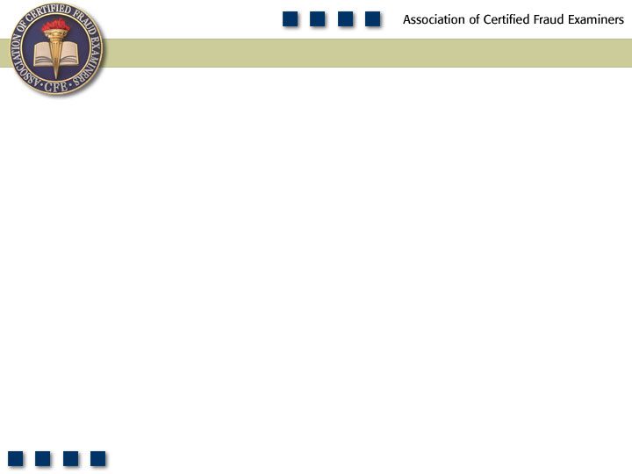
Chapter 13
External Fraud Schemes

Slide 2

Pop Quiz
What are some sources of external fraud threats?

Slide 3
Learning Objectives
List the three sources of external fraud
Explain why organizations are vulnerable to external fraud.
Discuss the types of fraud threats posed by customers.
Identify two types of check fraud schemes.
Define the term “paperhanger.”
Be familiar with the methods identified for preventing and detecting check fraud.
Define credit card fraud and identify two types of credit card schemes.

Slide 4
Learning Objectives
Be familiar with the methods identified for preventing and detecting credit card fraud.
Be able to discuss the various types of collusion that happen between contractors.
Be able to discuss the type of fraud that typically happens in the performance phase of a contract.
Define product substitution and list some common product substitution schemes.
Be familiar with the methods for preventing and detecting vendor fraud.

Slide 5
Learning Objectives
Explain how unrelated third parties can commit fraud against a company.
Discuss why organizations are targeted by corporate spies.
Name some of the types of information and departments targeted by corporate spies.
Describe some of the methods by which a company can mitigate the risk of computer hacking.
Describe some of the precautions a company should take to protect its physical and intellectual property.

Slide 6
External Fraud
Unauthorized activity, theft, or fraud carried out by a third party outside the institution that is the subject of the fraudulent behavior.
Sources of external fraud
  Customers
  Vendors
  Unrelated third parties

Slide 7
Why Should an Organization be Concerned About External Fraud?
No organization is immune
It is impossible to conduct business without interacting with outsiders
All businesses have exposure to the public

Slide 8
Organizations That Should Be Particularly Concerned
Any organization which:
  Is in possession of large amounts of proprietary data
  Houses large amounts of customer payment data
  Has in-house manufacturing facilities
  Participates in significant R&D

Slide 9
Threats from Customers
Unique fraud schemes to every industry
Universally applicable:
  Check Fraud
  Credit Card Fraud

Slide 10
Check Fraud
Counterfeit checks
  Easy to produce
  Small business employees do not have the time, resources, or expertise to scrutinize all checks
  Paperhanger – an expert in check fraud
E-Commerce check scams
  Victim offers something for sale on the Internet
  After check is deposited but doesn’t clear, fraudster asks for a refund and pockets the cash

Slide 11
Preventing and Detecting
Check Fraud
Check use is on the decline; the United States is the only country in the world that still uses a significant amount of personal checks
Educate employees on how to spot a fraudulent check
Request identification from patrons using checks
Adopt a no personal check policy

Slide 12
Credit Card Fraud
The misuse of a credit card to make purchases without authorization, or counterfeiting a credit card
  Unauthorized use of a lost or stolen card
  Stolen card numbers
    Albert Gonzalez case
    Usually obtained via the Internet
  Counterfeit cards

Slide 13
Preventing and Detecting
Credit Card Fraud
Educate employees responsible for processing customer payments
Ask for identification from all credit card users
Learn the red flags of customers using a fraudulent credit card
  Customer purchases a large item and insists on taking it at the time
  Customer becomes argumentative or appears to be rushed
  Customer pulls card directly from pocket rather than from a wallet

Slide 14
Threats from Vendors
It is necessary to conduct business with vendors
  Inefficient and impractical for a company to do everything themselves
  Vendors might have the expertise or can provide goods and services at a lower price
  Customer must have a contract with the vendor, but this alone does not prevent fraud from occurring

Slide 15
Threats from Vendors
Collusion among contractors
  Complementary bids – competitors submit token bids that are too high to be accepted
  Bid rotation – two or more contractors conspire to alternate the business between them on a rotating basis
  Phantom bids – phony bids from shell companies to create the illusion of competition

Slide 16
Threats from Vendors
Contract performance schemes
  Product substitution
    Delivery of inferior material
    Delivery of used, surplus, or reworked parts
  Cost mischarging – contractor charges the procuring entity for costs that are not allowable, unreasonable, or cannot be allocated directly to the contract

Slide 17
Preventing and Detecting
Vendor Fraud
Vendor audits
Ensure integrity of contractors
Look for red flags of unscrupulous vendors
  Contractor’s address, telephone number, or bank account info matches that of an employee
  Contractor’s address is incomplete
  Excessive number of change orders

Slide 18
Threats from Unrelated Third Parties
Companies choose to interact with customer and vendors; unrelated third parties target the company for a variety of reasons
Countless number of threats, chapter focuses on:
  Computer fraud
  Corporate espionage

Slide 19
Computer Fraud
Practically all companies use computers and the Internet
Computer crimes are difficult for fraud examiners because:
  They lack a traditional paper audit trail
  They require an understanding of the technology used in the crime
  They often require help from specialists

Slide 20
Computer Fraud
Computer Hacking – The use of technology to gain unauthorized access to sensitive information on a computer system
  Methods used to gain unauthorized access:
    Password cracking
    Social engineering
    Phishing
    Wire tapping

Slide 21
Computer Fraud
Data manipulation and Destruction
  Data manipulation – the use or manipulation of a computer to perpetrate a crime
  Data destruction – the unauthorized modification, suppression, or erasure of computer data or computer functions, with the intent to alter or hinder the normal functions of the targeted system

Slide 22
Preventing and Detecting
Computer Fraud
Establish a formal security policy
Implement firewalls
Implement an intrusion detection system
Encrypt data
Terminate network connection after:
  A certain number of unsuccessful login attempts
  A period of inactivity
Security software

Slide 23
Corporate Espionage
Why do companies resort to corporate espionage?
  Much information is already available in the public domain
  Raw data is just the first step of the intelligence gathering process; data must be analyzed to be valuable
  The most valuable information is confidential and safeguarded

Slide 24
Corporate Espionage
Favorite targets of corporate spies include:
  Research and development
  Marketing
  Manufacturing and production
  Human resources
Spies obtain information by:
  Posing as an employee or contract laborer
  Surveillance
  Sorting through discarded trash

Slide 25
Preventing and Detecting
Corporate Espionage
Protecting physical data
  Place sensitive documents in locked filing cabinets
  Use a shredder for discarded sensitive material
  Send and receive mail at a secure site and use a locked mailbox
  Guard the physical premises
  Lock and secure outdoor waste receptacles

Slide 26
Preventing and Detecting
Corporate Espionage
Preventing espionage
  Safeguard all materials bearing proprietary data
  Do not allow these materials to be in plain view, even on company premises
  All visitors must be verified and escorted while on company property
  Employees must sign nondisclosure agreements

