Slide 1
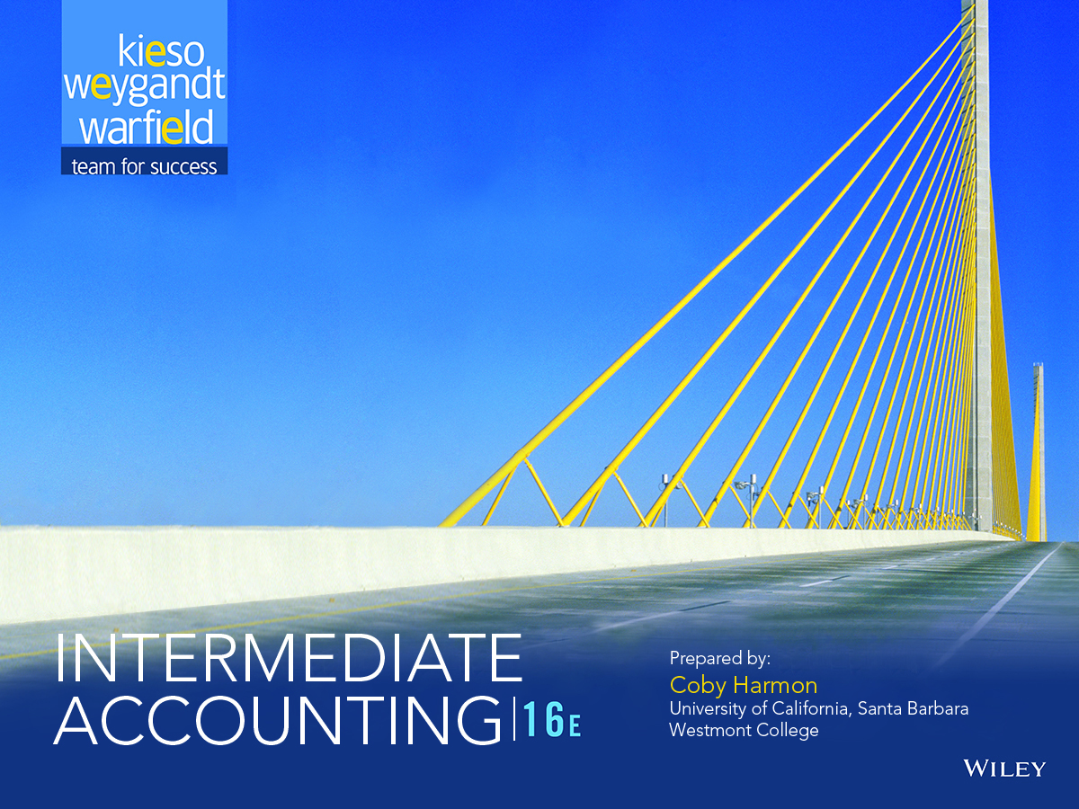

Slide 2
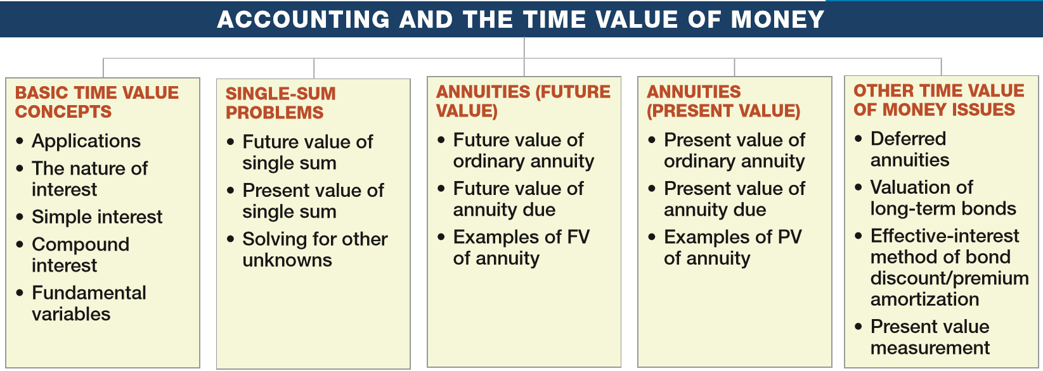
PREVIEW OF CHAPTER 6
Intermediate Accounting
16th Edition
Kieso ● Weygandt ● Warfield

Slide 3
LEARNING OBJECTIVES
6
Accounting and the Time Value of Money
After studying this chapter, you should be able to:
Describe the fundamental concepts related to the time value of money.
Solve future and present value of 1 problems.
Solve future value of ordinary and annuity due problems.
Solve present value of ordinary and annuity due problems.
Solve present value problems related to deferred annuities, bonds, and expected cash flows.
LO 1

Slide 4
BASIC TIME VALUE CONCEPTS
Time Value of Money
A relationship between time and money.
A dollar received today is worth more than a dollar promised at some time in the future.
When deciding among investment or borrowing alternatives, it is essential to be able to compare today’s dollar and tomorrow’s dollar on the same footing—to “compare apples to apples.”
LO 1

Slide 5
Applications of Time Value Concepts
Present Value-Based Accounting Measurements
Notes
Leases
Pensions and Other Postretirement Benefits
Long-Term Assets
Shared-Based Compensation
Business Combinations
Disclosures
Environmental Liabilities
LO 1

Slide 6
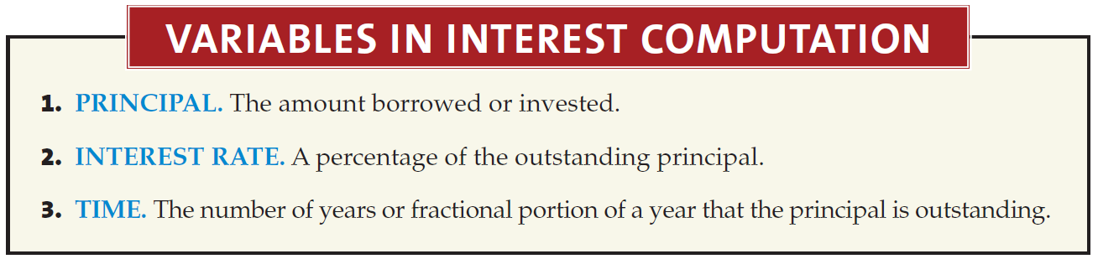
BASIC TIME VALUE CONCEPTS
The Nature of Interest
Payment for the use of money.
Excess cash received or repaid over the amount lent or borrowed (principal).
LO 1

Slide 7
BASIC TIME VALUE CONCEPTS
Simple Interest
Interest computed on the principal only.
Illustration: Barstow Electric Inc. borrows $10,000 for 3 years at a simple interest rate of 8% per year. Compute the total interest to be paid for the 1 year.
Interest = p x i x n
Annual Interest
= $10,000 x .08 x 1
= $800
Federal law requires the disclosure of interest rates on an annual basis.
LO 1

Slide 8
BASIC TIME VALUE CONCEPTS
Simple Interest
Interest computed on the principal only.
Illustration: Barstow Electric Inc. borrows $10,000 for 3 years at a simple interest rate of 8% per year. Compute the total interest to be paid for the 3 years.
Interest = p x i x n
Total
Interest
= $10,000 x .08 x 3
= $2,400
LO 1

Slide 9
BASIC TIME VALUE CONCEPTS
Simple Interest
Interest computed on the principal only.
Illustration: If Barstow borrows $10,000 for 3 months at a 8% per year, the interest is computed as follows.
Interest = p x i x n
Partial
Year
= $10,000 x .08 x 3/12
= $200
LO 1

Slide 10
BASIC TIME VALUE CONCEPTS
Compound Interest
Computes interest on
principal and
interest earned that has not been paid or withdrawn.
Typical interest computation applied in business situations.
LO 1

Slide 11
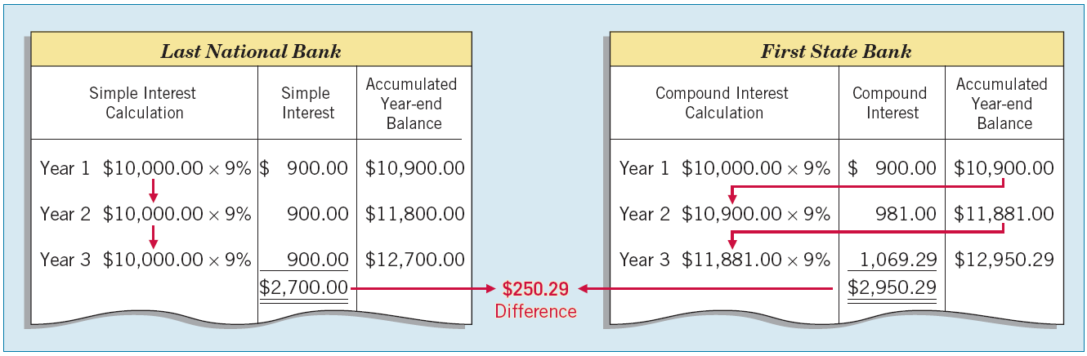
Compound Interest
Illustration: Tomalczyk Company deposits $10,000 in the Last National Bank, where it will earn simple interest of 9% per year. It deposits another $10,000 in the First State Bank, where it will earn compound interest of 9% per year compounded annually. In both cases, Tomalczyk will not withdraw any interest until 3 years from the date of deposit.
Year 1 $10,000.00 x 9%
$ 900.00
$ 10,900.00
Year 2 $10,900.00 x 9%
$ 981.00
$ 11,881.00
Year 3 $11,881.00 x 9%
$1,069.29
$ 12,950.29
ILLUSTRATION 6-1 Simple vs. Compound Interest
LO 1

Slide 12
WHAT DO THE NUMBERS MEAN? A PRETTY GOOD START
WHAT’S YOUR PRINCIPLE
The continuing debate on Social Security reform provides a great context to illustrate the power of compounding. One proposed idea is for the government to give $1,000 to every citizen at birth. This gift would be deposited in an account that would earn interest tax-free until the citizen retires. Assuming the account earns a modest 5% annual return until retirement at age 65, the $1,000 would grow to $23,839. With monthly compounding, the $1,000 deposited at birth would grow to $25,617.
Why start so early? If the government waited until age 18 to deposit the money, it would grow to only $9,906 with annual compounding. That is, reducing the time invested by a third results in more than a 50% reduction in retirement money. This example illustrates the importance of starting early when the power of compounding is involved.
LO 1

Slide 13
BASIC TIME VALUE CONCEPTS
Compound Interest Tables
Table 6-1 - Future Value of 1
Table 6-2 - Present Value of 1
Table 6-3 - Future Value of an Ordinary Annuity of 1
Table 6-4 - Present Value of an Ordinary Annuity of 1
Table 6-5 - Present Value of an Annuity Due of 1
Number of Periods = number of years x the number of compounding periods per year.
Compounding Period Interest Rate = annual rate divided by the number of compounding periods per year.
LO 1

Slide 14
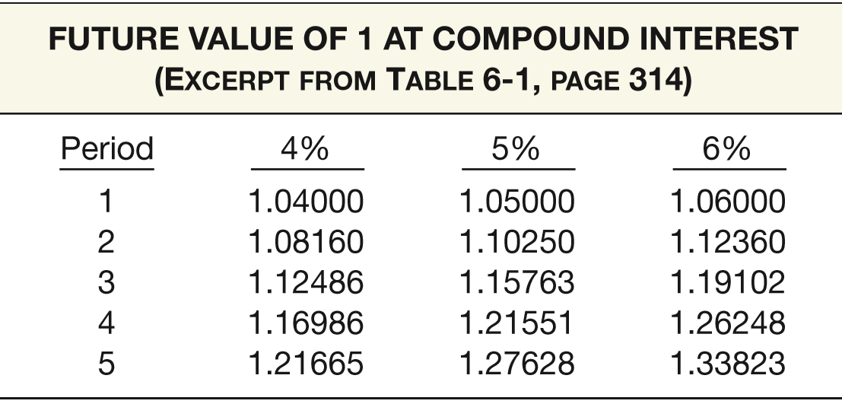
BASIC TIME VALUE CONCEPTS
Compound Interest Tables
ILLUSTRATION 6-2
Excerpt from Table 6-1
FUTURE VALUE OF 1 AT COMPOUND INTEREST
(Excerpt From Table 6-1, Page 1
How much principal plus interest a dollar accumulates to at the end of each of five periods, at three different rates of compound interest.
LO 1

Slide 15

BASIC TIME VALUE CONCEPTS
Compound Interest Tables
Formula to determine the future value factor (FVF) for 1:
Where:
FVFn,i = future value factor for n periods at i interest
n = number of periods
i = rate of interest for a single period
LO 1

Slide 16
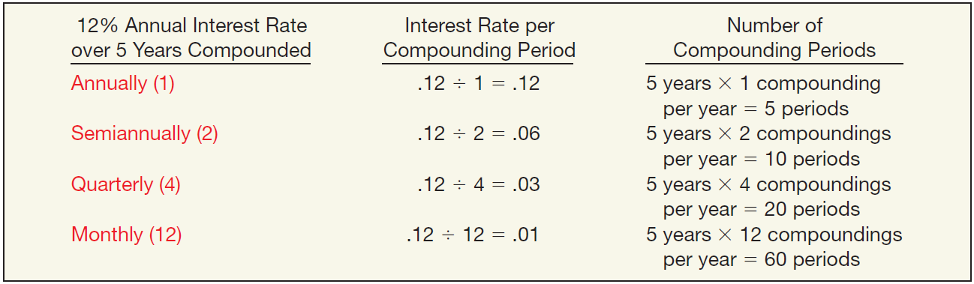
BASIC TIME VALUE CONCEPTS
Compound Interest Tables
Determine the number of periods by multiplying the number of years involved by the number of compounding periods per year.
ILLUSTRATION 6-4
Frequency of Compounding
LO 1

Slide 17
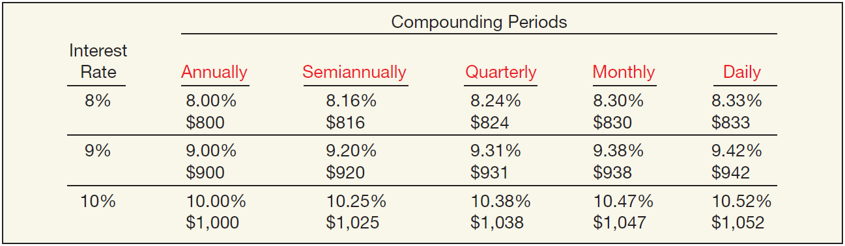
BASIC TIME VALUE CONCEPTS
Compound Interest Tables
A 9% annual interest compounded daily provides a 9.42% yield.
Effective Yield for a $10,000 investment.
ILLUSTRATION 6-5
Comparison of Different Compounding Periods
LO 1

Slide 18
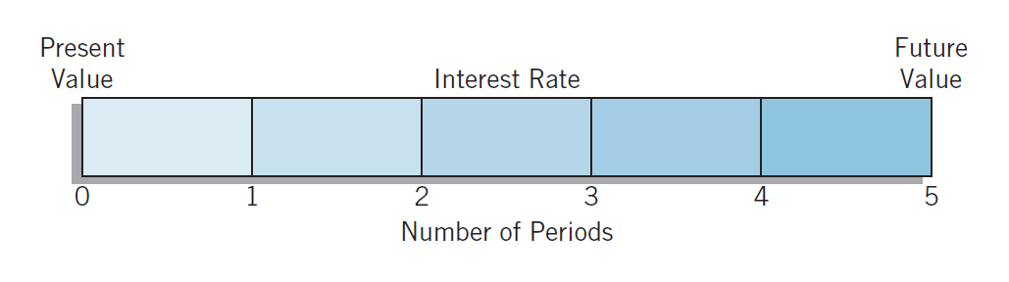
BASIC TIME VALUE CONCEPTS
Fundamental Variables
Rate of Interest
Number of Time Periods
Future Value
Present Value
ILLUSTRATION 6-6
Basic Time Diagram
LO 1

Slide 19
LEARNING OBJECTIVES
6
Accounting and the Time Value of Money
After studying this chapter, you should be able to:
Describe the fundamental concepts related to the time value of money.
Solve future and present value of 1 problems.
Solve future value of ordinary and annuity due problems.
Solve present value of ordinary and annuity due problems.
Solve present value problems related to deferred annuities, bonds, and expected cash flows.
LO 2

Slide 20
SINGLE-SUM PROBLEMS
Two Categories
Unknown Present Value
Unknown Future Value
ILLUSTRATION 6-6
Basic Time Diagram
LO 2

Slide 21

SINGLE-SUM PROBLEMS
Future Value of a Single Sum
Value at a future date of a given amount invested, assuming compound interest.
Where:
FV = future value
PV = present value (principal or single sum)
= future value factor for n periods at i interest
FVF
n,i
LO 2

Slide 22
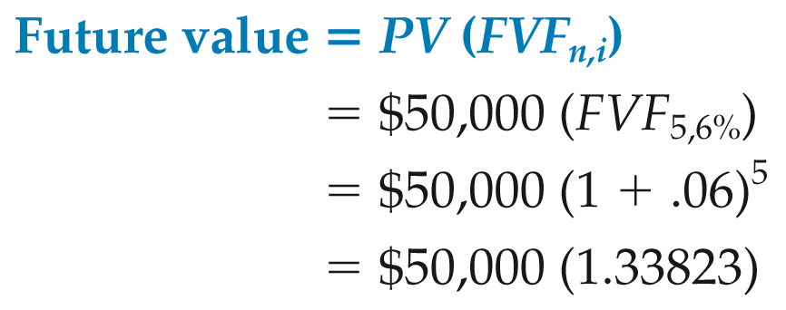
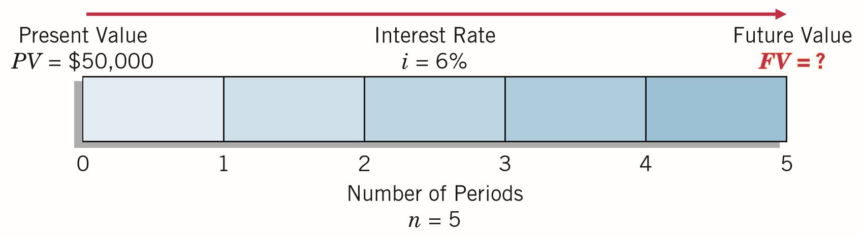
Future Value of a Single Sum
Illustration: Bruegger Co. wants to determine the future value of $50,000 invested for 5 years compounded annually at an interest rate of 6%.
= $66,912
ILLUSTRATION 6-7
Future Value Time Diagram (n = 5, i = 6%)
LO 2

Slide 23
Future Value of a Single Sum
Alternate Calculation
Illustration: Bruegger Co. wants to determine the future value of $50,000 invested for 5 years compounded annually at an interest rate of 6%.
What table do we use?
ILLUSTRATION 6-7
Future Value Time Diagram (n = 5, i = 6%)
LO 2

Slide 24
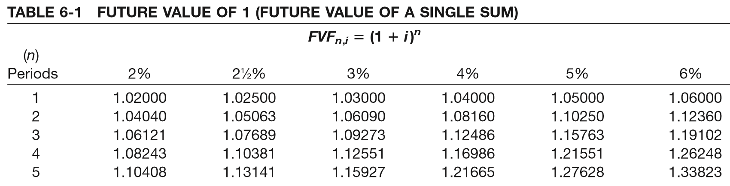
Future Value of a Single Sum
Alternate Calculation
i=6%
n=5
What factor do we use?
$50,000
x 1.33823
= $66,912
Present Value
Factor
Future Value
LO 2

Slide 25
Future Value of a Single Sum
Illustration: Assume that Commonwealth Edison Company deposited $250 million in an escrow account with Northern Trust Company at the beginning of 2017 as a commitment toward a power plant to be completed December 31, 2020. How much will the company have on deposit at the end of 4 years if interest is 10%, compounded semiannually?
Present Value $250,000,000
Future Value?
0
1
2
3
4
5
6
What table do we use?
LO 2

Slide 26
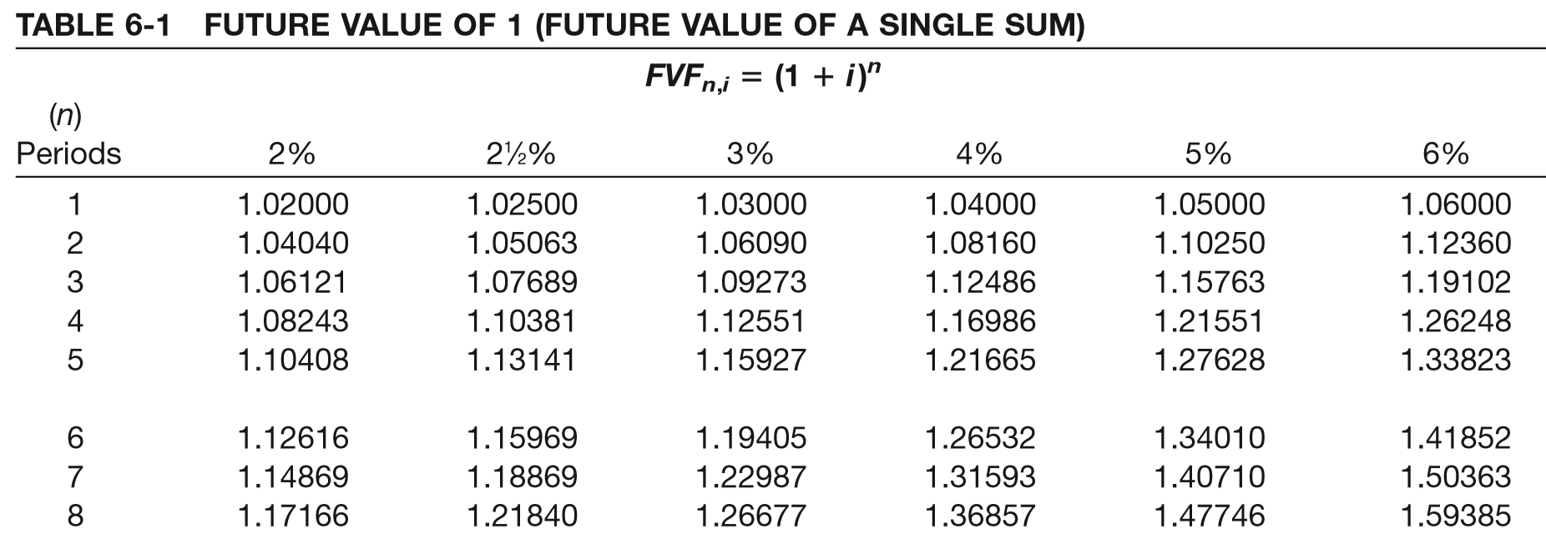
Future Value of a Single Sum
i=5%
n=8
$250,000,000
x 1.147746
= $369,395,000
Present Value
Factor
Future Value
LO 2

Slide 27

SINGLE-SUM PROBLEMS
Present Value of a Single Sum
Value now of a given amount to be paid or received in the future, assuming compound interest.
Where:
FV = future value
PV = present value (principal or single sum)
= present value factor for n periods at i interest
PVF
n,i
LO 2

Slide 28
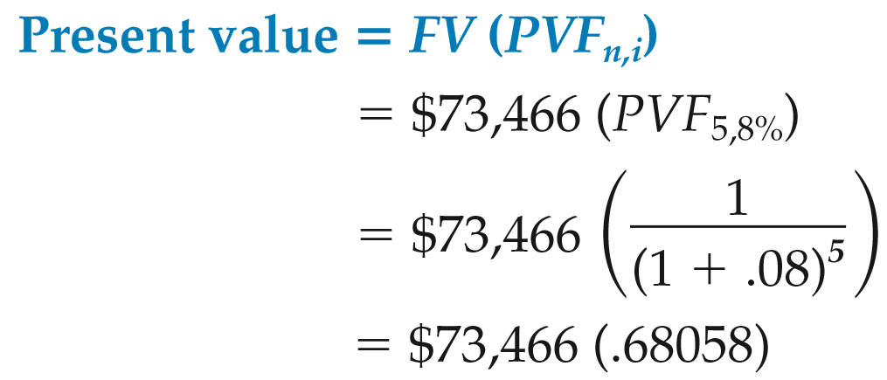
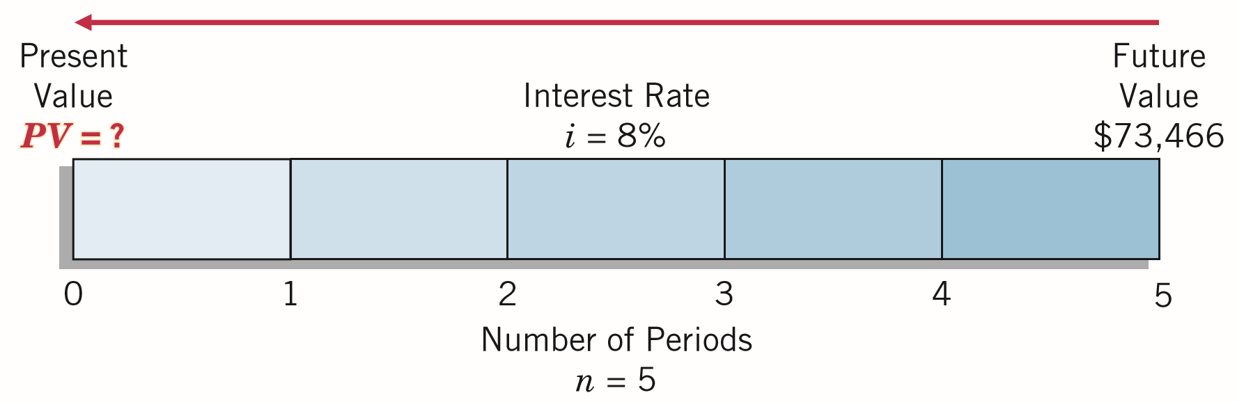
Present Value of a Single Sum
Illustration: What is the present value of $73,466 to be received or paid in 5 years discounted at 8% compounded annually?
= $50,000
(rounded by $.51)
ILLUSTRATION 6-11
Present Value Time Diagram (n = 5, i = 8%)
LO 2

Slide 29
Present Value of a Single Sum
Alternate Calculation
Illustration: What is the present value of $73,466 to be received or paid in 5 years discounted at 8% compounded annually?
What table do we use?
ILLUSTRATION 6-11
Present Value Time Diagram (n = 5, i = 8%)
LO 2

Slide 30
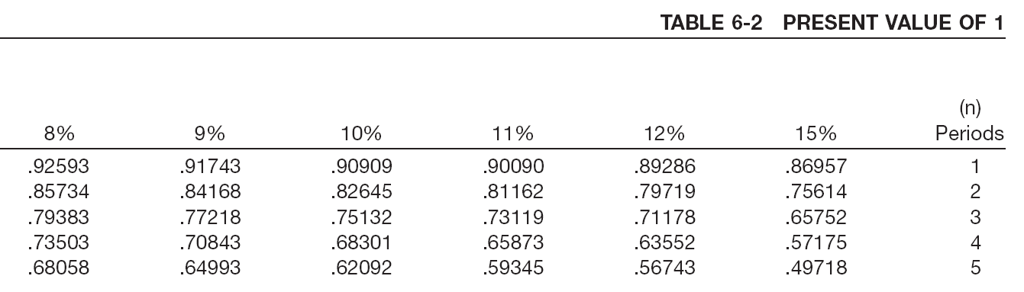
Present Value of a Single Sum
i=8%
n=5
What factor?
$74,466
x .68058
= $50,000
Future Value
Factor
Present Value
LO 2

Slide 31
Present Value of a Single Sum
Illustration: Assume that your rich uncle decides to give you $2,000 for a trip to Europe when you graduate from college 3 years from now. He proposes to finance the trip by investing a sum of money now at 8% compound interest that will provide you with $2,000 upon your graduation. The only conditions are that you graduate and that you tell him how much to invest now.
Future Value $2,000
Present Value?
0
1
2
3
4
5
6
What table do we use?
LO 2

Slide 32
Present Value of a Single Sum
i=8%
n=3
What factor?
$2,000
x .79383
= $1,587.66
Future Value
Factor
Present Value
LO 2

Slide 33
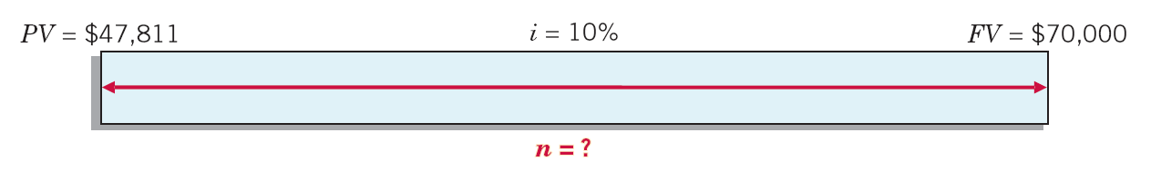
SINGLE-SUM PROBLEMS
Solving for Other Unknowns
Example—Computation of the Number of Periods
The Village of Somonauk wants to accumulate $70,000 for the construction of a veterans monument in the town square. At the beginning of the current year, the Village deposited $47,811 in a memorial fund that earns 10% interest compounded annually. How many years will it take to accumulate $70,000 in the memorial fund?
ILLUSTRATION 6-13
Time Diagram to Solve for Unknown Number of Periods
LO 2

Slide 34
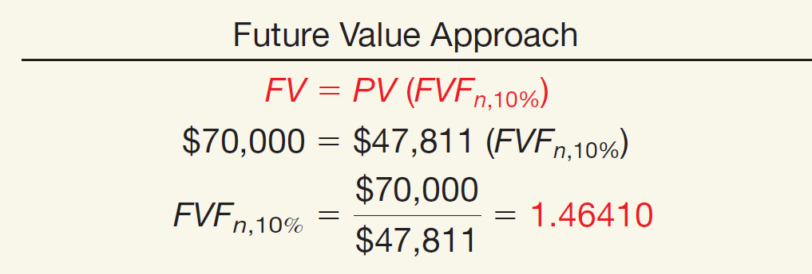
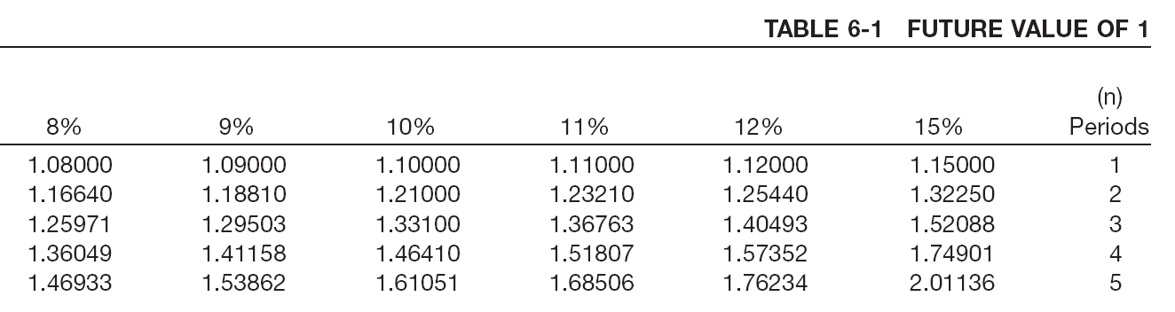
SINGLE-SUM PROBLEMS
Example—Computation of the Number of Periods
ILLUSTRATION 6-14
Using the future value factor of 1.46410, refer to Table 6-1 and read down the 10% column to find that factor in the 4-period row.
LO 2

Slide 35
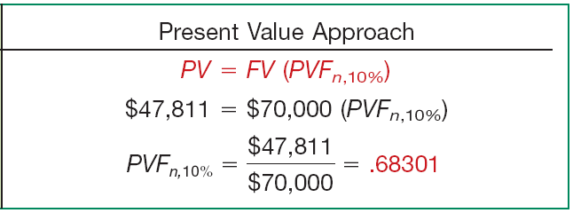
SINGLE-SUM PROBLEMS
Example—Computation of the Number of Periods
ILLUSTRATION 6-14
Using the present value factor of .68301, refer to Table 6-2 and read down the 10% column to find that factor in the 4-period row.
LO 2

Slide 36
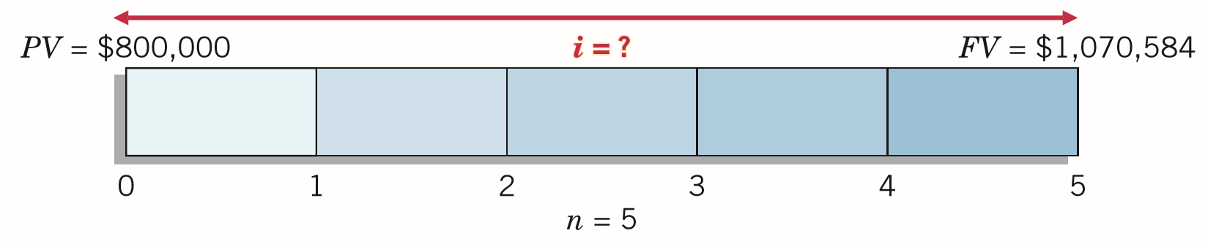
SINGLE-SUM PROBLEMS
Solving for Other Unknowns
Example—Computation of the Interest Rate
Advanced Design, Inc. needs $1,070,584 for basic research 5 years from now. The company currently has $800,000 to invest for that purpose. At what rate of interest must it invest the $800,000 to fund basic research projects of $1,070,584, 5 years from now?
ILLUSTRATION 6-15
Time Diagram to Solve for Unknown Interest Rate
LO 2

Slide 37
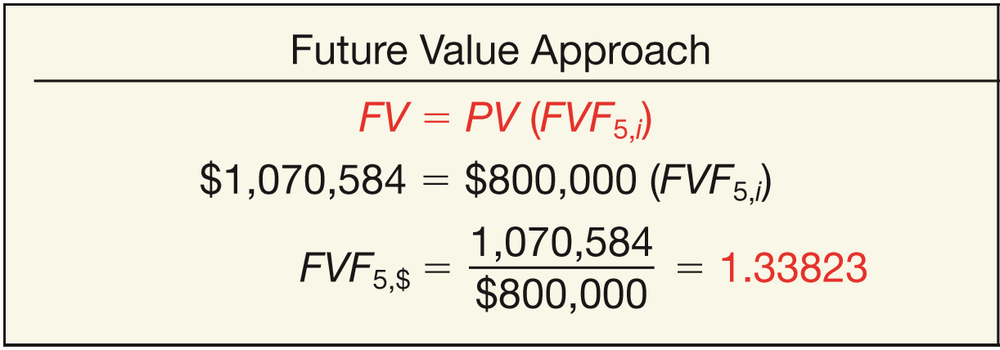
SINGLE-SUM PROBLEMS
Example—Computation of the Interest Rate
ILLUSTRATION 6-16
Using the future value factor of 1.33823, refer to Table 6-1 and read across the 5-period row to find the factor.
LO 2

Slide 38
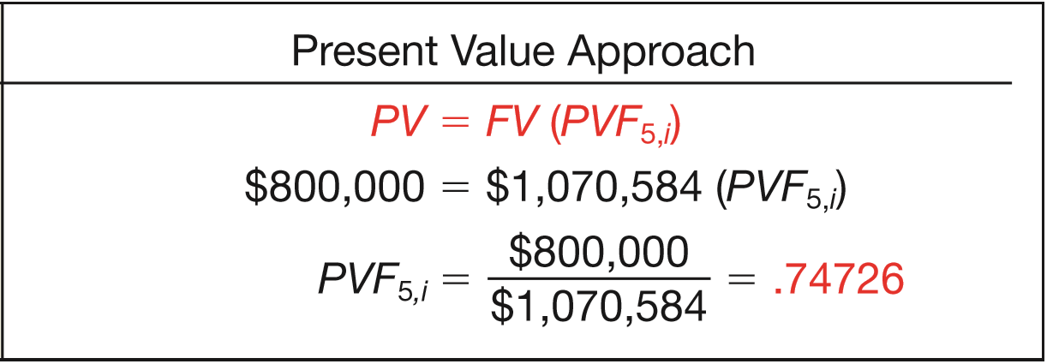
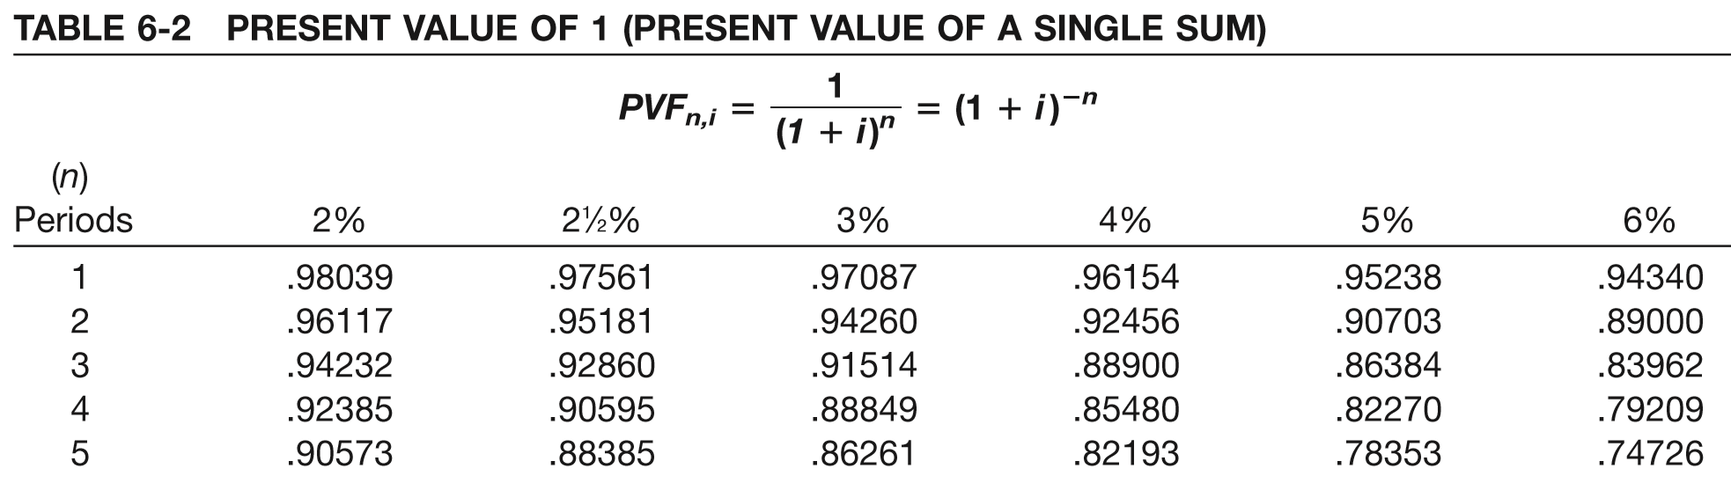
SINGLE-SUM PROBLEMS
Example—Computation of the Interest Rate
ILLUSTRATION 6-16
Using the present value factor of .74726, refer to Table 6-2 and read across the 5-period row to find the factor.

Slide 39
LEARNING OBJECTIVES
6
Accounting and the Time Value of Money
After studying this chapter, you should be able to:
Describe the fundamental concepts related to the time value of money.
Solve future and present value of 1 problems.
Solve future value of ordinary and annuity due problems.
Solve present value of ordinary and annuity due problems.
Solve present value problems related to deferred annuities, bonds, and expected cash flows.
LO 3

Slide 40
ANNUITIES
Annuity requires:
Periodic payments or receipts (called rents) of the same amount,
Same-length interval between such rents, and
Compounding of interest once each interval.
Two Types
Ordinary Annuity - rents occur at the end of each period.
Annuity Due - rents occur at the beginning of each period.
LO 3

Slide 41
ANNUITIES
Future Value of an Ordinary Annuity
Rents occur at the end of each period.
No interest during 1st period.
Present Value
Future Value
$20,000
20,000
20,000
20,000
20,000
20,000
20,000
20,000
0
1
2
3
4
5
6
7
8
LO 3

Slide 42
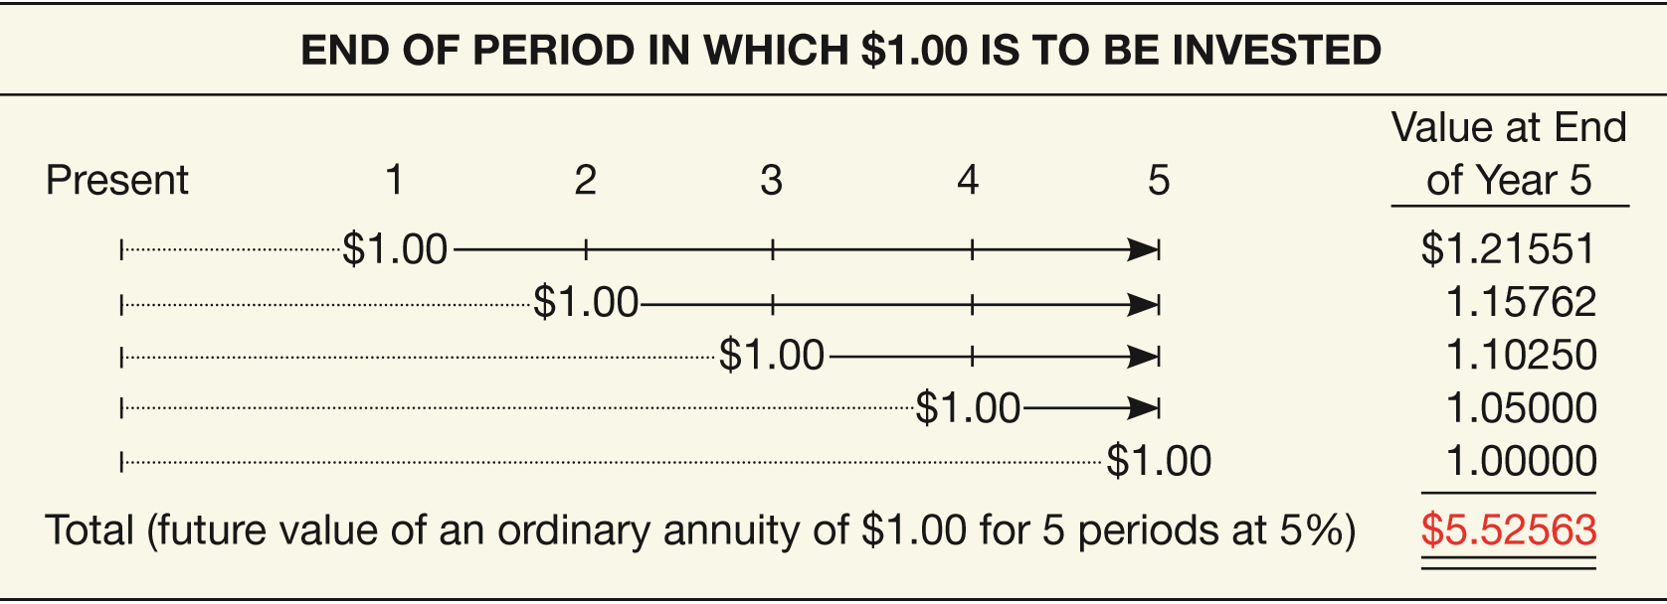
Future Value of an Ordinary Annuity
Illustration: Assume that $1 is deposited at the end of each of 5 years (an ordinary annuity) and earns 5% interest compounded annually. Following is the computation of the future value, using the “future value of 1” table (Table 6-1) for each of the five $1 rents.
ILLUSTRATION 6-17
Solving for the Future Value of an Ordinary Annuity
LO 3

Slide 43

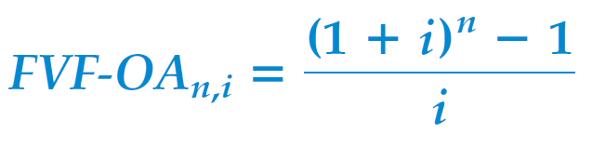
Future Value of an Ordinary Annuity
A formula provides a more efficient way of expressing the future value of an ordinary annuity of 1.
Where:
R = periodic rent
FVF-OA = future value factor of an ordinary annuity
i = rate of interest per period
n = number of compounding periods
n,i
LO 3

Slide 44
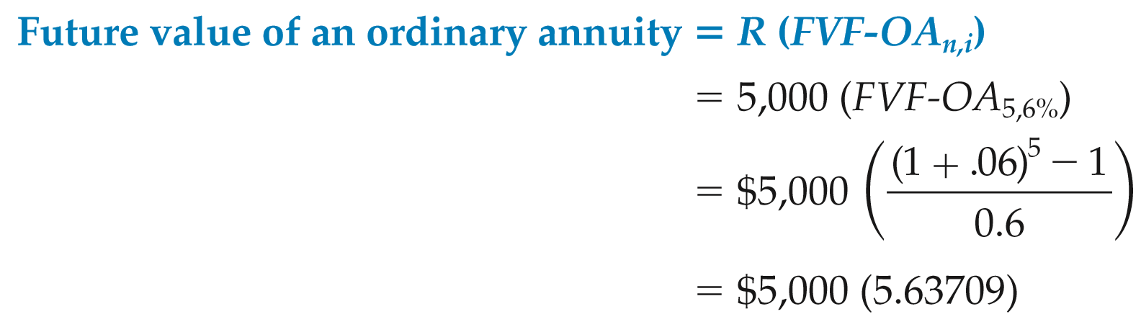
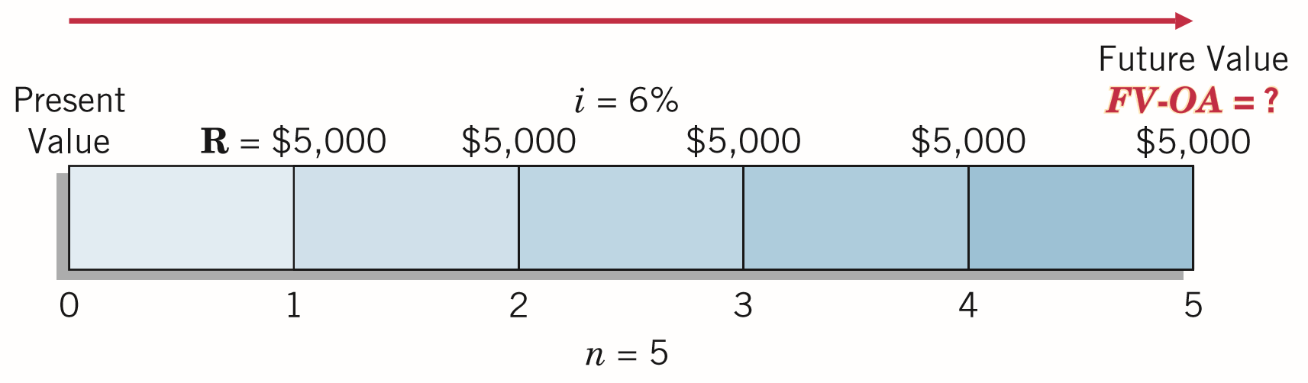
Future Value of an Ordinary Annuity
Illustration: What is the future value of five $5,000 deposits made at the end of each of the next 5 years, earning interest of 6%?
= $28,185.45
ILLUSTRATION 6-19
Time Diagram for Future Value of Ordinary Annuity (n = 5, i = 6%)
LO 3

Slide 45
Future Value of an Ordinary Annuity
Alternate Calculation
Illustration: What is the future value of five $5,000 deposits made at the end of each of the next 5 years, earning interest of 6%?
What table do we use?
ILLUSTRATION 6-19
Time Diagram for Future Value of Ordinary Annuity (n = 5, i = 6%)
LO 3

Slide 46
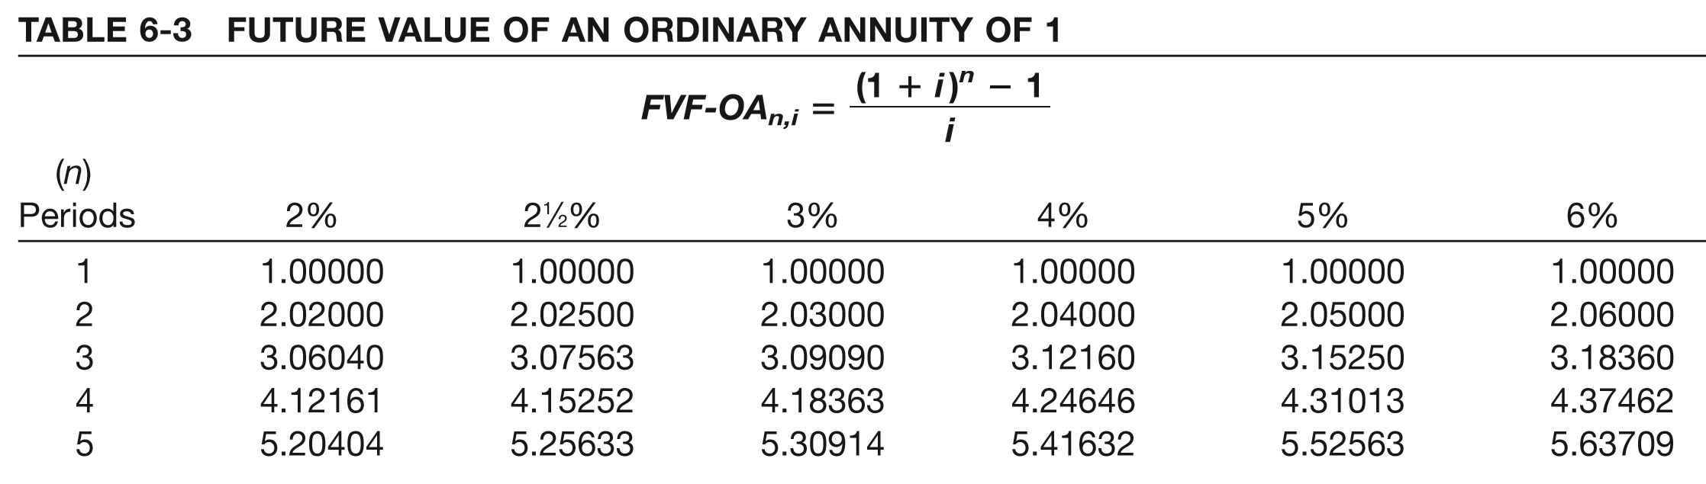
Future Value of an Ordinary Annuity
i=6%
n=5
What factor?
$5,000
x 5.63709
= $28,185.45
Deposits
Factor
Future Value
LO 3

Slide 47
Future Value of an Ordinary Annuity
Present Value
Future Values
$74,000
75,000
75,000
75,000
75,000
75,000
0
1
2
3
4
5
6
7
8
Illustration: Hightown Electronics deposits $75,000 at the end of each 6-month period for the next 3 years, to accumulate enough money to meet debts that mature in 3 years. What is the future value that the company will have on deposit at the end of 3 years if the annual interest rate is 10%?
What table do we use?
LO 3

Slide 48
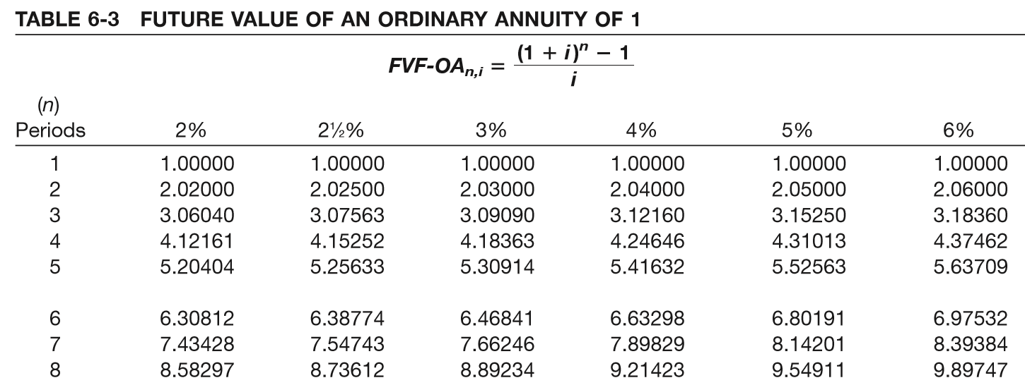
Future Value of an Ordinary Annuity
i=5%
n=6
$75,000
x 6.80191
= $510,143.25
Deposit
Factor
Future Value
LO 3

Slide 49
ANNUITIES
Future Value of an Annuity Due
Rents occur at the beginning of each period.
Interest will accumulate during 1st period.
Annuity Due has one more interest period than Ordinary Annuity.
Factor = multiply future value of an ordinary annuity factor by 1 plus the interest rate.
Future Values
$20,000
20,000
20,000
20,000
20,000
20,000
20,000
20,000
0
1
2
3
4
5
6
7
8
LO 3

Slide 50
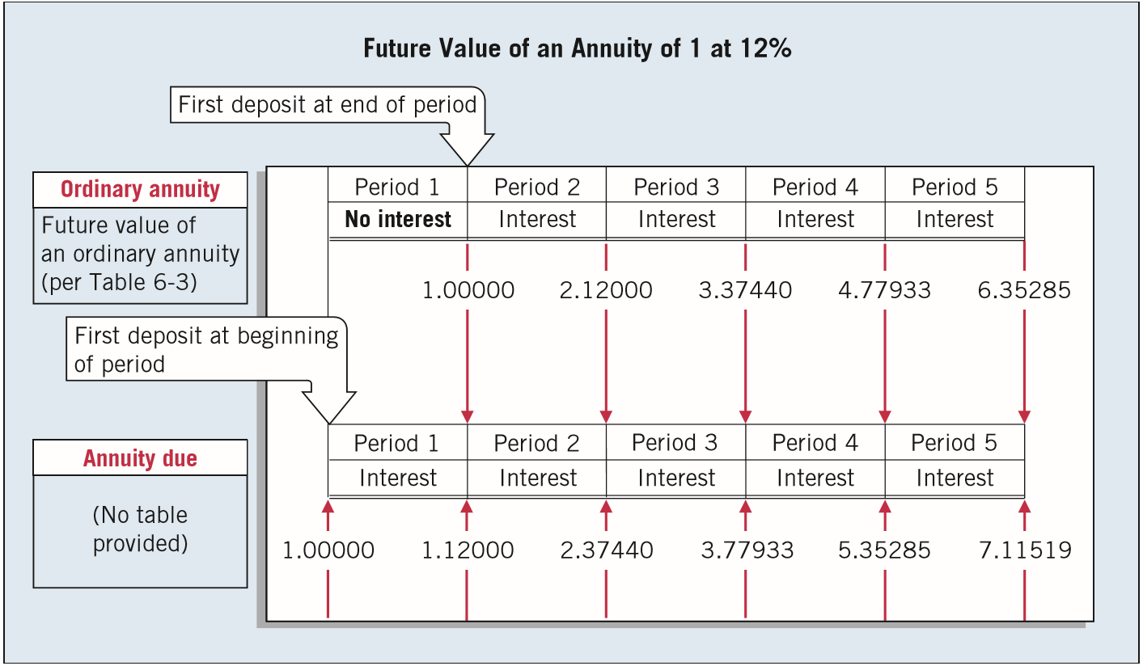
Future Value of an Annuity Due
ILLUSTRATION 6-21
Comparison of the Future Value of an Ordinary Annuity with an Annuity Due
LO 3

Slide 51
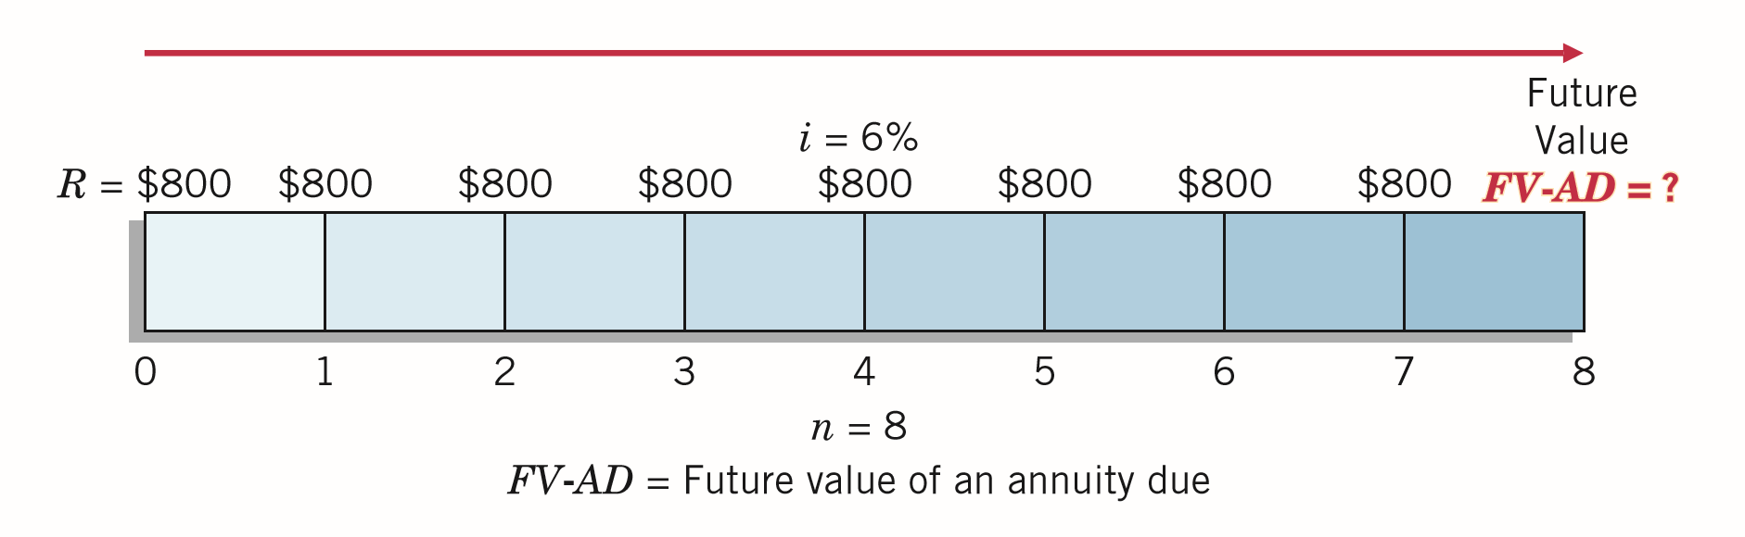
Future Value of an Annuity Due
Illustration: To illustrate the use of the ordinary annuity tables in converting to an annuity due, assume that Sue Lotadough plans to deposit $800 a year on each birthday of her son Howard. She makes the first deposit on his tenth birthday, at 6% interest compounded annually. Sue wants to know the amount she will have accumulated for college expenses by her son’s eighteenth birthday.
ILLUSTRATION 6-22
Annuity Due Time Diagram
LO 3

Slide 52
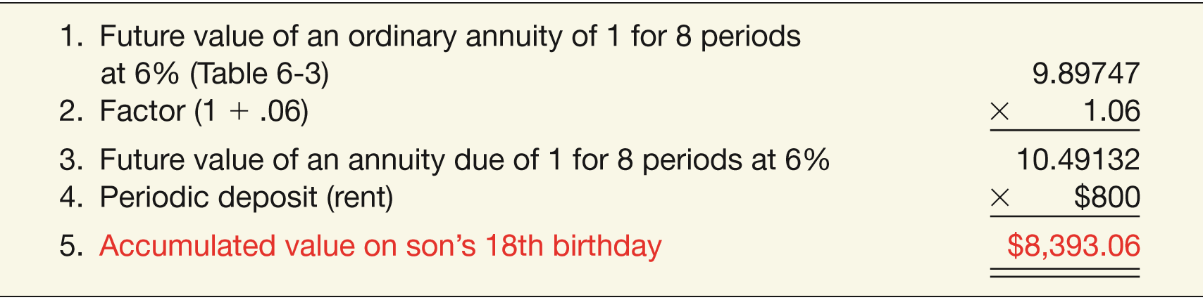
Future Value of an Annuity Due
Referring to the “future value of an ordinary annuity of 1” table for 8 periods at 6%, Sue finds a factor of 9.89747. She then multiplies this factor by (1 + .06) to arrive at the future value of an annuity due factor. As a result, the accumulated value on Howard’s eighteenth birthday is $8,393.06, as calculated in Illustration 6-23.
ILLUSTRATION 6-22
Annuity Due Time Diagram
ILLUSTRATION 6-23
Computation of Accumulated Value of Annuity Due
LO 3

Slide 53
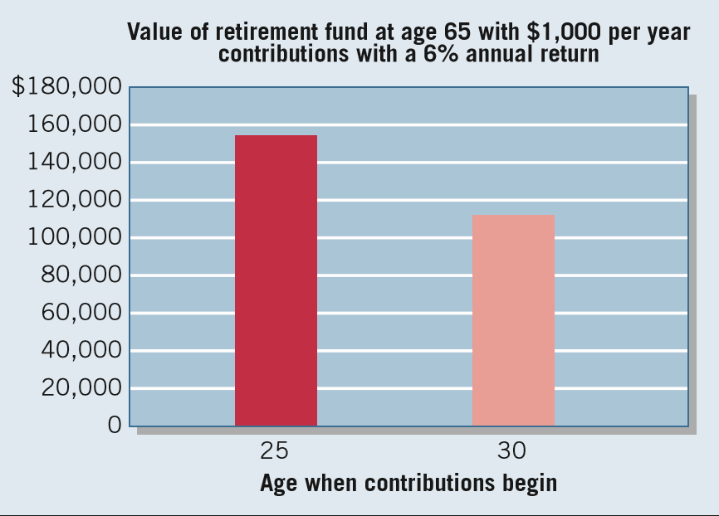
WHAT DO THE NUMBERS MEAN? DON’T WAIT TO MAKE THAT CONTRIBUTION!
WHAT’S YOUR PRINCIPLE
There is great power in compounding of interest, and there is no better illustration of this maxim than the case of retirement savings, especially for young adults. Under current tax rules for individual retirement accounts (IRAs), you can contribute up to $5,500 in an investment fund, which will grow tax-free until you reach retirement age. What’s more, you get a tax deduction for the amount contributed in the current year. Financial planners encourage young adults to take advantage of the
tax beneﬁts of IRAs. Indeed,
one type of IRA—a Roth—is
tax-free when you receive
payments in retirement. By
starting early, you can use the
power of compounding to
grow a pretty good nest egg.
As shown in the adjacent chart,
starting earlier can have a big
impact on the value of your
continued

Slide 54
WHAT DO THE NUMBERS MEAN? DON’T WAIT TO MAKE THAT CONTRIBUTION!
WHAT’S YOUR PRINCIPLE
retirement fund. As shown, by setting aside $1,000 each year, beginning when you are 25 and assuming a rate of return of 6%, your retirement account at age 65 will have a tidy balance of $154,762 [$1,000 × 154.76197 (FVF-OA40,6%)]. That’s the power of compounding. Not too bad you say, but hey, there are a lot of things you might want to spend that $1,000 on (clothes, a trip to Vegas or Europe, new golf clubs). However, if you delay starting those contributions until age 30, your retirement fund will grow only to a value of $111,435 ($1,000 × 111.43478 (FVF-OA35,6%)). That is quite a haircut—about 28%. That is, by delaying or missing contributions, you miss out on the power of compounding and put a dent in your projected nest egg.
Source: Adapted from T. Rowe Price, “A Roadmap to Financial Security for Young Adults,” Invest with Confidence (troweprice.com).
LO 3

Slide 55
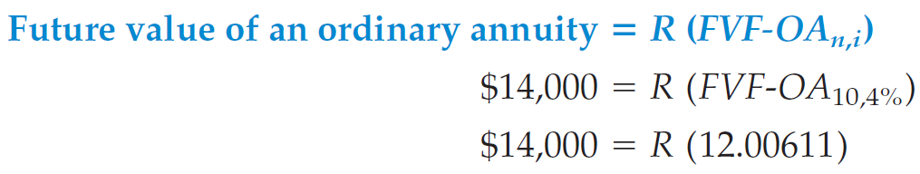
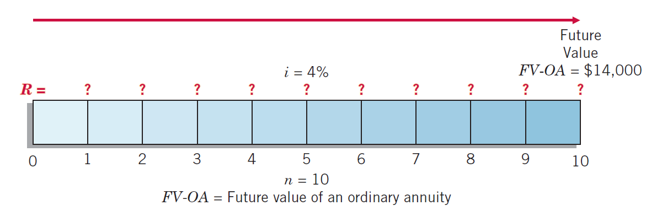
Future Value of Ordinary Annuity
Computation of Rent
Illustration: Assume that you plan to accumulate $14,000 for a down payment on a condominium apartment 5 years from now. For the next 5 years, you earn an annual return of 8% compounded semiannually. How much should you deposit at the end of each 6-month period?
R = $1,166.07
ILLUSTRATION 6-24
Future Value of Ordinary Annuity Time Diagram (n = 10, i = 4%)
LO 3

Slide 56
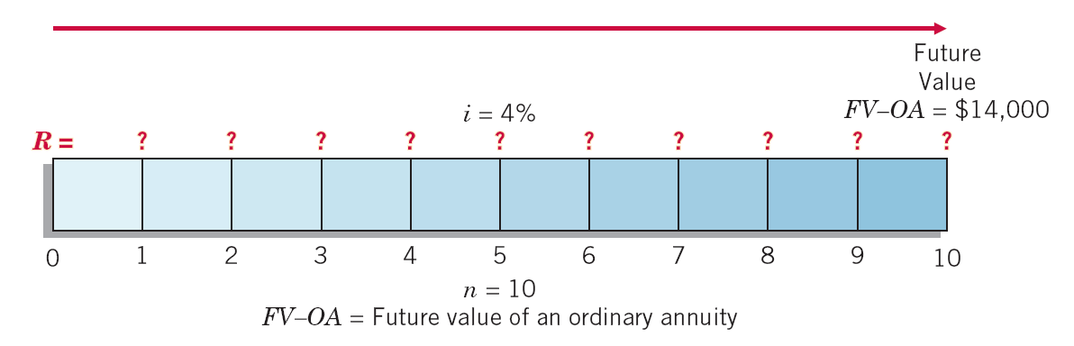
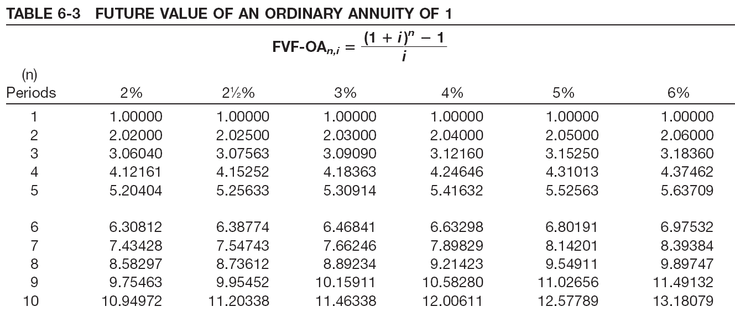
Future Value of Ordinary Annuity
Alternate Calculation
ILLUSTRATION 6-24
Computation of Rent
$14,000
= $1,166.07
12.00611
LO 3

Slide 57
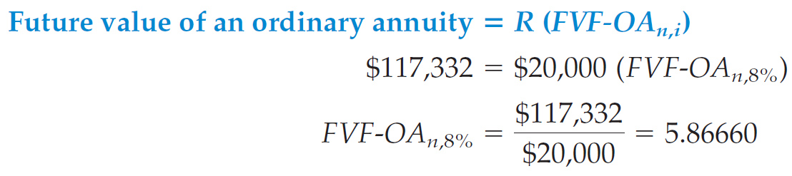
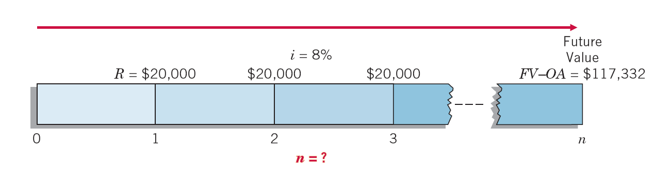
Future Value of Ordinary Annuity
Computation of Number of Periodic Rents
Illustration: Suppose that a company’s goal is to accumulate $117,332 by making periodic deposits of $20,000 at the end of each year, which will earn 8% compounded annually while accumulating. How many deposits must it make?
ILLUSTRATION 6-25
Future Value of Ordinary Annuity Time Diagram, to Solve for Unknown Number of Periods
5.86660
LO 3

Slide 58
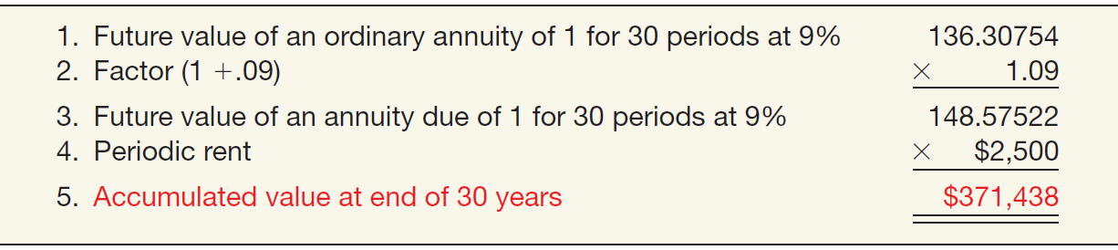
Future Value of an Annuity Due
Computation of Future Value
Illustration: Mr. Goodwrench deposits $2,500 today in a savings account that earns 9% interest. He plans to deposit $2,500 every year for a total of 30 years. How much cash will Mr. Goodwrench accumulate in his retirement savings account, when he retires in 30 years?
ILLUSTRATION 6-27
Computation of Accumulated Value of an Annuity Due
LO 3

Slide 59
Future Value of an Annuity Due
Present Value
Future Values
20,000
$20,000
20,000
20,000
20,000
20,000
20,000
20,000
0
1
2
3
4
5
6
7
8
Illustration: Bayou Inc. will deposit $20,000 in a 5% fund at the beginning of each year for 7 years beginning January 1, Year 1. What amount will be in the fund at the end of Year 7?
Use future value of ordinary annuity table.
LO 3

Slide 60
Future Value of an Annuity Due
i=5%
n=7
8.14201 x 1.05 = 8.5491105
$20,000
x 8.5491105
= $170,982.21
Deposit
Factor
Future Value
LO 3

Slide 61
LEARNING OBJECTIVES
6
Accounting and the Time Value of Money
After studying this chapter, you should be able to:
Describe the fundamental concepts related to the time value of money.
Solve future and present value of 1 problems.
Solve future value of ordinary and annuity due problems.
Solve present value of ordinary and annuity due problems.
Solve present value problems related to deferred annuities, bonds, and expected cash flows.
LO 4

Slide 62
ANNUITIES
Present Value of an Ordinary Annuity
Present value of a series of equal amounts to be withdrawn or received at equal intervals.
Periodic rents occur at the end of the period.
Present Value
$100,000
100,000
100,000
100,000
100,000
100,000
. . . . .
0
1
2
3
4
19
20
LO 4

Slide 63
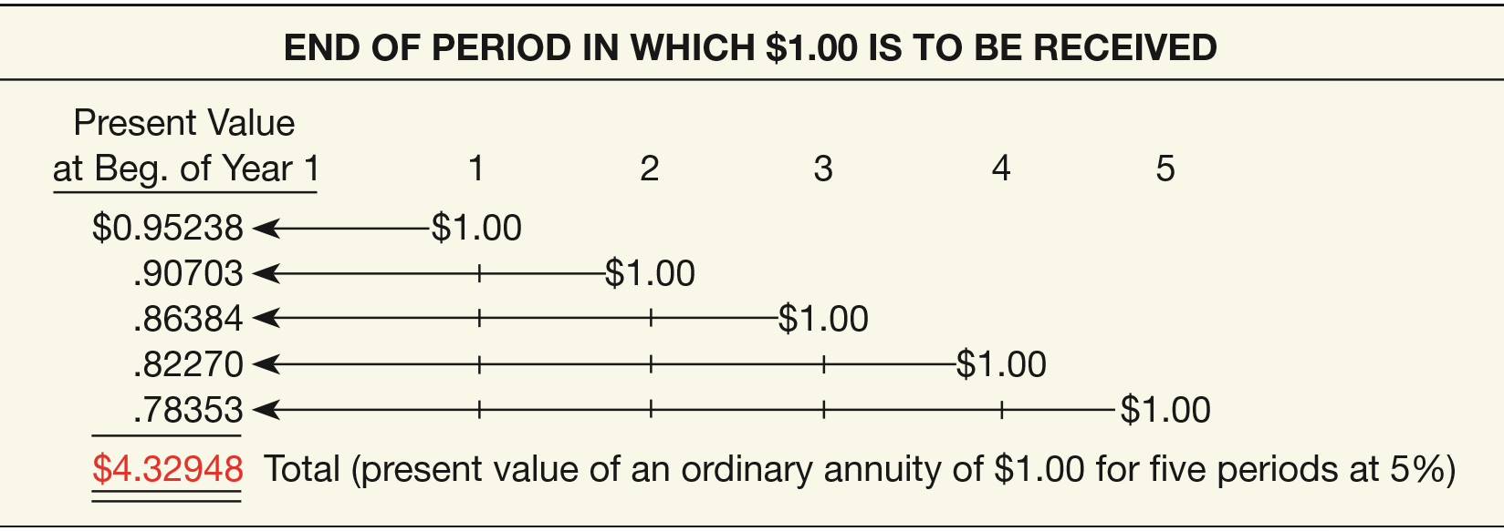
Present Value of an Ordinary Annuity
Illustration: Assume that $1 is to be received at the end of each of 5 periods, as separate amounts, and earns 5% interest compounded annually.
ILLUSTRATION 6-28
Solving for the Present Value of an Ordinary Annuity
LO 4

Slide 64
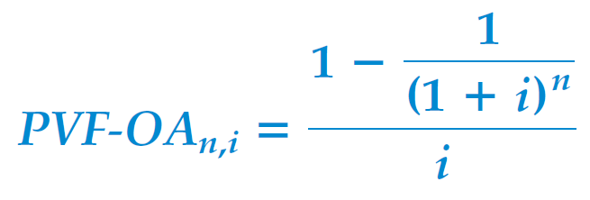
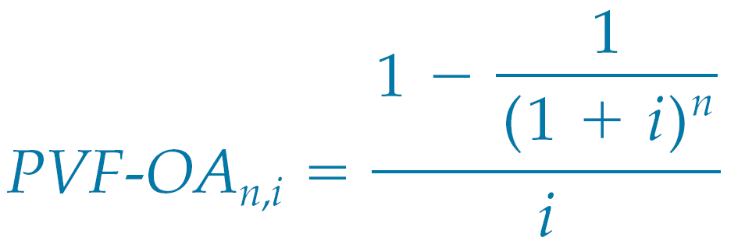
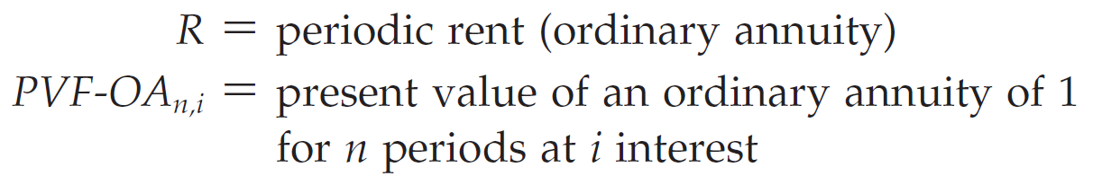
Present Value of an Ordinary Annuity
A formula provides a more efficient way of expressing the present value of an ordinary annuity of 1.
Where:
LO 4

Slide 65
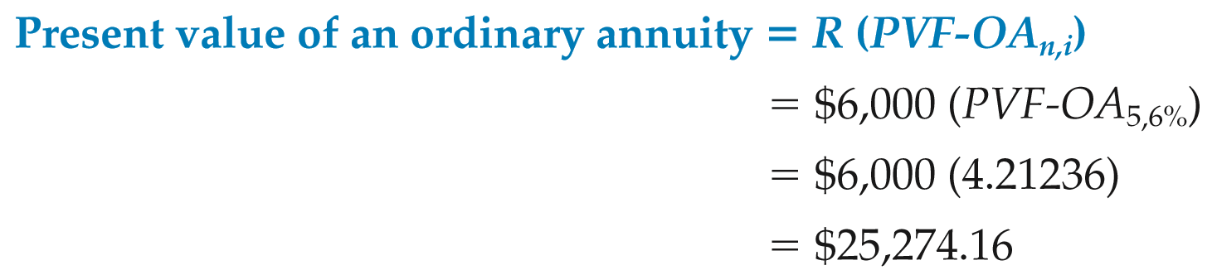
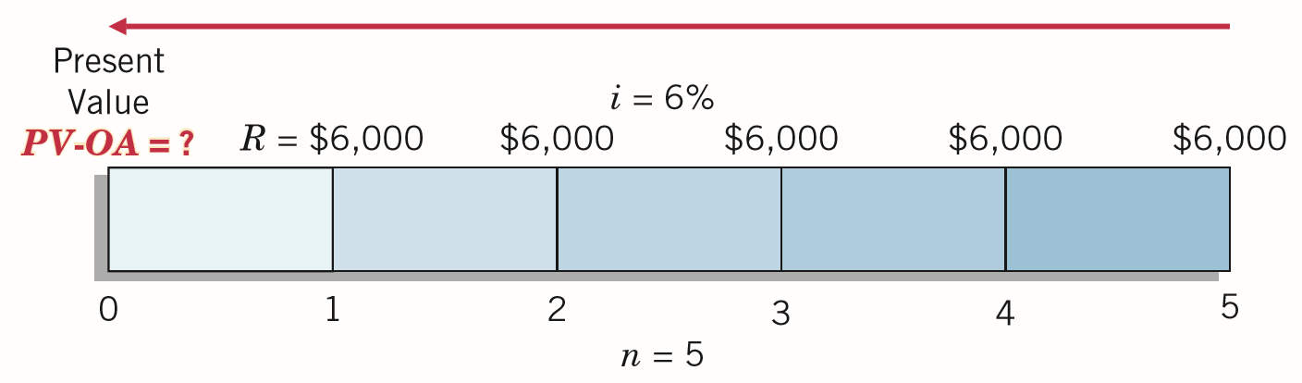
Present Value of an Ordinary Annuity
Illustration: What is the present value of rental receipts of $6,000 each, to be received at the end of each of the next 5 years when discounted at 6%?
ILLUSTRATION 6-30
LO 4

Slide 66
Present Value of an Ordinary Annuity
Present Value
$100,000
100,000
100,000
100,000
100,000
100,000
. . . . .
0
1
2
3
4
19
20
Illustration: Jaime Yuen wins $2,000,000 in the state lottery. She will be paid $100,000 at the end of each year for the next 20 years. How much has she actually won? Assume an appropriate interest rate of 8%.
What table do we use?
LO 4

Slide 67
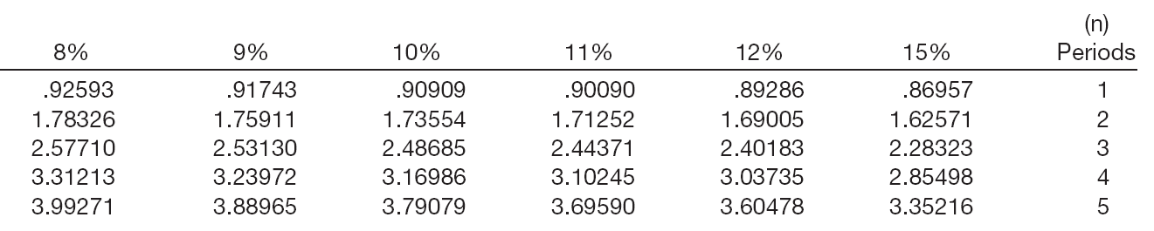
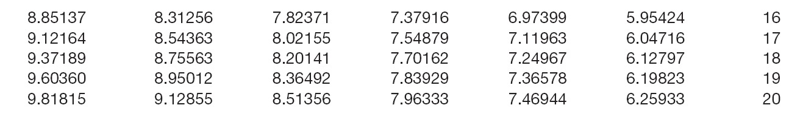
Present Value of an Ordinary Annuity
i=8%
n=20
$100,000
x 9.81815
= $981,815
Receipts
Factor
Present Value
LO 4

Slide 68
WHAT DO THE NUMBERS MEAN? UP IN SMOKE
WHAT’S YOUR PRINCIPLE
Time value of money concepts also can be relevant to public policy debates. For example, several states had to determine how to receive the payments from tobacco companies as settlement for a national lawsuit against the companies for the healthcare costs of smoking. The State of Wisconsin was due to collect 25 years of payments totaling $5.6 billion. The state could wait to collect the payments, or it could sell the payments to an investment bank (a process called securitization). If it were to sell the payments, it would receive a lump-sum payment today of $1.26 billion. Is this a good deal for the state? Assuming a discount rate of 8% and that the payments will be received in equal amounts (e.g., an annuity), the present value of the tobacco payment is:
$ 5.6 billion ÷ 25 = $224 million
$224 million × 10.67478* = $2.39 billion
*PV-OA (i = 8%, n = 25)
Why would some in the state be willing to take just $1.26 billion today for an annuity whose present value is almost twice that amount? One reason is that
continued
LO 4

Slide 69
WHAT DO THE NUMBERS MEAN? UP IN SMOKE
WHAT’S YOUR PRINCIPLE
Wisconsin was facing a hole in its budget that could be plugged in part by the lump-sum payment. Also, some believed that the risk of not getting paid by the tobacco companies in the future makes it prudent to get the money earlier. If this latter reason has merit, then the present value computation above should have been based on a higher interest rate. Assuming a discount rate of 15%, the present value of the annuity is $1.448 billion ($5.6 billion ÷ 25 = $224 million; $224 million × 6.46415), which is much closer to the lump-sum payment offered to the State of Wisconsin.
LO 4

Slide 70
ANNUITIES
Present Value of an Annuity Due
Present value of a series of equal amounts to be withdrawn or received at equal intervals.
Periodic rents occur at the beginning of the period.
Present Value
$100,000
100,000
100,000
100,000
100,000
100,000
. . . . .
0
1
2
3
4
19
20
LO 4

Slide 71
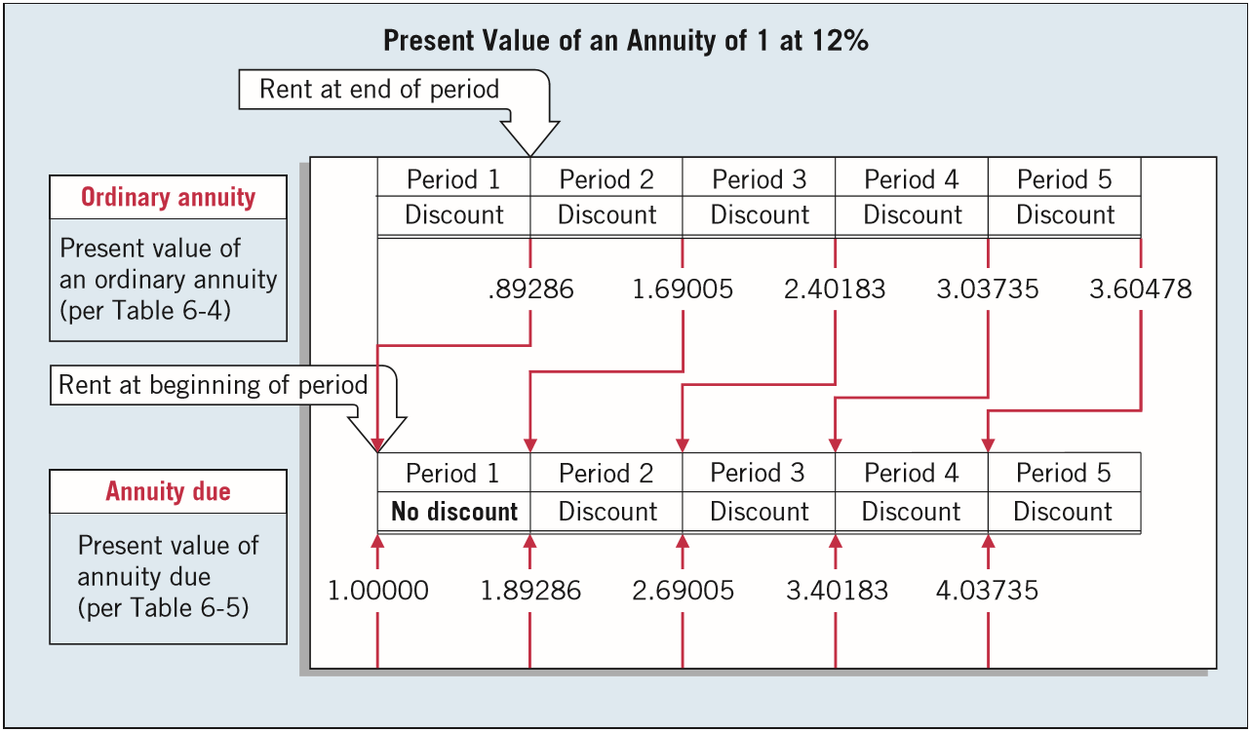
Present Value of an Annuity Due
ILLUSTRATION 6-31
Comparison of Present Value of an Ordinary Annuity with an Annuity Due
LO 4

Slide 72
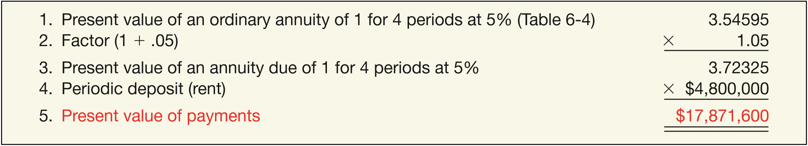
Present Value of an Annuity Due
Illustration: Space Odyssey, Inc., rents a communications satellite for 4 years with annual rental payments of $4.8 million to be made at the beginning of each year. If the relevant annual interest rate is 5%, what is the present value of the rental obligations?
ILLUSTRATION 6-33
Computation of Present Value of an Annuity Due
LO 4

Slide 73
Present Value of Annuity Problems
Illustration: Jaime Yuen wins $4,000,000 in the state lottery. She will be paid $200,000 at the beginning of each year for the next 20 years. How much has she actually won? Assume an appropriate interest rate of 8%.
Present Value
$200,000
200,000
200,000
200,000
200,000
200,000
. . . . .
0
1
2
3
4
19
20
What table do we use?
LO 4

Slide 74


Present Value of Annuity Problems
i=8%
n=20
$200,000
x 10.60360
= $2,120,720
Receipts
Factor
Present Value
LO 4

Slide 75

Present Value of Annuity Problems
Computation of the Interest Rate
Illustration: Assume you receive a statement from MasterCard with a balance due of $528.77. You may pay it off in 12 equal monthly payments of $50 each, with the first payment due one month from now. What rate of interest would you be paying?
Referring to Table 6-4 and reading across the 12-period row, you find 10.57534 in the 2% column. Since 2% is a monthly rate, the nominal annual rate of interest is 24% (12 x 2%). The effective annual rate is 26.82413% [(1 + .02) - 1].
12
LO 4

Slide 76

Present Value of Annuity Problems
Computation of a Periodic Rent
Illustration: Norm and Jackie Remmers have saved $36,000 to finance their daughter Dawna’s college education. They deposited the money in the Bloomington Savings and Loan Association, where it earns 4% interest compounded semiannually. What equal amounts can their daughter withdraw at the end of every 6 months during her 4 college years, without exhausting the fund?
12
LO 4

Slide 77
LEARNING OBJECTIVES
6
Accounting and the Time Value of Money
After studying this chapter, you should be able to:
Describe the fundamental concepts related to the time value of money.
Solve future and present value of 1 problems.
Solve future value of ordinary and annuity due problems.
Solve present value of ordinary and annuity due problems.
Solve present value problems related to deferred annuities, bonds, and expected cash flows.
LO 5

Slide 78
OTHER TIME VALUE OF MONEY ISSUES
Deferred Annuities
Rents begin after a specified number of periods.
Future Value of a Deferred Annuity - Calculation same as the future value of an annuity not deferred.
Present Value of a Deferred Annuity - Must recognize the interest that accrues during the deferral period.
Future Value
Present Value
100,000
100,000
100,000
. . . . .
0
1
2
3
4
19
20
LO 5

Slide 79
OTHER TIME VALUE OF MONEY ISSUES
Valuation of Long-Term Bonds
Two Cash Flows:
Periodic interest payments (annuity).
Principal paid at maturity (single-sum).
2,000,000
$140,000
140,000
140,000
140,000
140,000
140,000
. . . . .
0
1
2
3
4
9
10
LO 5

Slide 80
Valuation of Long-Term Bonds
Illustration: Alltech Corporation on January 1, 2017, issues $100,000 of 5% bonds due in 5 years with interest payable annually at year-end. The current market rate of interest for bonds of similar risk is 6%. What will the buyers pay for this bond issue?
Present Value
$5,000
5,000
5,000
5,000
105,000
0
1
2
3
4
5
6
LO 5

Slide 81

Valuation of Long-Term Bonds
i=6%
n=5
PV of Interest
$5,000 x 4.21236 = $21,061.80
Interest Payment
Factor
Present Value
LO 5

Slide 82
Valuation of Long-Term Bonds
i=6%
n=5
PV of Principal
$100,000 x .74726 = $74,726.00
Principal
Factor
Present Value
LO 5

Slide 83
Valuation of Long-Term Bonds
Illustration: Alltech Corporation issues $100,000 of 5% bonds due in 5 years with interest payable at year-end.
Present value of Interest $21,061.80
Present value of Principal 74,726.00
Bond current market value $95,787.80
LO 5

Slide 84


Valuation of Long-Term Bonds
ILLUSTRATION 6-45
Effective-Interest Amortization Schedule
LO 5

Slide 85
Present Value Measurement
Concept Statement No. 7 introduces an expected cash flow approach that uses a range of cash flows and incorporates the probabilities of those cash flows.
Choosing an Appropriate Interest Rate
Three Components of Interest:
Pure Rate
Expected Inflation Rate
Credit Risk Rate
Risk-free rate of return. FASB states a company should discount expected cash flows by the risk-free rate of return.
LO 5

Slide 86

Present Value Measurement
Illustration: Al’s Appliance Outlet offers a 2-year warranty on all products sold. In 2017, Al’s Appliance sold $250,000 of a particular type of clothes dryer. Al’s Appliance entered into an agreement with Ralph’s Repair to provide all warranty service on the dryers sold in 2017. Since there is not a ready market for these warranty contracts, Al’s Appliance uses expected cash flow techniques to value the warranty obligation. Based on
prior warranty
experience, Al’s
Appliance estimates
the expected cash
outflows associated
with the dryers sold
in 2017, as shown.
ILLUSTRATION 6-46
Expected Cash Outﬂows—Warranties

Slide 87

Present Value Measurement
Illustration 6-47 shows the present value of these cash flows, assuming a risk-free rate of 5% and cash flows occurring at the end of the year.
ILLUSTRATION 6-47
Present Value of Cash Flows
LO 5

Slide 88
WHAT DO THE NUMBERS MEAN? HOW LOW CAN THEY GO?
WHAT’S YOUR PRINCIPLE
Management of the level of interest rates is an important policy tool of the Federal Reserve Bank and its chair, Janet Yellen. Through a number of policy options, the Fed has the ability to move interest rates up or down, and these rate changes can affect the wealth of all market participants. For example, if the Fed wants to raise rates (because the overall economy is getting overheated), it can raise the discount rate, which is the rate banks pay to borrow money from the Fed. This rate increase will factor into the rates banks and other creditors use to lend money. As a result, companies will think twice about borrowing money to expand their businesses. The result will be a slowing economy. A rate cut does just the opposite. It makes borrowing cheaper, and it can help the economy expand as more companies borrow to expand their operations. Keeping rates low had been the Fed’s policy in the early 2000s. The low rates did help keep the economy humming. But these same low rates may have also resulted in too much real estate lending and the growth of a real estate bubble, as the price of housing was fueled by cheaper low-interest mortgage loans. But, as the old saying goes, “What goes up, must
continued
LO 5

Slide 89
WHAT DO THE NUMBERS MEAN? HOW LOW CAN THEY GO?
WHAT’S YOUR PRINCIPLE
come down.” That is what real estate prices did, triggering massive loan write-offs, a seizing up of credit markets, and a slowing economy. So just when a rate cut might have helped the economy, the Fed’s rate-cutting toolbox was empty. In response, the Fed began repurchasing long-term government bonds—referred to as “quantitative easing.” These repurchases put money into the market and reduce long-term Interest rates. After three rounds of quantitative easing, it now appears that the Fed was able to spur the economy out of its persistent funk. More recently, Fed watchers are trying to predict when the Fed will allow rates to rise, with many concerned that a rate increase could disrupt the economy’s fragile recovery.
Sources: Adam Shell, “Five Investments to Consider if the Fed Uncorks QE3,” USA TODAY (September 1, 2012); and M. Crutsinger, “Yellen Reiterates Fed’s Patience in Raising Rates,” Associated Press (February 24, 2015).
LO 5

Slide 90
COPYRIGHT
“Copyright © 2016 John Wiley & Sons, Inc. All rights reserved. Reproduction or translation of this work beyond that permitted in Section 117 of the 1976 United States Copyright Act without the express written permission of the copyright owner is unlawful. Request for further information should be addressed to the Permissions Department, John Wiley & Sons, Inc. The purchaser may make back-up copies for his/her own use only and not for distribution or resale. The Publisher assumes no responsibility for errors, omissions, or damages, caused by the use of these programs or from the use of the information contained herein.”

