Slide 1
Lecture Notes
WEEK2
Computer Performance Concepts
Notes:
This chapter addresses the issue of computer system performance. We begin with a
consideration of the need for balanced utilization of computer resources, which provides
a perspective that is useful throughout the book. Next we look at contemporary
computer organization designs intended to provide performance to meet current
and projected demand. Finally, we look at tools and models that have been developed
to provide a means of assessing comparative computer system performance.

Slide 2
What is Performance?
How can we make intelligent choices about computers?
Why is some computer hardware performs better at some programs, but performs less at other programs?
How do we measure the performance of a computer?
What factors are hardware related? software related?
How does machine’s instruction set affect performance?
Understanding performance is key to understanding underlying organizational motivation
Notes:
Increase hardware speed of processor
Fundamentally due to shrinking logic gate size
More gates, packed more tightly, increasing clock rate
Propagation time for signals reduced

Slide 3
Response Time and Throughput
Response Time
Time between start and completion of a task, as observed by end user
Response Time = CPU Time + Waiting Time (I/O, OS scheduling, etc.)
Throughput
Number of tasks the machine can run in a given period of time
Decreasing execution time improves throughput
Example: using a faster version of a processor
Less time to run a task → more tasks can be executed
Increasing throughput can also improve response time
Example: increasing number of processors in a multiprocessor
Increase Speed: Pipelining, Branch prediction, Superscalar
More tasks can be executed in parallel
Execution time of individual sequential tasks is not changed
But less waiting time in scheduling queue reduces response time

Slide 4

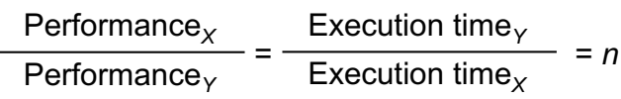
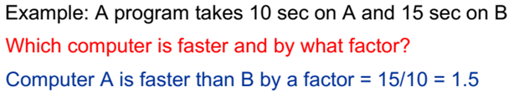
Higher Performance = Less Execution Time
For some program running on machine X
Relative Performance: X is n times faster than Y

Slide 5
What do we mean by Execution Time?
Real Elapsed Time
Counts everything; total time including:
Waiting time, Input/output, disk access, OS scheduling, … etc.
Useful number, but often not good for comparison purposes
Our Focus: CPU Execution Time
Time spent while executing the program instructions
Doesn't count the waiting time for I/O or OS scheduling
Can be measured in seconds, or
Can be related to number of CPU clock cycles
Notes:
The most important factor that affects CPU is the clock.
CPU time = Instruction count * CPI / Clock rate

Slide 6

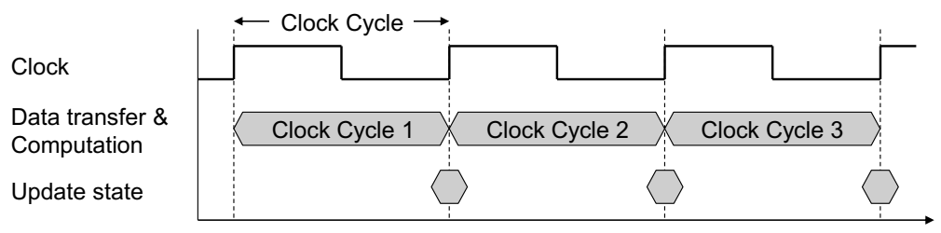
What is the Clock Cycle?
Operation of digital hardware is governed by a clock
Clock Cycle = Clock period
Duration between two consecutive rising edges of the clock signal
Clock rate = Clock frequency = 1 / Clock Cycle
1 Hz = 1 cycle/sec, 1 KHz = 10³ cycles/sec
1 MHz = 10⁶ cycles/sec, 1 GHz = 10⁹ cycles/sec
2 GHz clock has a cycle time = 1/(2×10⁹) = 0.5 nanosecond (ns)

Slide 7
Improving Performance
To improve performance, we need to
Reduce the number of clock cycles required by a program, or
Reduce the clock cycle time (increase the clock rate)
Example:
A program runs in 10 seconds on computer X with 2 GHz clock
What is the number of CPU cycles on computer X ?
We want to design computer Y to run same program in 6 seconds
But computer Y requires 10% more cycles to execute program
What is the clock rate for computer Y ?
Solution:
CPU cycles on computer X = 10 sec × 2 × 10⁹ cycles/s = 20 × 10⁹ cycles
CPU cycles on computer Y = 1.1 × 20 × 10⁹ = 22 × 10⁹ cycles
Clock rate for computer Y = 22 × 10⁹ cycles / 6 sec = 3.67 GHz

Slide 8
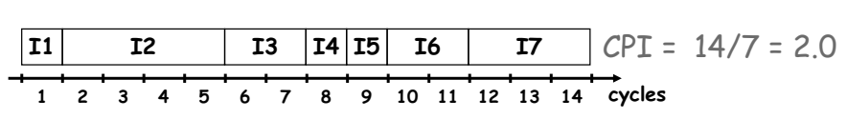
Clock Cycles per Instruction (CPI)
Instructions take different number of cycles to execute
Multiplication takes more time than addition
Floating point operations take longer than integer ones
Accessing memory takes more time than accessing registers
CPI is an average number of clock cycles per instruction
Important point
Changing the cycle time often changes the number of cycles required for various instructions

Slide 9
Performance Equation
To execute, a given program will require …
Some number of machine instructions
Some number of clock cycles
Some number of seconds
We can relate CPU clock cycles to instruction count
Performance Equation: (related to instruction count)

Slide 10
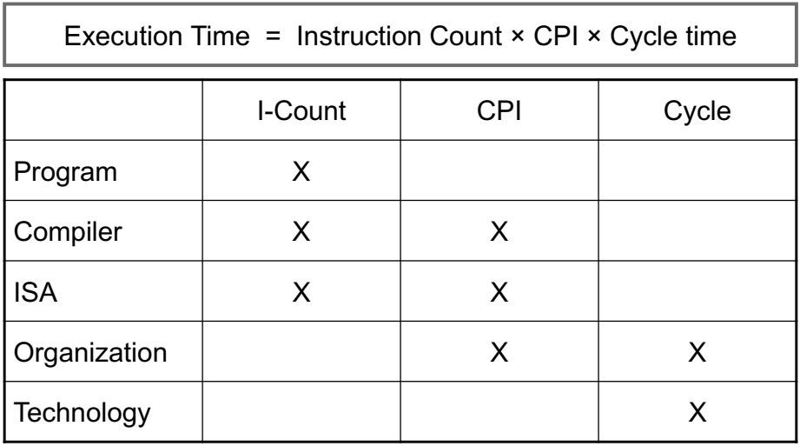
Understanding Performance Equation

Slide 11
Using the Performance Equation
For a given program
Machine A has a clock cycle time of 250 ps and a CPI of 2.0
Machine B has a clock cycle time of 500 ps and a CPI of 1.2
Which machine is faster for this program, and by how much?
Solution:
Both computer execute same count of instructions = I
CPU execution time (A) = I × 2.0 × 250 ps = 500 × I ps
CPU execution time (B) = I × 1.2 × 500 ps = 600 × I ps
Computer A is faster than B by a factor = 1.2

Slide 12
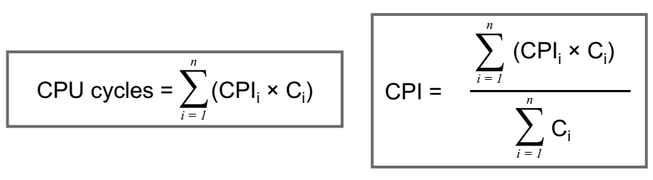
Determining the CPI
Different types of instructions have different CPI
Let CPI_{i} = clocks per instruction for class i of instructions
Let C_{i} = instruction count for class i of instructions
Designers often obtain CPI by a detailed simulation
Hardware counters are also used for operational CPUs

Slide 13
Example on Determining the CPI
Problem
A compiler designer is trying to decide between two code sequences for a particular machine. Based on the hardware implementation, there are three different classes of instructions: class A, class B, and class C, and they require one, two, and three cycles per instruction, respectively.
The first code sequence has 5 instructions: 2 of A, 1 of B, and 2 of C
The second sequence has 6 instructions: 4 of A, 1 of B, and 1 of C
Compute the CPU cycles for each sequence. Which sequence is faster?
What is the CPI for each sequence?
Solution:
CPU cycles (1st sequence) = (2×1) + (1×2) + (2×3) = 2+2+6 = 10 cycles
CPU cycles (2nd sequence) = (4×1) + (1×2) + (1×3) = 4+2+3 = 9 cycles
Second sequence is faster, even though it executes one extra instruction
CPI (1st sequence) = 10/5 = 2, CPI (2nd sequence) = 9/6 = 1.5

Slide 14
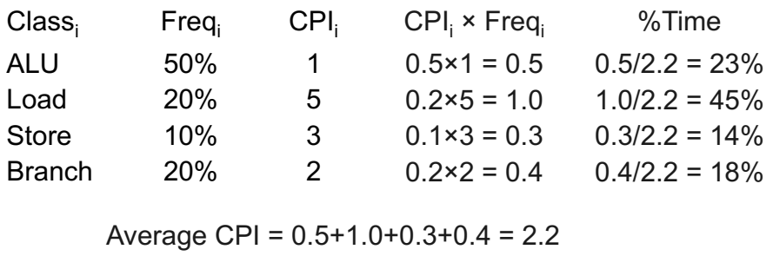
Second Example on CPI
Given: instruction mix of a program on a RISC processor
What is average CPI?
What is the percent of time used by each instruction class?
How faster would the machine be if load time is 2 cycles?
What if two ALU instructions could be executed at once?

Slide 15


MIPS as a Performance Measure
MIPS: Millions Instructions Per Second
Sometimes used as performance metric
Faster machine → larger MIPS
MIPS specifies instruction execution rate
We can also relate execution time to MIPS

Slide 16
Drawbacks of MIPS
Three problems using MIPS as a performance metric
Does not take into account the capability of instructions
Cannot use MIPS to compare computers with different instruction sets because the instruction count will differ
MIPS varies between programs on the same computer
A computer cannot have a single MIPS rating for all programs
MIPS can vary inversely with performance
A higher MIPS rating does not always mean better performance
Example in next slide shows this anomalous behavior

Slide 17
MIPS example
Two different compilers are being tested on the same program for a 4 GHz machine with three different classes of instructions: Class A, Class B, and Class C, which require 1, 2, and 3 cycles, respectively.
The instruction count produced by
The first compiler is 5 billion Class A instructions, 1 billion Class B instructions, and 1 billion Class C instructions.
The second compiler produces 10 billion Class A instructions, 1 billion Class B instructions, and 1 billion Class C instructions.
Which compiler produces a higher MIPS?
Which compiler produces a better execution time?

Slide 18
Solution to MIPS Example
First, we find the CPU cycles for both compilers
CPU cycles (compiler 1) = (5×1 + 1×2 + 1×3)×10⁹ = 10×10⁹
CPU cycles (compiler 2) = (10×1 + 1×2 + 1×3)×10⁹ = 15×10⁹
Next, we find the execution time for both compilers
Execution time (compiler 1) = 10×10⁹ cycles / 4×10⁹ Hz = 2.5 sec
Execution time (compiler 2) = 15×10⁹ cycles / 4×10⁹ Hz = 3.75 sec
Compiler1 generates faster program (less execution time)
Now, we compute MIPS rate for both compilers
MIPS = Instruction Count / (Execution Time × 10⁶)
MIPS (compiler 1) = (5+1+1) × 10⁹ / (2.5 × 10⁶) = 2800
MIPS (compiler 2) = (10+1+1) × 10⁹ / (3.75 × 10⁶) = 3200
So, code from compiler 2 has a higher MIPS rating !!!

