Slide 1
Speech Audiometry

Slide 2
Dynamics of speech
Intensity
– whisper - 20 dB HL
– Normal conversational speech - 50 to 60 dB
– Loud speech - 70 dB
– Shouting - 90 dB

Slide 3
Purpose of Speech Audiometry
To verify pure-tone thresholds.
To determine the extent of speech recognition difficulty.
To aid in diagnosis of retro-cochlear problems.
Assists in the selection of amplification systems.
Helps clinician educate patients about loss and make a prognosis about treatment outcomes.

Slide 4
Contribution of speech evaluation to differential diagnosis
Rollover effect: Reduction in speech recognition (more than 20% from maximum performance) with increases in intensity.
– Occurs with retrocochlear pathological conditions

Slide 5
Performance Intensity Functions
Curve reaches a peak (Pbmax), and then – Either remains high (normal), or – Drops at higher levels (Rollover)
Rollover Index = (PBmax – Pbmin)/PBmax

Slide 6
Rollover Indices for the preceding examples
Normal: (100 - 100) / 100 = 0.0
Rollover: (44 - 20) / 44 = 0.54
Cochlear: (80 - 70)/80 = 0.125
Rollover Indices of 0.45 or greater indicate a neural (VIIIth nerve) problem.

Slide 7
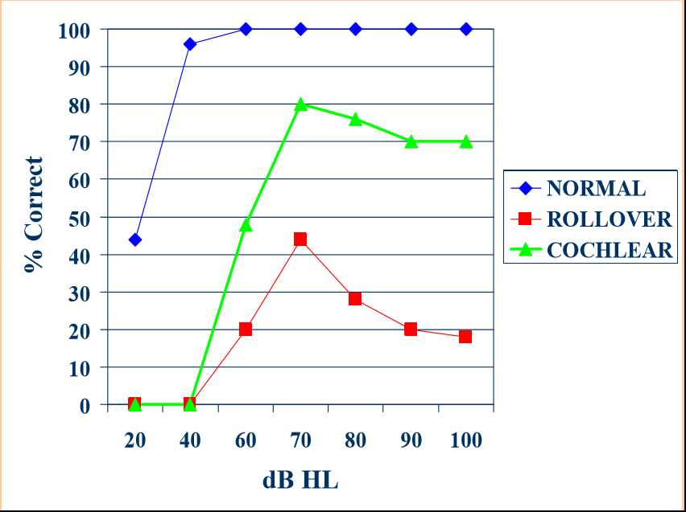

Slide 8
Presentation of Speech Tests
Monaural (one ear at a time, usual method).
Binaural (both ears simultaneously).
Can be presented with earphones.
Can be presented via bone conduction.  Can be presented in the sound field using speakers
Monitored live-voice (MLV)
Pre-recorded lists on CD or cassette.
Lists of words that patient repeats.
Standardized picture tests that require the patient to point to a picture that matches the spoken word
Standardized speech-in-noise tests.

Slide 9
Test environment
Normally sound treated booth - mandatory for MLV.
– Pt should not see the examiner’s face to avoid lip reading cues.
Recommend CDs whenever possible.

Slide 10
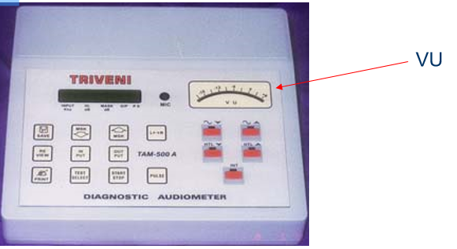
Live Voice Testing
Controlled Vocal Effort.
Adjust microphone sensitivity – To have the speech balanced at 0 dB on VU meter.

Slide 11
Patient’s and clinician’s role
Patient must understand type of speech stimuli (Open set or closed set).
Clinician must make sure that stimuli is presented properly

Slide 12
Level of auditory ability assessed
Awareness: tests that require the patients to simply indicate that a sounds was detected.
Discrimination: tests that require the patient to detect a change in the acoustic stimulus.
Identification/recognition: tests that require the patient to attach a label to the stimulus either by pointing to a corresponding picture or object or repeating the stimulus orally:
– Speech recognition threshold (SRT)
– Word recognition scores or sentence recognition scores.

Slide 13
Most Frequent Speech Data Obtained
Speech Recognition Thresholds (SRT)
– Uses spondee words: toothbrush, hotdog etc.
– Level of presentation is gradually decreased until patient is guessing words presented.
Speech Recognition Scores (SRS)
– Uses monosyllabic words, phonetically balanced.
– Presented at a fixed level above the SRT.
– Score is recorded as percent correct out of 25-50 words presented
Also known as word recognition score (WRS)

Slide 14
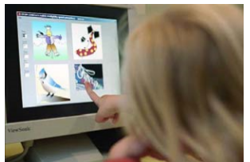
Speech Threshold Testing
Speech-Detection Threshold (SDT) or Speech Awareness Threshold (SAT)
– Lowest dB HL level that speech can be detected.
– Patient indicates when speech is audible.
– Used when patient cannot repeat words.
– SDT is lower than SRT
Speech Recognition Threshold (SRT)
– Lowest dB HL level that speech is understood.
– Patient repeats words or points to pictures.

Slide 15
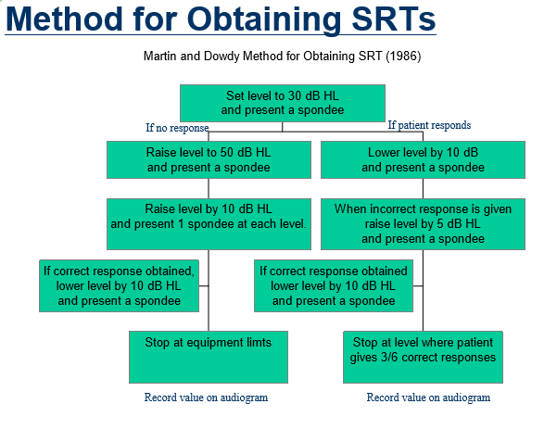

Slide 16
SRT relation to pure tone audiogram
SRTs can be predicted by finding the average of 500, 1000, and 2000 Hz (Pure tone average, PTA).
– In some cases, SRT may be higher (worse) than the three frequency PTA.
- Age, or disorders of the CANS.
– In other cases, the SRT may be much lower (better) than the PTA.
- When the audiogram falls precipitously in the high frequencies.

Slide 17
Exception for steeply-sloped high frequency losses
SRT will be better than PTA
In this case use Fletcher average: 500 Hz + 1000 Hz / 2.

Slide 18
Speech recognition scores testing
Speech recognition scores (SRS) or word recognition scores (WRS).
– Quantifies pt’s ability to discriminate speech:
It determines the extent of speech-recognition difficulty.
It aids in diagnosis of the site of the disorder in the auditory system.
It assists in the determination of the need for and proper selection of amplification systems.
It helps the clinician to make a prognosis for the outcome of the treatment efforts.

Slide 19
Word Recognition Testing
Open set : pt can respond with any word he/she can think of.
Closed set: response options are provided for the pt (multiple choice test).
Free response-client is free to respond or not.
Forced Response-client must say something.
– [Forced choice = closed set forced response.]

Slide 20
Method for Obtaining SRS
Decide method of delivery (MLV, recorded).
Choose materials to be used (word lists etc).
Inform patient with regards to method of response.
Select intensity.
Decide if multiple levels should be tested.
Decide if test will be presented with noise in the background.

Slide 21
SRT and Hearing Aid Fitting
Find most comfortable loudness level (MCL) and uncomfortable loudness level (UCL).
– NHLs find speech most comfortable at 40-55 dB above threshold.
Patient hears running speech and is asked to indicate where speech level is comfortable or uncomfortable.
Pt is instructed to indicate when speech is perceived to be at comfortable level.
– "I am going to continue talking to you as I make my voice louder and softer. I will keep asking you to tell me whether my voice is too soft, too loud or comfortably loud."
UCL minus SRT = dynamic range for speech.

Slide 22
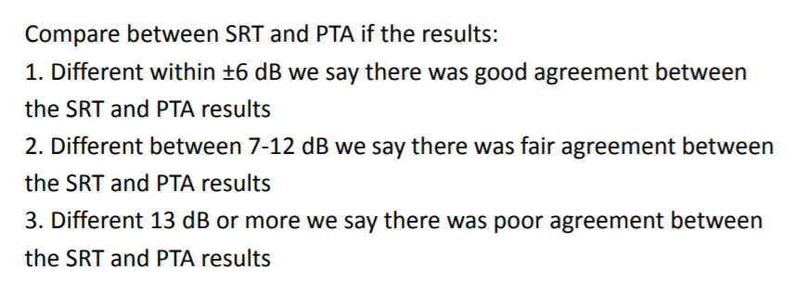
Interpretation of SRT results

Slide 23
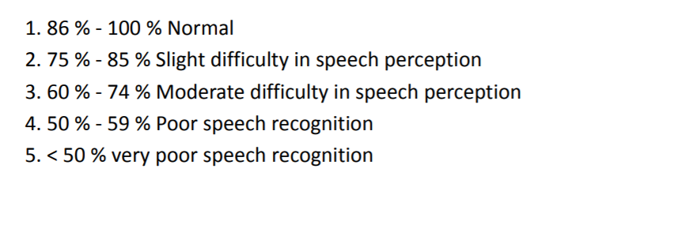
Interpretation of WRS results

