Slide 1
ENGL337

Slide 2
Sentences and Untterances
An UTTERANCE is any stretch of talk, by one person, before and after which there is silence on the part of that person. An utterance is the USE by a particular speaker, on a particular occasion, of a piece of language, such as a sequence of sentences, or a single phrase, or even a single word.
A SENTENCE is neither a physical event nor a physical object. It is, conceived abstractly, a string of words put together by the grammatical rules of a language. A sentence can be thought of as the IDEAL string of words behind various realizations in utterances and inscriptions.

Slide 3
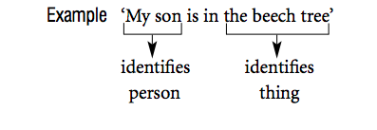
Reference
By means of reference, a speaker indicates which things in the world (including persons) are being talked about.

Slide 4
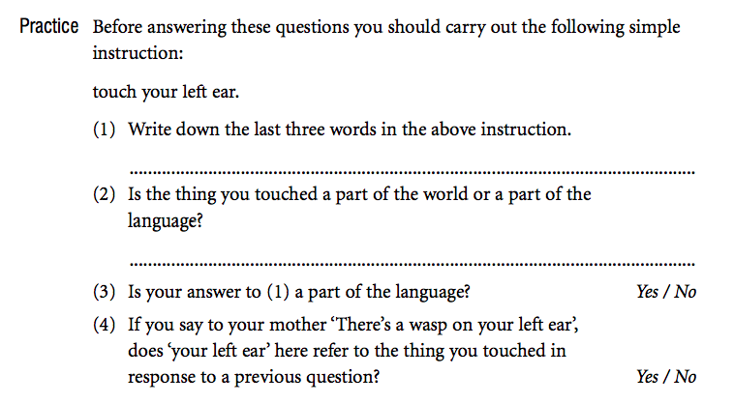

Slide 5
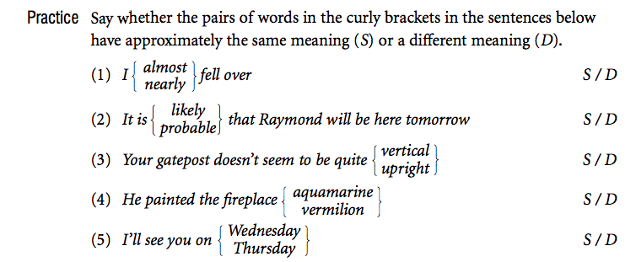
Sense
the SENSE of an expression is its place in a system of semantic relationships with other expressions in the language. The first of these semantic relationships that we will mention is sameness of meaning, an intuitive concept.

Slide 6
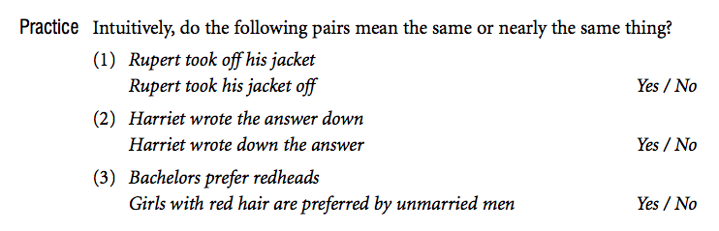
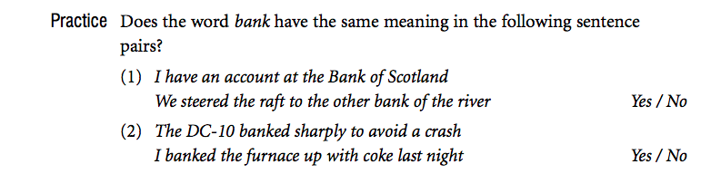

Slide 7
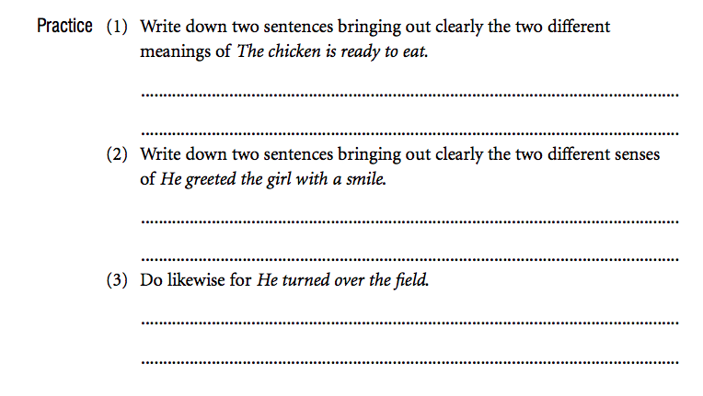

Slide 8

Denotation and Connotation

