Slide 1
ENGL337
Speech Act Theory

Slide 2
There are three main types of sentences:
Declarative - Assertion
Imperative - Ordering
Interrogative - Requesting information

Slide 3
Can you pass the salt?
Watch out, there’s a dog behind you!

Slide 4
Speech Act Theory (J.L Austin)
To utter something – either orally or in writing – is to do something. The act of speaking is, first and foremost, an act. This is the central insight behind the theory of speech acts, and although it seems relatively straightforward, it raises important questions about how the addressee is able to determine what sort of act the speaker intended to perform. The theory of speech acts, then, is inherently a pragmatic theory, since it involves an intention on the part of the speaker and an inference on the part of the hearer.

Slide 5
Austin observed that to perform a speech act is really to do a number of things at once: Most straightforwardly but least interestingly, we make speech sounds; that is, we perform a phonetic act. But beyond that, we generally perform three types of act simultaneously – a locutionary act, an illocutionary act, and a perlocutionary act.

Slide 6
The Three Types of Acts
Locutionary Act: the basic linguistic act of conveying some meaning. The locutionary act is the act of saying something with a certain meaning and reference.
Illocutionary Act: adds in the intentions of the speaker regarding what act they intended to perform by means of making that utterance.
Perlocutionary Act: what is actually achieved by means of the speech act. Perlocutionary effect : an effect that the speech act has on the thoughts, feelings, or actions of the addressee or others.

Slide 7
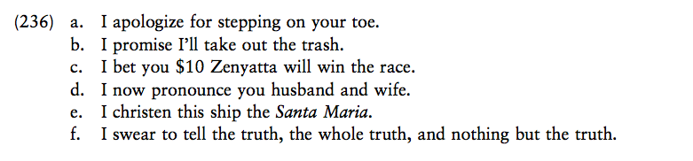
Explicit Performative

Slide 8
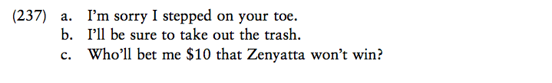
Implicit Performative

Slide 9
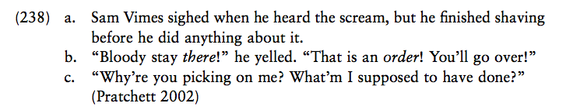
Are these examples of explicit performatives?
Direct Speech Act

Slide 10
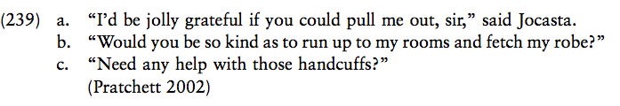
Indirect Speech Act

Slide 11
In indirect speech, there is a mismatch between the linguistic form and the illocutionary force; that is, in these cases, the illocutionary force is something other than the force canonically associated with that form.

Slide 12

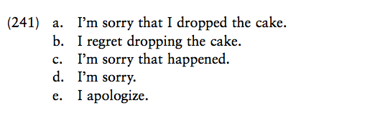
I am sorry!

Slide 13
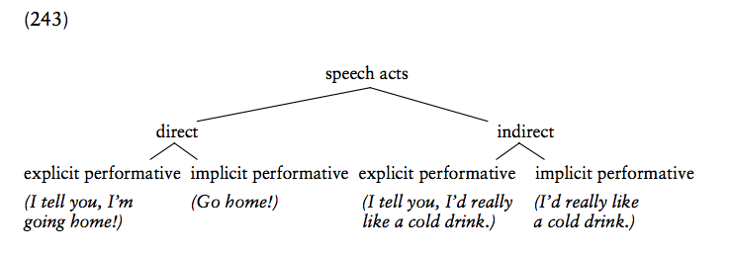

Slide 14
The CP, Implicature, and Indirect Speech Act
Searle (1975) notes that Grice’s Cooperative Principle, mutual knowledge, and “general powers of rationality” are all that is needed to allow the hearer to interpret an indirect speech act. This means that indirect speech acts are a subtype of conversational implicature, and the hearer’s inference to the indirect speech act is a subtype of conversational inference based on Grice’s maxims. It also means that, just as conversational implicatures are calculable, indirect speech acts must also be calculable.

Slide 15
