Slide 1
Planned Change
Maram Jaghama

Slide 2
Change management
Is a structured approach to shifting/ transitioning individuals, teams, and organizations from a current state to a desired future state.
In most cases, changes are planned. Planned change, in contrast to accidental change or change by drift, results from a well thought-out and deliberate effort to make something happen. Planned change is the deliberate application of knowledge and skills by a leader to bring about a change.

Slide 3
what often differentiates a successful change effort from an unsuccessful one is the ability of the change agent to deal appropriately with conflicted human emotions and to connect and balance all aspects of the organization that will be affected by that change. In organizational planned change, the manager is often the change agent.
change agent: a person skilled in the theory and implementation of planned change.

Slide 4
Initiating change requires: - Well-developed leadership and management skills - Vision and expert planning skills

Slide 5
many good ideas are never realized because of poor timing or a lack of power on the part of the change agent.
For example, both organizations and individuals tend to reject outsiders as change agents because they are perceived as having inadequate knowledge or expertise about the current status, and their motives often are not trusted. Therefore, there is more widespread resistance if the change agent is an outsider. The outside change agent, however, tends to be more objective in his or her assessment, whereas the inside change agent is often influenced by a personal bias regarding how the organization functions.

Slide 6
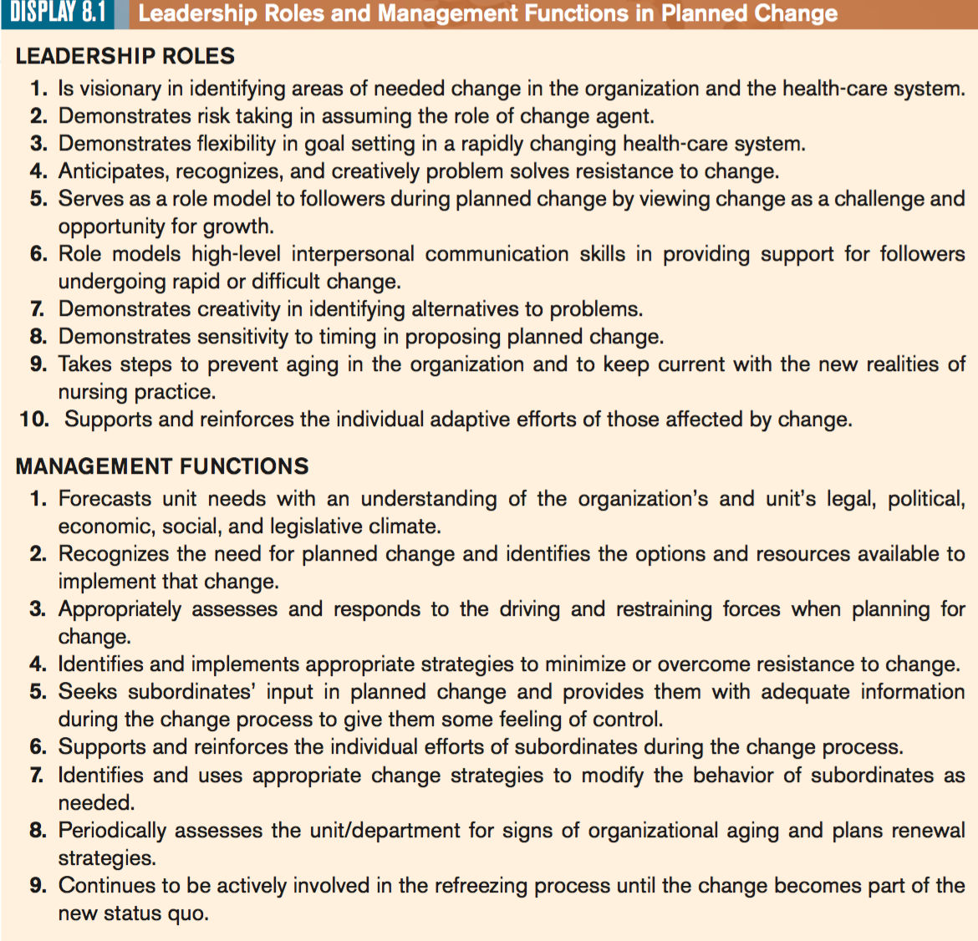

Slide 8
THE DEVELOPMENT OF CHANGE THEORY
KURT LEWIN: Lewin (1951) identified three phases through which the change agent must proceed before a planned change becomes part of the system: unfreezing, movement, and refreezing. • Unfreezing (when change is needed). • Moving (when change is initiated). • Refreezing (when equilibrium is established).

Slide 9
Lewin’s Model
Unfreezing – Occurs when the change agent convinces members of the group to change.
Movement – the change agent identifies, plans, and implements appropriate strategies, ensuring that driving forces exceed restraining forces. Sets goals, target dates to implement the change. Whenever possible we are going to try to implement change gradually!

Slide 10
Lewin’s Model
Refreezing – the change agent assists in stabilizing the system change so that is becomes integrated into the status quo. Change agent is out there being supportive, helping people adapt, making sure you have the tools you need to sustain the change, making sure you have the reasons and that you know why, making sure everything is stable.
Usually change takes about 3 – 6 months. We should never attempt a change unless that change agent can stay there the entire time.

Slide 11
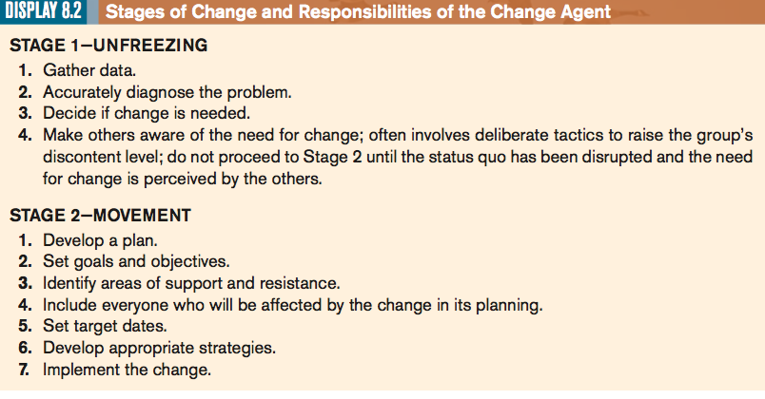
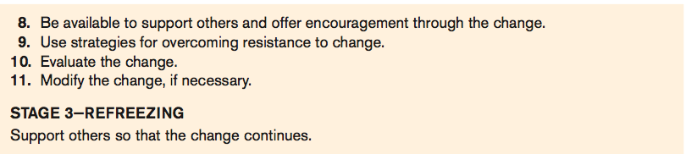

Slide 12
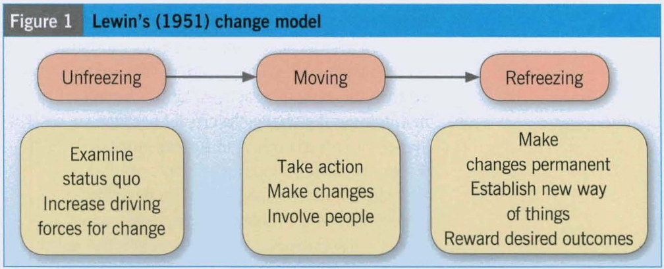

Slide 13
LEWIN’S Driving AND Restraining Forces
Lewin also theorized that people maintain a state of status quo or equilibrium by the simultaneous occurrence of both driving forces (facilitators) and restraining forces (barriers) operating within any field.
The forces that push the system toward change are driving forces, whereas the forces that pull the system away from change are called restraining forces.
Lewin’s model suggested that people like feeling safe, comfortable, and in control of their environment. For change to occur then, the balance of driving and restraining forces must be altered. The driving forces must be increased or the restraining forces decreased.

Slide 14
Driving / Restraining Forces
Driving Forces
Economic gain
improve situation
Challenge
Future impact
Growth, recognition, achievement, and / or improved relationships
Restraining Forces
Need for security
Lack of time or energy
Failure to see the big picture
Perceived loss of freedom
Negative past experience

Slide 15
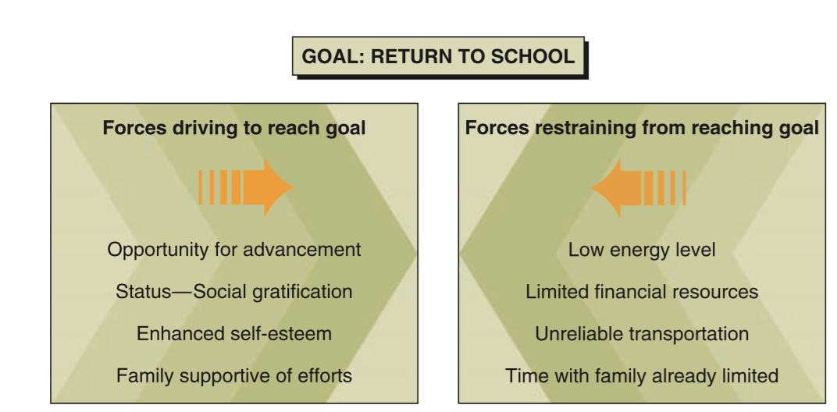
Example:

Slide 16
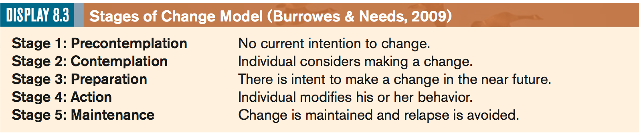
A CONTEMPORARY ADAPTATION OF LEWIN’S MODEL
Burrowes and Needs (2009) shared a more contemporary adaptation of Lewin’s model in their discussion of a five-step Stages of Change Model (SCM)

Slide 17
contemplation stage, at which point the individual considers making a change, but has not yet made a commitment to take action. This would be the phase in which unfreezing would occur, according to Lewin.
A transition from unfreezing to movement begins in the preparation stage, as the individual intends to take action in the short-term future.
The action stage then occurs (movement) in which the individual actively modifies his or her behavior.
The process ends with the maintenance stage at which point the individual works to maintain changes made during the action stage and prevent relapse.

Slide 18
CLASSIC CHANGE STRATEGIES
In addition to being aware of the stages of change, the change agent must be highly skilled in the use if behavioral strategies to prompt change in others.
The most appropriate strategy for any situation depending on the power of the change agent and the amount of resistance expected from the subordinates.
(Bennis et al, 1969)

Slide 19
One of these strategies:
Rational–empirical
Assumes that people are rational and receptive to change when given adequate facts
Give currents research as an evidence to support the change.
this set of strategies assumes that resistance to change comes from a lack of knowledge
This type of strategy is used when there is little anticipated resistance to the change or when the change is perceived as reasonable.

Slide 20
Normative–reeducative
Change will only occur when attitudes and relationships are altered
These strategies use group norms and peer pressure to socialize and influence people so that change will occur.
The change agent assumes that humans are social creatures, more easily influenced by others than by facts.
This strategy does not require the change agent to have a legitimate power base. Instead, the change agent gains power by skill in interpersonal relationships.
Power–coercive
Result of an individuals need to please a supervisor, or fear of losing their job.

Slide 21
An example maybe reflected in the change agent who wants someone to stop smoking.
The change agent might present the person with the latest research on cancer and smoking (the rational–empirical approach);
at the same time, the change agent might have friends and family encourage the person socially (normative–re-educative approach).
The change agent also might refuse to ride in the smoker’s car if the person smokes while driving (power–coercive approach).
By selecting from each set of strategies, the change agent increases the chance of successful change.

Slide 22
RESISTANCE: THE EXPECTED RESPONSE TO CHANGE
Conflict and resistance almost always accompany change because change alters the balance of a group.
Resistance may be rooted in anxiety or fear
Fear a loss of status, power, control, $$, job, whatever. There are misconceptions about the change (inadequate information).
Not all resistance is bad; it may be a warning that something needs readjusting or clarity
If you’re the change agent and you get resistance, you need to look into it! Take the person causing the most resistance, bring them in, and help me solve the problem.
Notes:
22

Slide 23
Planned Change As a Collaborative Process
As a rule, anyone who will be affected by a change should be included in planning it. When information and decision making are shared, subordinates feel that they have played a valuable role in the change.
Change agents and the elements of the system—the people or groups within it—must openly develop goals and strategies together. All must have the opportunity to define their interest in the change, their expectation of its outcome, and their ideas on strategies for achieving change.

Slide 24
The leader- manager as a role model during planned change

Slide 25
Integrating leadership roles and management functions in planned change

