Slide 1
The B vitamins

Slide 2
All B vitamins are water-soluble
Fresh foods naturally contain vitamins, but because these vitamins are organic, they can be readily destroyed during processing
water-soluble ones are the B vitamins
  Thiamin
  Riboflavin
  Niacin
  Biotin
  Pantothenic acid
  Vitamin B6
  Folate
  Vitamin B12
Vitamin C

Slide 3
water soluble vitamins:
Niacin
Vitamin B6 Folate
Choline
Vitamin C
have UL
Data are lacking to establish UL for the remaining B vitamins, but this does not mean that excessively high intakes are safe
Toxicity ? More is better ?
some of the water-soluble vitamins have adverse effects when taken in large doses.
The UL defines the highest amount of a nutrient that is likely not to cause harm for most healthy people when consumed daily.
The risk of harm increases as intakes rise above the UL

Slide 4
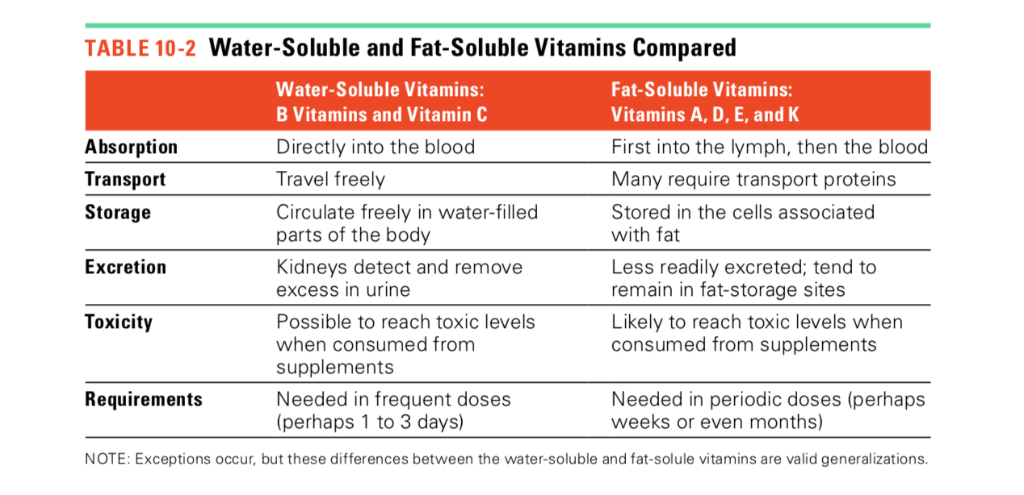

Slide 5
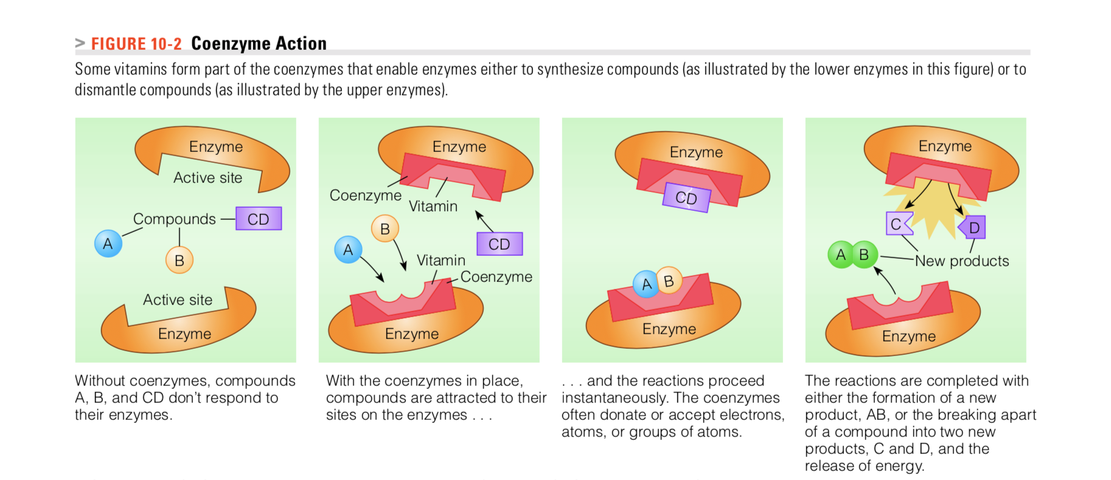
Several of the B vitamins (thiamin, riboflavin, niacin, pantothenic acid, and biotin) act as coenzymes that assist enzymes in the release of energy from carbohydrate, fat, and protein

Slide 6
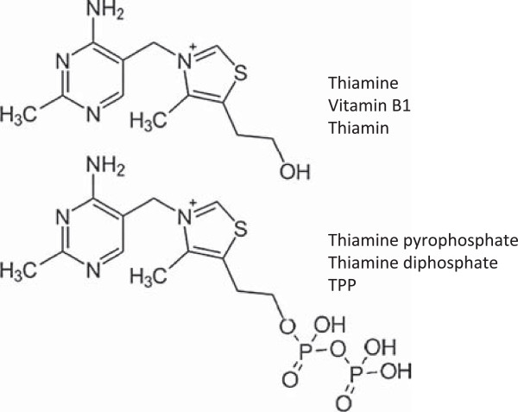
Thiamin (vitamin B1)
Thiamine: The vitamin part of the coenzyme TPP
Functions
  Important in the metabolism of carbohydrates
  Helps the body’s cells convert CHO into energy (conversion of pyruvate to acetyl CoA)
  Involved in nerve and muscle activity

Slide 7
Thiamin (vitamin B1)
Absorption and metabolism
Thiamin is readily absorbed by active transport at low concentrations in the small intestine and by passive diffusion at high concentrations
On a diet lacking in thiamin, signs of deficiency can occur after only 25–30 days.

Slide 8
Thiamin (vitamin B1)
Who is at risk of developing Thiamin Deficiency?
The malnourished
home- less people
Individuals who derive most of their energy from empty- calories foods and beverages risk thiamin deficiency ( For example : Alcohol provides empty kcal)
Alcohol impairs thiamin absorption and enhances thiamin excretion in the urine,

Slide 9
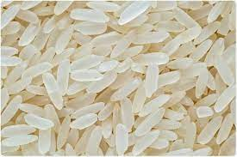
Thiamin (vitamin B1)
Deficiency
Two distinct major deficiency diseases
beriberi and Wernicke–Korsakoff syndrome.
Beriberi: First observed in Indonesia when the custom of polishing rice became wide- spread ( Polishing the rice removes the husk, bran and germ of the grain – removing many vitamins and nutrients)

Slide 10
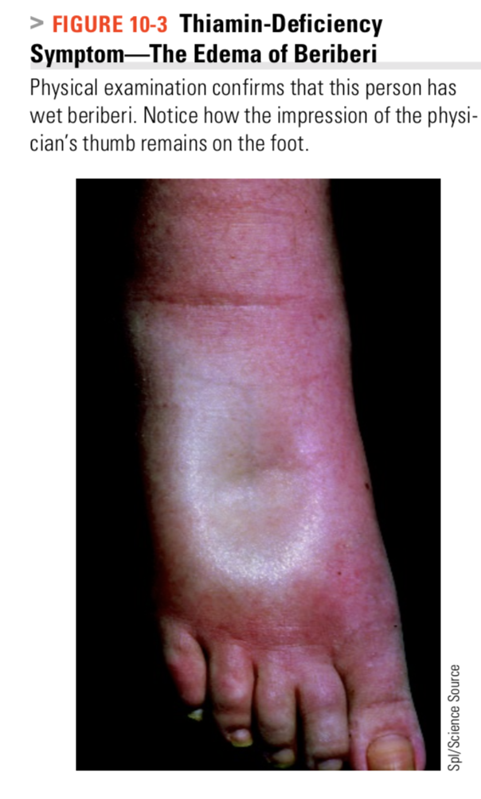
Beriberi is often described as dry or wet
“Dry” beriberi reflects damage to the nervous system and is characterized by muscle weakness in the arms and legs.
“Wet” beriberi reflects damage to the cardiovascular system and is characterized by dilated blood vessels, which cause the heart to work harder and the kidneys to retain salt and water, resulting in edema ( swelling)
Wernicke’s syndrome
usually seen in people who have been drinking alcohol heavily for some weeks and eaten very little. Alcohol requires thiamin for its metabolism and alcoholic beverages do not contain it.
Alcohol may also interfere with thiamin absorption.
Occasional cases are seen in people on a prolonged fast (such as hunger strikers) or with persistent vomiting

Slide 11
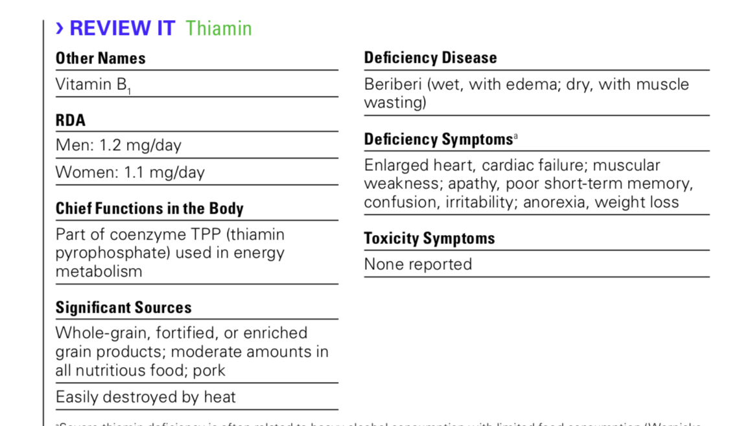
Food sources
Thiamin occurs in small quantities in many nutritious foods.
Pork is exceptionally rich in Thiamin
whole wheat and products, yeast and yeast extracts,, nuts, duck, oatmeal, fortified breakfast cereals.
No UL has been determined for Thiamin

Slide 12
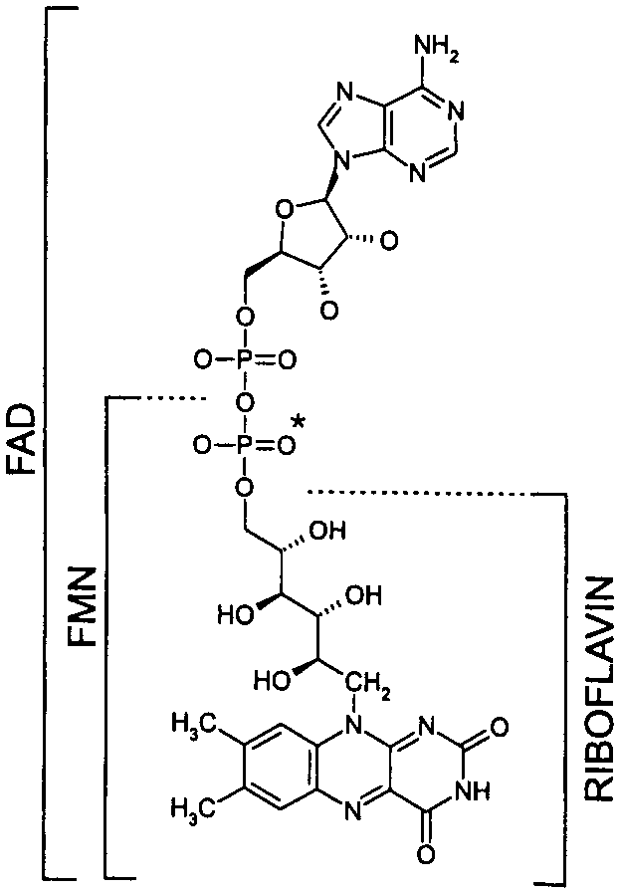
Riboflavin
Riboflavin serves as a coenzyme in many reactions, most notably in energy metabolism.
Riboflavin is part of two important coenzymes
Flavin mononucleotide (FMN)
Flavin adenine dinucleotide (FAD)

Slide 13
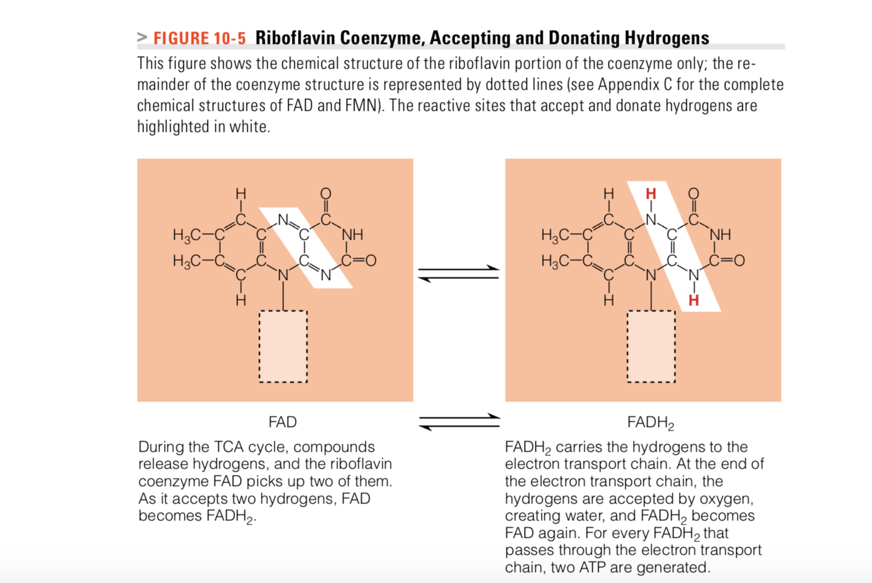
The coenzyme forms of riboflavin are FMN (flavin mononucleotide) and FAD (flavin adenine dinucleotide); both can accept and then donate two hydrogen

Slide 14
Absorption and Deficiency
Absorption is by a specialized carrier system in the proximal small intestine,
The vitamin is transported as free riboflavin and FMN or bound to plasma albumin.
Riboflavin is excreted primarily in urine; urinary excretion tends to reflect dietary intake.
Deficiency
Lack of the vitamin causes inflammation of the membranes of the mouth, skin, eyes, and GI tract. Excesses of riboflavin appear to cause no harm
No UL has been established.

Slide 15
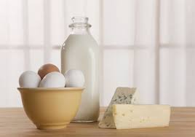
Riboflavin Food Sources
Riboflavin is present in most foods
Best sources are milk and milk products, eggs, liver, kidney, yeast extracts, and fortified breakfast cereals
Dairy products contribute significantly to riboflavin intake
However, Riboflavin is unstable in ultraviolet light, and after milk has been exposed to sunlight for 4 hours, up to 70% of riboflavin is lost.

Slide 16
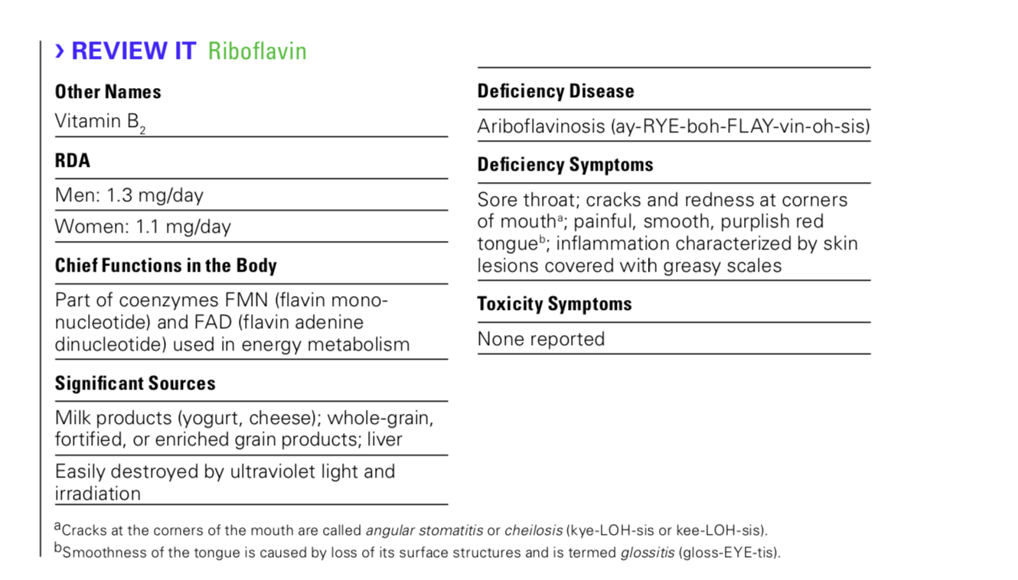

Slide 17

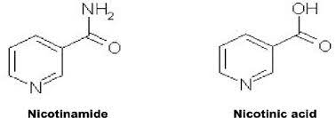
Niacin (vitamin B3)
Niacin is a generic term
The two chemical structures of Niacin found in food are nicotinic acid and nicotinamide (also known as niacinamide)
The body can easily convert nicotinic acid to nicotinamide, which is the major form of niacin in the blood.

Slide 18
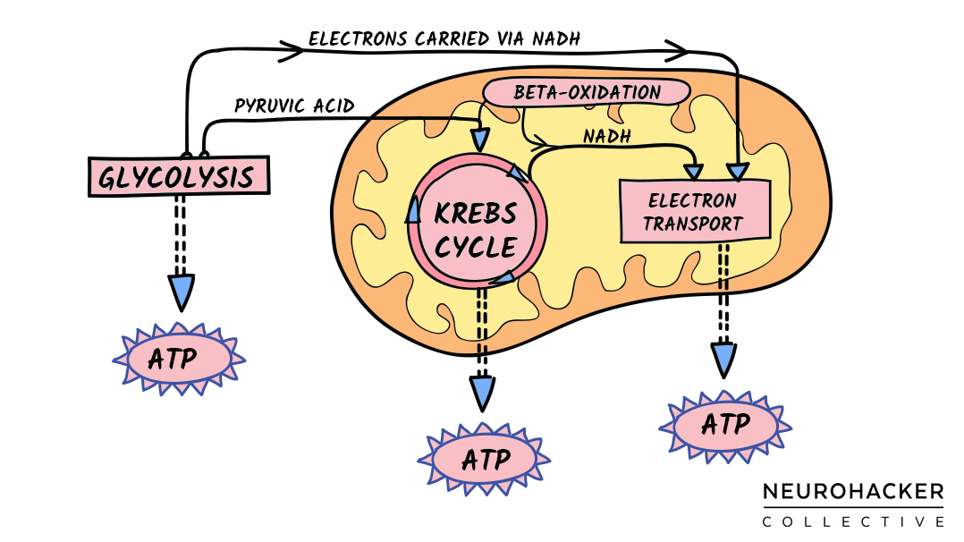
Function
The two coenzyme forms of niacin
NAD (nicotinamide adenine dinucleotide)
NADP (the phosphate form)
Coenzymes ( NAD and NADP) participate in many metabolic reactions
Important in energy-transfer reactions, especially the metabolism of glucose, fat, and alcohol.
NAD is similar to the riboflavin coenzymes in that it carries hydrogens (and their electrons) during metabolic reactions
https://neurohacker.com/nad-introduction-to-an-important-healthspan-molecule

Slide 19
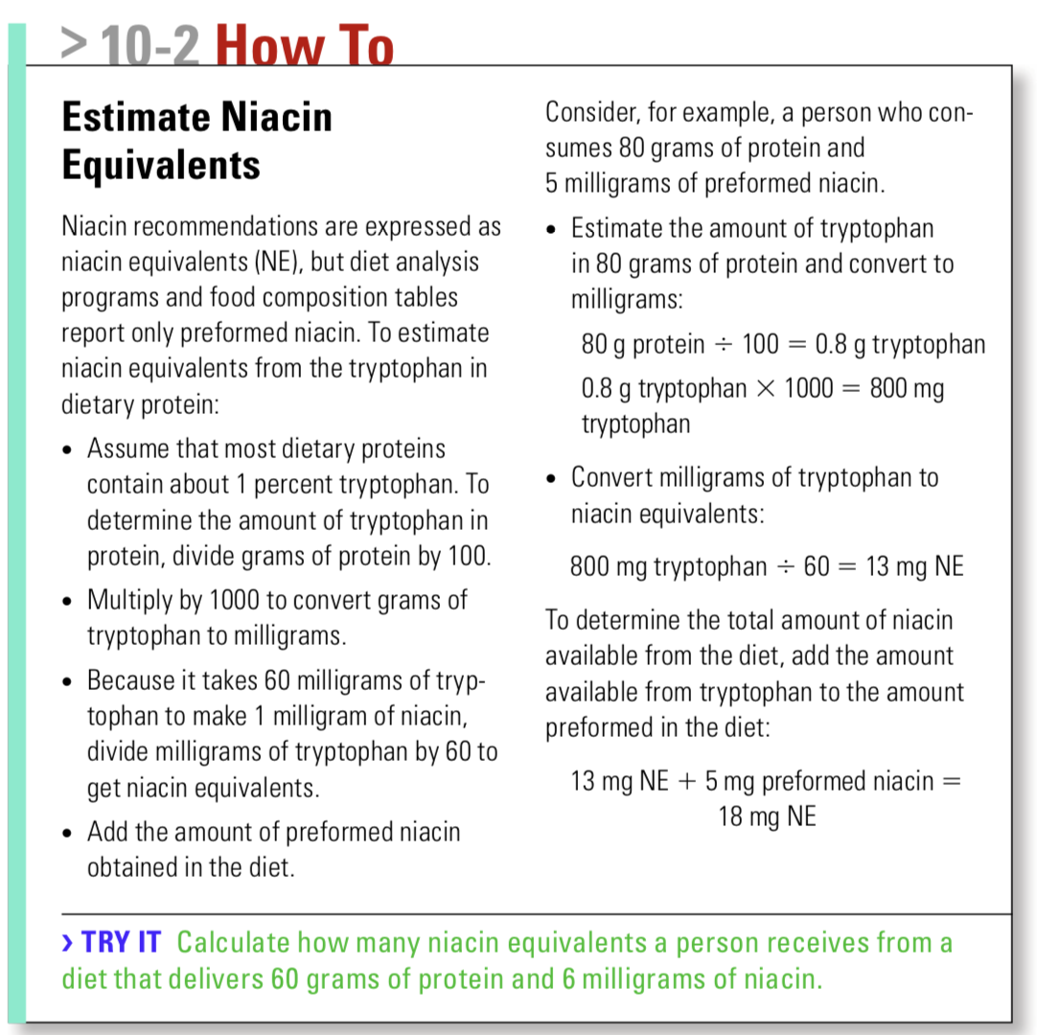
Niacin is unique among the B vitamins in that the body can make it from the amino acid tryptophan
Approximately 60 milligrams of dietary tryptophan is needed to make 1 milligram of niacin

Slide 20
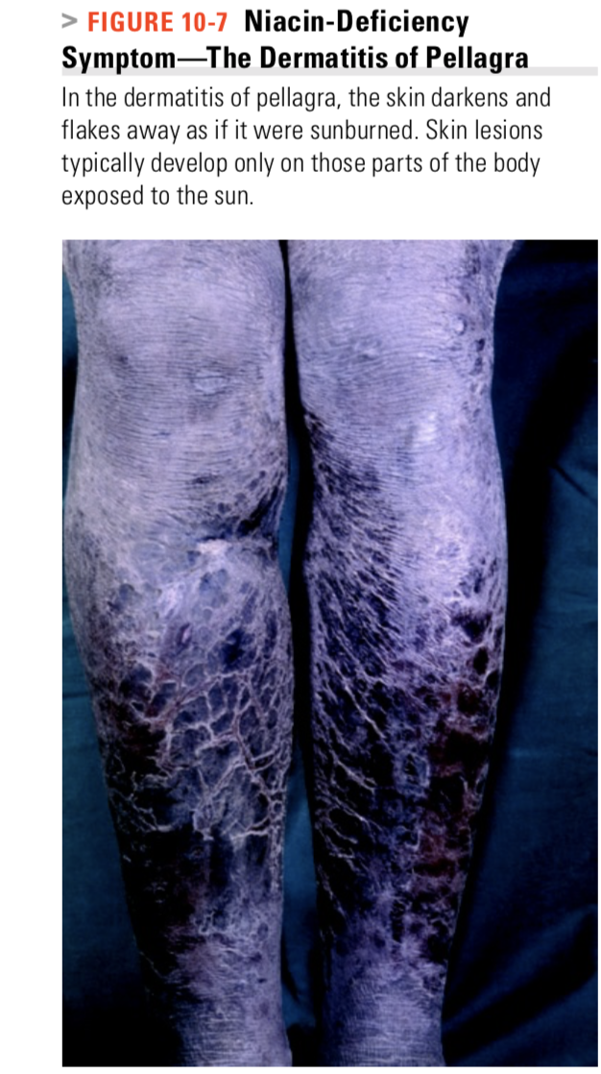
Niacin Deficiency
Deficiency disease: pellagra
The skin is inflamed where it is exposed to sunlight, resembling severe sunburn The skin lesions progress to pigmentation, cracking, and peeling
Often the skin of the neck is involved
Symptoms: diarrhea, dermatitis ( inflammation of the skin) , dementia, and eventually death ( The 4 D’s)

Slide 21
Toxicity
Naturally occurring niacin from foods has a physiological effect that causes no harm. Large doses of nicotinic acid from supplements or drugs, however, produce a variety of pharmacological effects, most notably “niacin flush.” Niacin flush occurs when nicotinic acid is taken in doses only three to four times the RDA. It dilates the capillaries and causes a tingling
Large doses of nicotinic acid can effectively lower LDL cholesterol and triglyceride ides and raise HDL cholesterol
The use of Niacin as drug needs to be closely monitored!!

Slide 22
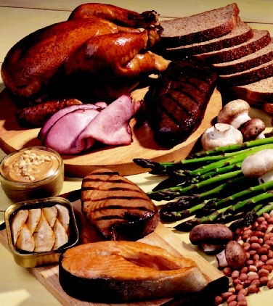
Niacin Food Source
Good sources of preformed niacin, in descending order, are liver and kidney (the richest sources), other meat, poultry, fish, brewer’s yeast and yeast extracts, peanuts, bran, wheat, and (surprisingly) coffee, including instant coffee. Other foods that are rich in protein provide tryptophan.

Slide 23
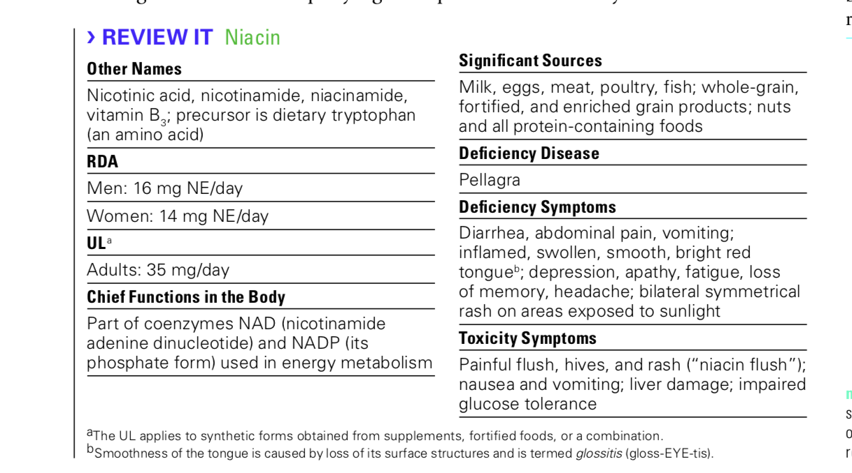
Has an UL

Slide 24
Biotin (vitamin B₇₎
Biotin is a coenzyme for several carboxylase enzymes
Biotin deficiency is very rare as biotin is found in a wide range of foods, and bacterial production in the large intestine appears to supplement dietary intake. Deficiency can, however, be produced when humans eat large amounts of uncooked egg white, which contains avidin.
Avidin tightly binds biotin in the gut, preventing absorption
Avidin is destroyed by heating.
Biotin- deficiency symptoms include skin rash, hair loss, and neurological impairment. More than two dozen raw egg whites must be consumed daily for several months to produce these effects

Slide 25
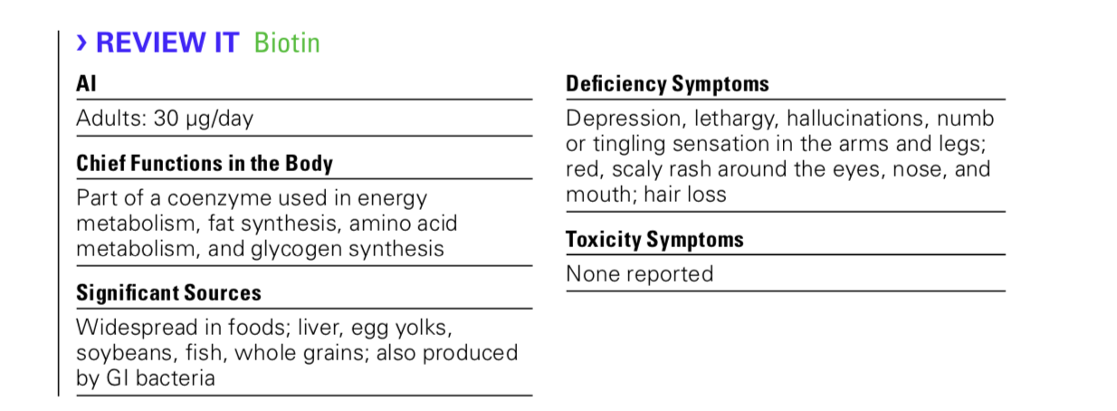

Slide 26
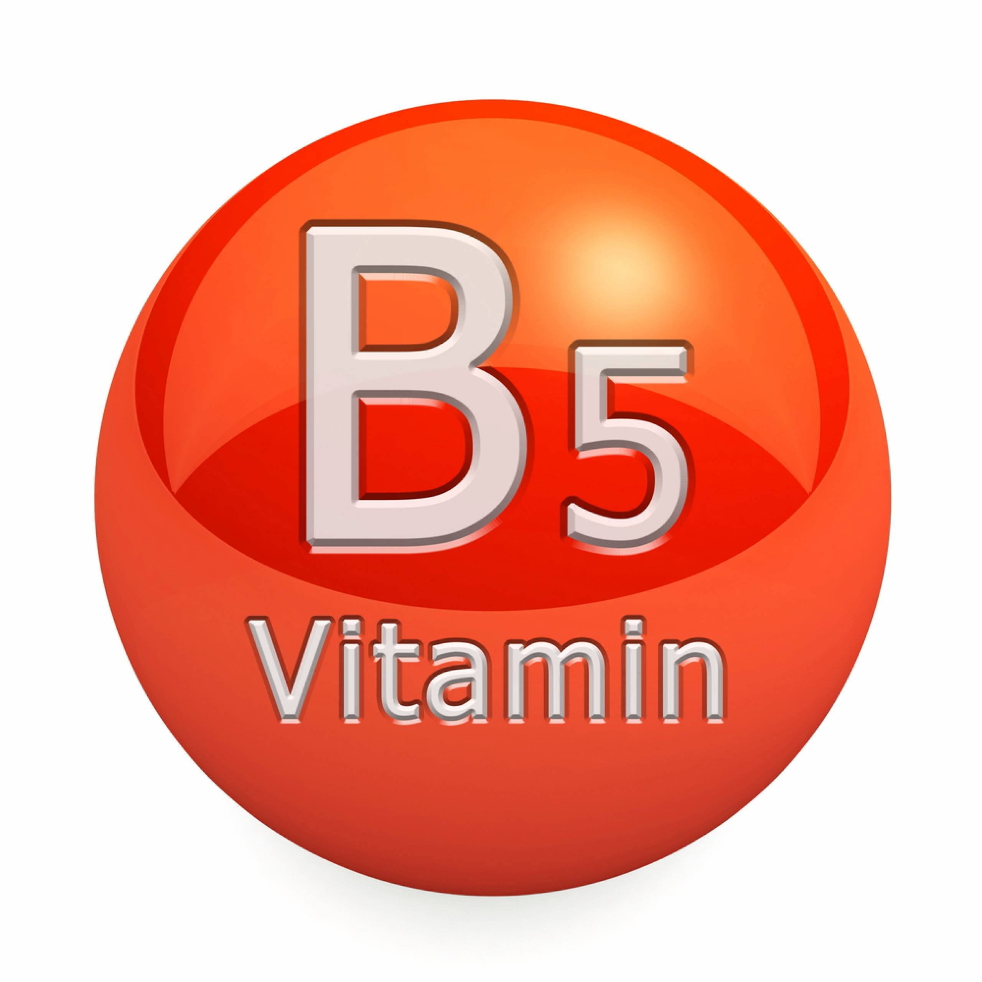
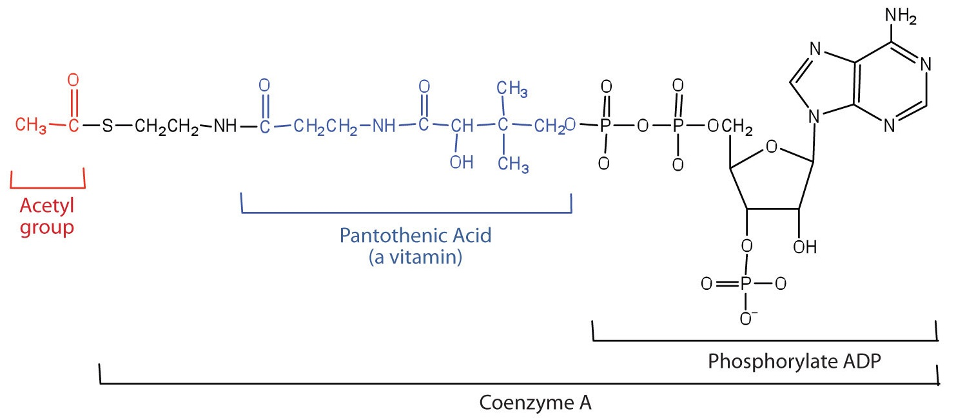
Pantothenic acid
Pantothenic acid is part of the chemical structure of coenzyme A—the same CoA that forms acetyl CoA, a key compound in several metabolic pathways
Pantothenic Acid Recommendations An AI for pantothenic acid has been set. It reflects the amount needed to replace daily losses.
Overview of Stage II of Catabolism. (2021, March 22). Retrieved May 31, 2021, from https://chem.libretexts.org/@go/page/68101

Slide 27
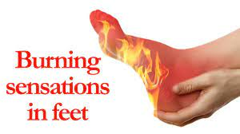
Pantothenic Acid Deficiency and Toxicity
Pantothenic acid deficiency is rare. Its symptoms involve a general failure of all the body’s systems and include fatigue, GI distress, and neurological disturbances.
The “burning feet” syndrome that affected prisoners of war in Asia during World War II is thought to have been caused by pantothenic acid deficiency. No toxic effects have been reported, and no UL has been established.

Slide 28
Pantothenic Acid Food Sources
Pantothenic acid is widespread in foods, and typical diets seem to provide adequate intakes.
Beef, poultry, whole grains, potatoes, tomatoes, and broccoli are particularly good sources
Losses of pantothenic acid during food production can be substantial because it is readily destroyed by the freezing, canning, and refining processes

Slide 29
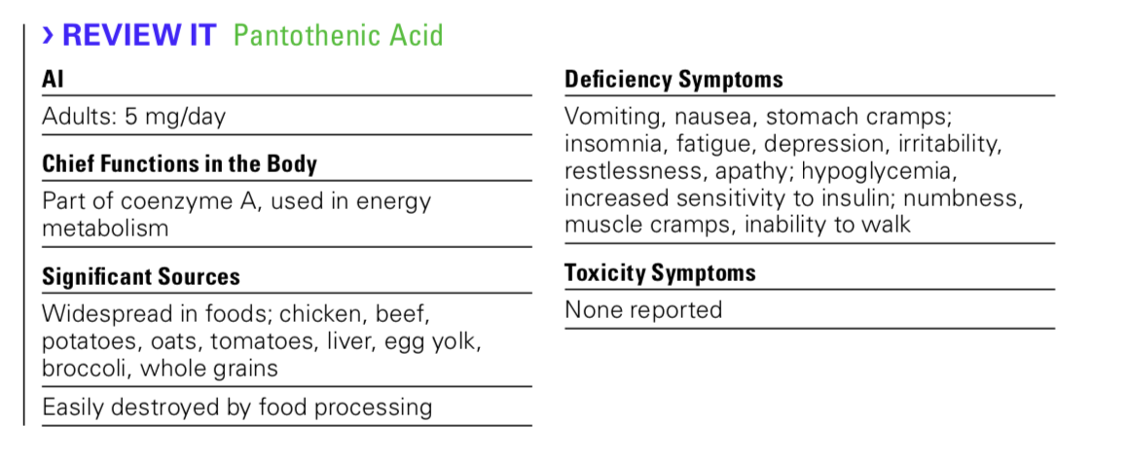

Slide 30
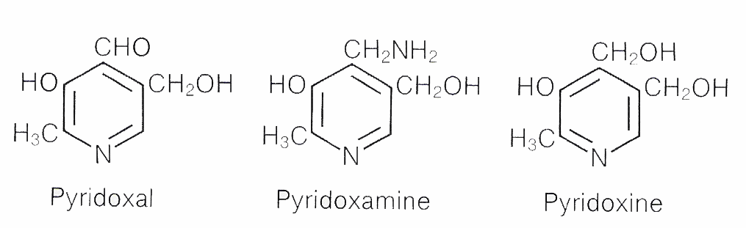
Vitamin B6
Occurs in three forms—pyridoxal, pyridoxine, and pyridoxamine.
Coenzyme PLP
PLP participates in more than 100 reactions, including carbohydrate, fatty acid, and amino acid metabolism

Slide 31
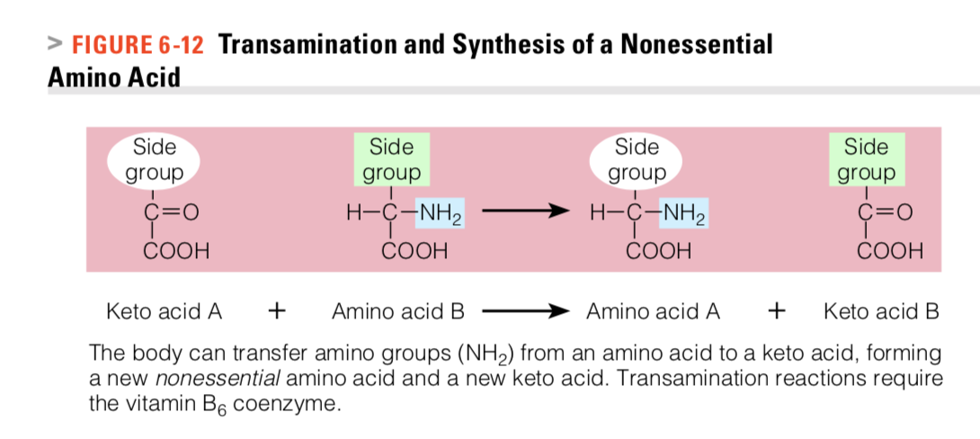
PLP can transfer amino groups (NH2) from an amino acid to a keto acid, the body can make nonessential amino acids
The ability to add and remove amino groups makes PLP valuable in protein and urea metabolism as well.
Reaction requires B6

Slide 32
FUNCTION
The conversions of the amino acid tryptophan to niacin or to the neurotransmitter serotonin also depend on PLP.
PLP participates in the synthesis of heme (the nonprotein portion of hemoglobin), nucleic acids (such as DNA and RNA), and lecithin (a phospholipid)

Slide 33
Vitamin B6 Recommendations
Unlike other water-soluble vitamins, vitamin B6 is stored extensively in muscle tissue.
Research does not support claims, however, that large doses of vitamin B6 enhance muscle strength or physical endurance.

Slide 34
Vitamin B6 Deficiency
Early symptoms of vitamin B6 deficiency include depression and confusion; advanced symptoms include abnormal brain wave patterns and convulsions
Low levels of vitamin B6 are associated with increased risks of some cancers and cardiovascular disease.
Alcohol contributes to the destruction and loss of vitamin B6 from the body.
Foods lose vitamin B6 when heated.

Slide 35
Vitamin B6 Food Sources
Most protein-rich foods such as meat, fish, and poultry provide ample vitamin B6; some vegetables and fruits are good sources too( potatoes, tomato juice , watermelon, banana)

Slide 36
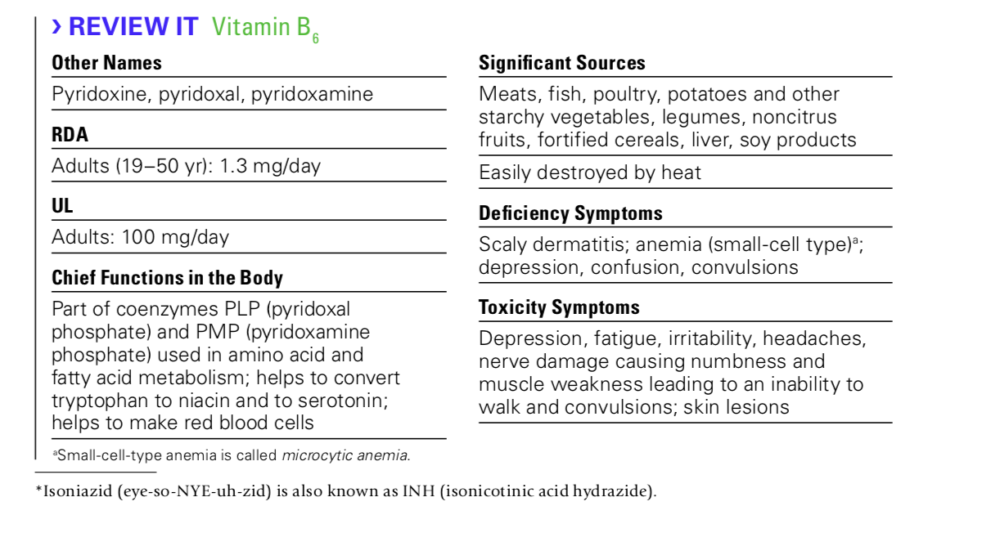
Vitamin B6 Toxicity
Neurological damage in people who had been taking more than 2 grams of vitamin B6 daily (20 times the current UL of 100 milligrams per day) for 2 months or more.

Slide 37
Folate
Folic acid
Primary co- enzyme form, THF (tetrahydrofolate)
Serves as part of an enzyme complex that transfers 1-carbon compounds that arise during metabolism.
Helps in converting vitamin B12 to one of its coenzyme forms,
Synthesizing the DNA required for all rapidly growing cells
Regenerating the amino acid methionine from homocysteine.
Essentia for DNA Synthesis and cell division and growth

Slide 38
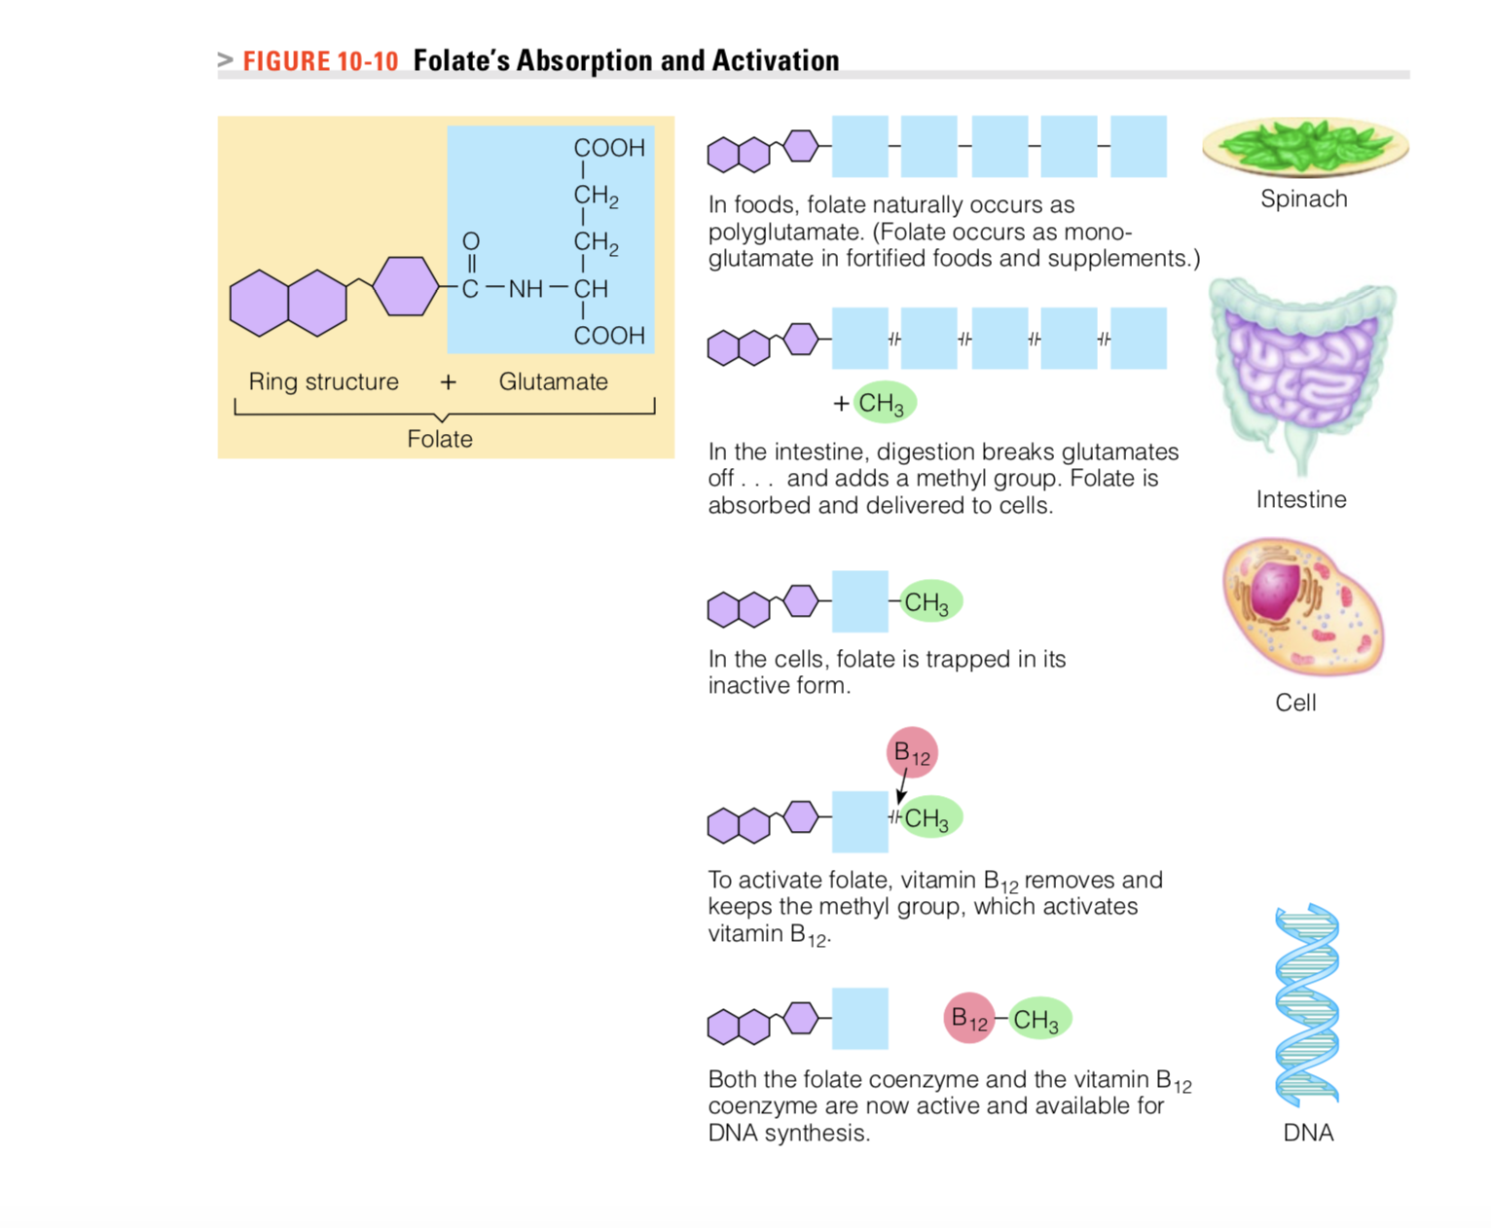
Folate absorption

Slide 39
The folate we get from food is in the “bound” form ( combined with many
Enzymes on the intestinal cell surfaces break down the polyglutamate to monoglutamate— (folate with only one glutamate attached)
monoglutamate binds to a methyl group (CH3) and goes to liver and other body cells.
To activate folate, the methyl group must be removed by an enzyme that requires the help of vitamin B12
Without that help, folate becomes trapped inside cells in its methyl form (inactive form)

Slide 40
Folate Recommendations
The bioavailability of folate about 50% from foods
100 % from supplements taken on an empty stomach.
Synthetic folate from fortified foods and supplements, on average, is 1.7 times more available than naturally occurring food folate
The need for folate rises considerably during pregnancy and whenever cells are multiplying, so the recommendations for pregnant women are considerably higher than for other adults.

Slide 41
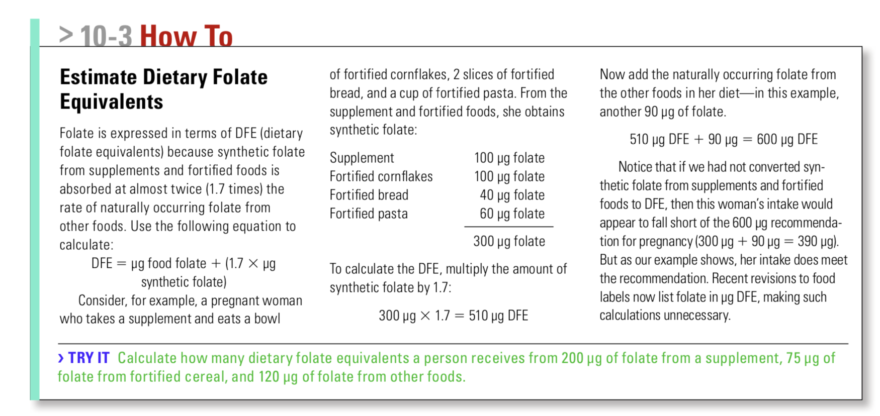

Slide 42
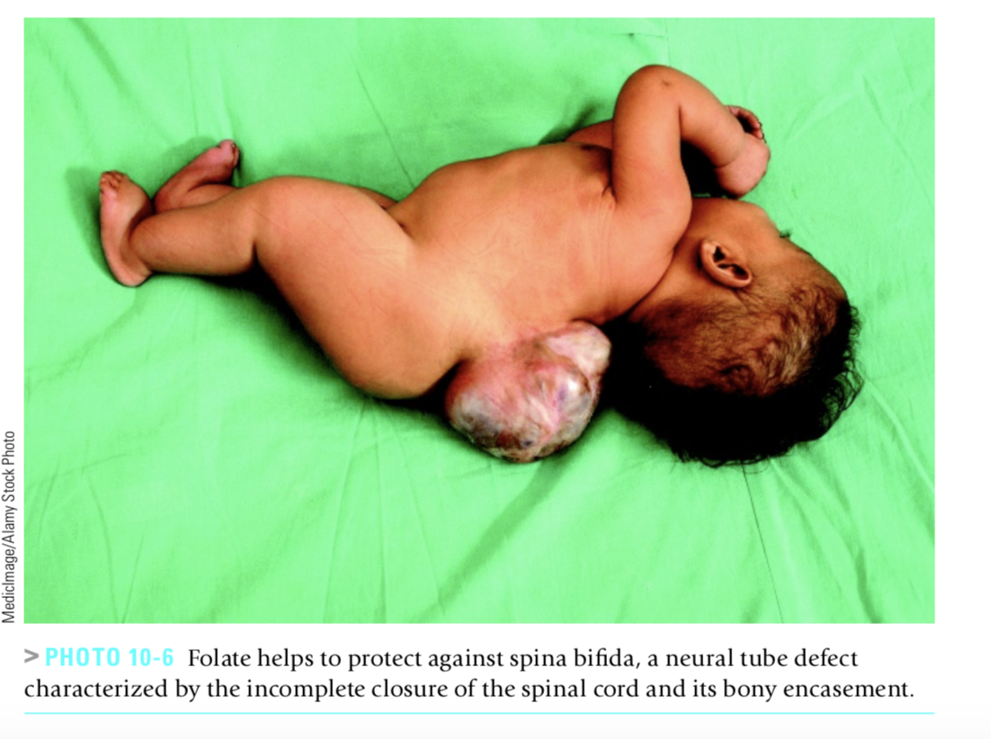
deficiency
The brain and spinal cord develop from the neural tube
Folate deficiency increases the risk of neural tube defects

Slide 43
deficiency
Folate deficiency impairs cell division and protein synthesis— processes critical to growing tissues.
In a folate deficiency, the replacement of red blood cells and GI tract cells reduces
Anemia and GI tract deterioration are common symptoms of folate deficiency

Slide 44
Folate supplements taken 1 month before conception and continued throughout the first trimester of pregnancy can help prevent neural tube defects
For this reason, all women of childbearing age who are capable of becoming pregnant should consume 0.4 milligram (400 micrograms) of folate daily
Folate fortification of grain products because neural tube defects occur early in development before most women realize they are pregnant!!!!

Slide 45
The Institute of recommends (RDI) 400 μg per day of dietary folate equivalents (DFEs) for men and women
600 μg/day in pregnancy
500 μg/day in lactation.

Slide 46
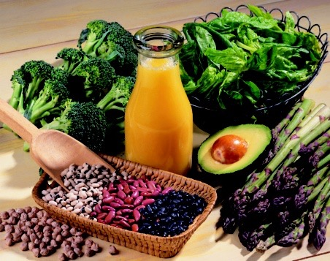
Folate Food Sources
Folate is especially abundant in legumes, fruits, and vegetables
leafy vegetables (spinach, broccoli, cabbage, lettuce)
folate is present in liver, kidney, beans, beetroot, bran, peanuts, avocadoes, bananas, eggs, and some fish.
Fortified grains

Slide 47
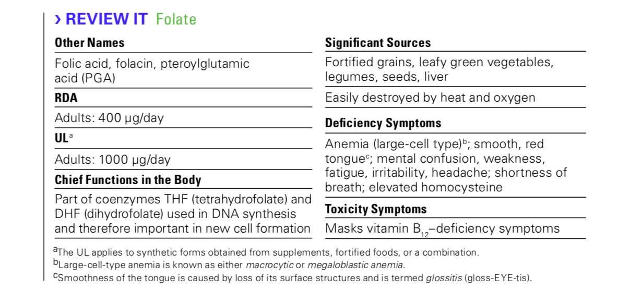

Slide 48
Vitamin B12
B12 and folate functions are related
Vitamin B12 removes a methyl group to activate the folate coenzyme.
When folate gives up its methyl group, the vitamin B12 coenzyme becomes activated
B12 and folate needed for
The regeneration of the amino acid methionine
Synthesis of DNA and RNA
B12 is also needed for healthy nerves, bones cell activity and metabolism

Slide 49
The digestion and absorption of vitamin B12
In food , B12 is attached to proteins- not free B12
In the stomach, hydrochloric acid and the digestive enzyme pepsin release vitamin B12 from the proteins to which it is attached in foods.
vitamin B12 passes from the stomach to the small intestine, it binds with a stomach secretion called intrinsic factor.
Intrinsic factor +vitamin B12 COMPLEX travel to the end of the small intestine, where receptors recognize the complex
(The receptors CAN’T recognize vitamin B12 without intrinsic factor)
The vitamin is gradually absorbed into the bloodstream as the intrinsic factor is degraded

Slide 50
Vitamin B12 Recommendations
The RDA for adults is only 2.4 micrograms of vitamin B12 a day
Most vitamin B12 deficiencies reflect inadequate absorption, not poor intake.
WHY Inadequate absorption typically occurs???
Two reasons:
A lack of hydrochloric acid
or a lack of intrinsic factor

Slide 51
deficiency
Common among the elderly because many older adults develop atrophic gastritis, a condition that damages the cells of the stomach
Without healthy stomach cells, production of hydrochloric acid and intrinsic factor diminishes.
Vitamin B12 deficiency caused by atrophic gastritis and a lack of intrinsic factor is known as pernicious anemia.
Some people inherit a defective gene for the intrinsic factor
Why is Anemia one of the most common symptoms of B12 deficiencies ?
Notes:
Because vitamin B12 is required to convert folate to its active form

Slide 52
deficiency
Anemia
But also vitamin needed to maintains the sheath that surrounds and protects nerve fibers and promotes their normal growth so deficiency
Impairs cognition.
Advanced neurological symptoms include a creeping paralysis that begins at the extremities and works inward and up the spine.

Slide 53
Vitamin B12 Food Sources
vitamin B12 is synthesized by microorganisms, the vitamin is only found in bacterially fermented foods
Bacteria in the intestine produce some vitamin B12
Vitamin B12 is unique among the vitamins in being found almost exclusively in foods derived from animals.
Bioavailability is greatest from milk and fish.
Vegans, who restrict all foods derived from animals, need a reliable source, such as vitamin B12–fortified soy milk or vitamin B12 supplements.

Slide 54
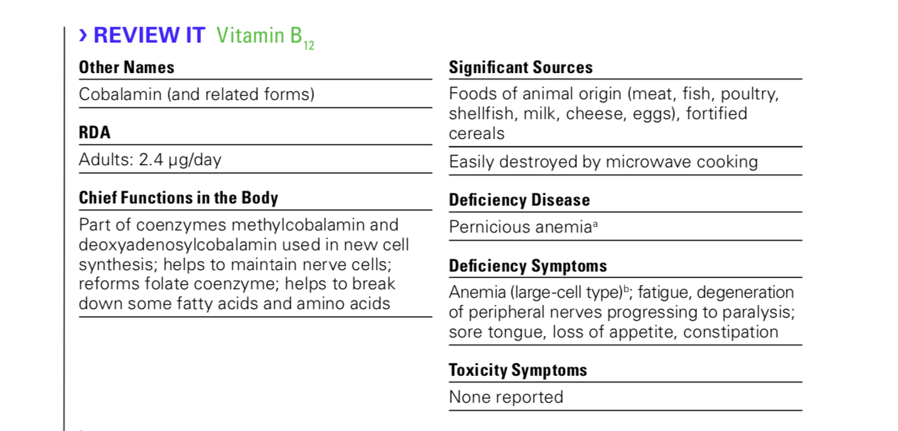

Slide 55
Vitamin C
Those receiving the citrus fruits quickly recovered from scurvy
In the mid-1700s, James Lind, a British physician serving in the navy, devised an experiment to find a cure for scurvy.
He divided 12 sailors with scurvy into 6 pairs.
Each pair received a different supplement
cider,
vinegar
sulfuric acid,
Seawater
oranges and lemons
strong laxative.

Slide 56
Vitamin C function
Serves as a cofactor helping a specific enzyme perform its job,
Acts as an antioxidant
As an Antioxidant
Vitamin C loses electrons easily, a characteristic that allows it to perform as an antioxidant. In the body, antioxidants defend against free radicals.
A free radical is a molecule with one or more unpaired electrons, which makes it unstable and highly reactive. Antioxidants can neutralize free radicals by donating an electron or two. In doing so, antioxidants protect other substances from free radical damage

Slide 57
functions
As an antioxidant
Vitamin C protects tissues from the oxidative stress of free radicals and thus may play an important role in preventing diseases.
Vitamin C enhances Iron absorption
As a cofactor
Vitamin C helps to form the fibrous structural protein of connective tissues known as collagen. Collagen serves as the matrix on which bones and teeth are formed
Assists in formation of hormones and neurotransmitters

Slide 58
Certain stresses increases vitamin C needs
These stresses include: infections; burns; extremely high or low temperatures; intakes of toxic heavy metals and smoking

Slide 59
Vitamin C Recommendations
Vitamin C and cold prevention?
conflicting and controversial evidence
Less symptoms and severity of common cold and reduced duration
Recommendations
Women: 75 mg/day
Men: 90 mg/day
Because people who smoke cigarettes regularly suffer significant oxidative stress, their requirement for vitamin C is increased an additional 35 milligrams

Slide 60
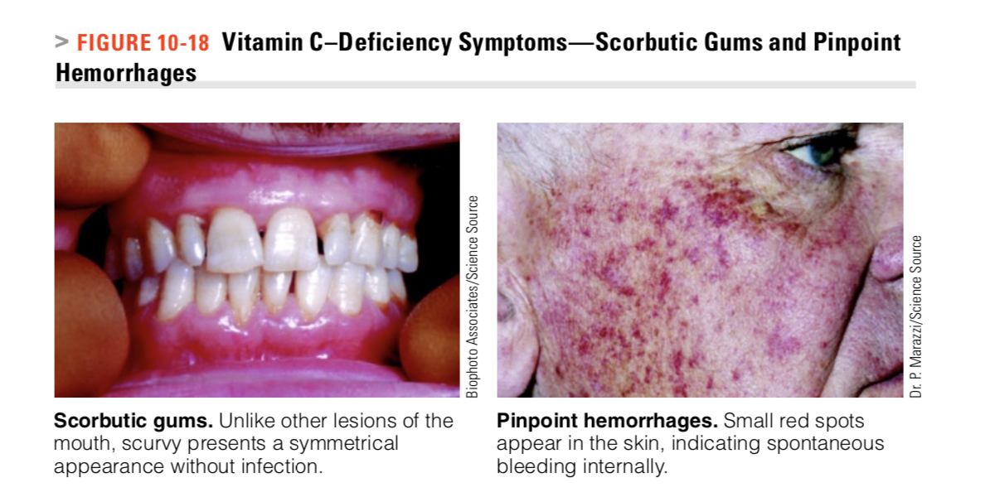
Vitamin C Deficiency
Scurvy symptoms (bleeding gums, loss of teeth, foul breath, painful legs)
Inadequate collagen synthesis causes further hemorrhaging.
Muscles, including the heart muscle, degenerate.
The skin becomes rough, brown, scaly, and dry.
Wounds fail to heal because scar tissue will not form.
Bone rebuilding declines
and fractures develop.

Slide 61
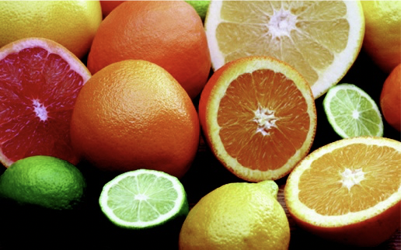
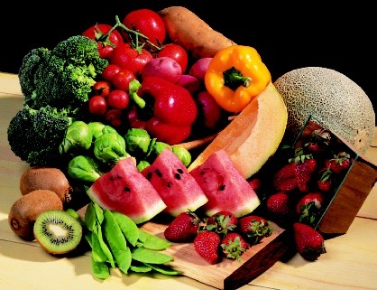
Food sources
Fruits and vegetables can easily provide a generous amount of vitamin C
Broccoli, bell pepper, strawberries, kiwi
Vitamin C is vulnerable to heat, raw fruits and vegetables usually have a higher nutrient density than their cooked counterparts
Citrus fruits
Tomatoes
Cabbage-type vegetables (such as brussels sprouts and cauliflower),
Potatoes are an important source of vitamin C

Slide 62
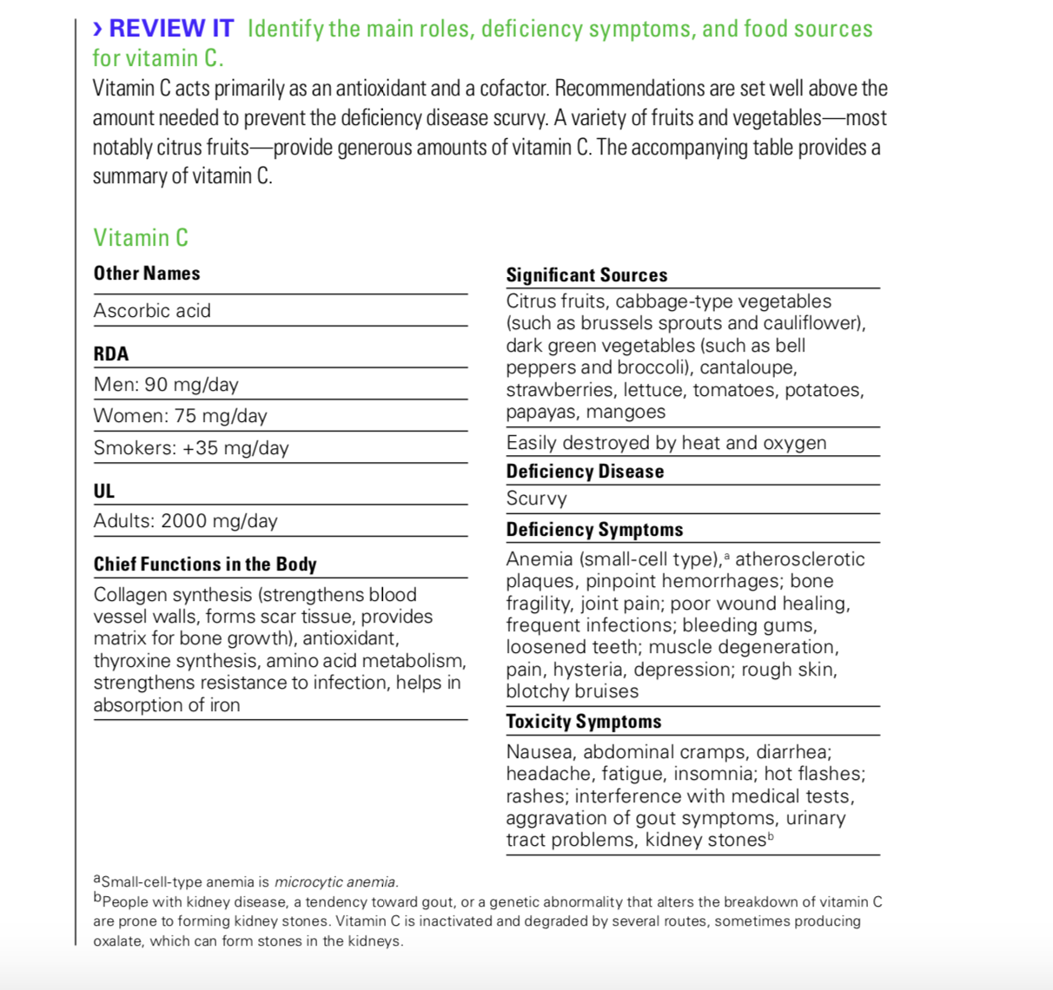
Vitamin C Toxicity
Side effects of vitamin C supplementation such as gastrointestinal distress and diarrhea have been reported. The UL for vitamin C was established based on these symptoms.

Slide 63
