Slide 1
Chapter Two
Transformers
aabdo@birzeit.edu Transformers

Slide 2
Introduction
A transformer is a device that changes ac electric power at one frequency
and voltage level to ac electric power at the same frequency and another
voltage level through the action of a magnetic field.
It operates based on Faraday’s Law : induced voltage on a conductor/coil
from a time changing magnetic field.
It consist of two or more coils wrapped around a common Ferromagnetic core.
aabdo@birzeit.edu Transformer

Slide 3
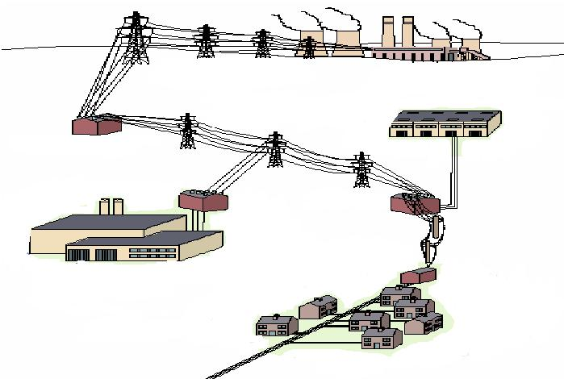
Introduction
400/132 KV
POWER STATION
132/11 KV
SMALL INDUSTRY
132/33 KV
LARGE INDUSTRY
11 KV/240 V
RESIDENTIAL
aabdo@birzeit.edu Transformer

Slide 4
Types of Transformers
Step up/Unit transformers – Usually located at the output of a generator. Its function is to step up the voltage level so that transmission of power is possible.
Step down/Substation transformers – Located at main distribution or secondary level transmission substations. Its function is to lower the voltage levels for distribution 1st level purposes.
Distribution Transformers – located at small distribution substation. It lowers the voltage levels for 2nd level distribution purposes.
Special Purpose Transformers - E.g. Potential Transformer (PT) , Current Transformer (CT).
Isolation and Impedance Matching Transformers.
aabdo@birzeit.edu Transformer

Slide 5
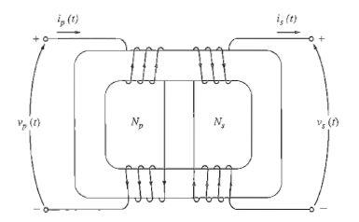
Types and Construction of Transformers
Types of cores for power transformer (both types are constructed from thin laminations electrically isolated from each other –minimize eddy currents)
1) Core Form : a simple rectangular laminated piece of steel with the transformer windings wrapped around two sides of the rectangle.
aabdo@birzeit.edu Transformer

Slide 6
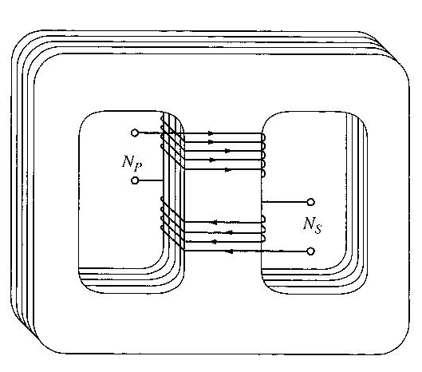
Types and Construction of Transformers
2) Shell Form : a three legged laminated core with the windings wrapped around the centre leg.
The primary and secondary windings are wrapped one on top of the other with the low-voltage winding innermost, due to 2 purposes:
1) It simplifies the problem of insulating the high-voltage winding from the core.
2) It results in much less leakage flux
aabdo@birzeit.edu Transformer

Slide 7
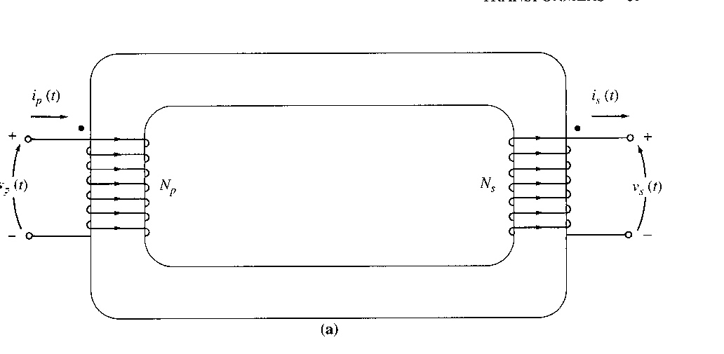
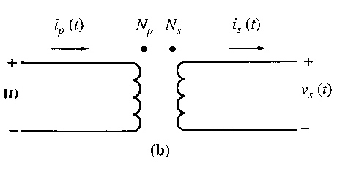
The Ideal Transformer
Definition – a lossless device with an input winding and an output winding.
Figures below show an ideal transformer and schematic symbols of a transformer.
aabdo@birzeit.edu Transformer
7

Slide 8
The Ideal Transformer
The transformer has N_{p} turns of wire on its primary side and N_{s} turns of wire on its secondary sides. The relationship between the primary and secondary voltage is as follows:
where a is the turns ratio of the transformer.
The relationship between primary and secondary current is:
N_{p} i_{p}(t) = N_{s} i_{s}(t)
Note that since both type of relations gives a constant ratio, hence the transformer changes ONLY the magnitude value of current and voltage. Phase angles are not affected.
aabdo@birzeit.edu Transformer

Slide 9
Dot Convention
The dot convention in schematic diagram for transformers has the following relationship:
If the primary voltage is +ve at the dotted end of the winding with respect to the undotted end, then the secondary voltage will be positive at the dotted end also. Voltage polarities are the same with respect to the dots on each side of the core.
If the primary current of the transformer flows into the dotted end of the primary winding, the secondary current will flow out of the dotted end of the secondary winding.
aabdo@birzeit.edu Transformer

Slide 10
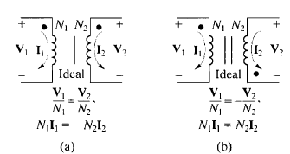
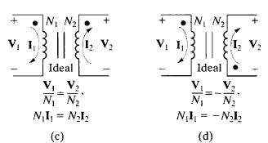
Dot Convention
If the coil voltages V1and V2 are both positive or negative at the dotmarked terminal, use a plus sign. Otherwise, use a negative sign.
If the coil currents I1 and I2 are both directed into or out of the dotmarked terminal, use a minus sign. Otherwise, use a plus sign.
aabdo@birzeit.edu Transformer

Slide 11
Power in an Ideal Transformer
The power supplied to the transformer by the primary circuit:
P_{in} = V_{p} I_{p} cos θ_{p}
Where θ_{p} the angle between the primary voltage and the primary current.
The power supplied by the transformer secondary circuit to its loads is given by:
P_{out} = V_{s} I_{s} cos θ_{s}
Where θs the angle between the secondary voltage and the secondary current.
The primary and secondary windings of an ideal transformer have the SAME power factor – because voltage and current angles are unaffected θ_{p} = θ_{s} = θ
aabdo@birzeit.edu Transformer

Slide 12
Power in an Ideal Transformer
Input and output power in ideal transformer:
P_{out} = V_{s} I_{s} cos θ
We know that, V_{s} = V_{p} / a and I_{s} = a I_{p}
P_{out} = V_{p} I_{p} cos θ = P_{in}
Output Power = Input Power
The same idea can be applied for reactive power Q and apparent power S.
aabdo@birzeit.edu Transformer

Slide 13
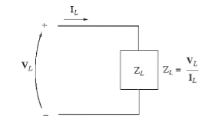
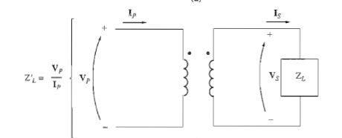
Impedance Transformation
The impedance is defined as the ratio of the phasor voltage across it to the phasor current flowing through it:
Definition of impedance and impedance scaling through a transformer:
aabdo@birzeit.edu Transformer

Slide 14
Impedance Transformation
Hence, the impedance of the load is:
The apparent impedance of the primary circuit of the transformer is:
Since primary voltage can be expressed as V_{P}=aV_{S}, and primary current as I_{P}=I_{S}/a, thus the apparent impedance of the primary is
aabdo@birzeit.edu Transformer

Slide 15
Impedance Transformation
Example 2-1:
A generator rated at 480 V, 60 Hz is connected a transmission line with an impedance of 0.18+j0.24 Ω. At the end of the transmission line there is a load of 4+j3Ω.
If the power system is exactly as described above in Figure (a), what will the voltage at the load be? What will the transmission line losses be?
b) Suppose a 1:10 step-up transformer is placed at the generator end of the transmission line and a 10:1 step-down transformer is placed at the load end of the line (Figure (b)). What will the load voltage be now? What will the transmission line losses be now?
aabdo@birzeit.edu Transformer

Slide 16
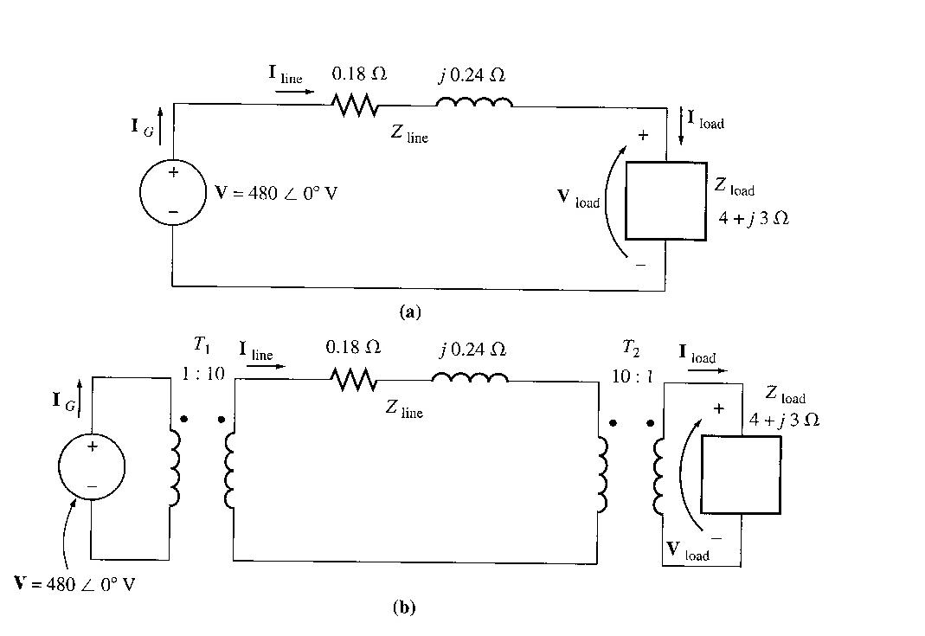
Impedance Transformation
Example 2-1:
aabdo@birzeit.edu Transformer

Slide 17
The Equivalent Circuit of a Transformer
Taking into account real transformer, there are several losses that has to be taken into account in order to accurately model the transformer, namely:
Copper (I²R) Losses – Resistive heating losses in the primary and secondary windings of the transformer.
Eddy current Losses – resistive heating losses in the core of the transformer. They are proportional to the square of the voltage applied to the transformer.
Hysteresis Losses – these are associated with the rearrangement of the magnetic domains in the core during each half-cycle. They are complex, non-linear function of the voltage applied to the transformer.
Leakage flux – The fluxes and which escape the core and pass through only one of the transformer windings are leakage fluxes. They then produced self-inductance in the primary and secondary coils.
aabdo@birzeit.edu Transformer

Slide 18
Exact Equivalent Circuit
The Exact equivalent circuit will take into account all the major imperfections in real transformer.
Copper loss
They are modelled by placing a resistor R_{P} in the primary circuit and a resistor R_{S} in the secondary circuit.
Leakage flux
the leakage flux in the primary and secondary windings produces a voltage given by:
Since flux is directly proportional to current flow, therefore we can assume that leakage flux is also proportional to current flow in the primary and secondary windings. The following may represent this proportionality:
Where P = 1/R permeance of flux path
aabdo@birzeit.edu Transformer

Slide 19
Exact Equivalent Circuit
The constants in these equations can be lumped together. Then,
Where
L_{P} = N_{P}² P is the self-inductance of the primary coil, and
L_{S} = N_{S}² P is the self-inductance of the secondary coil.
Therefore the leakage element may be modelled as an inductance connected together in series with the primary and secondary circuit respectively.
aabdo@birzeit.edu Transformer
19

Slide 20
Exact Equivalent Circuit
Core excitation effects: magnetization current and hysteresis & eddy current losses
The magnetization current i_{m} is a current proportional (in the unsaturated region) to the voltage applied to the core and lagging the applied voltage by 90° - modeled as reactance X_{m} across the primary voltage source.
The core loss current i_{h+e} is a current proportional to the voltage applied to the core that is in phase with the applied voltage – modeled as a resistance R_{C} across the primary voltage source.
aabdo@birzeit.edu Transformer

Slide 21
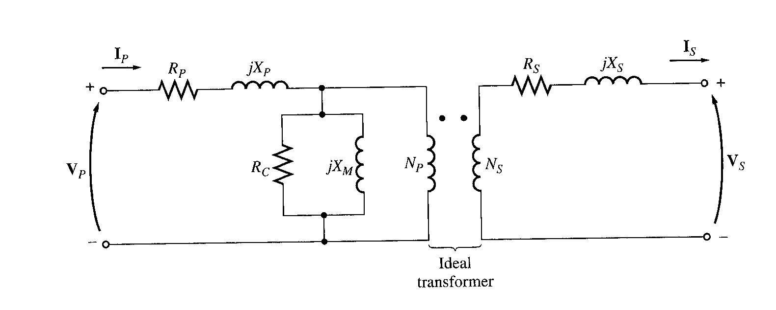
Exact Equivalent Circuit
The resulting equivalent circuit:
copper loss: Rp and Rs
Leakage Flux: Xp and Xs
Core loss: Rc
Magnetizing (mutual) Flux : Xm
aabdo@birzeit.edu Transformer

Slide 22
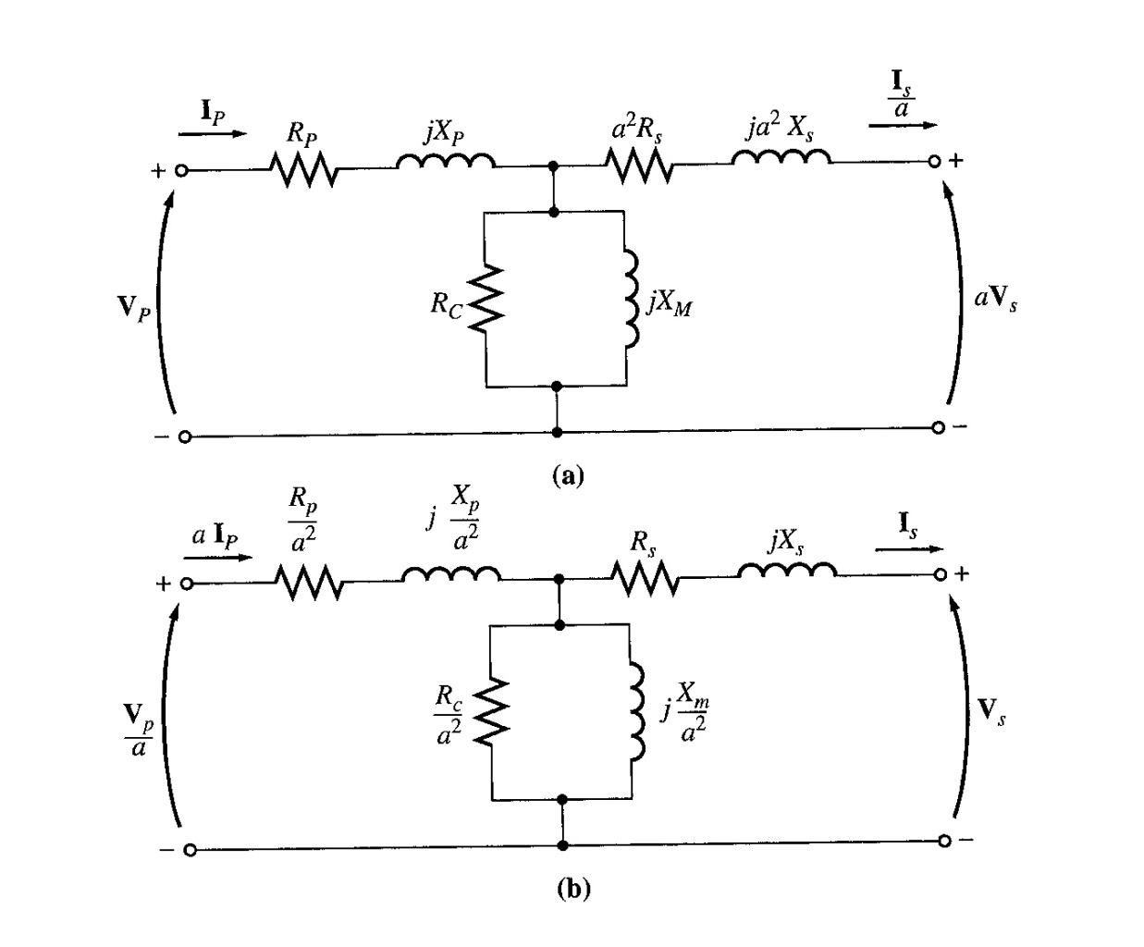
Exact Equivalent Circuit
Based upon the equivalent circuit, in order for mathematical calculation, this transformer equivalent has to be simplified by referring the impedances in the secondary back to the primary or vice versa.
a- Equivalent transformer circuit referred to the primary
b- Equivalent transformer circuit referred to the secondary
aabdo@birzeit.edu Transformer

Slide 23
Approximate Equivalent Circuit
The derived equivalent circuit is detailed but it is considered to be too complex for practical engineering applications. The main problem in calculations will be the excitation and the eddy current and hysteresis loss representation adds an extra branch in the calculations.
In practical situations, the excitation current will be relatively small as compared to the load current, which makes the resultant voltage drop across R_{p} and X_{p} to be very small, hence R_{p} and X_{p} may be lumped together with the secondary referred impedances to form and equivalent impedance. In some cases, the excitation current is neglected entirely due to its small magnitude.
aabdo@birzeit.edu Transformer

Slide 24
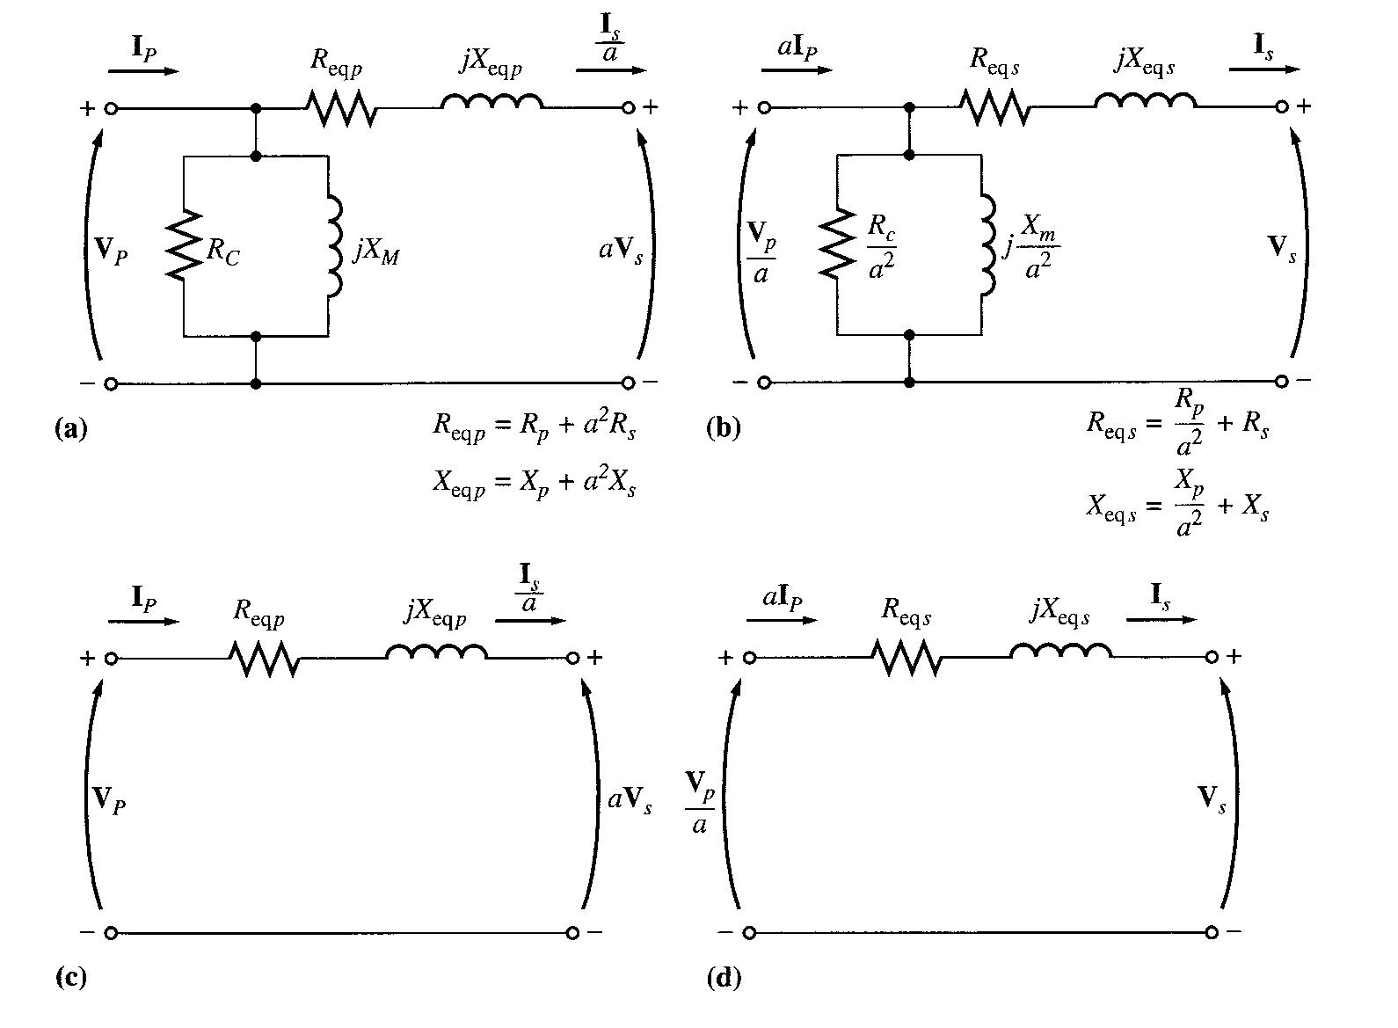
Approximate Equivalent Circuit
Referred to the primary side; (b) Referred to the secondary side
(c) With no excitation branch, referred to the primary side
(d) With no excitation branch, referred to the primary side
aabdo@birzeit.edu Transformer

Slide 25
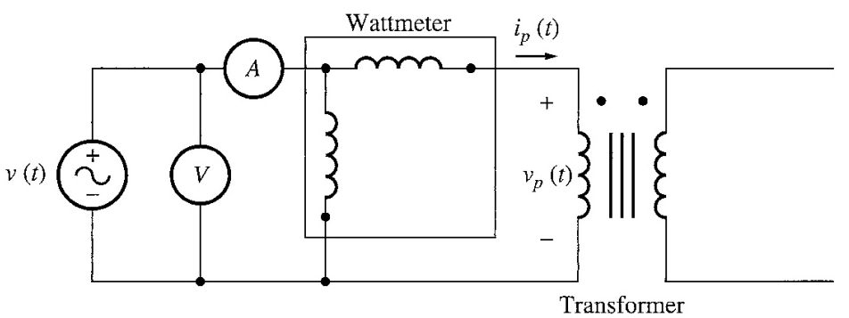

Determining the Values of Components in the Transformer Model
The values of the inductances and resistances in the transformer model can be determined experimentally.
An adequate approximation of these values can be obtained by:
open-circuit test,
short-circuit test.
Open-circuit Test
The transformer’s secondary winding is open-circuited, and its primary winding is connected to a full-rated line voltage.
All the input current will be flowing through the excitation branch of the transformer. The series element R_{P} and X_{P} are too small in comparison to R_{C} and X_{M} to cause a significant voltage drop. Essentially all input voltage is dropped across the excitation branch.
aabdo@birzeit.edu Transformer

Slide 26
Determining the values of Components in the Transformer Model
Full line voltage is applied to the primary – input voltage, input current, input power measured.
Then, power factor of the input current and magnitude and angle of the excitation impedance can be calculated.
To obtain the values of R_{C} and X_{M} , the easiest way is to find the admittance of the branch:
- Conductance of the core loss resistor,
- Susceptance of the magnetizing inductor,
These two elements are in parallel, thus their admittances add.
Total excitation admittance,
The magnitude of the excitation admittance (referred to primary),
aabdo@birzeit.edu Transformer
26

Slide 27
Determining the values of Components in the Transformer Model
The angle of the admittance can be found from the circuit power factor.
The power factor is always lagging for a real transformer. Hence,
This equation can be written in the complex number form and hence the values of R_{C} and X_{M} can be determined from the open circuit test data.
aabdo@birzeit.edu Transformer

Slide 28
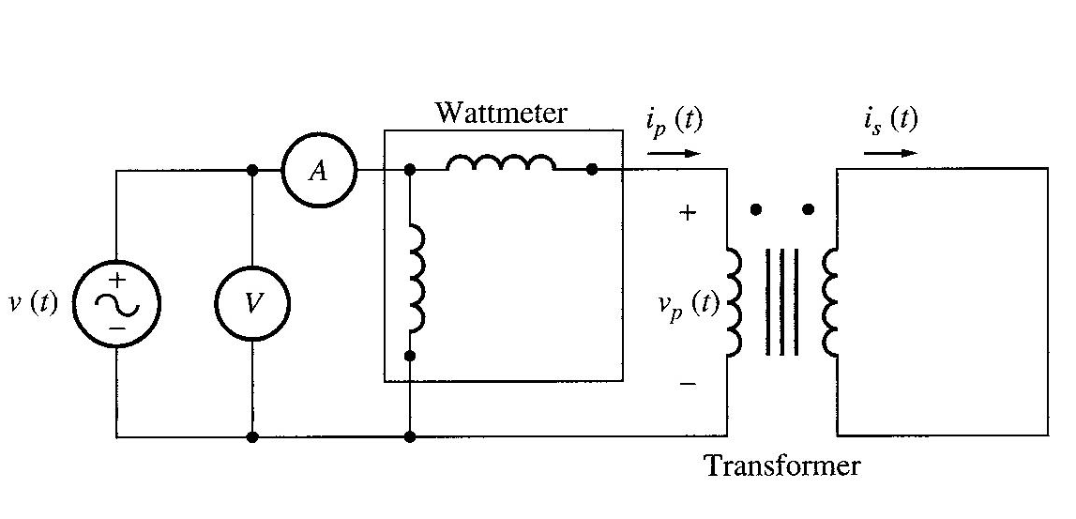
Determining the values of Components in the Transformer Model
Short -circuit Test
The secondary terminals are short circuited, and the primary terminals are connected to a fairly low-voltage source.
The input voltage is adjusted until the current in the short circuited windings is equal to its rated value. The input voltage, current and power are measured.
aabdo@birzeit.edu Transformer

Slide 29
Determining the values of Components in the Transformer Model
The excitation branch is ignored, because negligible current flows through it due to low input voltage during this test. Thus, the magnitude of the series impedances referred to the primary is:
Power factor, (lagging)
Therefore,
The series impedance
aabdo@birzeit.edu Transformer

Slide 30
Determining the values of Components in the Transformer Model
Example 2-2
The equivalent circuit impedances of a 20-kVA, 8000/240 V, 60-Hz transformer are to be determined. The open-circuit test was performed on the secondary
side of the transformer (to reduce the maximum voltage to be measured) and the short circuit test were performed on the primary side of the transformer (to reduce the maximum current to be measured). The following data were taken:
Open circuit test Short circuit test
(on the secondary) (on the primary)
V_{OC} = 240 V V_{SC} = 489 V
I_{OC} = 7.133 A I_{SC} = 2.5 A
P_{OC} = 400 W P_{SC} = 240 W
Find the impedance of the approximate equivalent circuit referred to the primary side, and sketch the circuit
aabdo@birzeit.edu Transformer

Slide 31
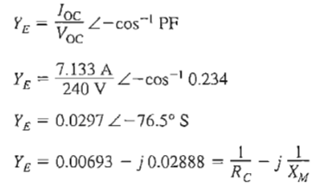
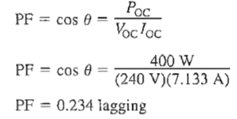
Determining the values of Components in the Transformer Model
Solution:
- We should note that the transformer is step-down with the following ratio 8000/240V:
Therefore:
The open-circuit test was performed on the secondary side of the transformer (to reduce the maximum voltage to be measured)
the short circuit test were performed on the primary side of the transformer (to reduce the maximum current to be measured).
- The turns ratio of this transformer is a = 8000/240 = 33.3333.
The power factor during the
open-circuit test is
- The excitation admittance is given by
aabdo@birzeit.edu Transformer

Slide 32
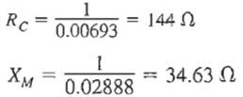
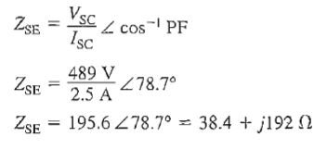
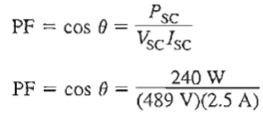


Determining the values of Components in the Transformer Model
Solution:
- Therefore , the values of the excitation branch referred to the Low-voltage (secondary) side are:
- The power factor during the short-circuit test is
- The series impedance is given by
- Therefore, the equivalent resistance and reactance referred to the high-voltage (primary) side are
aabdo@birzeit.edu Transformer

Slide 33

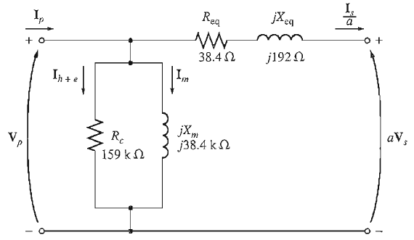
Determining the values of Components in the Transformer Model
Solution:
- The resulting simplified equivalent circuit referred to the high-voltage (primary) side can be found by converting the excitation branch values to the high-voltage side.
- The equivalent circuit
aabdo@birzeit.edu Transformer

Slide 34
The Per-Unit System
Power-system quantities such as voltage, current, power, and impedance are
often expressed in per-unit or percent of specified base values.
Advantage of the per-unit system:
Simplify the calculations and make the values more meaningful.
The transformer equivalent circuit can be simplified.
The ideal transformer winding can be eliminated. The per-unit system
allows us to avoid the possibility of making serious calculation errors
when referring quantities from one side of a transformer to the other.
Per-unit quantities are calculated as follows:
aabdo@birzeit.edu Transformer

Slide 35
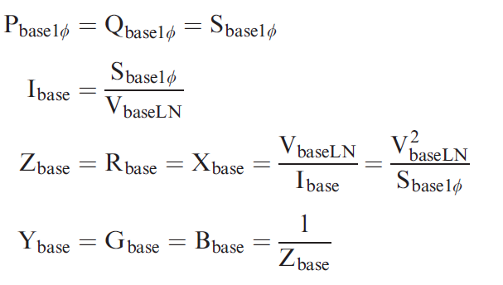
The Per-Unit System
in order for electrical laws to be valid in the per-unit system, the following relations must be used for other base values:
aabdo@birzeit.edu Transformer

Slide 36
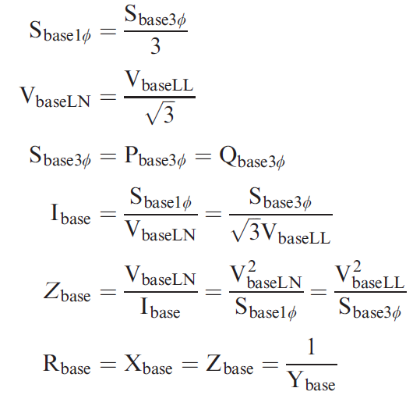
The Per-Unit System
Balanced three-phase circuits can be solved in per-unit on a per-phase basis after converting Δ-load impedances to equivalent Y impedances.
aabdo@birzeit.edu Transformer

Slide 37
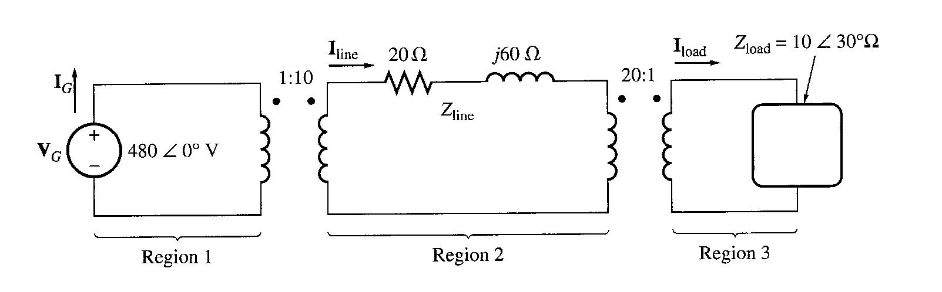
The Per-Unit System
Example 2-3
A simple power system is shown below. This system contains a 480V generator connected to an ideal 1:10 step-up transformer, a transmission line, an ideal 20:1 step-down transformer, and a load. The impedance of the transmission line is 20 + j60Ω, and the impedance of the load is . The base values for this system are chosen to be 480V and 10kVA at the generator.
Find the base voltage, current, impedance, and apparent power at every point in the power system.
Convert this system to its per-unit equivalent circuit.
Find the power supplied to the load in this system.
Find the power lost in the transmission line.
aabdo@birzeit.edu Transformer

Slide 38
Transformer Voltage Regulation and Efficiency
The output voltage of a transformer varies with the load even if the input voltage remains constant. This is because a real transformer has series impedance within it.
Full load Voltage Regulation is a quantity that compares the output voltage at no load with the output voltage at full load, defined by this equation:
At no load, V_{S} = V_{P}/a thus,
In per-unit system,
Ideal transformer, VR = 0%.
aabdo@birzeit.edu Transformer

Slide 39
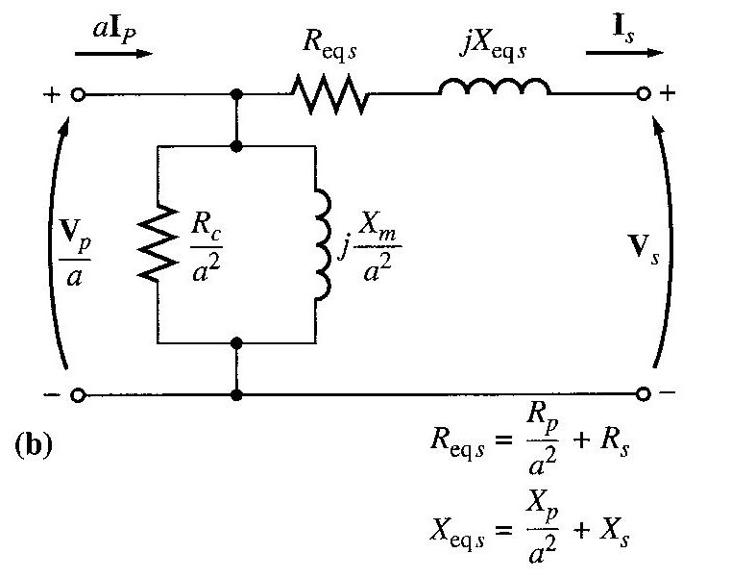
The Transformer Phasor Diagram
To determine the voltage regulation of a transformer, we must understand the voltage drops within it. Consider the simplified equivalent circuit referred to the secondary side:
Ignoring the excitation of the branch, more consideration is given to the series impedances (R_{eq} +jX_{eq}).
Voltage Regulation depends on magnitude of the series impedance and the phase angle of the current flowing through the transformer.
Phasor diagrams will determine the effects of these factors on the voltage regulation. A phasor diagram consist of current and voltage vectors.
aabdo@birzeit.edu Transformer

Slide 40
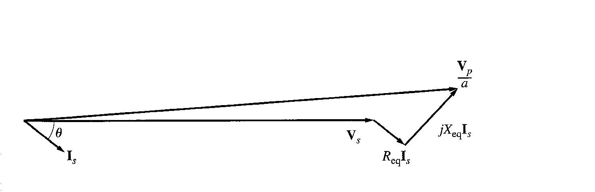
Transformer Voltage Regulation and Efficiency
A phasor diagram consist of current and voltage vectors.
Assume that the reference phasor is the secondary voltage V_{S}. Therefore the reference phasor will have ѳ degrees in terms of angle.
Based upon the equivalent circuit, apply Kirchoff Voltage Law,
From this equation, the phasor diagram can be visualised.
Figure below shows a phasor diagram of a transformer operating at a lagging power factor. For lagging loads, V_{P} / a > V_{S} so the voltage regulation with lagging loads is > 0.
At lagging power factor
aabdo@birzeit.edu Transformer

Slide 41
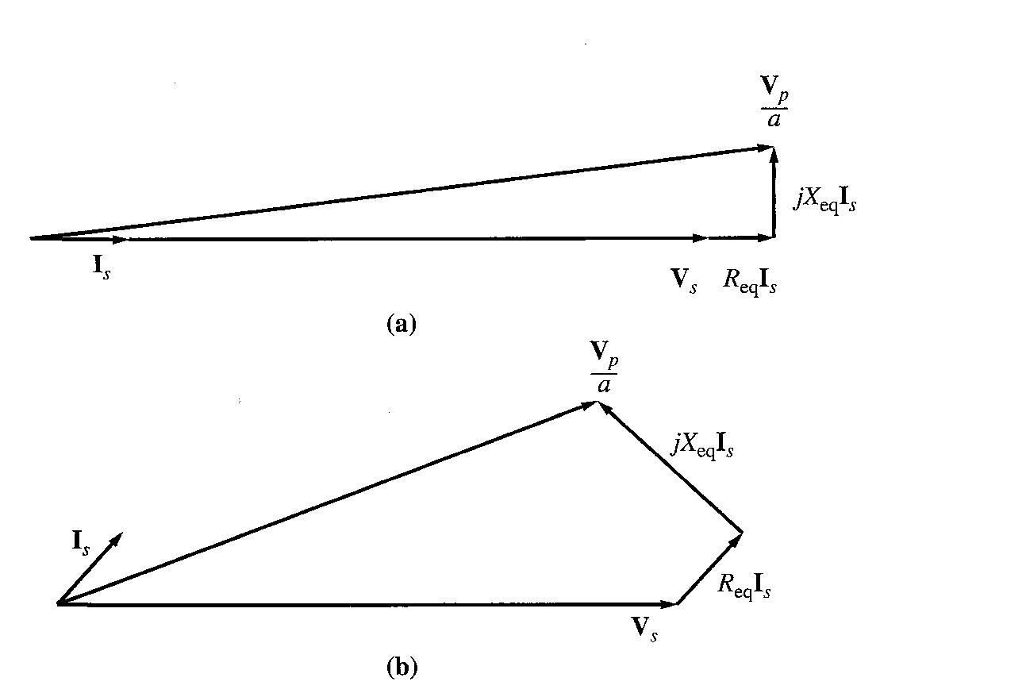
Transformer Voltage Regulation and Efficiency
When the power factor is unity, V_{S} is lower than V_{P} so V_{R} > 0. But, V_{R} is smaller than before (during lagging PF).
Unity PF
With a leading power factor, V_{S} is higher than the referred V_{P} so V_{R} < 0.
Leading PF
aabdo@birzeit.edu Transformer

Slide 42
Transformer Voltage Regulation and Efficiency
In summary:
Due to the fact that transformer is usually operated at lagging pf, hence there is an approximate method to simplify calculations.
Lagging PF | Unity PF | Leading PF
V_{P} / a > V_{S} | V_{P} / a > V_{S} | V_{S} > V_{P} / a
VR > 0 | VR > 0 (smaller than VR lag) | VR < 0
aabdo@birzeit.edu Transformer

Slide 43
Transformer Efficiency
Transformer efficiency is defined as (applies to motors, generators and transformers):
Types of losses incurred in a transformer:
Copper I²R losses
Hysteresis losses
Eddy current losses
Therefore, for a transformer, efficiency may be calculated using the following:
aabdo@birzeit.edu Transformer

Slide 44
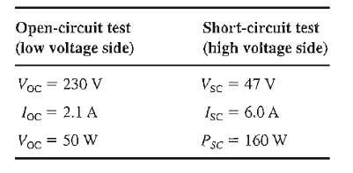
Transformer Voltage Regulation and Efficiency
Example 2-5
A 15kVA, 2300/230 V transformer is to be tested to determine its excitation branch components, its series impedances, and its voltage regulation. The following data have been taken from the transformer:
Find the equivalent circuit referred to the high voltage side
Find the equivalent circuit referred to the low voltage side
Calculate the full-load voltage regulation at 0.8 lagging PF, 1.0 PF, and at 0.8 leading PF.
Plot the voltage regulation as load is increased from no load to full load at power factors of 0.8 lagging, 1.0, and 0.8 leading.
Find the efficiency at full load with PF 0.8 lagging.
Important example you need to solve it
aabdo@birzeit.edu Transformer

Slide 45
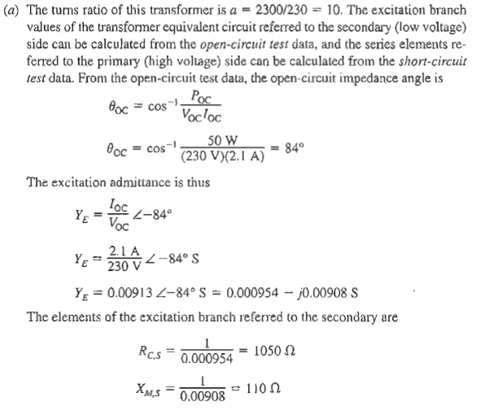
Transformer Voltage Regulation and Efficiency
aabdo@birzeit.edu Transformer

Slide 46
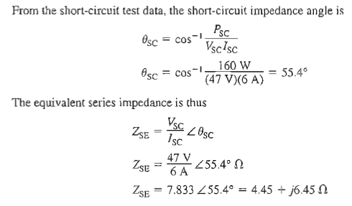
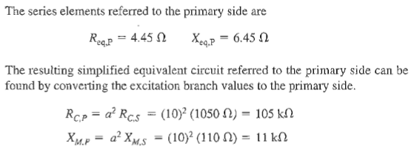
Transformer Voltage Regulation and Efficiency
aabdo@birzeit.edu Transformer

Slide 47
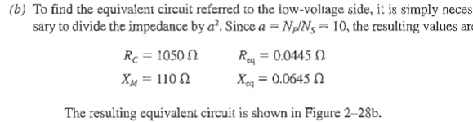
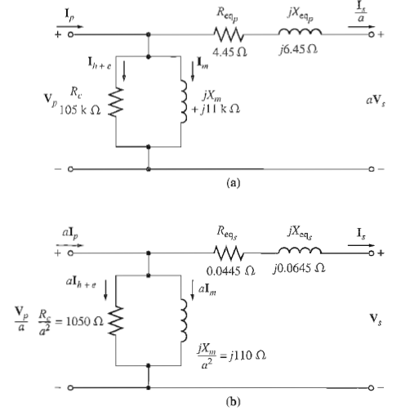
Transformer Voltage Regulation and Efficiency
aabdo@birzeit.edu Transformer

Slide 48
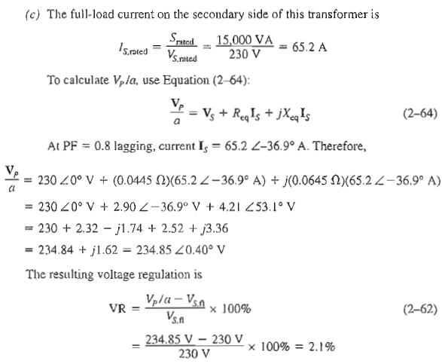
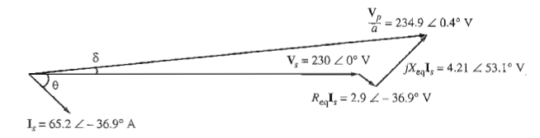
Transformer Voltage Regulation and Efficiency
aabdo@birzeit.edu Transformer

Slide 49
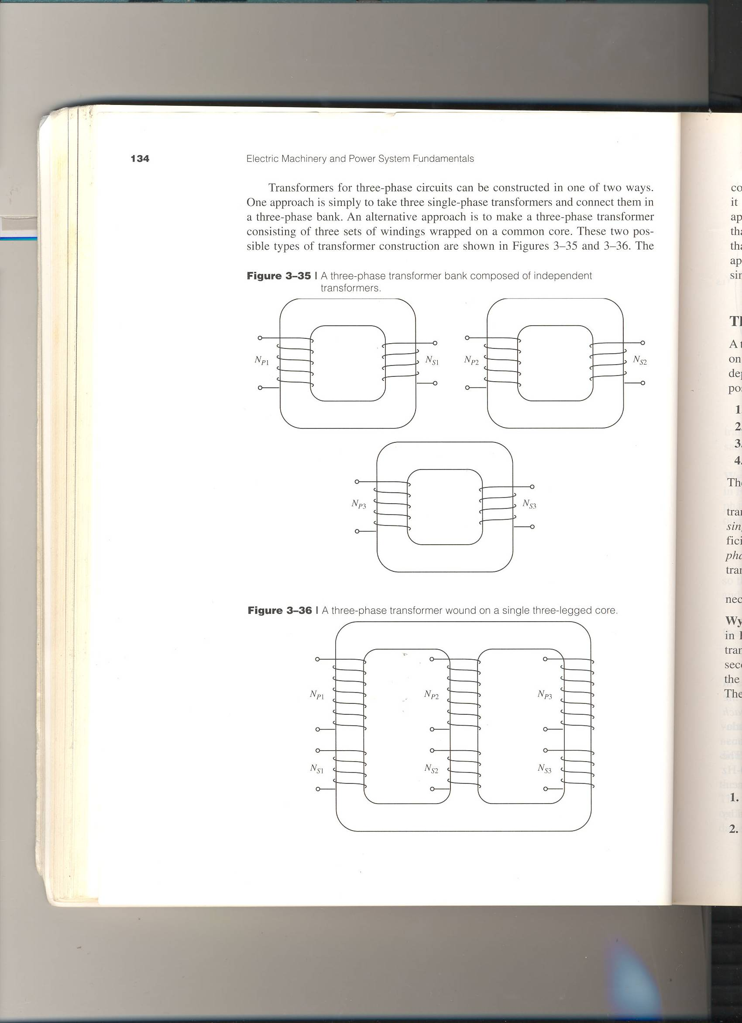
Three-Phase Transformer Connections
The primaries and secondaries of any three-phase transformer can be independently connected in either a wye (Y) or a delta (∆).
The important point to note when analyzing any 3-phase transformer is to look at a single transformer in the bank.
Any single phase transformer in the bank behaves exactly like the single-phase transformers already studied.
aabdo@birzeit.edu Transformer

Slide 50
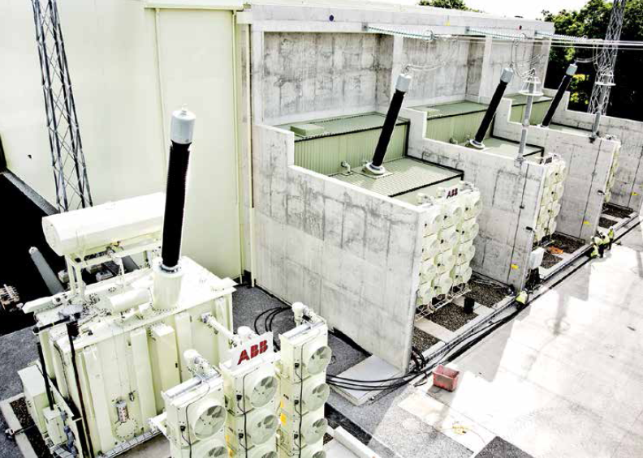
Three-Phase Transformer Connections
Spare power ABB transformer at an HVDC site.

Slide 51
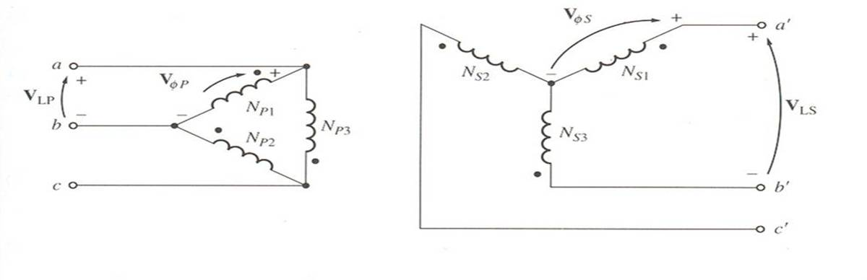
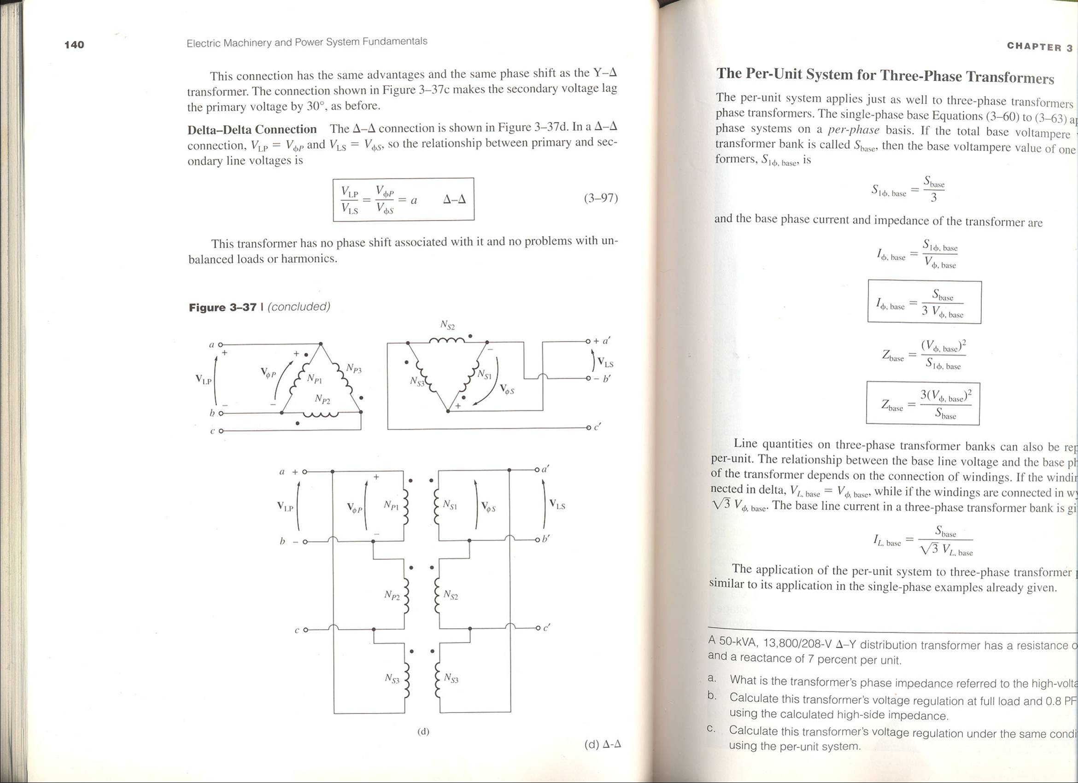
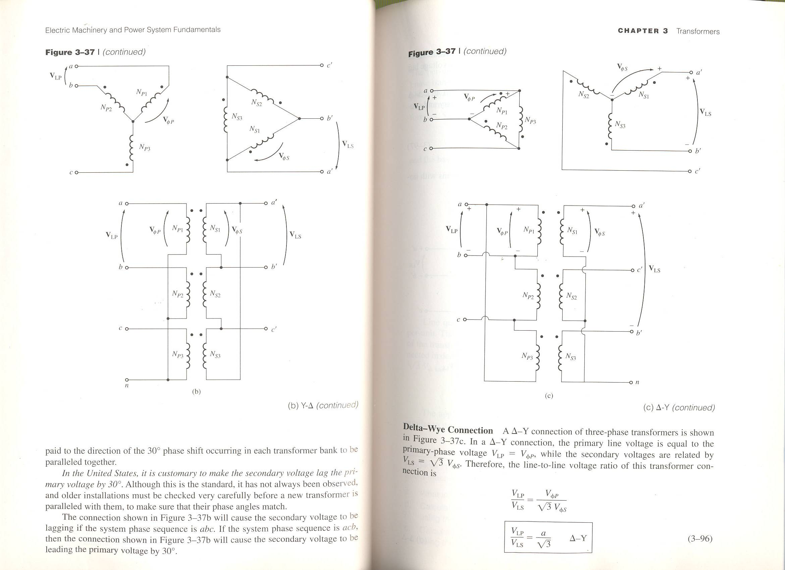
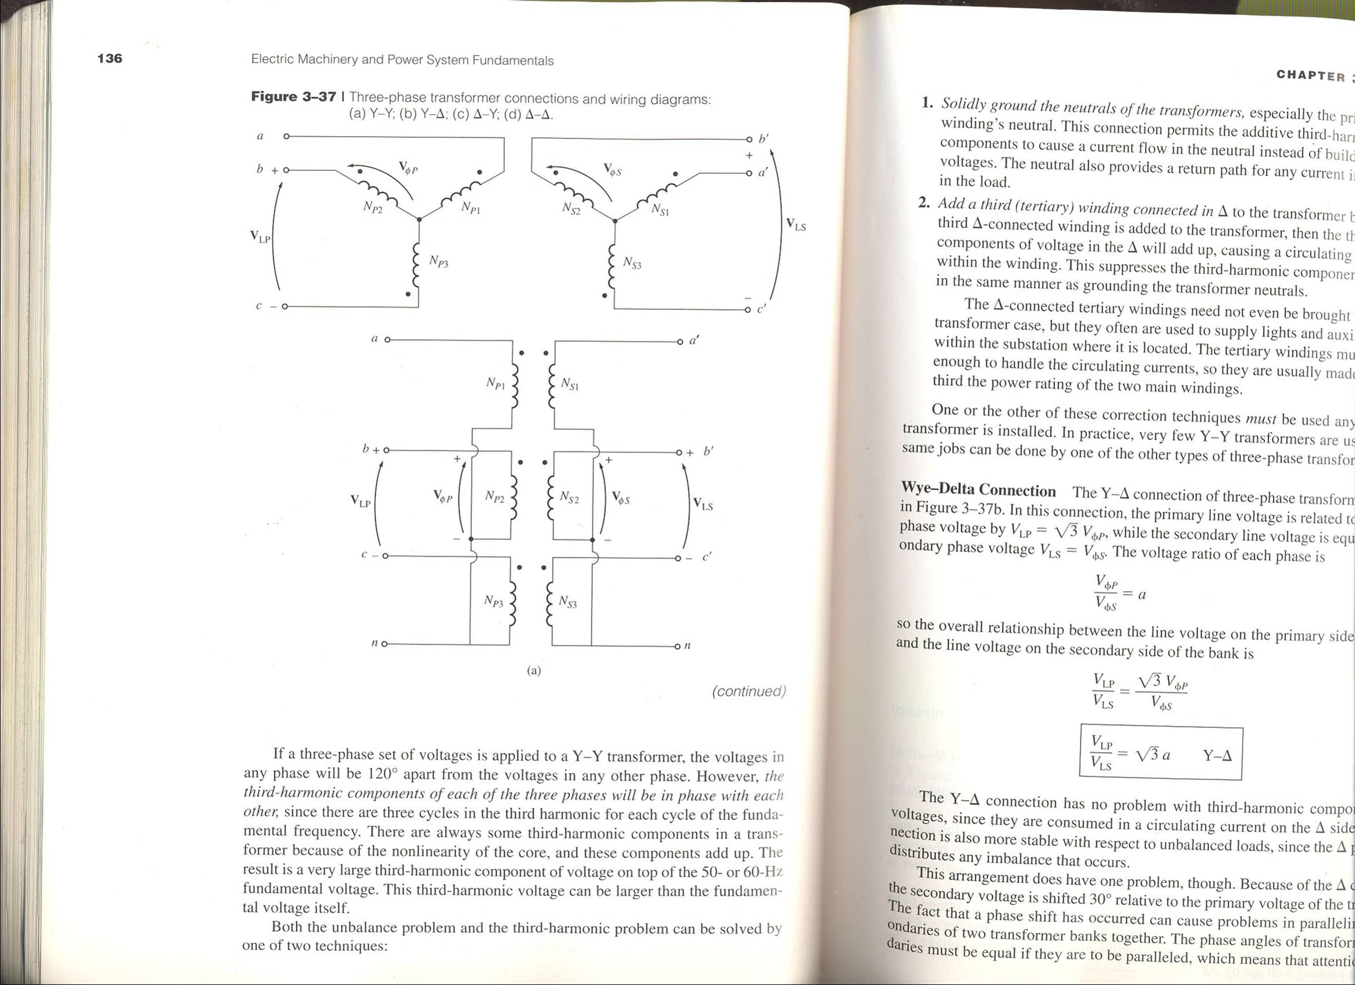
Three-Phase Transformer Connections
Delta – wye (Δ – Y)
Delta – delta (Δ – Δ)
Wye – delta (Y- Δ)
Wye – wye (Y – Y)
aabdo@birzeit.edu Transformer
51

Slide 52
Three-Phase Transformer Connections
The impedance, voltage regulation, efficiency, and similar calculations for three phase transformers are done on a per-phase basis, using same techniques as single-phase transformers.
A simple concept that all students must remember is that, for a Delta configuration,
For Wye configuration,( for balanced case I_{N}=0 and neutral can be left open and only 3 wires are required)
aabdo@birzeit.edu Transformer

Slide 53
Calculating 3-Phase Transformer Turns Ratio
The basic concept of calculating the turns ratio for a single phase transformer is utilised where,
Therefore to cater for 3 phase transformer, suitable conversion into per phase is needed to relate the turns ratio of the transformer with the line voltages.
aabdo@birzeit.edu Transformer

Slide 54

Three-Phase Transformer Connections
Wye – Wye (Y – Y)
Voltage Ratio
aabdo@birzeit.edu Transformer

Slide 55
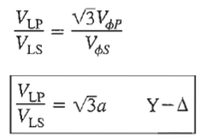
Three-Phase Transformer Connections
Wye – Delta (Y- Δ)
aabdo@birzeit.edu Transformer

Slide 56
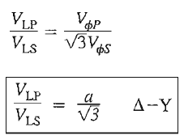
Three-Phase Transformer Connections
Delta – Wye (Δ – Y)
aabdo@birzeit.edu Transformer

Slide 57

Three-Phase Transformer Connections
Delta – Delta (Δ – Δ)
aabdo@birzeit.edu Transformer

Slide 58
Homework
Homework problems are: 2.1, 2.6, 2.12;
These problems are from the 5th edition text book.
aabdo@birzeit.edu Transformer

