Slide 1
Training the Gut, Training Low, and Training high
NUTD 337

Slide 2
Causes of GI discomfort
Mechanical
Movement
Physiological: blood flow to intestine, stress
Nutritional
High fat, protein, and/or fiber, large volume, concentrated CHO

Slide 3
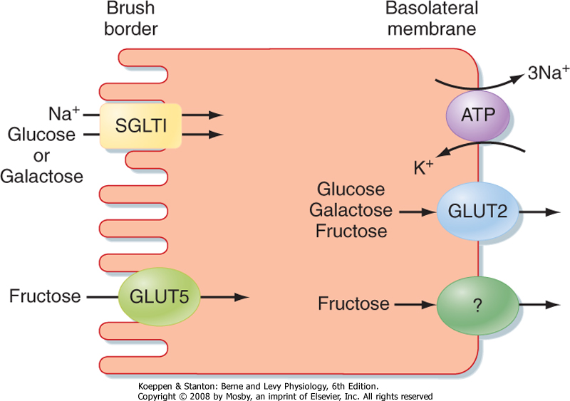
CHO intestinal absorption

Slide 4
Train your gut
Essential to train
  The gut on CHO consumption
  Training increase CHO delivery to the blood stream
What CHO
  Better performance with CHO blend vs single type
    More power in cycling (currel & Jeuknesdrop 2008)

Slide 5
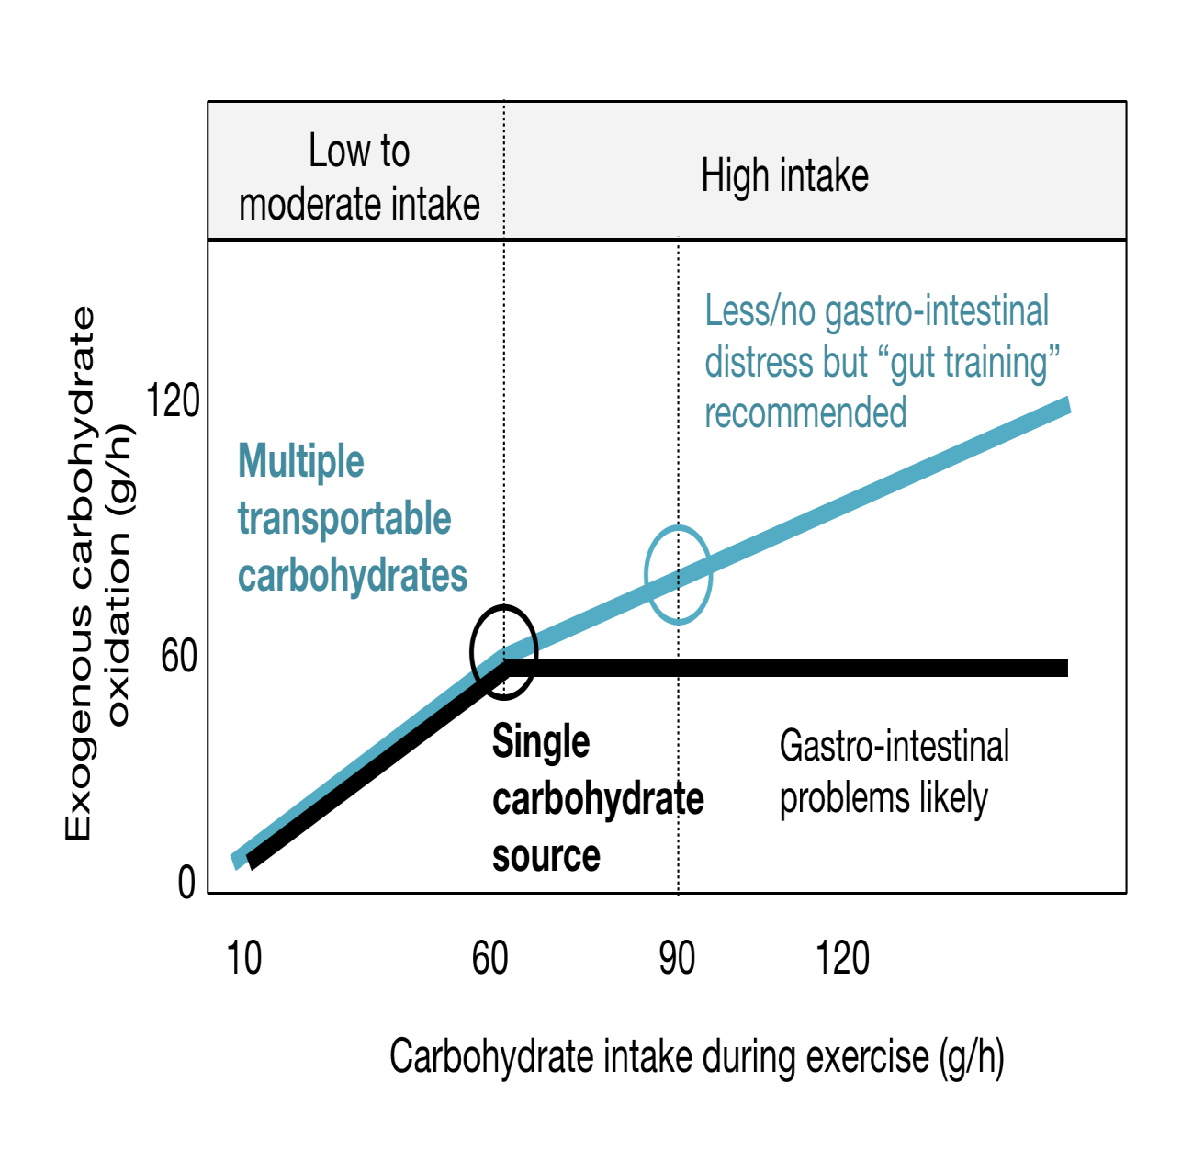
NO GI discomfort
Source: Jeukendrup 2014 (http//bit.ly/2QINjYO)

Slide 6
Why train
Why train
  Blend increases CHO oxidation
  Increased SGLT1 expression
Gut Microbiota
  Need CHO to ferment
  No CHO will go for PRO and fat
    Creates GI discomfort

Slide 7
Training the gut
Ingest CHO blend
2 wks (3 day adaptation begins)
Avoid dairy
Avoid high fiber foods
Avoid NSAID
Avoid dehydration

Slide 8
Training Low or High

Slide 9
The goal
You eat to
  train….you don’t train to eat!
  to meet the demands of the game
  to improve your performance
CHO most important macronutrient for performance
Periodize
  Changing your diet patterns to achieve smaller non performance related goals to reach your greater performance related goal

Slide 10
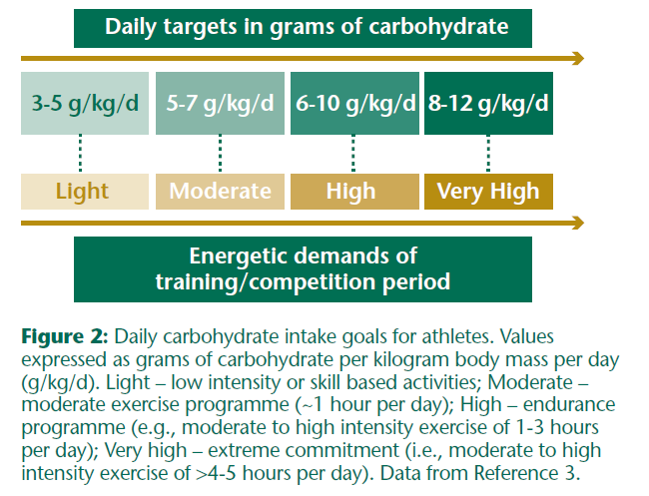
CHO need for athletes
Source: https://sugar.ca/Sugars-and-Health/Physical-Activity.aspx

Slide 11
Your instruments
Train high/low
Recover high/low
Train twice/day
Train the gut
Sleep low/high

Slide 12
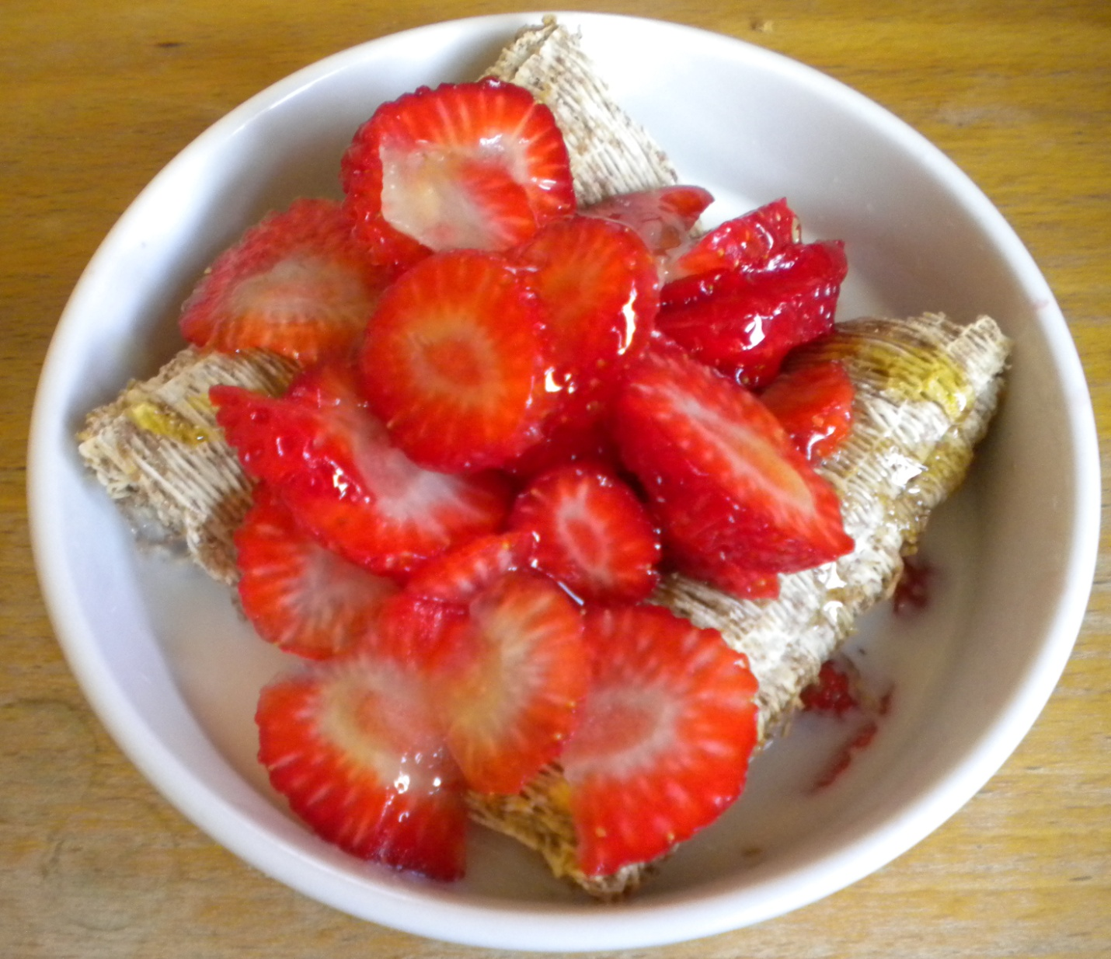
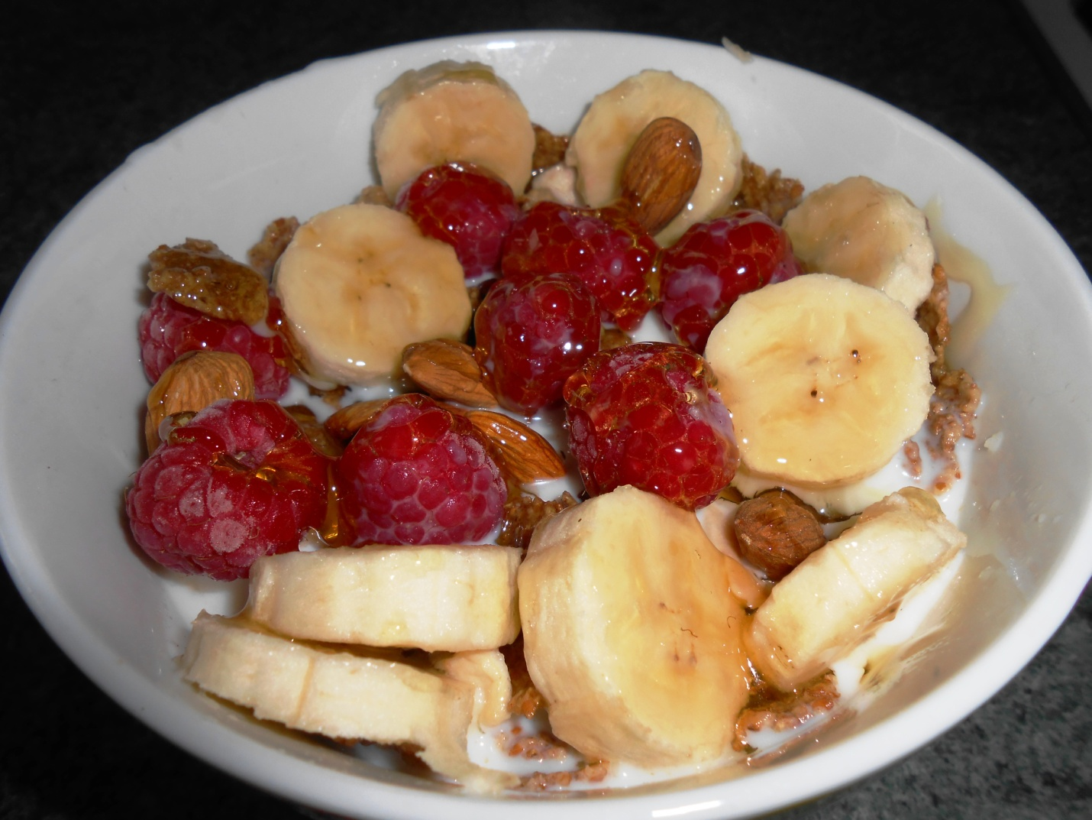
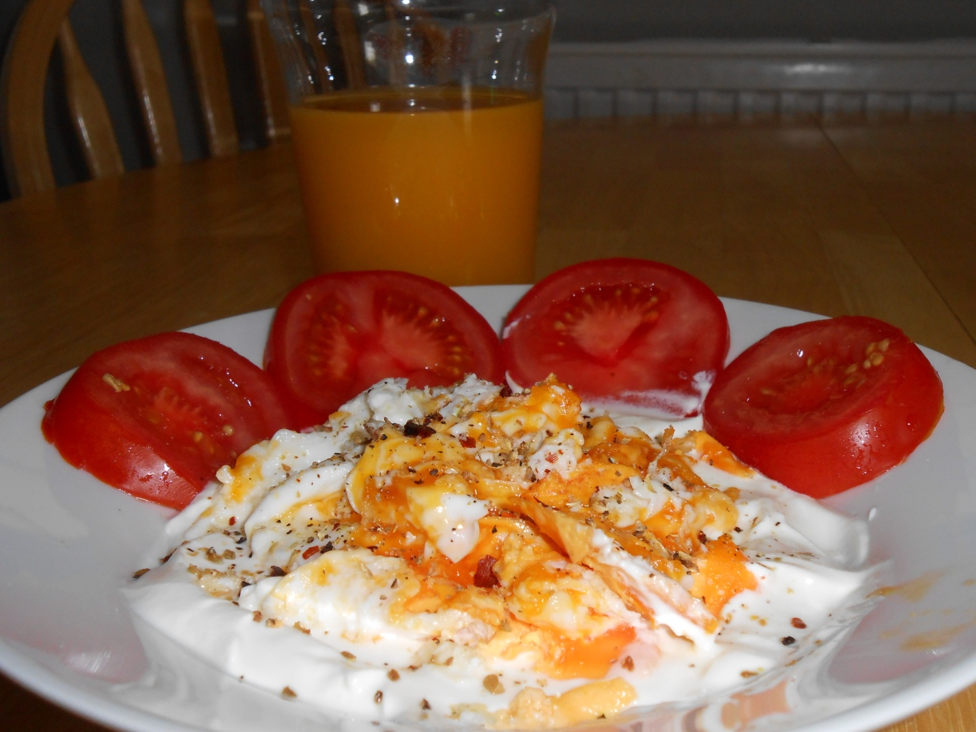
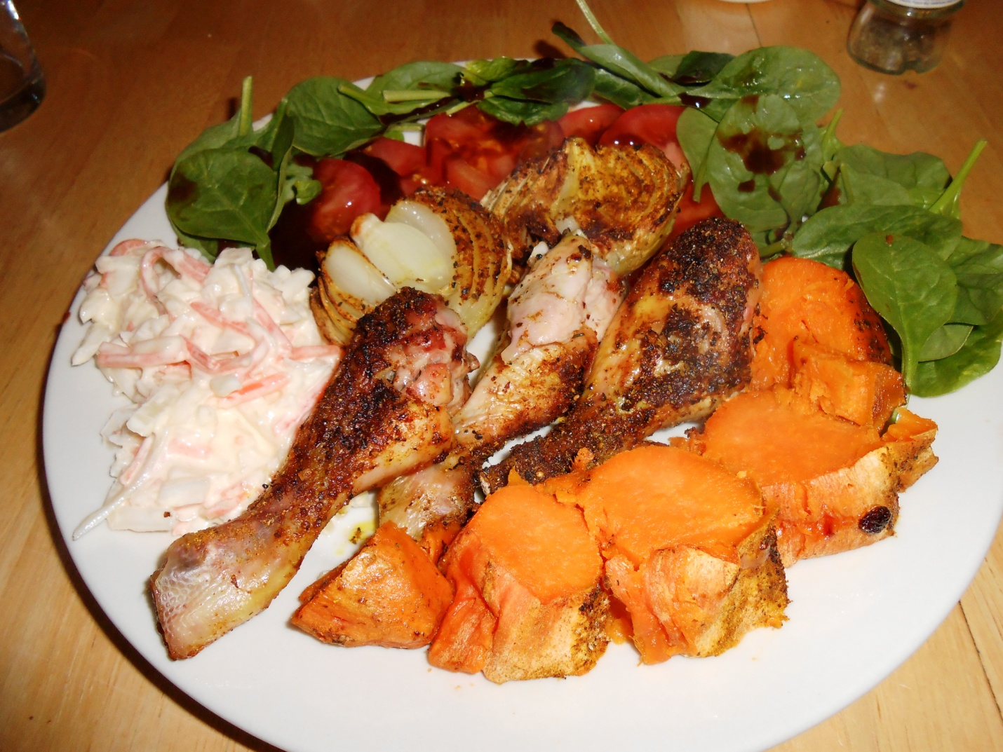

Slide 13
Train High
High CHO diet
Recover high
High intensity training
Recover low/Sleep low
Train Low (endurance)
AMPK
Mitochondrial Biognesis
MPS

Slide 14
Lessons
Train low is done maxium 3 days/week
Train low does not mean don’t eat CHO…just limit
Recover high means fuel with CHO
  Before session
  After session starting with 1 to 1.2 g/kg CHO from 1st hour for 4 hours

Slide 15
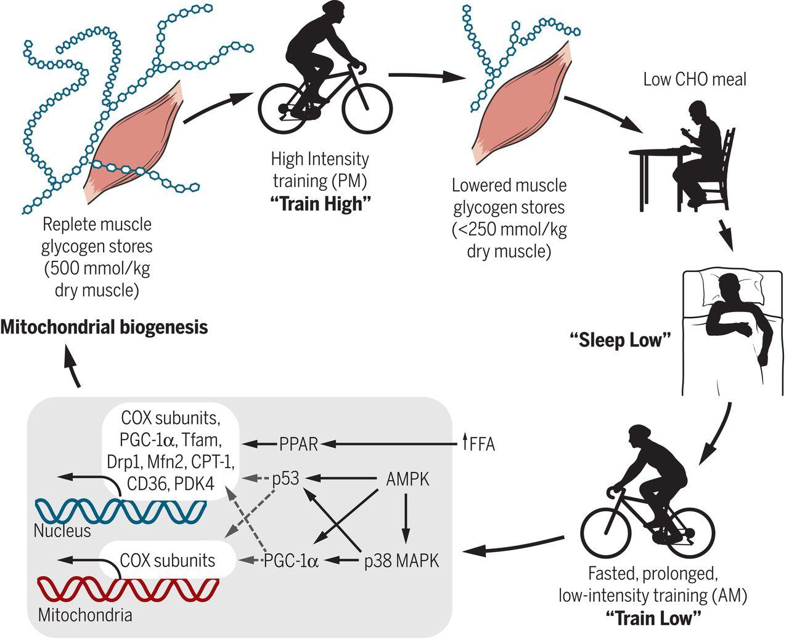
Source: Burke & Howley 2018, http:/goo.gl/MRjqFM

Slide 16
Let make a weekly session
Give color codes for the type of training
Make a one week plan
Not graded

