Slide 1
Writing Goals and Objectives
Writing in CSD

Slide 2
What are clinical goals?
In a clinical setting, goals (or objectives) refer to the outcomes desired for the client. They may be classified as long term or short term.

Slide 3
Long Term Goals
Long-term goals involve results that will often take months or years to achieve. These might include long-term goals such as raising scores on a standardized achievement test, reading at a level commensurate with age and grade level, or successfully completing a multi-year therapy program.

Slide 4
Examples of Long Term Goals:
John will improve scores on the Facial Expression Inventory.
Ann will read at a level commensurate with her age and grade.

Slide 5
Short Term Goals
A short-term goal is a specific objective the client must master before he or she is able to achieve the long-term goal(s). Short-term goals focus on specific targets, units, tasks, or steps and are usually achieved in a short time period. The short-term goals a client is working on will usually change quickly as he or she masters those and new short-term goals are established.

Slide 6
Examples of Short Term Goals:
John will use appropriate facial expressions to convey happiness when speaking in 8 of 10 attempts.
Ann will correctly read words with the vowel y with 90% accuracy.

Slide 7
General Guidelines for Writing Goals

Slide 8
Two considerations:
A well-written goal must be measurable. The goal must be stated in such a way that the clinician (and anyone else) can assess whether or not the client has performed the goal. For example, a goal stating that a client will understand a concept would be impossible to measure. Only by demonstrating through a concrete action (initiate a greeting, for example) can the client perform a goal that can be measured.
A well-written goal must pass The Dead Man Rule. If a dead man could do it, it’s not an effective goal. For example, “Sit in a chair” is not a good goal; a dead man could do that. “Attend to a task for 3 minutes without getting up from the chair,” however, is a goal a dead man could not do.

Slide 9
How to Properly Format Session Goals
(Source: The Survival Guide for the Beginning Speech-Language Clinician by Susan Moon Meyer. Gaithersburg, MD: Aspen Publishers, Inc. ISBN: D-8342-1116-S.

Slide 10
Well-written goals contain three components:
Performance
Condition
Criterion

Slide 11
Important: Please note that all goals begin with the client’s name and a future tense verb (Jane will + verb).

Slide 12
Performance
Performance refers to what you expect the client to do or perform to show mastery of the goal.
Ex.: Jane will produce voiceless consonants

Slide 13
The verb used should be concrete and one that can be evaluated by the clinician (Examples of appropriate verbs include name, read orally, repeat orally, state, write, match, count, demand, draw, say, reach, remove, etc.)
The verb should not be one that could be interpreted differently by different people (Examples of inappropriate verbs include know, understand, appreciate, enjoy, learn, believe)

Slide 14
Condition
This part of the goal refers to the condition under which the performance is to be done.
Ex.: Jane will produce voiceless consonants when preceding vowels

Slide 15
Other examples of conditions include while producing /a/, in disyllabic words, during conversation, while reading, when telling a story, without prompts, within a 2 second period, while talking on the telephone, without yanking the clinician's arm, during each therapy session)

Slide 16
Criterion
This part of the goal refers to how well the client is expected to perform the goal (for example,90% of the time, in 8 out of 10 attempts, for three consecutive trials, in two consecutive sessions)
Ex.: Jane will produce voiceless consonants when preceding vowels in 90% of the appropriate contexts

Slide 17
A criterion of 90% is usually used in speech language therapy. In the case of mentally challenged or very young clients, a criterion of 80% is often used.

Slide 18
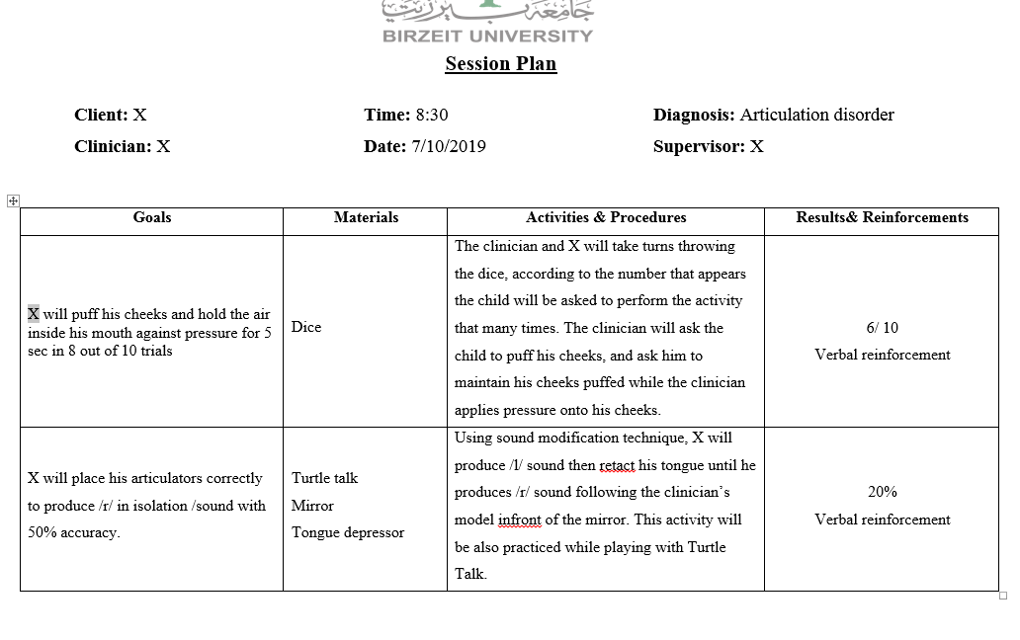
Example session Plan

Slide 19
Samples of well-written goals

Slide 20
Articulation
John will correctly imitate /s/ in isolation in 8 out of 10 attempts.
John will accurately self-correct 90% of the incorrect /s/ productions during reading.

Slide 21
Phonology
John will produce liquids in 90% of the appropriate contexts.
John will close syllables on spontaneously produced monosyllabic target words in 90% of his attempts.

Slide 22
Language
John will spontaneously name 20 of 25 pictures in a children’s dictionary.
John will appropriately use the pronouns “he” and “she” during conversation in 90% of his attempts.

Slide 23
Voice
John will produce appropriate oral resonance on v-c combinations in 90% of his attempts.
John will use appropriate pitch while producing /a/ in 8 out of 10 trials.

Slide 24
Fluency
John will speak with less than 0.5 stuttered words per minute during 5 minutes of spontaneous conversation with the clinician.
John will use pull-outs during all episodes of blocking while speaking on the telephone for 5 minutes.

Slide 25
Pragmatics
John will request (by pointing or using eye gaze) an object that is out of reach twice during a 10-minute period.
John will take 3 consecutive turns when a familiar joint action routine is initiated by the clinician.

Slide 26
Behavioral
John will sit without kicking for 5 minutes after the removal of constraints (clinician’s hands on client’s knees).
John will follow 8 out 10 directions within 2 seconds of initial presentation.

Slide 27
Documentation in Speech Therapy

Slide 28
Treatment plans
Once the assessment is complete, a treatment plan is established. This plan usually includes measurable objectives that client should achieve throughout the therapy period.
This is established before the beginning of therapy.

Slide 29
Treatment plan sections
Identifying information
Diagnostic summary
Goals and Objectives
Reinforcement plan
Family involvement

Slide 30
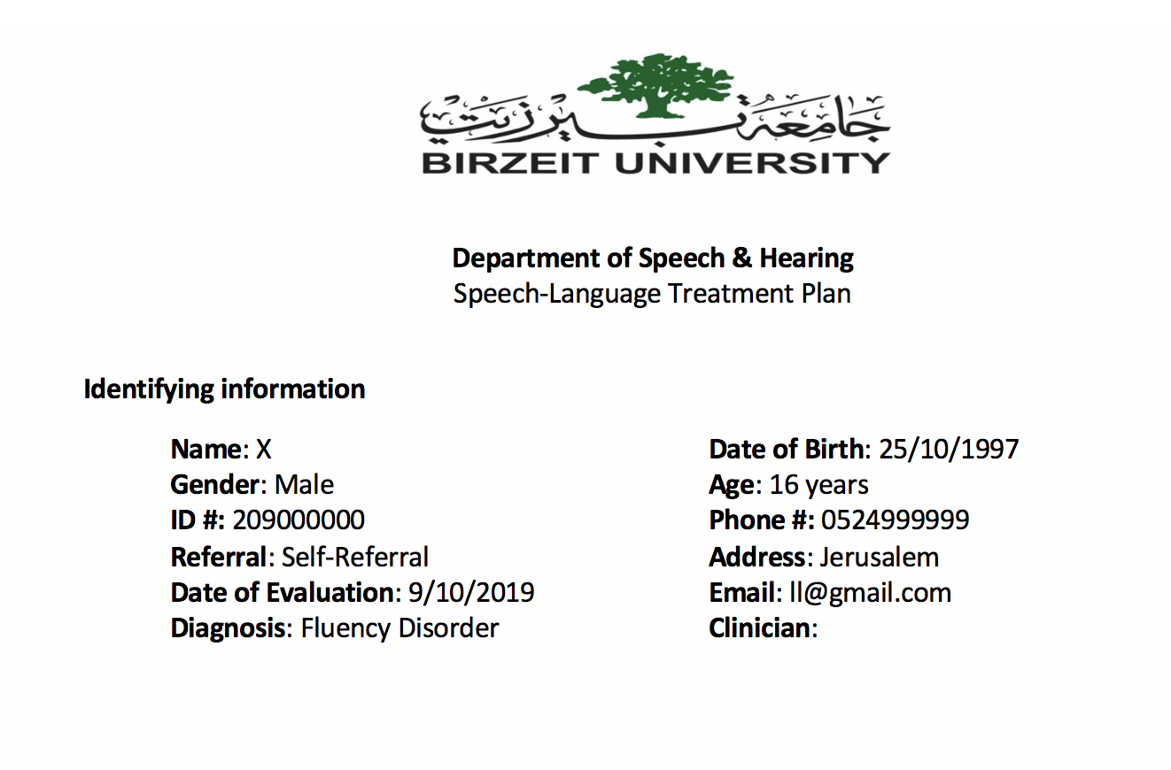
Identifying information

Slide 31
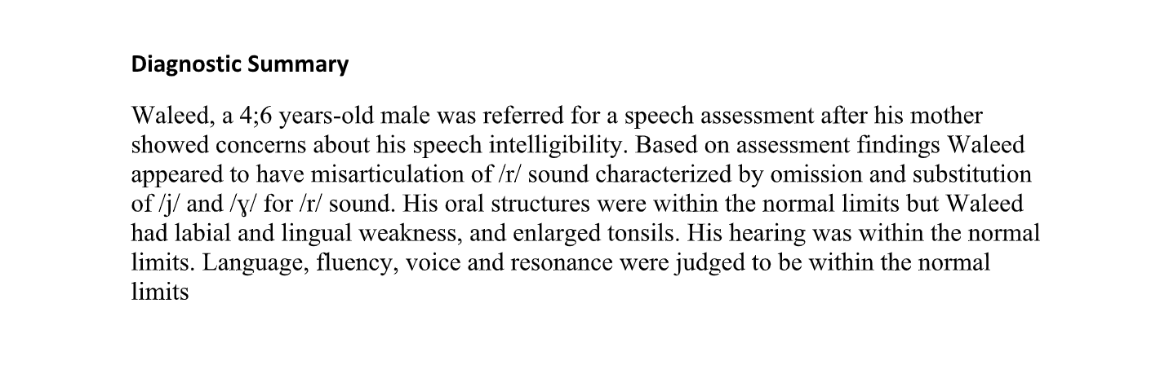
Diagnostic summary

Slide 32
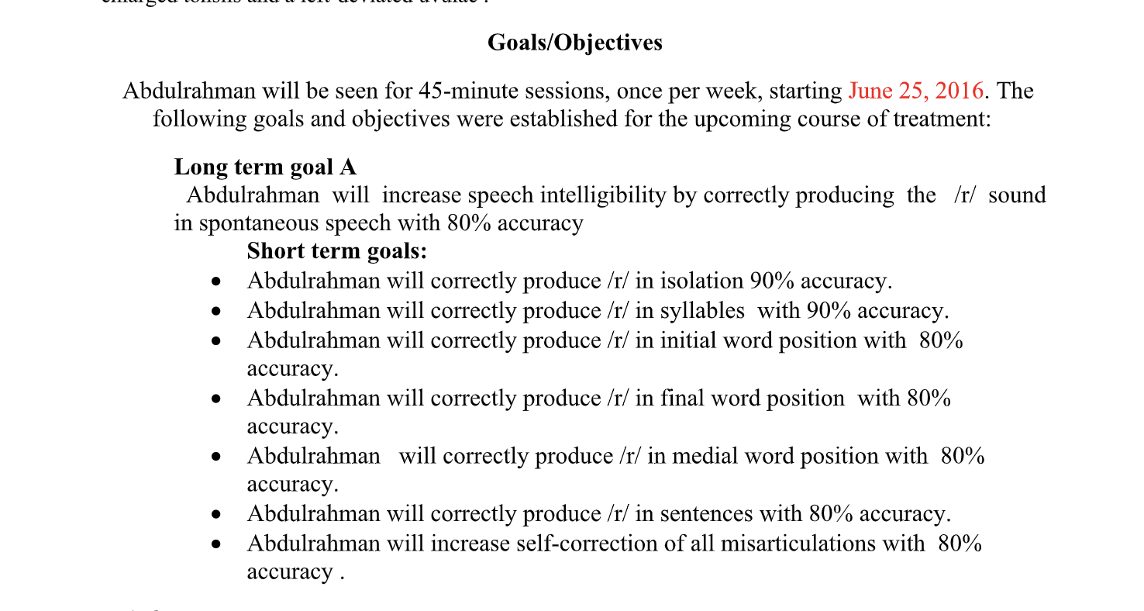
Goals and objectives

Slide 33
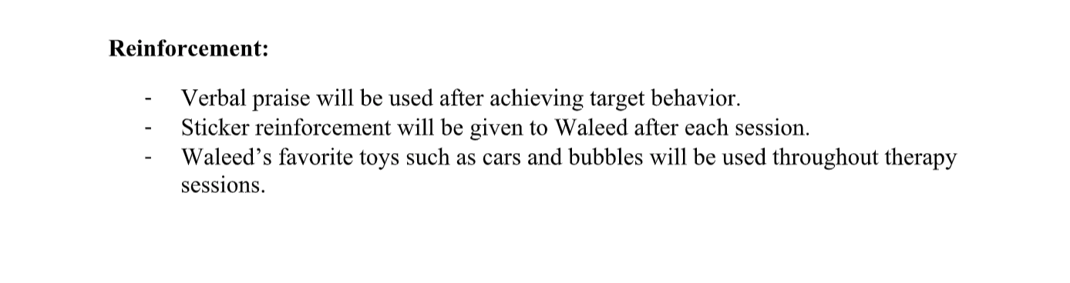
Reinforcement plan

Slide 34
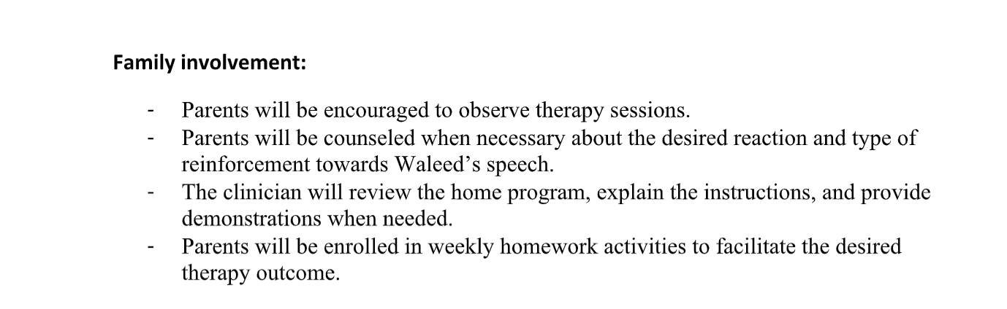
Family involvement

Slide 35
Progress report
These reports are written periodically to track the client’s progress through therapy.

Slide 36
Progress report sections
Identifying information
Diagnostic summary
Goals and Objectives ( achieved/not achieved)
Treatment procedures and activities
Current status
Recommendations

Slide 37
Progress report sections
Identifying information
Goals and Objectives ( achieved/not achieved)
Treatment procedures and activities
Current status
Recommendations

Slide 38
Identifying information
This will be a typical section. Similar to the identifying information section of the treatment plan.
You should add the date of treatment plan to this section (when did the treatment plan was developed).

Slide 39
Diagnostic summary
This is a section where the evaluation outcomes are summarize. It is the same “diagnostic summary” you write in the evaluation report.

Slide 40
Goals and Objectives
Two key information must be provided in this section :
start date of therapy, End/last date of therapy, frequency of therapy number of sessions given so far, length of sessions.
The long-term and short-term goals that are originally set for the clien, with a description of which ones were/were not achieved.

Slide 41
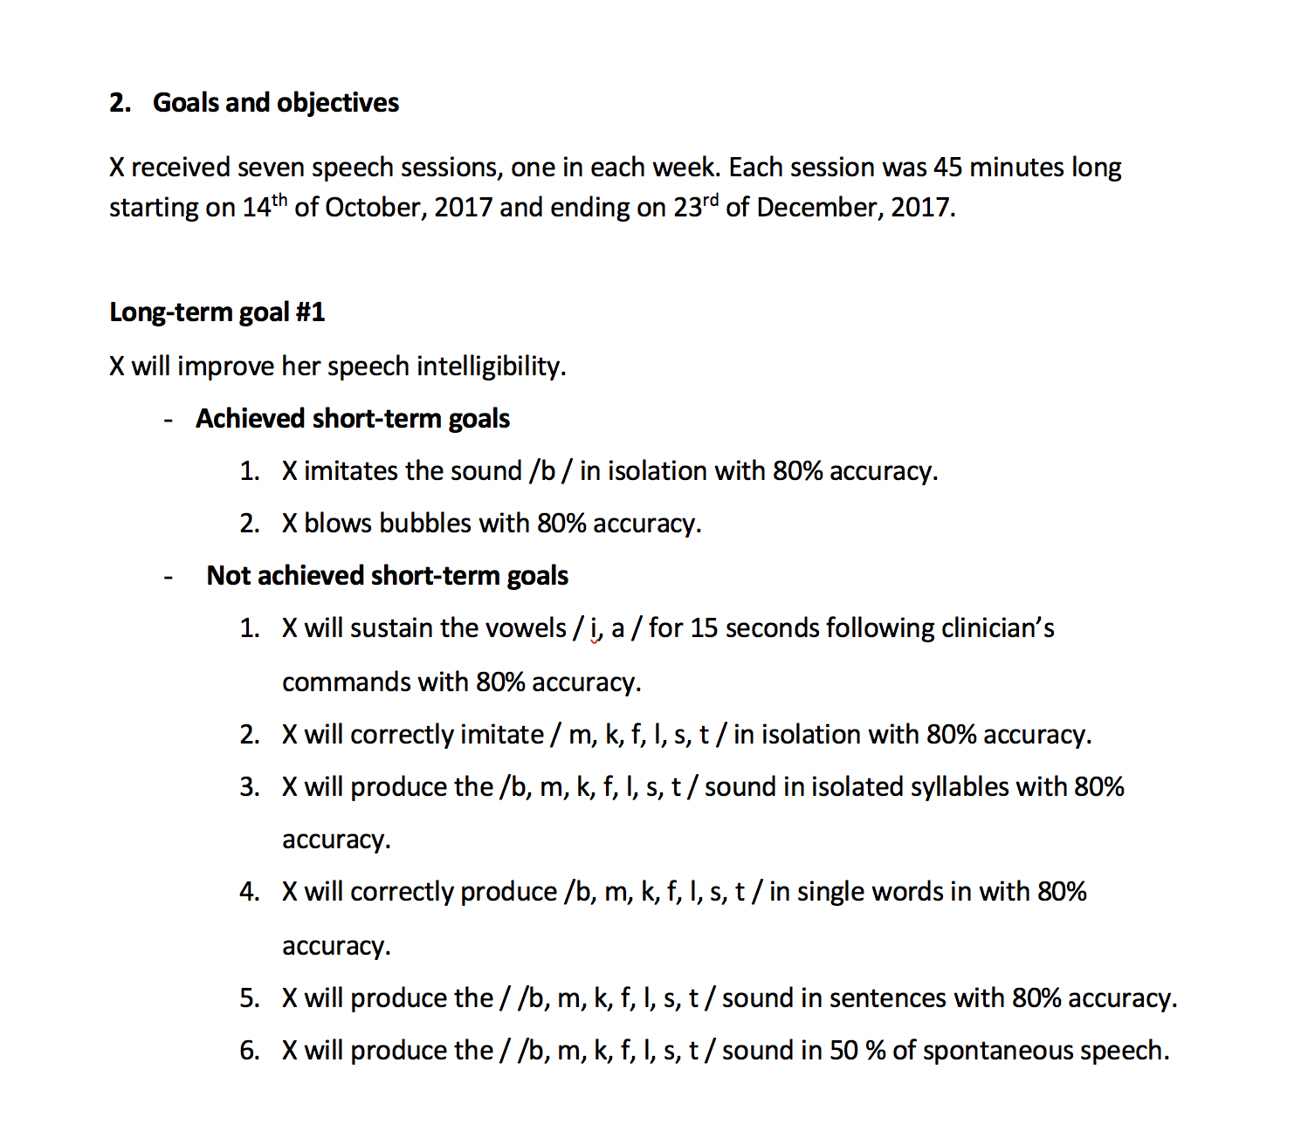
Goals and Objectives

Slide 42
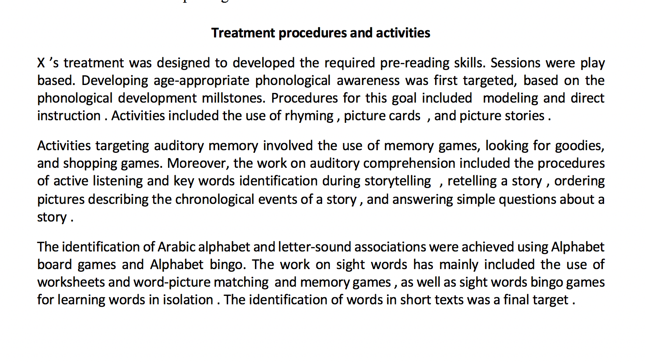
Treatment procedures and activities

Slide 43
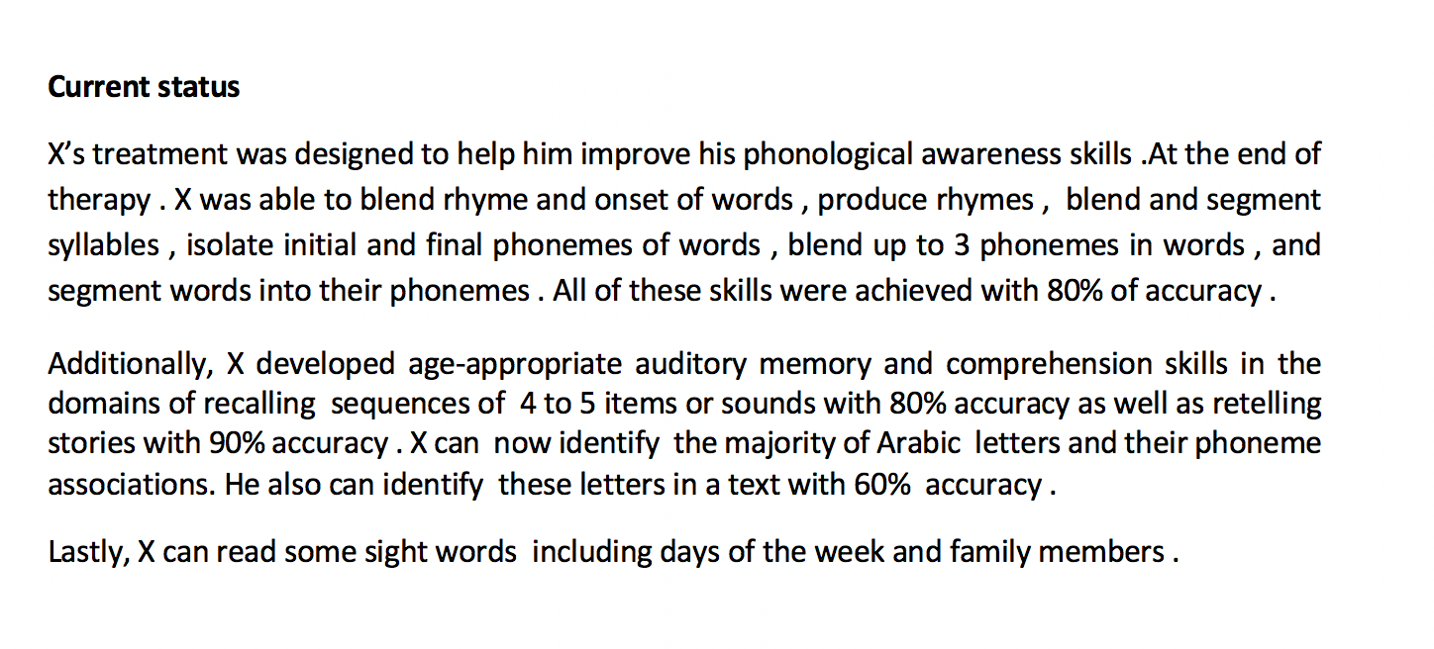
CURRENT STATUS

Slide 44
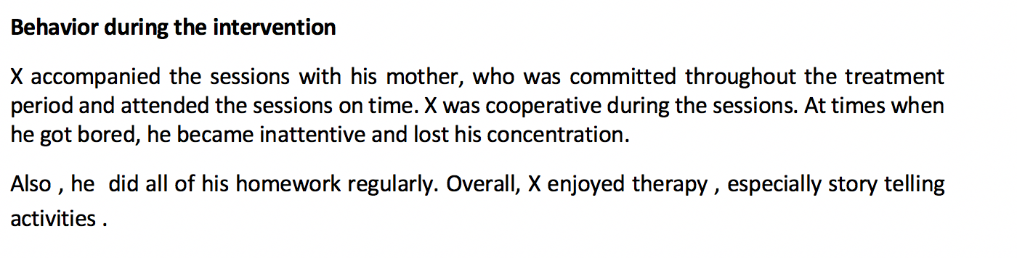
Behavior during intervention

Slide 45
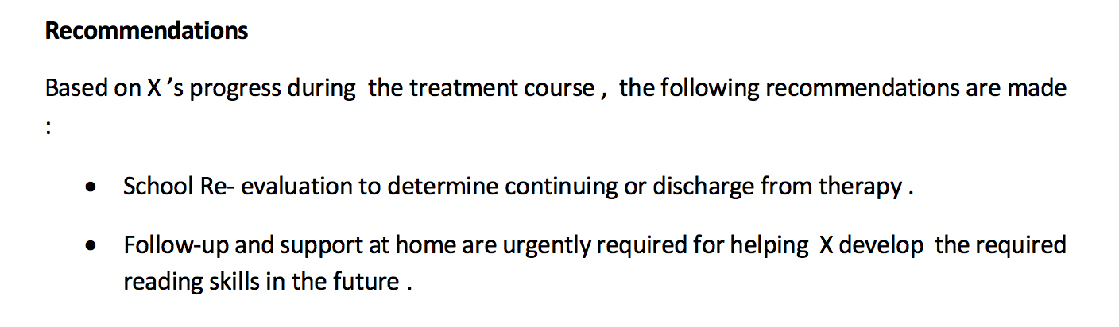
Recommendations

