Slide 1

MANAGERIAL ECONOMICS
14th Edition
© 2016 Cengage Learning
By
Mark Hirschey and Eric Bentzen

Slide 2
Demand Analysis
© 2016 Cengage Learning
Chapter 4

Slide 3
Chapter 4
OVERVIEW
Utility Theory
Indifference Curves
Budget Constraints
Individual Demand
Optimal Consumption
Demand Sensitivity Analysis: Elasticity
Price Elasticity of Demand
Price Elasticity and Marginal Revenue
Price Elasticity and Optimal Pricing Policy
Cross-price Elasticity of Demand
Income Elasticity of Demand
© 2016 Cengage Learning

Slide 4
Chapter 4
KEY CONCEPTS
utility
nonsatiation principle
indifference
ordinal utility
cardinal utility
utility function
utils
market baskets
marginal utility
law of diminishing marginal utility
indifference curves
substitutes
complements
perfect substitutes
perfect complements
budget constraint
income effect
substitution effect
price-consumption curve
income-consumption curve
Engle curve
normal goods
inferior goods
optimal market basket
revealed preference
marginal rate of substitution
consumption path
© 2016 Cengage Learning

Slide 5
Utility Theory
Assumptions About Consumer Preferences
  More is better.
  Consumers rank-order desirability of products.
Utility functions relate well-being to consumption.
Marginal utility shows added benefit of a small increase in consumption.
  Marginal utility is usually positive, MU>0.
Law of Diminishing Marginal Utility
  Marginal utility eventually declines for everything.
© 2016 Cengage Learning

Slide 6
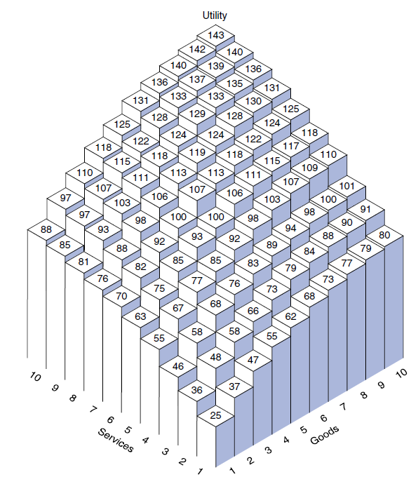
© 2016 Cengage Learning

Slide 7
Indifference Curves
Basic Characteristics
  Higher indifference curves are better.
  Indifference curves do not intersect.
  Indifference curves slope downward.
  Indifference curves are concave to origin.
Perfect substitutes are products that satisfy the same need, e.g., car models.
Perfect complements are products consumed together, e.g., cars and tires.
© 2016 Cengage Learning

Slide 8
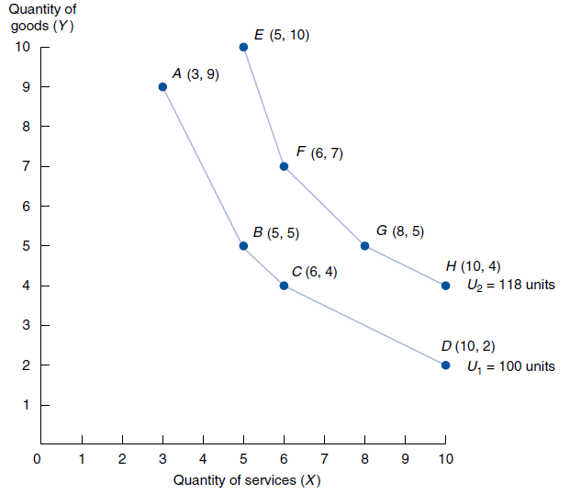
© 2016 Cengage Learning

Slide 9
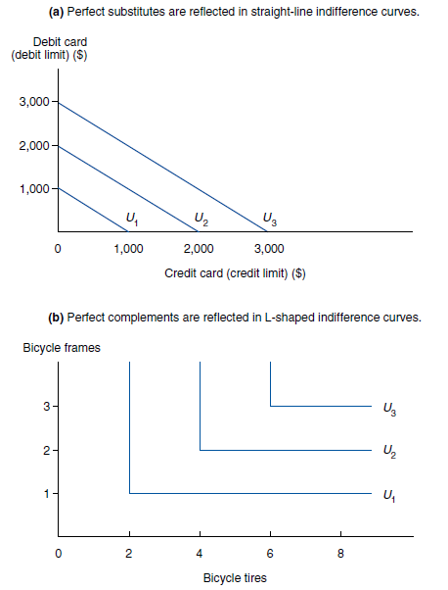
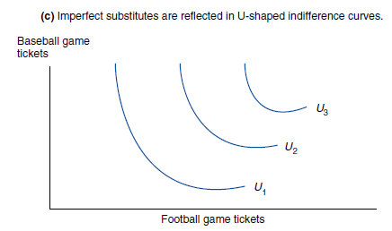
© 2016 Cengage Learning

Slide 10
Budget Constraints
Basic Characteristics
  Show affordable combinations of X and Y.
  Slope of –P_{X}/P_{Y} reflects relative prices.
Effects of Changing Income and Prices
  Budget increase (decrease) causes parallel outward (inward) shift.
  Relative price change alters budget slope.
Income and Substitution Effects
  Income effect changes overall consumption.
  Substitution effect alters relative consumption.
© 2016 Cengage Learning

Slide 11
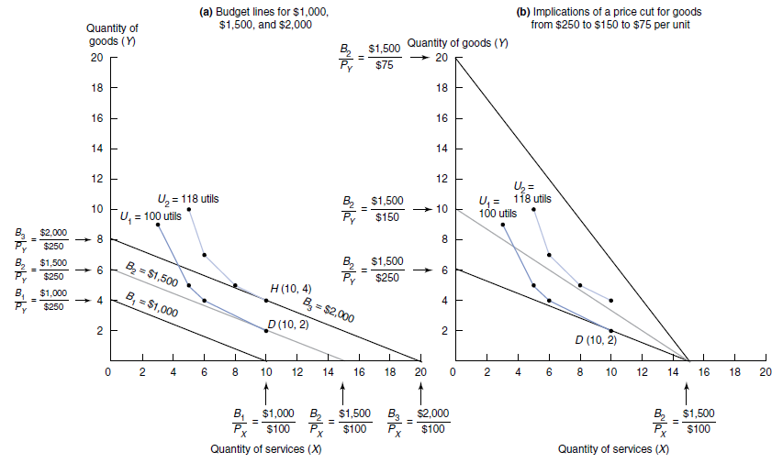
© 2016 Cengage Learning

Slide 12
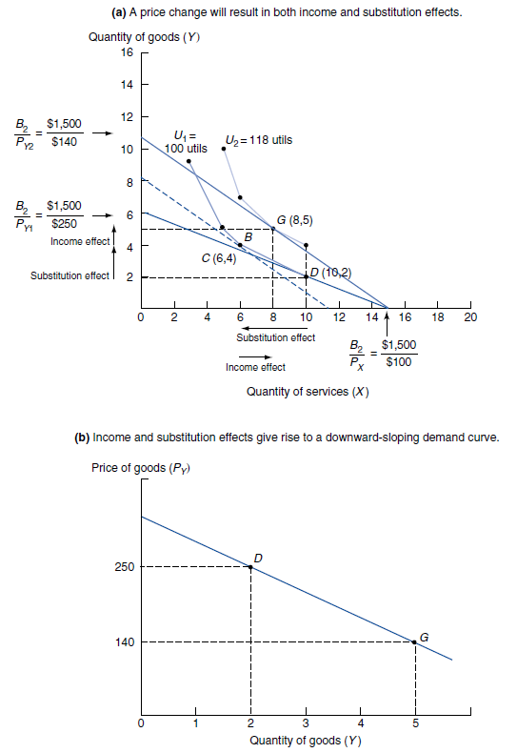
© 2016 Cengage Learning

Slide 13
Individual Demand
Price-consumption curve shows consumption impact of price changes.
  Reflects movement along demand curve.
Income-consumption curve shows consumption impact of income changes.
  Reflects shift from one demand curve to another.
Engle curves plot income and consumption.
  Normal good consumption rises with income.
  Inferior good consumption falls with income (rare).
© 2016 Cengage Learning

Slide 14
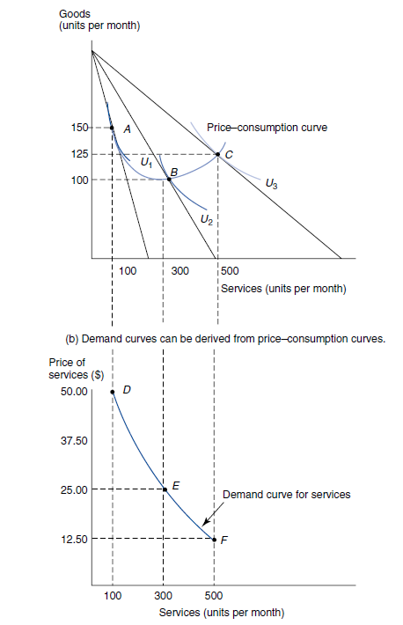
© 2016 Cengage Learning

Slide 15
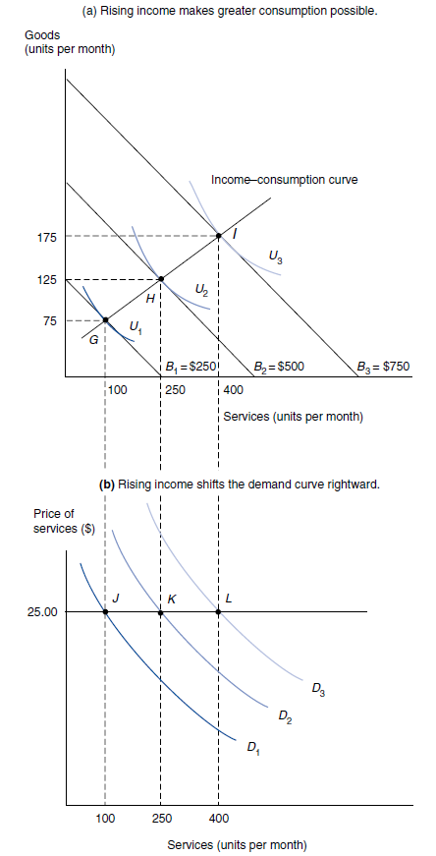
© 2016 Cengage Learning

Slide 16
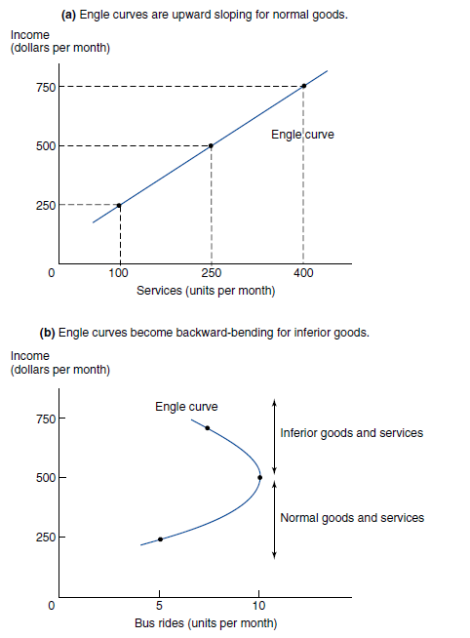
© 2016 Cengage Learning

Slide 17
Optimal Consumption
Marginal Rate of Substitution (MRS)
  MRS_{XY} = -MU_{X}/MU_{Y} and equals indifference curve slope.
  MRS_{XY} shows tradeoff between X and Y consumption, holding utility constant.
  MRS_{XY} diminishes as substitution of X for Y increases.
Utility maximization requires
  P_{X}/P_{Y} = MU_{X}/MU_{Y}, or
  MU_{X}/P_{X} = MU_{Y}/P_{Y}.
© 2016 Cengage Learning

Slide 18
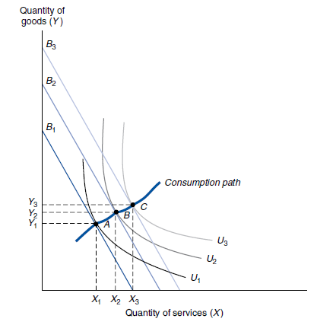
© 2016 Cengage Learning

Slide 19
Demand Sensitivity Analysis: Elasticity
Elasticity measures sensitivity.
Point elasticity shows sensitivity of Y to small changes in X.
  ε_{X} = ∂Y/Y ÷ ∂X/X.
Arc elasticity shows sensitivity of Y to big changes in X.
  E_{X} = (Y₂–Y₁)/(Y₂+Y₁) ÷ (X₂-X₁)/(X₂+X₁).
© 2016 Cengage Learning

Slide 20
Price Elasticity of Demand
Price Elasticity Formula
  Point price elasticity,
  ε_{P} = (∂Q/Q)/( ∂P/P)
  In all cases, ε_{P} < 0 .
Price Elasticity and Total Revenue
  Price cut increases revenue if │ε_{P}│> 1.
  Revenue constant if │ε_{P}│= 1.
  Price cut decreases revenue if │ε_{P}│< 1.
© 2016 Cengage Learning

Slide 21
Price Elasticity and Marginal Revenue
Elasticity Varies along Demand Curve
  As price rises, so too does │ε_{P}│.
  As price falls, so too does│ε_{P}│.
Price Elasticity and Price Changes
  MR > 0 if │ε_{P}│> 1.
  MR = 0 if │ε_{P}│= 1.
  MR < 0 if │ε_{P}│< 1.
© 2016 Cengage Learning

Slide 22
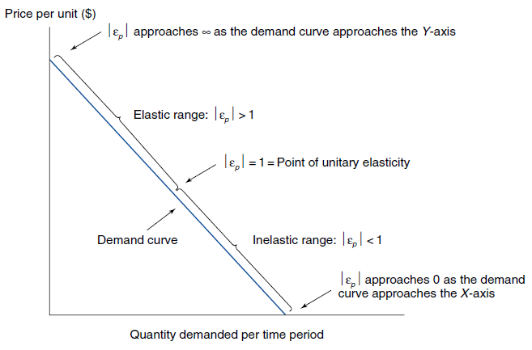



© 2016 Cengage Learning

Slide 23


If P = 14.3 – 0.05Q
Q = 286 – 20P

Slide 24
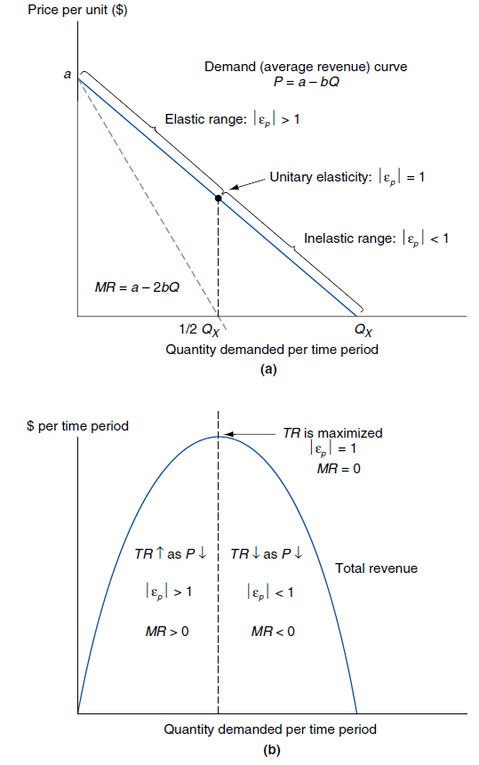

© 2016 Cengage Learning

Slide 25
Price Elasticity and Optimal Pricing Policy
Optimal Price Formula
  MR and ε_{P} are directly related.
  MR = P X [1+(1/ ε_{P})].
  Optimal P* = MC/[1+(1/ ε_{P})].
Determinants of Price Elasticity
  Essential goods have low│ε_{P}│.
  Nonessential goods have high│ε_{P}│.
© 2016 Cengage Learning

Slide 26
Cross-price Elasticity of Demand
Cross-price elasticity shows demand sensitivity to changes in other prices.
  ε_{PX} = (∂Q_{Y}/Q_{Y} )/( ∂P_{X}/P_{X})
Substitutes have ε_{PX} > 0.
  E.g., Coke demand and Pepsi prices.
Complements have ε_{PX} < 0.
  E.g., Coke demand and Fritos prices.
Independent goods have ε_{PX} = 0.
  E.g., Coke demand and car prices.
© 2016 Cengage Learning

Slide 27
Income Elasticity of Demand
Income elasticity shows demand sensitivity to changes in income.
  ε_{I} = (∂Q/Q)/( ∂I/I)
Normal goods have ε_{I} > 0.
  Noncyclical normal goods have 0 < ε_{I} < 1, e.g., candy.
  Cyclical normal goods have ε_{I} > 1, e.g., housing.
Inferior goods have ε_{I} < 0.
  Very rare.
© 2016 Cengage Learning

