Slide 1
Fluid Mechanics ME 335 Afif Hasan Mechanical engineering
PUMPS

Slide 2
Outline
Pump types
Specifications
Performance curves
Operating point
Pump selection
Affinity laws
Connecting pumps

Slide 3
Function
Function: Fluids are moved by pumps, fans, blowers, and compressors. These use work to increase the mechanical energy of a fluid, which in turn can increase the flow rate (velocity), pressure, or elevation of the fluid.
Liquids are typically moved by pumps. Gases are moved by fans (large volume, small pressure difference), blowers (large volume, moderate pressure difference), or compressors (large pressure differences). Specialized equipment is also used to produce vacuums in process systems.

Slide 4
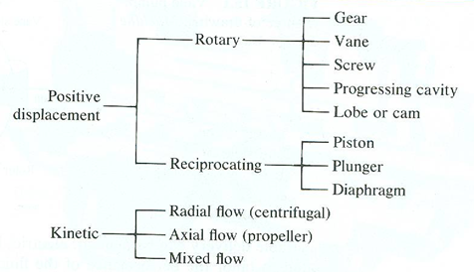
Pumps types

Slide 5
Reciprocating pumps
Positive displacement pumps operate by trapping a fixed volume of liquid then releasing it to a higher pressure by means of a piston or rotary gear.
Reciprocating pumps use a piston, plunger, or diaphragm to raise the pressure of a liquid.
The pumping chambers are surrounded by one-way valves so that liquid can only move in from the low pressure side and out from the high pressure side.
They are classed as "single acting" if fluid is moved only on the down stroke, or "double acting" if fluid is moved by both sides of the piston.

Slide 6

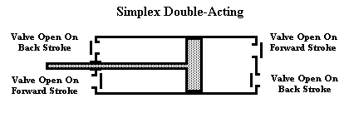
Reciprocating pump
Because of the mechanism, these pumps produce a pulsating flow; but since flow is independent of head, they can be used to produce large pressure changes.
Reciprocating pumps are best for low volume, high head applications (up to 50000 psi). They cannot be used when pulsating flow is a problem.

Slide 7
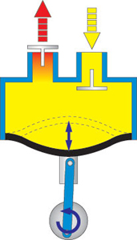
Diaphragm pumps
Diaphragm pumps are a sub-class of reciprocating pump.
The pumping chamber is separated from the moving parts by a flexible diaphragm.
Their chief advantage is that the fluid being pumped never comes in contact with the mechanism and eliminates leakage; thus they are good for toxic or very expensive liquids.
They cannot produce large head differences.
advantage is that the fluid being pumped never comes in contact with the mechanism and eliminates leakage; thus they are good for toxic or very expensive liquids.

Slide 8
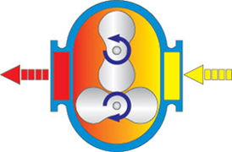
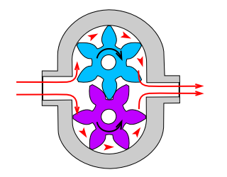
Rotary pumps
Rotary pumps use a gear, lobe, screw, cam, or vane to compress liquid.
Liquid enters through a gap between the rotating element and pump wall at a low pressure where it is trapped.
Then, as the element rotates, it squeezes the liquid out through a one-way valve on the opposite side of the casing.
Typically, rotary pumps are used in high head, low flow applications. They are good for high viscosity and low vapor pressure fluids.
The fluid pumped must be "lubricating"; solids cannot be present.

Slide 9
Rotary pumps
Positive displacement rotary pumps also have their weaknesses.
Because of the nature of the pump, the clearance between the rotating pump and the outer edge must be very close, requiring that the pumps rotate at a slow, steady speed.
If rotary pumps are operated at high speeds, the fluids will cause erosion.

Slide 10
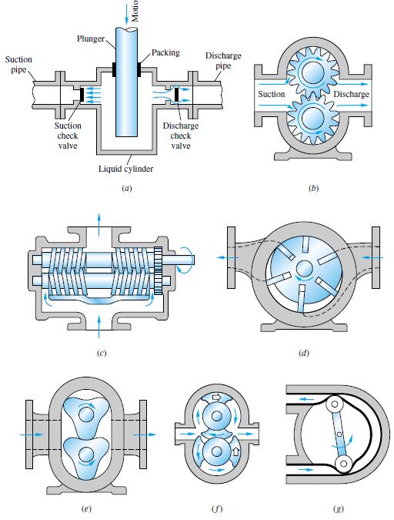
Schematic design of positive-
displacement pumps: (a) reciprocating
piston or plunger,
(b) External gear pump,
(c) double-screw pump,
(d) sliding vane,
(e) Three-lobe pump,
( f ) double circumferential
piston,
(g) flexible-tube squeegee.

Slide 11
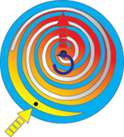
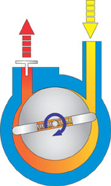
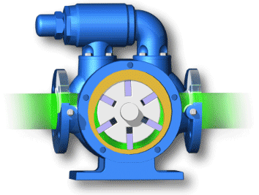
Vane pump Scroll pump

Slide 12
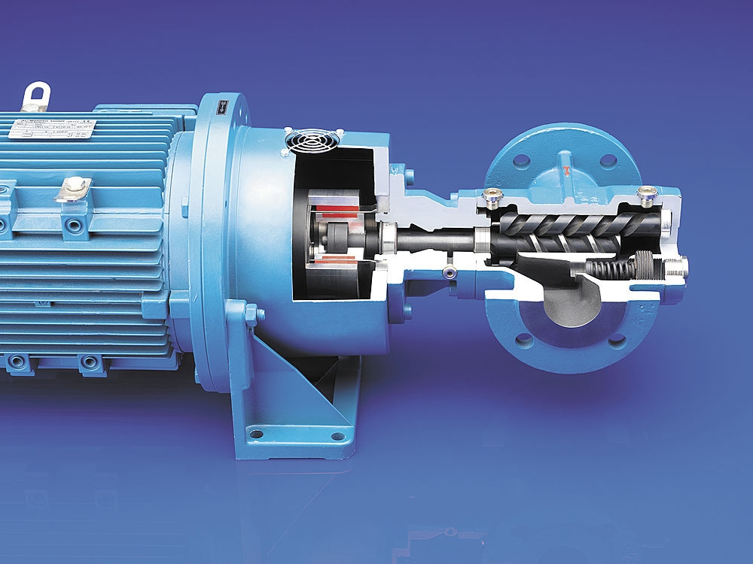
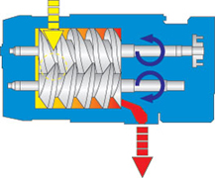
Screw pump

Slide 13
Kinetic energy pumps
Axial
Radial
Mixed

Slide 14
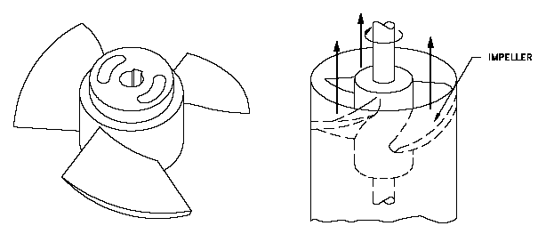
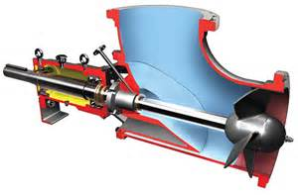
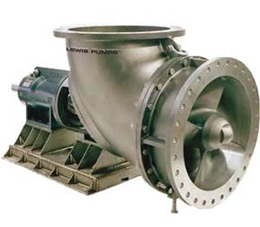
Axial pump
Axial flow pumps differ from radial flow in that the fluid enters and exits along the same direction parallel to the rotating shaft.
Axial flow pumps operate at much lower pressures and higher flow rates than radial flow pumps.

Slide 15
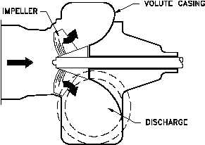
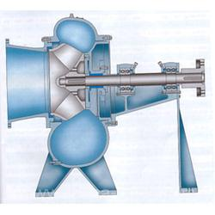
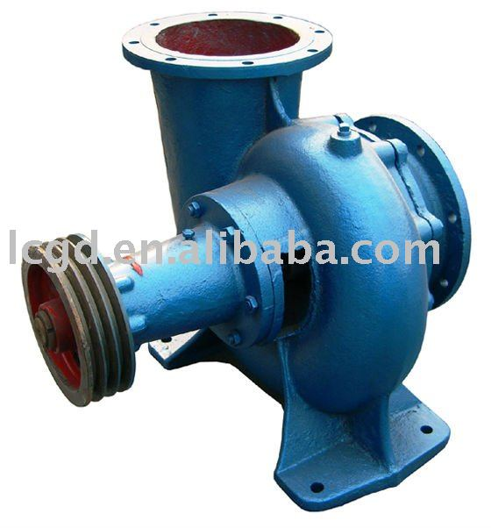
Mixed flow pumps
Mixed flow pumps, as the name suggests, function as a compromise between radial and axial flow pumps, the fluid experiences both radial acceleration and lift and exits the impeller somewhere between 0-90 degrees from the axial direction.
As a consequence mixed flow pumps operate at higher pressures than axial flow pumps while delivering higher discharges than radial flow pumps

Slide 16
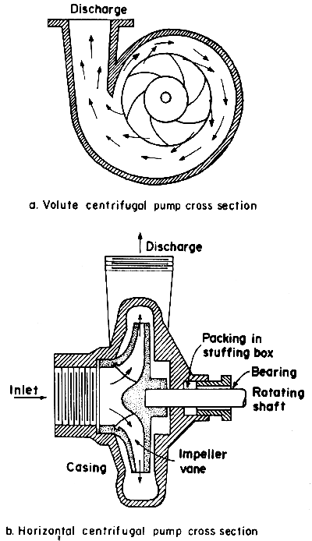
Centrifugal pump
A centrifugal pump increases liquid pressure by increasing its velocity by means of a rotating impeller.
Liquid enters at the center of the impeller, is accelerated by the impeller vanes, and leaves through the side of the pump casing. Changing direction by 90º

Slide 17
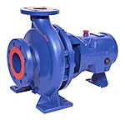
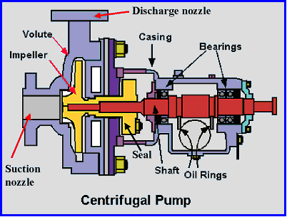
Centrifugal pump

Slide 18
Pumps Specifications
Pumps are commonly rated by horsepower, flow rate, outlet pressure in feet (or metres) of head, inlet suction in suction feet (or metres) of head.
The performance of a centrifugal pump can be shown graphically on a characteristic curve. A typical characteristic curve shows the total dynamic head, brake horsepower, efficiency, and net positive Suction head all plotted over the capacity range of the pump.

Slide 19
Head
"Head" is just a way of expressing pressure -- specifically, in terms of the height of a column of liquid that would produce the same pressure.
The main reason for using head instead of pressure to measure a centrifugal pump's energy is that the pressure from a pump will change if the specific gravity (weight) of the liquid changes, but the head will not change. Since any given centrifugal pump can move a lot of different fluids, with different specific gravities, it is simpler to discuss the pump's head and forget about the pressure.

Slide 20
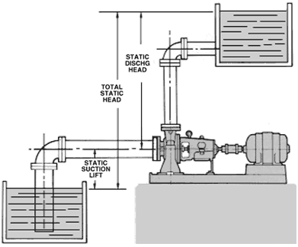
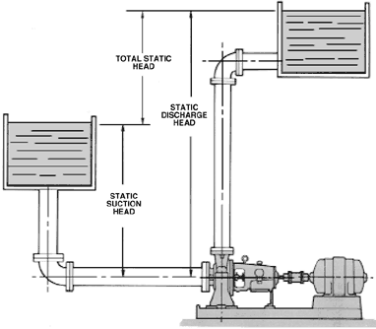
Head
STATIC DISCHARGE HEAD is the vertical distance in feet between the pump centerline and the point of free discharge or the surface of the liquid in the discharge tank.
TOTAL STATIC HEAD is the vertical distance in feet between the free level of the source of supply and the point of free discharge or the free surface of the discharge liquid.

Slide 21
Friction head
FRICTION HEAD (h_{f}) is the head required to overcome the resistance to flow in the pipe and fittings. It is dependent upon the size, condition and type of pipe, number and type of pipe fittings, flow rate, and nature of the liquid.
h_{f} = (L/d)(V² /g) f

Slide 22
Capacity
Capacity means the flow rate with which liquid is moved or pushed by the pump to the desired point in the process.
It is commonly measured in either gallons per minute (gpm) or cubic meters per hour (m³/hr), or liter per minute ( l/min).

Slide 23
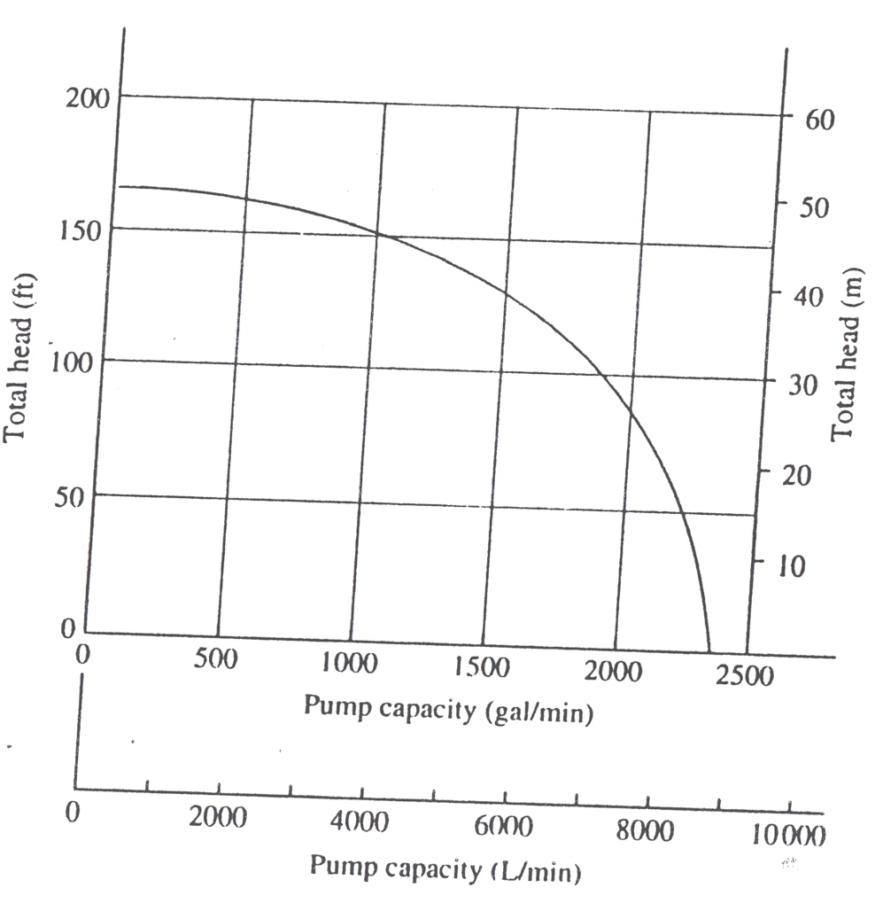
H- Q curve

Slide 24
Power
The power added to the fluid flow by the pump (Po), is defined using SI units by:
where:
Po is the output power of the pump (W)
ρ is the fluid density (kg/m³)
g is the gravitational constant (9.81 m/s²)
H is the energy Head added to the flow (m)
Q is the flow rate (m³/s)

Slide 25
Power
Power is more commonly expressed as kW (10³ W) or horsepower (multiply kW by 0.746),
hp is equivalent to the pressure head added by the pump when the suction and discharge pipes are of the same diameter.
The power required to drive the pump is determined by dividing the output power by the pump efficiency.

Slide 26
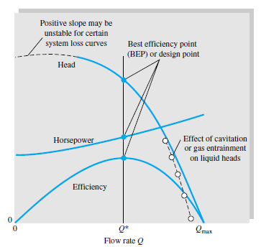
Typical centrifugal pump curves

Slide 27
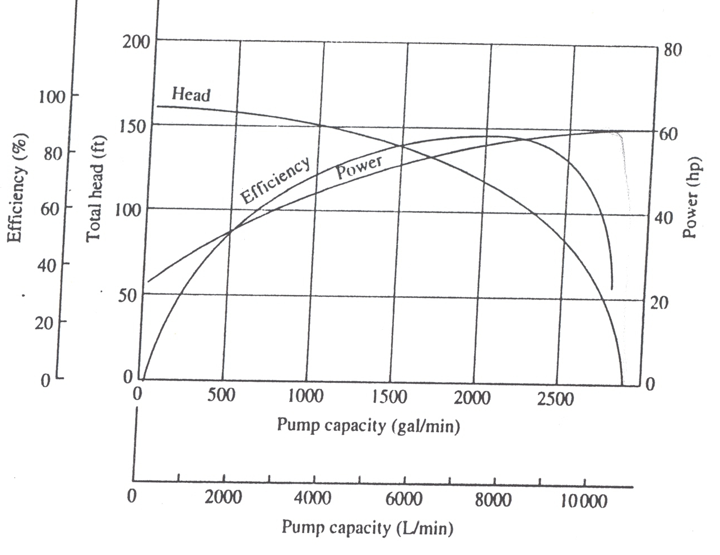
Power, efficiency, head curves

Slide 28
Pump driver
All pumps must have a driver to supply power.
Typically, drivers are electric motors , gas/Petrol/ Diesel engines may be used in remote locations.
As a general rule, motors are single speed devices -- variable speed motor drivers are expensive.

Slide 29
Pump efficiency
Pump efficiency is defined as the ratio of the power imparted on the fluid by the pump in relation to the power supplied to drive the pump.
Its value is not fixed for a given pump, efficiency is a function of the discharge and therefore also operating head.
For centrifugal pumps, the efficiency tends to increase with flow rate up to a point midway through the operating range (peak efficiency) and then declines as flow rates rise further

Slide 30
Power, efficiency, head curves

Slide 31
Net Positive Suction Head
Net Positive Suction Head Available is a function of the system in which the pump operates.
It is the excess pressure of the liquid in feet absolute over its vapor pressure as it arrives at the pump suction,
to be sure that the pump selected does not cavitate. It is calculated based on system or process conditions.
NPSH as the total suction head in feet absolute, determined at the suction nozzle and corrected to datum, less the vapor pressure of the liquid in feet absolute.

Slide 32
Net Positive Suction Head - NPSH
Net Positive Suction Head - NPSH
The Net Positive Suction Head - NPSH - can be expressed as the difference between the Suction Head, and the Liquids Vapor Head as
NPSH = h_{s} - h_{v} (3)
NPSH = [p_{s} / γ + v_{s}² / 2 g] - p_{v} / γ (3b)
Where NPSH = Net Positive Suction Head (m, in)
where pi and Vi are the pressure and velocity at the pump inlet and pv is the vapor pressure of the liquid.

Slide 33
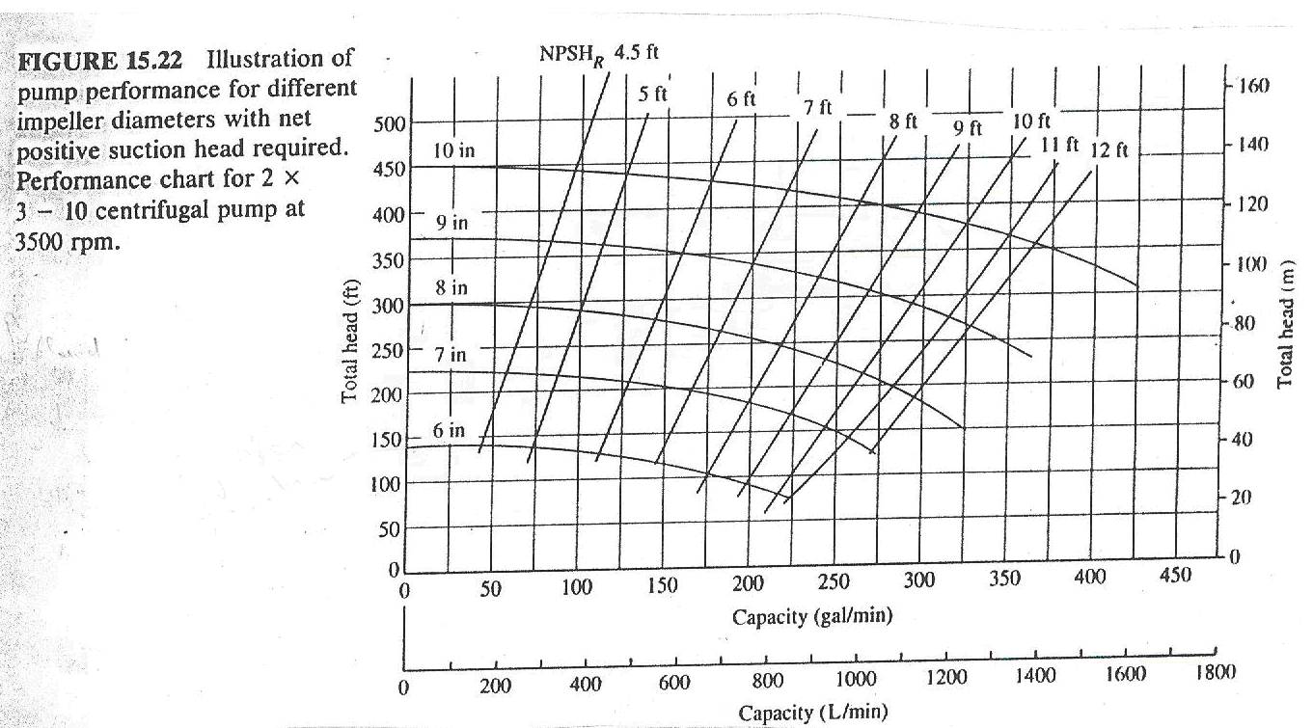
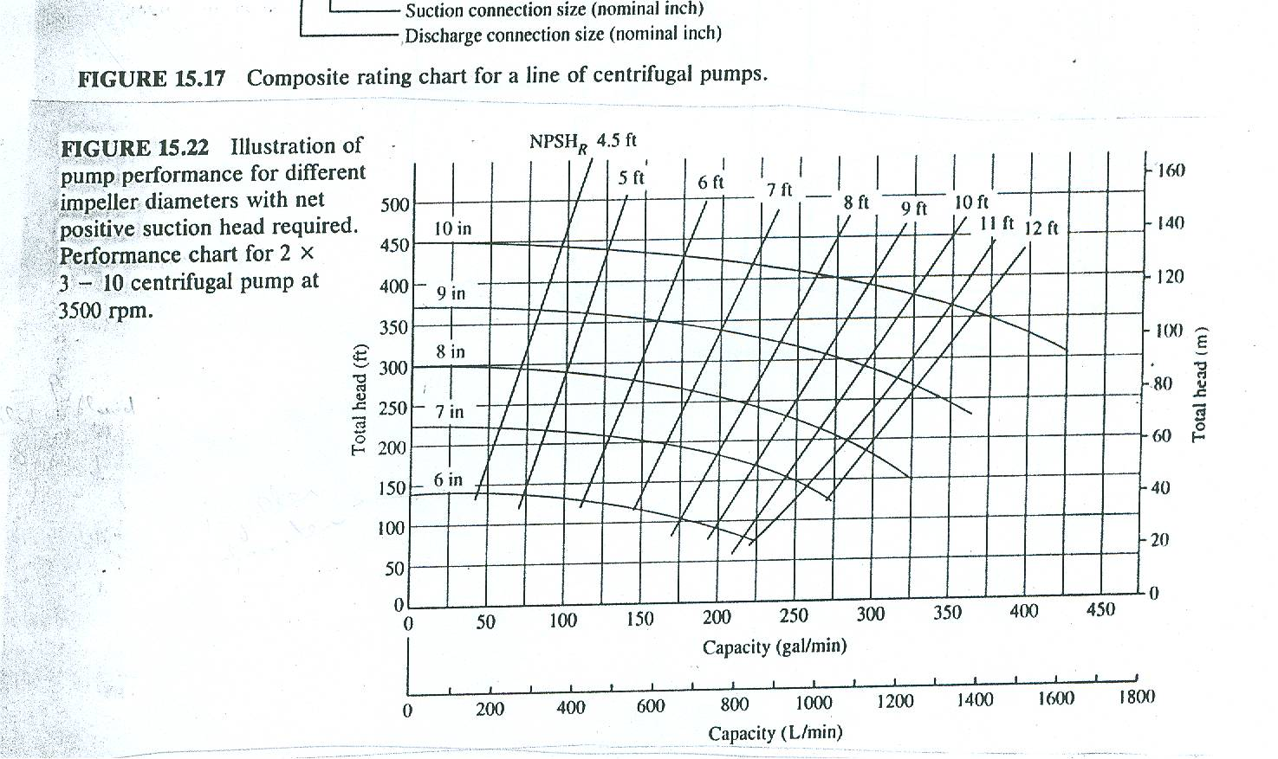
Net Positive Suction Head

Slide 34
Net Positive Suction Head
Fig. 11.7 Measured-performance curves for two models of a centrifugal water pump: (a) basic casing with three impeller sizes

Slide 35
Net Positive Suction Head
Measured-performance curves for two models of a centrifugal water pump: (b) 20 percent larger casing with three larger impellers at slower speed.

Slide 36
EXAMPLE 11.2 p. 727 White
The 32-in pump of Fig. 11.7a is to pump 24,000 gal/min of water at 1170 r/min from a reservoir whose surface is at 14.7 lbf/in2 absolute. If head loss from reservoir to pump inlet is 6 ft, where should the pump inlet be placed to avoid cavitation for water at (a) 60°F, pv= 0.26 lbf/in2 absolute, SG =1.0 and (b) 200°F, pv =11.52 lbf/in2 absolute, SG= 0.9635?
If the pump inlet is placed at a height Zi above a reservoir whose free surface is at pressure pa, we can use energy equation to rewrite NPSH as
(P1/Ɣ) +z1 +(V₁² /2g) = (P_{B}/Ɣ) +z_{B} +(V_{B}² /2g) + h_{f}
(Pa/Ɣ) = (P_{i}/Ɣ) +z_{i} +(V_{i}² /2g) + h_{fi}

Slide 37
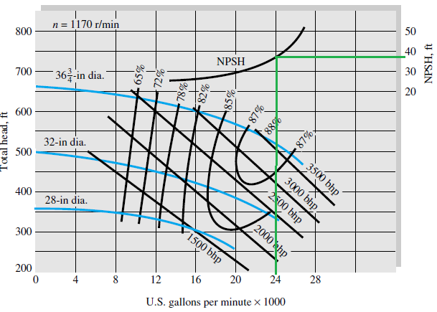
EXAMPLE 11.2 p. 727 White
For either case read from Fig. 11.7a at 24,000 gal/min that the required NPSH is 40 ft. For this case gama = 62.4 lbf/ft3.
The pump must be placed at least 12.7 ft below the reservoir surface to avoid cavitation.

Slide 38
EXAMPLE 11.2 p. 727 White
B) At 200F Pv=11.52psi for this case ɣ= 62.4(0.9635)= 60.1 lbf/ft3. Equation (11.20) applies again with the higher p.

Slide 39
Operating point
The operating point is at the intersection of the system curve and pump curve.
The point where the pump operates on its curve is dependent upon the characteristics of the system in which it is operating, commonly called the System Head Curve
This representation is in a graphic form and, since friction losses vary as a square of the flow rate, the system curve is parabolic in shape;
(P1/Ɣ) +z1 +(V₁² /2g) = (P_{B}/Ɣ) +z_{B} +(V_{B}² /2g) + h_{f} + h_{minor} + hp

Slide 40
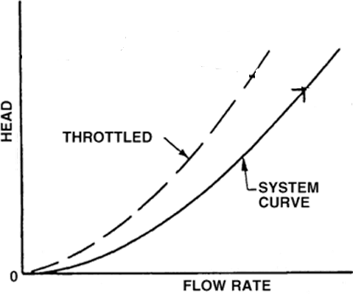
System curve
(P1/Ɣ) +z1 +(V₁² /2g) = (P_{B}/Ɣ) +z_{B} +(V_{B}² /2g) + h_{f} + h_{minor} + hp
If P1 =P2 = Atmospheric and V1 =V2
h_{p} = ∆z + C1 V²/2g
h_{p} = ∆ z + C2 Q²
^{Since}
^{V= 4 Q/d2*π}

Slide 41
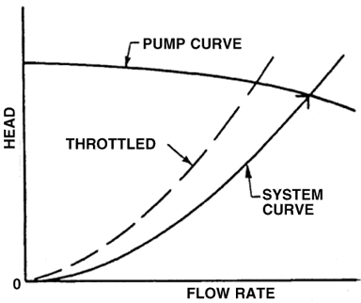
System head curve
The flow rate can be reduced by throttling the discharge valve.
Hence hf will increase.

Slide 42
Operating point

Slide 43
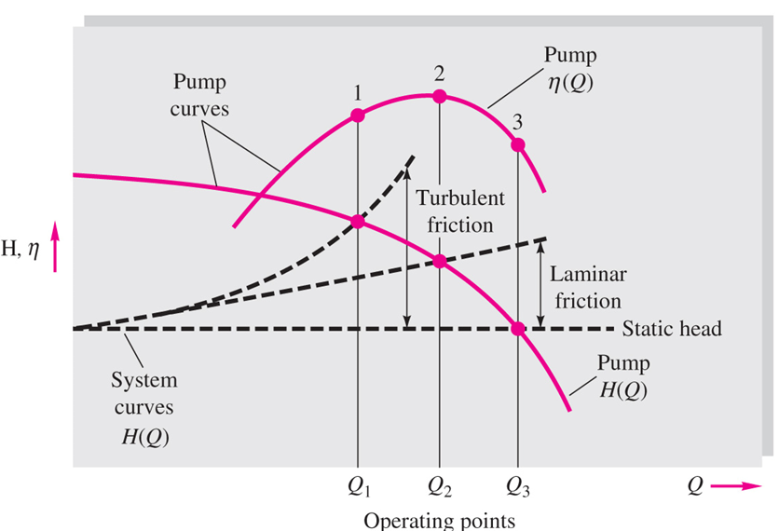
Fig. 11.17 Illustration of pump operating points for three types of
system-head curves.

Slide 44
Matching Pumps to System Characteristics
The ultimate test of a pump is its match with the operating-system characteristics.
Physically, the system head must match the head produced by the pump, and this intersection should occur in the region of best efficiency.

Slide 45
EXAMPLE 11.6
We want to use the 32-in pump of Fig. 11.7a at 1170 r/min to pump water at 60°F from one reservoir to another 120 ft higher through 1500 ft of 16-in-ID pipe with friction factor f = 0.030.
(a) What will the operating point and efficiency be?
For reservoirs the initial and final velocities are zero; thus the system head is

Slide 46

EXAMPLE 11.6
plot Eq. (2) on Fig. 11.7a and see where it intersects the 32-in pump-head curve, as in Fig. E11.6. A graphical solution gives approximately
H= 430 ft , Q= 15,000 gal/min
An analytic solution is possible if we fit the pump-head curve to a parabola;
at the operating point

Slide 47
Example pump selection

Slide 49
Selecting a pump
When selecting a pump, consider the following factors;
Nature of liquid (viscosity, toxicity, slurry containing solids etc)
Required capacity ( flow , discharge or Q)
Required total head , hp
Suction conditions
Discharge conditions
Types of power supply ( electricity AC/DC, mechanical , )
Cost of pump and operation.

Slide 50
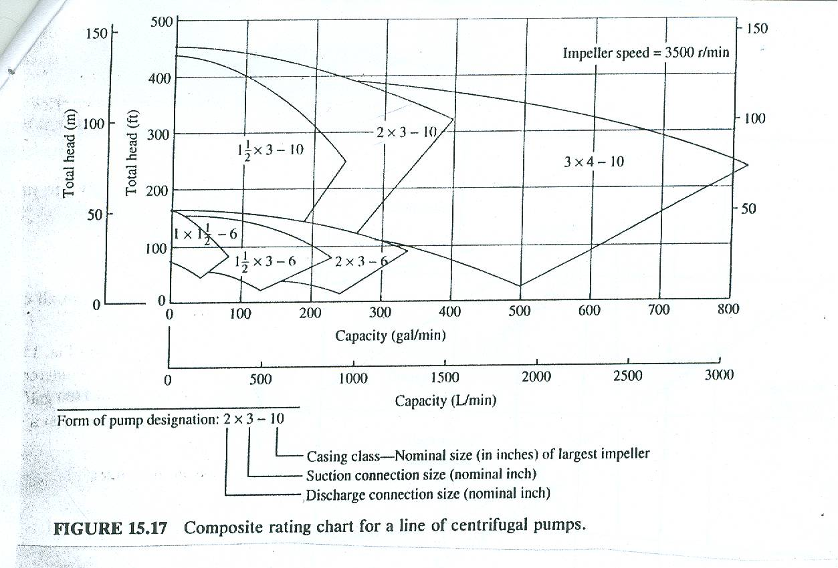
Selecting a pump
Pump is selected for specific application based on the pump head, hp; the flow rate, Q and taken into consideration NPSH

Slide 51
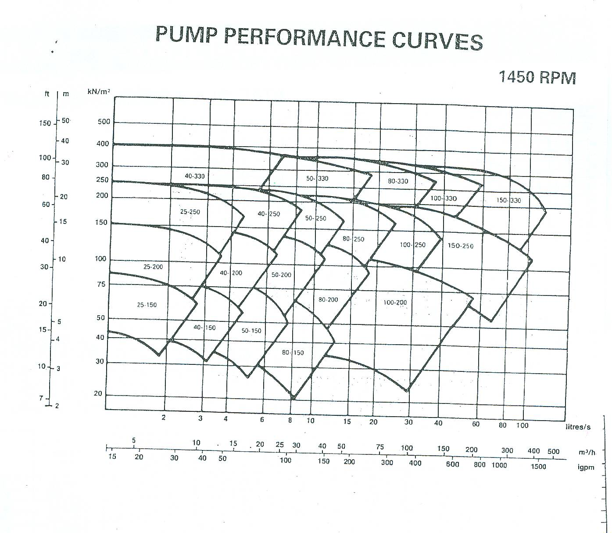

Slide 52
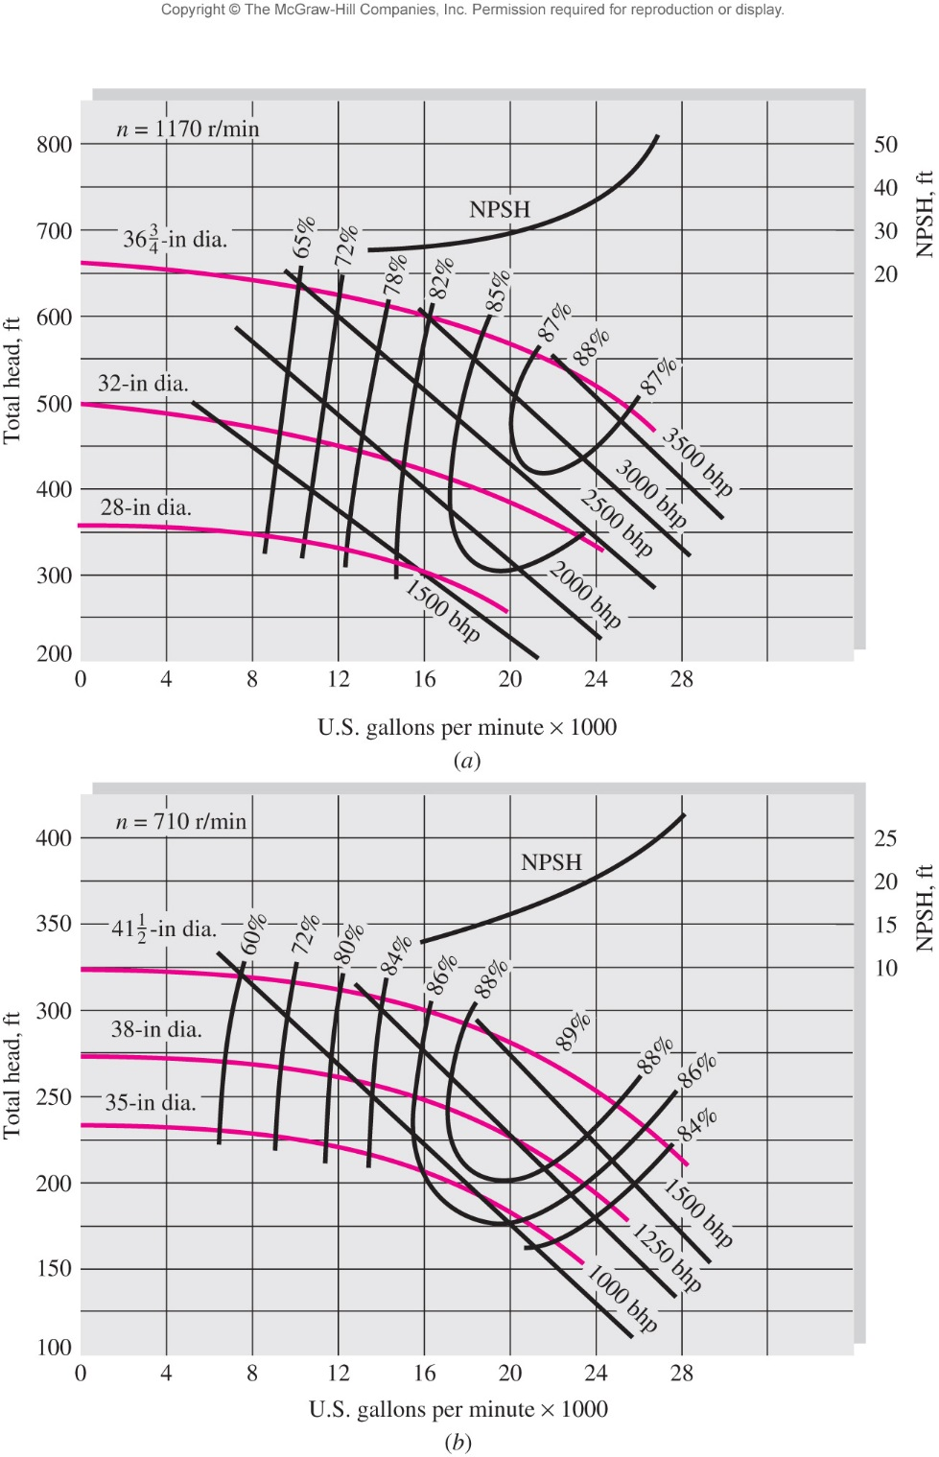

Slide 53
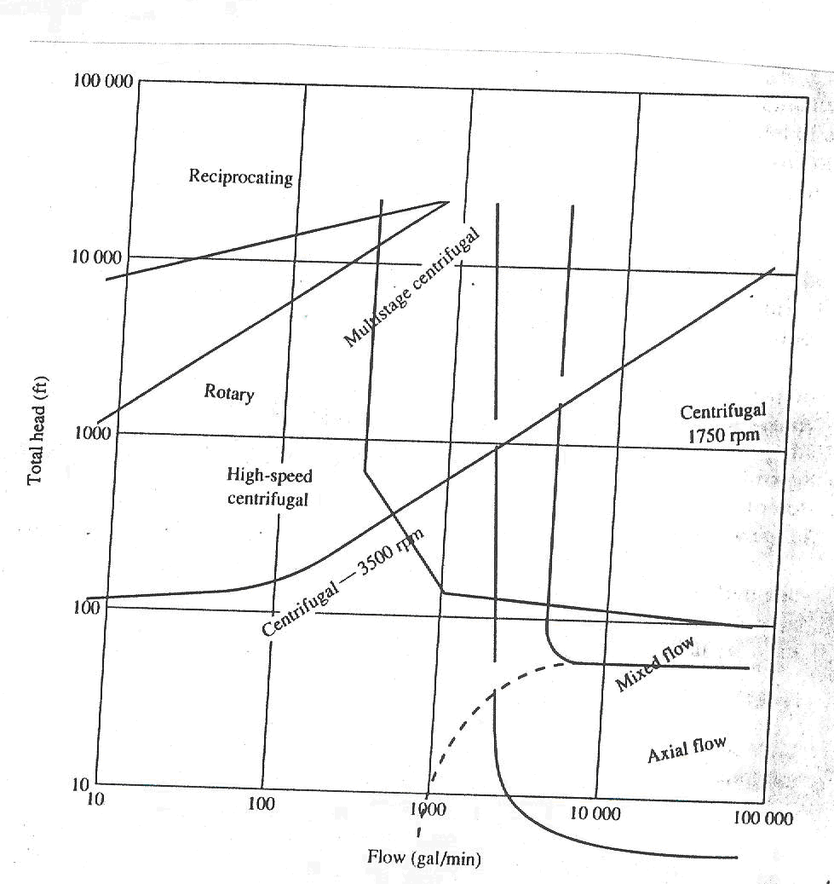
Selecting type of pump

Slide 54
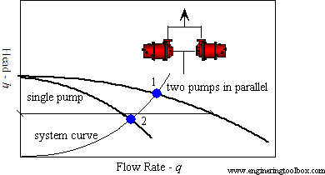
Pumps in parallel
Two or more pumps are arranged in parallel, their resulting performance curve is obtained by adding their flowrates at the same head.

Slide 55
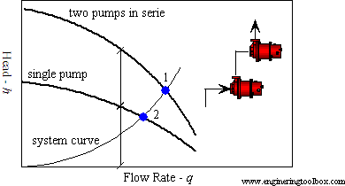
Pumps in series
Two (or more) pumps are arranged in serial, their resulting pump performance curve is obtained by adding heads at the same flow rate.

Slide 56
Slides ( # 59 to 67 ) on pumps scaling are not required

Slide 57
Dimensionless Pump Performance
Head output variables H and brake horsepower should be dependent upon discharge Q, impeller diameter D, and shaft speed n, at least. Other possible parameters are the fluid density , viscosity , and surface roughness ;
For each function in there are seven variables and three primary dimensions (M, L, and T); hence we expect 7 - 3 = 4 dimensionless groups. You can verify as an exercise that appropriate dimensionless forms;
The quantities ρnD2/ and ϵ/D are recognized as the Reynolds number and roughness ratio, respectively.

Slide 58
Dimensionless Pump Performance
Three new pump parameters have arisen

Slide 59
Similarity Rules
in correlating pump data leads to simple rules for comparing pump performance.
If pump 1 and pump 2 are from the same geometric family and are operating at homologous points (the same dimensionless position on a chart such as Fig. 11.8), their flow rates, heads, and powers will be related as follows

Slide 60
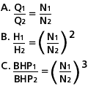
Affinity laws
The affinity laws express the mathematical relationship between the several variables involved in pump performance. They apply to all types of centrifugal and axial flow pumps.
With impeller diameter D held constant and N varied:
Where:
Q = Capacity, GPM H = Total Head, Feet BHP = Brake Horsepower N = Pump Speed, RPM

Slide 61
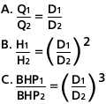
Affinity laws
With speed N held constant, D is varied:

Slide 62
Example
To illustrate the use of these laws, refer to Fig. 8 below. It shows the performance of a particular pump at 1750 RPM with various impeller diameters. This performance data has been determined by actual tests by the manufacturer. Now assume that you have a 13" maximum diameter impeller, but you want to belt drive the pump at 2000 RPM.

Slide 63
Example
The affinity laws listed under 1 above will be used to determine the new performance, with N1 =1750 RPM and N2 = 2000 RPM.
The first step is to read the capacity, head, and horsepower at several points on the 13" dia. curve in Fig. 9 below. For example, one point may be near the best efficiency point where the capacity is 300 GPM, the head is 160 ft, and the BHP is approx. 20 hp.

Slide 64
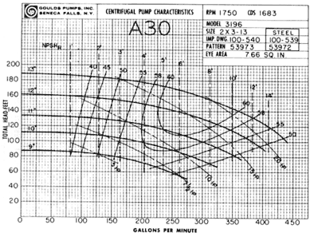
Example

Slide 65
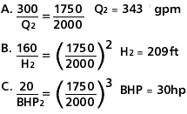
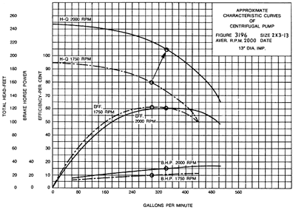
Example

