Slide 1
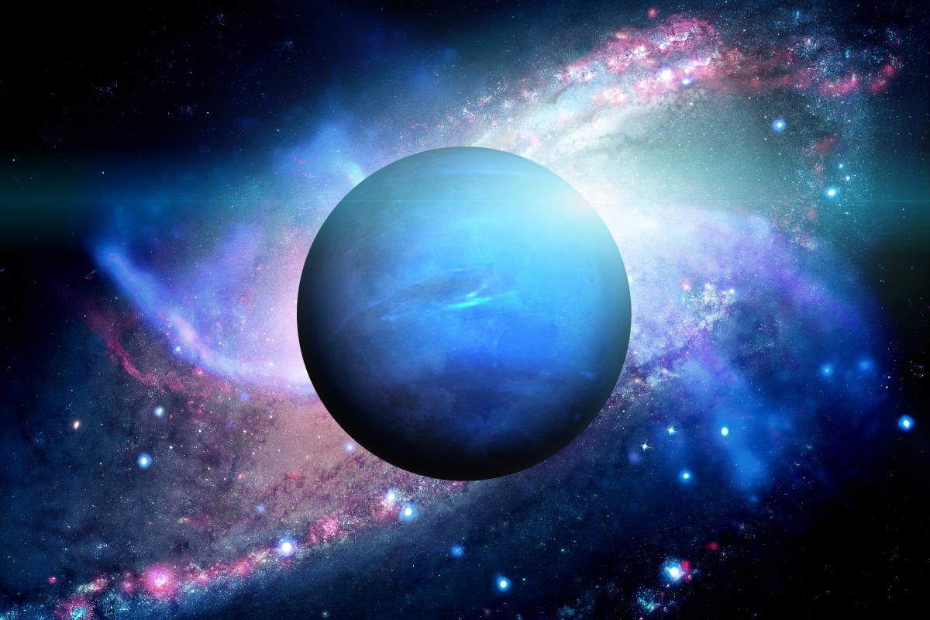
Neptune
The windiest Planet

Slide 2
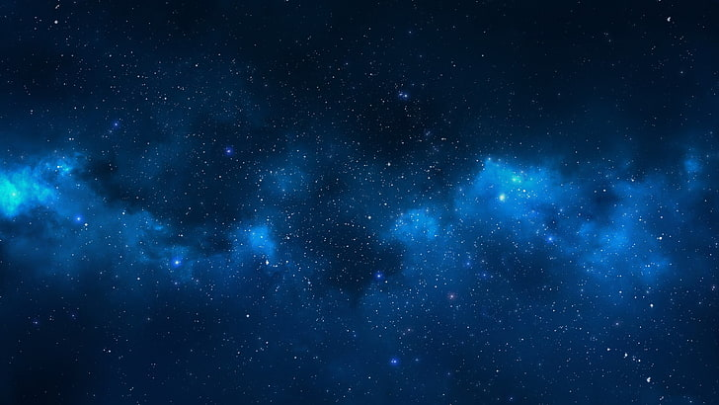
Overview:
Dark, cold and whipped by supersonic winds, ice giant Neptune is the eighth and most distant planet in our solar system. More than 30 times as far from the Sun as Earth , in 2011 Neptune completed its first 165-year orbit since its discovery in 1846.
The ice giant Neptune was the first planet located through mathematical calculations. Using predictions made by Urbain Le Verrier, Johann Galle discovered the planet in 1846. The planet is named after the Roman god of the sea, as suggested by Le Verrier

Slide 3
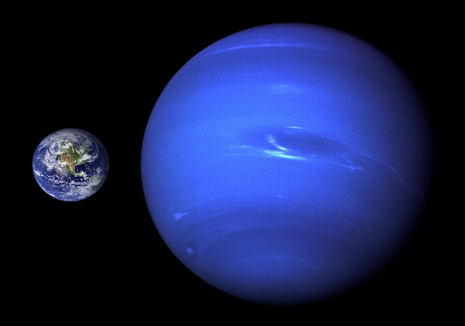
Size and Distance:
With a radius of 24,622 kilometers, Neptune is about four times wider than Earth.
From an average distance of 4.5 billion kilometers, Neptune is 30 AU away from the Sun. It takes sunlight 4 hours to travel from the Sun to Neptune.

Slide 4
Orbit and Rotation:
One day on Neptune takes about 16 hours . And Neptune makes a complete orbit around the Sun (a year in Neptunian time) in about 165 Earth years .

Slide 5
Structure :
Neptune is one of two ice giants in the outer solar system (the other is Uranus). Most (80 percent or more) of the planet's mass is made up of a hot dense fluid of "icy" materials—water, methane and ammonia—above a small, rocky core. Of the giant planets, Neptune is the densest.

Slide 6
Surface and Atmosphere:
Neptune does not have a solid surface. Its atmosphere (made up mostly of hydrogen, helium and methane) extends to great depths, gradually merging into water and other melted ices over a heavier, solid core with about the same mass as Earth.
Neptune's atmosphere is made up mostly of hydrogen and helium with just a little bit of methane*.

Slide 7
Neptune ,The windiest planet:
Neptune is our solar system's windiest world. Despite its great distance and low energy input from the Sun, Neptune's winds can be three times stronger than Jupiter's and nine times stronger than Earth's. These winds whip clouds of frozen methane across the planet at speeds of more than 2,000 kilometers per hour. Even Earth's most powerful winds hit only about 400 kilometers per hour.
In 1989 a large, oval-shaped storm in Neptune's southern hemisphere dubbed the "Great Dark Spot" was large enough to contain the entire Earth. That storm has since disappeared, but new ones have appeared on different parts of the planet.

Slide 8
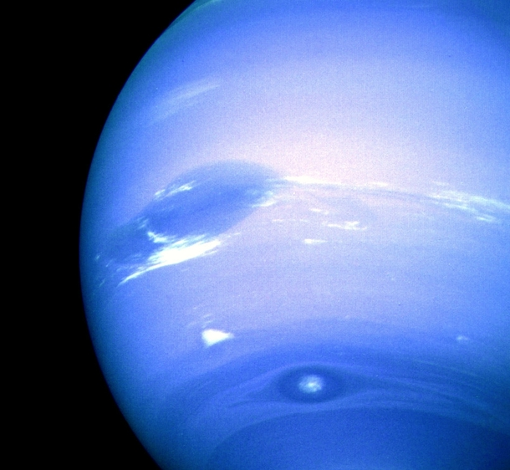
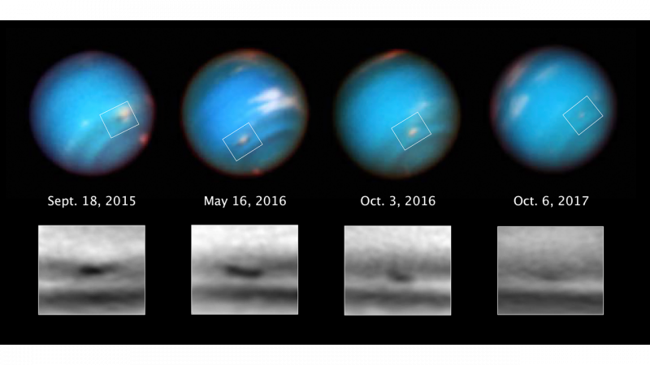

Slide 9
Rings:
Neptune at least five main rings and four prominent ring arcs that we know of so far. Starting near the planet and moving outward, the main rings are named Galle, Leverrier, Lassell, Arago and Adams. The rings are thought to be relatively young and short-lived.

Slide 10
Moons:
Neptune has 14 known moons. Neptune's largest moon Triton was discovered on October 10, 1846, by William Lassell, just 17 days after Johann Gottfried Galle discovered the planet.

Slide 11
History of Neptune Discovery :
Galileo recorded Neptune as a fixed star during observations with his small telescope in 1612 and 1613. More than 200 years later, the ice giant Neptune became the first planet located through mathematical predictions rather than through regular observations of the sky. Because Uranus didn't travel exactly as astronomers expected it to, French mathematician Urbain Joseph Le Verrier proposed the position and mass of a then-unknown planet that could cause the observed changes to Uranus' orbit. Le Verrier sent his predictions to Johann Gottfried Galle at the Berlin Observatory, who found Neptune on his first night of searching in 1846. Seventeen days later, Neptune's largest moon Triton was discovered as well.More than 140 years later, in 1989, NASA's Voyager 2 became the first-and only-spacecraft to study Neptune up close. Voyager returned a wealth of information about Neptune and its moons-and confirmed evidence the giant world had faint rings like the other gas planets.

Slide 12
Facts:
-Neptune is the only planet in our solar system not visible to the naked eye
-Sometimes Neptune is even farther from the Sun than dwarf planet Pluto. Pluto's highly eccentric, oval-shaped orbit brings it inside Neptune's orbit for a 20-year period every 248 Earth years.
-Neptune’s axis of rotation is tilted 28(for earth…..) degrees with respect to the plane of its orbit around the Sun, which is similar to the axial tilts of Mars and Earth. This means that Neptune experiences seasons just like we do on Earth; however, since its year is so long, each of the four seasons lasts for over 40 years.
-Neptune's neighbor Uranus is a blue-green color due to such atmospheric methane, but Neptune is a more vivid, brighter blue, so there must be an unknown component that causes the more intense color.

Slide 13
References:
- https://solarsystem.nasa.gov/
- https://www.youtube.com/watch?v=4NkwRvOhDiQ
- https://nineplanets.org/neptune/

Slide 14
Thank you ☺

