Slide 1


Slide 2
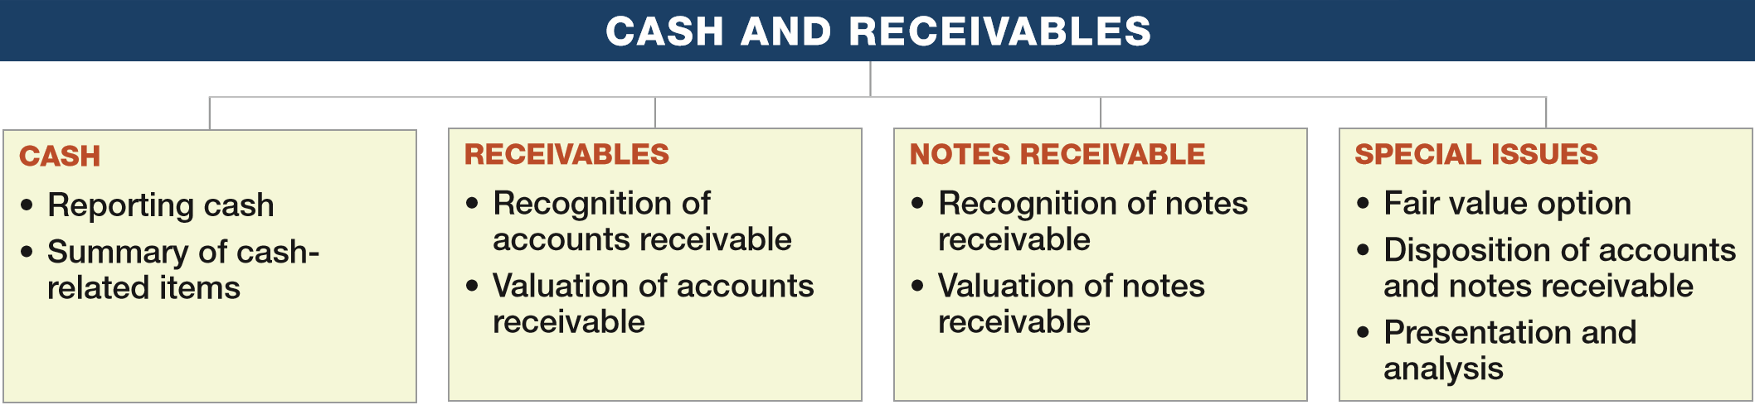
PREVIEW OF CHAPTER 7
Intermediate Accounting
16th Edition
Kieso ● Weygandt ● Warfield

Slide 3
LEARNING OBJECTIVES
7
Cash and Receivables
After studying this chapter, you should be able to:
Indicate how to report cash and related items.
Define receivables and understand accounting issues related to their recognition.
Explain accounting issues related to valuation of accounts receivable.
Explain accounting issues related to recognition and valuation of notes receivable.
Explain the fair value option.
Explain accounting issues related to disposition of accounts and notes receivable.
Describe how to report and analyze receivables.
LO 1

Slide 4
CASH
What is Cash?
Most liquid asset.
Standard medium of exchange.
Basis for measuring and accounting for all items.
Current asset.
Examples: coin, currency, available funds on deposit at the bank, money orders, certified checks, cashier’s checks, personal checks, bank drafts and savings accounts.
LO 1

Slide 5
CASH
Reporting Cash
Cash Equivalents
Short-term, highly liquid investments that are both
readily convertible to cash, and
so near their maturity that they present insignificant risk of changes in value.
Examples: Treasury bills, Commercial paper, and Money market funds.
LO 1

Slide 6
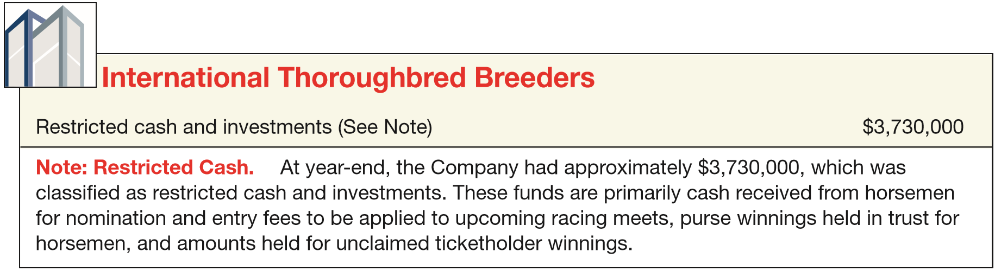
Reporting Cash
Restricted Cash
Companies segregate restricted cash from “regular” cash.
Examples, restricted for:
(1) plant expansion, (2) retirement of long-term debt, and (3) compensating balances.
ILLUSTRATION 7-1
Disclosure of Restricted Cash
LO 1

Slide 7
Reporting Cash
Bank Overdrafts
Company writes a check for more than the amount in its cash account.
Generally reported as a current liability.
Offset against other cash accounts only when accounts are with the same bank.
LO 1
LO 1

Slide 8
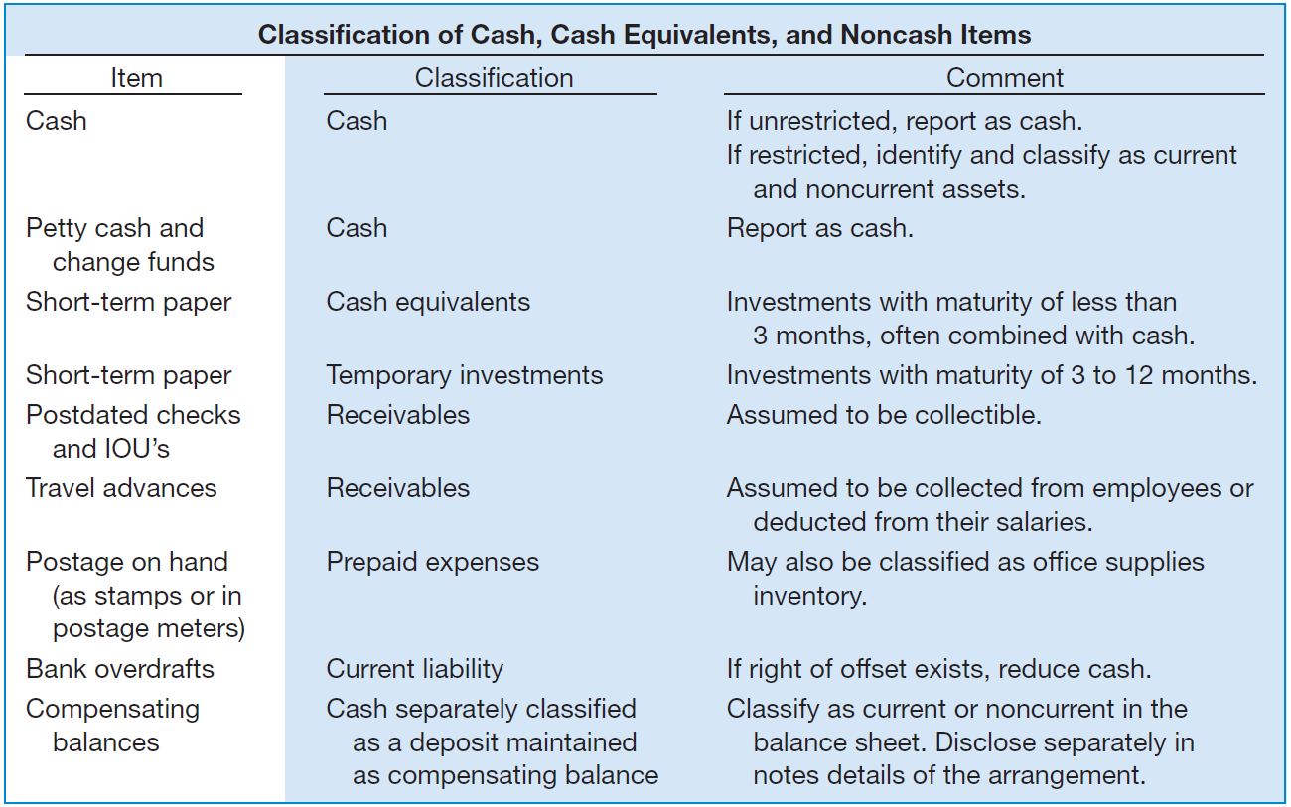
ILLUSTRATION 7-2
Classiﬁcation of Cash-Related Items
LO 1

Slide 9
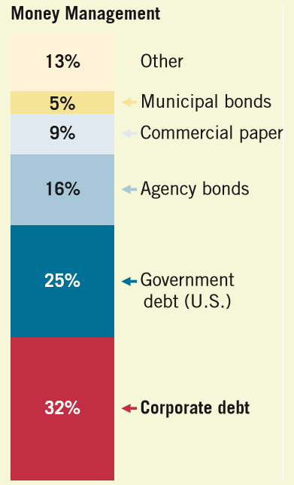
WHAT DO THE NUMBERS MEAN? WHERE DID I PARK MY CASH?
WHAT’S YOUR PRINCIPLE
We have learned that companies report both cash and cash equivalents as cash on their balance sheets. But where do they park cash that is not used to pay for inventory, employees, or other expenses? As shown in the chart to the right, companies plow the largest portion of their cash holdings into corporate debt. As indicated, corporate debt is the parking place of choice, followed by U.S. Treasury and agency debt. Surveyed corporate treasurers say that high-grade corporate bonds are preferred because they are reasonably safe while providing a greater yield premium relative to Treasurys. Seems like a good strategy as long as the corporate issuers can make their payments. However, if the economy takes a downturn, similar to investments in auction-rate notes, these investments may not be true cash equivalents.
Source: J. Willhite, “Companies Park Cash in Corporate Debt,” Wall Street Journal (December 4, 2012).
LO 1

Slide 10
LEARNING OBJECTIVES
7
Cash and Receivables
After studying this chapter, you should be able to:
Indicate how to report cash and related items.
Define receivables and understand accounting issues related to their recognition.
Explain accounting issues related to valuation of accounts receivable.
Explain accounting issues related to recognition and valuation of notes receivable.
Explain the fair value option.
Explain accounting issues related to disposition of accounts and notes receivable.
Describe how to report and analyze receivables.
LO 2

Slide 11
RECEIVABLES
Receivables - Claims held against customers and others for money, goods, or services.
Oral promises of the purchaser to pay for goods and services sold.
Written promises to pay a sum of money on a specified future date.
Accounts Receivable
Notes
Receivable
LO 2

Slide 12
RECEIVABLES
Nontrade Receivables
Advances to officers and employees.
Advances to subsidiaries.
Deposits paid to cover potential damages or losses.
Deposits paid as a guarantee of performance or payment.
Dividends and interest receivable.
Claims against: Insurance companies for casualties sustained; defendants under suit; governmental bodies for tax refunds; common carriers for damaged or lost goods; creditors for returned, damaged, or lost goods; customers for returnable items (crates, containers, etc.).
LO 2

Slide 13
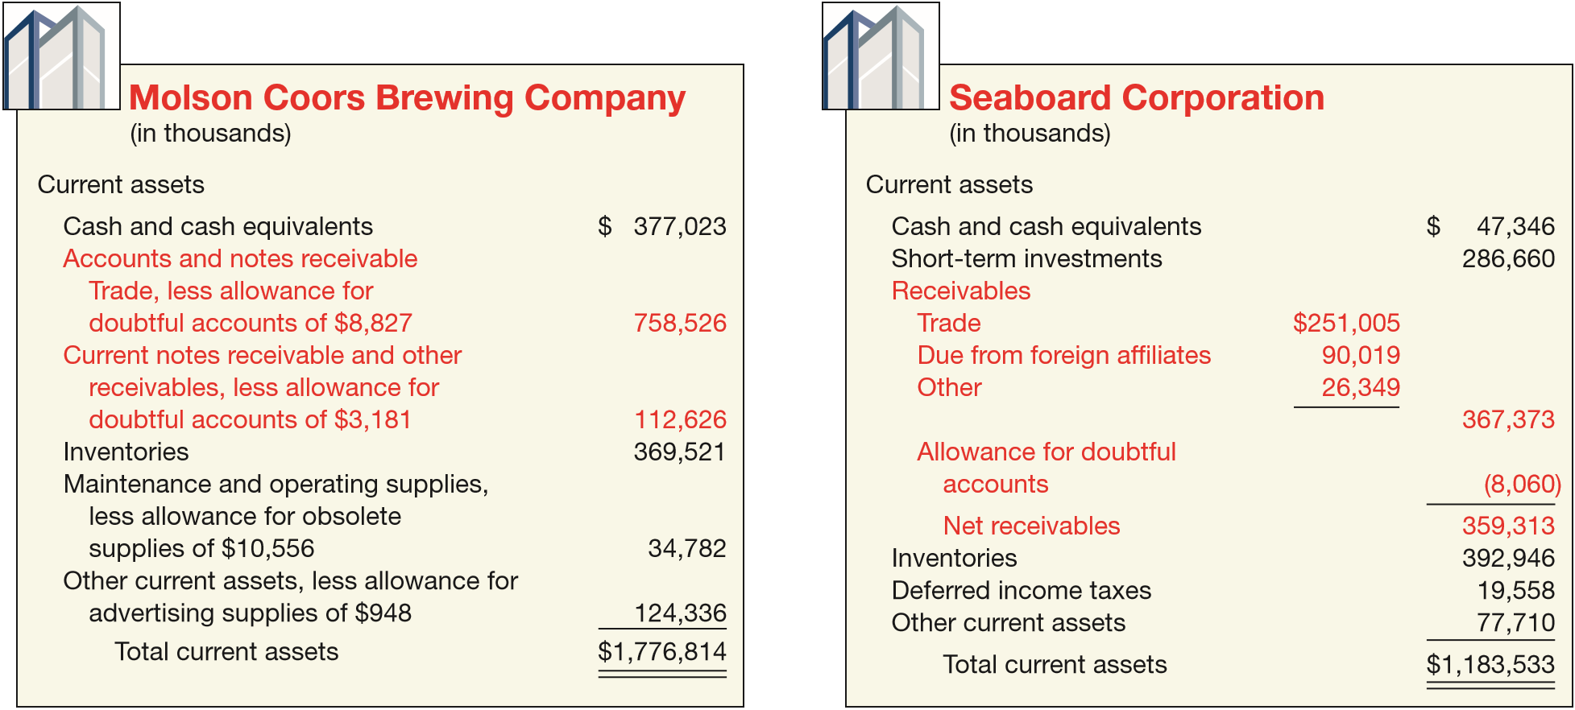
RECEIVABLES
Nontrade Receivables
ILLUSTRATION 7-3
Receivables Balance
Sheet Presentations
LO 2

Slide 14
Recognition of Accounts Receivables
Accounts receivable generally arise as part of a revenue arrangement.
The revenue recognition principle indicates that a company should recognize revenue when it satisfies its performance obligation by transferring the good or service to the customer.
LO 2

Slide 15
Recognition of Accounts Receivables
For example, if Lululemon sells a yoga outfit to Jennifer Burian for $100 on account, the yoga outfit is transferred when Jennifer obtains control of this outfit. When this change in control occurs, Lululemon should recognize an account receivable and sales revenue. Lululemon makes the following entry:
Accounts Receivable 100
Sales Revenue 100
LO 2

Slide 16
Recognition of Accounts Receivables
Some key indicators that Lululemon has transferred and that Jennifer has obtained control of the yoga outfit.
Lululemon has the right to payment from the customer.
Lululemon has passed legal title to the customer.
Lululemon has transferred physical possession of the goods.
Lululemon no longer has significant risks and rewards of ownership of the goods.
Jennifer has accepted the asset.
LO 2

Slide 17
Recognition of Accounts Receivables
Measurement of the Transaction Price
The transaction price is the amount of consideration that a company expects to receive from a customer in exchange for transferring goods or services.
Variable Consideration
In some cases the price of a good or service is dependent on future events. These future events often include such items as discounts, returns and allowances, rebates, and performance bonuses.
LO 2

Slide 18
Recognition of Accounts Receivables
Trade Discounts
Reductions from the list price.
Not recognized in the accounting records.
Customers are billed net of discounts.
10 % Discount for new Retail Store Customers
LO 2

Slide 19
Recognition of Accounts Receivables
Cash Discounts (Sales Discounts)
Offered to induce prompt payment.
Presented in terms such as
  2/10, n/30
  2/10, E.O.M.,
  net 30, E.O.M.
Gross Method vs. Net Method.
Payment terms are 2/10, n/30
LO 2

Slide 20
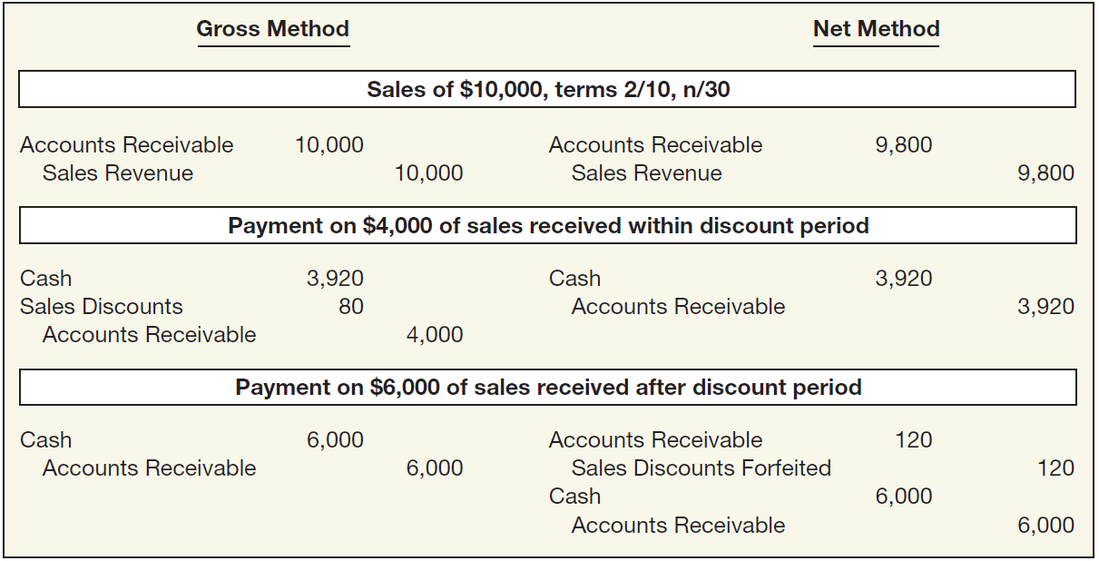
Cash Discounts (Sales Discounts)
ILLUSTRATION 7-4
Entries under Gross and Net Methods of Recording Cash (Sales) Discounts
LO 2

Slide 21
Cash Discounts (Sales Discounts)
Illustration: On June 3, Bolton Company sold to Arquette Company merchandise having a sale price of $2,000 with terms of 2/10, n/60, f.o.b. shipping point. On June 12, the company received a check for the balance due from Arquette Company. Prepare the journal entries on Bolton Company books to record the sale assuming Bolton records sales using the gross method.
June 3
Accounts Receivable 2,000
Sales 2,000
June 12
Cash ($2,000 x 98%) 1,960
Sales Discounts 40
Accounts Receivable 2,000
LO 2

Slide 22
Cash Discounts (Sales Discounts)
Illustration: On June 3, Bolton Company sold to Arquette Company merchandise having a sale price of $2,000 with terms of 2/10, n/60, f.o.b. shipping point. On June 12, the company received a check for the balance due from Arquette Company. Prepare the journal entries on Bolton Company books to record the sale assuming Bolton records sales using the net method.
June 3
Accounts Receivable 1,960
Sales 1,960
June 12
Cash ($2,000 x 98%) 1,960
Accounts Receivable 1,960
LO 2

Slide 23
Cash Discounts (Sales Discounts)
Illustration: On June 3, Bolton Company sold to Arquette Company merchandise having a sale price of $2,000 with terms of 2/10, n/60, f.o.b. shipping point. Prepare the journal entries on Bolton Company books to record the sale assuming Bolton records sales using the net method, and Arquette did not remit payment until July 29.
June 3
Accounts Receivable 1,960
Sales 1,960
June 29
Cash 2,000
Accounts Receivable 1,960
Sales Discounts Forfeited 40
LO 2

Slide 24
Recognition of Accounts Receivables
Sales Returns and Allowances
Sales Returns and Allowances is a contra revenue account to Sales Revenue.
Allowance for Sales Returns and Allowances is a contra asset account to Accounts Receivable.
The use of both Sales Returns and Allowances, and Allowance for Sales Return and Allowances accounts is helpful to identify potential problems associated with inferior merchandise, inefficiencies in filling orders, or delivery or shipment mistakes.
LO 2

Slide 25
Sales Returns and Allowances
Illustration: Assume that Max Glass sells $5,000 of hurricane glass to Oliver Builders on account. Max Glass estimates that $400 of these glass sales will either be returned or an allowance will be granted. Max Glass records the sale on account and records an allowance for sales returns and allowances as follows.
Accounts Receivable 5,000
Sales Revenue 5,000
Sales Returns and Allowances 400
Allowance for Sales Returns and Allowances 400
LO 2

Slide 26
Sales Returns and Allowances
Illustration: Assume that Max Glass now grants an allowance of $400 to Oliver Builders because some of the hurricane glass is of lower quality than originally ordered. The entry to record this transaction is as follows.
Allowance for Sales Returns and Allowances 400
Accounts Receivable 400
LO 2

Slide 27
Recognition of Accounts Receivables
Time Value of Money
Theoretically, any revenue after the period of sale is interest revenue.
Companies ignore interest revenue related to accounts receivable because the amount of the discount is not usually material in relation to the net income for the period.
The profession specifically excludes from present value considerations “receivables arising from transactions with customers in the normal course of business which are due in customary trade terms not exceeding approximately one year.”
LO 2

Slide 28
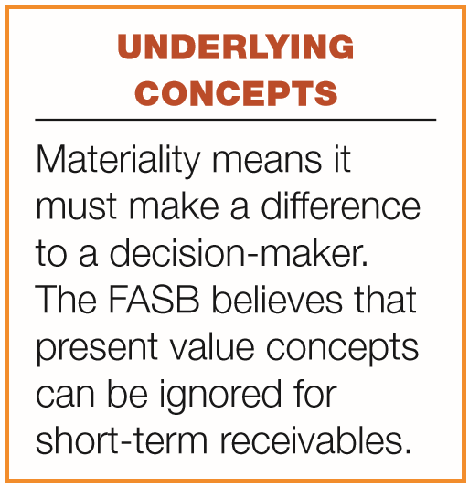
Time Value of Money
A company should measure receivables in terms of their present value.
In practice, companies ignore interest revenue related to accounts receivable because the discount is not usually material in relation to the net income for the period.
LO 2

Slide 29
Recognition of Accounts Receivables
How are these accounts presented on the Balance Sheet?
Allowance for Doubtful Accounts
Accounts Receivable
Beg. 500
25 Beg.
End. 500
25 End.
LO 2

Slide 30
Recognition of Accounts Receivables
LO 2

Slide 31
Recognition of Accounts Receivables
Alternate Presentation
LO 2

Slide 32
Recognition of Accounts Receivables
Journal entry for credit sale of $100?
Accounts Receivable 100
Sales 100
Allowance for Doubtful Accounts
Accounts Receivable
Beg. 500
25 Beg.
End. 500
25 End.
LO 2

Slide 33
Recognition of Accounts Receivables
Journal entry for credit sale of $100?
Accounts Receivable 100
Sales 100
Allowance for Doubtful Accounts
Accounts Receivable
Beg. 500
25 Beg.
Sale 100
End. 600
25 End.
LO 2

Slide 34
Recognition of Accounts Receivables
Collected $333 on account?
Cash 333
Accounts Receivable 333
Allowance for Doubtful Accounts
Accounts Receivable
Beg. 500
25 Beg.
Sale 100
End. 600
25 End.
LO 2

Slide 35
Recognition of Accounts Receivables
Collected $333 on account?
Cash 333
Accounts Receivable 333
Allowance for Doubtful Accounts
Accounts Receivable
Beg. 500
25 Beg.
Sale 100
333 Coll.
End. 267
25 End.
LO 2

Slide 36
Recognition of Accounts Receivables
Adjustment of $15 for estimated bad debts?
Bad Debt Expense 15
Allowance for Doubtful Accounts 15
Allowance for Doubtful Accounts
Accounts Receivable
Beg. 500
25 Beg.
Sale 100
333 Coll.
End. 267
25 End.
LO 2

Slide 37
Recognition of Accounts Receivables
Adjustment of $15 for estimated bad debts?
Bad Debt Expense 15
Allowance for Doubtful Accounts 15
Allowance for Doubtful Accounts
Accounts Receivable
Beg. 500
25 Beg.
Sale 100
333 Coll.
15 Est.
End. 267
40 End.
LO 2

Slide 38
Recognition of Accounts Receivables
Write-off of uncollectible accounts for $10?
Allowance for Doubtful accounts 10
Accounts Receivable 10
Allowance for Doubtful Accounts
Accounts Receivable
Beg. 500
25 Beg.
Sale 100
333 Coll.
15 Est.
End. 267
40 End.
LO 2

Slide 39
Recognition of Accounts Receivables
Write-off of uncollectible accounts for $10?
Allowance for Doubtful accounts 10
Accounts Receivable 10
Allowance for Doubtful Accounts
Accounts Receivable
Beg. 500
25 Beg.
Sale 100
333 Coll.
15 Est.
10 W/O
W/O 10
End. 257
30 End.
LO 2

Slide 40
Recognition of Accounts Receivables
LO 2

Slide 41
LEARNING OBJECTIVES
7
Cash and Receivables
After studying this chapter, you should be able to:
Indicate how to report cash and related items.
Define receivables and understand accounting issues related to their recognition.
Explain accounting issues related to valuation of accounts receivable.
Explain accounting issues related to recognition and valuation of notes receivable.
Explain the fair value option.
Explain accounting issues related to disposition of accounts and notes receivable.
Describe how to report and analyze receivables.
LO 3

Slide 42
RECEIVABLES
Valuation of Accounts Receivable
Reporting of receivables involves
classification and
valuation on the balance sheet.
Classification involves determining the length of time each receivable will be outstanding.
Value and report short-term receivables at net realizable value.
LO 3

Slide 43
Valuation of Accounts Receivable
Uncollectible Accounts Receivable
Record credit losses as debits to Bad Debt Expense (or Uncollectible Accounts Expense).
Normal and necessary risk of doing business on credit.
Two methods to account for uncollectible accounts:
the direct write-off method and
the allowance method.
LO 3

Slide 44
Valuation of Accounts Receivable
Methods of Accounting for Uncollectible Accounts
Direct Write-Off
Theoretically deficient:
  No matching.
  Receivable not stated at cash realizable value.
  Not GAAP when material in amount.
Allowance Method
Losses are estimated:
  Percentage-of-sales.
  Percentage-of-receivables.
  GAAP requires when material in amount.
LO 3

Slide 45
Valuation of Accounts Receivable
Direct Write-Off Method for Uncollectible Accounts
When a company determines a particular account to be uncollectible, it charges the loss to Bad Debt Expense.
Assume, for example, that on December 10 Cruz Co. writes off as uncollectible Yusado’s $8,000 balance. The entry is:
Bad Debt Expense 8,000
Accounts Receivable (Yusado) 8,000
LO 3

Slide 46
Valuation of Accounts Receivable
Allowance Method for Uncollectible Accounts
  Involves estimating uncollectible accounts at the end of each period.
  Ensures that companies state receivables on the balance sheet at their net realizable value.
  Companies estimate uncollectible accounts and net realizable value using information about past and current events as well as forecasts of future collectibility.
LO 3

Slide 47
Valuation of Accounts Receivable
Recording Estimated Uncollectibles
  Illustration: Assume that Brown Furniture in 2017, its first year of operations, has credit sales of $1,800,000. Of this amount, $150,000 remains uncollected at December 31. The credit manager estimates that $10,000 of these sales will be uncollectible. The adjusting entry to record the estimated uncollectibles (assuming a zero balance in the allowance account) is:
Bad Debt Expense 10,000
Allowance for Doubtful Accounts 10,000
LO 3

Slide 48
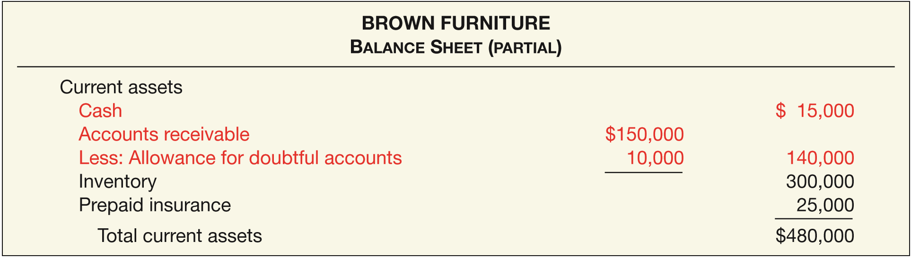
Recording Estimated Uncollectibles
ILLUSTRATION 7-5
Presentation of Allowance for Doubtful Accounts
The amount of $140,000 represents the net realizable value of the accounts receivable at the statement date.
LO 3

Slide 49
Allowance Method for Uncollectible Accounts
Write-Off of an Uncollectible Account
  When companies have exhausted all means of collecting a past-due account and collection appears impossible, the company should write off the account.
  In the credit card industry, for example, it is standard practice to write off accounts that are 210 days past due.
LO 3

Slide 50
Write-Off of an Uncollectible Account
Illustration: The financial vice president of Brown Furniture authorizes a write-off of the $1,000 balance owed by Randall Co. on March 1. The entry to record the write-off is:
Allowance for Doubtful Accounts 1,000
Accounts Receivable 1,000
Assume that on July 1, Randall Co. pays the $1,000 amount that Brown had written off on March 1. These are the entries:
Accounts Receivable 1,000
Allowance for Doubtful Accounts 1,000
Cash 1,000
Accounts Receivable 1,000
LO 3

Slide 51
Valuation of Accounts Receivable
Estimating the Allowance
Percentage-of-Receivables Approach
  Reports estimate of receivables at realizable value.
Companies may apply this method using
  one composite rate, or
  an aging schedule using different rates.
LO 3

Slide 52
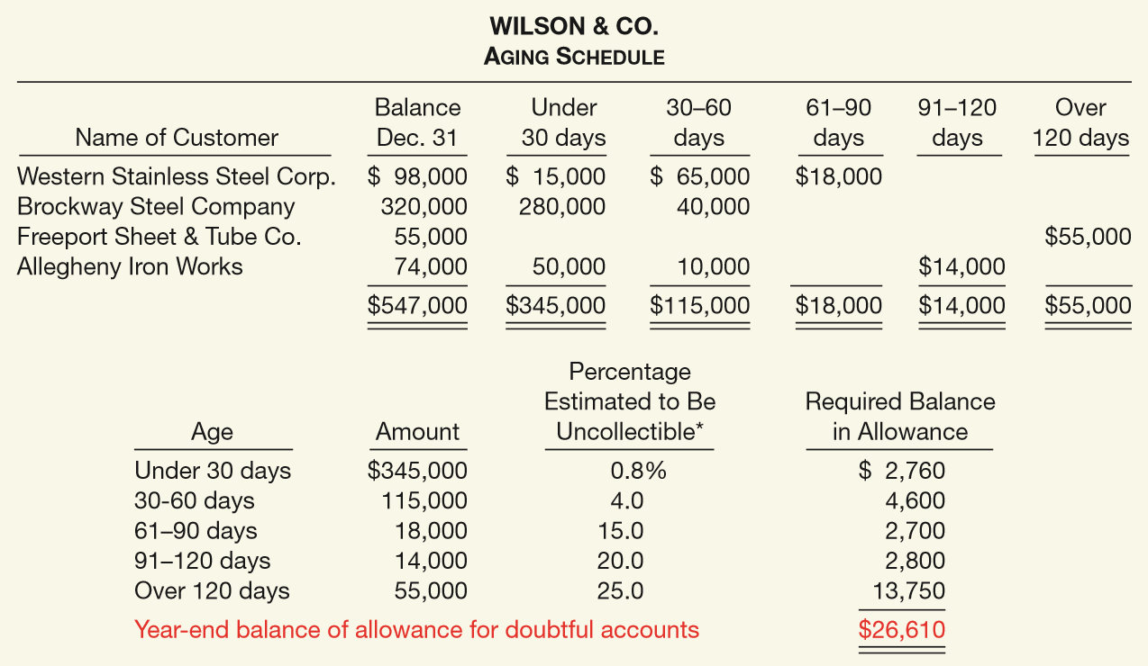
Estimating the Allowance
ILLUSTRATION 7-6
Accounts Receivable Aging Schedule
LO 3

Slide 53
Estimating the Allowance
ILLUSTRATION 7-6
Accounts Receivable Aging Schedule
What entry would Wilson make assuming that the allowance account had a zero balance?
Bad Debt Expense 26,610
Allowance for Doubtful Accounts 26,610
LO 3

Slide 54
Estimating the Allowance
ILLUSTRATION 7-6
Accounts Receivable Aging Schedule
What entry would Wilson make assuming the allowance account had a credit balance of $800 before adjustment?
Bad Debt Expense ($26,610 – $800) 25,810
Allowance for Doubtful Accounts 25,810
LO 3

Slide 55
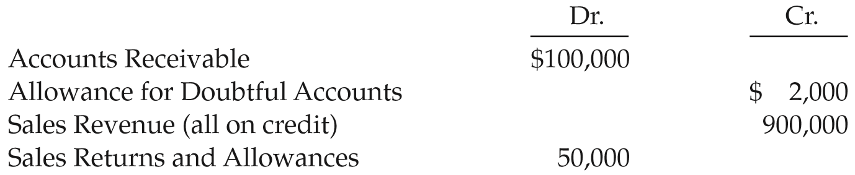
Estimating the Allowance
Illustration: Ducan Company reports the following financial information before adjustments.
Instructions: Prepare the journal entry to record Bad Debt Expense assuming Duncan Company estimates bad debts at (a) 5% of accounts receivable and (b) 5% of accounts receivable but Allowance for Doubtful Accounts had a $1,500 debit balance.
LO 3

Slide 56
Estimating the Allowance
Illustration: Ducan Company reports the following financial information before adjustments.
Instructions: Prepare the journal entry to record Bad Debt Expense assuming Duncan Company estimates bad debts at (a) 5% of accounts receivable.
Bad Debt Expense 3,000
Allowance for Doubtful Accounts 3,000
$100,000 x 5% = $5,000 - $2,000 = $3,000
LO 3
LO 3

Slide 57
Estimating the Allowance
Illustration: Ducan Company reports the following financial information before adjustments.
Instructions: Prepare the journal entry to record Bad Debt Expense assuming Duncan Company estimates bad debts at (b) 5% of accounts receivable but the Allowance had a $1,500 debit balance.
Bad Debt Expense 6,500
Allowance for Doubtful Accounts 6,500
$100,000 x 5% = $5,000 + $1,500 = $6,500
LO 3
LO 3

Slide 58
LEARNING OBJECTIVES
7
Cash and Receivables
After studying this chapter, you should be able to:
Indicate how to report cash and related items.
Define receivables and understand accounting issues related to their recognition.
Explain accounting issues related to valuation of accounts receivable.
Explain accounting issues related to recognition and valuation of notes receivable.
Explain the fair value option.
Explain accounting issues related to disposition of accounts and notes receivable.
Describe how to report and analyze receivables.
LO 4

Slide 59
NOTES RECEIVABLE
Supported by a formal promissory note.
Written promise to pay a certain sum of money at a specific future date.
A negotiable instrument.
Maker signs in favor of a payee.
Interest-bearing (has a stated rate of interest) or
Zero-interest-bearing (interest included in face amount).
LO 4

Slide 60
NOTES RECEIVABLE
  Generally originate from:
  Customers who need to extend payment period of an outstanding receivable.
  High-risk or new customers.
  Loans to employees and subsidiaries.
  Sales of property, plant, and equipment.
  Lending transactions (majority of notes).
LO 4

Slide 61
Recognition of Notes Receivable
Short-Term
Long-Term
Record at
Face Value,
less allowance
Record at
Present Value
of cash expected to be collected
Interest Rates
Stated rate = Market rate
Stated rate > Market rate
Stated rate < Market rate
Note Issued at
Face Value
Premium
Discount
LO 4

Slide 62
Note Issued at Face Value
Illustration: Bigelow Corp. lends Scandinavian Imports $10,000 in exchange for a $10,000, three-year note bearing interest at 10 percent annually. The market rate of interest for a note of similar risk is also 10 percent. How does Bigelow record the receipt of the note?
i = 10%
$10,000 Principal
$1,000
$1,000
$1,000 Interest
0
1
2
3
4
n = 3
LO 4

Slide 63
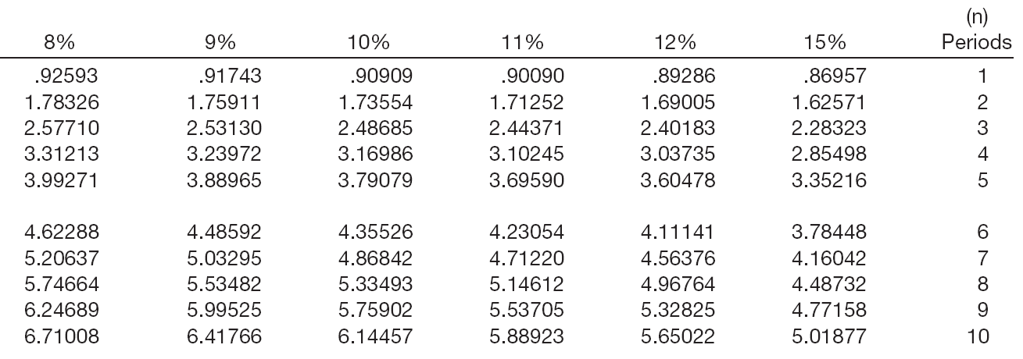
Note Issued at Face Value
PV of Interest
$1,000 x 2.48685 = $2,487
Interest Received
Factor
Present Value
LO 4

Slide 64
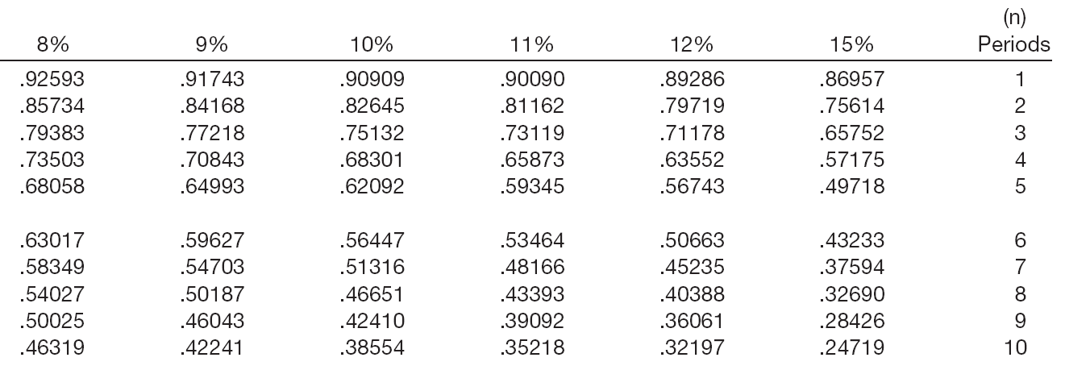
Note Issued at Face Value
PV of Principal
$10,000 x .75132 = $7,513
Principal
Factor
Present Value
LO 4

Slide 65
Note Issued at Face Value
Summary
Present value of interest $ 2,487
Present value of principal 7,513
Present value of the note $10,000
Journal Entries
Jan. yr. 1
Notes Receivable 10,000
Cash 10,000
Dec. yr. 1
Cash 1,000
Interest Revenue 1,000
LO 4

Slide 66
Zero-Interest-Bearing Note
Illustration: Jeremiah Company receives a three-year, $10,000 zero-interest-bearing note. The market rate of interest for a note of similar risk is 9 percent. How does Jeremiah record the receipt of the note?
i = 9%
$10,000 Principal
$0
$0
$0 Interest
0
1
2
3
4
n = 3
LO 4

Slide 67
Zero-Interest-Bearing Note
PV of Principal
$10,000 x .77218 = $7,721.80
Principal
Factor
Present Value
LO 4

Slide 68
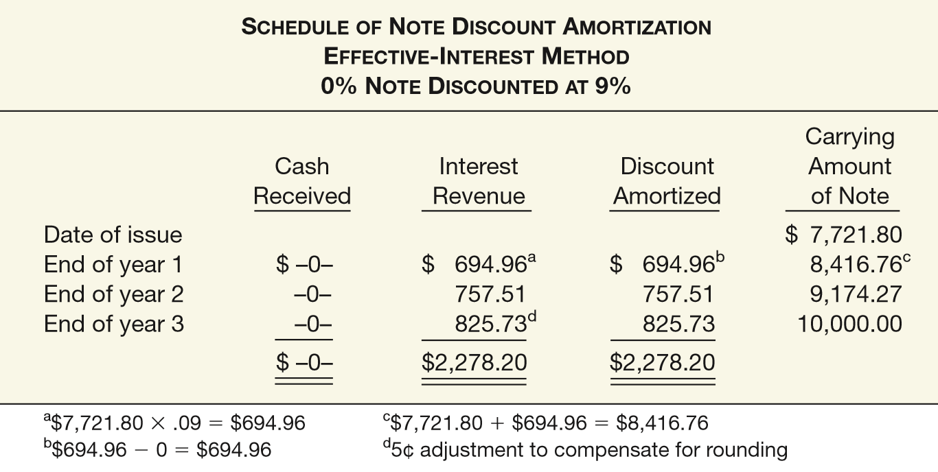
Zero-Interest-Bearing Note
ILLUSTRATION 7-10
Discount Amortization Schedule—Effective-Interest Method
LO 4

Slide 69
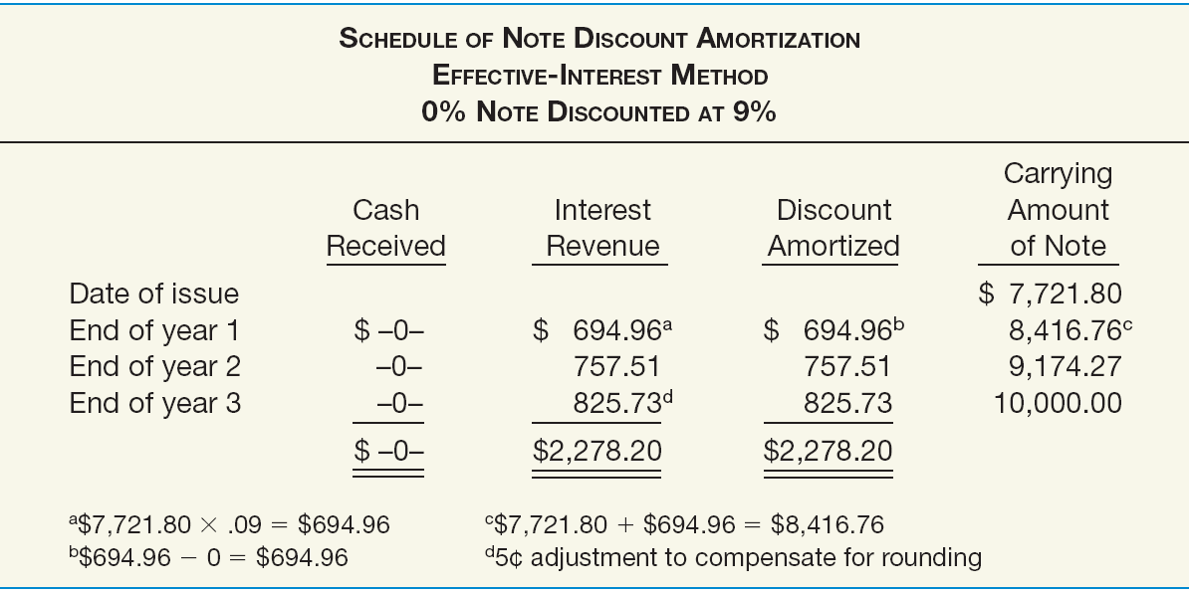
Zero-Interest-Bearing Note
ILLUSTRATION 7-10
Discount Amortization Schedule—Effective-Interest Method
Prepare the journal entry to record the receipt of the note.
Notes Receivable 10,000.00
Discount on Notes Receivable 2,278.20
Cash 7,721.80
LO 4

Slide 70
Zero-Interest-Bearing Note
ILLUSTRATION 7-10
Discount Amortization Schedule—Effective-Interest Method
Prepare the journal entry to record interest revenue at the end of the first year.
Discount on Notes Receivable 694.96
Interest Revenue ($7,721.80 × 9%) 694.96
LO 4

Slide 71
Interest-Bearing Note
Illustration: Morgan Corp. makes a loan to Marie Co. and receives in exchange a three-year, $10,000 note bearing interest at 10 percent annually. The market rate of interest for a note of similar risk is 12 percent. Prepare the journal entry to record the receipt of the note?
i = 12%
$10,000 Principal
$1,000
$1,000
$1,000 Interest
0
1
2
3
4
n = 3
LO 4

Slide 72
Interest-Bearing Note
PV of Interest
$1,000 x 2.40183 = $2,402
Interest Received
Factor
Present Value
LO 4

Slide 73
Interest-Bearing Note
PV of Principal
$10,000 x .71178 = $7,118
Principal
Factor
Present Value
LO 4

Slide 74
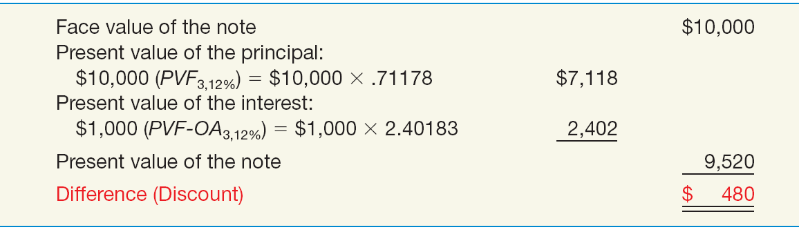
Interest-Bearing Note
ILLUSTRATION 7-12 Computation of Present Value—Effective Rate Different from Stated Rate
Illustration: Record the receipt of the note?
Notes Receivable 10,000
Discount on Notes Receivable 480
Cash 9,520
LO 4

Slide 75
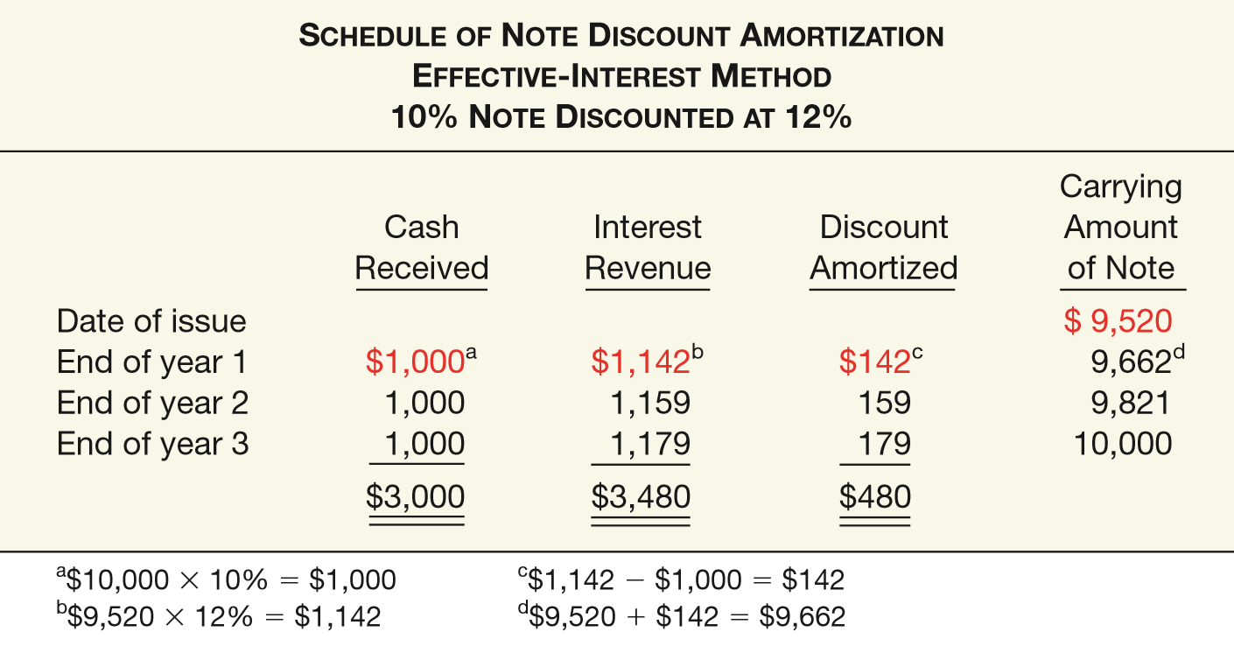
Interest-Bearing Note
ILLUSTRATION 7-13
Discount Amortization Schedule—Effective-Interest Method
LO 4

Slide 76
Interest-Bearing Note
ILLUSTRATION 7-13
Discount Amortization Schedule—Effective-Interest Method
Prepare the journal entry to record interest revenue at the end of the first year.
Cash 1,000
Discount on Notes Receivable 142
Interest Revenue 1,142
LO 4

Slide 77
Recognition of Notes Receivable
Notes Received for Property, Goods, or Services
In a bargained transaction entered into at arm’s length, the stated interest rate is presumed to be fair unless:
  No interest rate is stated, or
  Stated interest rate is unreasonable, or
  Face amount of the note is materially different from the current cash sales price.
LO 4

Slide 78
Notes Received for Property, Goods, or Services
Illustration: Oasis Development Co. sold a corner lot to Rusty Pelican as a restaurant site. Oasis accepted in exchange a five-year note having a maturity value of $35,247 and no stated interest rate. The land originally cost Oasis $14,000. At the date of sale the land had a fair market value of $20,000. Oasis uses the fair market value of the land, $20,000, as the present value of the note. Oasis therefore records the sale as:
($35,247 - $20,000) = $15,247
Notes Receivable 35,247
Discount on Notes Receivable 15,247
Land 14,000
Gain on Disposal of Land 6,000
LO 4

Slide 79
NOTES RECEIVABLE
Valuation of Notes Receivable
Short-Term reported at net realizable value (same as accounting for accounts receivable).
Long-Term - FASB requires companies disclose not only their cost but also their fair value in the notes to the financial statements.
LO 4

Slide 80
WHAT DO THE NUMBERS MEAN? PLEASE RELEASE ME?
WHAT’S YOUR PRINCIPLE
As the economy climbed out of the great recession of 2008, several U.S. banks reported increases in net income compared to the same quarter in the previous year. How did the market greet this news? With a resounding “blah.” For example, Wells Fargo’s report led to a share price decline of 8.4 percent, and Citigroup saw a 1.7 percent drop in its share price when it announced earnings. What gives? It seems that the source of earnings increase matters to the market. And in the case of banks, a signiﬁcant portion of these earnings increases were the result of decreases in the banks’ bad debt expense, not increased revenues on loans and investments. These decreases happened when the banks’ reserves that had accumulated in the allowance for loan losses were judged to be too high. How big was the effect? As shown in the chart on the next slide, of the $14.3 billion in earnings reported by the top 10 U.S. banks, $3.5 billion came from releasing loan loss reserves. For Citi, without the reserve release, it would have reported a loss. As shown in the left side of the chart, the 10 largest banks had $127.2 billion in the allowance for loan losses at the end of 2011, and $26.7 billion was drawn down (released) in that same year. So is this a problem? Supposedly, reserves should be released when there is a decline in the likelihood that loans will not be paid. However, some market-watchers doubt that banks can afford to keep up the pace

Slide 81
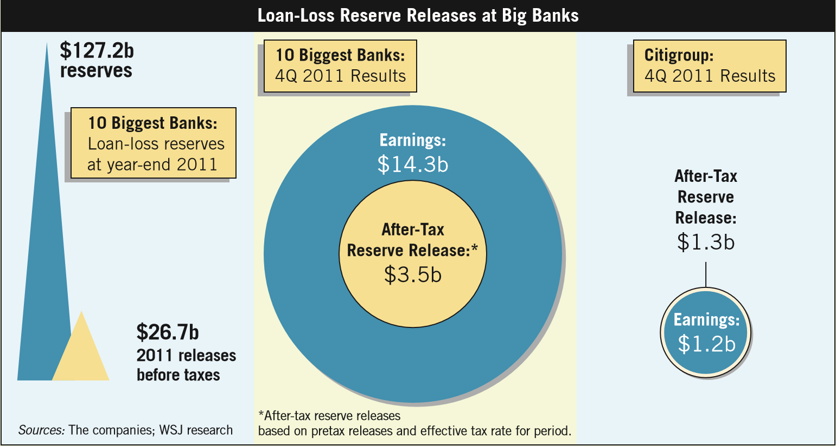
WHAT DO THE NUMBERS MEAN? PLEASE RELEASE ME?
WHAT’S YOUR PRINCIPLE
LO 4

Slide 82
WHAT DO THE NUMBERS MEAN? PLEASE RELEASE ME?
WHAT’S YOUR PRINCIPLE
of reserve releases. Lowering reserves could increase pressure on proﬁts that are being hit by slow economic growth, low interest rates, and other costs. For example, in a recent quarter, U.S. banks experienced an earnings decline of 7.3 percent compared to the same quarter from a year earlier. The culprit? Big banks experienced increased costs to settle legal cases related to sales of risky mortgage securities before the ﬁnancial crisis. Three of the biggest United States banks—JPMorgan Chase, Bank of America, and Citigroup—together posted $4.4 billion in legal costs during the quarter. According to one analyst, “The releases are masking some horrible operating performance. . . . The bottom line is your earnings power is decreasing.” To be fair, analysts often criticize banks when they increase the allowance for loan losses during proﬁtable periods. In some cases, the banks are accused of managing earnings. That is, in good times they increase loan loss reserves, which reduces (or smoothes) earnings. Then in bad times, the reserves can be released, thereby increasing earnings. The SEC has reprimanded some banks for this alleged earnings management— in not only the tough times, but the good times as well.
Sources: S. Kapner, “Citi Shines, but Investors Shrug,” Wall Street Journal (October 18, 2011), p. C1; M. Rapoport, “Banks Depleting Earnings Backstop: Days Numbered for Using Reserves to Increase Profit,” Wall Street Journal (February 8, 2012), p. C1; and Associated Press, “Legal Costs Weigh Down U.S. Banks Earnings,” The New York Times (February 24, 2015).
LO 4

Slide 83
LEARNING OBJECTIVES
7
Cash and Receivables
After studying this chapter, you should be able to:
Indicate how to report cash and related items.
Define receivables and understand accounting issues related to their recognition.
Explain accounting issues related to valuation of accounts receivable.
Explain accounting issues related to recognition and valuation of notes receivable.
Explain the fair value option.
Explain accounting issues related to disposition of accounts and notes receivable.
Describe how to report and analyze receivables.
LO 5

Slide 84
SPECIAL ISSUES
Fair Value Option
Companies have the option to use fair value as the basis of measurement in the financial statements.
If companies choose the fair value option,
  Receivables are recorded at fair value.
  Unrealized holding gains or losses reported as part of net income.
Company reports the receivable at fair value each reporting date.
LO 5

Slide 85
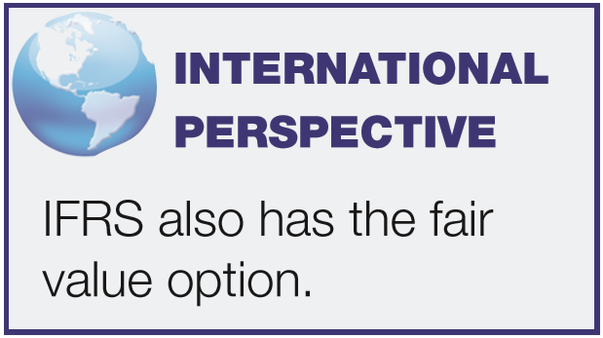
SPECIAL ISSUES
Fair Value Option
Companies may elect at time the financial instrument is
  originally recognized or
  when some event triggers a new basis of accounting.
Must continue to use fair value measurement for the specific instrument until the company no longer owns this instrument.
If not elected at date of recognition, company may never use fair value option on that specific instrument.
LO 5

Slide 86
Recording Fair Value Option
Illustration: Escobar Company has notes receivable that have a fair value of $810,000 and a carrying amount of $620,000. Escobar decides on December 31, of the current year, to use the fair value option for these receivables. This is the first valuation of these recently acquired receivables. At December 31, Escobar makes an adjusting entry to record the increase in value of Notes Receivable and to record the unrealized holding gain, as follows.
Notes Receivable 190,000
Unrealized Holding Gain or Loss—Income 190,000
LO 5

Slide 87
LEARNING OBJECTIVES
7
Cash and Receivables
After studying this chapter, you should be able to:
Indicate how to report cash and related items.
Define receivables and understand accounting issues related to their recognition.
Explain accounting issues related to valuation of accounts receivable.
Explain accounting issues related to recognition and valuation of notes receivable.
Explain the fair value option.
Explain accounting issues related to disposition of accounts and notes receivable.
Describe how to report and analyze receivables.
LO 6

Slide 88
Disposition of Accounts and Notes Receivable
Owner may transfer accounts or notes receivables to another company for cash. Reasons:
Competition.
Sell receivables because money is tight.
Billing and collection are time-consuming and costly.
Transfer accomplished by:
Secured borrowing.
Sale of receivables.
LO 6

Slide 89
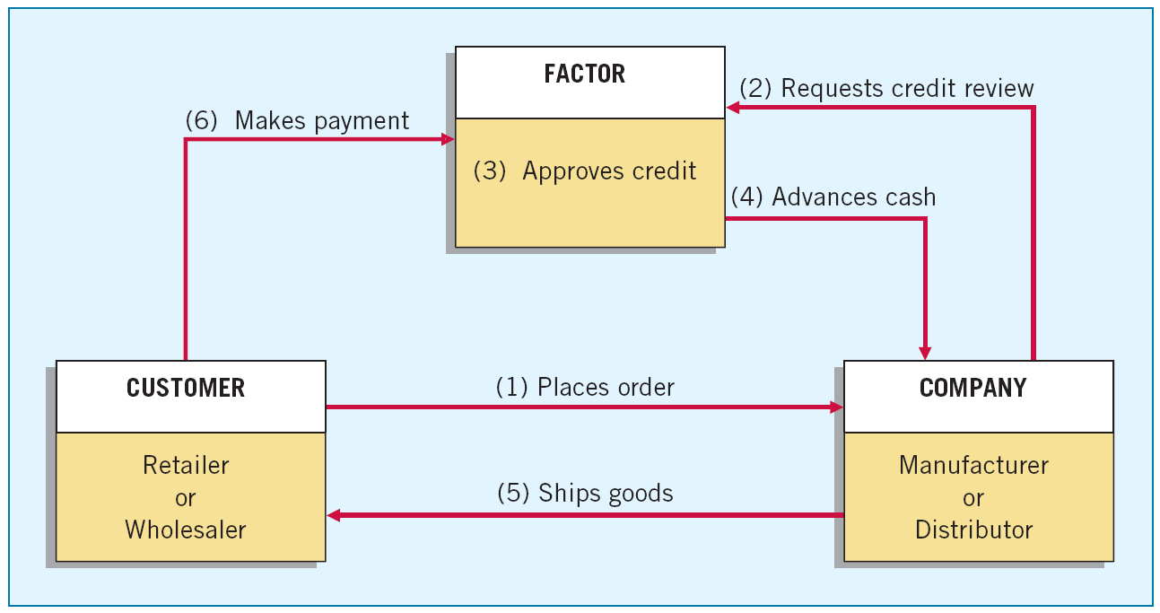
Sales of Receivables
ILLUSTRATION 7-14
Basic Procedures in Factoring
Factors are finance companies or banks that buy receivables from businesses for a fee.
LO 6

Slide 90
Sales of Receivables
Sale Without Recourse
Purchaser assumes risk of collection.
Transfer is outright sale of receivable.
Seller records loss on sale.
Sale With Recourse
Seller guarantees payment to purchaser.
Financial components approach used to record transfer.
LO 6

Slide 91
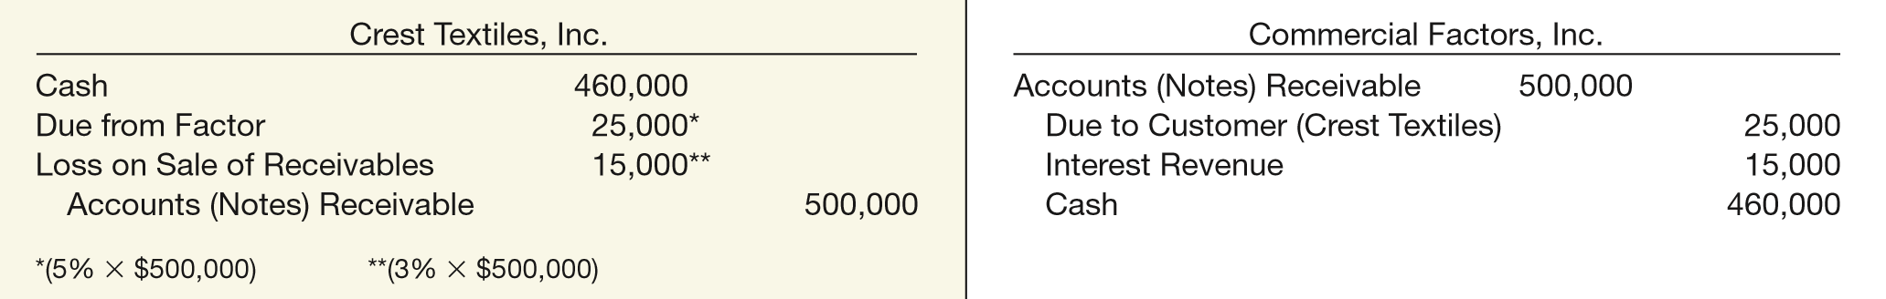
Sales of Receivables – Without Recourse
Illustration: Crest Textiles, Inc. factors $500,000 of accounts receivable with Commercial Factors, Inc., on a without recourse basis. Commercial Factors assesses a finance charge of 3 percent of the amount of accounts receivable and retains an amount equal to 5 percent of the accounts receivable (for probable adjustments). Crest Textiles and Commercial Factors make the following journal entries for the receivables transferred without recourse.
ILLUSTRATION 7-15
Entries for Sale of Receivables without Recourse
LO 6

Slide 92
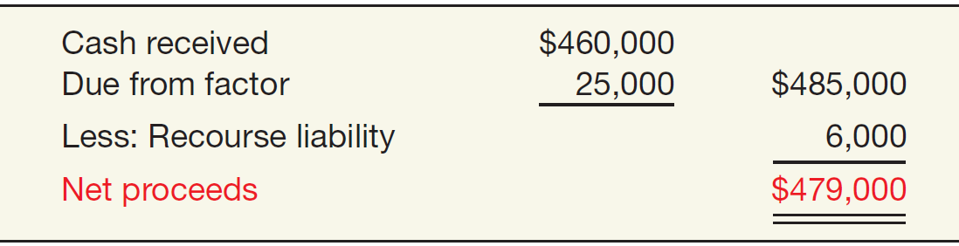

Sales of Receivables – With Recourse
Illustration: Assume Crest Textiles sold the receivables on a with recourse basis. Crest Textiles determines that this recourse obligation has a fair value of $6,000. To determine the loss on the sale of the receivables, Crest Textiles computes the net proceeds from the sale as follows.
ILLUSTRATION 7-16
Net Proceeds
Computation
ILLUSTRATION 7-17
Loss on Sale Computation
LO 6

Slide 93
Sales of Receivables
Illustration: Prepare the journal entries for both Crest Textiles and Commercial Factors for the receivables sold with recourse.
Crest Textiles, Inc.
Cash 460,000
Due from Factor 25,000
Loss on Sale of Receivables 21,000
Accounts (Notes) Receivable 500,000
Recourse Liability 6,000
Commercial Factors, Inc.
Accounts Receivable 500,000
Due to Customer (Crest Textiles) 25,000
Interest Revenue 15,000
Cash 460,000
LO 6

Slide 94
Disposition of Accounts and Notes Receivable
Secured Borrowing
Illustration: March 1, 2017, Howat Mills, Inc. provides (assigns) $700,000 of its accounts receivable to Citizens Bank as collateral for a $500,000 note. Howat Mills continues to collect the accounts receivable; the account debtors are not notified of the arrangement. Citizens Bank assesses a finance charge of 1 percent of the accounts receivable and interest on the note of 12 percent. Howat Mills makes monthly payments to the bank for all cash it collects on the receivables.
LO 6

Slide 95
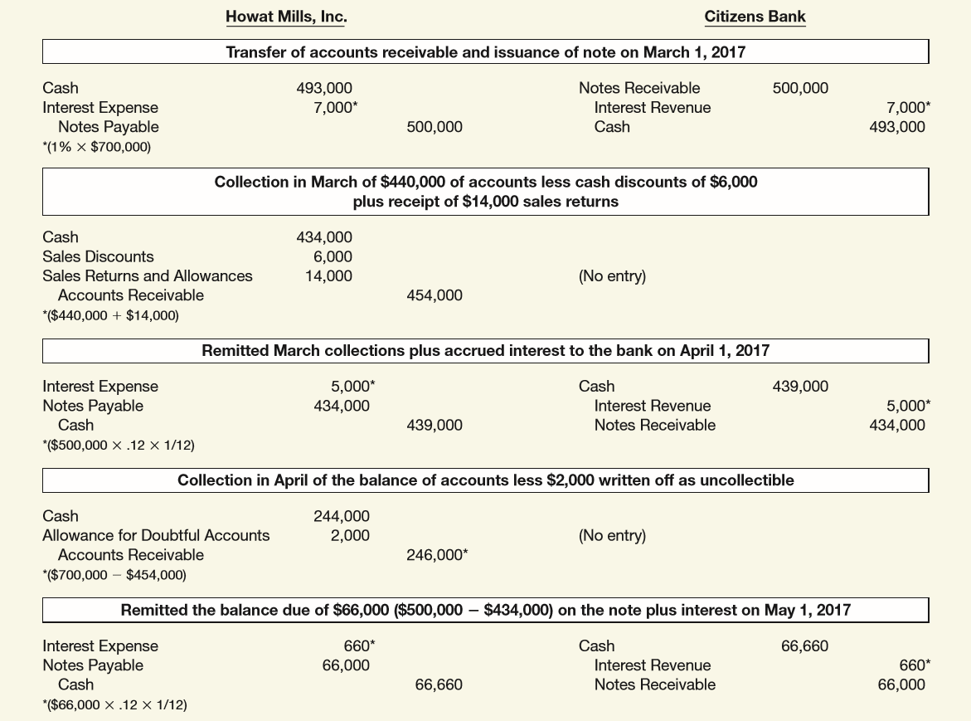
ILLUSTRATION 7-19
Entries for Transfer of Receivables—Secured Borrowing

Slide 96
Secured Borrowing
Illustration: On April 1, 2017, Rasheed Company assigns $400,000 of its accounts receivable to the Third National Bank as collateral for a $200,000 loan due July 1, 2017. The assignment agreement calls for Rasheed to continue to collect the receivables. Third National Bank assesses a finance charge of 2% of the accounts receivable, and interest on the loan is 10% (a realistic rate of interest for a note of this type).
Instructions:
Prepare the April 1, 2017, journal entry for Rasheed Company.
Prepare the journal entry for Rasheed’s collection of $350,000 of the accounts receivable during the period from April 1, 2017, through June 30, 2017.
On July 1, 2017, Rasheed paid Third National all that was due from the loan it secured on April 1, 2017. Prepare the journal entry to record this payment.
LO 6

Slide 97
Secured Borrowing
Instructions:
Prepare the April 1, 2017, journal entry for Rasheed Company.
Prepare the journal entry for Rasheed’s collection of $350,000.
On July 1, 2017, Rasheed paid Third National all that was.
a)
Cash 192,000
Finance Charge ($400,000 x 2%) 8,000
Notes Payable 200,000
b)
Cash 350,000
Accounts Receivable 350,000
c)
Notes Payable 200,000
Interest Expense (10% x $200,000 x 3/12) 5,000
Cash 205,000
LO 6

Slide 98
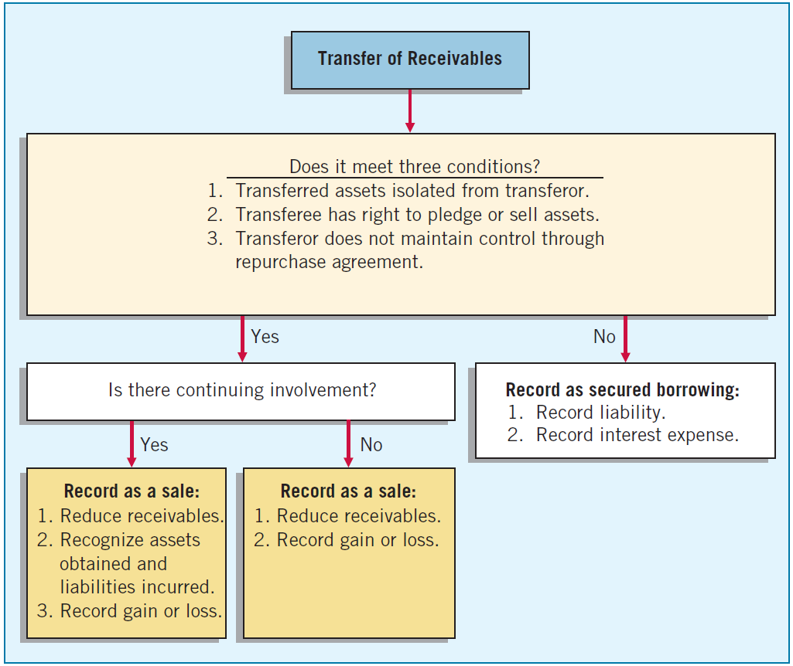
Secured Borrowing versus Sale
ILLUSTRATION 7-20
Accounting for Transfers of Receivables
The FASB concluded that a sale occurs only if the seller surrenders control of the receivables to the buyer.
Three conditions must be met.
LO 6

Slide 99
WHAT DO THE NUMBERS MEAN? SECURITIZATIONS—GOOD OR BAD?
WHAT’S YOUR PRINCIPLE
A popular form of sale (transfer) of receivables is securitization. Securitization takes a pool of assets, such as credit card receivables, mortgage receivables, or car loan receivables, and sells shares in these pools of interest and principal payments. This, in effect, creates securities backed by these pools of assets. Virtually every asset with a payment stream and a long-term payment history is a candidate for securitization. What are the differences between factoring and securitization? Factoring usually involves sale to only one company, fees are high, the quality of the receivables is low, and the seller afterward does not service the receivables. In a securitization, many investors are involved, margins are tight, the receivables are of generally higher quality, and the seller usually continues to service the receivables. Securitizations got a black eye in the booming mortgage market leading up to the ﬁnancial crisis of 2008. In that setting, mortgage loans to high-risk (subprime) borrowers were securitized with lenders selling the loans to investment banks or trusts (special purpose entities) at a gain. Investors in the securities issued by the trusts

Slide 100
WHAT DO THE NUMBERS MEAN? SECURITIZATIONS—GOOD OR BAD?
WHAT’S YOUR PRINCIPLE
were happy because they earned a return that they believed was excellent, given the risk they took. However, due to lax regulatory oversight of the mortgage lending process, many of the securitizations resulted in lenders having to take back the loans when subprime borrowers could not make the payments when the economy and the housing market slowed. The costs of these bad securitizations are still being felt by banks several years after the mortgage market meltdown. The moral of the story is that accounting matters. Lenders had strong incentives to want to report upfront gains on sales of loans. But in most cases, these gains should never have been booked. The FASB has since issued new rules to tighten up “gain-on-sale” accounting for securitizations and loan losses. With these new rules, lenders have to keep the loans on their balance sheets. Under these conditions, lenders would be much less likely to lend so much money to individuals with poor credit ratings.
Sources: M. Hudson, “How Wall Street Stoked the Mortgage Meltdown,” Wall Street Journal (June 27, 2007), p. A10; and Associated Press, “Legal Costs Weigh Down US Banks Earnings,” The New York Times (February 24, 2015).

Slide 101
LEARNING OBJECTIVES
7
Cash and Receivables
After studying this chapter, you should be able to:
Indicate how to report cash and related items.
Define receivables and understand accounting issues related to their recognition.
Explain accounting issues related to valuation of accounts receivable.
Explain accounting issues related to recognition and valuation of notes receivable.
Explain the fair value option.
Explain accounting issues related to disposition of accounts and notes receivable.
Describe how to report and analyze receivables.
LO 7

Slide 102
Presentation and Analysis
Presentation of Receivables
Segregate the different types of receivables that a company possesses, if material.
Appropriately offset the valuation accounts against the proper receivable accounts.
Determine that receivables classified in the current assets section will be converted into cash within the year or the operating cycle, whichever is longer.
Disclose any loss contingencies that exist on the receivables.
Disclose any receivables designated or pledged as collateral.
Disclose the nature of credit risk inherent in the receivables.
LO 7

Slide 103
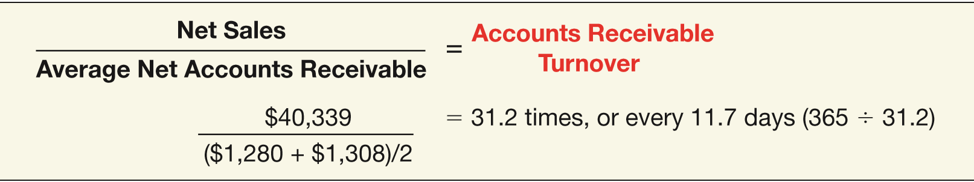
Presentation and Analysis
Analysis of Receivables
Accounts Receivable Turnover Ratio:
  Use to evaluate the liquidity of accounts receivable.
  Measures the number of times, on average, a company collects receivables during the period.
ILLUSTRATION 7-22
Computation of Accounts Receivable Turnover
LO 7

Slide 104
APPENDIX 7A
CASH CONTROLS
Management faces two problems in accounting for cash transactions:
  Establish proper controls to prevent any unauthorized transactions by officers or employees.
  Provide information necessary to properly manage cash on hand and cash transactions.
LO 8 Explain common techniques employed to control cash.

Slide 105
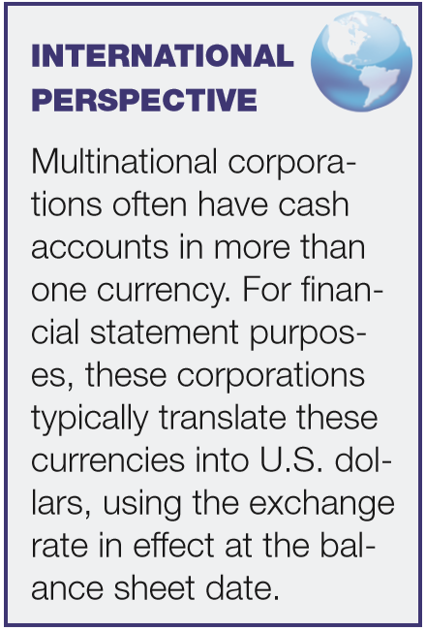
APPENDIX 7A
CASH CONTROLS
USING BANK ACCOUNTS
To obtain desired control objectives, a company can vary the number and location of banks and the types of accounts.
  General checking account
  Collection float.
  Lockbox accounts
  Imprest bank accounts
LO 8

Slide 106
APPENDIX 7A
CASH CONTROLS
THE IMPREST PETTY CASH SYSTEM
To pay small amounts for miscellaneous expenses.
Steps:
Record $300 transfer of funds to petty cash:
Petty Cash 300
Cash 300
The petty cash custodian obtains signed receipts from each individual to whom he or she pays cash.
LO 8

Slide 107
APPENDIX 7A
CASH CONTROLS
THE IMPREST PETTY CASH SYSTEM
Steps:
Custodian receives a company check to replenish the fund.
Supplies Expense 42
Postage Expense 53
Miscellaneous Expense 76
Cash Over and Short 2
Cash 173
LO 8

Slide 108
APPENDIX 7A
CASH CONTROLS
THE IMPREST PETTY CASH SYSTEM
Steps:
If the company decides that the amount of cash in the petty cash fund is excessive by $50, it lowers the fund balance as follows.
Cash 50
Petty Cash 50
LO 8

Slide 109
APPENDIX 7A
CASH CONTROLS
PHYSICAL PROTECTION OF CASH BALANCES
Company should
  Minimize the cash on hand.
  Only have on hand petty cash and current day’s receipts.
  Keep funds in a vault, safe, or locked cash drawer.
  Transmit each day’s receipts to the bank as soon as practicable.
  Periodically prove (reconcile) the balance shown in the general ledger.
LO 8

Slide 110
APPENDIX 7A
CASH CONTROLS
RECONCILIATION OF BANK BALANCES
Schedule explaining any differences between the bank’s and the company’s records of cash.
Reconciling Items:
  Deposits in transit.
  Outstanding checks.
  Bank charges and credits.
  Bank or Depositor errors.
Time Lags
LO 8

Slide 111
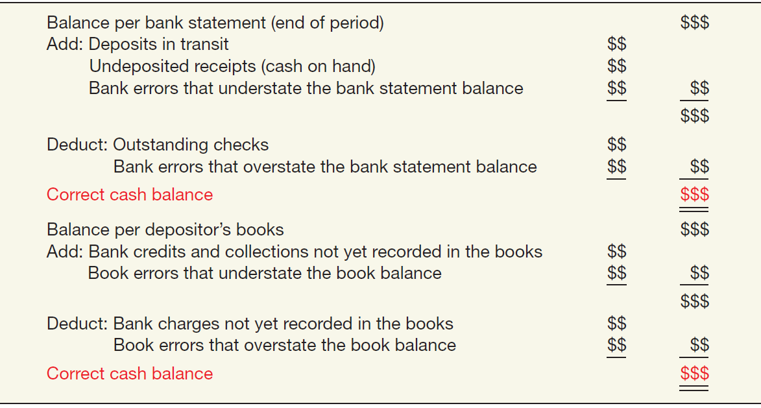
APPENDIX 7A
CASH CONTROLS
RECONCILIATION OF BANK BALANCES
ILLUSTRATION 7A-1
Bank Reconciliation Form and Content
LO 8

Slide 112
Illustration: Nugget Mining Company’s books show a cash balance at the Denver National Bank on November 30, 2017, of $20,502. The bank statement covering the month of November shows an ending balance of $22,190. An examination of Nugget’s accounting records and November bank statement identified the following reconciling items.
A deposit of $3,680 that Nugget mailed November 30 does not appear on the bank statement.
Checks written in November but not charged to the November bank statement are:
Check #7327 $ 150
#7348 4,820
#7349 31
Nugget has not yet recorded the $600 of interest collected by the bank November 20 on Sequoia Co. bonds held by the bank for Nugget.
Bank service charges of $18 are not yet recorded on Nugget’s books.
The bank returned one of Nugget’s customer’s checks for $220 with the bank statement, marked “NSF.” The bank treated this bad check as a disbursement.
Nugget discovered that it incorrectly recorded check #7322, written in November for $131 in payment of an account payable, as $311.
A check for Nugent Oil Co. in the amount of $175 that the bank incorrectly charged to Nugget accompanied the statement.
LO 8

Slide 113
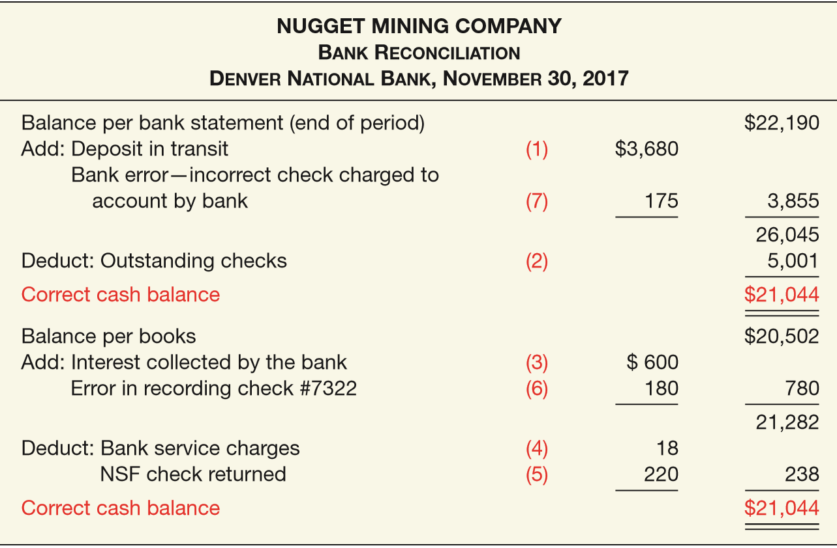

ILLUSTRATION 7A-2
Sample Bank Reconciliation
LO 8

Slide 114
APPENDIX 7A
CASH CONTROLS
Illustration: Journalize the adjusting entry on the books of Nugget Mining Company.
Nov. 30
Cash 542
Office Expense 18
Accounts Receivable 220
Accounts Payable 180
Interest Revenue 600
LO 8

Slide 115
APPENDIX 7A
CASH CONTROLS
Question
The reconciling item in a bank reconciliation that will result in an adjusting entry by the depositor is:
a. outstanding checks.
b. deposit in transit.
c. a bank error.
d. bank service charges.
LO 8

Slide 116
APPENDIX 7B
COLLECTIBILITY ASSESSMENT BASED ON EXPECTED CASH FLOWS
MEASUREMENT OF COLLECTIBILITY
The allowance for doubtful accounts and related bad debt expense on a loan or note receivable can be estimated as the difference between the investment in the loan (generally the principal plus accrued interest or amortized cost) and the expected future cash flows discounted at the loan’s historical effective-interest rate.
LO 9 Describe the estimation of the allowance based on expected cash flows.

Slide 117
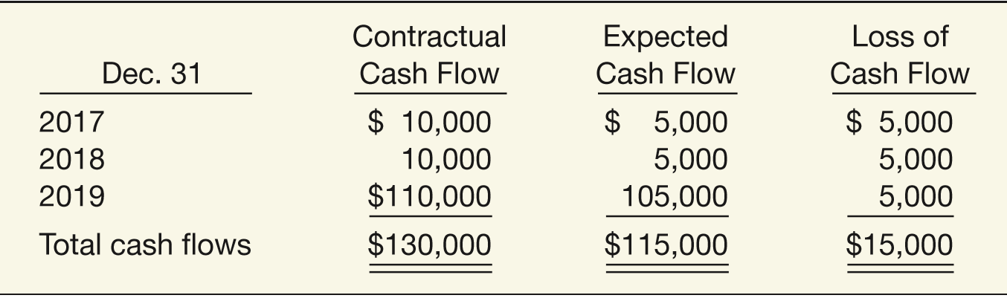
APPENDIX 7B
COLLECTIBILITY ASSESSMENT BASED ON EXPECTED CASH FLOWS
Illustration: At December 31, 2016, Ogden Bank recorded an investment of $100,000 in a loan to Carl King. The loan has an historical effective-interest rate of 10 percent, the principal is due in full at maturity in three years, and interest is due annually. The loan officer performs a review of the loan’s expected future cash flows and utilizes the present value method for measuring the collectibility of the loan. King is experiencing financial difficulty and thinks he will have a difficult time making full payment. Illustration 7B-1 shows the cash flow schedule prepared by the loan officer.
ILLUSTRATION 7B-1
Collectibility Analysis of Loan
LO 9

Slide 118
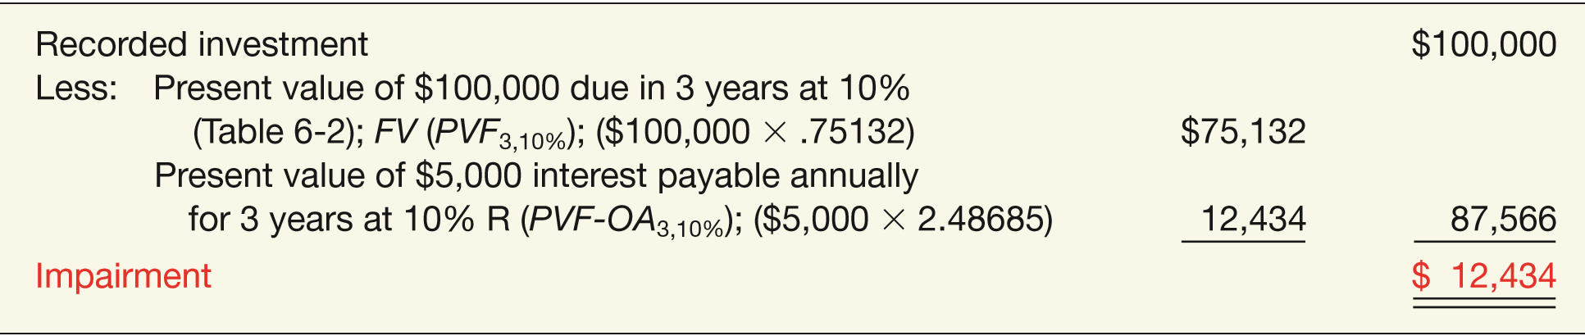
APPENDIX 7B
COLLECTIBILITY ASSESSMENT BASED ON EXPECTED CASH FLOWS
As indicated, this loan is impaired. The expected cash flows of $115,000 are less than the contractual cash flows, including principal and interest, of $130,000. The amount of the impairment to be recorded equals the difference between the recorded investment of $100,000 and the present value of the expected cash flows, as shown in Illustration 7B-2.
ILLUSTRATION 7B-2
Computation of Impairment Loss
Ogden Bank must measure the loss at a present-value amount, not at an undiscounted amount, when it records the loss.
LO 9

Slide 119
APPENDIX 7B
COLLECTIBILITY ASSESSMENT BASED ON EXPECTED CASH FLOWS
Ogden Bank (the creditor) recognizes an impairment $12,434 by debiting Bad Debt Expense for the expected loss. At the same time, it reduces the overall value of the receivable by crediting Allowance for Doubtful Accounts. The journal entry to record the loss is therefore as follows.
Bad Debt Expense 12,434
Allowance for Doubtful Accounts 12,434
Carl King (the debtor) makes no entry because he still legally owes $100,000.
LO 9

Slide 120
RELEVANT FACTS - Similarities
  The accounting and reporting related to cash is essentially the same under both IFRS and GAAP. In addition, the definition used for cash equivalents is the same.
  Like GAAP, cash and receivables are generally reported in the current assets section of the balance sheet under IFRS.
  Like GAAP, for trade and other accounts receivable without a significant financing component, an allowance for uncollectible accounts should be recorded to result in receivables reported at net realizable value. The estimation approach used is similar to that under GAAP.
  Similar to GAAP, IFRS requires that loans and receivables be accounted for at amortized cost, adjusted for allowances for doubtful accounts.
LO 10 Compare the accounting procedures for cash and receivables under GAAP and IFRS.

Slide 121
RELEVANT FACTS - Differences
  Under IFRS, companies may report cash and receivables as the last items in current assets under IFRS. Under GAAP, these items are reported in order of liquidity.
  While IFRS implies that receivables with different characteristics should be reported separately, there is no standard that mandates this segregation. GAAP has explicit guidance in the area.
  Unlike GAAP, IFRS has a different approach to estimating uncollectible accounts on receivables with a significant financing component (e.g., notes receivable). For long-term receivables that have not experienced a deterioration in credit quality after origination, uncollectible accounts are estimated based on expected losses over the next 12 months. For long-term receivables that experience a credit quality decline, uncollectible accounts are estimated based on lifetime expected losses (which is the model used under GAAP for all receivables).
LO 10

Slide 122
RELEVANT FACTS - Differences
  The fair value option is similar under GAAP and IFRS but not identical. The international standard related to the fair value option is subject to certain qualifying criteria not in the U.S. standard. In addition, there is some difference in the financial instruments covered.
  Under IFRS, bank overdrafts are generally reported as cash. Under GAAP, such balances are reported as liabilities.
  IFRS and GAAP differ in the criteria used to account for transfers of receivables. IFRS is a combination of an approach focused on risks and rewards and loss of control. GAAP uses loss of control as the primary criterion. In addition, IFRS generally permits partial transfers; GAAP does not.
LO 10

Slide 123
ON THE HORIZON
Both the IASB and the FASB have indicated that they believe that financial statements would be more transparent and understandable if companies recorded and reported all financial instruments at fair value. That said, in IFRS 9 the IASB created a split model, where some financial instruments are recorded at fair value but other financial assets, such as loans and receivables, can be accounted for at amortized cost if certain criteria are met. While the FASB has adopted a similar approach to classifications, there remain differences in the accounting for impairments on financial instruments with a significant financing component (just about all notes receivable). As indicated, the IASB approach estimates uncollectible accounts over shorter future periods, compared to the FASB model. Most believe that both Boards’ approaches to estimating uncollectible accounts represent improvements and address the weakness in previous bad debt accounting that was highlighted by the financial crisis. Time will tell if one model or the other provides more useful information to investors and creditors.
LO 10

Slide 124
IFRS SELF-TEST QUESTION
Under IFRS, receivables are to be reported on the balance sheet at:
  amortized cost.
  amortized cost adjusted for estimated loss provisions.
  historical cost.
  replacement cost.
LO 10

Slide 125
IFRS SELF-TEST QUESTION
Which of the following statements is false?
  Receivables include equity securities purchased by the company.
  Receivables include credit card receivables.
  Receivables include amounts owed by employees as result of company loans to employees.
  Receivables include amounts resulting from transactions with customers.
LO 10

Slide 126
IFRS SELF-TEST QUESTION
Under IFRS:
  the entry to record estimated uncollected accounts is the same as GAAP.
  loans and receivables should only be tested for impairment as a group.
  it is always acceptable to use the direct write-off method.
  all financial instruments are recorded at fair value.
LO 10

Slide 127
COPYRIGHT
“Copyright © 2016 John Wiley & Sons, Inc. All rights reserved. Reproduction or translation of this work beyond that permitted in Section 117 of the 1976 United States Copyright Act without the express written permission of the copyright owner is unlawful. Request for further information should be addressed to the Permissions Department, John Wiley & Sons, Inc. The purchaser may make back-up copies for his/her own use only and not for distribution or resale. The Publisher assumes no responsibility for errors, omissions, or damages, caused by the use of these programs or from the use of the information contained herein.”

