Slide 1
LANGUAGE DISORDERS IN CHILDREN

Slide 2
DEFINITIONS OF LANGUAGE DISORDERS

Slide 3
DEVELOPMENTAL LANGUAGE DISORDRS
(ASHA) has defined language disorder as an impairment in “comprehension and/or use of a spoken, written and/or other symbol system.
The disorder may involve (1) the form of language (phonology, morphology and syntax), (2) the content of language (semantics)
(3) the function or use of language in communication (pragmatics).
This definition assumes a naturalist perspective (Tomblin, 2008),in which impairment is characterized as a deviation from the average level of ability achieved by a similar group of people.

Slide 4
Normative perspective: Instead of worrying about the level of language impairment, It is important to ask about the impact of the language impairment on the child’s overall development and ability to function in everyday situations.
language disorder should only be diagnosed when it interferes with the child’s ability to meet societal expectations now or in the future.
This could include difficulties with social relationships, academic achievement, and future employment prospects.

Slide 5
CATEGORIES OF LANGUAGE DISORDERS
Children with primary DLD, (DSM-V) uses the term language impaired to refer to this group.
Children of school age with primary DLDs that co-exist with literacy disorders refer to as having language-learning disorders.
Children with DLDs that are associated with or secondary to some other developmental disorder such as ASD or intellectual disorder (ID).

Slide 6
MODALITIES OF LANGUAGE
DISORDER
1. Form: including morphology,syntax, and
phonology (SSD).
2. Content: essentially consisting of semantic components of language, vocabulary knowledge, and knowledge of objects and events.
3. Use: the domain of pragmatics, or the ability to use language in context for social purposes.

Slide 7
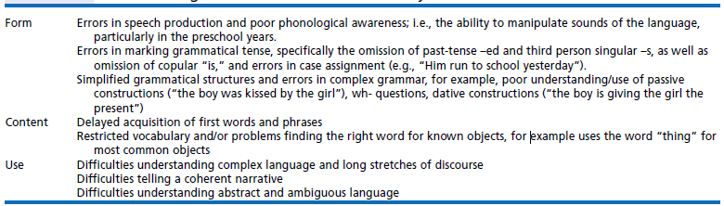

Slide 8
DIAGNOSTIC ISSUES
DLD Measured Relative to What?
Mental Age Referencing: (IQ)cognition-mental abilities-and Language abilities highly affect each others.
Chronological Age Referencing: (Lahy 1990).
Mental age still provides us with some guidelines to help in determining the goals
of intervention.
-Lahey suggested that chronological age is the
most reliably measurement.
Children with ID we have to work on language goals appropriate for his or her chronological age.

Slide 9
ETIOLOGY OF DLD
Nature versus Nurture.
We are who we are via nature (as a foundation) and then are further shaped by nurture .
Environment.
Genetic factors: Behavioral genetics,
endophenotypes, molecular genetics,
- chromosome 16q and non-word repetition.
-19q and expressive language scores.
Five candidate genes associated with spoken langauge disorders:FOXP2 and CNTNAP2 on chromosome7 ---ATP2C2 and CMIP on chromosome16 KIAA0319 on chromosome6

Slide 10
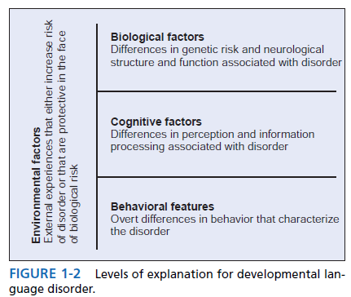
ETIOLOGY OF DLD

Slide 11
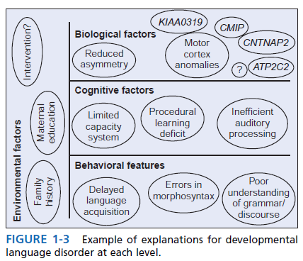
ETIOLOGY OF DLD

Slide 12
Etiology cont.
Neurobiological Factors in DLD:
-Functional specialization(Synaptic Pruning),results in localization
-Left lateralization,
-MRI,fMRI,NIRS,EEG.MEG.
Environmental Factors.
Cognitive Models of DLD:
-Auditory Processing.
-Limited Processing Capacity. (capacity and
demands).
-Procedural Deficits:
Procedural memory systems-rule based learning.
declarative memory systems-knowledge learning.

Slide 13
ASSESSMENT

Slide 14
GENERAL PRINCIPLES OF ASSESSMENT
Assessment is the process of collecting valid and reliable information, integrating it, and interpreting it to make a judgment or a decision.
The goal is to decide whether the child has a significant impairment in language form, content, and/or use, to describe that deficit in some detail relative to the normal developmental sequence of language acquisition.
and to determine how this deficit will affect the child’s daily activities (school, family, and occupation).
Issues of cause or a disease category are less central

Slide 15
Cont.
The SLP almost never comes to assessment conclusions in isolation.
Prior to meeting the child and/or family for the first time, it is necessary to review the referral letter and any other supporting
documentation.
The clinician needs to determine what information is already in the file and what
needs to be learned during the assessment
process.

Slide 16
Basic Questions
What is the problem, What do other professionals (doctor, teacher, other speech-language pathologist) see as this child’s area(s) of deficit?
When did the problem begin, or has the child always had it? Was the onset sudden or gradual?
Does the problem vary in severity, getting worse at some times or with some people and better with others, or is it always about the same?
Is the child perceived as failing at school, How does the family see the child and react to the difficulties?

Slide 17
Case History
Detailed case history will be helpful in refining assessment plans.
sensitive interviewing requires mutual respect; making sure that the clients understand the purpose of the interview; listening carefully; asking clear, open and close-ended questions.
The case history should highlight the family’s major concerns.
A case history also provides an opportunity to document any pre-, peri- or post-natal risk factors that may affect language development.

Slide 18
Cont.
And family history of speech, language, or literacy difficulties.
The case history should also be used as a
vehicle to elicit from parents clear examples of
the child’s communicative attempts.

Slide 19
Low Structured Observations or
Assessment
To observe the child in low structure settings.
A number of observations can be made:
First, the clinician will gain an impression of the child’s expressive language abilities including the length, complexity, and
intelligibility of the child’s utterances.
Second, potential comprehension difficulties may be apparent in the child, Pragmatic skills may also be observed

Slide 20
Cont.
Finally, observation of behaviours outside the domain of language may also be informative. These may include the quality of the child’s imaginative play, attention span, gross and
fine motor skills, and social interests and
interactions.
This set of observations provides the clinician with a working hypothesis of the nature and severity of the child’s language impairment, which can then be tested using standardized assessments.

Slide 21
Language Sample
Video recording.
Recording a conversation between the child
and others.
Language sample :
First, they can be readily used with children from diverse linguistic and cultural backgrounds.
Second, language samples can be a useful way of documenting changes, either over time or in response to intervention.

Slide 22
Cont.
Finally, language samples provide a unique
opportunity to survey pragmatic language
skills in more naturalistic contexts.
Aspects of pragmatic language such as turn-taking, initiation, topic maintenance, intonation, and reciprocity.
These pragmatic language skills are difficult to
assess using standardized tests, but will be important in formulating treatment plans.

Slide 23
THE ASSESSMENT PLAN
Clinician will have reviewed existing case files.
Requested information from other professionals working with the child.
Interviewed the family (and possibly the child).
Observed the child during less formal activities.
And taken a sample of the child’s language and communication skills in naturalistic conversation.
This information should result in a working
hypothesis about the nature of the language
deficit and type of assessment to be done.

Slide 24
Assessment Purposes.
Screening:
Screening is used only to identify children at risk of DLD.
For children who fail screening, a more extensive assessment will be needed.
Establishing Baseline Function:
Assessment is used to determine the child’s current level (strength, weakness).
Examine all areas of communicative function.
Examine areas related to the child’s ability to use language, such as hearing, cognitive skills, and oral-motor abilities.

Slide 25
Cont.
Establishing Intervention Goals:
Reference the child’s current language skills against the typical developmental sequence.
Identify the areas in which the child is functioning below expectations for developmental level.
The comprehension of syntax or vocabulary;
The expression of words, sounds or sentences, or the use of a range of different communicative functions would then be targeted for intervention.

Slide 26
Cont.
Measuring Change in Intervention:
Assessment is an on-going process.
Reassessment is necessary to determine whether the goals of the program have been met.
Ongoing assessment is necessary to decide when to dismiss a client from intervention.
Dismissal posing these questions:
Is more change needed? • Is more change possible? • Can more change be achieved without costs that outweigh its benefits?

Slide 27
Reasons For Discharge
1. The child has achieved all the goals identified in the diagnostic phase of the program and is no longer viewed as having a developmental language disorder.
2. The child has reached a plateau and efforts to modify the intervention program do not achieve more progress.
3. The child is making progress, but this progress cannot be attributed to the intervention program.

Slide 28
What to Assess
Our assessments will include measures of language form, content, and use.
Domains of language in at least two different modalities: comprehension and production.
Assess collateral areas include, at a minimum, hearing, oral-motor functioning, general cognitive abilities, and social functioning.

Slide 29
Domains of Language
1.Form (syntax, morphology, phonology): Inflectional marking of words, basic sentence components such as noun, verb, prepositional,
adverbial phrases; sentence types, such as negatives, interrogatives, embedded clauses, Form also includes the ability to produce sounds accurately, the consistency of sound production, and the use of phonological simplication processes.

Slide 30
Cont.
2. Content (semantics): Knowledge of vocabulary; the ability to express and understand concepts about objects and events;
the use and comprehension of semantic relations among these objects and events; understanding of lexical ambiguity and multiple meanings (e.g., that “cold” can refer to temperature, illness, or a personal quality).

Slide 31
Cont.
3. Use (pragmatics): The range of communicative functions (reasons for talking); the frequency of communication; discourse skills (turn-taking, topic maintenance and change,
requests for clarification); the flexibility to modify language for different listeners and social situations; the ability to convey a coherent and informative narrative.

Slide 32
Comprehension and Production
Comprehension is, as Miller and Paul (1995) put it a private event, something that happens within the child’s mind.
Children function quite differently in terms of their comprehension performance in different contexts and settings.
Miller and Paul (1995) suggested pairing traditional comprehension assessment with assessment of language comprehension in more naturalistic settings with non-linguistic supports such as gesture, gaze, and other contextual cues.

Slide 33
Cont.
Assessment of language production gives us direct access to how children express themselves with language.
Tests that require children to repeat sentences of increasing length and complexity can be important markers of language impairment.
Children may also produce language differently in different contexts.
In addition to standardized measures, we sample spontaneous speech in naturalistic settings in order to determine functional and valid targets for intervention.

Slide 34
Assessing Collateral Areas
Hearing.
Oral-Motor Assessment.
Examination of the External Face and Head.
Intraoral Examination.
Examination of Velopharyngeal Function
and Resonance.
Examination of Volitional Oral Movements.
Diadochokinetic Assessment.
Evaluating Respiratory and Phonatory Function.

Slide 35
Cont.
Nonverbal Cognition.
Social Functioning.
Standardized Tests.
INTEGRATING AND INTERPRETING ASSESSMENT DATA.
DIAGNOSIS.
Severity Statement.
Prognostic Statement.
Recommendations.
The Clinical Report.

Slide 36
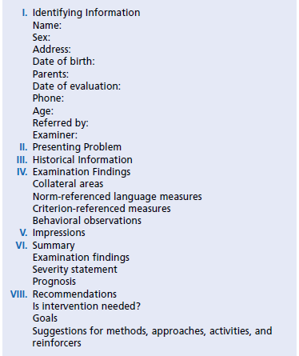
Outline for a Clinical Report

Slide 37
Principles of Intervention

Slide 38
THE PURPOSE OF INTERVENTION
Olswang and Bain (1991):
Change or Eliminate the underlying problem.
Change or Modify the disorder.
Teach compensatory strategies.
Intervention may be focused the child’s environment.
Fourth option is combined with one of the other three to maximize the child’s communicative potential.

Slide 39
Cont.
Identification of the basic purpose of the intervention based on:
The age of the client.
The intervention history of the client.
The nature of the disorder.
The way the environment interacts with the child’s communicative function.
The data collected from the communication
assessment.

Slide 40
Expected Results
Child responds correctly to more items on a test.
Accurately imitates the language stimuli given by the clinician.
Child’s being able use the forms and functions targeted in the intervention to effect real communication.
Make the child a better communicator.
Intervention has led to changes in language behavior that would not occur if no intervention were provided.

Slide 41
HOW CAN INTERVENTION CHANGE
LANGUAGE BEHAVIOR
Facilitation:
The rate of growth or learning is accelerated, but the final outcome is not changed.
Helps children to achieve language milestones sooner than they would have if left to their own devices.
Does not mean that they ultimately achieve higher levels of language function than they would have without intervention.

Slide 42
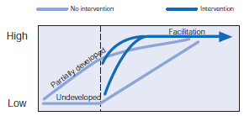
Cont.
Facilitation can bring language to a higher level of awareness.
This awareness can influence other aspects of language development.
Other systems in development that accelerating language skills may be enhanced.

Slide 43
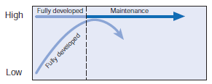
Cont.
Maintenance:
Intervention for maintenance preserves a behavior that would otherwise decrease or disappear.
keep an immature system intact, going, and functional so that it is able to reach its full development at a later stage.

Slide 44
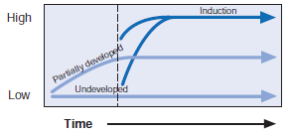
Cont.
Induction:
Intervention completely determines whether some endpoint will be reached.
Without the intervention,the outcome is not achieved.

Slide 45
DEVELOPING INTERVENTION PLANS
Intervention should be carefully considered and planned in detail before implemented.
Evidence-Based Practice:(Conscientious), making use of the available scientific evidence in choosing our intervention methods.
External evidence.
Internal evidence.

Slide 46
Products of Intervention: Setting Goals
There are three aspects of the intervention plan:
The intended products, or objectives, of the intervention.
The processes used to achieve these objectives.
The contexts, or environments, in which the intervention takes place.
Three types of goals: Long,Intermediate,Short term goals.

Slide 47
Cont.
Zone of proximal development(ZPD):the distance between a child’s current level of independent functioning and potential level of performance.
ZPD defines what the child is ready to learn with some help from a competent adult.
Communicative Effectiveness:how efficient the targeted behaviors will be in increasing a child’s ability to communicate.
Client Phonological Abilities.(phonological constraints)
Teachability: easily demonstrated or pictured,easily accessed and organized stimulus, used frequently.

Slide 48
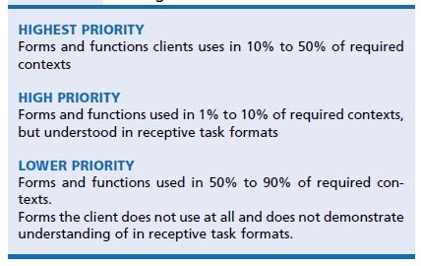
Suggestion for Setting Priorities among Intervention Goals

Slide 49
Intervention Approaches
The Clinician-Directed Approach:(CD),(DTI)
( Discrete-Drill- Trial Intervention).
Clinician specifies all aspects of intervention.
Drill:prompts, faded, reinforced, motivating event,shaping the client incorrect responce.
Drill Play: antecedent motivating event, subsequent motivating event.
Modeling:third-person model(confederate).

Slide 50
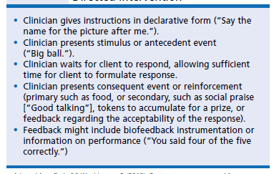
Training Protocol for Clinician-
Directed Intervention

Slide 51
Child-Centered Approaches:(CC)indirect language stimulation (ILS), facilitative play, pragmaticism, developmental or developmental/pragmatic approaches.
For Obstinate and Unassertive child.
Self-talk and parallel talk.
Imitations.
Expansions. (Grammatically correct version)
Extensions(semantic information).
Buildups and breakdowns.
Recast sentences(verbal reflective question).

Slide 52
Cont.
Hybrid Approaches:
Target one or a small set of specific language goals.
Clinician maintains a good deal of control in selecting activities and materials.
Clinician uses linguistic stimuli just to model and highlight the forms being targeted.
Hybrid techniques were effective for improving vocabulary and phonological awareness in children with DLD.

Slide 53
Cont.
Focused Stimulation:
Child is tempted to produce utterances with obligatory contexts for the forms being targeted.
The clinician helps the child succeed in this by providing a very high density of models of the
target forms in a meaningful communicative
context usually play.
This approach is very effective for improving comprehension of a form, as well as production.

Slide 54
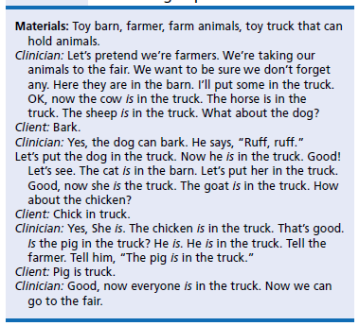
A Focused Stimulation Approach to Teaching Copula “Is”

Slide 55
Cont.
Vertical Structuring:
Vertical structuring is a particular form of expansion.
Add to child’s utterance either Grammatically or semantically features.
Used like focused stimulation to highlight target structures.
Vertical structuring has been used primarily to target early developing language forms.

Slide 56
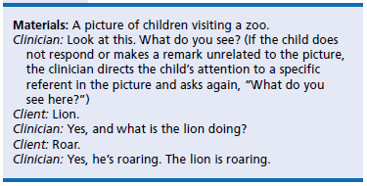
Eg:

Slide 57
Cont.
Milieu Communication Training: three major components that characterize this approach:
(1) environmental arrangement.(to fit the targeted goal)
(2) responsive interaction.(in my response I expand his response relating to my therapy target)
(3) conversation-based contexts that use child interest and initiation as opportunities for modeling and prompting communication
in everyday settings.
Incidental teaching and focused attention.
Mand-model.
with preschool children with intellectual and language disorders, ASD, children from high-risk and low-income families.

Slide 58
Enhanced Milieu Teaching (EMT).
Effective for children who:
produce some verbal imitation.
have at least 10 productive words.
are in the early stages of language development.
(4) with (MLUs) from 1 to 3.5.
EMT has focused on parent-delivered therapy.

Slide 59
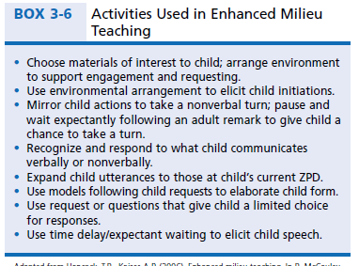
Cont.

Slide 60
Specific Language Impairment
(SLI)

Slide 61
Definition
Significant limitations in language functioning that cannot be attributed to:
Intellectual dysfunction.
Hearing disorders.
Oral structural or oral motor abnormalities.
Neurological disorders.
Social inabilities.
The DSM‑5 criteria include persistent difficulties in the acquisition and use of language across modalities (i.e.,spoken, written, sign language) due to deficits in comprehension or production.
An individual’s language abilities must be below age expectations.

Slide 62
Prevalence and Causation.
The prevalence of SLI is 7% (Fox, Dodd, & Howard, 2002).
SLI occurs more frequently in males than females.
A gene locus that is linked to individuals with speech and language impairments has been identified.
A child with SLI is more likely to have a family member with language impairment.
A child’s environment also affects language development.

Slide 63
Major Characteristics
The morphosyntax features of language are the primary deficit for children with SLI.
They take longer time to reach the same linguistic milestones as their peers.
(a) verb forms (e.g., third-person singular s, past tense ed, copula verbs [is, are], auxiliary verbs [is, are, do, can]).
(b) articles (a, the).
(c) possessive ’s.
(d) pronouns.

Slide 64
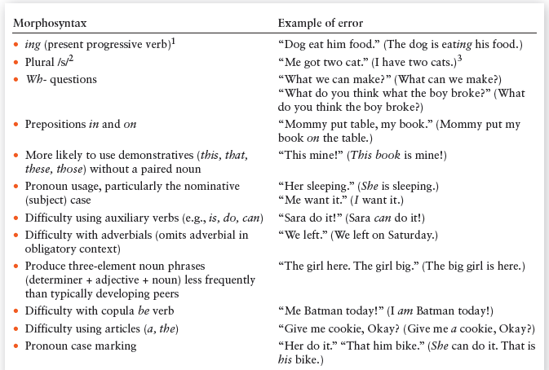
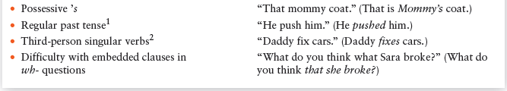
Morphosyntax Deficits in Children with SLI

Slide 65
Cont.
Children with SLI enter school, they have difficulty with the more sophisticated language needed for academics.
Written language has more compound and complex sentences than spoken language.
Children with SLI have difficulty with syntactically complex sentences and use embedded clauses less often than children who are developing typically.
Children with SLI have difficulty with vocabulary
development.

Slide 66
Cont.
Children with SLI often produce word combinations up to 3½ years behind their peers.
Children with SLI have difficulty learning to use verbs.
Lexical problems of children with SLI relate to:
(a) the additional time needed for word retrieval.
(b) decreased ability to expand new object names to objects in the same semantic category.

Slide 67
Cont.
(c) the need to learn new words.
Pragmatic difficulties:
Social communication problems are limitations in an individual’s social, cognitive, and language skills necessary for contextually appropriate, meaningful, and effective interpersonal communication (Adams, 2005).
Children with SLI have difficulty entering into peer-group conversations.
Struggle to make conversational repairs such as clarifying their communication when there is a conversational breakdown.
Data show that many adults who were diagnosed as having SLI as children continue to experience serious problems with employment, independent living, and personal relationships.

Slide 68
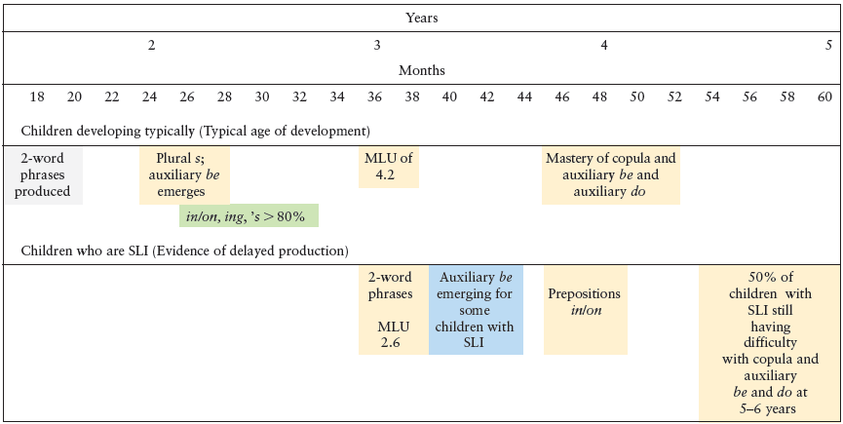
Comparison of Development of Children with and without Specific Language Impairment

Slide 69
Children with SLI also have more frequent phonological impairments than their typically
developing peers.
It has been estimated that up to 40% of children with SLI have phonological deficits.
The phonological differences emerge at an early age.
SLI children have smaller consonant and vowel inventories and use a more restricted and less mature variety of syllable shapes than do their typically developing peers.(CV,CCV,CVC)

Slide 70
Associated Problems
Children with SLI need more time to process information than do children developing typically.
Children with SLI have capacity limitations in their cognitive processing resources.
The slower rate of processing results in reduced ability to rapidly name pictures and recognize words.
The rate of nonword repetition tasks (i.e., repetitions of nonsense words) also is reduced in children with SLI. This task depend on child’s phonological short-term memory.

Slide 71
Cont.
A higher-than-expected proportion of children with SLI are diagnosed with attention-deficit/ hyperactivity disorder (ADHD), about two times more likely to show ADHD symptoms than children developing typically.
Impulsivity, high activity, and distractibility.
Approximately 80% of school-age children with SLI experience reading problems-dyslexia
Phonological awareness deficits result in problems detecting, segmenting, and blending sounds in words, hindering children’s reading decoding.
Children with SLI demonstrate frequent grammatical errors in their writing and have difficulty with written verb morphology.

Slide 72
Special Consideration for Special Populations

Slide 73
INTELLECTUAL DISABILITY
The American Association on Intellectual and Developmental Disabilities (AAIDD) definition of intellectual disability (Schalock et al., 2010):
“Intellectual disability is a disability characterized by significant limitations both in intellectual functioning and in adaptive behavior, which covers many everyday social and practical skills. This disability originates before the age of 18.”

Slide 74
Cont.
In addition, the AAIDD (2010) diagnosis requires that:
1. Limitations in present functioning must be considered within the context of community environments typical of the individual’s age, peer group, and culture.
2. Valid assessments consider linguistic and cultural differences in the way people communicate, move, and behave.
3. Within an individual, limitations often coexist with strengths.
4. The major purpose of describing limitations is to develop a profile of needed supports.
These conditions help to ensure that, if appropriate, individualized supports are provided over a sustained period, which will improve the person’s level of life functioning.

Slide 75
Cont.
Intellectual functioning, or intelligence: refers to general mental capacity, such as learning, reasoning, and problem solving, planing
This may be operationalized based on IQ test scores.
Adaptive behaviour comprises three skill types:
Conceptual skills: language and literacy; money, time, and number concepts; and self-direction.

Slide 76
Cont.
Social skills: interpersonal skills, social responsibility, self-esteem, gullibility, naïveté (ساذج) ,social problem solving, and the ability to follow rules/obey laws and to avoid being victimized.
Practical skills: activities of daily living (personal care), occupational skills, healthcare, travel/transportation, schedules/routines, safety, use of money, and use of the telephone.
Adaptive behaviours must be relative to the
individual’s cultural group.

Slide 77
Cognitive Characteristics
Slower developmental trajectory.
Pronounced deficits in executive functioning (EF; Willner et al., 2010) and working memory (Henry & Winfield, 2010; Caretti, Belachi, & Cornoldi, 2010) than would be expected.
EF skills were not strongly correlated with IQ scores, but that impairments in EF may be more closely associated with impairments in adaptive behavior.

Slide 78
Language Characteristics
Delayed language acquisition is often one of the first signs of ID.
Miller and Chapman (1984) estimated that approximately 50% of children wit nonspecific ID had language skills commensurate with nonverbal abilities.
25% had expressive language deficits relative to comprehension skills.
The remainder(25%) had deficits in both comprehension and expression.

Slide 79
Cont.
Form
Grammatical acquisition follows a typical developmental sequence, albeit at a slower developmental pace.
Children with ID tend to use shorter, less complex sentences with fewer elaborations and relative clauses than do typical peers.
Content
Age-equivalent vocabulary scores did not differ significantly from syntactic measures.

Slide 80
Con.
Use
Pragmatic competence in everyday situations requires the integration of cognitive, linguistic, and social-emotional cues, making it particularly vulnerable in ID.
ID may be slow to develop intentional communication in the pre-verbal stages of development.
ID are less able to clarify meaning and request clarification when they have not understood utterances.
ID have considerable difficulties constructing coherent narratives (Murfett, Powell, & Snow, 2008).

Slide 81
Cont.
Literacy
Literacy is slower to progress for children with ID.
Children with ID initiated word reading and oral language skills which predict reading comprehension abilities less often

Slide 82
Down Syndrome
Down syndrome (DS) is the most common genetic cause of intellectual disability, occurring in approximately 1 in 700 live births
(Canfield et al., 2006).
DS results from an extra (third) copy of chromosome 21 (which is why it is sometimes referred to as trisomy 21).
Increasing maternal age significantly increases risk of Down syndrome.
Down syndrome is characterised by mild to moderate ID.

Slide 83
Cont.
hypotonia (low muscle tone), distinctive facial features such as microgenia (an abnormally small chin), round face, macroglossia (protruding or oversized tongue), epicanthal fold (fold of skin on the eyelid), short stature and shorter limbs, and hyperflexibility of joints
DS is also associated with a number of health concerns including a higher risk for congenital heart defects, gastroesophageal reflux disease, recurrent ear infections, obstructive sleep apnea, and thyroid disfunction

Slide 84
Cont.
Co-morbid autism is diagnosed in 10% of children with DS.
DS are at greatly increased risk of experiencing early onset Alzheimer’s disease.

Slide 85
Cognitive Characteristics
DS experience global developmental delays in fine and gross motor skills.
Mild to moderate intellectual disability, with the majority of IQ scores between 40 and 70 (Hodapp, Evans, & Gray, 1999).
Marked deficits on measures of working memory, but these are more pronounced with verbal material relative to visuospatial working memory.
Executive functions, the cognitive processes integral to adaptive, goaldirected actions, are vulnerable in DS (Kittler, Krinsky-McHale, & Devenny, 2008).

Slide 86
Cont.
Problems with response inhibition (impulse control), cognitive flexibility, and planning.
Difficulties persisting with learning tasks.
Individuals with DS have greater difficulty than mental-age–matched comparison groups learning new rules and applying them (Lanfranchi et al., 2010).
Take longer time to solve problems and are more likely to abandon efforts at problem solving.
Clearly, deficits in executive skills can impact academic performance as children with DS struggle to stay on task and monitor and adapt their own behavior to achieve learning goals.

Slide 87
Language Characteristics
Expressive language is more severely impaired than receptive language abilities (Laws & Bishop, 2003).
Form:
Speech intelligibility in DS is poor relative to cognitive ability.
Most speech sound errors are developmental in nature (e.g., cluster reduction and final consonant deletion) vowel distortions and inconsistent pronunciations.
Apraxia of speech has also been reported in DS (Rupela & Manjula, 2007).

Slide 88
Cont.
Syntactic comprehension is characterised by slowed growth and even decline in late adolescence (Laws & Gunn, 2004).
DS produce shorter and less complex sentences and fewer question/negation forms than typically developing peers.
Particular limitations in tense marking (past tense –ed; third person singular –s)similar to
children with SLI.
Price et al. (2008) reported that grammar was more severely impaired in DS than in Fragile X syndrome.

Slide 89
Cont.
Content:
Acquisition of first words in DS is significantly delayed and subsequent growth of expressive vocabulary is slower than expected.
Expressive vocabulary is impaired relative to peers matched on nonverbal IQ (Caselli et al., 2008;Price et al., 2007).
There is some evidence that gesture is preferentially used by young children with DS and supports vocabulary comprehension.
word learning and vocabulary growth may be affected by limitations in phonological short-term memory.

Slide 90
Cont.
Use:
Early joint communicative behaviors such as mutual eye contact, vocalizations, and dyadic interactions with caregivers may be delayed or less coordinated than those observed in typically developing (TD) infants (Berger & Cunningham,1983; Jasnow et al., 1988).
By the age of two, infants with DS catch up, with many children with DS showing more social-interactive behaviors than TD peers (Mundy et al., 1988).

Slide 91
Cont.
Narrative skills of children with DS also reflect a good conceptual understanding of the story.
Roberts et al.
(2007) reported that children with DS provided fewer elaborative utterances in conversational turns relative to peers matched for nonverbal ability instead providing minimally adequate replies.
DS are less likely to signal non-comprehension of language or request clarifications in referential communication tasks (Abbeduto et al., 2008).

Slide 92
Cont.
Literacy:
Reading skills of children with DS are extremely variable and little is known about the proportion of children with DS who achieve reading proficiency (Martin et al., 2009).
like other aspects of language development, literacy development in DS follows protracted.
Individuals with DS are more likely to have profile similar to that of “poor comprehenders” in which word reading abilities outstrip reading comprehension skills (Roch & Levorato, 2009).
Poor reading comprehension was associated with levels of oral language comprehension.

Slide 93
Williams Syndrome
Williams syndrome (WS) is a complex neurodevelopmental disorder that results from the deletion of approximately 25 genes on one copy of chromosome 7q11.23 (Osborne, 2006).
Prevalence rate of 1 in 7,500 live births (Stromme et al., 2002).
Physical features include characteristic facial dysmorphology, cardiovascular heart disease, growth deficiency, and connective tissue abnormalities.
Behavioral aspects is one of overfriendliness, social gregariousness, and marked anxiety .

Slide 94
Cognitive Characteristics
Infants and toddlers with WS experience global developmental delays.
Older children and adults with WS generally have mild to moderate ID.
Most notably, children with WS have profound difficulties with visual-spatial construction, 20 points lower than scores on other intelligence scales.
Difficulties with adaptive behavior, particularly in the areas of motor development and independent living.

Slide 95
Language Characteristics
WS has been put forward as the archetypal evidence for dissociations between cognitive and linguistic skill.
Exquisite mastery of syntax and vocabulary in the context of pronounced nonverbal cognitive deficits.

Slide 96
Form:
Canonical babbling is significantly delayed in infants with WS relative to age-matched infants (Mervis & Becerra, 2007).
There are no reports of significant speech sound disorders or reduced intelligibility in older, verbal children with WS.
Grammar is “intact” and much better than expected for overall level of nonverbal cognitive ability superior than those with DS.
Deficits in grammatical understanding are evident, but these are strongly related to verbal working memory abilities and general levels of cognitive ability (Mervis & John, 2010).

Slide 97
Content:
Understanding and production of concrete vocabulary are relative strengths for individuals with WS, resulting in consistently higher scores on measures of vocabulary.
Profound difficulty with relational or conceptional vocabulary experienced by individuals with WS This vocabulary is important for marking spatial, temporal, and dimensional concepts as well as for devices such as conjunction and disjunction.

Slide 98
Use:
WS have pronounced pragmatic difficulties, despite the superficial air of social skills.
The emergence of joint attention is delayed and there is an atypical temporal relationship between gesture and word production, referential gestures such as pointing precede referential word production.
Children with WS are more likely to look at faces than children with ASD, their ability to integrate gaze cues for communication purposes is impaired
Pragmatic difficulties are evident in conversational behavior, in which individuals with WS are less likely to provide contingent and informative responses than peers with more specific DLDs.

Slide 99
children with WS made considerably more social evaluative statements and fewer cognitive inferences.
Children with WS have more difficulty monitoring their own comprehension and signalling when their conversational partners provide ambiguous or inadequate messages.
Literacy:
The reading skills of children with WS are variable.
Reading comprehension scores are generally significantly lower than word reading abilities.

Slide 100
Fragile X Syndrome
Definition and Classification
Fragile X syndrome (FXS) is a single gene disorder located on the bottom end of the X chromosome (FMR1),(FMRP).
FXS is an inherited disorder, and is the most common inherited form of ID.
FXS occurs in approximately 1 in 4000 males and 1 in 8000 females.
FXS do not have clearly dysmorphic features and are often difficult to identify before the age of 3, unlike children with DS, whose physical features are noticeable from birth.

Slide 101
Cont.
These include elongated face, long and prominent ears, highly arched palate,enlarged head, hypotonia, flat feet, hyperextensible finger joints,and large testicles (macroorchidism).
Occasional joint dislocations, recurrent otitis media, strabismus, mitral valve prolapse, and/or dilation at the base of the aorta and gastrointestinal reflux, which is seen in the majority of male infants with FXS.
Co-morbid conditions are extremely common in FXS and affect language development and disorder.

Slide 102
Most striking are the high rates of autism spectrum disorder identified in males with the full FXS mutation; approximately 30% to 50% of boys with FXS meet criteria for a diagnosis of autism spectrum disorder (Harris, 2008).
This makes FXS the single largest known genetic cause of ASD, though only 2% to 6% of ASD cases can be attributed to FXS (Reddy, 2005).
FMRP expression is predictive of cognitive ability, it does not appear to be associated with severity of ASD symptoms (Loesch et al., 2007).

Slide 103
Other co-morbidities include attentiondeficit hyperactivity disorder (ADHD), which is reported to affect 44% to 93% of children with FXS meeting diagnostic criteria for ADHD (Sullivan et al., 2006).
Seizures, which affect approximately 20% of males; and high rates of anxiety, reported in a national parent survey to affect approximately 70% of males and 56% of females (Bailey et al,. 2008).

Slide 104
Cognitive Characteristics
ID is the predominant cognitive characteristic; nearly all males have a degree of ID that is similar to that seen in DS.
Females tend to have less severe ID; approximately 25% have IQ scores less than 70, though about half have borderline IQ scores (Cornish, 2008).
Deficits in executive function has also been proposed, with significant deficits in sequential processing, working memory deficits, cognitive flexibility, planning, selective attention, inhibitory control problems, and fine and gross motor delay (Hooper et al., 2008).

Slide 105
Language Characteristics
Gender differences in language attainment are particularly pronounced in FXS, with girls invariably demonstrating higher levels of linguistic competence relative to males with FXS.
It will be absolutely essential for the clinician to establish whether co-morbid ASD is present
Researchs in FXS has been directed at understanding the genetic pathways to behavior; as a result very little is known about environmental influences on language development in FXS, or whether modifying the languagelearning environment can positively alter developmental trajectories(Finestack et al., 2009).

Slide 106
Form:
In general, the speech sound production of boys with FXS is commensurate with nonverbal mental age expectations.
Less intelligible in connected speech.
Phonological processing is less well developed in FXS demonstrating significant impairments in phonological short-term memory .
Boys with FXS are delayed in both their understanding and production of grammar and morphosyntax.
Boys with FXS have shorter MLUs.

Slide 107
Cont.
Less complex noun and verb phrases are evident in conversational language.
Production of questions/negation may be more in line with nonverbal skills.
Expressive and receptive grammatical skills of boys with FXS are somewhat better than boys with DS, and are comparable in individuals with and without co-morbid ASD (Price et al., 2007, 2008).

Slide 108
Content:
Some investigators reporting weaker vocabulary scores and others suggesting that vocabulary is commensurate with nonverbal mental age expectations (Finestack et al., 2009).
expressive vocabulary is impaired and rates of vocabulary growth are slower than those seen for younger typically developing children (Roberts et al., 2002).
We know very little about the integrity of semantic networks in FXS or about how flexibly children with FXS use their semantic knowledge, for example in understanding figurative expressive or verbal humor.

Slide 109
Use:
Closely matched with ASD boys.
Different language characteristics have been reported including increased use of tangential language, perseverative and repetitive speech, delayed echolalia, and use of stereotyped phrases (Cornish et al., 2004).
Boys with FXS have difficulty maintaining coherent, semantically rich conversational exchanges (Roberts, Martin et al., 2007).
Children with FXS also show evidence of poor understanding of other people’s minds, as indexed by false belief tasks (Grant, Apperly, & Oliver,2007).

Slide 110
These deficits appear to be associated with deficits in working memory and executive control (inhibition) rather than social understanding per se.
Measures of referential communication also reveal pragmatic weaknesses in FXS.
Literacy:
Investigations of literacy development in FXS are lacking.
No systematic investigations of percentages of children with FXS who develop functional reading.
Given oral language weaknesses and pervasive pragmatic difficulties, reading comprehension is likely to present significant challenges to individuals with FXS.

Slide 111
Visual Impairment
(VI) may experience some early delays in the acquisition of language, but by school age these problems are largely resolved (Mulford, 1988).
VI may also learn to read with the help of specially adapted writing systems such as Braille and computer programs that convert text to speech.
Pragmatic skills are vulnerable in children with VI.

Slide 112
Cont.
Early differences in language acquisition may be attributable in part to disruptions in early visual experiences joint attention.
VI are delayed in their acquisition of first words and phrases (Lahey, 1988).
Researchs has consistently demonstrated that children with VI develop age appropriate vocabularies and MLUs by their third birthday.
Some pragmatic impairments include the extensive, and sometimes inappropriate use of questions.
A paucity of communicative gestures; and extensive use of imitative speech, repetitions.

Slide 113
Cont.
Some methods of facilitating language and social communication in this population include:
Provide labels and descriptions of the objects the child handles and what he or she can do with these objects
• Ask both open-ended and more directive questions
• Provide more qualitative information not only about the child’s actions, but also other things going on in the environment
• Model and encourage the child to engage in pretend play
• Engage in shared book reading activities

Slide 114
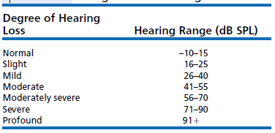
Hearing Impairment

Slide 115
Sensori-Neural Hearing Loss
Cognitive Characteristics:
Many (HI) children score within the normal range on appropriate tests of nonverbal reasoning.
Approximately 30% of children with moderate to profound losses have additional medical conditions that may adversely affect cognitive development.

Slide 116
Language Characteristics
In profound hearing losses, what language the child will learn and when he or she will learn it.
Deaf children born to deaf parents are likely to learn American Sign Language and will have exposure to this language from the earliest opportunity.
Members of Deaf have developed a rich culture and fulfilling social world for members of the community.

Slide 117
Three Important Issues
Majority of deaf children are born to hearing parents
Who do not know Sign and
May not even be immediately aware that their child has a hearing impairment.
Within Signing communities, there are individual differences in language competence
Until recently we have lacked linguistically and culturally appropriate assessment instruments.
Improvements in universal screening of hearing of newborn infants mean that hearing impairment is now identified at birth.
FDA approved cochlear implantation for children as young as 12 months in year 2000.

Slide 118
Form:
early speech sound inventories and patterns of babbling observed in children with HI are different from those of hearing children.
In (CI) cases once words are acquired, the sequence of phonemes learned is roughly similar to that of hearing children, though protracted in development.
Children with HI are more likely to produce voicing errors, extra nasality,and initial syllable omission.
Many children with severe and profound hearing losses will have lower levels of speech intelligibility.

Slide 119
Cont.
Spoken language morphology and syntax have long been recognized as particularly challenging for children with HI.
rate of MLU growth is slower than that seen in NH children (Geffner 1987).
It appears that age of (CI) implantation or level of residual hearing can dramatically influence growth; in this case earlier definitely better.
Many children fail to acquire the typical range of morphemes used in English.

Slide 120
Cont.
Children with HI (including CI users) may rely more on semantic/conceptual cues than purely grammatical markers in developing morphology (Ruder,2004).
Children with primary DLD, children with HI are able to mark plural –s with little difficulty but are more likely to omit third person singular –s.
Children with HI are significantly delayed in their acquisition of complex grammatical structures (Friedmann & Szterman, 2006).

Slide 121
Content:
Overall, there is some evidence that vocabulary levels may be delayed in HI.
CI use can alter the developmental trajectory such that children achieve typical levels of receptive vocabulary (Hayes, Geers, Treiman, & Moog, 2009).
Language revealed similar growth curves and patterns of vocabulary development, and indicated that predictors of language growth in Signing HI children are similar to those seen in NH populations,namely maternal education and maternal language input (Woolfe et al., 2010).
Children with HIhave more difficulty labelling new referents and recalling the label after training (Houston et al., 2005).

Slide 122
Use:
early exposure to language and communication in socially meaningful contexts is more important than hearing status per se.
Falkman and Hjelmquist (2006) reported that non-native signers were less successful than hearing peers on referential communication tasks, but that performance was associated with working memory, rather than social cognition.

Slide 123
Literacy:
Literacy outcomes for children with HI have changed dramatically with the introduction of CI.
It has also been the case that the gap between HI and NH readers has increased over time; a delay of 1 year at age 8 can become a 4-year delay at age 14 (Harris &Moreno, 2004).
There is evidence that CI use can result in near normal levels of reading comprehension (Spencer et al., 2003),though others have reported continued deficits in reading and spelling in adolescents with HI (Harris & Terleksti, 2010).

Slide 124
Cont.
Kretschmer and Kretschmer (2001) reported that children with HI exhibit more emergent literacy behaviors when they are provided with engaging,print-rich environments at home and at school, and when their early attempts at writing in these environments are similar in form and content to NH peers.
Exposing children with HI to books and stories, demonstrating the uses of writing in everyday activities, and providing attractive writing materials and opportunities will be useful in this population, as in others, for fostering literacy development.

Slide 125
Autism Spectrum Disorders
ASD
(DSM‑5,V; American Psychiatric Association ,APA 2013):
(ASD) to categorize individuals who have:
(a) deficits in social communication and social interaction.
(b) demonstrate restricted repetitive behaviors, interests, and activities (RRBs).
specific nonfunctional routines.
repetitive motor manners.
preoccupation with parts of objects.

Slide 126
Cont.
ASD category now is an umbrella term that applies to individuals with:
1- Autistic disorder.
2- Asperger’s disorder.
3- Childhood Disintegrative Disorder.
4- Any other pervasive developmental disorder not otherwise specified.
Note: new category called “social (pragmatic) communication disorder”: have difficulties with social skills but do not show restricted or repetitive patterns of behavior.
Individuals with ASD must show symptoms from early childhood, even if those symptoms are not recognized until later.

Slide 127
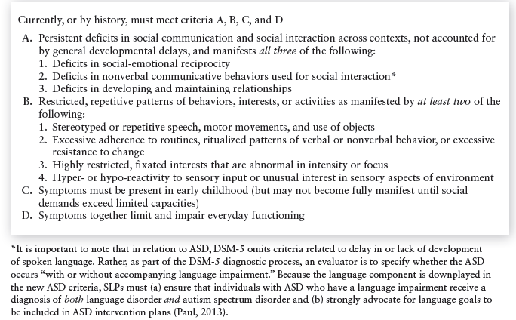
DSM‑5,V Criteria for Autism Spectrum Disorder

Slide 128
Early Communication
Studies at babies who are at genetic risk of developing ASD, by virtue of having an older sibling with the disorder showed:
within the first year of life infants who later receive a diagnosis of ASD are indistinguishable from low-risk peers in terms of social behavior (Rogers, 2009).
Between the end of the first year and the child’s second birthday, differences in social interaction
behaviors become more apparent and some children show signs of regression (Ozonoff et al., 2010).

Slide 129
Cont.
These aberrant social behaviors include:
reduced eye contact.
reduced social smiling.
reduced social interest.
reduced social imitation.
reduced response to their own name.
fewer responses to bids for joint attention.
This combination of social behaviors often
co-occurs with delays in gestural communication and language.

Slide 130
Cognitive Characteristics
50% to 70% of children with ASD obtaining scores on nonverbal IQ measures of less than 70 (Matson & Shoemaker, 2009).
ASD is diagnosed in children with IQ ranges in the average (28%) or above average range (3%) (Charman et al., 2011).
Executive functions (EF) are very often impaired in children with ASD.
Deficits in social cognition or in understanding other minds, are the most well known cognitive deficits ,which is linked to:
--problems learning new words.
--understanding non-literal language.

Slide 131
Language Characteristics
Structural language skills are extremely variable in ASD.
Significant percentage of children with minimal language skills in early life develop at least some spoken language skills by the age of nine (Lord, Risi, & Pickles, 2004).
9% of children remaining nonverbal in later childhood (Hus, Pickles, Cook, Risi, & Lord, 2007).
Tow different “neurocognitive phenotypes” (Tager-Flusberg & Joseph, 2003).
Autism Language Normal (ALN) phenotype.
Autism Language Impaired (ALI) phenotype.

Slide 132
Form
Significant proportion of children with ASD perform poorly on measures of nonsense word repetition, which taps phonological short-term memory.
Rhyme awareness is very poor.
Atypical patterns in processing speech prosody, more prominent at the sentence level than at the level of an individual word.
Distortions of speech sounds and voicing patterns.
Sound substitutions are rare.

Slide 133
Cont.
Children with ASD use fewer grammatical morphemes than non-ASD peers to mark verb tense and agreement.
children with ASD produce short and grammatically simple sentences relative to non-ASD peers.
Sentence repetition also reveal poorer performance for individuals with ALI.
Impaired sentence comprehension is particularly striking in ALI.

Slide 134
Content
Vocabulary scores are consistently depressed in a large proportion of children with ASD.
Receptive vocabulary is considered to be good.
The underlying organization of the semantic system in ASD is atypical and impoverished.
Individuals with ASD show slow match for semantically related words.
Individuals with ASD do not use semantic information to facilitate encoding and recall.

Slide 135
Use
Pragmatic deficits are universal within ASD.
Individuals with ASD have significant deficits in conversational skills.
Demonstrating either too many or too few initiations.
Poor topic maintenance.
Fewer contingent conversational responses.
Socially inappropriate utterances.
Understanding of language in context is regarded as particularly problematic for individuals with ASD.
Individuals with ASD as evidenced by poor understanding of figurative and metaphorical language
ALI are more likely to have difficulties with higher level pragmatic language skills than ALN peers.

Slide 136
Literacy
Less attention has been paid to the reading abilities of children with ASD.
Some children with ASD were given the label “hyperlexia”.
More recent investigations have revealed
much more varied reading patterns in children with ASD.
ASD children with poor phonological skills tend to have problems with decoding text.
Language, aspects of influence literacy development.
Aspects of autistic cognition may also influence literacy development.

Slide 137
ADHD
ADHD is a chronic condition that affects the child’s ability to control attention and behavior in an optimal and adaptive manner.
Two components to the disorder: inattention and hyperactivity/impulsivity.
An onset before the age of 12.
Present in two or more contexts (i.e., both at home and at school).
The symptoms of ADHD must be present for at least 6 months.
Interfere with social, academic, or vocational functioning.
Prevalence rate is approximately 3% to 5% of school-aged children with boys outnumbering girls 3:1.

Slide 138
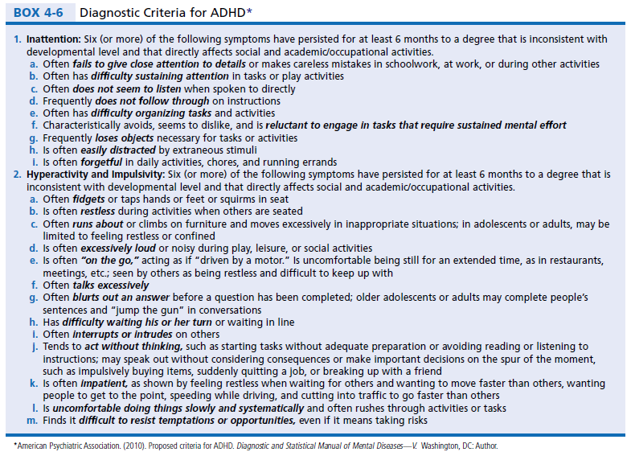
ADHD

Slide 139
Cognition
The majority of children with ADHD will have nonverbal IQ scores within the normal range.
ADHD has also been observed in children with ID and children with exceptional Iqs.
No differences between children with different IQ scores with respect to severity of ADHD.
Impaired EF( mainly inhibition, working memory, and planning).
Children with ADHD find it difficult to wait for something desirable.

Slide 140
Language
language profiles are variable.
rates of co-morbidity are higher than would be expected in the general population (Im-Bolter & Cohen, 2007).
when language impairments and speech sound disorders occur together that there is an increased rate of co-morbid ADHD (McGrath et al., 2008).
relationship between DLD and ADHD is a matter of debate:
the two disorders may have at least some biological risk factors in common(neural circuits in the frontal lobe overlap in both ADHD and language production.
cognitive and behavioral deficits associated with ADHD can disrupt language learning and/or language processing.

Slide 141
Form
There is no evidence that children with ADHD as a group have specific difficulties with phonology or speech sound production.
ADHD group did not differ from typical peers with DLDs on overall levels of verbal ability.
ADHD and DLD groups had difficulties with rapid temporal processing of auditory stimuli.
children with ADHD had greater difficulty on nonverbal tests of processing speed than DLD counterparts.

Slide 142
Content
Studies involving assessment of the vocabulary and semantic skills of children with ADHD are lacking.
Studies of adults with reported histories of ADHD revealed less accuracy at mapping semantic features and slower to respond to lexical labels.
Children with ADHD may have subtle difficulties rapidly accessing the lexicon, or making connections between words.
Difficulties in understanding humor and non-literal language, making inferences, and understanding metaphor.

Slide 143
Use
Most likely the problem for children with ADHD.
Children with ADHD are reported to have significant pragmatic language difficulties, sometimes indistinguishable from peers with ASD.
Problems with inappropriate initiation, interruption, difficulty maintaining a topic, and responding with appropriate amounts of information.
Difficulties with pragmatic aspects of language have been found to mediate social skills deficits in this population.

Slide 144
Literacy
Rates of co-morbidity between ADHD and reading disorders (RD) are extremely high.
Prevalence rates for each disorder alone is 5%.
Rates of comorbid disorder are 25% to 40%.
Deficits in EF can adversely affect reading tasks.
Child’s disruptive behavior can have implications for the learning environment.
Level of maternal education has been associated with reading outcomes for children with ADHD.

Slide 145
Assessment and Intervention in the Prelinguistic Period

Slide 146
FAMILY-CENTERED PRACTICE
Assessment and Intervention
in the Prelinguistic Period
The burden of caring for the development of infants at risk for communication disorders falls on their families.
WE have to deal with the family in which the infant finds a home.
We need to think about the needs of the family, to provide that infant with the best environment for growth and development.

Slide 147
SERVICE PLANS FOR PRELINGUISTIC
CLIENTS
According to (IDEA; PL 105-17) an IFSP must be build for children from birth to-3 age range whom are at high risk of developing language or communication disorders.
IFSP is a plan for comprehensive services to support the child’s development in the family context.

Slide 148
Elements of IFSP
Information about the child’s present level of physical, cognitive, social, emotional, communicative……..
A statement of the family’s resources, priorities, and concerns.
3. A statement of the major outcomes expected to be achieved for the child and family procedures, and time.
4. A statement of the specific early intervention services , frequency and environments.

Slide 149
Cont.
5. A list of other services such as ,medical and other services, funding source.
6. Projected dates for initiation of the services as soon as possible.
7. The name and discipline of the service coordinator and team members.
8. A plan for transition to preschool services.
For some infants IFSP may be implemented very soon after the baby leaves the hospital.
For others, a decision may be made to wait and watch the child’s development before instituting a plan.

Slide 150
RISK FACTORS FOR COMMUNICATION
DISORDERS IN INFANTS
Prenatal Factors.
Prematurity and Low Birth Weight:
-Prematurity birth prior to 37 weeks’ gestation.
-Low birth weight less than 2500 gms.
-Very low birth weight (VLBW) less than1500gms
Genetic and Congenital Disorders.
Other Risks Identified after the Newborn Period.

Slide 151
ASSESSMENT AND INTERVENTION
FOR HIGH-RISK INFANTS AND THEIR
FAMILIES IN THE NEWBORN INTENSIVE CARE NURSERY (NICU)
Each year approximately 12% of infants begin life in (NICU).
ASHA has recently outlined the roles that SLPs can play in the NICU (ASHA, 2004a).
Assisting families in the NICU.
May be called in to consult on the management plan of an infant being cared for in the NICU.

Slide 152
Hearing Conservation and Aural
Habilitation
NICU itself may be hazardous to the baby’s health.
Incubators, cardiorespiratory monitors, and ventilators present in the NICU can generate noise levels of more than 85 dB.
Result in hearing loss by means of cochlear damage.
Hearing screening for all newborns in the NICU.
Further, the SLP should encourage the parents to have the infant’s hearing tested by an audiologist periodically throughout the child’s early years, even if losses are not identified during the newborn period.

Slide 153
Child Behavior and Development
assessment for infants should not be to predict future behavior, but to determine the infant’s current strengths and needs.
what risks the infant faces.
Evaluate the infant’s level of physiological organization and level of behavioural organization and homeostasis determine the ability to participate in interactions.

Slide 154
Management (Intervention)
The goal of intervention for the baby in the NICU is:
-To achieve stabilization and homeostasis of physiological and behavioral states.
-To prevent or minimize any secondary disorders that might be associated with the child’s condition.
Several strategies for support.(page 190).

Slide 155
Parent-Child Communication
Three stages of behavioral organization in high-risk newborn:
1. Turning In (or physiological state).
2. Coming Out.
3. Reciprocity.
Family –child interaction is crucial in this stage.

Slide 156
Management
“kangaroo care”:skin-to-skin contact.
Swaddle the infant to their unclothed chest for about 30 minutes each day.
This technique seems to have great potential for improving parent-child interactions during the infant’s first days.
SLPs can help parents to identify states that the kid can get benefit of communicative interaction.

Slide 157
ASSESSMENT AND INTERVENTION
FOR PREINTENTIONAL INFANTS
AND THEIR FAMILIES: 1 TO 8 MONTHS
Preintentional: have not yet developed the cognitive skills to represent ideas in their minds and to pursue goals through planned actions.
Bates (1976) referred to this stage of development as “perlocutionary’’.
-Infants do not intend any particular outcome by their behavior but adults act as they do.

Slide 158
PREINTENTIONAL INFANTS:
Hearing Conservation & Aural Habilitation
Hearing should be evaluated by audiologist every 3 to 6 months during the first year.
Furthermore, parents should be counselled to be aware of otitis media signs.
Maintenance of hearing aids is crucial to optimal communicative development.
Some children candidates for cochlear implants

Slide 159
good candidates for cochlear implants
• Are at least 8 to 12 months of age.
• Have profound hearing loss in both ears.
• Can receive little or no useful benefit from hearing aids.
• Have no other medical conditions that would make the surgery risky.
• Have families who are involved in all aspects of the informed consent process, understand their roles in successful use of cochlear implants.
informed consent from the family
• Have support from their educational program to emphasize the development of auditory skills.

Slide 160
PREINTENTIONAL INFANTS
Child Behavior and Development
The goal is not to predict future status but only to identify current strengths and needs.
A variety of instruments can be used for assessing early development.
For children whose general developmental level or communication level is behind the expectations according to his chronological age (or for corrected gestational age) a general stimulation program to enhance motor and cognitive development may be initiated.
This program implemented in collaboration with a team of professionals.

Slide 161
Management
A team effort focused on the family as well as the child.
Programs that place the baby in a setting with other handicapped or at-risk infants.
Provide general motor and cognitive stimulation, services to target small motor, fine motor, and oral-motor behavior.
Most services for infants at this stage will be home-based.

Slide 162
PREINTENTIONAL INFANTS
Parent-Child Communication
Formal tests are used to assess parent-child interaction.
Parent-child interaction can be assessed informally by observing parent-child interaction we look to the following:
1. Pleasure and positive affect.
2. Responsiveness to the child’s cues of readiness and unreadiness to interact.
3. Acceptance of the baby’s overall style and temperament.
4. Reciprocity and mutuality—the degree to which the parent and infant seem to be in tune with each other.

Slide 163
Cont.
5. Appropriateness of choice objects and activities for interactions that interest and engage the baby; the parent’s awareness of safety issues.
6. Language stimulation and responsiveness; the degree to which the mother talks to the baby appropriately, engages in back and-forth and “choral” babbling activities.
7. Encouragement of joint attention and scaffolding the baby’s participation, the extent to which the mother is effective in directing the baby’s attention to objects of mutual interest

Slide 164
Management
Intervention in the area of parent-CHILD communication, in either a home- or center-based setting.
Involves three components:
1-We need to make parents and other caregivers aware of the infants normal communicative patterns and how to tune into the baby’s communicative capacities.
2-We need to provide instruction and modeling of adult-infant communication.
3-We need to help the parents develop self-monitoring skills so that they can evaluate and modify their own performance.

Slide 165
Awareness of Infant Communication Patterns
Mothers tend to interact more frequently and respond more consistently to babies who smile and vocalize at them more often.
In case this pattern of interaction failed we have not to blame parents.
In stead we have to help parents become aware of basic interactive patterns of preintentional infants.
Parents have to learn that:
1-Infants are simply expressing their inborn style, as well as their physiological and neurological immaturity in these behaviors.

Slide 166
Cont.
2-The parents need to know that the most important thing they can do for their babies is to enjoy them.
3-Parents need to know that communication that enhances development has two major characteristics: it is
Enriching: using visual, auditory, and tactile stimuli and experiences.
Responsive: make their interactions responsive and contingent on what the infant is doing.

Slide 167
Modeling Interactive Behaviors
Four types of interactive behaviors:
Turntaking, Imitation, Establishing joint Attention, and Developing Anticipatory Sets.
Use the infant’s readiness to interact.
engage in them whenever the infant signals readiness.
When these signals are perceived, the interactions should be initiated.
Once the infant does something, parents/ caregivers/clinicians can imitate it, then wait for the infant to do something else.
Use a “match and wait” strategy in developing turn-taking and imitation skills.

Slide 168
Cont.
Help parents learn to develop joint attentional routines with their babies.
Help establishing anticipatory sets.
Anticipatory sets are expectations that actions have been often repeated will occur in a particular sequence.
Anticipatory sets develop the baby’s Joint Action.

Slide 169
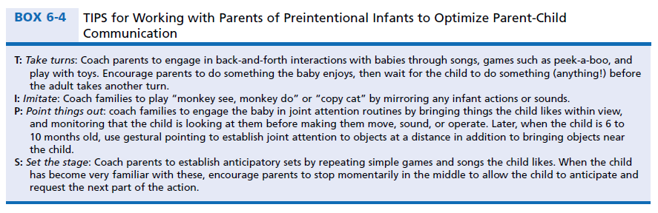

Slide 170
ASSESSMENT AND INTERVENTION
FOR INFANTS AT PRELINGUISTIC STAGES OF COMMUNICATION: 9 TO 18 MONTHS
They become intentional communicators.
Halliday’s (1975) “learn how to mean.”
Bates’s (1976), these children are in the illocutionary stage of communication.
CGA will be taken in consideration.

Slide 171
PRELINGUISTIC STAGES: Assessment
Formal assessment procedures.
Observation of the child’s play.
Parent-reports /checklists.
Modeling conventional use of objects and child engagement in simple pretend play.
Parents continue to use TIPS engage in turn-taking, imitation, building anticipatory sets, and joint attentional activities in their interactions with the baby.
Typical functions expressed at this level includes:
-requesting objects or actions.
-attempting to get the adult’s attention on what the child is interested in.
-initiating social interactions through greeting, calling, or showing off.

Slide 172
PRELINGUISTIC STAGES: Management
Providing advice or support to the family of an at-risk infant.
Foster the communication the child is showing.
Coach parents to learn how to support the child’s move toward more conventional communication.
Upping the ante” technique.
Demonstrate contingent relations between words and actions.

Slide 173
Cont.
The use of prelinguistic milieu teaching (PMT)
- Contingent motor imitation.
Contingent vocal imitation.
Use three types of prompts: time delay, verbal, and gaze intersection.
Modeling : verbal modeling , gestural modeling.
Natural consequences.
Book-reading situations.
Behaviors that can facilitate communication development in this setting:
Waiting for the child to initiate interest in something in the book by looking or pointing.
Being face-to-face during book sharing.
Asking questions.
Verbally inviting children to interact.
Labelling and talking about pictures in the book.

Slide 174
Milieu Communication Training (MCT)
Training is undertaken in everyday environments
Activities take place throughout the day, rather than only at “therapy time.”
Preferred toys and activities are included in the environment so that participation in activities is self-reinforcing.
Adults encourage spontaneous communication by refraining from prompting and using “expectant waiting” (use of gaze, posture, and facial expression to indicate the adult expects the child to do something).
The child initiates teaching situation by gesturing or indicating interest in a desired object or activity.
Teachers provide prompts and cues for expansion of the child’s initiation.
Expanded child responses are rewarded with access to adesired object or activity.

Slide 175
Assessment and Intervention for Emerging Language

Slide 176
Emerging Language (EL)
Emerging Language (EL):the period in which conventional words are just beginning to appear as viable forms of communication.
This stage corresponds to the “toddler” age range, or an 18- to 36-months developmental level.
Children may enter the emerging language stage at any age during this period.

Slide 177
Screening and Eligibility for Services
According to (IDEA) 2004.
Children with disabilities to be identified as early as possible and to receive prompt intervention.
Early intervention is effective, often resulting in faster gains than those seen in normal development.
Children we will serve include those born with known risk factors.
Other children, though, may also present as toddlers with apparently specific language delays.

Slide 178
Cont.
Criteria for language delay at 24 months less than 50 words expressive vocabulary or no word combinations.
For toddlers who have delays in cognition, motor, social, and Other areas besides language, evaluation is also important.
For children in the 18- to 36-month age range, the decision to intervene should be based on an accumulation of risk factors.

Slide 179
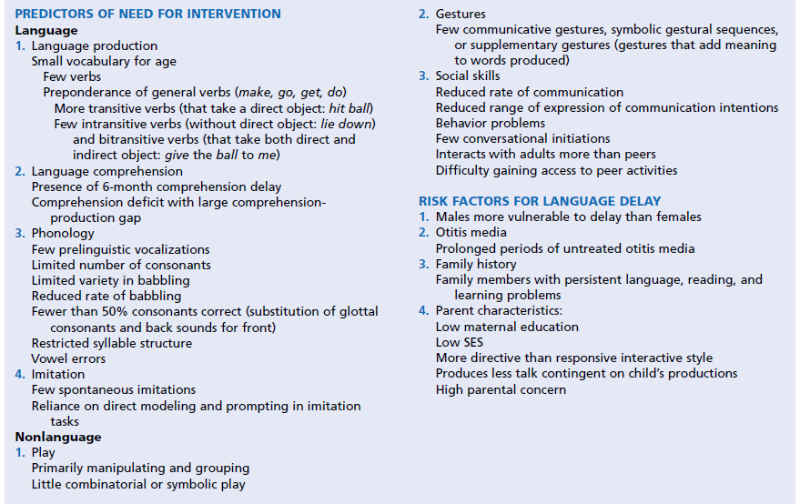
Predictors and Risk Factors for Language Growth in Toddlers

Slide 180
Communicative Skills in Normally
Speaking Toddlers
18 months of age produced an average of two communicative acts per minute:
-To request objects or actions.
-To establish joint attention.
-To engage in social interaction.
24 months, children produce an average of five to seven communicative acts per minute.
The majority of these communicative acts consist of words or word combinations.

Slide 181
Cont.
18 to 24 months toddlers combined words into simple two-word sentences.
98% of 24- to 36-month-olds produced two words sentences, 90% produced three-words sentences, and 84% produced four-words sentences at this age.
Normally developing 24-month-olds produced at least 10 different consonants.
70% correct in their consonant productions.
75% of 24- to 36-month-olds are more than 50% intelligible.

Slide 182
Cont.
Syllable shapes (CV) and (CVC).
Two-syllable form was the CVCV reduplicated syllable.
2-year-olds are beginning to produce consonant clusters.
Receptive vocabulary size is always larger than the size of the productive lexicon.
18- to 24-month age range probably understand only two to three words out of each sentence they hear.
24 to 36 months of age that the majority of children understand three-word sentences.
Child combine cues from gestures, facial expressions, and the way they know things usually happen with their understanding of words.

Slide 183
ASSESSING COMMUNICATIVE INTENTION
children with emerging language attempt to communicate intentionally with those around them using different ways.
Communication changes over the course of the second and third years of life:
-It becomes more verbal.
-Increase in frequency of communication.
-Range of intentions the child is trying to express
increases.

Slide 184
Cont.
Three aspects of communication to be examined as part of this assessment:
-Range of communicative functions expressed.
-The frequency of communication.
-The means by which the child attempts to convey his or her messages.

Slide 185
Range of Communicative Functions
Proto-imperatives are used to get an adult to do or not do something:
-Requests for objects or action
-Rejections or protests.
Proto-declaratives are preverbal attempts to get an adult to focus on an object or event.
Discourse functions: includes
-Requests for information.
-Acknowledgments.
-Answers.

Slide 186
Frequency of Intentions Expression
18-month-olds to produce about two instances of intentional communication per minute.
More than five per minute in 24-month-olds.
If 18 months of age produces fewer than 10 total communicative acts within a 15-minute observation this rate would be considered significantly low.
If a nonspeaking client produces fewer than three proto-declarative acts within a 15-minute observation period, there is a risk for development of functional speech.

Slide 187
Forms of Communication
Progression in forms of communication:
1. Gestural communication are predominant at approximately 8 to 12 months of age.
2. Gestures are combined with word-like vocalizations containing consonants at 12 to 18 months.
3. Conventional words or word combinations are used with the increases of Range of intentions the child express at 18 to 24 months.

Slide 188
Communicative Act
Any communicative act :
1. It must be directed, primarily by means of gaze, to the adult.
2. It must have the effect (across message), or at least the obviously intended effect of influencing the adult’s behavior, focus of attention.
3. The child must be persistent in the attempt to convey a message if the adult fails to respond or responds in a way the child had not intended.

Slide 189
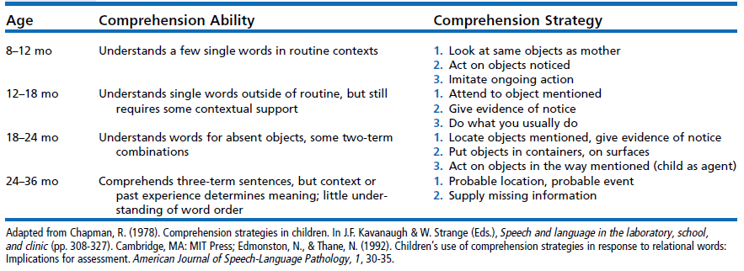
Summary of Comprehension Abilities in Children Up to 3 Years Old

Slide 190
ASSESSING COMPREHENSION
Determines whether the child understands any single words without the support of nonlinguistic cues.
The clinician must be careful not to look at the item being named, point toward it, or name an item the child already is handling or reaching toward.
verbs can be tested next through words for actions.
Child demonstrate comprehension of each word two to three times.

Slide 191
Cont.
If the child fails to show reliable signs of any lexical comprehension, an attempt can be made to step back to 8- to 12-month-level.
The same words can be tested again, but this time paired with gestural cues.
If performance is better with the addition of these nonverbal cues, the child can be said to be using 8- to 12-month strategies.
If the child demonstrates linguistic comprehension of three to five nouns and three to five verbs at the 12- to 18-month level,Step Up

Slide 192
18- to 24-month-level comprehension
Assess understanding of two-word instructions. action-object semantic relation.
Unexpected or unusual combinations are used
If a child fails to respond correctly to a majority of the two-term combinations presented, Step Back.
Assess understanding of two-word instructions 12-18 months using usual and expected combinations.
If the child succeeded on a majority of the 18- to 24-month items, Step Up.

Slide 193
24- to 36-month-level comprehension
Typical children at this level are able to process three words instructions agent-action-object.
Unexpected or unusual combinations are used
If a child fails to respond correctly to a majority of the three-term combinations presented, Step Back.
Assess understanding of three-word instructions 24-36 months using usual and expected combinations.

Slide 194
Assessing Phonological Skills
There is close relationship between the development of words and sounds in very young children , specially consonants.
Children with small expressive vocabularies also show small phonetic inventories of consonants and a restricted number of syllable shapes.
There is a strong correlation between the amount of vocalization containing consonants and language outcome in late talkers.

Slide 195
Cont.
Assessing phonological production is very useful:
-As a prognostic indicator.
-As an aid in choosing words to be included in the child’s first lexicon training.
Phonological assessment is done through consonant inventory.
The consonant inventory can be used in two different ways:
1-Consonants already in the inventory can be used to select words to be taught to the child.
2-The number of consonants present in the inventory can be used as an index of severity of phonological delay.

Slide 196
Cont.
Normal consonant production in 10 minutes communication sample:
18- to 24-month-olds produced an average of about 14 different consonants.
24- to 36-month-olds produced an average of 18 different consonants.
Children with small expressive vocabularies produced significantly fewer consonants:
18 to 24 months produced an average of about 6 different consonants.
24 to 36 months produced an average of about 10 different consonants.

Slide 197
Syllable Structure Level (SSL)
Level 1: The vocalization is composed of a voiced vowel ([a]),voiced syllabic consonant ([l]), or CV syllable in which the consonant is a glottal stop or glide ([ʔa], [wi]).
Level 2: The vocalization is composed of a VC ([up]) or CVC with a single consonant type (regardless to the Voicing differences) ([kek]), or a CV syllable that does not fit the criteria for level 1. Voicing differences in CVCs are disregarded (toad would be considered a level 2 vocalization).
Level 3: The vocalization is composed of syllables with two or more different consonant types (regardless to the Voicing differences) , disregarding voicing differences ([pati] would be considered a level 3 vocalization.
If fewer than 25% of the syllables are at level 3,there is deficit in phonological performance.

Slide 198
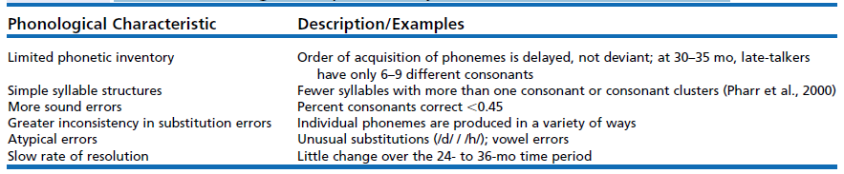
Predictors of Long-Term Speech Delay in Late-Talkers at 30 to 35 Months

Slide 199
Assessing Semantic-Syntactic Production
In normal development, children do not begin to combine words until vocabulary size reaches about 50 words.
If a client is producing fewer than 50 words,we have to work on increasing expressive vocabulary size before trying to get the child to produce word combinations.
Using a mean length of utterance (MLU) is fairly easy and appropriate for this age group.

Slide 200
Aspects of Word Combinations Within a Communication Sample
Relative Frequency of Word Combinations:
Frequency of single-word versus two-word utterances.
Collect a representative sample.
If an at-risk toddler’s MLU exceeds 1.5 at about 24 months,OR
If half the utterances contain word combinations:
Normal development has been overcome.
It was found that 30% to 40% of late-talking toddlers had moved into the normal range of syntactic production by age 3.

Slide 201
Cont.
If the proportion of word combinations is close to or exceeds 50%, we can conclude that the client is functioning at least at a 24-month level in terms of syntactic production.
If the proportion of word combinations is much less than 50%, we can conclude that the client is functioning below 24-month level.
If the proportion of word combinations is too great it may be that the child is moving out of the emerging language stage into the next phase of language development.

Slide 202
Cont.
Semantic Relations Expressed:
Word combinations result in new meanings that are not present in the meaning of either of the words alone.
Children do not combine their words randomly but use consistent word order to denote the relations.
Combining words to produce Semantic Relations is characteristic of normally developing children in the 18- to 36-month age range.

Slide 203
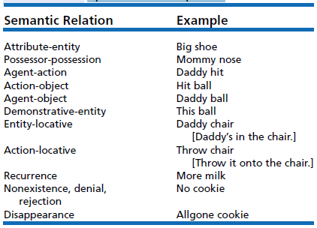
Semantic Relational Categories
Used by Brown (1973) to Account for the Majority of Word Combinations in Toddlers’ Spontaneous Speech

Slide 204
Cont.
Code each multiword utterance into one of the semantic categories.
Utterances that did not fit any of these would be placed into an “Other” classification.
Proportion of “Other” should be about 30%.
If it is more than 50%, we would want to inspect the “other” utterances to see whether they are encoding higher-level semantic relations like:
Time (go now), manner (go fast), sequence (eat [then] drink), or causality (cry [because] hurt).
This suggest to us that the child is exhibiting some advanced cognitive development.

Slide 205
Cont.
If the proportion of “other” utterances is less than 40% or 50%,we then look at the distribution of semantic relations.
If a client is encoding a range of these relations, we conclude that the child is moving toward normal semantic and syntactic development.
In summary, assessing production in a child with emerging language involves looking at Phonological Skills, Vocabulary Size and Content, and Semantic-Syntactic Combinations.

