Slide 1
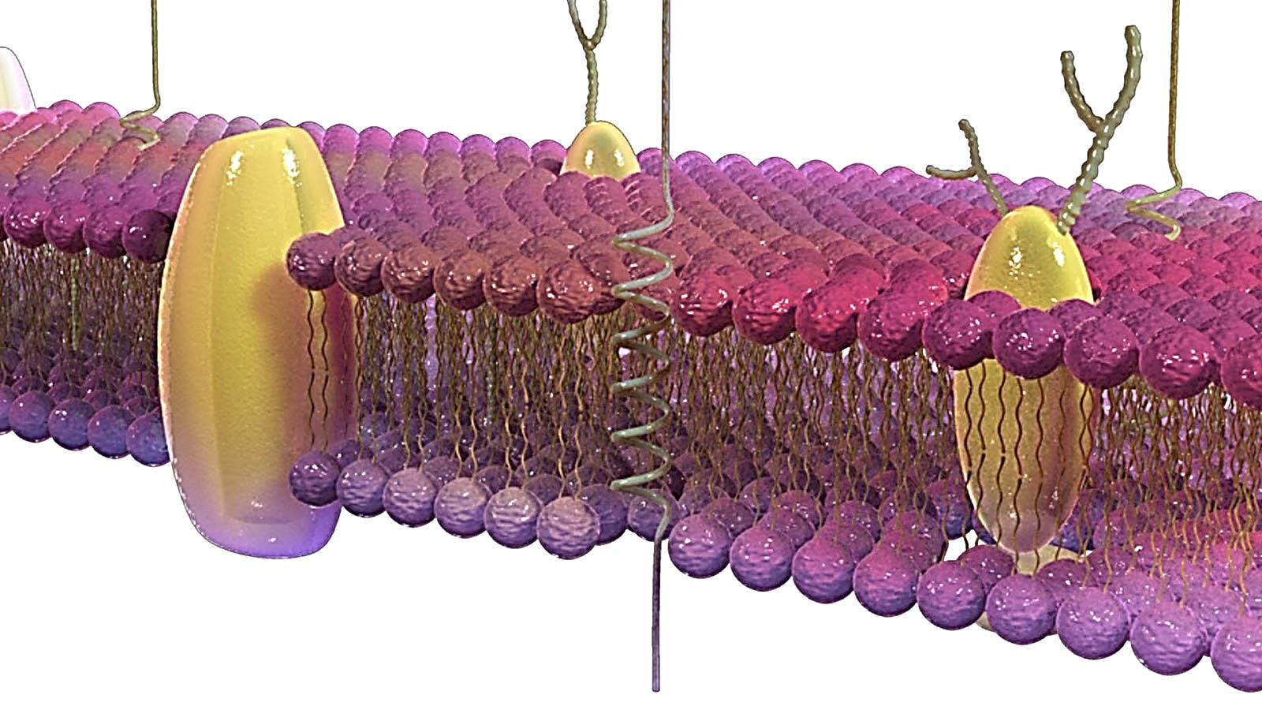
Biological Membranes: Diffusion and Osmosis.

Slide 2
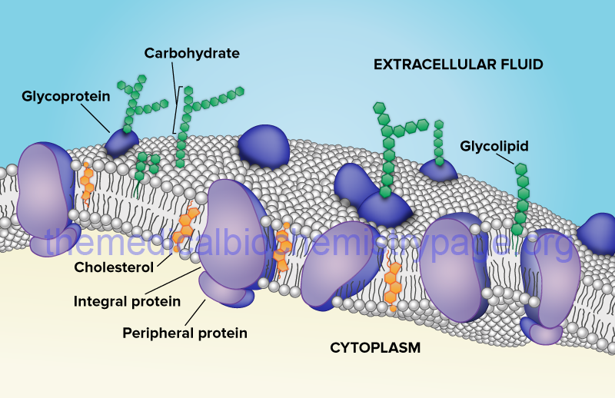
Biological membranes are formed of
Phospholipid bilayer (amphipathic).
Proteins (integral or peripheral).
Cholesterol.
Sugar.

Slide 3
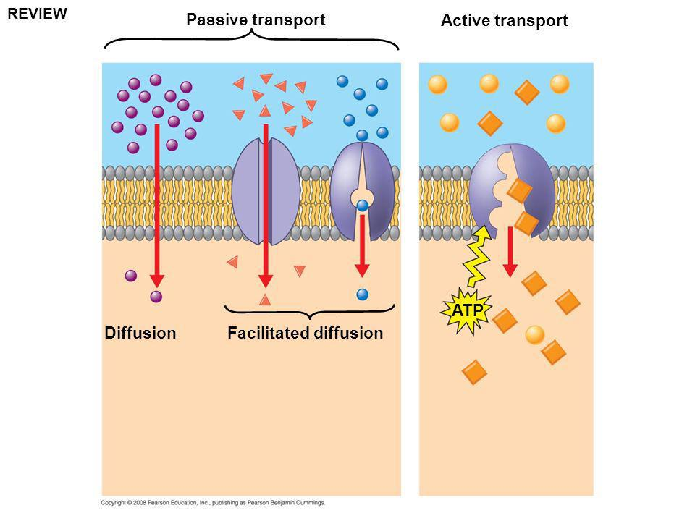
Molecules move towards equilibrium.
Plasma membrane regulate solute movement.
Solute cross the plasma membrane by:
Diffusion.
Facilitated Diffusion.
Active transport.

Slide 4
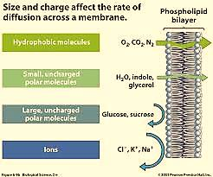
Solute transport depends on solute properties:
Polarity
Size

Slide 5
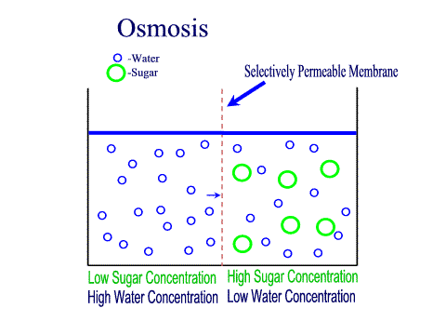
Osmosis:
Water molecules can move by simple diffusion.
osmosis:
Is the diffusion of water molecules across a selectively permeable membrane from low solute concentration region to a region of high solute concentration.

Slide 6
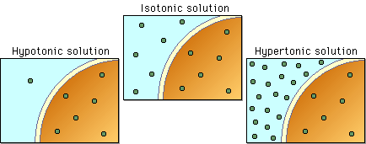
Osmosis:
Solution tonicity:

Slide 7
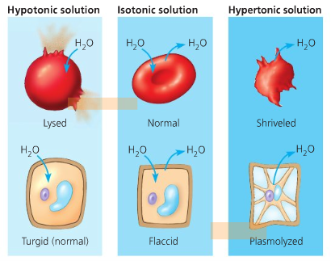

Slide 8
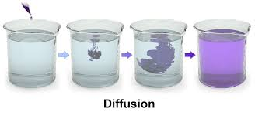
What to do?
Diffusion in liquid:

Slide 9
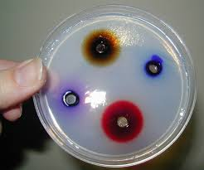
Diffusion in solid:
This depends on the size of the compound.
The larger the size or mass the slower the compound.

Slide 10
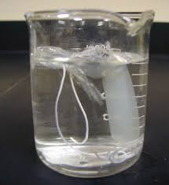
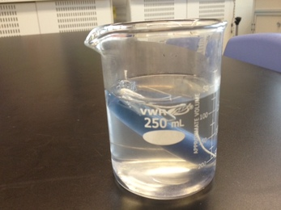
Diffusion in artificial cell:

Slide 11
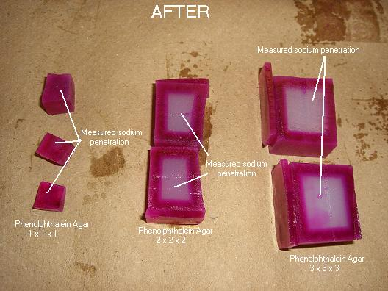
Surface area and cell size:

Slide 12
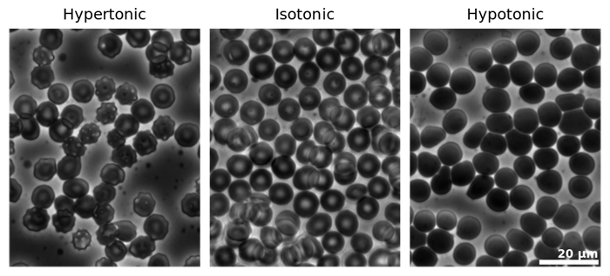
Osmosis in animal cells (blood cells):
Shriveled
10% NaCl
Normal
0.9% NaCl
Lysed
0.1% NaCl

Slide 13
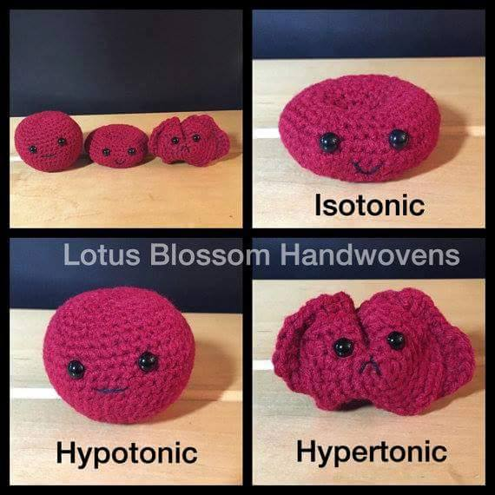

Slide 14
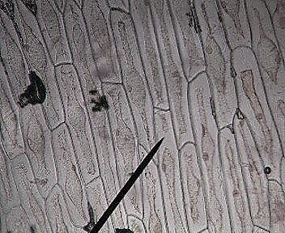
Osmosis in plant cells (onion cells):

Slide 15
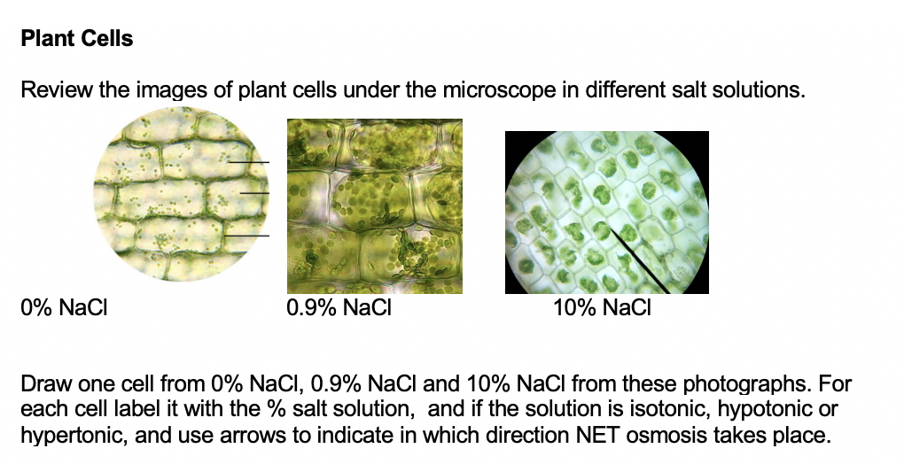
0-0.1% hypotonic
Turgid cell
0.9% normal cell
(flaccid )
10% hypertonic
Shriveled (plasmolysis )

Slide 16
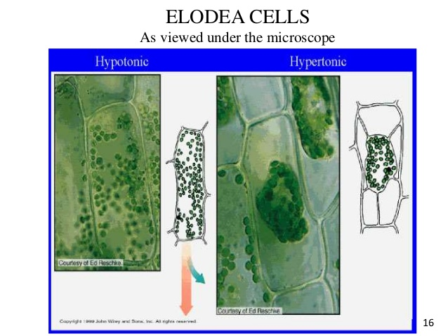

Slide 17
Example
0.1%NaCl | 0.9%NaCl | 10%NaCl
Tonicity :hypotonic
Cell status: Turgid cell

