Slide 1
Measures of disease frequency
Lecture- 2

Slide 2
Measures of disease frequency
Risk = incidence proportion = cumulative incidence
Incidence rate= incidence density
Prevalence

Slide 3
Measures of disease frequency
Risk- the probability of a person developing a certain disease or condition.
Number of subjects developing disease during a time period
Risk=
Number of subjects followed for the time period
Measuring an event- onset of disease, death from a given disease, or any event that marks a health outcome!
Have to specify a period of time- otherwise risk values are meaningless!!!

Slide 4
Measures of disease frequency Risk
e.g- oral contraceptive use and bacteriuria
Total population 2390 women
482 were OC users in 1973 of which 27 developed bacteruria in 1976
Risk of bacteruria among OC users=27/482=5.6% during this 3 –year period.

Slide 5
Measures of disease frequency Risk
Attack rate- the risk of being infected with a condition during an epidemic period
Used with infectious outbreaks!!!!
e.g influenza epidemic- attack rate of 10%- 10% of the population developed the disease during the epidemic period!!!!

Slide 6
Measures of disease frequency Risk
Case fatality rate- proportion of people, among those who develop the disease, who proceed to die from the disease.
Used with infectious outbreaks!!!!
Case fatality rate is a function of the severity of a disease

Slide 7
Measures of disease frequency Risk
Risk= A/N
Drawbacks of risk as a measurement of disease occurrence-
Competing risks
Loss to follow-up
A/N is always an underestimation of the true risk

Slide 8
Measures of disease frequency Incidence rate
Incidince rate- measures the rapidity with which newly diagnosed cases of the disease of interest develop.
Incidence rate- number of new cases of the disease
Sum for each individual in the population of the length of time at risk of getting the disease

Slide 9
Measures of disease frequency Incidence rate
2
A
D
IR= A/PT= 2/22= 0.09 cases/person-year
2
B
3
C
D
Patient
7
D
2
E
6
F
0
2
4
6
8
Observation (years)

Slide 10
Measures of disease frequency Incidence rate
Person time (PT)= average number of people in the population x time
Incidence rate is not a probability. Ranges (0,∞ )
Incidence rate is an instantaneous concept
Mortality (incidence rate)
- Crude (unadjusted)
- Age specific or gender specific.. etc..

Slide 11
Measures of disease frequency Incidence rate
Under steady-state conditions , a situation in which rates do not change with time , the reciprocal of the incidence rate equals the average time until an event occurs this time is referred to as the ”waiting time”
e.g mortality rate of 11 deaths per 1000 person-years- average time until death- expectation of life- expected survival time- 1000/11= 90.9 years
”unfortunatly mortality rates typically change with time”

Slide 12
Measures of disease frequency Incidence rate
Example- according to the swedish cancer Registery, in the years 1971,1972 and 1973 there were 97 , 121 and 112 cases of pancreatic cancer, respectively, among men age 70-74 years. At the beginning of 1971 there were 309,949 men in this age group and at the end of 1973 , 332,400 men. Calcualte the Incidence rate of pancreatic cancer in this population.
IR= new cases of disease/ person time
New cases of disease= 97+121+112= 330
Person time???

Slide 13
Measures of disease frequency Incidence rate
Example- according to the swedish cancer Registery, in the years 1971,1972 and 1973 there were 97 , 121 and 112 cases of pancreatic cancer, respectively, among men age 70-74 years. At the beginning of 1971 there were 309,949 men in this age group and at the end of 1973 , 332,400 men. Calcualte the Incidence rate of pancreatic cancer in this population.
Persontime= average population size x time
Average poulation size= 309,949+332,400/2= 321,174.5
Time- observation period- 3 years
321,174.5 x 3 = 963,523.5

Slide 14
Measures of disease frequency Incidence rate
Example- according to the swedish cancer Registery, in the years 1971,1972 and 1973 there were 97 , 121 and 112 cases of pancreatic cancer, respectively, among men age 70-74 years. At the beginning of 1971 there were 309,949 men in this age group and at the end of 1973 , 332,400 men. Calcualte the Incidence rate of pancreatic cancer in this population.
IR= 330/963,523.5=0.00034 per year

Slide 15
Measures of disease frequency Relation between Risk and Incidence rate
Risk = Incidence rate x Time
An approx.- works only with low risks!!!!

Slide 16
Measures of disease frequency prevalence
Prevalence – is a measure of disease status- the proportion of people in a population that has the disease!!!!
Number of individuals having the disease at a specific time
Prevalence=
Number of individuals in the population at that point in time

Slide 17
Point Prevalence
Proportion of individuals in a specified population at-risk who have a disease/condition of interest at a given point in time

Slide 18
Point Prevalence
Calendar time (ex. Oct 10, 2007)
Infants who enter a study when they show up at the clinic and are examined only once

Slide 19
Period Prevalence
Proportion of individuals in a specified population at-risk who have a disease/condition of interest over a specified period of time
Examples: annual prevalence rate, lifetime prevalence rate

Slide 20
Point Prevalence rate =
# persons with the condition
total number of persons
Period Prevalence rate =
# persons with condition
total number of persons
at a point in time
in a specified period of time

Slide 21
Asthma question
Type of measure:
Point prevalence?
Period prevalence?
Lifetime prevalence?
Interview question:
Do you currently have asthma?
✔

Slide 22
Asthma question
Type of measure:
Point prevalence?
Period prevalence?
Lifetime prevalence?
Interview question:
Have you had asthma in the last 10 years?
✔

Slide 23
Asthma question
Type of measure:
Point prevalence?
Period prevalence?
Lifetime prevalence?
Interview question:
Have you ever had asthma?
✔

Slide 24
Measures of disease frequency prevalence
What factors affect prevalence??
1. Incidence
2. Duration of disease
So prevalence is not useful as incidence to study the causes of disease!!!
Prevalence is useful for studying the disease burden on a population!!!

Slide 25
Measures of disease frequency prevalence and incidence rate
In a steady state........
Incidence rate and duration are stable over time........
P
= IR x D
1-P
For small prevalences.......
P = IR x D

Slide 26
Measures of disease frequency prevalence and incidence rate
Example- in 1973-1977, the average annual incidence rate of lung cancer in Connecticut was 45.9 per 100,000 and the average annual prevalence was 23.0 per 100.000. so the average duration of lung cancer is--
D=P/I = 23.0/10⁵
= 0.5 year
45.9/10⁵/year
Individuals diagnosed with lung cancer during this period survived an average of 6 months from diagnosis to death!!!

Slide 27
Factors influencing observed prevalence rate
Longer duration of the disease
Prolongation of life without cure
Increase in new cases (incidence / risk)
Out-migration of non-diseased people
In-migration of susceptible/diseased people
Improved diagnostics &/or reporting

Slide 28
Factors influencing observed prevalence rate
Shorter duration of the disease
Increased case-fatality rate
Decrease in new cases (incidence / risk)
In-migration of “healthy” people
Out-migration of diseased people
Improved cure rate

Slide 29
True or False?
Incidence will decrease if a new drug is effective in reducing deaths from the disease
T F√

Slide 30
True or False?
Incidence measures the absolute risk of developing the disease
T ? F

Slide 31
True or False?
Incidence measures the absolute risk of developing the disease
T√ F

Slide 32
True or False?
Incidence (risk) is the probability that a healthy individual will develop the disease during a specified period of time
T ? F

Slide 33
True or False?
True or False?
Incidence (risk) is the probability that a healthy individual will develop the disease during a specified period of time
T√ F

Slide 34
True or False?
Incidence (risk) will decrease if a particular prevention program is effective
T ? F

Slide 35
True or False?
Incidence (risk) will decrease if a particular prevention program is effective
T√ F

Slide 36
Characteristics of risk, prevalence and incidence rate
Characteristic
Risk
Prevalence
IR
What is measured?
Prob. Of disease
% of population with disease
Rapidity of disease occurrence
Units
None
none
/ time
Time of disease diagnosis
Newly diagnosed
Existing
Newly diagnosed

Slide 37
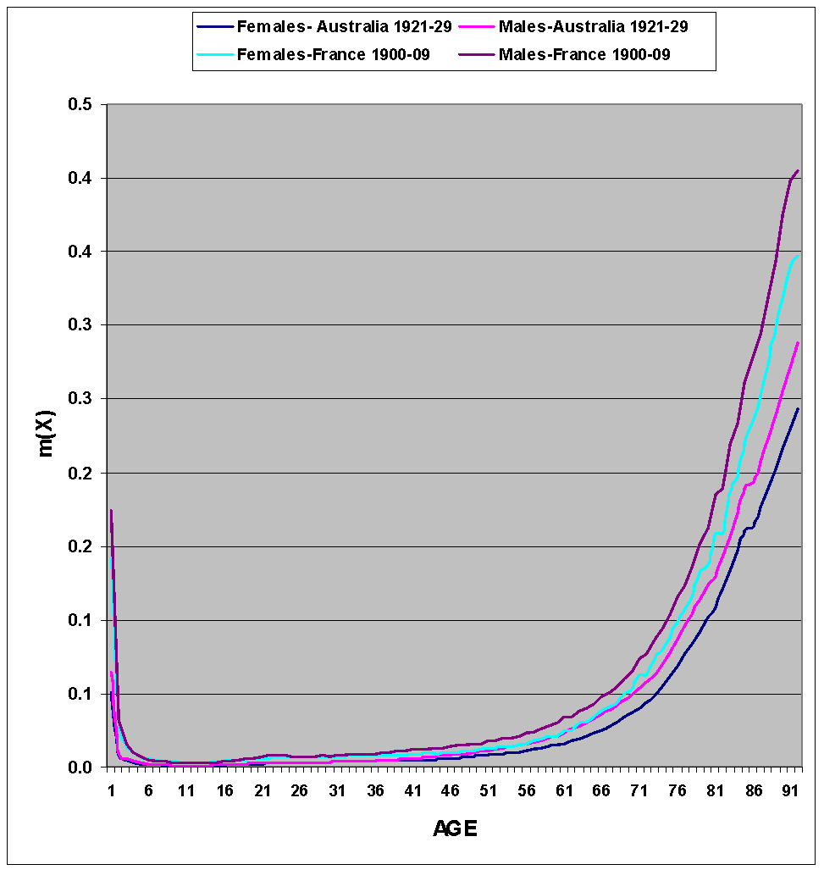
Mortality curves

Slide 38
Age-sex Pyramids
A simple graphic tool describing the age-sex structure of a given population at a specific point in time
It is in practice a kind of (double) histogram (one for each sex) representing the population size for each age (and sex) group shifted 90⁰ in a way that the lowest age groups are at the basis of the graph and each sex looks into the opposite direction (usually females right and males left)
The X axes represents the size of the age group and the Y axes its age (or year of birth)

Slide 39
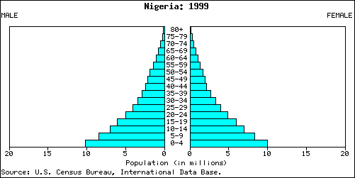
Nigeria 1999

Slide 40
The pyramid shape
Age structure is the result of the fertility, mortality and at times also migration patterns the specific population went through during the last decades
Since these patterns many times leave a unique stamp on the pyramid shape, the age-pyramid may serve as a “story teller” of the demographic history of the specific population
Age structure indicators: Proportions at different ages and specifically children (0-14), old people (65+) and those at working ages (15-64)

Slide 41
Other age structure indicators
Besides the proportions at different ages two additional common indicators are:
Sex ratio by age
The age dependency ratio
Sex ratio: usually men to women (x100) – beginning with a slight advantage for men (106) diminishes continuously arriving at high ages to very low levels (50 men to 100 women)
Dependency ratio: a simple indicator connecting between age structure and economic issues

Slide 42
Life Expectancy
LE_{age X} = average number of years a person aged x will live, if subject to the mortality rates contained in the life table (i.e. if the age-specific death rates for a given year prevailed for the rest of that person’s life)

Slide 43
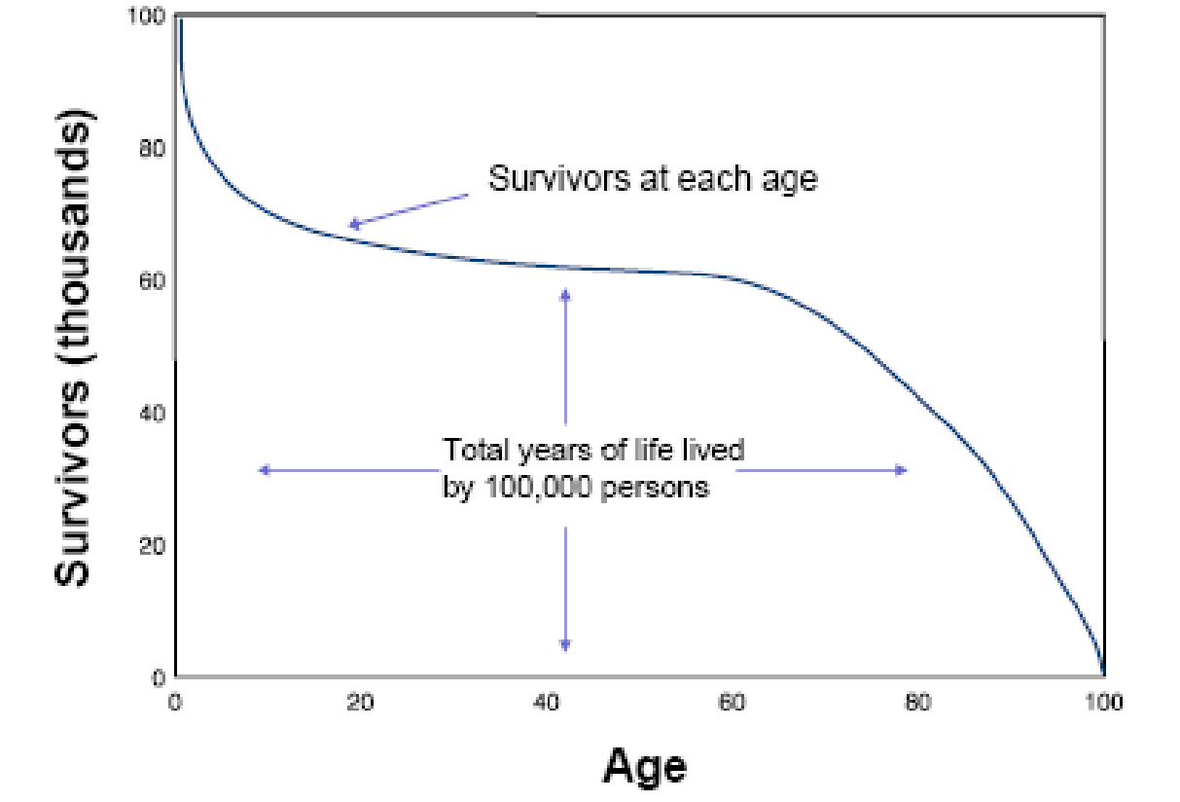
“In the long run, we are all dead”
- John Maynard Keynes

Slide 44
Is there an upper limit to life expectancy?
Compression of mortality: An increasing of concentration of deaths at older ages
Compression of morbidity: An increasing of illness and disability in the latter years of life with fewer years of disabled life before death among the elderly
Are health gains matching or exceeding gains in survival?

Slide 45
If there is no compression of mortality and no postponement of morbidity, then increasing life expectancy will result in growing numbers of ill and disabled elderly, creating increasing burdens on the health care system and society

Slide 46
Highest – Japan: 82.6 years
Lowest – Swaziland: 39.6 years*
* 40% below world average!

Slide 47
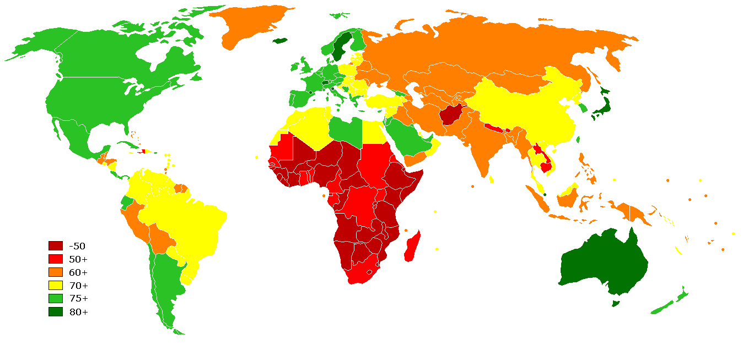

Slide 48
Cameroon
52.9
Netherlands
79.1
Canada
80.3
Nigeria
47.4
China
72.9
Palest. Terr.
73.4
Colombia
72.9
Philippines
71.7
Ethiopia
52.9
Russia
65.5
Georgia
76.3
Tajikistan
64.6
Ghana
59.5
Uganda
51.8
India
68.6
Ukraine
67.9
Kenya
55.3
USA
78.1
Kyrgyzstan
65.9
Uzbekistan
65.0
CIA World Factbook (2008 estimates)

Slide 49
Infant Mortality
Number of deaths before one year of age (from a specific cause or all causes) divided by total number of live births (/100,000 live births)

Slide 50
Why IMR?
Good indicator of overall health status (and healthcare) of a population
Major determinant of LE at birth
Sensitive to changes in socio-economic conditions

