Slide 1
Completing the tests in the acquisition and payment cycle: verification of selected accounts
Chapter 19

Slide 2
Chapter 19 Learning Objectives
19-1 Recognize the many accounts in the acquisition and payment cycle.
19-2 Design and perform audit tests of property, plant, and equipment
and related accounts.
19-3 Design and perform audit tests of prepaid expenses.
19-4 Design and perform audit tests of accrued liabilities.
19-5 Design and perform audit tests of income and expense accounts.

Slide 3
OBJECTIVE 19-1
Recognize the many accounts in the acquisition and payment cycle.

Slide 4
Types of other accounts in the acquisition and payment cycle
There are many accounts associated with the acquisition and payment cycle. Some of the other key accounts are:
  Property, plant, and equipment
  Prepaid expenses
  Other liabilities
  Income and expense accounts
A comprehensive list of the accounts associated with the acquisition and payment cycle is included in Table 19-1.

Slide 6
OBJECTIVE 19-2
Design and perform audit tests of property, plant, and equipment and related accounts.

Slide 7
Audit of property, plant, and equipment
Property, plant, and equipment are assets that have expected lives of more than one year, are used in the business, and are not acquired for resale.
Classifications of property, plant, and equipment are detailed in Table 19-2.
Overview of Equipment-Related Accounts: The primary accounting records for equipment and other property, plant, and equipment accounts is generally a fixed asset master file.
Equipment and related accounts are illustrated in Figure 19-1.

Slide 10
Audit of property, plant, and equipment (cont.)
In the audit of equipment and related accounts, it is helpful to separate the tests into the following categories:
  Perform substantive analytical procedures.
  Verify current year acquisitions.
  Verify current year disposals.
  Verify the ending balance in the asset account.
  Verify depreciation expense.
  Verify the ending balance in accumulated depreciation.

Slide 11
Audit of property, plant, and equipment (cont.)
Perform Substantive Analytical Procedures: Most are used to assess the likelihood of material misstatement in depreciation expense and accumulated depreciation.
These tests are presented in Table 19-3.
Verify Current Year Acquisitions: The balance-related audit objectives and tests of details of balances for equipment additions are presented in Table 19-4.

Slide 13
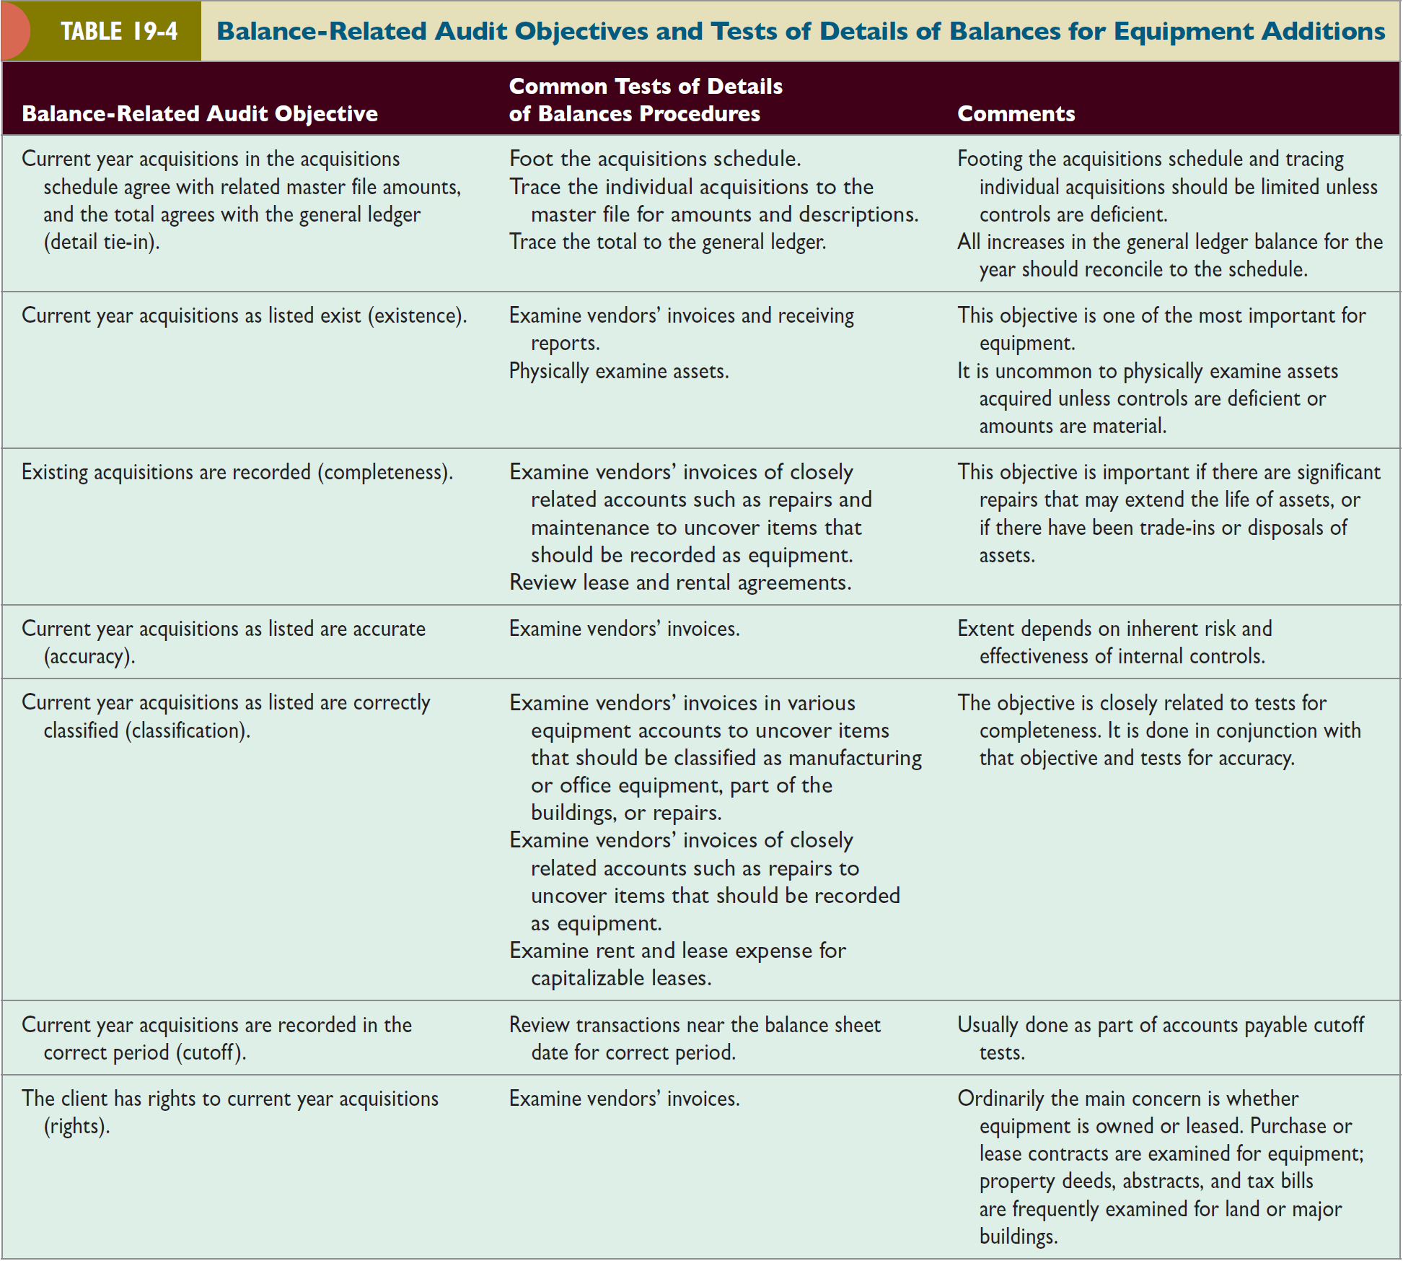

Slide 14
Audit of property, plant, and equipment (cont.)
Verify Current Year Disposals: Failure to record disposals can significantly affect the financial statements. The search for unrecorded disposals is essential.
This search involves the following steps:
  Review whether newly acquired assets replace existing assets.
  Analyze gains and losses on the disposal of assets and miscellaneous income for receipts from asset disposals.
  Review plant modifications and changes in product line, property taxes, and insurance coverage for indications of deletions of equipment.
  Make inquiries of management and production personnel about disposal of assets.

Slide 15
Audit of property, plant, and equipment (cont.)
Verify Ending Balance of Asset Account: The auditor’s objectives when auditing the ending balance in the equipment account are:
  All recorded equipment physically exists on the balance sheet date (existence).
  All equipment owned is recorded (completeness).
Verify Depreciation Expense: The most important balance-related audit objective for depreciation expense is accuracy. In determining accuracy, the auditor must consider:
  The useful life of current year acquisitions
  The method of depreciation
  The estimated salvage value
  The policy of depreciating assets in the year of acquisition and disposal

Slide 16
Audit of property, plant, and equipment (cont.)
Verify Ending Balance in Accumulated Depreciation: Debits to accumulated depreciation are normally tested as part of the audit of disposals of assets, whereas credits are verified as part of depreciation expense.
Two objectives are usually emphasized in the audit of the ending balance in accumulated depreciation:
  Accumulated depreciation as stated in the property master file agrees with the general ledger.
  Accumulated depreciation in the master file is accurate.

Slide 17
OBJECTIVE 19-3
Design and perform audit tests of prepaid expenses.

Slide 18
Audit of prepaid expenses
Prepaid expenses, deferred charges, and intangibles are assets that vary in life from several months to several years.
These include:
Prepaid insurance is found in most audits and is representative of this group of accounts.
Overview of Prepaid Insurance: The accounts typically used for prepaid insurance are illustrated in Figure 19-2.

Slide 20
Audit of prepaid insurance (cont.)
Internal Controls: This includes controls over the acquisition and recording of insurance, controls over the insurance register, and controls over the charge-off of insurance expense.
Audit Tests: The auditor obtains a schedule from the client that lists for each policy in force:
  Policy information, including policy number, amount of coverage, and annual premium
  Beginning prepaid insurance balance
  Payment of policy premiums
  Amount charged to insurance expense
  Ending prepaid insurance balance

Slide 21
Audit of prepaid insurance (cont.)
Audit Tests (cont.): Analytical procedures for prepaid insurance:
  Compare total prepaid insurance and insurance expense with previous years.
  Compare the ratio of prepaid insurance to insurance expense and compare it with previous years.
  Compare the individual insurance policy coverage on the schedule with the preceding year.
  Compare the computed prepaid insurance balance for the current year on a policy-by-policy basis with that of the preceding year.
  Review the insurance coverage listed on the schedule with an appropriate client official or insurance broker for adequacy of coverage.

Slide 22
Audit of prepaid insurance (cont.)
Audit Tests (cont.): Tests for balance-related objectives:
Insurance policies in the prepaid insurance schedule exist and existing policies are listed (Existence and Completeness).
The client had rights to all insurance policies in the prepaid insurance schedule (Rights).
Prepaid amounts on the schedule are accurate and the total is correctly added and agrees with the general ledger (Accuracy and Detail Tie-In).
The insurance expense related to prepaid insurance is correctly classified (Classification).
Insurance transactions are recorded in the correct period (Cutoff).

Slide 23
OBJECTIVE 19-4
Design and perform audit tests of accrued liabilities.

Slide 24
Audit of accrued liabilities
Accrued liabilities are estimated unpaid obligations for services or benefits that have been received before the balance sheet date.
Common accrued liabilities include:
A second type of accrual involves estimates where the amount of the obligation is uncertain such as warranty costs and accrued pension benefits.

Slide 25
Audit of accrued liabilities (cont.)
Auditing Accrued Property Taxes: The accounts typically used by companies for accrued property taxes are illustrated in Figure 19-3.
When verifying accrued property taxes, the two most significant balance-related audit objectives are:
  Existing properties for which accrual of taxes is appropriate are on the accrual schedule (Completeness).
  Accrued property taxes are accurately recorded and the treatment is consistent from year to year (Accuracy).

Slide 27
OBJECTIVE 19-5
Design and perform audit tests of income and expense accounts.

Slide 28
Audit of income and expense accounts
The following two concepts are essential in the audit of income and expense accounts:
  The matching of periodic income and expense is necessary for a correct determination of operating results.
  The consistent application of accounting principles for different periods is necessary for comparability.
Approach to Auditing Income and Expense Accounts:
  Substantive analytical procedures
  Tests of controls and substantive tests of transactions
  Tests of details of account balances

Slide 29
Audit of income and expense accounts (cont.)
Substantive Analytical Procedures: A few substantive analytical procedures for income and expense accounts are shown in Table 19-5.
Tests of Controls and Substantive Tests of Transactions: These simultaneously verify balance sheet and income statement accounts.
Tests of Details of Account Balances—Expense Analysis: A typical schedule showing expense analysis for legal expenses is shown in Figure 19-4.
Tests of Details of Account Balances—Allocation: Several expense accounts result from allocation of accounting data rather than discrete transactions, such as depreciation, depletion, and amortization.

Slide 32
