Slide 1
Selected Topics in
DB&Software Security

Slide 2
Agenda
Buffer overflow.
Race condition.
SQL injection.
Statistical database security.

Slide 3

Buffer overflow
Stack overflow(covered)
Heap overflow
Integer overflow
Input validation
Return to libc
Defenses(input validation)
SELF STUDY

Slide 4
Buffer Overflow
Buffer overflows are extremely common today, and offer an attacker a way to gain access to and have a significant degree of control over a vulnerable machine.
“Imagine if I could execute one or two commands on your valuable server, workstation, or palmtop computer. Depending on the privileges I'd have to run these commands, I could add accounts, access a command prompt, remotely control the GUI, alter the system's configuration ... anything I want to do, really. Attackers love this ability to execute commands on a target computer.”

Slide 5
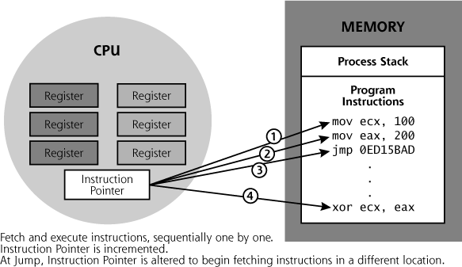
How program execute

Slide 6
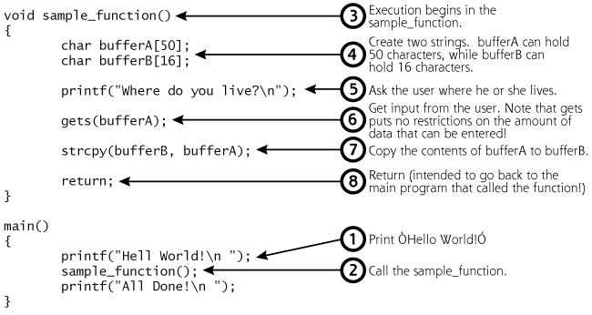
Vulnerable code

Slide 7
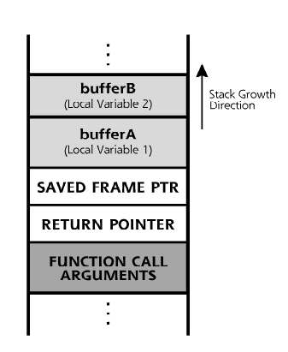
Stack state

Slide 8
Stack overflow
The most valuable information on the stack is the so-called return address
“At what address to execute code when the current function is ending/returning.”
Plain stack overflow
Locate a buffer that can be overwritten, and that overwrites the return address from the function call
Add executable code in memory to jump to when the function returns
Overwrite the return address with the new address of our own executable code

Slide 9
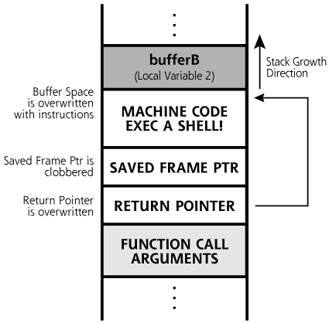
Stack overflow -cont

Slide 10
How to find
fgets
gets
getws
sprintf
strcat
strcpy
strncpy
scanf
memcpy
memmove

Slide 11
Or more brute force approach
Try the program with many different input (as much as ypu will discover a vulnerability)
EAX = 00F7FCC8 EBX = 00F41130 ECX = 41414141
EDX = 77F9485A ESI = 00F7FCC0 EDI = 00F7FCC0
EIP = 41414141 ESP = 00F4106C EBP = 00F4108C
EFL = 00000246

Slide 12
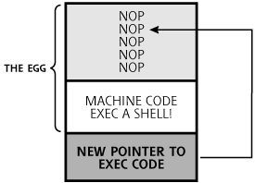
The structure of an exploit(sploit)

Slide 13
Race condition
“A race condition (or race hazard) is a flaw in a system or process whereby the output and/or result of the process is unexpectedly and critically dependent on the sequence or timing of other events. The term originates with the idea of two signals racing each other to influence the output first.”
An attacker can try to exploit a race condition to change a value after it has been checked before it is used TOCTTOU.

Slide 14
Example
CTSS (One of the early time/sharing OS)
  Once, a user found that the password file was given as the ’Message of the day’
  Every user had a unique home diretory
  When a user invoked the editor a scratch file is created which has a fixed name ,say scratch, and this name is independent of the name of the file that is desired.(This was a reasonable design decision since a user could run one application at a time and no one else has access to the user directory).so far so good ☺
  System was treated as a user with its own directory
  Several users are working as a system managers for certain period.

Slide 15
Example-cont
One system manager start to edit the message of the day scratch=mess.
Second system manager starts to edit the password file scratch=PWD.
Then the first manager stored the edited file so we get mess=scratch=PWD.
mess
mess
mess
scratch
scratch
scratch
Hello ☺
Hello ☺
igP/hEvZ
Hello ☺
igP/hEvZ
igP/hEvZ
PWD
PWD
PWD
igP/hEvZ
igP/hEvZ
igP/hEvZ

Slide 16
Sql injection
Common Vulnerability
User input used in database
User input modified to have impact on SQL statement
Example
string sql=“select * from client where name =‘”+name+” ’ ”
The intention is to deal with select * from client where name =’Bob’
However when an attacker enter name as
’Bob’ OR 1=1- -

Slide 17
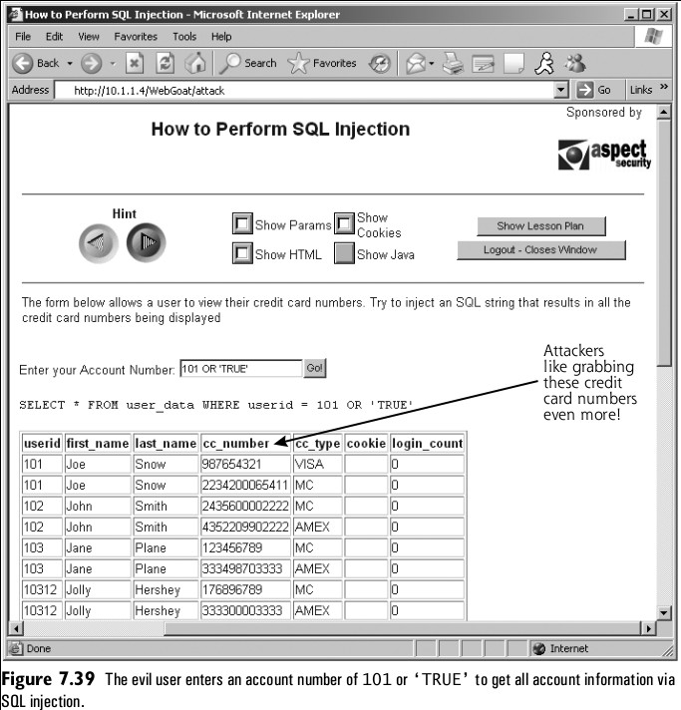
Example

Slide 18
Statistical database security.
The distinctive feature of a statistical database is that information is retrieved by means of aggregate queries
Examples
  COUNT
  SUM
  AVG
  MAX
  MIN

Slide 19
Tracker attack
Employ statistical queries to leak sensitive information about individual.
”A query predicate R that allows the tracking down of information about a single tuple is called an individual tracker. A general tracker T is a predicate that can be used to find the answer to any inadmissible query.

Slide 20
Example
Name | Sex | Program | Units | Grade Ave
Alma | F | MBA | 8 | 63
Bill | M | CS | 15 | 58
Carol | F | CS | 16 | 70
Don | M | MIS | 22 | 75
Errol | M | CS | 8 | 66
Flora | F | MIS | 16 | 81
Gala | F | MBA | 23 | 68
Homer | M | CS | 7 | 50
Igor | M | MIS | 21 | 70

Slide 21
Query single record
Q1
  SELECT COUNT(*)
  FROM Students
  Where Sex=’F’ AND Program =’CS’
Q2
  SELECT AVG(Grade Ave)
  From Students
  Where Sex=’F’ AND Program =’CS’
  Easy to prevent with constraint query >=3

Slide 22
Is the problem solved
Q1
  SELECT COUNT(*)
  FROM Students
  Where Program=’CS’
Q2
  SELECT COUNT(*)
  FROM Students
  Where Program=’CS’ AND Sex=’M’
Q3
  SELECT AVG(Grade Ave)
  FROM Students
  Where Program=’CS’
Q4
  SELECT AVG(Grade Ave)
  FROM Students
  Where Program=’CS’ AND Sex=’M’

Slide 23
Is the problem solved -cont
With a simple math
  Q1:4
  Q2:3
  Q3:61
  Q4:58
  Carol grade = 4*61-3*58=70 (OBS got it)
  Is there any systematic way to do this or just we are lucky ☺ since Carol was the single female CS student

Slide 24
So what
Let T be the general Tracker and Let R be a predicate that identify the tuple r.
So we can make two queries using RˇT and R ˇ Not(T). Our target r is the only tuple that is used in both queries.
  R: Name = ’Carol’
  T: Program=’MIS’
Q1: SELECT SUM(Units)
    FROM Students
    Where Name =’Carol’ OR Program=’MIS’

Slide 25
Example-cont
Q2: SELECT SUM(Units)
    FROM Students
    Where Name =’Carol’ OR Not (Program=’MIS’)
Q3: SELECT SUM(Units)
    FROM Students
Q1:75
Q2:77
Q3:136
136-(75+77)=16 units

Slide 26
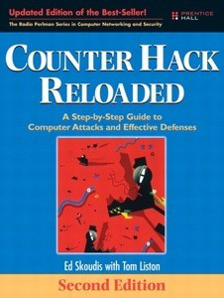

BIB

