Slide 1
Organizational Behavior 15th Ed
Chapter 1
Robbins and Judge
What Is Organizational Behavior?

Slide 2
Chapter 1 Learning Objectives
After studying this chapter you should be able to:
Demonstrate the importance of interpersonal skills in the workplace.
Describe the manager’s functions, roles and skills.
Define organizational behavior (OB).
Show the value to OB of systematic study.
Identify the major behavioral science disciplines that contribute to OB.
Demonstrate why few absolutes apply to OB.
Identify the challenges and opportunities managers have in applying OB concepts.
Compare the three levels of analysis in this book’s OB model.

Slide 3
Demonstrate the importance of interpersonal skills in the workplace
LO 1
Interpersonal Skills Result In…
Understanding OB helping to determine manager effectiveness
Leadership and communication skills that are critical as a person progresses in a career
Lower turnover of quality employees
Higher quality applications for recruitment
Better financial performance

Slide 4
Describe the manager’s functions, roles and skills.
LO 2
Manager: Someone who gets things done through other people in organizations.
Organization: A consciously coordinated social unit composed of two or more people that functions on a relatively continuous basis to achieve a common goal or set of goals.
Planning, organizing, leading, and controlling are the most often studied.
Mintzberg concluded that managers perform ten different, highly interrelated roles or sets of behaviors attributable to their jobs.

Slide 5
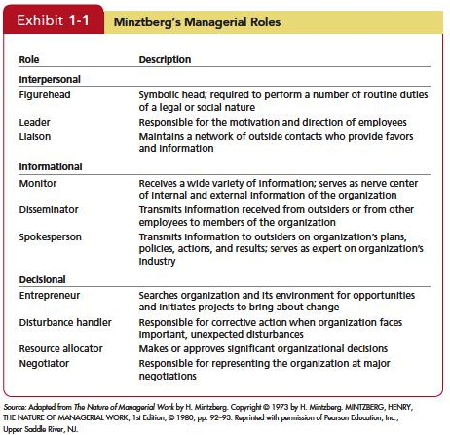
Describe the manager’s functions, roles and skills
LO 2
Insert Exhibit 1.1

Slide 6
Describe the manager’s functions, roles and skills
LO 2
Management Skills
Technical Skills --The ability to apply specialized knowledge or expertise. All jobs require some specialized expertise, and many people develop their technical skills on the job.
Human Skills -- Ability to work with, understand, and motivate other people, both individually and in groups, describes human skills.
Conceptual Skills -- The mental ability to analyze and diagnose complex situations.

Slide 7
Effective Versus Successful Managerial Activities
LO 2
Luthans and associates found that all managers engage in four managerial activities.
Traditional management.
Communication.
Human resource management.
Networking.

Slide 8
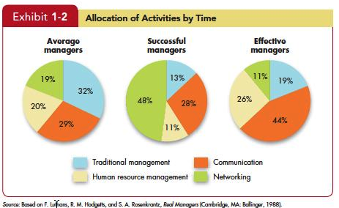
Effective Versus Successful Managerial Activities
LO 2
Insert Exhibit 1.2

Slide 9
Define “Organizational Behavior” (OB)
LO 3
OB is a field of study that investigates the impact that individuals, groups, and structure have on behavior within organizations for the purpose of applying such knowledge toward improving an organization’s effectiveness.

Slide 10
Show the value to OB of systematic study .
LO 4
Systematic Study of Behavior
Behavior generally is predictable if we know how the person perceived the situation and what is important to him or her.
Evidence-Based Management (EBM)
Complements systematic study.
Argues for managers to make decisions on evidence.
Intuition
Systematic study and EBM add to intuition, or those “gut feelings” about “why I do what I do” and “what makes others tick.”
If we make all decisions with intuition or gut instinct, we’re likely working with incomplete information.

Slide 11
Identify the major behavioral science disciplines that contribute to OB
LO 5
Organizational behavior is an applied behavioral science that is built upon contributions from a number of behavioral disciplines.

Slide 12
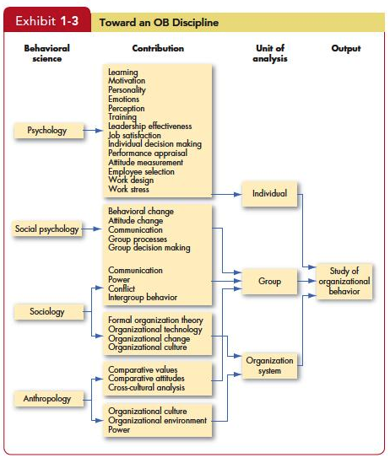
Identify the major behavioral science disciplines that contribute to OB
LO 5
Insert Exhibit 1.3

Slide 13
Identify the major behavioral science disciplines that contribute to OB
LO 5
Psychology
Psychology is the science that seeks to measure, explain, and sometimes change the behavior of humans and other animals.
Social Psychology
Social psychology blends the concepts of psychology and sociology.

Slide 14
Identify the major behavioral science disciplines that contribute to OB.
LO 5
Sociology
Sociologists study the social system in which individuals fill their roles; that is, sociology studies people in relation to their fellow human beings.
Anthropology
Anthropology is the study of societies to learn about human beings and their activities.

Slide 15
Few absolutes apply to OB
LO 6
There are few, if any, simple and universal principles that explain organizational behavior.
Contingency variables—situational factors are variables that moderate the relationship between the independent and dependent variables.

Slide 16
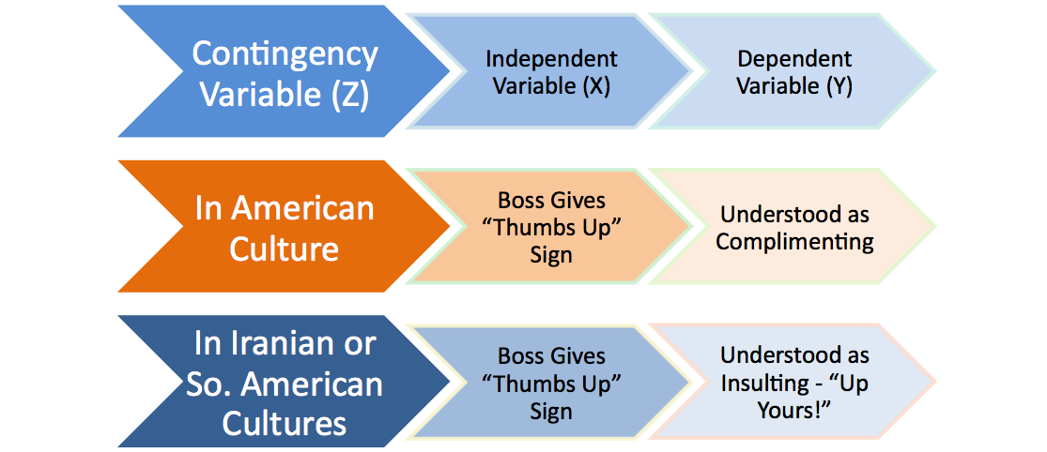
Few absolutes apply to OB
LO 6
Situational factors that make the main relationship between two variables change—e.g., the relationship may hold for one condition but not another.

Slide 17
Identify the challenges and opportunities of OB concepts
LO 7
Responding to Economic Pressure
In economic tough times, effective management is an asset.
In good times, understanding how to reward, satisfy, and retain employees is at a premium. In bad times, issues like stress, decision making, and coping come to the fore.

Slide 18
Identify the challenges and opportunities of OB concepts
LO 7
Responding to Globalization
increased Foreign Assignments
working with People from Different Cultures

Slide 19
Identify the challenges and opportunities of OB concepts
LO 7
Managing Workforce Diversity
Workforce diversity acknowledges a
workforce of women and men;
many racial and ethnic groups;
individuals with a variety of physical or psychological abilities;
and people who differ in age and sexual orientation.

Slide 20
Identify the challenges and opportunities of OB concepts
LO 7
Improving Customer Service
Today the majority of employees in developed countries work in service jobs.
Employee attitudes and behavior are associated with customer satisfaction.

Slide 21
Identify the challenges and opportunities of OB concepts
LO 7
Improving People Skills
People skills are essential to managerial effectiveness.
OB provides the concepts and theories that allow managers to predict employee behavior in given situations.

Slide 22
Identify the challenges and opportunities of OB concepts
LO 7
Stimulating Innovation and Change
Successful organizations must foster innovation and master the art of change.
Employees can be the impetus for innovation and change or a major stumbling block.
Managers must stimulate employees’ creativity and tolerance for change.

Slide 23
Identify the challenges and opportunities of OB concepts
LO 7
Coping with “Temporariness”
Organizations must be flexible and fast in order to survive.
Managers and employees must learn to cope with temporariness.
Learning to live with flexibility, spontaneity, and unpredictability.
OB provides help in understanding a work world of continual change, how to overcome resistance to change, and how to create an organizational culture that thrives on change.

Slide 24
Identify the challenges and opportunities of OB concepts
LO 7
Working in Networked Organizations
Networked organizations are becoming more pronounced.
A manager’s job is fundamentally different in networked organizations. Challenges of motivating and leading “online” require different techniques.

Slide 25
Identify the challenges and opportunities of OB concepts
LO 7
Helping Employees Balance Work-Life Conflicts
The creation of the global workforce means work no longer sleeps.
Communication technology has provided a vehicle for working at any time or any place.
Employees are working longer hours per week.
The lifestyles of families have changed—creating conflict.
Balancing work and life demands now surpasses job security as an employee priority.

Slide 26
Identify the challenges and opportunities of OB concepts
LO 7
Creating a Positive Work Environment
Organizations have realized creating a positive work environment can be a competitive advantage.
Positive organizational scholarship or behavior studies what is ‘good’ about organizations.
This field of study focuses on employees’ strengths versus their limitations as employees share situations in which they performed at their personal best.

Slide 27
Identify the challenges and opportunities of OB concepts
LO 7
Improving Ethical Behavior
Ethical dilemmas are situations in which an individual is required to define right and wrong conduct.
Good ethical behavior is not so easily defined.
Organizations are distributing codes of ethics to guide employees through ethical dilemmas.
Managers need to create an ethically healthy climate.

Slide 28
Three levels of analysis in this book’s OB model.
LO 8
Exhibit 1-4
Notes:
This book proposes three types of variables, inputs, processes, and outcomes, at three levels of analysis, individual, group, and organizational.
The model proceeds from left to right, with inputs leading to processes, and processes leading to outcomes.

Slide 29
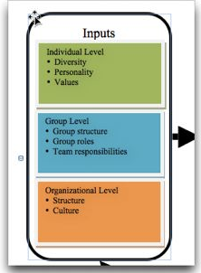
Three levels of analysis in this book’s OB model.
LO 8
Inputs
Inputs are the variables like personality, group structure, and organizational culture that lead to processes.
Group structure, roles, and team responsibilities are typically assigned immediately before or after a group is formed.
1-29
Notes:
Finally, organizational structure and culture are usually the result of years of development and change as the organization adapts to its environment and builds up customs and norms.

Slide 30
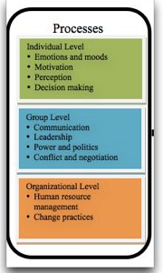
Three levels of analysis in this book’s OB model.
LO 8
Processes
If inputs are like the nouns in organizational behavior, processes are like verbs.
Processes are actions that individuals, groups, and organizations engage in as a result of inputs and that lead to certain outcomes.
1-30

Slide 31
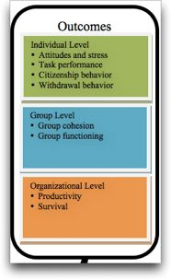
Three levels of analysis in this book’s OB model.
LO 8
Outcomes
Outcomes are the key variables that you want to explain or predict, and that are affected by some other variables.
1-31

Slide 32
Variables of Interest
LO 8
Attitudes and stress
Employee attitudes are the evaluations employees make, ranging from positive to negative, about objects, people, or events.
Stress is an unpleasant psychological process that occurs in response to environmental pressures.
Task performance
The combination of effectiveness and efficiency at doing your core job tasks is a reflection of your level of task performance.

Slide 33
Variables of Interest
LO 8
Citizenship behavior
The discretionary behavior that is not part of an employee’s formal job requirements, and that contributes to the psychological and social environment of the workplace, is called citizenship behavior.
Withdrawal behavior
Withdrawal behavior is the set of actions that employees take to separate themselves from the organization.

Slide 34
Variables of Interest
LO 8
Group cohesion
Group cohesion is the extent to which members of a group support and validate one another at work.
Group functioning
Group functioning refers to the quantity and quality of a group’s work output.

Slide 35
Variables of Interest
LO 8
Productivity
An organization is productive if it achieves its goals by transforming inputs into outputs at the lowest cost. This requires both effectiveness and efficiency.
Survival
The final outcome we will consider is organizational survival, which is simply evidence that the organization is able to exist and grow over the long term.

Slide 36
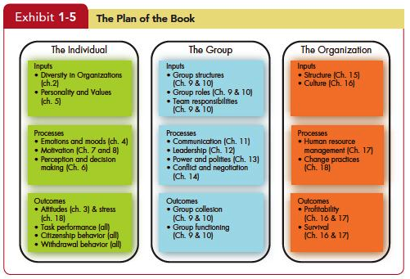
Variables of Interest
LO 8
Insert Exhibit 1.5

Slide 37
Managerial Summary
Organizational behavior uses systematic study to improve predictions of behavior over intuition alone.
Because people are different, we need to look at OB in a contingency framework, using situational variables to explain cause-and-effect relationships.
Organizational behavior offers specific insights to improve a manager’s people skills.

Slide 38
Managerial Summary
It helps managers to see the value of workforce diversity and practices that may need to be changed in different countries.
It can improve quality and employee productivity by showing managers how to empower their people, and help employees balance work–life conflicts.
It can help managers cope in a world of temporariness and learn how to stimulate innovation.
Finally, OB can guide managers in creating an ethically healthy work climate.

Slide 39
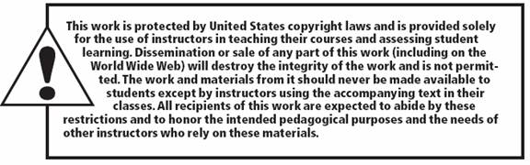
All rights reserved. No part of this publication may be reproduced, stored in a retrieval system, or transmitted, in any form or by any means, electronic, mechanical, photocopying, recording, or otherwise, without the prior written permission of the publisher. Printed in the United States of America.
Copyright © 2013 Pearson Education, Inc. publishing as Prentice Hall

