Slide 1
Introduction to Server-Side Development with PHP
Chapter 8

Slide 2
Objectives
1
2
Server-Side Development
Web Server’s Responsabilities
3
4
Quick Tour of PHP
Program Control
5
Functions
7

Slide 3
What IS Server-Side Development
Section 1 of 5

Slide 4
What is Server-Side Development
The basic hosting of your files is achieved through a web server.
Server-side development is much more than web hosting: it involves the use of a programming technology like PHP or ASP.NET to create scripts that dynamically generate content
Consider distinction between client side and server side…

Slide 5
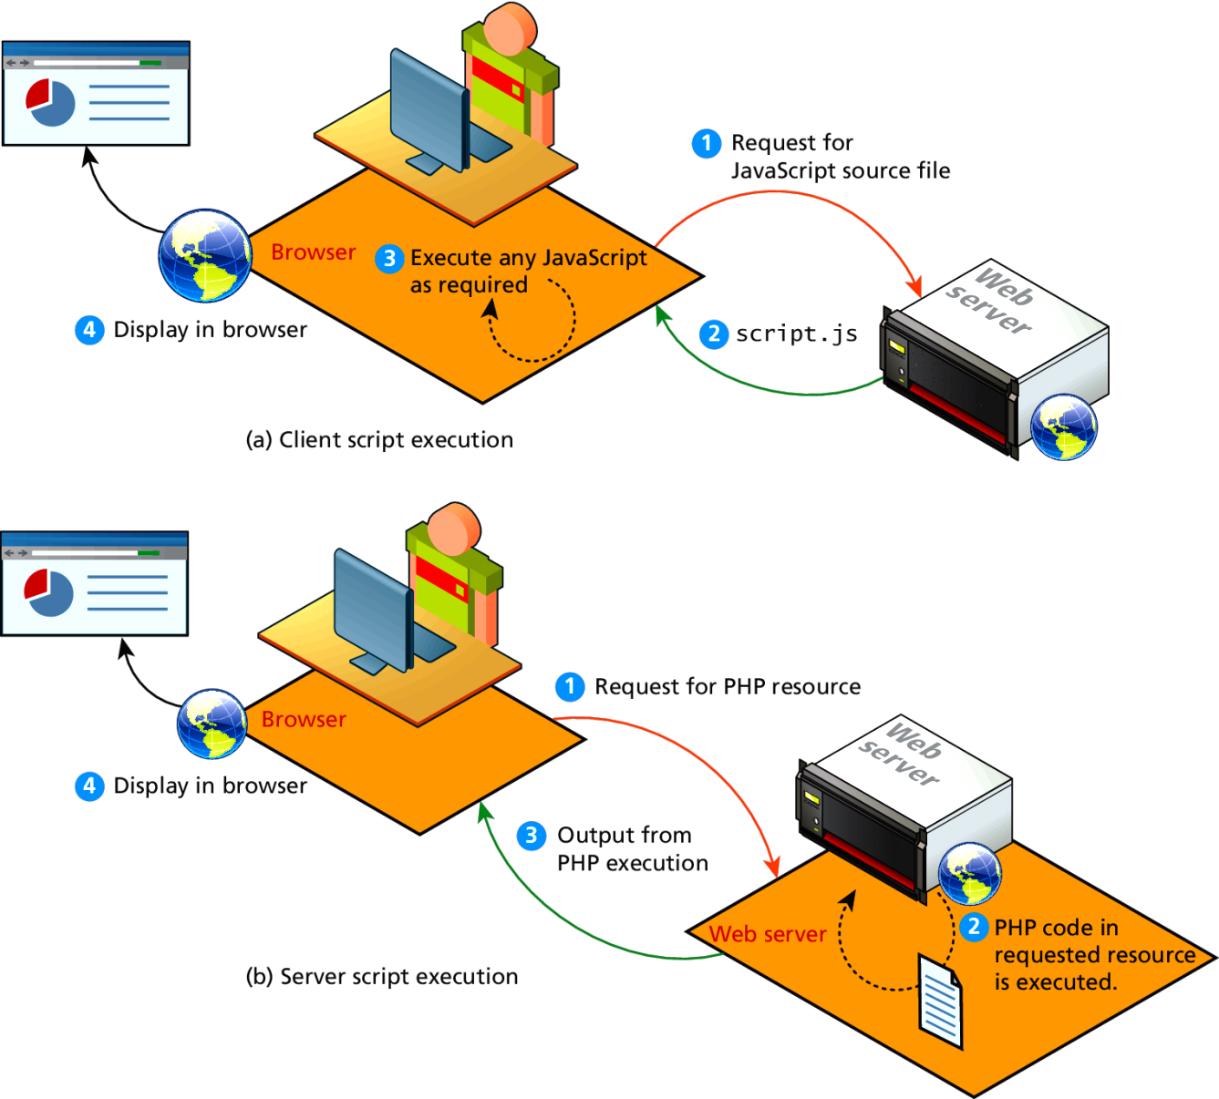
Comparing Client and Server Scripts

Slide 6
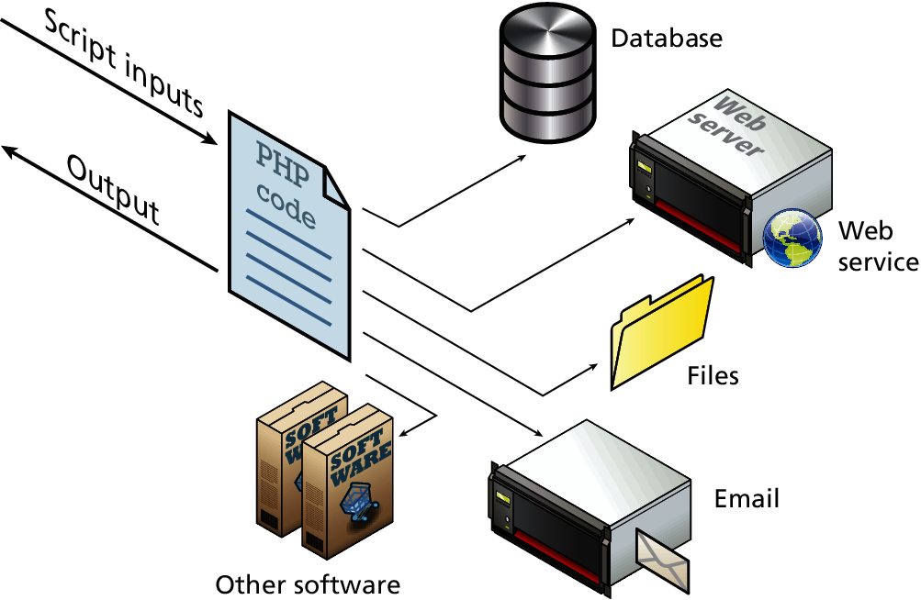
Server-Side Script Resources
So many tools in your kit

Slide 7
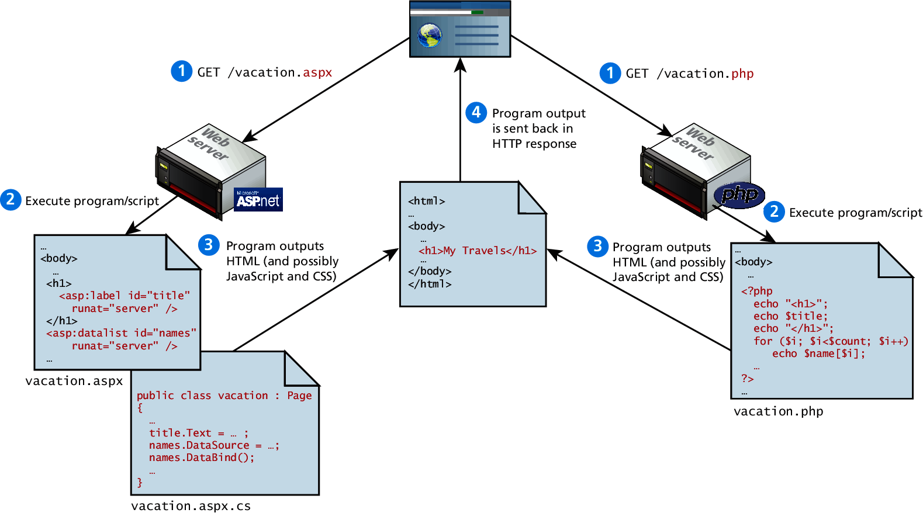
Web Development Technologies

Slide 8
Comparing Server-Side Technologies
ASP (Active Server Pages). Like PHP, ASP code (using the VBScript programming language) can be embedded within the HTML. ASP programming code is interpreted at run time, hence it can be slow in comparison to other technologies.
ASP.NET. ASP.NET is part of Microsoft’s .NET Framework and can use any .NET programming language (though C# is the most commonly used). ASP.NET uses an explicitly object-oriented approach. It also uses special markup called web server controls that encapsulate common web functionality such as database-driven lists, form validation, and user registration wizards. ASP.NET pages are compiled into an intermediary file format called MSIL that is analogous to Java’s byte-code. ASP.NET then uses a Just-In-Time compiler to compile the MSIL into machine executable code so its performance can be excellent. However, ASP.NET is essentially limited to Windows servers.

Slide 9
Comparing Server-Side Technologies
JSP (Java Server Pages). JSP uses Java as its programming language and like ASP.NET it uses an explicit object-oriented approach and is used in large enterprise web systems and is integrated into the J2EE environment. Since JSP uses the Java Runtime Engine, it also uses a JIT compiler for fast execution time and is cross-platform. While JSP’s usage in the web as a whole is small, it has a substantial market share in the intranet environment, as well as with very large and busy sites.
Node.js. This is a more recent server environment that uses JavaScript on the server side, thus allowing developers already familiar with JavaScript to use just a single language for both client-side and server-side development. Unlike the other development technologies listed here, node.js also is its own web server software, thus eliminating the need for Apache, IIS, or some other web server software.

Slide 10
Comparing Server-Side Technologies
Perl. Until the development and popularization of ASP, PHP, and JSP, Perl was the language typically used for early server-side web development. As a language, it excels in the manipulation of text. It was commonly used in conjunction with the Common Gateway Interface (CGI), an early standard API for communication between applications and web server software.
PHP. Like ASP, PHP is a dynamically typed language that can be embedded directly within the HTML, though it now supports most common object-oriented features, such as classes and inheritance. By default, PHP pages are compiled into an intermediary representation called opcodes that are analogous to Java’s byte-code or the .NET Framework’s MSIL. Originally, PHP stood for personal home pages, although it now is a recursive acronym that means PHP: Hypertext Processor.

Slide 11
Comparing Server-Side Technologies
Python. This terse, object-oriented programming language has many uses, including being used to create web applications. It is also used in a variety of web development frameworks such as Django and Pyramid.
Ruby on Rails. This is a web development framework that uses the Ruby programming language. Like ASP.NET and JSP, Ruby on Rails emphasizes the use of common software development approaches, in particular the MVC design pattern. It integrates features such as templates and engines that aim to reduce the amount of development work required in the creation of a new site.

Slide 12
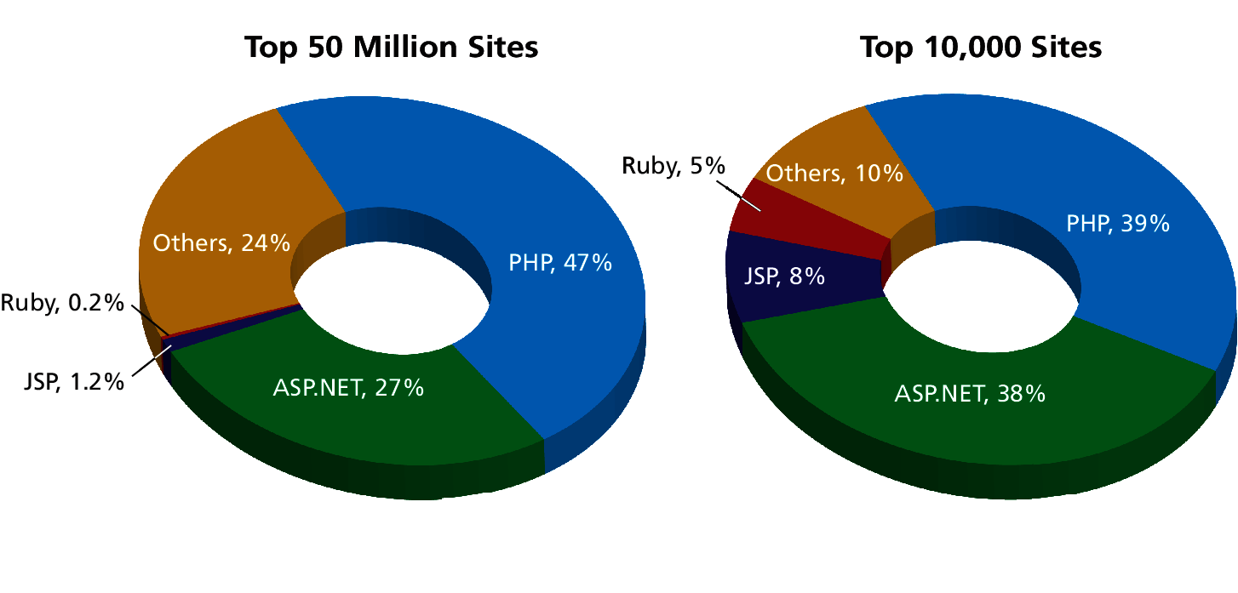
Market Share
Of web development environments

Slide 13
Web Server’s Responsabilities
Section 2 of 5

Slide 14
A Web Server’s Responsibilities
A web server has many responsibilities:
handling HTTP connections
responding to requests for static and dynamic resources
managing permissions and access for certain resources
encrypting and compressing data
managing multiple domains and URLs
managing database connections
managing cookies and state
uploading and managing files

Slide 15
LAMP stack
WAMP, MAMP, …
You will be using the LAMP software stack
Linux operating system
Apache web server
MySQL DBMS
PHP scripting language

Slide 16
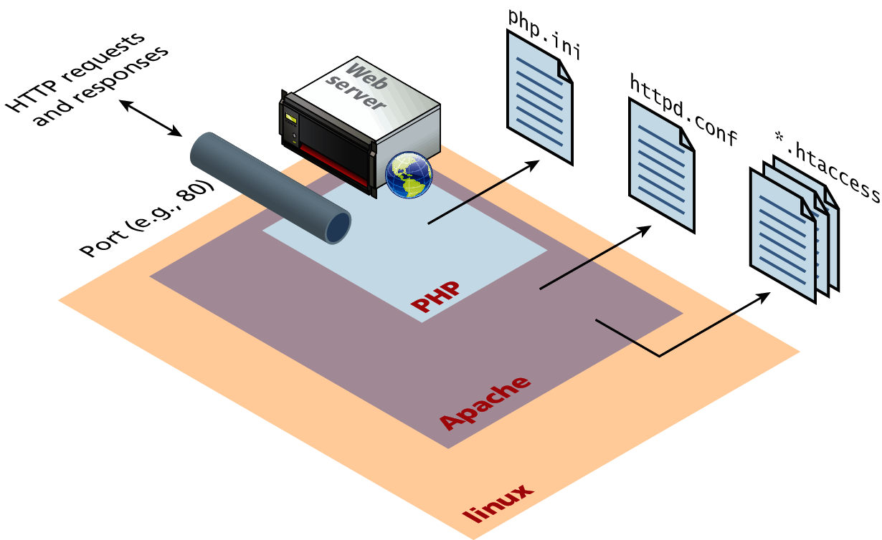
Apache and Linux
LA
Consider the Apache web server as the intermediary that interprets HTTP requests that arrive through a network port and decides how to handle the request, which often requires working in conjunction with PHP.

Slide 17
Apache
Continued
Apache runs as a daemon on the server. A daemon is an executing instance of a program (also called a process) that runs in the background, waiting for a specific event that will activate it.
When a request arrives, Apache then uses modules to determine how to respond to the request.
In Apache, a module is a compiled extension (usually written in the C programming language) to Apache that helps it handle requests. For this reason, these modules are also sometimes referred to as handlers.

Slide 18
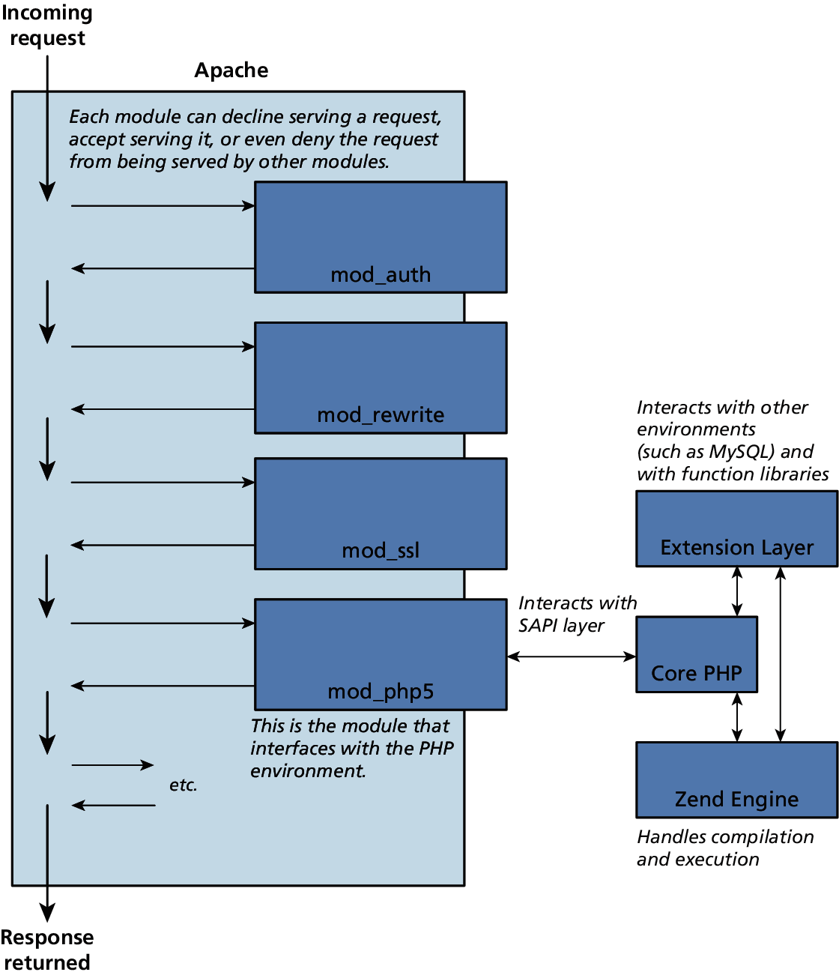
Apache and PHP
PHP Module in Apache

Slide 19
Apache Threads
Multi-thread and multi-process
Apache runs in two possible modes:
multi-process (also called preforked)
multi-threaded (also called worker)
The default installation of Apache runs using the multi-process mode.

Slide 20
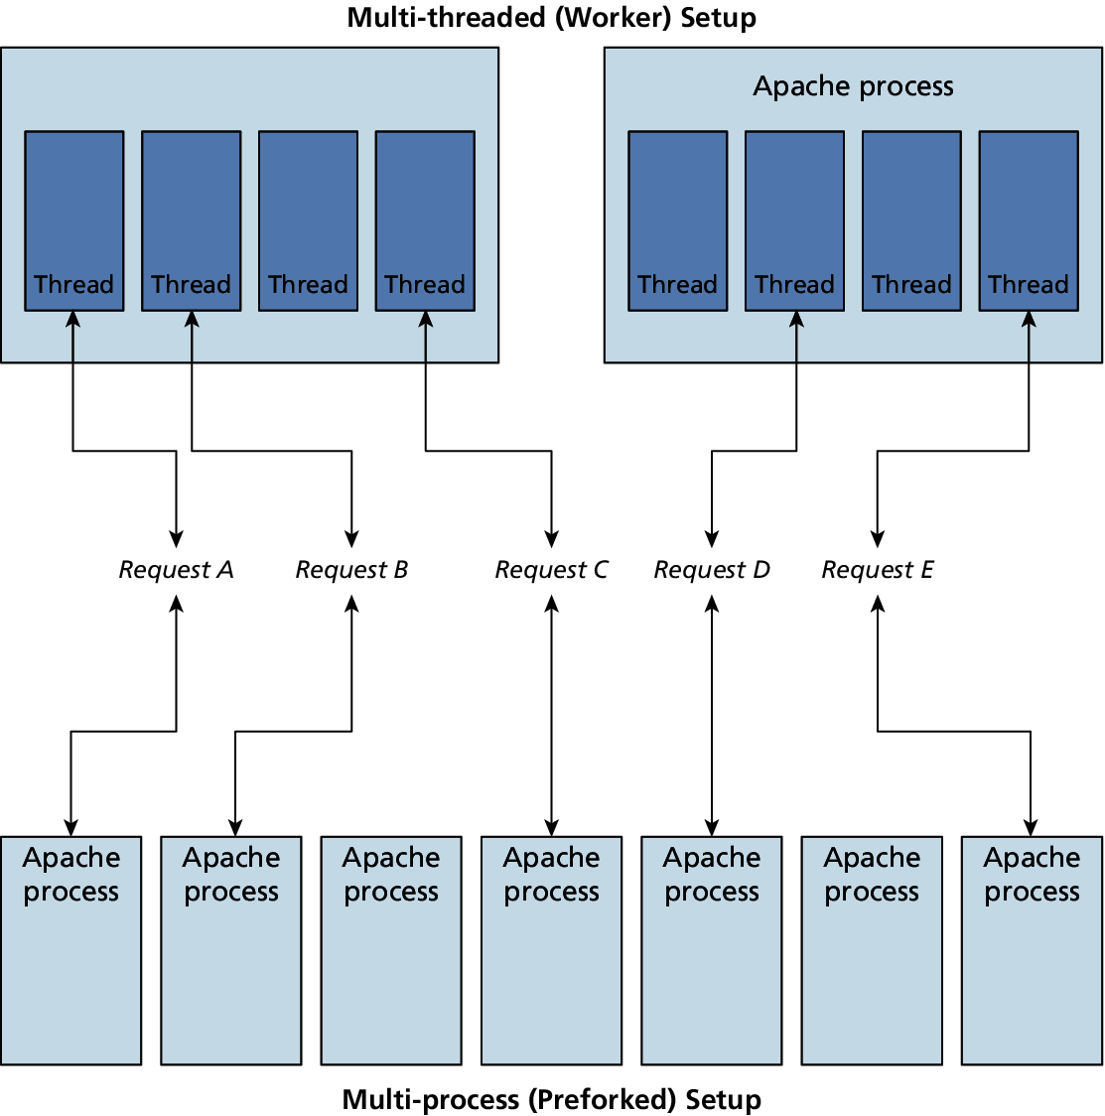
Apache Threads
Multi-thread and multi-process

Slide 21
PHP Internals
PHP itself is written in C
There are 3 main modules
PHP core. The Core module defines the main features of the PHP environment, including essential functions for variable handling, arrays, strings, classes, math, and other core features.
Extension layer. This module defines functions for interacting with services outside of PHP. This includes libraries for MySQL, FTP, SOAP web services, and XML processing, among others.
Zend Engine. This module handles the reading in of a requested PHP file, compiling it, and executing it.

Slide 22
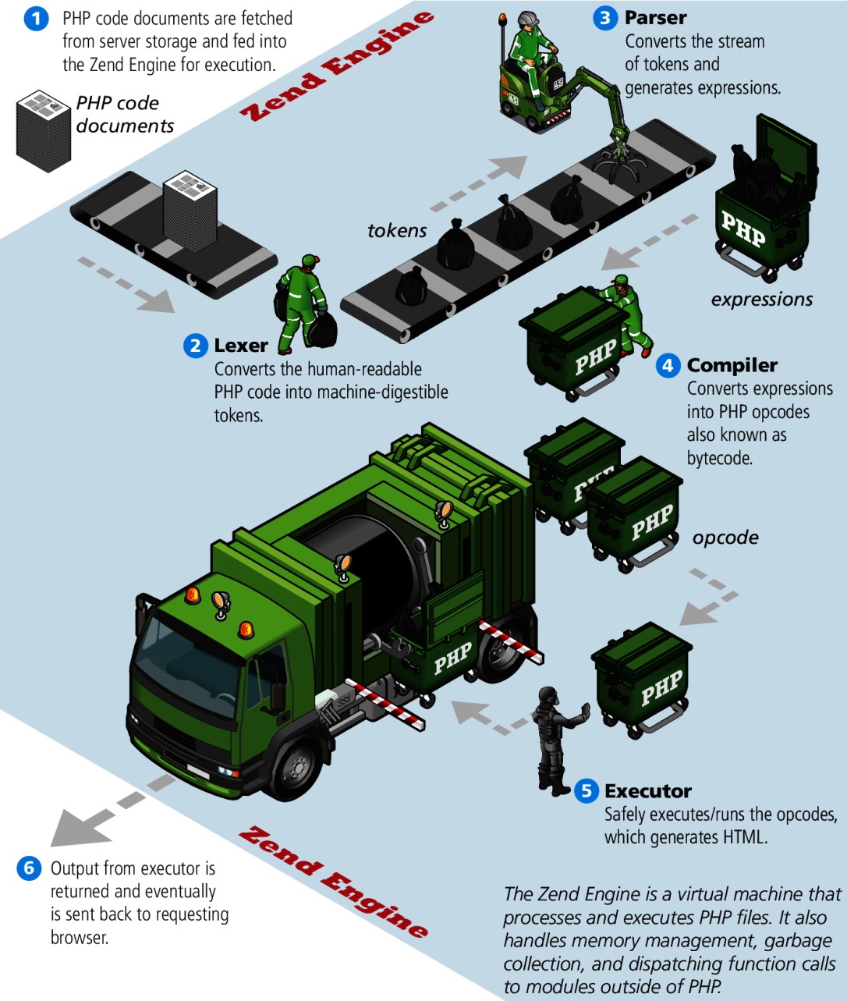
Zend Engine
No, your code is not garbage.

Slide 23
Installing LAMP locally
Turn this key
The easiest and quickest way to do so is to use the
EasyPHP for Windows only
XAMPP For Windows installation package
MAMP for Mac installation package
Both of these installation packages install and configure Apache, PHP, and MySQL.
Later we can come back and configure these systems in more detail.

Slide 24
XAMPP Control Panel
Turn this key

Slide 25
XAMPP Settings
Defaults are
PHP requests in your browser will need to use the localhost domain (127.0.0.1)
PHP files will have to be saved somewhere within the C:\xampp\htdocs folder

Slide 26
Quick Tour Of PHP
Section 3 of 5

Slide 27
Quick Tour
PHP, like JavaScript, is a dynamically typed language.
it uses classes and functions in a way consistent with other object-oriented languages such as C++, C#, and Java
The syntax for loops, conditionals, and assignment is identical to JavaScript
Differs when you get to functions, classes, and in how you define variables

Slide 28
PHP Tags
The most important fact about PHP is that the programming code can be embedded directly within an HTML file.
A PHP file will usually have the extension .php
programming code must be contained within an opening <?php tag and a matching closing ?> tag
any code outside the tags is echoed directly out to the client

Slide 29
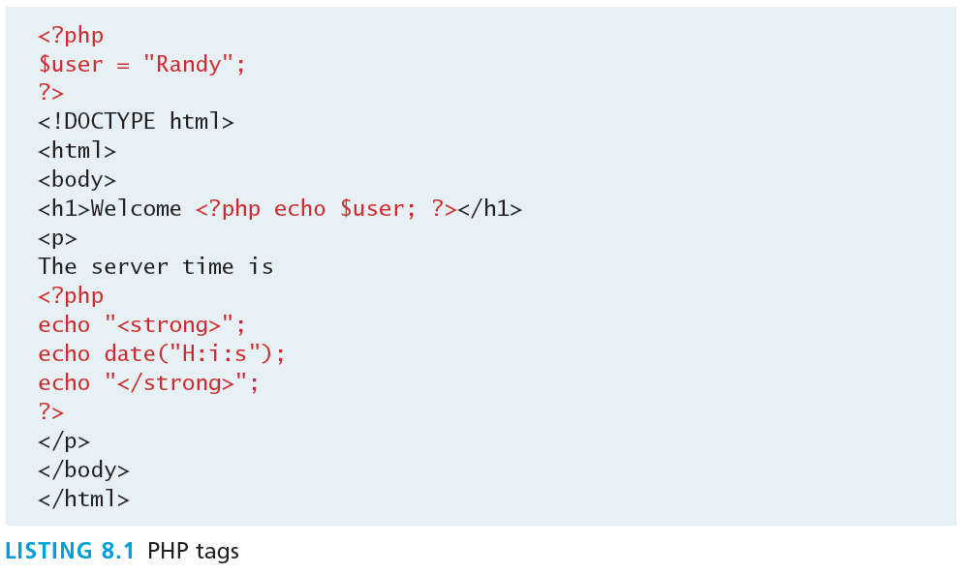
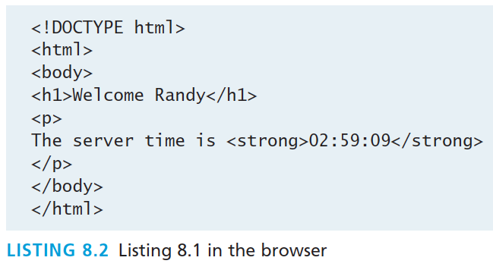
PHP Tags

Slide 30
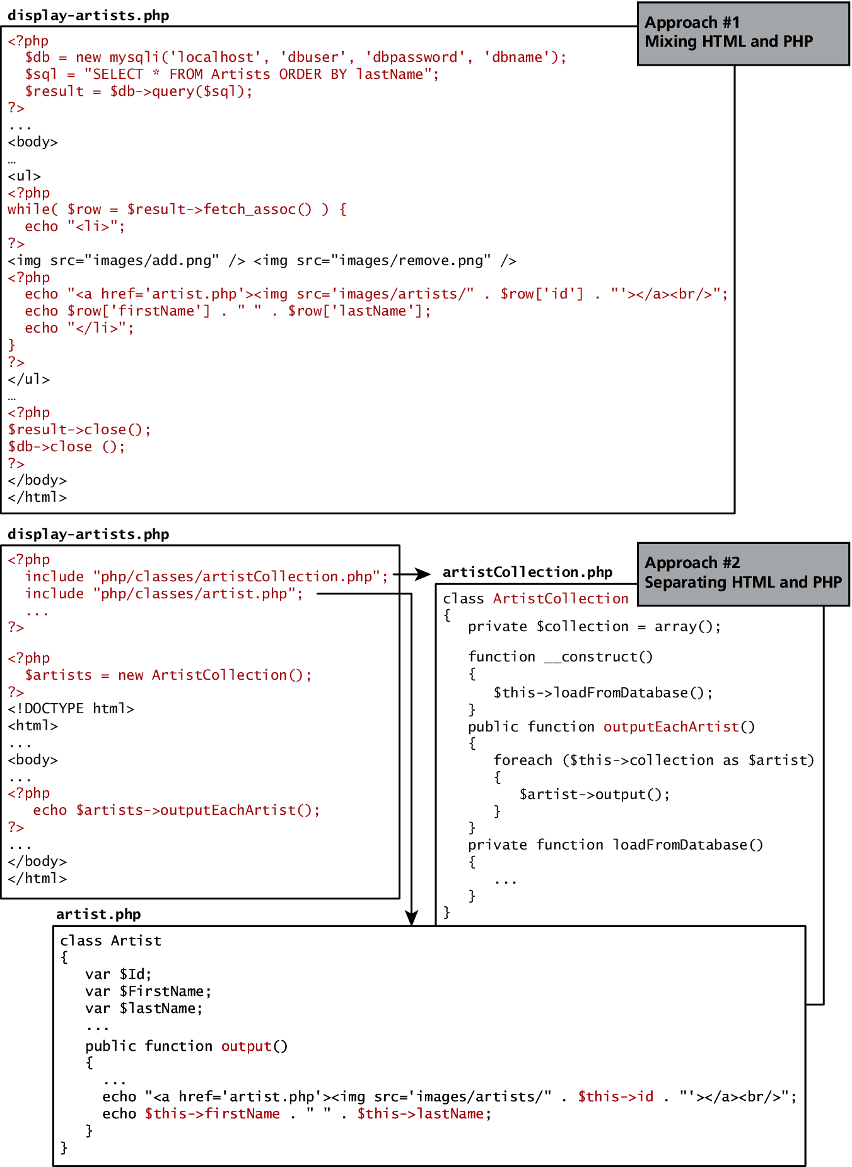
HTML and PHP
Two approaches

Slide 31
HTML and PHP
Two approaches

Slide 32
PHP Comments
3 kinds
The types of comment styles in PHP are:
Single-line comments. Lines that begin with a # are comment lines and will not be executed.
Multiline (block) comments. These comments begin with a /* and encompass everything that is encountered until a closing */ tag is found.
End-of-line comments. Whenever // is encountered in code, everything up to the end of the line is considered a comment.

Slide 33
PHP Comments
3 kinds
<?php
# single-line comment
/*
This is a multiline comment.
They are a good way to document functions or complicated blocks of code
*/
$artist = readDatabase(); // end-of-line comment
?>

Slide 34
Variables
Variables in PHP are dynamically typed.
Variables are also loosely typed in that a variable can be assigned different data types over time
To declare a variable you must preface the variable name with the dollar ($) symbol.
$count = 42;

Slide 35
Data Types
Data Type | Description
Boolean | A logical true or false value
Integer | Whole numbers
Float | Decimal numbers
String | Letters
Array | A collection of data of any type (covered in the next chapter)
Object | Instances of classes

Slide 36
Constants
A constant is somewhat similar to a variable, except a constant’s value never changes . . . in other words it stays constant.
Typically defined near the top of a PHP file via the define() function
once it is defined, it can be referenced without using the $ symbol

Slide 37
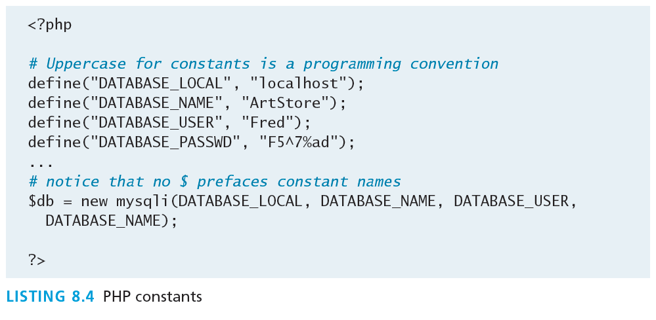
Constants

Slide 38
Writing to Output
Hello World
To output something that will be seen by the browser, you can use the echo() function.
echo ("hello"); //long form
echo "hello"; //shortcut

Slide 39
String Concatenation
Easy
Strings can easily be appended together using the concatenate operator, which is the period (.) symbol.
$username = "World";
echo "Hello". $username;
Will Output Hello World

Slide 40
String Concatenation
Example
$firstName = "Pablo";
$lastName = "Picasso";
/*
Example one:
The first four lines are equivalent. Notice that you can reference PHP variables within a string literal defined with double quotes.
The resulting output for the first four lines is: <em>Pablo Picasso</em>
The last one displays: <em> $firstName $lastName </em>
*/
echo "<em>" . $firstName . " ". $lastName . "</em>";
echo '<em>' . $firstName . ' '. $lastName. '</em>';
echo '<em>' . $firstName . ' '. $lastName. "</em>";
echo "<em> $firstName $lastName </em>";
echo '<em> $firstName $lastName </em>'; Won’t Work!!

Slide 41
String Concatenation
Example
/*
Example two:
These two lines are also equivalent. Notice that you can use either the single quote symbol or double quote symbol for string literals.
*/
echo "<h1>";
echo '<h1>';

Slide 42
String Concatenation
Example
/*
Example three:
These two lines are also equivalent. In the second example, the escape character (the backslash) is used to embed a double quote within a string literal defined within double quotes.
*/
echo '<img src="23.jpg" >';
echo "<img src=\"23.jpg\" >";

Slide 43
String escape Sequences
Sequence | Description
\n | Line feed
\t | Horizontal tab
\\ | Backslash
\$ | Dollar sign
\" | Double quote

Slide 44
Complicated Concatenation
echo "<img src='23.jpg' alt='". $firstName . " ". $lastName . "' >";
echo "<img src='$id.jpg' alt='$firstName $lastName' >";
echo "<img src=\"$id.jpg\" alt=\"$firstName $lastName\" >";
echo '<img src="' . $id. '.jpg" alt="' . $firstName . ' ' . $lastName . '" >';
echo '<a href="artist.php?id=' .$id .'">' .$firstName .' ' . $lastName .'</a>';

Slide 45
Complicated Concatenation
echo "<img src='23.jpg' alt='". $firstName . " ". $lastName . "' >";
echo "<img src='$id.jpg' alt='$firstName $lastName' >";
echo "<img src=\"$id.jpg\" alt=\"$firstName $lastName\" >";
echo '<img src="' . $id. '.jpg" alt="' . $firstName . ' ' . $lastName . '" >';
echo '<a href="artist.php?id=' .$id .'">' .$firstName .' ' . $lastName .'</a>';

Slide 46
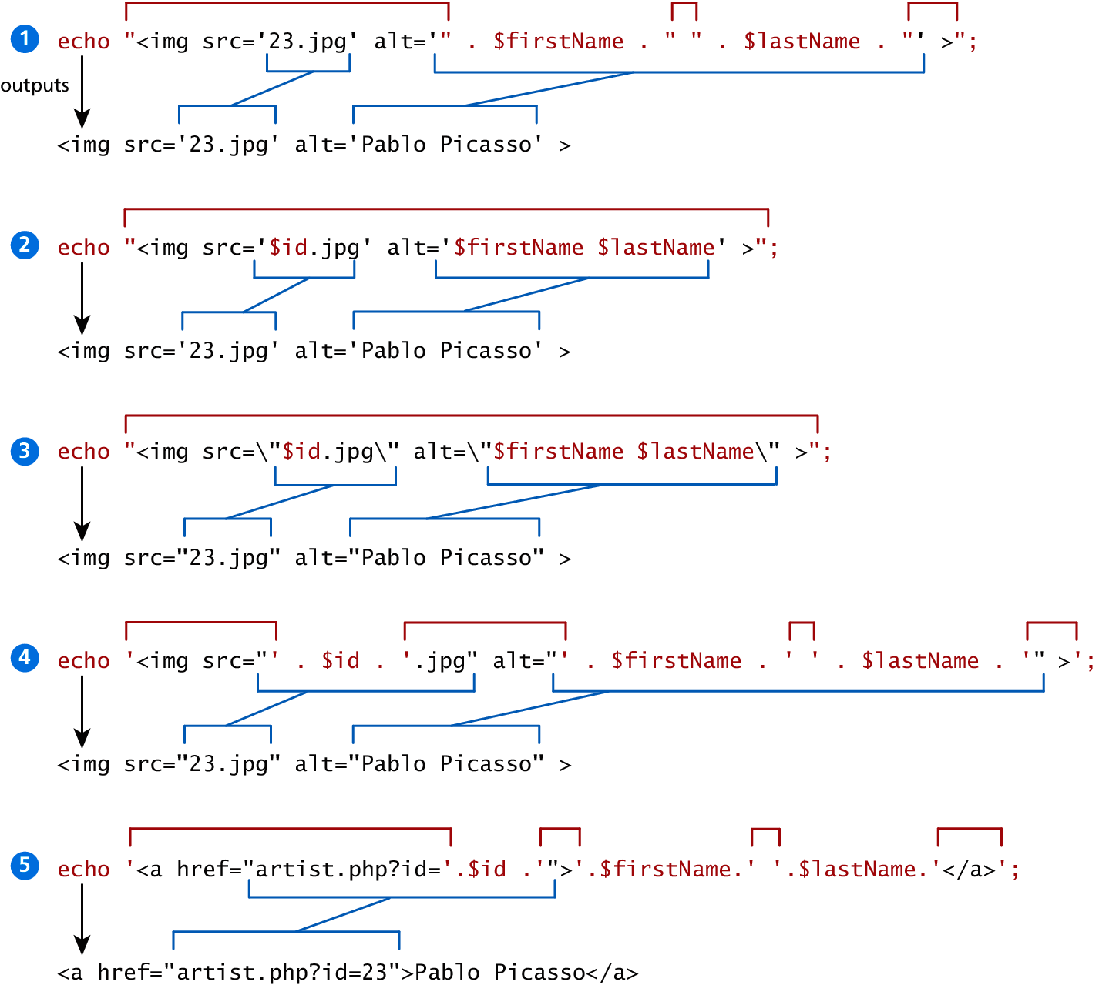
Illustrated Example

Slide 47
PrintF
Good ol’ printf
As an alternative, you can use the printf() function.
derived from the same-named function in the C programming language
includes variations to print to string and files (sprintf, fprintf)
takes at least one parameter, which is a string, and that string optionally references parameters, which are then integrated into the first string by placeholder substitution
Can also apply special formatting, for instance, specific date/time formats or number of decimal places

Slide 48
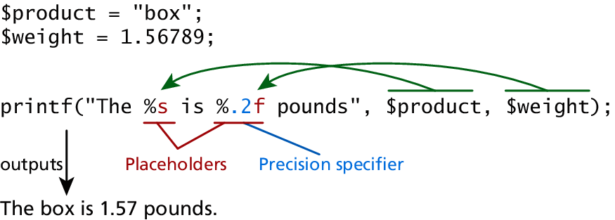
PrintF
Illustrated example

Slide 49
PrintF
Type specifiers
Each placeholder requires the percent (%) symbol in the first parameter string followed by a type specifier.
b for binary
d for signed integer
f for float
o for octal
x for hexadecimal

Slide 50
PrintF
Precision
Precision allows for control over how many decimal places are shown. Important for displaying calculated numbers to the user in a “pretty” way.
Precision is achieved in the string with a period (.) followed by a number specifying how many digits should be displayed for floating-point numbers.

Slide 51
Program CONTROL
Section 4 of 5

Slide 52
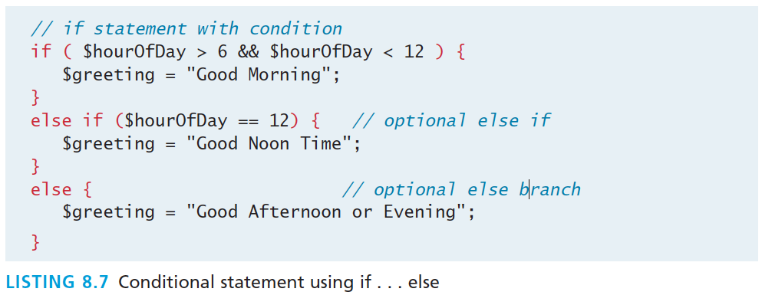
If…else
The syntax for conditionals in PHP is almost identical to that of JavaScript

Slide 53
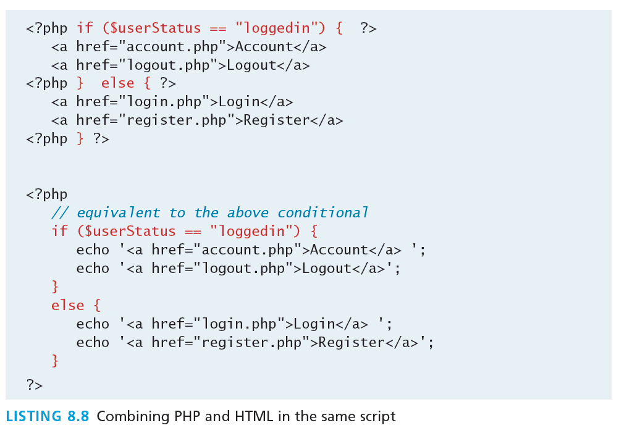
If…else
Alternate syntax

Slide 54
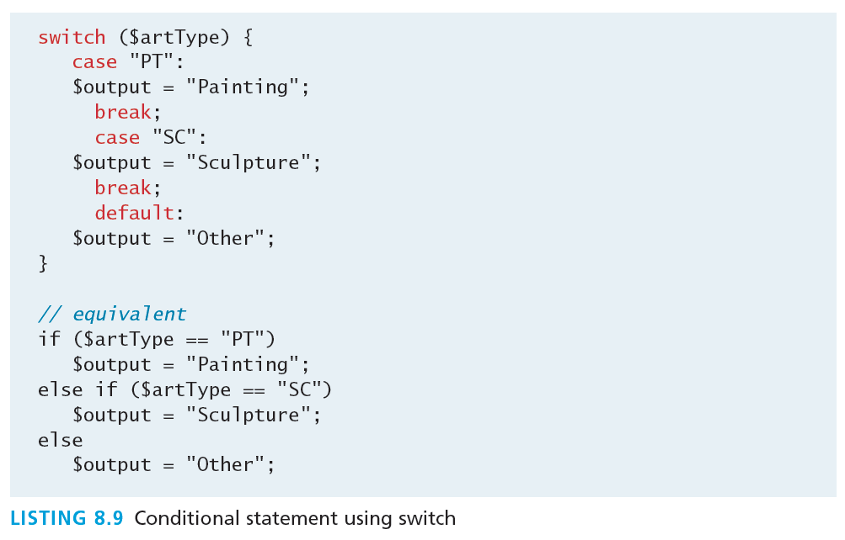
Switch…case
Nearly identical

Slide 55
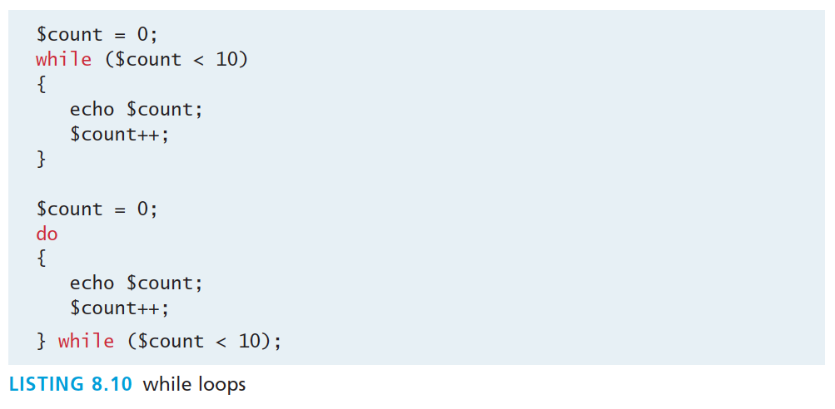
While and Do..while
Identical to other languages

Slide 56
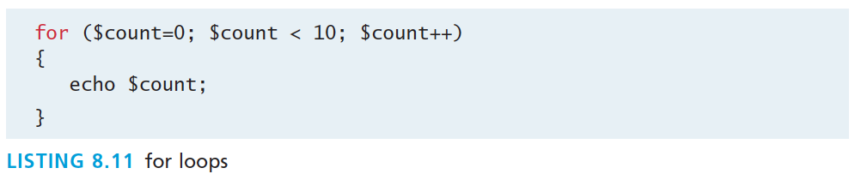
For
Identical to other languages

Slide 57
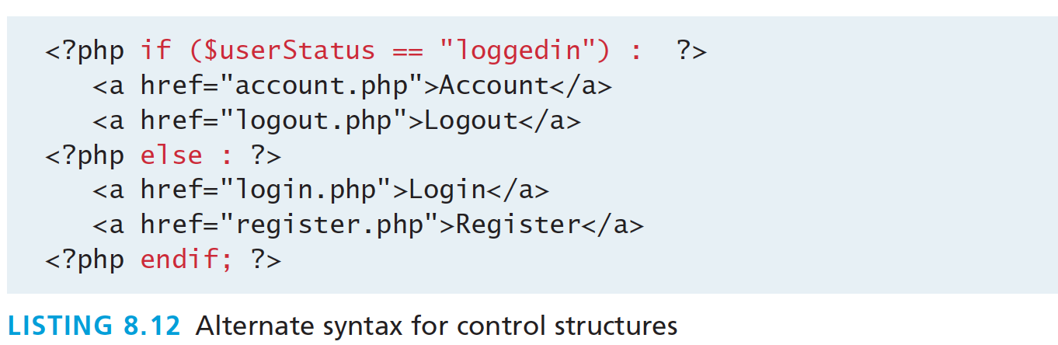
Alternate syntax for Control Structures
PHP has an alternative syntax for most of its control structures. In this alternate syntax
the colon (:) replaces the opening curly bracket,
while the closing brace is replaced with endif;, endwhile;, endfor;, endforeach;, or endswitch;

Slide 58
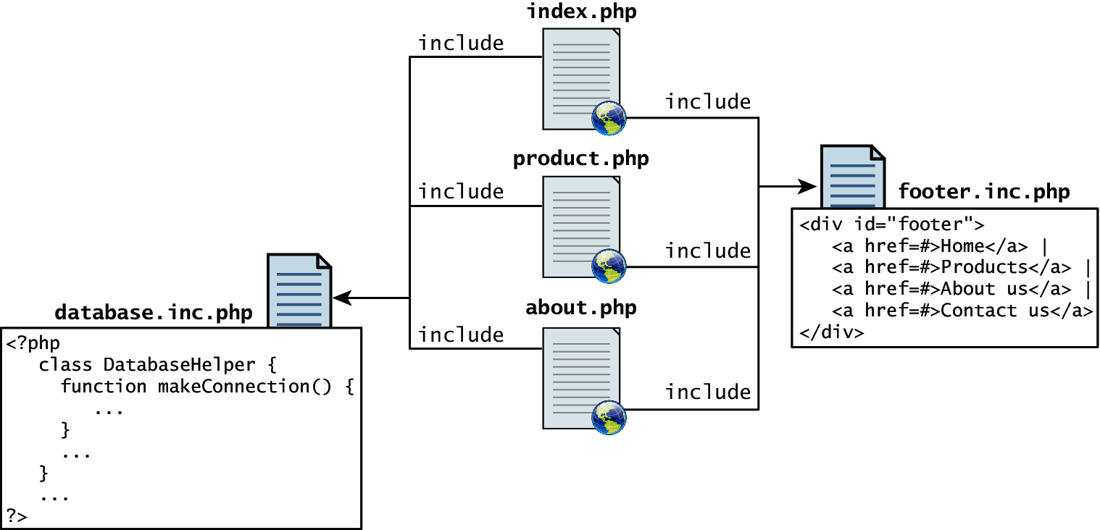
Include Files
Organize your code
PHP does have one important facility that is generally unlike other nonweb programming languages, namely the ability to include or insert content from one file into another.

Slide 59
Include Files
Organize your code
PHP provides four different statements for including files, as shown below.
include "somefile.php";
include_once "somefile.php";
require "somefile.php";
require_once "somefile.php";
With include, a warning is displayed and then execution continues. With require, an error is displayed and execution stops.

Slide 60
Include Files
Scope
Include files are the equivalent of copying and pasting.
Variables defined within an include file will have the scope of the line on which the include occurs
Any variables available at that line in the calling file will be available within the called file
If the include occurs inside a function, then all of the code contained in the called file will behave as though it had been defined inside that function

Slide 61
functions
Section 5 of 5

Slide 62
Functions
You mean we don’t write everything in main?
Just as with any language, writing code in the main function (which in PHP is equivalent to coding in the markup between <?php and ?> tags) is not a good habit to get into.
A function in PHP contains a small bit of code that accomplishes one thing. In PHP there are two types of function: user-defined functions and built-in functions.
A user-defined function is one that you the programmer define.
A built-in function is one of the functions that come with the PHP environment

Slide 63
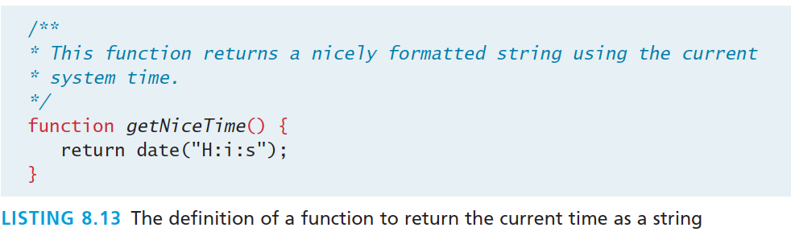
Functions
syntax
While the example function in Listing 8.13 returns a value, there is no requirement for this to be the case.

Slide 64
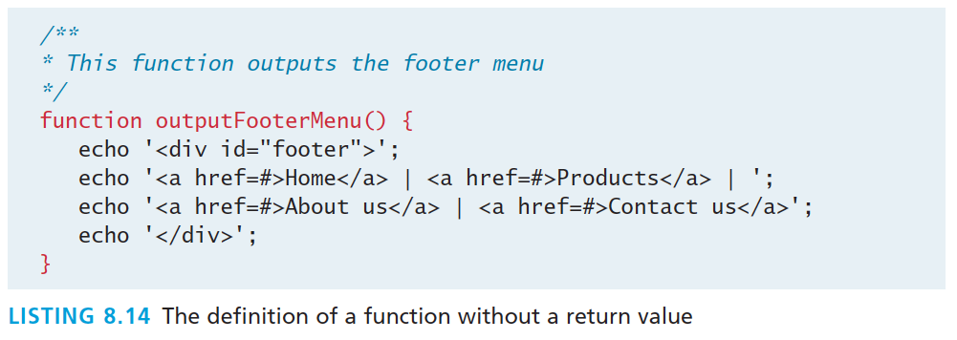
Functions
No return – no big deal.

Slide 65
Call a function
Now that you have defined a function, you are able to use it whenever you want to. To call a function you must use its name with the () brackets.
Since getNiceTime() returns a string, you can assign that return value to a variable, or echo that return value directly, as shown below.
$output = getNiceTime();
echo getNiceTime();
If the function doesn’t return a value, you can just call the function:
outputFooterMenu();

Slide 66
Parameters
Parameters are the mechanism by which values are passed into functions.
To define a function with parameters, you must decide
how many parameters you want to pass in,
and in what order they will be passed
Each parameter must be named

Slide 67
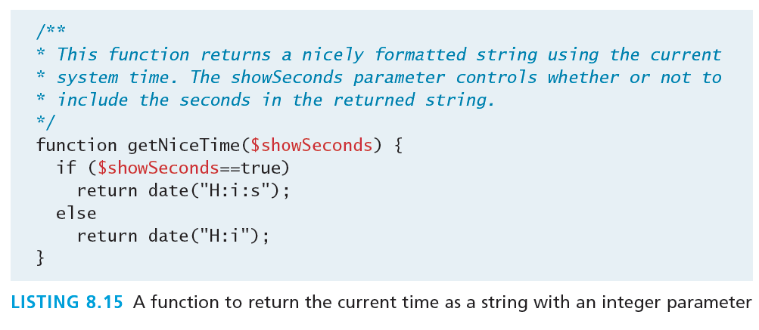
Parameters
Thus to call our function, you can now do it in two ways:
echo getNiceTime(1); // this will print seconds
echo getNiceTime(0); // will not print seconds

Slide 68
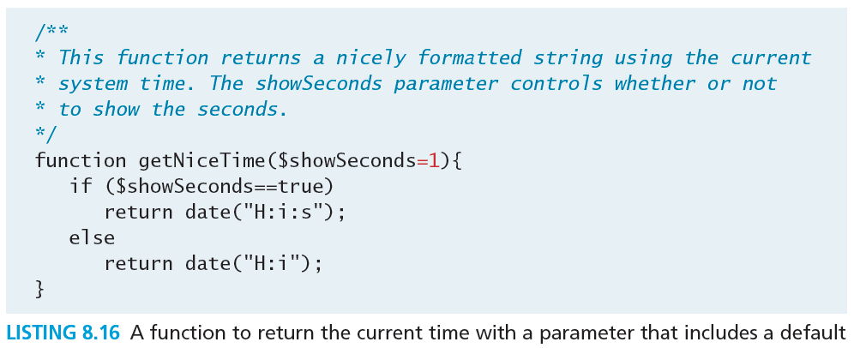
Parameter Default Values
Now if you were to call the function with no values, the $showSeconds parameter would take on the default value, which we have set to 1, and return the string with seconds.

Slide 69
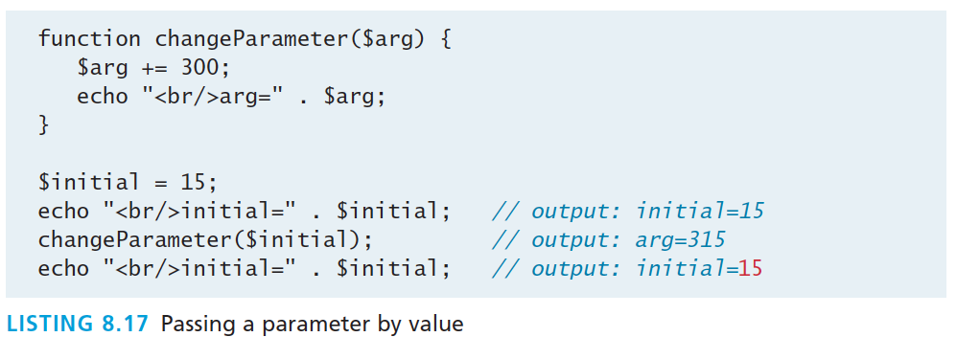
Pass Parameters by Value
By default, arguments passed to functions are passed by value in PHP. This means that PHP passes a copy of the variable so if the parameter is modified within the function, it does not change the original.

Slide 70
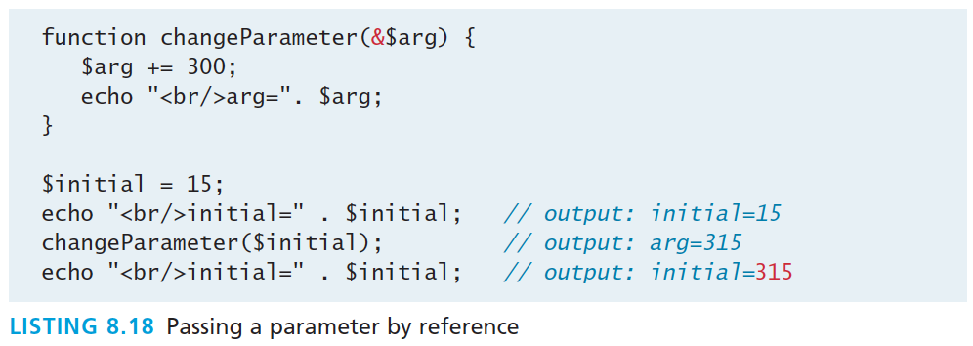
Pass Parameters by Reference
PHP also allows arguments to functions to be passed by reference, which will allow a function to change the contents of a passed variable.
The mechanism in PHP to specify that a parameter is passed by reference is to add an ampersand (&) symbol next to the parameter name in the function declaration

Slide 71
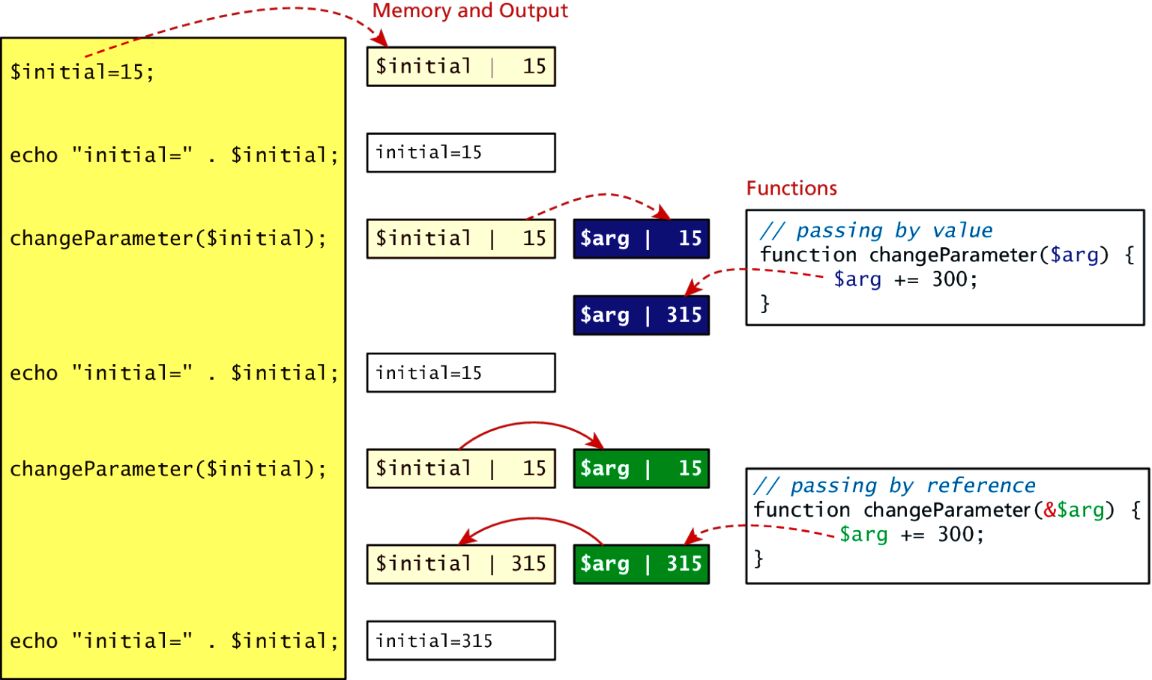
Value vs Reference

Slide 72
Variable Scope in functions
All variables defined within a function (such as parameter variables) have function scope, meaning that they are only accessible within the function.
Any variables created outside of the function in the main script are unavailable within a function.
$count= 56;
function testScope() {
echo $count; // outputs 0 or generates run-time
//warning/error
}
testScope();
echo $count; // outputs 56

Slide 73
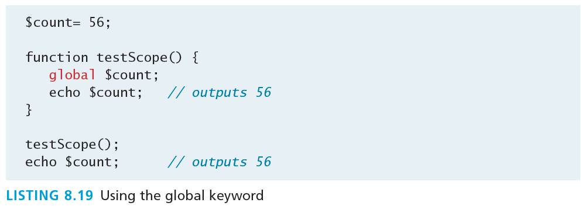
Global variables
Sometimes unavoidable
Variables defined in the main script are said to have global scope.
Unlike in other programming languages, a global variable is not, by default, available within functions.
PHP does allow variables with global scope to be accessed within a function using the global keyword

Slide 74
What You’ve Learned
1
2
Server-Side Development
Web Server’s Responsabilities
3
4
Quick Tour of PHP
Program Control
5
Functions
7

