Slide 1
Chapter 10
Fats, Frying, and Emulsions

Slide 2
Types of Fat
Invisible fats:
Found naturally in foods such as:
Meat, poultry, fish, dairy products, eggs, nuts, and seeds.

Slide 3
Types of Fat Cont’d.
2. Visible fats:
Are used in food preparation, e.g. baked goods like cakes and cookies, fried food like doughnuts, French fries etc.
Examples of visible fats:
Shortening (hydrogenated vegetable oil which is solid at room temperature), lard , ghee, butter and margarine; and oils

Slide 4
Fats from the Nutritional Viewpoint
Fats are necessary because:
Carry the fat soluble vitamins and other nutrients.
Examples
Butter is a good natural source of vitamin A.
Fortified margarine contains β carotene.
Oils carry the essential fatty acids.
But they are a concentrated source of energy, that’s why overconsumption is a concern (not good) because it may lead to:
Obesity → Diabetes and Dyslipidemia (unhealthy lipid profile) → (heart diseases).
Some types of cancer.

Slide 5
Functions of Fat in Food Preparation
Enhances the flavor of food, making it more appealing.
Tenderizes the gluten in flour when used in baked goods .
Good medium for heat transfer because fat can be heated to high temperatures.
Adds color to the food like yellow from butter in cakes or brown in fried foods.

Slide 6
Functions of Fat in Food Preparation Cont’d.
Adds texture to food:
Flaky texture in pastry when shortening or butter are used.
Crispness in fried foods.
Creamy taste in dairy products and ice cream.
Tenderness to baked product.

Slide 7
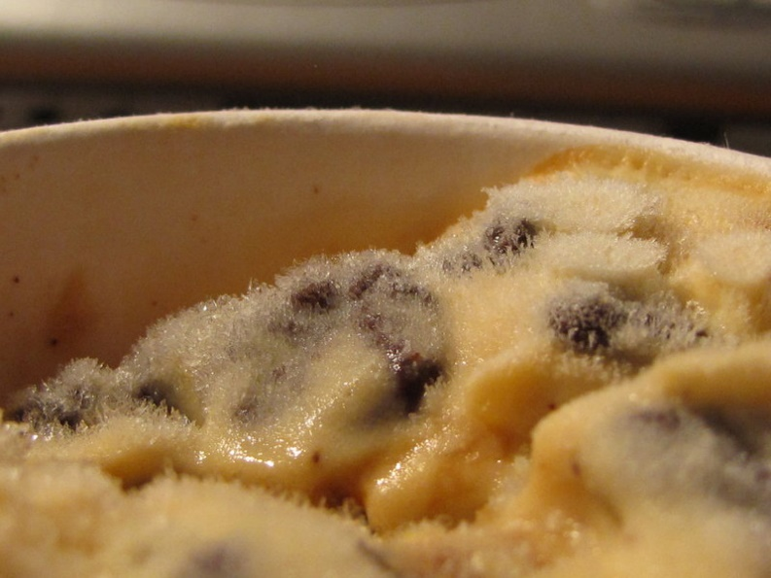
Functions of Fat in Food Preparation Cont’d.
Fat controls crystallization:
Crystal formation in ice-cream is
controlled in part by the fat in
dairy products such as milk.
Fat adds moistness:
Meat moistness is in part due to its fat content.
Fat is a major component of emulsions in salad dressings:
Such as mayonnaise which is an Emulsion.

Slide 8
What is an Emulsion
An emulsion:
Is a dispersion of two substances that ordinarily do not mix.
Function of the emulsifying agent:
Is a substance that forms a bridge between 2 immiscible liquids such as oil and water or oil and vinegar [which do not mix].

Slide 9
Natural & Prepared Emulsions
Emulsions:
Are found naturally in foods such as:
Fat is dispersed in the watery portion of the food such as in milk, cream, egg yolk.
Water is dispersed in the fat: such as in butter.
Can be prepared:
Fat is dispersed in water: like when making salad dressings, sauces and gravies, puddings, cream soups.
Water is dispersed in the fat such as in margarine, mayonnaise.

Slide 10
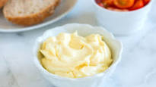
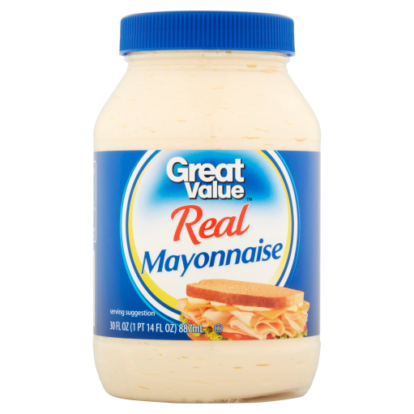
Mayonnaise Ingredients
1 egg yolk
1 cup of oil (or ¾ c)
2 Tbsp. of acid
Salt and other flavoring agents.
Pasteurized eggs are used
in commercial mayonnaise.

Slide 11
Types of Prepared Emulsions
Temporary emulsion:
Separates on standing like water and oil,
Must be shaken before use.
2. Permanent emulsion:
Does not separate on standing.
Needs a stabilizer which is another name for (emulsifier):
In mayonnaise the egg yolk is the main stabilizer.
Lecithin (phosphatidylcholine) is the main stabilizer or emulsifier in egg yolks.

Slide 12
Properties of Fat
Insoluble in water
Solid vs. liquid at room temperature
Smoke point
Flash point
Plasticity
Flavor

Slide 13
Factors that Affect the Melting Point of Fats Solid vs. Liquid
Degree of Saturation
As the saturation increases the melting point increases.
E.g.
Fats that contain a high % of SFAs (saturated fatty acids):
Are solid at room temp
Have a higher melting point
Fats that contain a high % of MUFAs and PUFAs
Are liquid at room temp.
Have a lower melting point

Slide 14
Factors that Affect the Melting Point of Fats Solid vs. Liquid Cont’d.
Trans v. Cis configuration of Fats
Trans FAs have a higher melting point than Cis FAs:
Amount of Trans FA in a fat:
As Trans FAs increase in a fat, the melting point of that fat increases.
Trans FAs are found in much higher proportion in hydrogenated plant oils (solid at room temperature).

Slide 15
Factors that Affect the Melting Point of Fats Solid vs. Liquid Cont’d.
Length of chain in Saturated FAs (SFAs):
[LONG (≥14Cs) vs SHORT ( ≤ 8 Cs) chains]:
As the no. of C atoms in SFAs increases, the melting point increases (need more energy to melt).
e.g.
Shortening vs butter:
Shortening has a higher melting point than butter because:
Shortening contains a high % of LCSFAs (long)
Butter : contains a high % of SCSFAs (short)

Slide 16
Smoke point
Temperature at which smoke comes out of the surface of heated fat.
The smoke point generally refers to the temperature at which a cooking fat or oil begins to:
Break down to (glycerol & free fatty acids)
The glycerol is then further broken down to acrolein which is a component of the bluish smoke
It is the presence of the acrolein that causes the smoke to be extremely irritating to the eyes and throat
The smoke point also marks the beginning of both flavor and nutritional degradation

Slide 17
Smoke Point Cont’d.
Therefore, the smoke point is a key consideration when selecting a fat for frying because:
Since deep frying is a very high temperature process, it requires a fat with a high smoke point.
Higher smoke point oils can withstand higher temperatures.

Slide 18
Smoke Point Cont’d.
Refining : increases the smoke point of oils
E.g.
Smoke point of butter is 127 °C
Smoke point for refined soybean oil and other refined oils is 232 °C
High smoke point oils are better for deep fat frying and sautéing.

Slide 19
Flash Point
Flash point :
The point at which combustion occurs.
It is considerably above the temperature of the smoke point.

Slide 20
Plasticity of Fats
The ability to be molded or shaped.
Solid fats have this property because:
Solid fats contain both solid crystals and liquid oil.

Slide 21
Flavor of Fat
Flavor:
Some fats have a distinctive flavor such as: butter, olive oil, sirej, tahineh.
Other fats are plain such as vegetable oils: corn, soy, sunflower etc.
Usually flavorful fats are more expensive.

Slide 22
Types of Fats
Natural Fats and Oils
Are extracted (separated) from various food items.
Processed Fats
Refined Fats

Slide 23
1. Natural Fats
Butter:
Is extracted from milk (salted and unsalted)
Is ≈ [80% fat + 18% water + 2% protein]
Water is dispersed in the fat (which acts as an emulsifier).
The color of butter depends on the cows’ feed,
If feed is green grass, then the color of butter is more yellowish naturally:
The greener the grass the more pigment there is in the butter
So to get a uniform color of butter all year round, carotene is added as a coloring agent during manufacturing.

Slide 24
Natural Fats Cont’d.
Ghee:
Is a class of clarified butter that originated in South Asia
Is commonly used in South Asian (Indian, Bangladeshi, Nepali and Pakistani) cuisine
Is typically produced by melting butter and allowing the components to separate by density.
Water evaporates
Some solids float to the surface and are skimmed off,
Remainder of the milk solids sink to the bottom and are left behind when the butter fat (which would then be on top) is poured off.

Slide 25
2. Processed Fats
Made to produce solid vegetable oil such as Shortening
Shortening: is made by 2 processes:
Hydrogenation
OR
Re-esterification

Slide 26
Hydrogenation Process
H gas is bubbled through the oil
In the presence of a nickel catalyst (to speed up the rxn.)
Some of the double bonds are broken and H is added
Result is:
More saturation and increased melting point,
And more Trans FAs
Both saturation & Trans FAs have negative health effects.

Slide 27
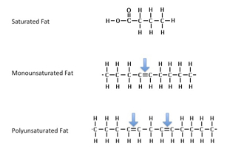
Result of Hydrogenation Process

Slide 28
Trans-Fatty Acids and Health
According to recent studies:
Trans FAs increase cholesterol in blood,
So dietary recommendation is to decrease Trans FA consumption,
And starting Jan 2006, (the FDA) in USA it is required to declare Trans-fat content on Nutrition Facts label.

Slide 29
Sources of Trans Fats
Rich sources of trans fatty acids Baked goods such as doughnuts and pastry. Deep fried foods such as fried chicken and French fried potatoes, and Imitation cheeses such as “sandwich slices” labeled as imitation process cheese food (edible ingredients comprising fat, protein, water, and flavor). Snack chips, cookies, and crackers often contain high amounts of trans fat as well. | Natural sources of trans fatty acids Small amounts of trans fats occur naturally in: Some meat Including beef, lamb Dairy products, and butterfat These sources have been found to have: Significantly lower levels of trans fatty acids than those which are a result of manual hydrogenation.

Slide 30
Re-esterification
Is a process of re-positioning of the FAs to increase saturation.
Is used in order to decrease Trans FA content of the processed fat oil by ≈ 50% + increased saturation).

Slide 31
Re-esterification Process
FAs are freed from the glycerol backbone
Shuffled within a FA pool
then
Re-esterified (repositioned): inserted into new positions:
Either back on the same glycerol (Intra-esterification)
Or onto (a different) another glycerol (inter-esterification)
The question is: are re-esterified fats healthier? More studies are needed.

Slide 32
Why Change Oils into Plastic Fats such as Shortening ?
Properties of Plastic Fats such as shortening:
Have a high smoke point which is (useful in frying), (unlike natural butter).
Resist oxidation which causes rancidity of fats with off flavors.
Have a longer shelf life but should be kept in a well-sealed container.
Help in making baked products such as: cakes, cookies, and pie crusts.
Can be creamed into the sugar when making these bakeries.

Slide 33
Examples of Plastic Fats
Margarine is a mixture of:
Hydrogenated vegetable oil especially soy & cotton seed oils +
Liquid vegetable oil blended into the Hydrogenated oil +
Milk , butter milk , or whey +
Additives: salt and preservatives, vitamins A and D, color, flavor.

Slide 34
Types of Margarines
Regular or standard margarine:
80% fat, used in baking.
Light or reduced fat margarine:
Less than 80% fat (45-75 % fat),
More water; this type is:
Generally not used in baked products because recipes are standardized for a specific amount of fat in them.
Not used for frying (deep fat frying or sautéing) because of excessive spattering.

Slide 35
Types of Margarines Cont’d.
Whipped margarine: has more gas in it, more volume, less weight.
Margarines made with oils that have a distinctive flavor such as olive oil in order to meet consumers’ preferences.
Trans-fat free margarine: made by inter- esterification.
Margarine made with butter blends: (contain both) in order to have more buttery flavor with less cholesterol than pure butter.

Slide 36
Types of Margarines Cont’d.
Unsalted margarine: no salt added.
Margarine containing phytosterols or phytostanols:
Natural phytochemicals are obtained:
From plant oil refineries or from plants which have been:
Shown to reduce blood cholesterol level by:
Blocking the absorption of dietary cholesterol
Consuming this kind of margarine was found to reduce cholesterol level by about 10-15%; these are considered heart healthy foods.

Slide 37
Oil Processing
Crude oil:
Is obtained from seeds or nuts or fruits by pressing.
Is not refined
Remaining meal has some oil in it:
Some oil is extracted by the use of a solvent like hexane which evaporates from the extracted oil. This (refined) oil is used by people.
What remains after extracting the above refined oil is used for:
Animal feed OR
Fuel

Slide 38
Crude Oil Cont’d.
Is further refined
to remove excess free FAs.
Excess free FAs:
Decrease the oil’s flavor and
Decrease the oil’s effectiveness in frying.

Slide 39
3. Refined Fats
Crude oil can be further refined through:
Chemical Refining: to neutralize strong tastes
Bleaching: removing color pigments
Deodorizing: removing smells
On labels : RBD (refined, bleached, deodorized)
Refined oils tend to have much higher smoke points than their unrefined counterparts.

Slide 40
Winterized Oils
Oils that:
Have been cooled down to refrigerator temp.
Then filtered in order to remove TAGs that crystallize at refrigerator Temp.
Winterized oils Are used for:
Salad dressing which should remain in the liquid form in the refrigerator.
This is more desirable by consumers.

Slide 41
Types of Oils and their Use
Soybean oil:
Prone to oxidation because it is rich in alpha linolenic acid:
Omega 3 FA, 18-carbon chain and 3 double bonds, which are found in the cis configuration.
That is why it was not widely used.

Slide 42
Types of Oils and their Use Cont’d.
2. Low linolenic acid soybean oil:
Soybeans that are low in Linolenic acid are produced by plant breeding :
Conventional method: two closely related plants are ‘sexually crossed’. The aim is to combine the favorable traits from both parent plants and exclude their unwanted traits in a singular new and better plant variety.
Genetic modification: inserting desired genes or deactivating certain undesired genes.

Slide 43
Types of Oils and their Use Cont’d
3. Canola oil:
Canola oil is produced from canola plants,
Not rapeseed plants
The canola plant was developed by natural crossbreeding from the rapeseed plant
Rapeseeds are rich in Erucic acid (MUFA omega-9 fatty acid)
Erucic acid is toxic to humans if consumed in large amounts.
Canola plant has very low levels of erucic acid.

Slide 44
Types of Oils and their Use Cont’d.
Canola oil
Is labeled (GRAS) generally recognized as safe by the FDA
Is very low in saturated fat (just 7%, the lowest level of any vegetable oil) .
Has a very high proportion of MUFAs (58% oleic acid)
Is a healthy and safe choice of oil.
Is used in the manufacturing of:
Salad dressings
Margarines
Shortenings and
In commercial frying

Slide 45
Types of Oils and their Use Cont’d.
4. Cotton seed oil:
Has a neutral flavor
Used in salad dressing.
Changed into shortening for baking purposes.
5. Flaxseed oil :
Rich in Omega-3 FAs (alpha-linolenic acid [ALA], essential FA)
Has a low smoke point.
6. Sunflower oil:
Has a good flavor, used in cooking.
7. Safflower oil:
Is the highest in PUFAs (about 78%)
Is more expensive.
Its flavor is not stable.

Slide 46
Types of Oils and their Use Cont’d.
8. Corn oil:
Has a naturally sweet taste,
It is used mainly in margarine manufacturing.
9. Peanut oil:
Is rich in MUFAs
Has a high smoke point
Has excellent oxidative stability
Has a strong flavor
It is preferred by snack food manufacturers because of its flavor.

Slide 47
Types of Oils and their Use Cont’d.
10. Olive oil:
Much used in the Mediterranean region.
Increasing popularity (USA and northern Europe) because of its health benefits.
It is around ≈ 92% MUFAs mainly Oleic acid [Omega 9 FA]
It is stable to oxidation because it is low in PUFAs.

Slide 48
Types & Processing Methods of Olive Oil
Extra-Virgin olive oil and virgin olive oil cannot contain any refined oil
Virgin means the oil was produced by the use of:
Physical means, and
No chemical treatment, and
No heat treatment.

Slide 49
Types & Processing Methods of Olive Oil Cont’d.
2. Refined Olive Oil:
Has been chemically treated to:
Neutralize strong tastes (characterized as defects)
↓Acid content (free fatty acids).
Refined oil is commonly regarded as lower quality than virgin oil.
3. Olive pomace oil
Oil extracted from the pomace by using: Solvents, mostly hexane + Heat

Slide 50
Methods of Testing Olive Oil
1. Quantitative analysis:
Is done to measure the oil's chemical degradation
2. Qualitative analysis:
Organoleptic quality of the oil

Slide 51
Quantitative analysis of Olive Oil
Measure the oil's acidity, which is the percent %, measured by weight, of free oleic acid in the oil.
As the oil degrades:
More fatty acids are freed from the glyceride:
This increases the level of acidity in the oil.
And thereby increasing rancidity (oil deterioration).

Slide 52
Quantitative analysis of Olive Oil Cont’d.
Measure the oil’s oxidation level through measuring the organic peroxide level:
Free fatty acids take up Oxygen and produce peroxides: (oxygen–oxygen single bond)
More peroxides means more oxidation took place,
More oxidation means more rancidity.

Slide 53
Quantitative Analysis Interpretation
More free fatty acids means:
higher acidity level.
Free fatty acids take up oxygens and
produce organic peroxides.
Therefore more peroxides means:
Higher oxidation level.
Higher oxidation level means:
higher rancidity level.

Slide 54
Qualitative Analysis of Olive Oil
Is used to classify olive oil by taste
Also called Organoleptic quality
Perception by a sensory organs
Is a subjective judgement
Blind taste test:
Is done by a panel of professional tasters
Methodology for different samples
Gather the samples …
Taste! ...
Tabulate the results ...
Analyze the results ...

Slide 55
Commercial Grades of Olive Oil
1. Extra-virgin olive oil
Contains ≤ 0.8% acidity
Is judged to have a superior taste.
Is used in salads
Is added at the table to:
Dipping
Soups
Stews

Slide 56
Commercial Grades of Olive Oil Cont’d.
2. Virgin olive oil
Has an acidity ˂ 2%
Is judged to have a good taste.

Slide 57
Commercial Grades of Olive Oil Cont’d.
3. Oils labeled as Pure olive oil or Olive oil
Are usually a blend of refined and virgin olive oil.
Contain ≤ 1.5% acidity .
Commonly lacks a strong flavor.

Slide 58
Commercial Grades of Olive Oil Cont’d.
4. Refined olive oil
Is obtained by refining virgin olive oils that have:
a high acidity level
and/or
Organoleptic defects
Both acidity and defects are eliminated through refining.
Has an Acidity: ≤ 0.3%

Slide 59
Commercial Grades of Olive Oil Cont’d.
5. Olive pomace oil
Is refined pomace olive oil often blended with some virgin olive oil
Is fit for consumption, but may not be described simply as olive oil
Has a more neutral flavor than pure or virgin olive oil
Has the same fat composition as regular olive oil
Has a high smoke point
Is widely used in restaurants as well as home cooking

Slide 60
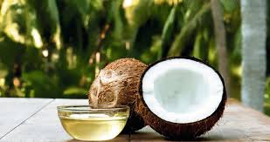
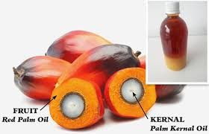
Tropical Oils
1. Coconut oil:
Solid at room temp. , about ≈ 92% SFAs
Many of the SFAs are short chain
Used in confectionaries and cookie fillings
2. Palm kernel oil:
High in SFAs
Solid at room temperature

Slide 61
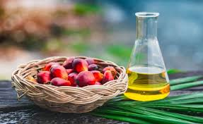
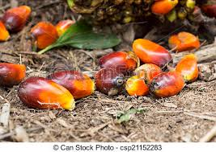
Tropical Oils Cont’d.
3. Palm oil:
Is made from the fruit itself
Is around ≈ 50% SFAs
Most of the SFAs are long chain
Is semi solid at room temperature
Has a long shelf life.
Recently it is being used with soybean oil to produce Trans fat free margarines

Slide 62
New Oils
Are produced with the desired FA profile by using:
Genetic modification: (genetically modified produce) e.g. soybeans, sunflower, rapeseeds (canola).
Advantages of new oils:
Increased stability without hydrogenation and Trans FA production.
Healthier FA profile
No conclusive evidence of its harm to humans till now

Slide 63
Fat Deterioration
Rancidity Factors:
Degree of un-saturation (no. of double bonds):
The higher the un-saturation, the more prone to rancidity e.g.
Oleic acid = 1 double bond, more stable (keeps better) than linoleic acid.
Linoleic acid= 2 double bonds, more stable than linolenic
Linolenic acid = 3 double bonds, has a greater chance of becoming rancid than linoleic acid and oleic acid.
2. Level of acidity (free fatty acids) in the oil:
More free fatty acids, higher chance of becoming rancid.

Slide 64
The Clipping Action
Is freeing FAs from the glycerol backbone
Is caused by:
Moisture:
Causes hydrolysis
Yields free fatty acids and glycerol, prevention of this process is especially important in:
Butter (should be kept in tightly closed containers).
2. Air: Oxygen causes oxidation which leads to:
Oxidative rancidity
Unsaturated portions of the triglyceride are the most susceptible to oxidative changes
Saturated fats are more resistant to this chemical change.

Slide 65
Oxidative rancidity is more ↑ likely to occur when there is:
Light: (ultra-violate rays); sunshine, light (oil should be kept in opaque containers).
Heat: oil should be kept in cool places.
Metals: such as Fe and Cu, oil should not be kept in containers made of these metals.
Oxidative rancidity is responsible for most of the spoilage of fats and fatty foods.

Slide 66
Fat Protection against Rancidity
Fats can be protected against rancidity to some degree by:
Controlling the storage conditions and
Use of antioxidants.

Slide 67
Selection of Fats for
Fats used for frying particularly deep fat frying should:
Be highly stable.
Have a high smoke point e.g. soybean, canola, peanut, cottonseed oils.
Be neutral flavor OR Have the desirable flavor.
Unrefined oils should not be used for frying.

Slide 68
In order to maintain high quality fried foods, frying oil should be: Regularly monitored.
Fat is damaged by:
High temp.
Oxygen contact
Salt
Water
Food particles

Slide 69
When should frying oil be changed? Frying
When Frying OIL:
Darkens considerably.
Smoke point lowers:
Smoke point lowers as a result of :
Free fatty acid formation due to high heat and moisture in food.
Suspended matter such as flour or batter.
Greater surface area exposed to oxygen [air].
Starts to foam.

Slide 70
Low Fat Food Preparation
Natural way :
Through stir frying and/or saute’ing with the use of less fats (oils, etc.).
Un-natural way
Through the use of fat replacers.

Slide 71
Types of fat replacers used in reduced fat products
Fat based:
1. Those that do not provide calories because they are
not digested or absorbed into the blood
Can be used in frying e.g.
Trade name like : Olestra, O lean
2. Those that provide fewer calories e.g.
Trade name: Salatrim which is used in: confectionaries, baked products, and some dairy products.

Slide 72
Types of Fat Replacers Cont’d.
CHO based:
These are derived from CHOs like: cellulose, malto-dextrins (oligosaccharides having 3-9 monosaccharide units), gums, modified starches, pectin.
Functions:
Thickeners
Stabilizers
Add form and structure
Hold water
Act as emulsifiers
Used in salad dressings and margarines
Trade names : E.g. Z-Trim, Nu-Trim, Soy-Trim, Rice-Trim etc.

Slide 73
Types of Fat Replacers Cont’d.
Protein based:
Made using: egg, milk, whey, soy, gelatin, gluten.
Used in making products like frozen desserts, yogurt etc.
Trade name E.g. Simplesse

