Slide 1
Thermal Fluid Engineering ENMC4411
Combustion systems
(Chapter 14 Sontag et al )
Afif Akel Hasan
Mechanical & Mechatronics Engineering Department
Birzeit University

Slide 2
Outline
Fuels
Combustion reactions
AF, Excess air, equivalence ratio
Enthalpy of formation
First law for reactive CV at SSSF

Slide 3
Objectives
Objective: the objective of this chapter is to consider first law analysis for a systems involving chemical combustion.
Process such as in power generation : internal combustion engine, gas turbines and steam power plants.

Slide 4
Fuels
Fuels : A fuel is a substance undergoes an exothermic reaction.
Or Any material that can be burned to release thermal energy is called a fuel.
Most familiar fuels consist primarily of hydrogen and carbon.
They are called hydrocarbon fuels and are denoted by the general formula C_{n}H_{m}.
Forms of Hydrocarbon fuels include:
A) Solid e.g. coal, wood, solid waste.
B) Liquid : hydrocarbons such as gasoline, alcohol.
C) Gases hydrocarbons: natural gas, butane gas.

Slide 5
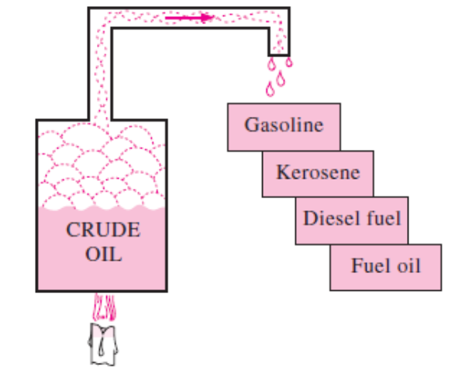
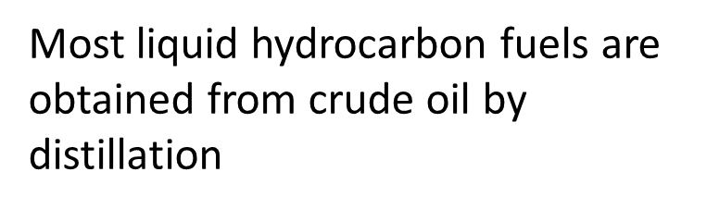
Hydrocarbon Fuels
Although liquid hydrocarbon fuels are mixtures of many different hydrocarbons,
They are usually considered to be a single hydrocarbon for convenience.
For example, gasoline is treated as octane, C8H18, and
the diesel fuel as dodecane, C12H26.
Another common liquid hydrocarbon fuel is methyl alcohol, CH3OH, which is also called methanol and is used in some gasoline blends.
The gaseous hydrocarbon fuel natural gas, which is a mixture of methane and smaller amounts of other gases, is often treated as methane, CH4, for simplicity.

Slide 6
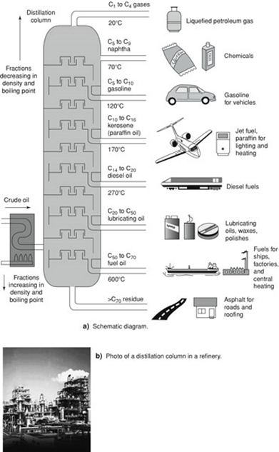
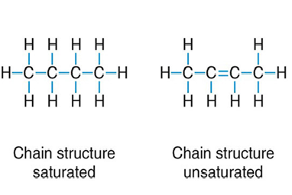
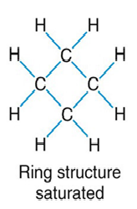
Hydrocarbon Fuels

Slide 7
Characteristic of some fuels
Coal analysis:
  Ultimate analysis reports mass percent of elements in coal.
  Proximate analysis reports mass recent of volatile matter, moisture, fixed carbon and ash.
  Composition of liquid fuels are considered to be as the pure major constituent, although it is made of mixture, Example gasoline considered to be octane C8H18, diesel is considered to be delicate C12H26. Major constituent of natural gas NG as methane CH4.

Slide 8
Combustion process
Combustion process involves the oxidation of the fuel constituent (its reaction with oxygen).
Oxidation of constituent in the fuel can be represented by chemical equation; mass of each element involved in the reaction is pressured (remains constant).
Example: combustion of carbon
C + O2 →CO2
1mole +1mole →1mole
12g + 32g → 44g
Reactants combine by their moles stoichiometric reaction.

Slide 9
Hydrocarbon combustion
Consider combustion of methane with pure oxygen:
CH₄ + 2O₂ → CO₂ +2H₂O
1mole+ 2mole→ 1mole + 2mole
Element balance:
C: reactants 1 in CH4
Products 1 in CO2
O: reactants 4 in O2
Products 2 in CO2 plus 2 in H2O equal 4.
Note: the mole is equal to molecular weight in grams (1 mole of H2O=2+16=18grams).

Slide 10
Air combustion
in combustion process oxygen is supplied by air which consists of about 21% on mole basis as O2. Note that air composition is approximately as 79%N2.
Now the 79% of air which is N2 doesn’t react but it only undergoes a change of state from that of reactants to that of the products.
Now one mole of air contains 79% N2 then for each mole of O2 it is a companied by 79/21=3.76 moles N2.
Rework CH4 combustion with air:
CH4+2O2+2(3.76)N2→CO2+2H2O+2(3.76)N2
Note 1 kmol O2 + 3.76 kmol N2 = 4.76 kmol air

Slide 11
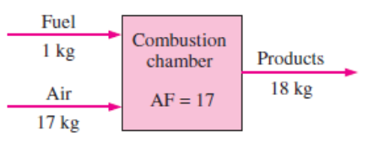
Air fuel ratio
Air fuel ratio AF: is defined as the ratio of air in mass or mole basis to the mass or mole of the fuel.
Then: 1 ) mass basis AF mass=m air /m fuel
2) Mole basis AF mole = n air /n fuel
Note that AF for stoichiometric reaction is 100% theoretical.

Slide 12
Fuel to air ratio
Fuel to air ratio FA: is the ratio of fuel to air in mass or mole basis then FA=1/AF
Note that FA for stoichiometric reaction is 100% theoretical
Molecular weight of air =28.97.

Slide 13
Theoretical Air
It is the minimum amount of air to supply sufficient oxygen for the complete combustion of the fuel.
Remember complete combustion requires the conversion of all carbon into carbon dioxide and no CO in the products.
Theoretical air is also called stoichiometric ratio.
In the previous methane combustion 2 moles of air is the theoretical air.
CH4+2O2+2(3.76)N2→CO2+2H2O+2(3.76)N2
CH4+2(O2+ 3.76N2)→CO2+2H2O+2(3.76)N2

Slide 14
Excess air
It is the amount of air supplied over the theoretical air.
Excess air is supplied to insure complete combustion of fuel. For example 150% theoretical air means 150-100= 50% excess air.
For example in previous CH4 combustion if 3 moles of air is supplied for each mole of CH4 then air is 3/2 or 150% theoretical and 50% excess.
Rework CH4 combustion with 150% theoretical air, you multiply air moles by 1.5 and balance oxygen in the products also the nitrogen.
CH4+1.5*2(O2+ 3.76N2)→CO2+2H2O+1.5*2(3.76)N2 +
(1.5-1)*2O2
CH4+1.5*2(O2+ 3.76N2)→CO2+2H2O+1.5*2(3.76)N2 + O2
Note the O2 in the product, check the element balance.
If insufficient air is used then CO might form in the product.

Slide 15
Equivalence ratio
Φ is defined as
Φ = (FA)actual /(FA) stoichiometric
e.g. for 150% theoretical air
Φ = (FA) actual/ (FA) stoichiometric = 100/150 =100/150=2/3

Slide 16
Example 14.1. AF for combustion of octane
Example 14.1. AF for combustion of octane.
Chemical reaction: to be balanced
C8H18+ (O2+3.76N2) → CO2 + H2O+ N2
Element balance: C : reactants 8 products multiply CO2 by 8 H: reactants 18 products multiply H2O by 9
O: products 25 then multiply O2 in reactant by 25/2
C8H18+12.5(O2+3.76N2) → 8 CO2+9 H2O + 12.5*3.76N2
(AF) mole = mole of air/mole of C8H18
=( 12.5*4.76) mole air / 1 mole fuel =59.5mole air/mole fuel.
(AF) mass = mass air/mass fuel = 59.5* 28.97kg air /(8*12+18*1)fuel =15kg air /kg C8H18

Slide 19
Dew point of combustion products
Dew point : is the saturation temperature at the vapor pressure of water in the mixture ( product).
Assuming products at 0.1MPa =100KPa.
For the octane combustion;
Yv = 9/(8+9+12.5*3.76)= 0.0729
Pv= yP=0.0729*100= 7.29KPa.
From steam tables the Tsat when P= 7.29KPa is 39.7ºC.
Pv: water vapor pressure.
P: total Pressure
Y: mole fraction
C8H18+12.5(O2+3.76N2) → 8 CO2+9 H2O + 12.5*3.76N2

Slide 22
Enthalpy of formation
So far we studied enthalpy change of fixed chemical composition with no reaction, now we will learn how to deal with enthalpy when chemical reactions are involved?
Recall the pure substances enthalpy is measured reference to some reference point e.g water h_{f} (triple point) =0
Definition: enthalpy of formation h_{f}⁰ is the enthalpy of compound at 25ºC, 0.1MPa with reference to base of zero enthalpy of elements at same temperature and pressure.
Example h_{f}⁰ CO 2 = -393 522KJ/Kmole.

Slide 23
Enthalpy of formation
Consider SSSF process involving reaction of C:
C+O2→CO2
Assuming reactants and products each at 25ºC, 0.1MPa
1st law: Qcv + H_{R} =H_{P}
or Qcv + nihi = nehe
then Qcv = - nihi + nehe = -HR +HP
for CO2 formation Qcv = -393522KJ/KmoleCO2
if we take pure element enthalpy as zero:
h_{f O2}=0 , and h _{f} C =0
Qcv=Hp= -393 522KJ/Kmole CO2

Slide 24
Enthalpy of formation
Enthalpy of formation at 25 ºC, 0.1MPa for selected substance is given in table A10. enthalpy of formation is determined experimentally.
Reference state should be clarified if element exists in more than one form.
Example carbon h_{f}⁰ graphite= 0.0

Slide 25
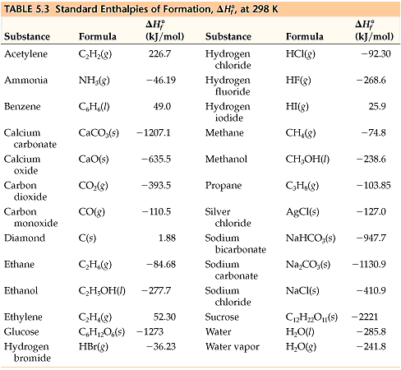

Slide 26
Enthalpy
Enthalpy of a substance at temperature T is then
Enthalpy of formation at 0.1 MPa and 25 ºC found from tables, while difference from standard state to the other state is found for ideal gas either assuming constant specific heats or from tables if available that is calculated from variable specific heats.

Slide 30
First-law Analysis Of Reacting Systems
a chemically reacting steady-flow system
In combustion analysis, it is more convenient to work with quantities expressed per mole of fuel.
Such a relation is obtained by dividing each term of the equation above by the molal flow rate of the fuel, yielding
where Nr and Np represent the number of moles of the reactant r and the
product p, respectively, per mole of fuel

Slide 31
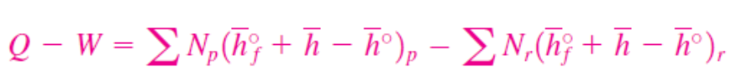
First-law Analysis Of Reacting Systems

Slide 32
Enthalpy of reaction
Enthalpy of reaction h_{R}, which is defined as the difference between the enthalpy of the products at a specified state and the enthalpy of the reactants at the same state for a complete reaction.
Enthalpy of reaction is usually referred to as the enthalpy of combustion h_{C} which represents the amount of heat released during a steady-flow combustion process when 1 kmol (or 1 kg) of fuel is burned completely at a specified temperature and pressure

Slide 35
Heating value
Heating value of the fuel, which is defined as the amount of heat released when a fuel is burned completely in a steady-flow process and the products are returned to the state of the reactants.
In other words, the heating value of a fuel is equal to the absolute value of the enthalpy of combustion of the fuel

Slide 36
Lower & higher heating value
The heating value depends on the phase of the H2O in the products.
The heating value is called the higher heating value (HHV) when the H2O in the products is in the liquid form, and
it is called the lower heating value (LHV) when the H2O in the products is in the vapor form

Slide 38
Adiabatic Combustion Temperature
In the absence of any work interactions and any changes in kinetic or potential energies, the chemical energy released during a combustion process either is lost as heat to the surroundings or is used internally to raise the temperature of the combustion products.
The smaller the heat loss, the larger the temperature rise. In the limiting case of no heat loss to the surroundings (Q = 0), the temperature of the products reaches a maximum, which is called the adiabatic flame or adiabatic combustion temperature of the reaction
Hprod = Hreact

Slide 39
EXAMPLE
In a rocket, hydrogen is burned with air, both reactants supplied as gases at Po, To. The combustion is adiabatic and the mixture is stoichiometeric (100% theoretical air). Find the products dew point and the adiabatic flame temperature (~2500 K).

Slide 40
End of Combustion

