Slide 1
Lecture 12
NUTD 343
Dr. Emilia Rappocciolo

Slide 2
brucellosis
Human brucellosis:
A zoonotic infection caused by different Brucella spp.
  B. abortus, B. suis, and B. melitensis.
Gram-negative aerobic small rods, nonmotile,
pathogenic to animals and humans, in infected animals it is located:
In the uterus of pregnant animals
In the mammary glands of lactating females
the pathogens can be excreted in milk
People who get infected with Brucella Sp.
People working with animals/meat - professional hazard
Consumption of raw milk and some products made from raw milk (cheese) have been implicated in foodborne brucellosis.

Slide 3
brucellosis
Brucella survive for a long time in milk and milk products. Pasteurization of milk/milk products kills Brucella cells. The infectious dose for human infection is 10–100 cells.
Symptoms:
appear in in humans 3–21 days after eating contaminated food
undulant fever with irregular rise and fall of temperature
Profuse sweats, body aches, joints pain, chills, and weakness
Outbreaks in the US were from consumption of imported cheese
CDC estimate about 839 cases of brucellosis annually
Control measures:
pasteurization of milk
Manufacturing of dairy products from pasteurized milk
proper sanitation
Diagnosis: culture, serology , PCR

Slide 4
brucellosis
Palestine: between 2000 and 2020 7935 cases of brucellosis.
Vaccination of animals did reduce the number initially, but problems with keeping animals vaccinated seem to make the disease increase in incidence again.

Slide 6
Viruses and prions
Enteric viruses are responsible for most foodborne illnesses in the US and most other countries.
Enteric viruses include: Norovirus, Hepatitis A virus, Rotavirus
Data collected from 2000 to 2008 by the CDC in the US:
foodborne viruses are responsible for about 5.5 million cases annually
bacterial foodborne illnesses are responsible for about 3.6 million
most illnesses are caused by norovirus - 58%
non-typhoidal Salmonella - 11%
Clostridium perfringens - 10%
Campylobacter - 9%

Slide 7
Viruses and prions
Viruses- difficult to detect/recover from contaminated food
human enteric viruses do not multiply in food - may die rapidly during food storage and preservation.
Contaminated Food
to study enteric viruses it is necessary to use mammalian cell culture
Suitable cell culture is now available for Norovirus.
Before 1940, polio viruses transmitted through raw milk were considered the only virus involved in foodborne viral infections.
Hepatitis A and norovirus are most predominant

Slide 8
Food association
Food contaminated with the fecal matter from infected people directly (from food handlers) or indirectly (via sewage and polluted water) is the main source of hepatitis A and Norovirus outbreaks.
Infected food handlers, even without symptoms, can contaminate ready-to-eat food with fecal matter
Vegetables (salads) can be contaminated with polluted water.
Shellfish (oysters, clams) harvested from water polluted with sewage and eaten raw or improperly heated
The virus can survive in shellfish for a long time
In the US, the major cause of foodborne viral disease outbreaks is the contamination of ready-to-eat foods due to poor personal hygiene and contaminated equipment

Slide 9
prevention
Major preventative methods of foodborne virus infections:
Kill the viruses in contaminated foods
Adopt good sanitation and personal hygiene habits
Proper heat treatment, pasteurization can kill the viruses
Steaming lightly to open shellfish may not effective heat-treatment
Hydrostatic pressure processing is used instead of light steaming to open the shellfish (viruses killed if pressure >300 MPa )
Oxidative agents (hypochlorite), kill viruses in contaminated equipment or in water used in food processing
keep suspected people away from handling ready-to-eat foods
Vaccination against hepatitis A is available - used to control the disease.

Slide 10
detection
Enteric viruses do not multiply in food, are present in low numbers, therefore their detection from contaminated food poses difficulties.
To ID hepatitis A virus - cell culture and immunological methods have been developed.
The reverse transcription PCR (RT-PCR) is effective in detecting hepatitis A and Norovirus and is commonly used.
By this method, viruses were detected in suspected food samples (ham, turkey, and roast beef)
Enzyme immunoassays (EIA) are also adopted using antibodies to viral capsid proteins
now genome sequencing can be used for identification.

Slide 12
norovirus
Norovirus infection is self-limiting, vomiting and diarrhea
Occurs all year round - peaks in winter months
It is a non-enveloped - single-stranded RNA virus
Transmission:
from person to person through contacts or aerosolized vomit, water,
foods contaminated with feces or vomit

Slide 13
norovirus
Associated with large numbers of people present in close contact
  hospitals, cruise ships, hotels, restaurants, nursing homes, daycare centers, prisons, military installments, sports stadiums
  Fresh produce, including lettuce, tomato, melons, green onions, strawberries, raspberries, peppers, fresh-cut fruits, and salads,
  Food handlers, processors
  Irrigation water
  shellfish, such as oysters, clams are the source of foodborne norovirus.
The infectious dose of is very low: about 10 viral particles.

Slide 14
norovirus
Norovirus infect the mature enterocytes covering the intestinal villi
causes massive cell damage and malabsorption
Gastrointestinal symptoms: (appear within 1- 2 days after ingestion)
explosive projectile vomiting, nausea, cramps, diarrhea, chills, headache, dehydration, high fever
Adults are more susceptible than children
Symptoms last for 1-2 days.
The disease is self-limiting and the viruses are excreted in the feces of infected persons (100 billion virus particles/gram of feces) for a prolonged time

Slide 15
Hepatitis A
Hepatitis A - non-enveloped, single-stranded RNA virus
Grown in mammalian cell cultures but requires a long adaptation period
Annually, 1.4 million people suffer from HAV infection worldwide.
The virus remains stable in the environment for at least a month, may be resistant to heating and disinfectant-chlorine
Enteric virus, excreted in very high numbers in human feces
HAV transmission occurs through contaminated food, water, food handlers, direct contact with an infected person
Infectious dose: very low, about 10–100 virus particles.

Slide 16
Hepatitis A
After ingestion of HAV from contaminated food, virus move to the liver and invade hepatocytes
General symptoms in the early stage (occur after ~ 4 weeks)
fever, malaise, nausea, vomiting, abdominal discomfort, and inflammation of the liver
Jaundice develops at a later stage
feces are pale colored and urine becomes dark
Virus particles shed in feces (10⁹ per gram).
Severity of the disease is associated with age.
Young children display an asymptomatic form of the disease while young adults and adults show symptomatic disease

Slide 17
prions
Prions
Cause a transmissible neuro-degenerative disorder
single protein molecule - devoid of nucleic acid
Cause the mad cow disease
Cause Ceutzfeldt disease in humans
Prions are not inactivated by heat, irradiation or preservatives
Once they get to the food, we can not get rid of them

Slide 18
prions
Mad cow disease:182,000 cattle destroyed in the UK
Meat industry was almost ruined
1st appeared in cows in 1986
In 1972 Pruisner investigated a patient whose brain was decaying without immune response. He linked the disease with other known diseases in animals (scrapie) and humans (kuru)
In 1982 Pruisner formulated the prion theory:
  Healthy neuron contain PrPc (healthy protein)
  When an infectious modified prion (PrPsc) contacts the normal prion, it changes its morphology to become infectious and destroys the brain
Infectious prions are transmitted by eating meat from infected cows

Slide 19
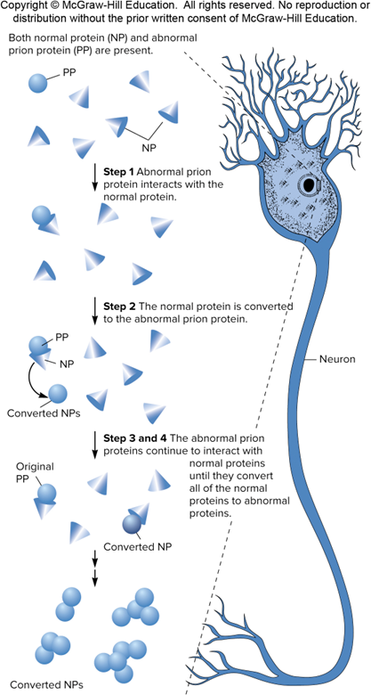
prions

