Slide 1
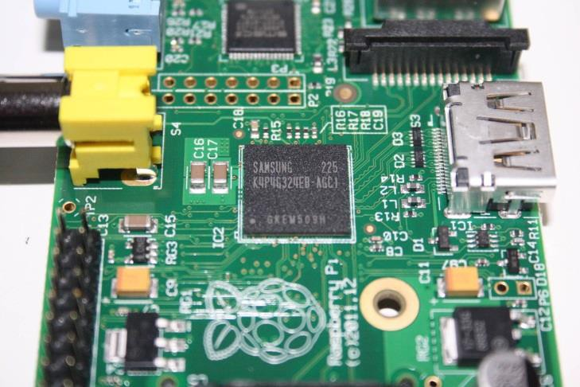
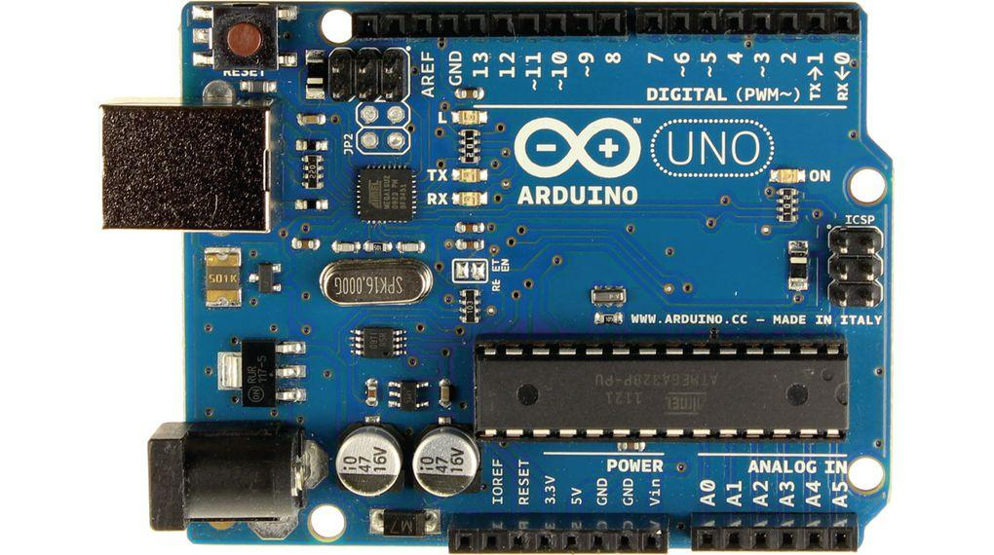
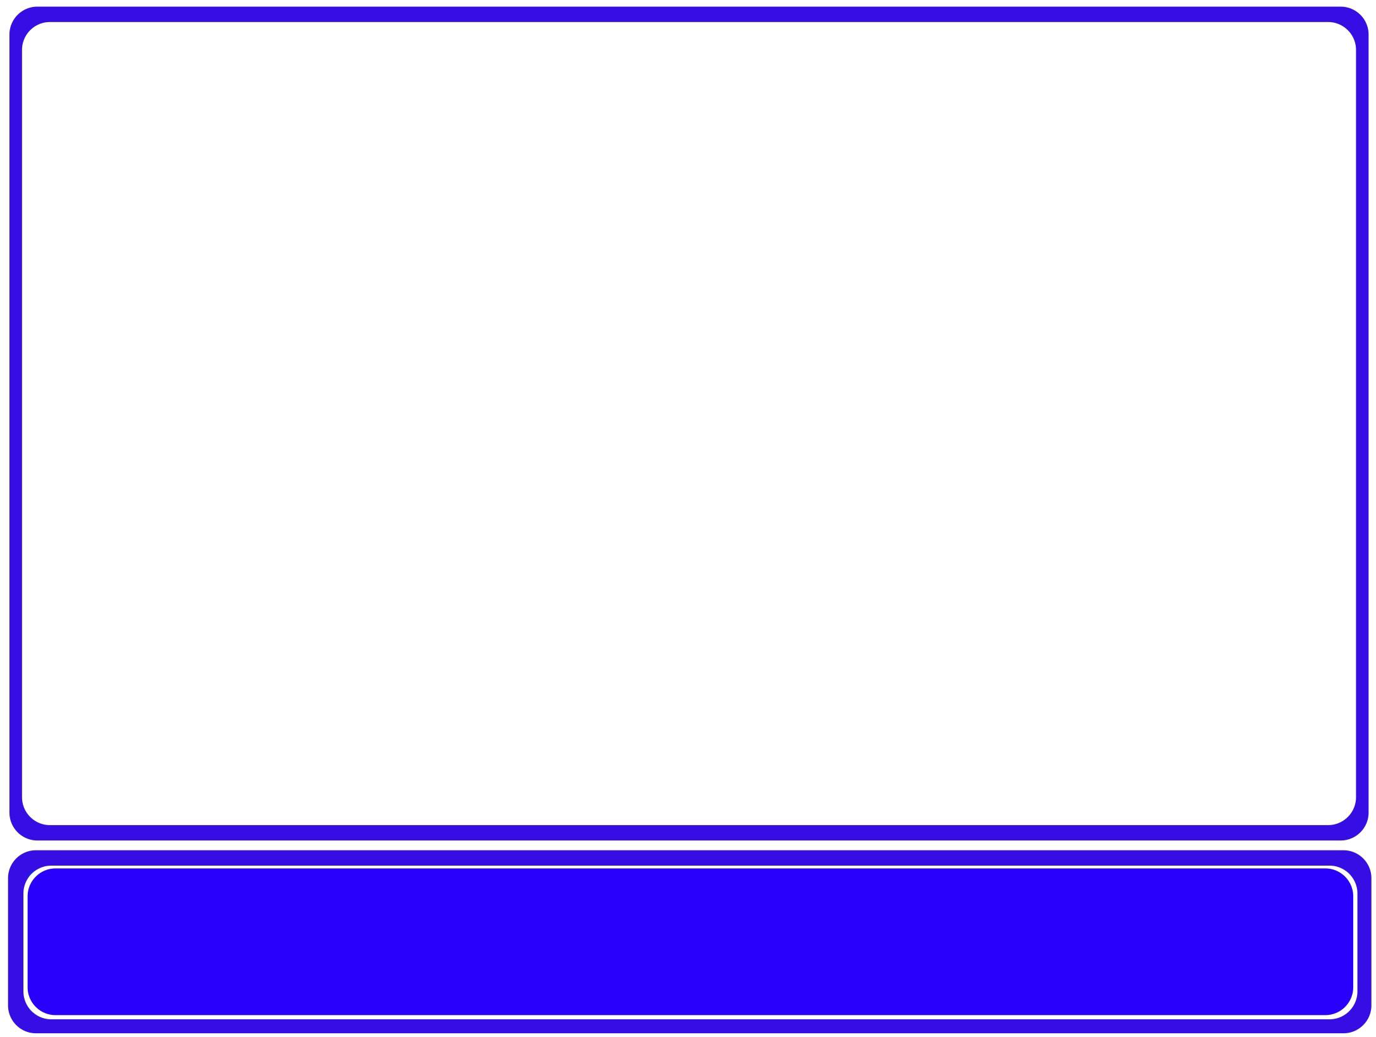
Arduino and Raspberry pi interfacing Protocols

Slide 2
Embedded Communication Protocols Agenda
Embedded systems communication concepts.
UART protocol.
I2C protocol.
SPI protocol.
CAN

Slide 3
Embedded systems communication concepts
Bit rate
  It is the number of bits that are sent per unit of time usually bits/sec.
Baud rate
  It is the number of symbols that are sent per unit of time usually, symbol can be combination of any number of bits according to design choice.
  In case that symbol is only 1 bit, then baud rate will equal the bit rate.

Slide 4
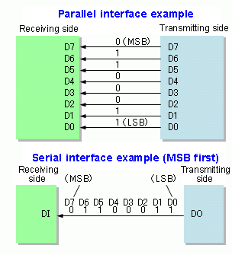
Embedded systems communication concepts
Parallel Communication
Sending multiple bits simultaneously.
Serial communication
Sending bit by bit.

Slide 5
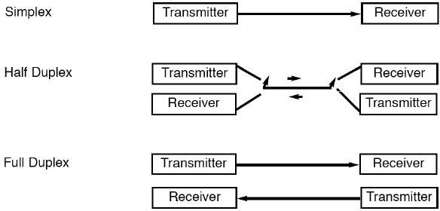
Embedded systems communication concepts

Slide 6
Embedded systems communication concepts
Synchronous serial communication
  Synchronous serial communication describes a serial communication protocol in which data is sent in a continuous stream at a constant rate.
  Synchronous communication requires that the clocks in the transmitting and receiving devices are synchronized – running at the same rate – so the receiver can sample the signal at the same time intervals used by the transmitter so that there is an extra wire for clock carrying.
Tx
Sender
Receiver
Rx Clck

Slide 7
Embedded systems communication concepts
Asynchronous serial communication
  Asynchronous serial communication is a form serial communication in which the communicating endpoints' interfaces are not continuously synchronized by a common clock signal.
  Instead of a common synchronization signal, the data stream contains synchronization information in form of start and stop signals, before and after each unit of transmission, respectively. The start signal prepares the receiver for arrival of data and the stop signal resets its state to enable
triggering of a new sequence.
Sender
Tx
Receiver
Rx

Slide 8
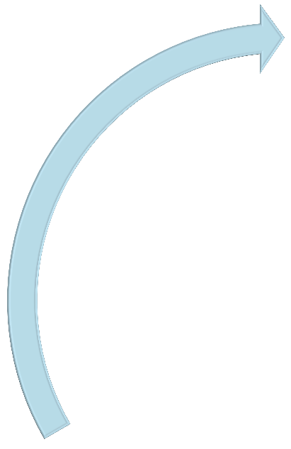
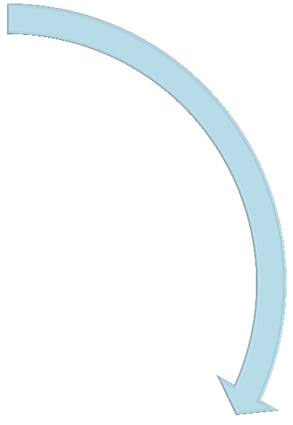




Protocols examples
SPI UART
I2C

Slide 9



UART
UART
SPI
I2C

Slide 10
UART
What is UART ?
  UART stands for Universal Asynchronous Receiver Transmitter. There is one wire for transmitting data, and one wire to receive data. A common parameter is the baud rate known as "bps" which stands for bits per second. If a transmitter is configured with 9600bps, then the receiver must be listening on the other end at the same speed.
  UART is a serial communication, so bits must travel on a single wire. If you wish to send a char (8-bits) over UART, the char is enclosed within a start
and a stop bit, so to send 8-bits of char data, it would require 2-bit overhead; this 10-bit of information is called a UART frame.

Slide 11
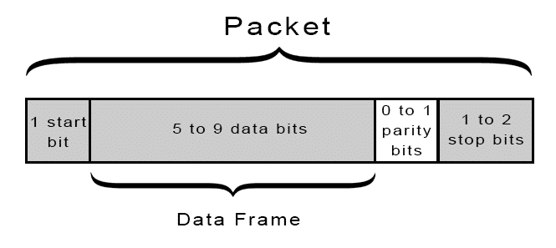
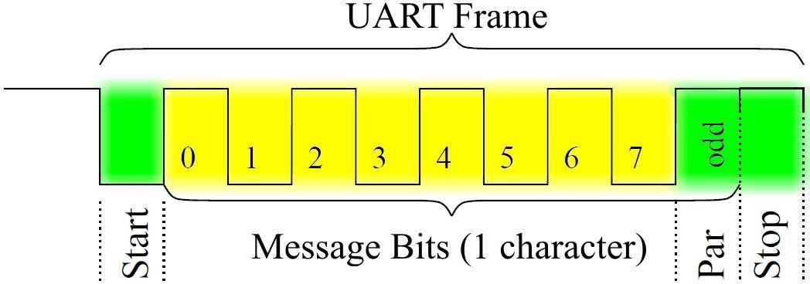
UART
UART frame format

Slide 12
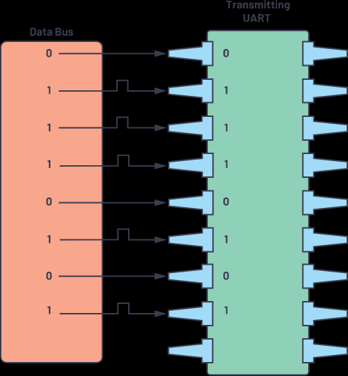
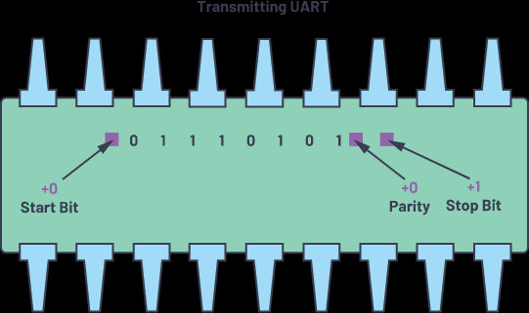
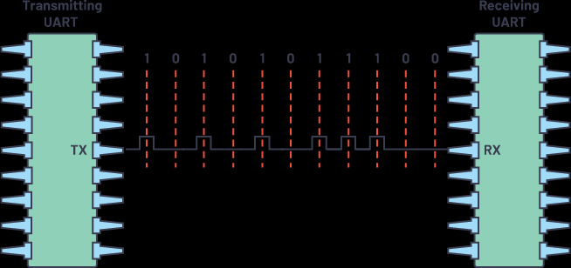
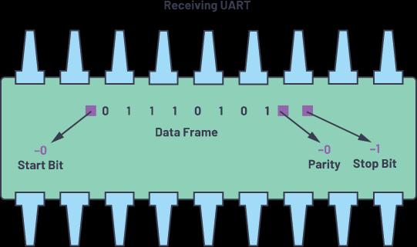
Steps of UART Transmission
(2)
(1)
(3)
(4)
Notes:
(1)

Slide 13
UART
UART frame format
  Start bit: 1 bit indicates the start of a new frame, always logic low.
  Data: 5 to 9 bits of sent data.
  Parity bit: 1 bit for error checking
    Even parity: clear parity bit if number of 1s sent is even.
    Odd parity: clear parity bit if number of 1s sent is odd.
  Stop bit: 1 or 2 bits indicate end of frame, always logic high.

Slide 14
UART
UART notes
  UART supports PC communication through RS232.
  UART standard baud rate examples (110, 300, 600, 1200, 4800, 9600, ....).
  UART is a full duplex communication protocol.
  UART is point to point communication protocol, which means communication can be between 2 devices only at the same time.
https://www.electronicwings.com/arduino/basic-functions-related-to-serial-communication-in-arduino

Slide 15
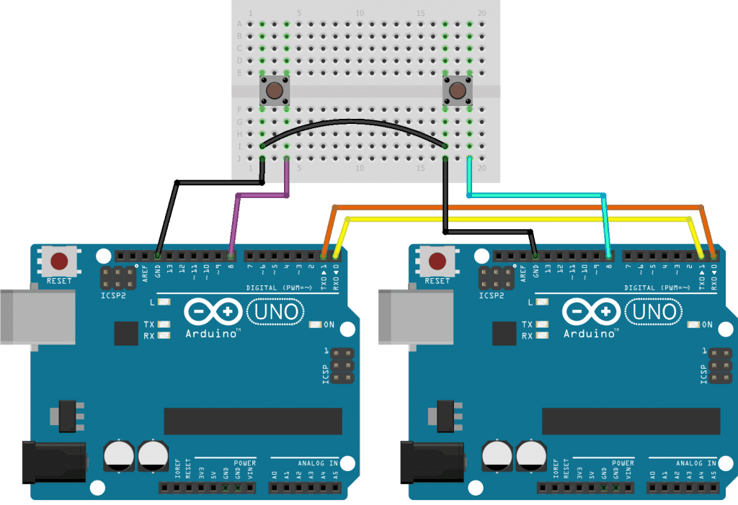
Example: Send a char value depending on the state of pin 8. We will send the char value of '1' if pin 8 is LOW or a char value of '0' if the pin 8 is HIGH.
void setup() {
pinMode(8, INPUT_PULLUP); // set push button pin as input
pinMode(13, OUTPUT); // set LED pin as output
digitalWrite(13, LOW); // switch off LED pin
Serial.begin(9600); // initialize UART with baud rate of 9600 bps
}
void loop() {
if (Serial.available()) {
char data_rcvd = Serial.read(); // read one byte from serial buffer and save to data_rcvd
if (data_rcvd == '1') digitalWrite(13, HIGH); // switch LED On
if (data_rcvd == '0') digitalWrite(13, LOW); // switch LED Off
}
if (digitalRead(8) == HIGH) Serial.write('0'); // send the char '0' to serial if button is not pressed.
else Serial.write('1'); // send the char '1' to serial if button is pressed.
}
SERIAL.BEGIN()
SERIAL.AVAILABLE()
SERIAL.READ()
SERIAL.WRITE()
https://www.electronicwings.com/arduino/basic-functions-related-to-serial-communication-in-arduino
Notes:
send a char value depending on the state of pin 8. We will send the char value of '1' if pin 8 is HIGH or a char value of '0' if the pin 8 is LOW.

Slide 16


I2C
SPI
UART
I2C

Slide 17
I2C
What is I2C?
  I²C (Inter-Integrated
Circuit), is a multi-master, multi-slave, serial
computer bus invented by Philips Semiconductor (now NXP Semiconductors). It is typically used for attaching lower-speed peripheral ICs to processors and microcontrollers.
I2C is a synchronous serial communication using two wires, one wire for data (SDA) and the other wire for clock (SCL).

Slide 18
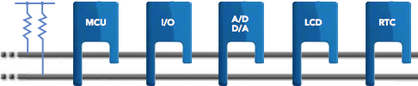
I2C
I2C bus

Slide 19
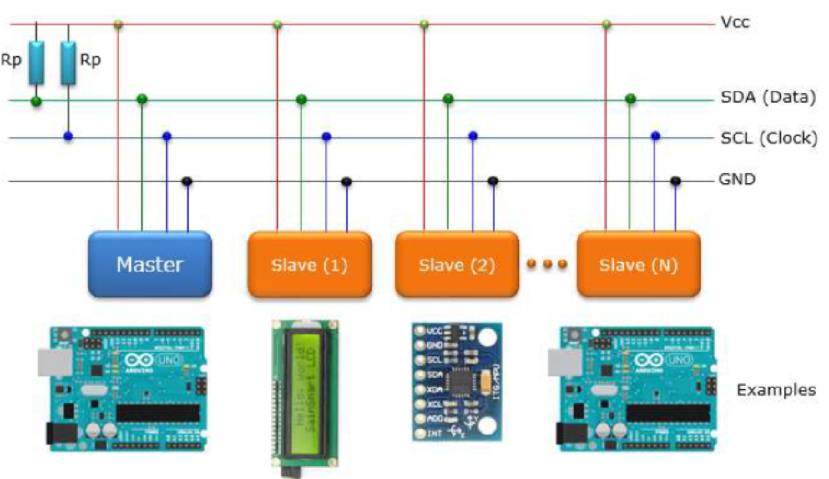

Slide 20
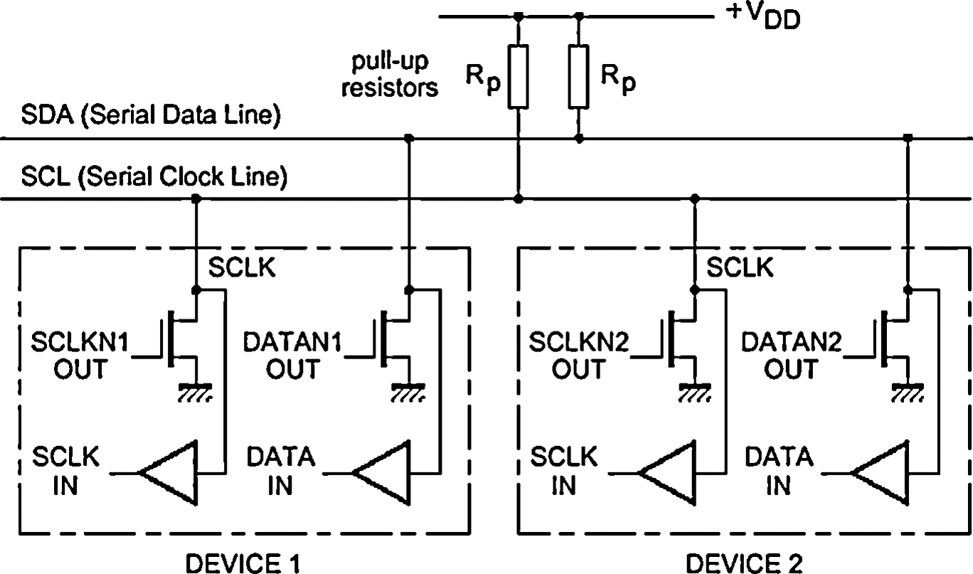
I2C
I2C bus

Slide 21
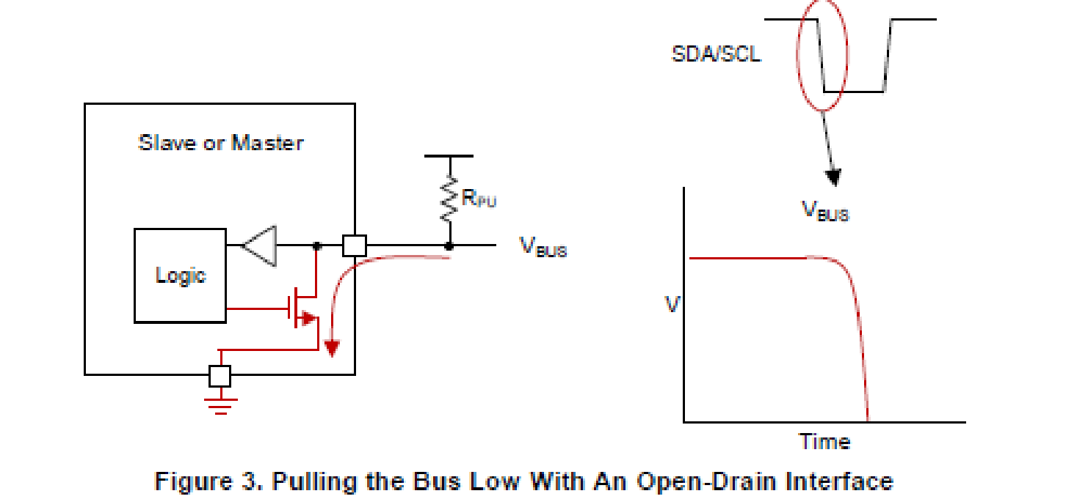
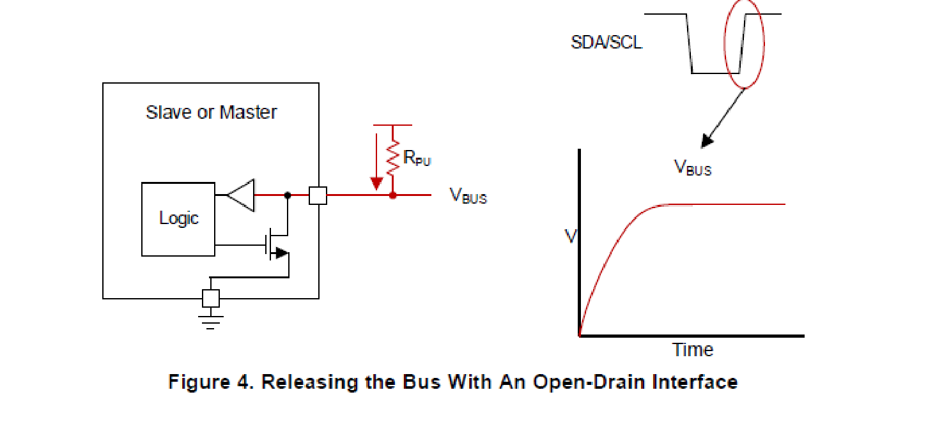

Slide 22
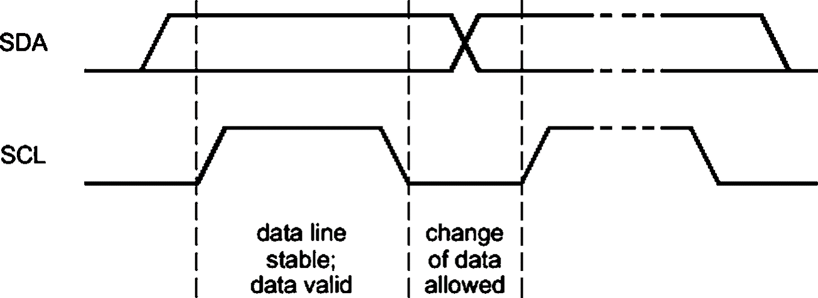
I2C
I2C data validity
  For the data to be valid on the SDA line, it must not change while the SCL is high. The data on the SDA line should change only and only when the SCL line goes low.

Slide 23
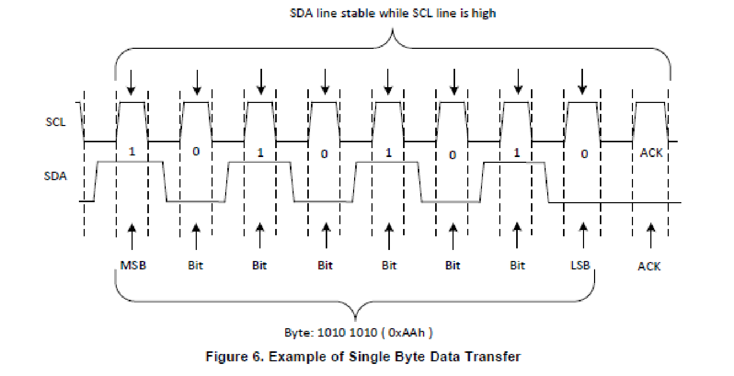

Slide 24
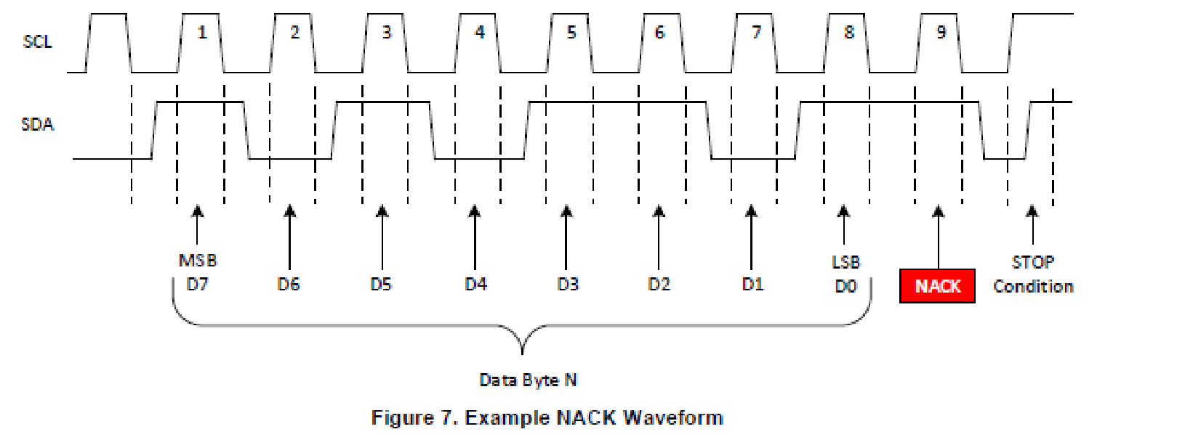
https://labjack.com/content/i2c-simulator

Slide 25
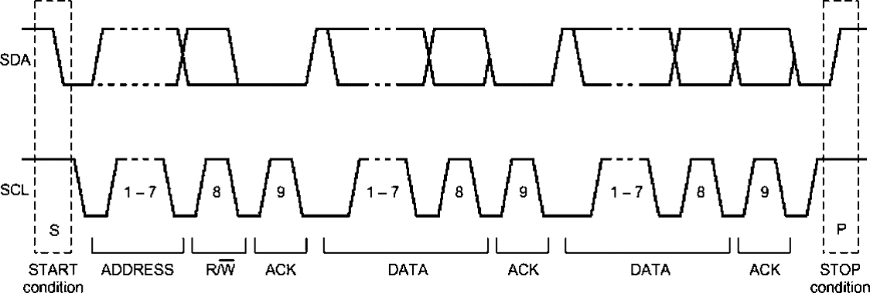
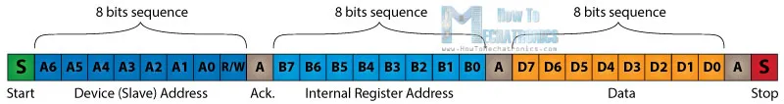
I2C
I2C frame format

Slide 26
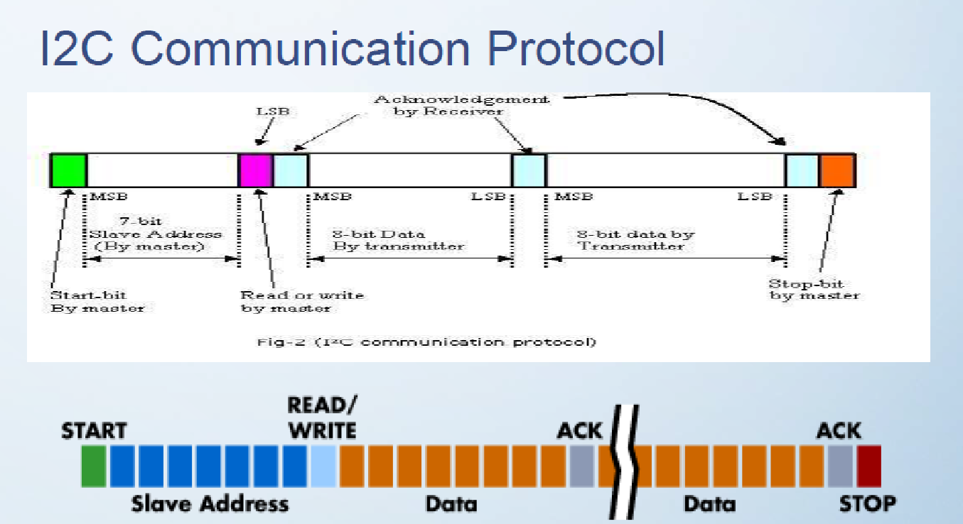
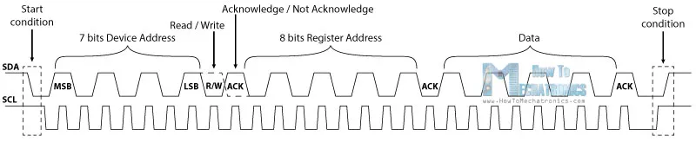

Slide 27
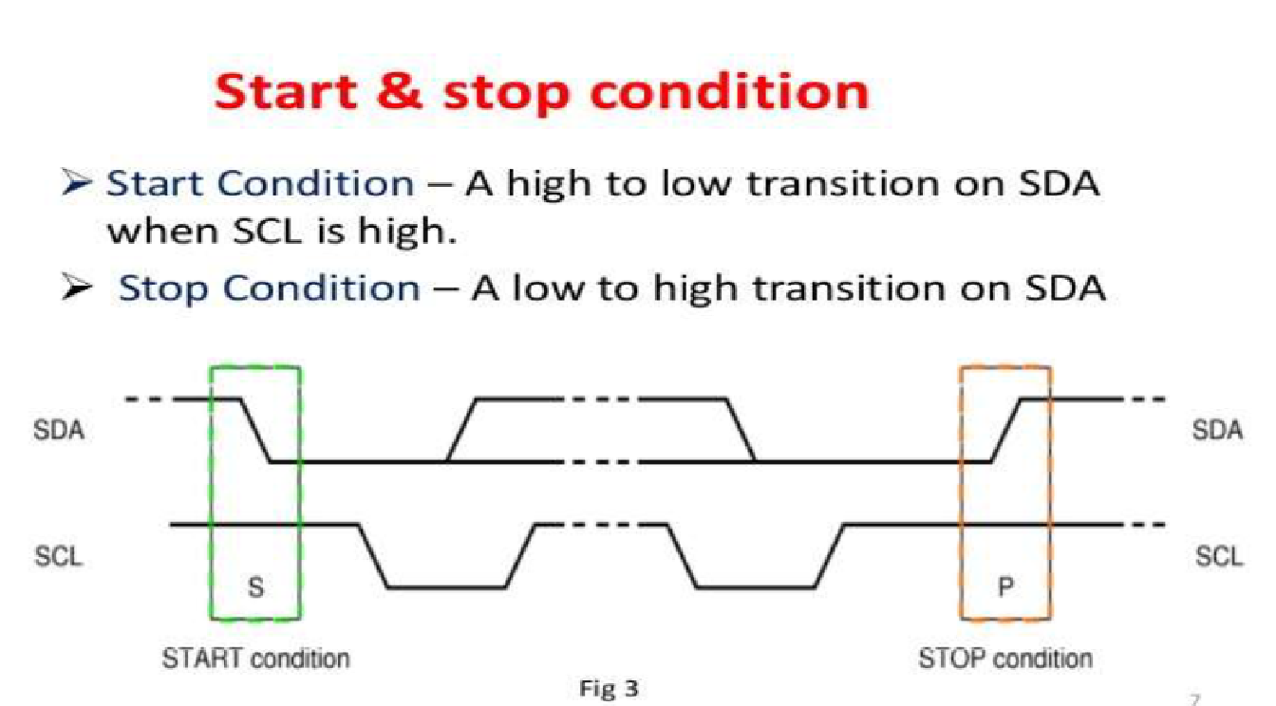

Slide 28
I2C
I2C frame format
  Start bit: 1 bit indicates the start of a new frame, always logic low.
  Address: 7 bits that decides slave address which is the device that will process the upcoming sent data by the master.
  R/W̅ : 1 bit to decide type of operation, logic high for read, logic low for write.
  ACK: 1 bit sent by the slave as acknowledge by polling line low.
  Data: each 8-bits of data sent is followed by ACK bit by the receiver.
  Stop bit: 1 bit indicates the end of the frame.

Slide 29
I2C
I2C bus arbitration mechanism
  Since the bus structure is a wired AND (if one device pulls a line low it stays low), you can test if the bus is idle or occupied.
  When a master changes the state of a line to HIGH, it MUST always check that the line really has gone to HIGH. If it stays low then this is an indication that the bus is occupied and some other device is pulling the line low.
  Therefore the general rule is: If a master can't get a certain line to go
high, it lost arbitration and needs to back off and wait until a stop condition is seen before making another attempt to start transmitting.

Slide 30
I2C
Case 1: Master (Transmitter) to Slave (Receiver) Data Transfer
  The Master sends the START sequence to begin the transaction.
  It is followed by Master sending 7-bit Slave address and the R/W̅ bit set to zero. We set it to zero because the Master is writing to the Slave.
  The Slave acknowledges by pulling the ACK bit low.
  Once the Slave acknowledges the address, Master can now send data to the Slave byte-by-byte. The Slave has to send the ACK bit after every byte it receives.
  This goes on till Slave can no longer receive data and does NOT send the
ACK bit.
  This is when the Master realizes that the Slave is not accepting anymore and then STOPs the transaction (or RE-START).
  An example of this case would be like performing page write operations
on a EEPROM chip.
24

Slide 31
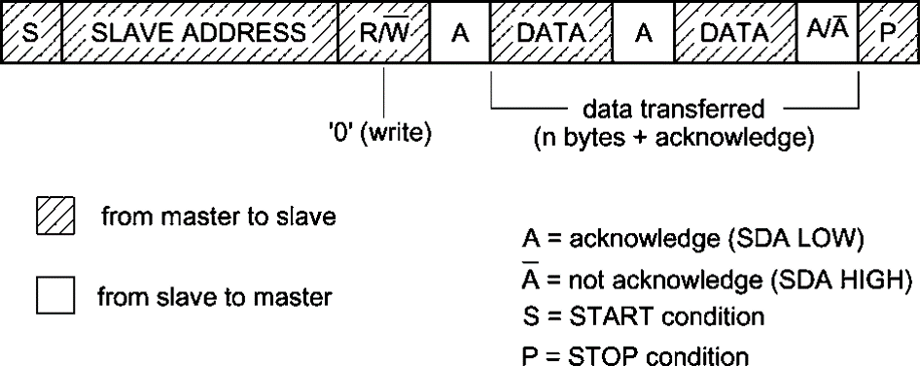
I2C
Case 1: Master (Transmitter) to Slave (Receiver) Data Transfer

Slide 32
I2C
Case 2: Slave (Transmitter) to Master (Receiver) Data Transfer
  The Master sends the START sequence, followed by the 7-bit Slave address and the R/W̅ bit set to 1.
  We set R/W̅ bit to 1 because the Master is reading from the Slave.
  The Slave acknowledges the address, thus ready to send data now.
  Slave keeps on sending data to the Master, and the Master keeps on sending ACK to the Slave after each byte until it can no longer accept any more data.
  When the Master feels like ending the transaction, it does not send the
ACK, thus ending with the STOP sequence.
  An example of this case could be an Analog to Digital Converter (ADC) sending data to the microcontroller continuously. The microcontroller accepts data as long as it wants to, after which it stops/finishes execution.

Slide 33
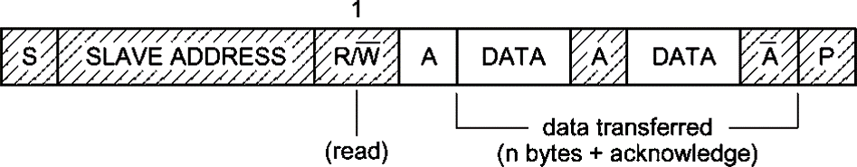
I2C
Case 2: Slave (Transmitter) to Master (Receiver) Data Transfer

Slide 34
I2C
Case 3: Bi-directional Read and Write in same Data Transfer
  The Master sends out the START sequence, followed by the 7-bit Slave address and the R/W̅ bit, then the Slave acknowledges the address.
  Depending upon the value of the R/W̅ bit, read/write operations are performed (like the previous two cases).
  Whatever the case it may be, it always ends with the receiver not sending the ACK.
  At the end the Master attempts a repeated START and the entire process repeats again, until the Master decides to STOP.
  An example of this case could be performing sequential read from a EEPROM chip. It is bi-directional because the CPU first writes the address from where it would like to start reading, followed by reading from the device.

Slide 35
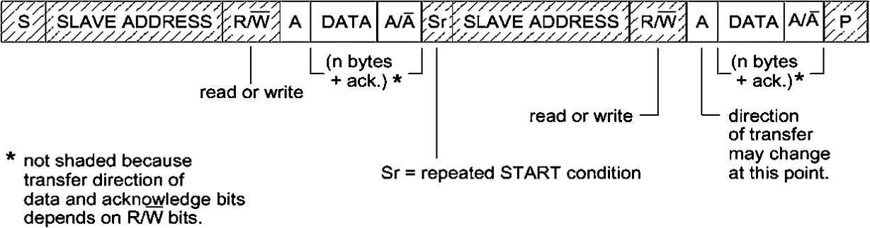
I2C
Case 3: Bi-directional Read and Write in same Data Transfer

Slide 36
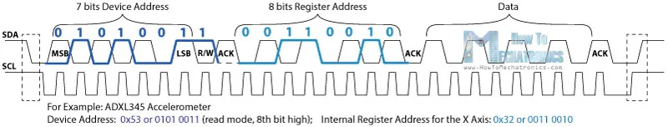
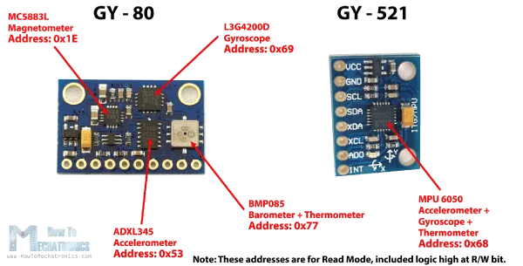
Example Accelerometer ADXL345
Notes:
Example

Slide 37
Wire.h Library
The Wire library has several useful functions for working with I2C.
begin() – This initiates the library and sets up the Arduino to be either master or slave.
requestFrom() – This function is used by the master to request data from a slave.
beginTransmission() – This function is used by the master to send data to a specified slave.
endTransmission() – This function is used by the master to end a transmission started with the beginTransmission function.
write() – Used by both master and slave to send data on the I2C bus.
available() – Used by both master and slave to determine the number of bytes in the data they are receiving.
read() – Reads a byte of data from the I2C bus.
SetClock() – Used by the master to set a specific clock frequency.
onReceive() – Used by the slave to specify a function that is called when data is received from the master.
onRequest() – Used by the slave to specify a function that is called when the master has requested data.
Notes:
Wire.h Library

Slide 38
Arduino I2C Functions
a) Wire.begin(address)
address : 7-bit slave address of the device. If not specified, the device joins the bus as a master.
This function is used to initiate the wire library and join the bus as a master or slave.
b) Wire.beginTransmission(address)
address : 7-bit address of the device to transmit to.
This function is used to begin transmission to the I2C slave device with the given address. After this, queue bytes for transmission using the Wire.write() function and transmit them by calling the Wire.endTransmission() function.
c) Wire.endTransmission(stop)
stop : Boolean data type. True will send a stop message after the request, thus releasing the bus. False will continually send a restart after the request, thus keeping the connection active.
This function ends transmission to slave device started using Wire.beginTransmission() function and transmits the bytes that were queued by Wire.write() function.

Slide 39
Arduino I2C Functions
d) Wire.write(value), Wire.write(string), Wire.write(data, length)
value : value to be sent as a single byte.
string : string to be sent as a series of bytes.
data : array of data to be sent as bytes.
length : number of bytes to be sent.
This function writes data from the slave device in response to a request from the master, or queues bytes for transmission from master to a slave device in between calls to Wire.beginTransmission() and Wire.endTransmission().
e) Wire.available()
This function returns the numbers of bytes available to be read with the Wire.read() function.

Slide 40
Arduino I2C Functions
f) Wire.read()
This function reads a byte that was transmitted from a slave device to a master device after a Wire.requestFrom() function, or read a byte that was transmitted from a master device to a slave device
g) Wire.requestFrom(address, quantity, stop)
address : 7-bit address of device to request bytes from.
quantity : number of bytes to be requested.
stop : Boolean data type. True will send a stop message after the request, thus releasing the bus. False will continually send a restart after the request, thus keeping the connection active.
This function is used by the master to request bytes from a slave device.

Slide 41
#include <Wire.h>
int ADXLAddress = 0x53; // Device address in which is included the 8th bit for selecting the mode, read in this case.
#define X_Axis_Register_DATAX0 0x32 // Hexadecima address for the DATAX0 internal register.
#define X_Axis_Register_DATAX1 0x33 // Hexadecima address for the DATAX1 internal register.
int X0,X1,X_out;
void setup() {
Wire.begin(); // Initiate the Wire library
Serial.begin(9600);
delay(100);
// Enable measurement
Wire.beginTransmission(ADXLAddress);
Wire.endTransmission();
}
void loop() {
Wire.beginTransmission(ADXLAddress); // Begin transmission to the Sensor
//Ask the particular registers for data
Wire.write(X_Axis_Register_DATAX0);
Wire.write(X_Axis_Register_DATAX1);
Wire.endTransmission(); // Ends the transmission and transmits the data from the two registers
Wire.requestFrom(ADXLAddress,2); // Request the transmitted two bytes from the two registers
if(Wire.available()<=2) { //
X0 = Wire.read(); // Reads the data from the register
X1 = Wire.read();
}
Serial.print("X0= ");
Serial.print(X0);
Serial.print(" X1= ");
Serial.println(X1);

Slide 42
I2C
I2C notes
  I2C supports a wide range of voltage levels, hence you can provide +5 volts, or +3.3 volts as Vcc easily, and other lower/higher voltages as well.
  This gives us a wide range of choices for the values of the pull-up resistors Anything within the range of 1k to 47k should be fine, however values lower than 10k are usually preferred.
  I2C is a half duplex communication protocol.
  I2C supports serial 8-bit data transfers up to a speed of 100 kbps, which is
the standard clock speed of SCL. However, I2C can also operate at higher speeds – Fast Mode (400 kbps) and High Speed Mode (3.4 Mbps).

Slide 43
I2C
I2C notes
  Maximum number of nodes is 112, as address is 7-bits and there are 16 nodes reserved.
  I2C is used for short distance communication.
  The Slave is allowed to hold the clock line low until it is ready to give out the result. The Master must wait for the clock to go back to high before continuing with its work, this is called clock stretching.

Slide 44


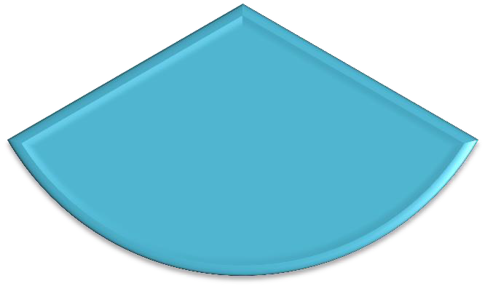
SPI
SPI
UART
I2C

Slide 45
SPI
What is SPI?
Serial Peripheral
Interface (SPI) bus is a synchronous serial
communication interface specification used for short distance communication.
The SPI bus can operate with a single master device and with one or more slave devices.

Slide 46
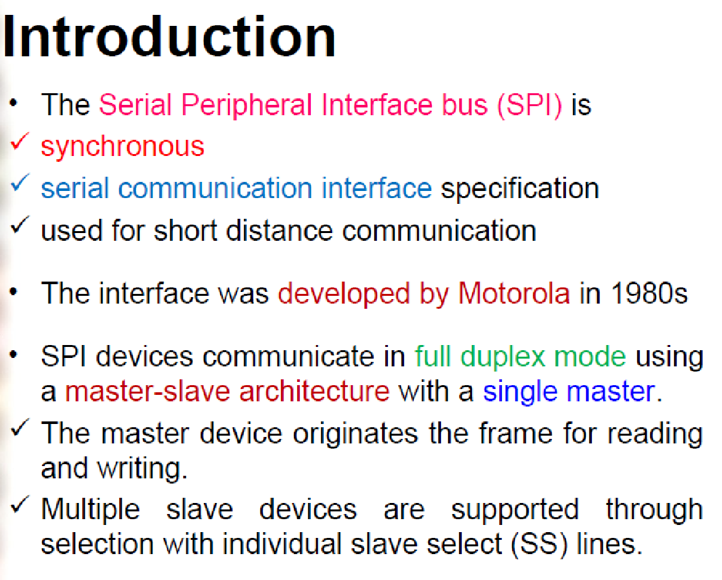

Slide 47
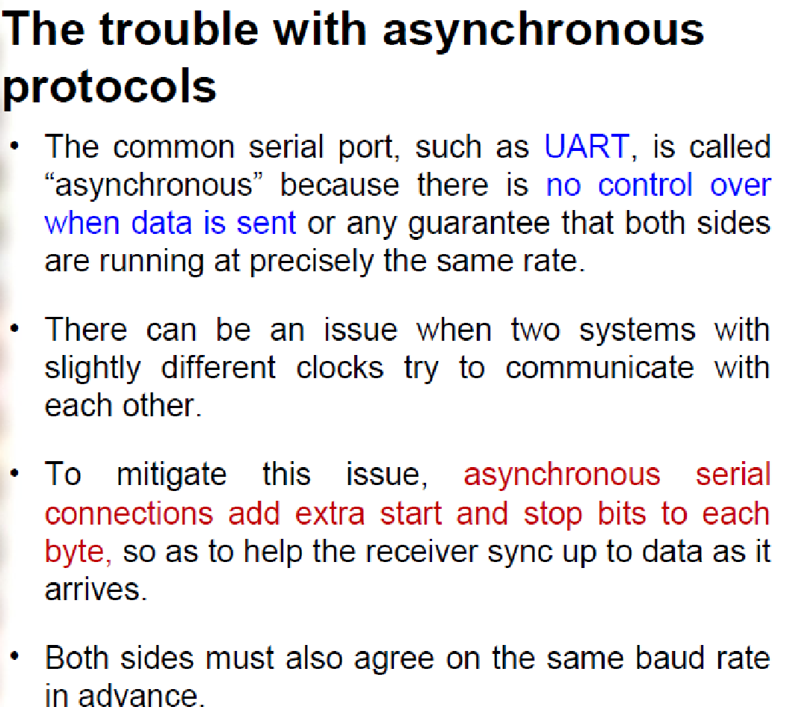

Slide 48
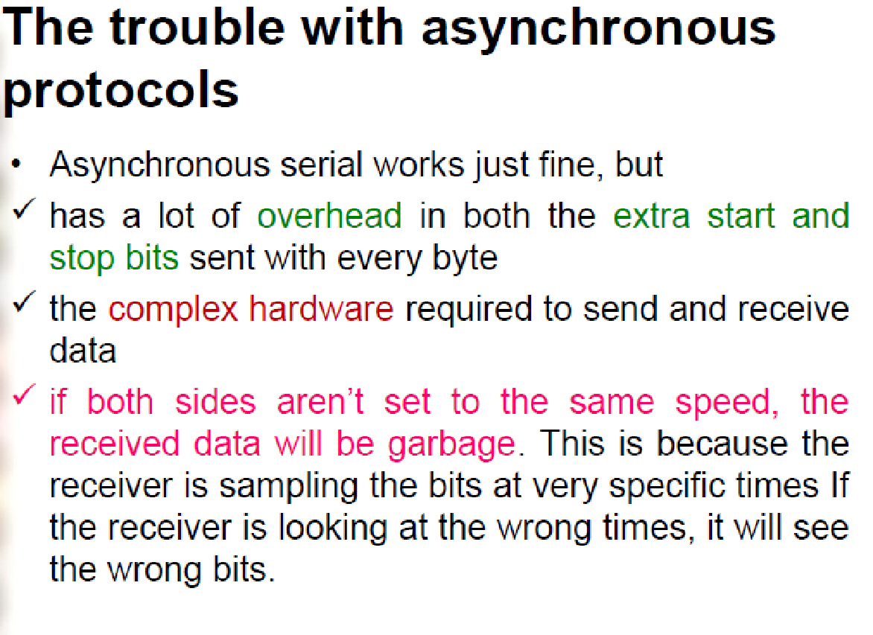

Slide 49
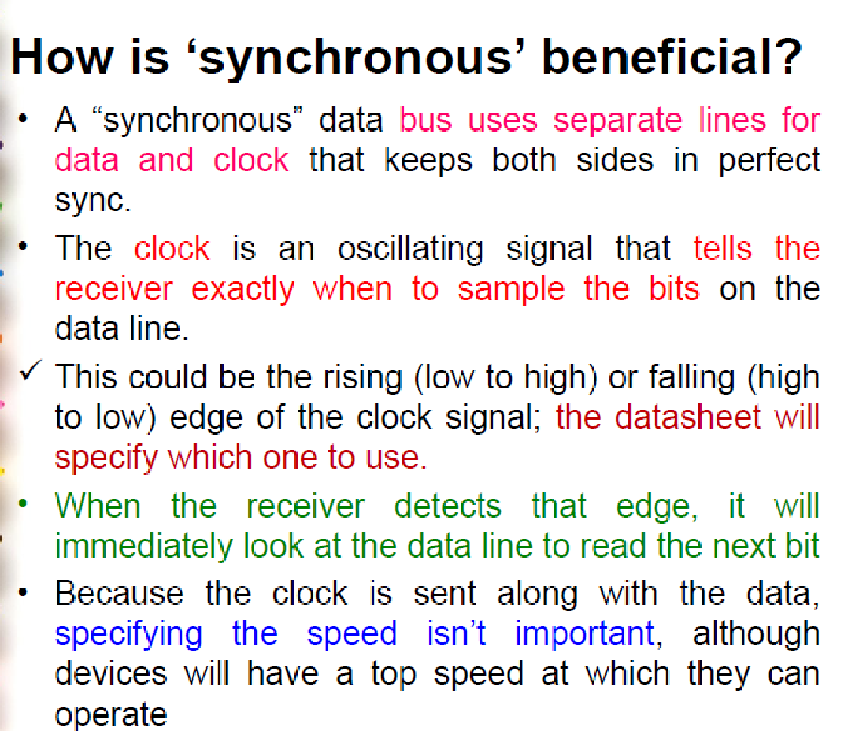

Slide 50
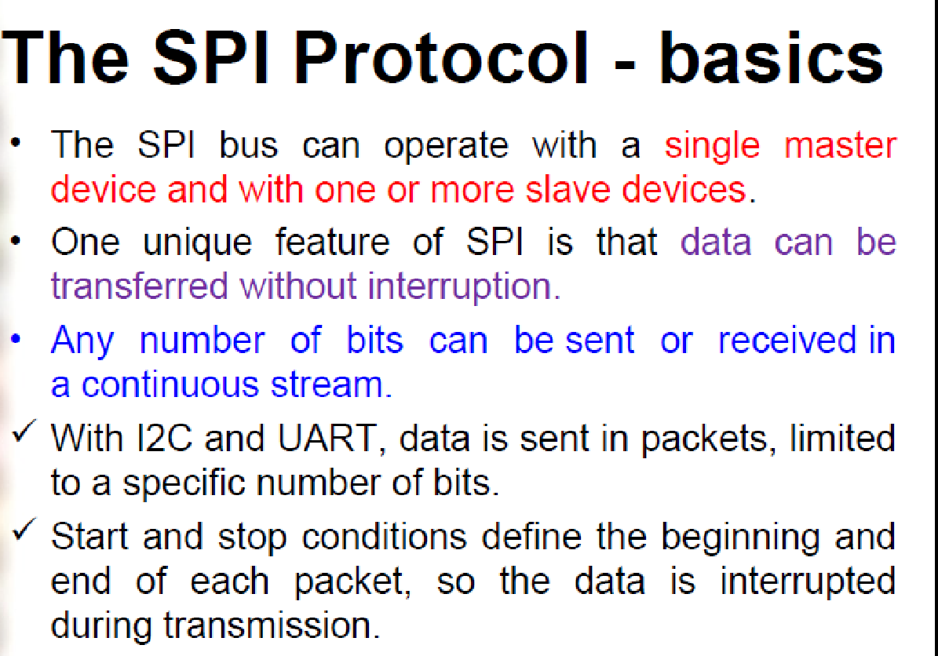

Slide 51
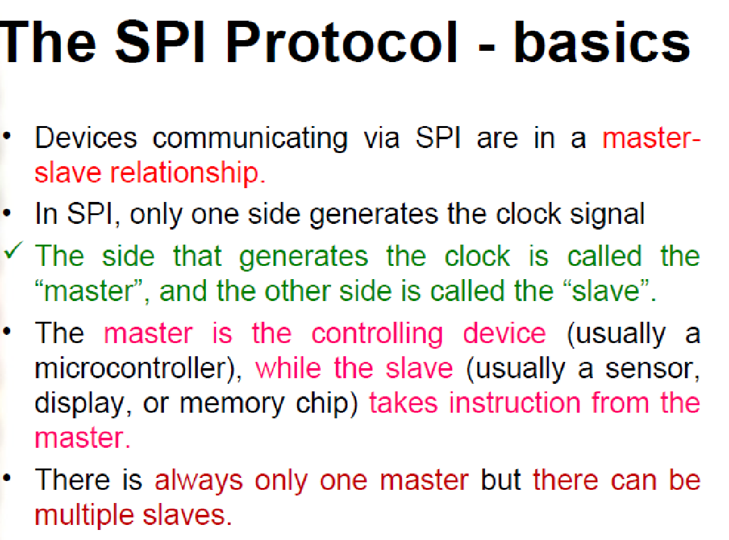

Slide 52
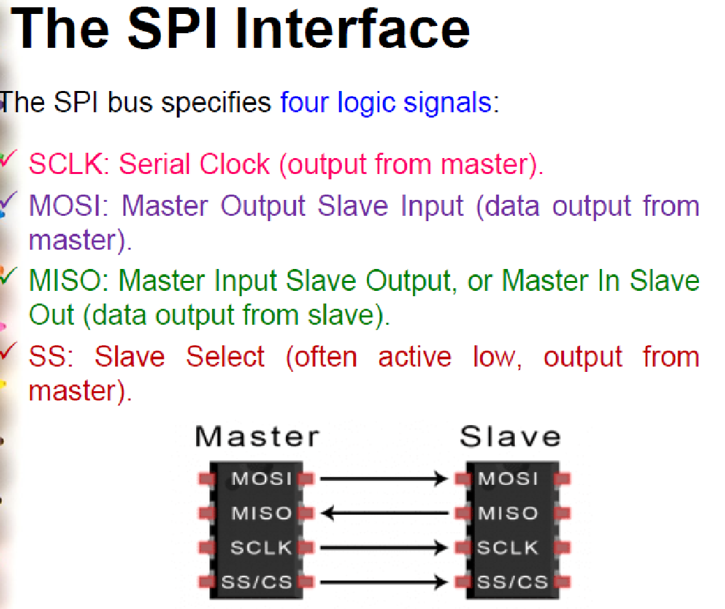

Slide 53
SPI
SPI connection
  SCLK : Serial Clock (output from master).
  MOSI : Master Output, Slave Input (output from master).
  MISO : Master Input, Slave Output (output from slave).
  SS : Slave Select (active low, output from master).
Note: SPI speed rate up 14Mbps, I2C up to 400Kbps
https://www.analog.com/media/en/analog-dialogue/volume-52/number-3/introduction-to-spi-interface.pdf
Notes:
SPI speed rate up 14Mbps, I2C up to 400Kbps

Slide 54
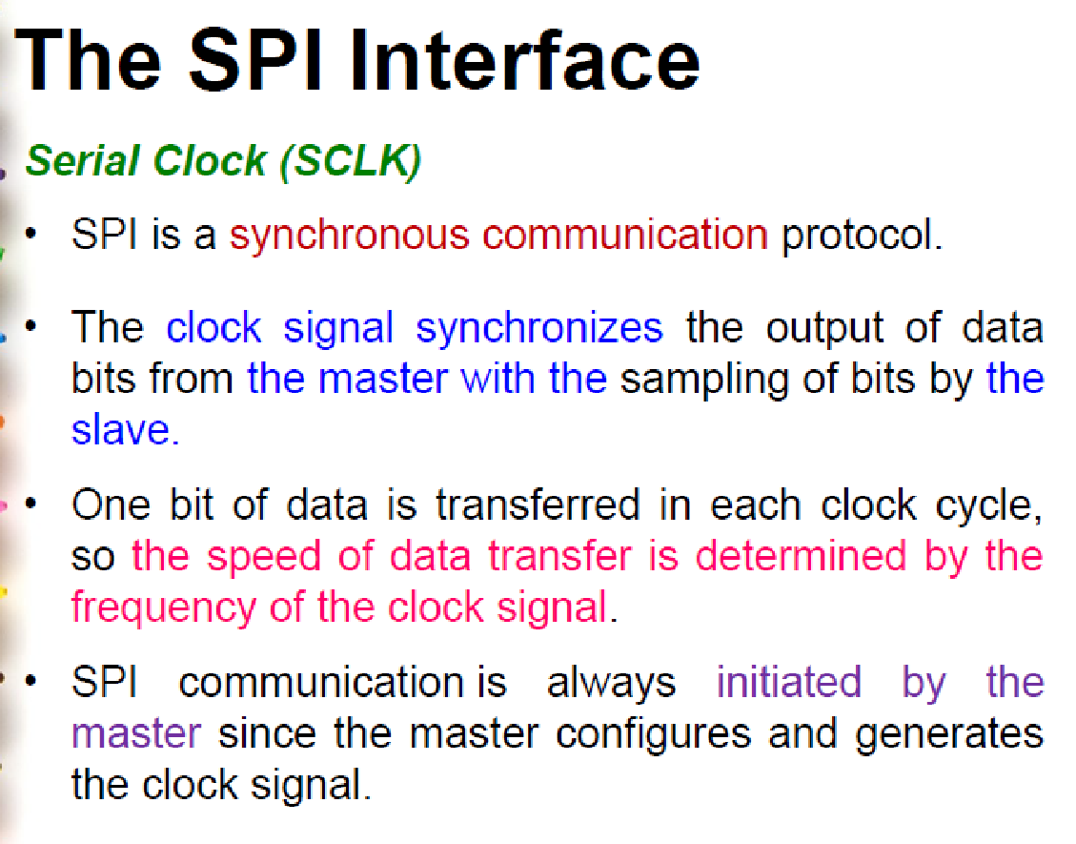

Slide 55
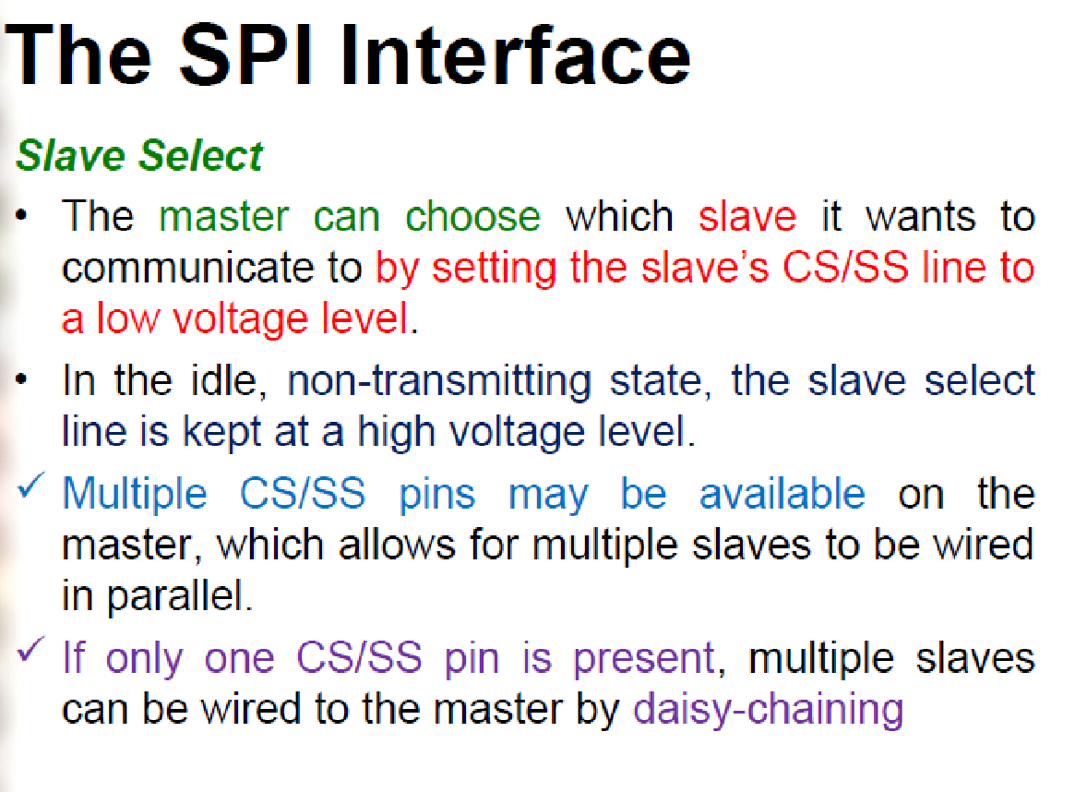

Slide 56
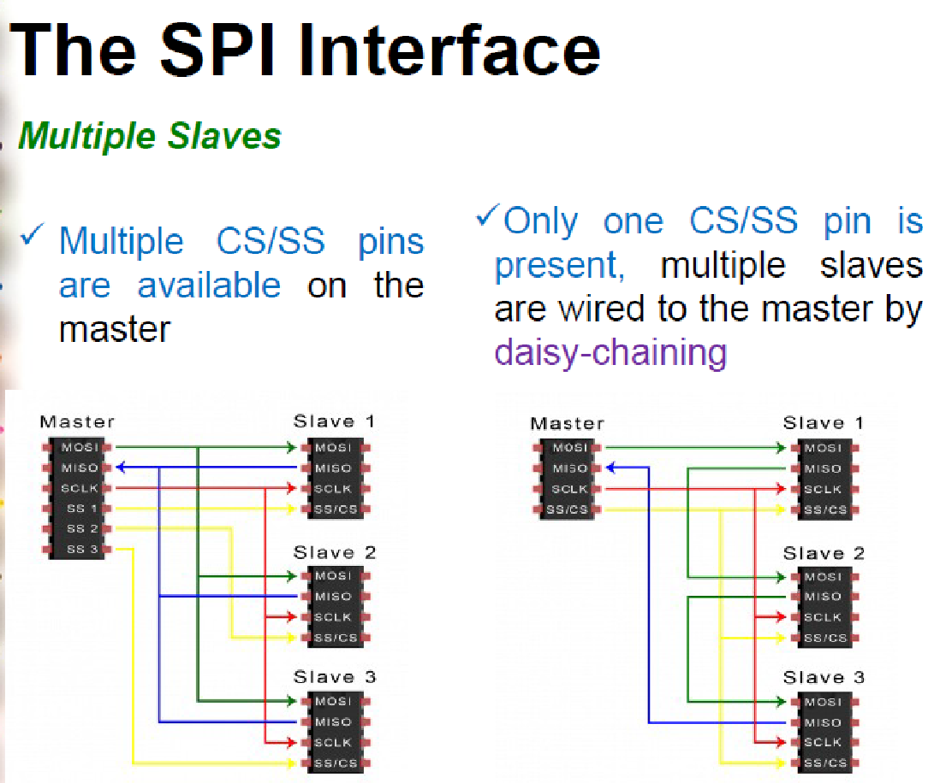

Slide 57
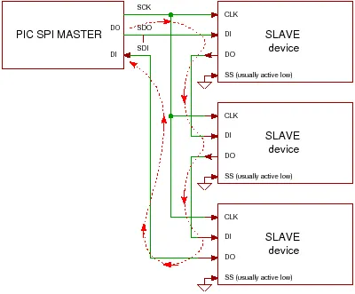
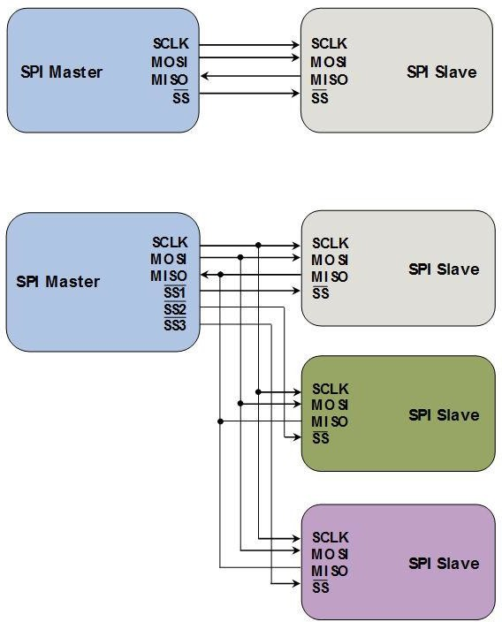
SPI
SPI connection
With Daisy Chain scheme all data sent by the master is shifted into all devices and all data sent from each device is shifted out to the next (shown by red dotted arrow). For this scheme to work you have to make sure that each slave uses the clock in the same way and you have to get the right number of bits, so there is more work to do in software.

Slide 58
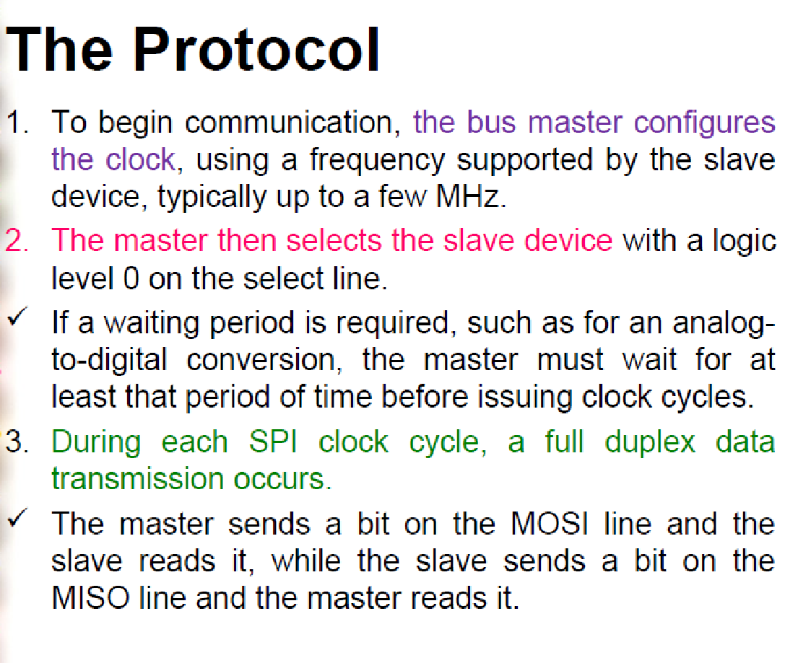

Slide 59
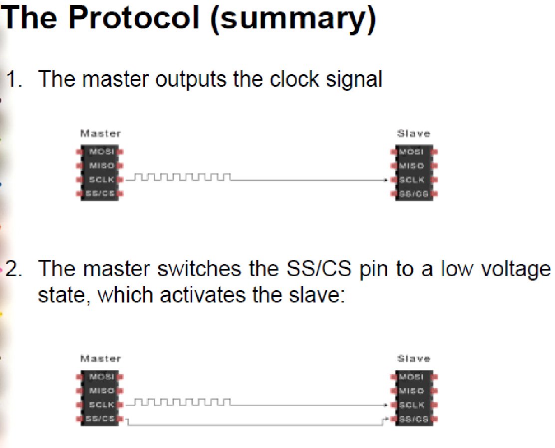

Slide 60
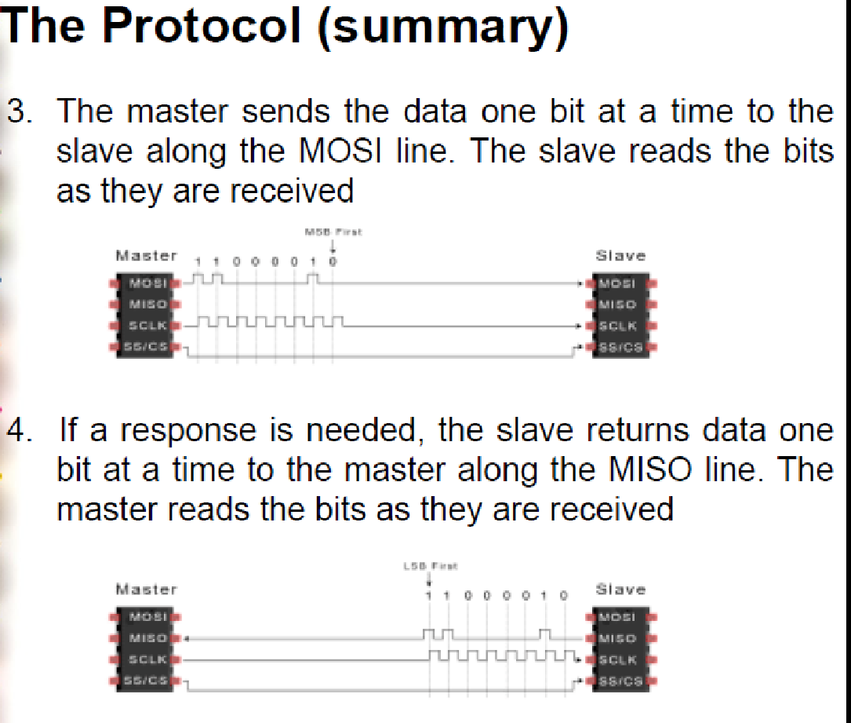

Slide 61
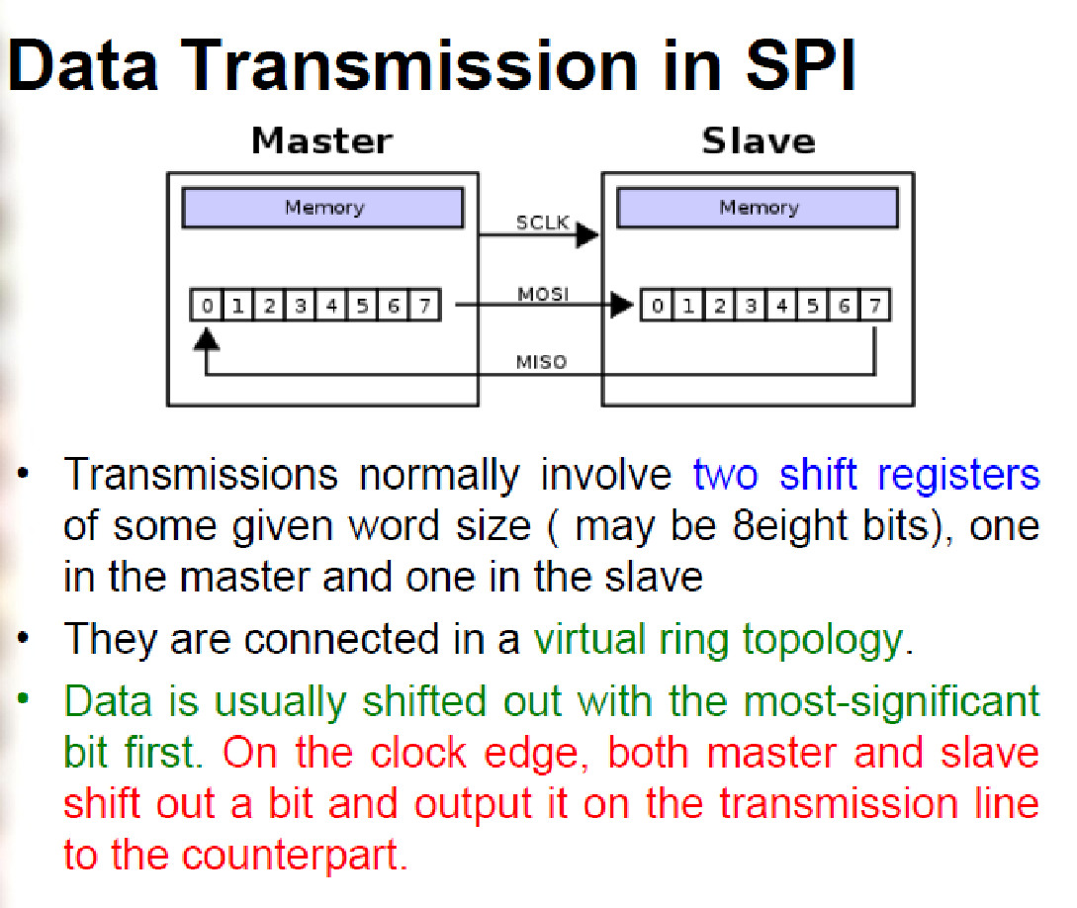

Slide 62
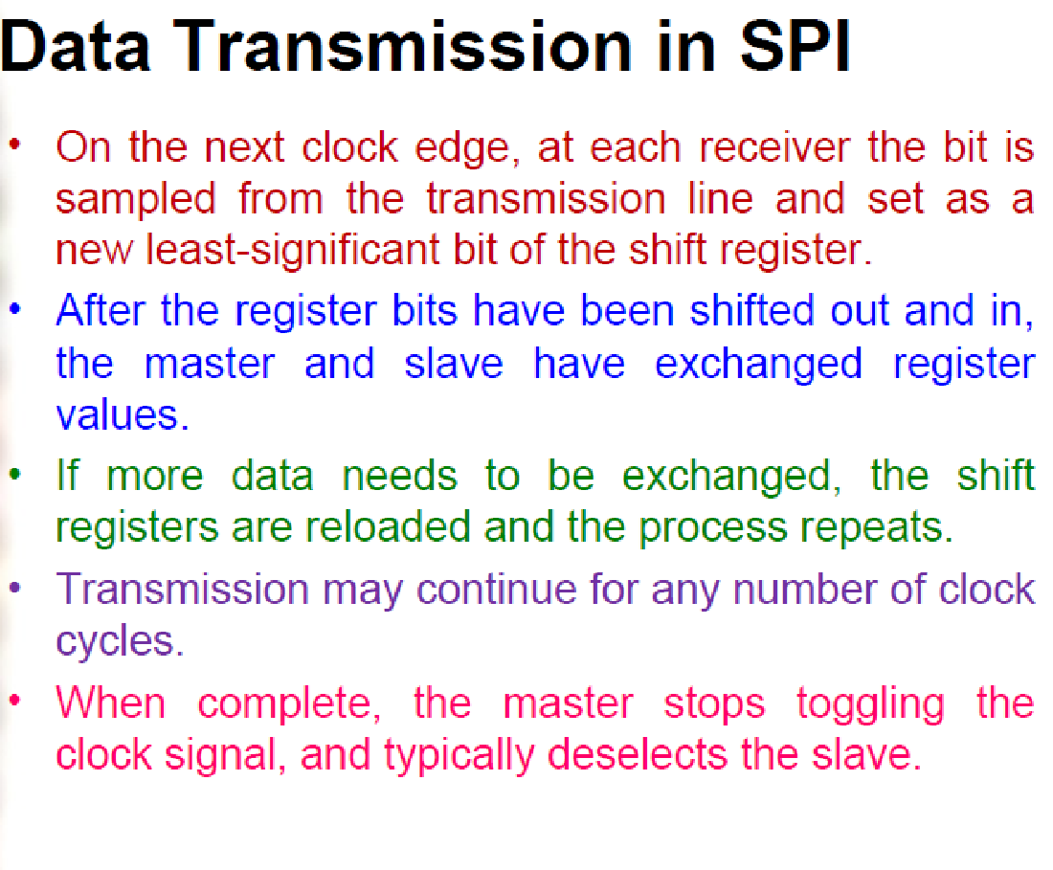

Slide 63


Modes of Transmission
Animation 1 shows data shifted out of Microchip A into Microchip B, and from Microchip B into Microchip A.
Notes:
Modes of Transmission

Slide 64



Slide 65


SPI Modes
Data appears to be sampled on the rising clock edge, just as before.
To find out what this means for CPHA, we first need to determine CPOL.
CPOL appears to be 0 (idle low).
Therefore, CPHA is 0 (first edge).
SPI Mode 0 (0,0)
Data appears to be sampled on the rising clock edge.
To find out what this means for CPHA, we first need to determine CPOL.
CPOL appears to be 1 (idle high).
Therefore, CPHA is 1 (second edge).
SPI Mode 3 (1,1)
Notes:
SPI Mode 0

Slide 66


Slide 67


Slide 68





Shift Registers
74HC595
The 74HC575 is an 8-stage serial shift register that also has an internal storage register. The storage register buffers the output data and can be clocked independently of the shift register. This prevents the data from changing while it is being loaded.
Notes:
74HC595

Slide 69



Use SPI to interface with sensors
Notes:
Use SPI to interface with sensors

Slide 70
#include <SPI.h>
int slaveSelect = 2;
int delayTime = 50;
void setup() {
pinMode(slaveSelect, OUTPUT);
SPI.begin();
SPI.setBitOrder(LSBFIRST);
}
void loop() {
for (int i; i < 256; i++) //For loop to set data = 0 then increase it by one for every iteration of the loop, when the counter reaches the condition (256) it will be reset
{
digitalWrite(slaveSelect, LOW); //Write our Slave select low to enable the SHift register to begin listening for data
SPI.transfer(i); //Transfer the 8-bit value of data to shift register, remembering that the least significant bit goes first
digitalWrite(slaveSelect, HIGH); //Once the transfer is complete, set the latch back to high to stop the shift register listening for data
delay(delayTime); //Delay
}
}

Slide 71
SCP1000 Barometric Pressure Sensor Display
The SCP1000 barometric pressure sensor can read both air pressure and temperature and report them via the SPI connection
Data Sheet
https://www.sparkfun.com/datasheets/Components/SCP1000-D01.pdf
https://github.com/atomslabs/ArduinoProjects/blob/master/Using%20SPI%20to%20read%20a%20Barometric%20Pressure%20Sensor
Notes:
Data Sheet

Slide 72


SCP1000
Each SPI communication frame contains two or three 8 bit words: the first word defines the register address (6 bits wide, bits [A5:A0] followed by the type of access (‘0’ = Read or ‘1’ = Write) and one zero bit (bit 0, LSB). The following word(s) contain the data being read or written. The MSB of the words are sent first. Bits from MOSI line are sampled in on the rising edge of SCK and bits to MISO line are latched out on falling edge of SCK.

Slide 73


Example of SPI communication
Notes:
Example of SPI communication

Slide 74
The Code for SCP1000……
#include <SPI.h>
//Sensor's memory register addresses:
const int PRESSURE = 0x1F; //3 most significant bits of pressure
const int PRESSURE_LSB = 0x20; //16 least significant bits of pressure
const int TEMPERATURE = 0x21; //16 bit temperature reading
const byte READ = 0b11111100; // SCP1000's read command
const byte WRITE = 0b00000010; // SCP1000's write command
// pins used for the connection with the sensor
// the other you need are controlled by the SPI library):
const int dataReadyPin = 6;
const int chipSelectPin = 7;
void setup() {
Serial.begin(9600);
// start the SPI library:
SPI.begin();
// initalize the data ready and chip select pins:
pinMode(dataReadyPin, INPUT);
pinMode(chipSelectPin, OUTPUT);
//Configure SCP1000 for low noise configuration:
writeRegister(0x02, 0x2D);
writeRegister(0x01, 0x03);
writeRegister(0x03, 0x02);
// give the sensor time to set up:
delay(100);
}
void loop() {
//Select High Resolution Mode
writeRegister(0x03, 0x0A);
// don't do anything until the data ready pin is high:
if (digitalRead(dataReadyPin) == HIGH) {
//Read the temperature data
int tempData = readRegister(0x21, 2);
// convert the temperature to celsius and display it:
float realTemp = (float)tempData / 20.0;
Serial.print("Temp[C]=");
Serial.print(realTemp);
Notes:
The Code

Slide 75
//Read the pressure data highest 3 bits:
byte pressure_data_high = readRegister(0x1F, 1);
pressure_data_high &= 0b00000111; //you only needs bits 2 to 0
//Read the pressure data lower 16 bits:
unsigned int pressure_data_low = readRegister(0x20, 2);
//combine the two parts into one 19-bit number:
long pressure = ((pressure_data_high << 16) | pressure_data_low) / 4;
// display the temperature:
Serial.println("\tPressure [Pa]=" + String(pressure));
}
}
// SCP1000 expects the register name in the upper 6 bits
// of the byte. So shift the bits left by two bits:
thisRegister = thisRegister << 2;
// now combine the address and the command into one byte
byte dataToSend = thisRegister & READ;
Serial.println(thisRegister, BIN);
// take the chip select low to select the device:
digitalWrite(chipSelectPin, LOW);
// send the device the register you want to read:
SPI.transfer(dataToSend);
// send a value of 0 to read the first byte returned:
result = SPI.transfer(0x00);
// decrement the number of bytes left to read:
bytesToRead--;
// if you still have another byte to read:
if (bytesToRead > 0) {
// shift the first byte left, then get the second byte:
result = result << 8;
inByte = SPI.transfer(0x00);
// combine the byte you just got with the previous one:
result = result | inByte;
// decrement the number of bytes left to read:
bytesToRead--;
}
// take the chip select high to de-select:
digitalWrite(chipSelectPin, HIGH);
// return the result:
return (result);
}
//Read from or write to register from the SCP1000:
unsigned int readRegister(byte thisRegister, int bytesToRead) {
byte inByte = 0; // incoming byte from the SPI
unsigned int result = 0; // result to return
Serial.print(thisRegister, BIN);
Serial.print("\t");

Slide 76
//Sends a write command to SCP1000
void writeRegister(byte thisRegister, byte thisValue) {
// SCP1000 expects the register address in the upper 6 bits
// of the byte. So shift the bits left by two bits:
thisRegister = thisRegister << 2;
// now combine the register address and the command into one byte:
byte dataToSend = thisRegister | WRITE;
// take the chip select low to select the device:
digitalWrite(chipSelectPin, LOW);
SPI.transfer(dataToSend); //Send register location
SPI.transfer(thisValue); //Send value to record into register
// take the chip select high to de-select:
digitalWrite(chipSelectPin, HIGH);
}

Slide 77


Slide 78


Slide 79


Slide 80


Slide 81


Slide 82


Slide 83

Contents
Notes:
Contents

Slide 84
Introduction
•
CAN was dedicatedly developed for automobile in the 1980’s, today CAN chips are manufactured by Motorola, Intel, Phillips etc.
•
Half duplex, Message based protocol that overtook Ethernet and USB because of its price to performance ratio & simple hardware.
•
ISO-11898 is the CAN standard, CAN2.0A – 11 bit identifier and CAN2.0B
-29 bit identifier.
•
High speed CAN - 1Mbps(suspension , engine control ) and Low speed CAN – 125kbps(power window, wiper control).

Slide 85

Before CAN

Slide 86

After CAN

Slide 87

Real-world applications
- 8 -

Slide 88

Introduction
Typical CAN bus
Source: http://processors.wiki.ti.com

Slide 89

CAN Characteristics
Physical Medium
Single twisted pair wire terminated on each end
Node A
Node B
120 Ω
120 Ω

Slide 90

CAN requirements
Twisted pair cable eliminate the electromagnetic interference.
Recommended to have maximum 30 nodes with 120 ohm termination .
According to the ‘rule of thumb’, signal rate * length <= 50
Bus length in meters | Signal rate in Mbps
40 | 1
100 | 0.5
500 | 0.10
1000 | 0.05
Source : http://digital.ni.com
Source : www.esp elecrtonics.com

Slide 91

CAN frame format
Source: https://en.wikipedia.org
Arbitration : When multiple nodes access the bus same time, the node with least arbitration wins.
RTR : When RTR = ‘1’ then it is remote frame, otherwise data frame.
IDE : Select standard CAN when ‘0’ and extended CAN when ‘1’
Continued..

Slide 92



Slide 93


CAN Message Format
•
Standard Data Frame
•
Extended Data Frame

Slide 97

CAN frame format
Source: http://canbus.pl
Continued..

Slide 98
CAN frame format
DLC: Data length code(4 bits) contains number of bytes of data being transmitted.
DATA: up to 64 bits (8 bytes) of data can be transmitted.
CRC: 16 bit cyclic redundancy check detects the transmission error.
ACK: Dominant bit(0) after receiving correct data, otherwise writes recessive bit(1).
EOF: Marks the end of frame and disable the bit stuffing .
IFS: Inter frame space is the time required to move correctly received frame to message buffer area.

Slide 99

CAN OSI : Physical layer
Physical layer can only be implemented on hardware.
When transmitting it converts 1’s and 0’s into electrical signal and back again to bits when receiving.
Source: http://www.ti.com/product/SN65HVD231/datasheet
Continued..

Slide 100
CAN OSI : Datalink layer
It can be implemented both on hardware and software.
Carrier Sense: Nodes checks the bus status, if the bus is idle then accesses it otherwise wait.
Multiple Access/CD+ AMP: Avoid collision when multiple nodes access the bus same time.
CSMA/CD+AMP explained
Source: http://canbus.pl

Slide 101

CAN Arbitration
CSMA/CA & Wired-AND Logic

Slide 102
CAN Arbitration
-CSMA/CA
-All nodes must wait for an idle bus condition .
-If two nodes begin transmitting simultaneously, they then participate in an arbitration process.
-The node with the lower ID number wins the arbitration and continues transmitting its message.
-The loser of the arbitration backs off and re-tries.

Slide 103


Slide 104

Advantages
CAN is multi master capable communication.
Reduce the wiring complexity between nodes.
.
Error detection and correction capability.
Easy interface with other protocol.
High speed up to 1Mbps .
Low Cost
Reliable
Robust
Source: www.ixxat.com

Slide 105

CAN Disadvantages
Notes:
CAN Disadvantages

Slide 106


