Slide 1
CHAPTER 1
Introduction

Slide 2
1.1 THE CONCEPT OF INTEREST
Interest may be regarded as a reward paid by one person or organization (the borrower) for the use of an asset, referred to as capital, belonging to another person or organization (the lender). The precise conditions of any transaction will be mutually agreed. For example, after a stated period of time, the capital may be returned to the lender with the interest due. Alternatively, several interest payments may be made before the borrower finally returns the asset.
Capital can referred to as principal.

Slide 3
Risk
If there is some risk of default (i.e., loss of capital or non-payment of interest), a lender would expect to be paid a higher rate of interest than would otherwise be the case. this additional interest is known as the risk premium.
For example, a person who uses his money to finance the drilling for oil in a previously unexplored region would expect a relatively high return on his investment if the drilling is successful, but might have to accept the loss of his capital if no oil were to be found.
A further factor that may influence the rate of interest on any transaction is an allowance for the possible depreciation or appreciation in the value of the currency in which the transaction is carried out. This factor is obviously very important in times of high inflation.

Slide 4
1.2 SIMPLE INTEREST
If an amount C is deposited in an account that pays simple interest at the rate of i per annum and the account is closed after n years (there being no intervening payments to or from the account), then the amount paid to the investor when the account is closed will be
C( 1 + ni ) (1.2.1)
This payment consists of a return of the initial deposit C, together with interest of amount
niC (1.2.2)

Slide 5
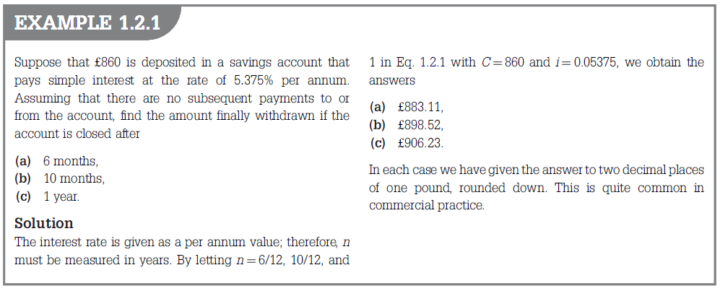

Slide 6
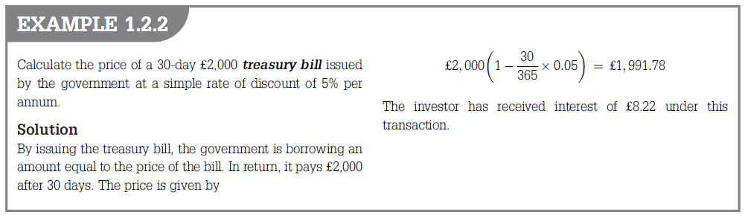
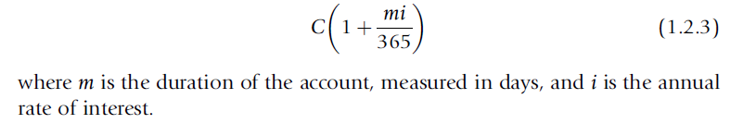

Slide 7
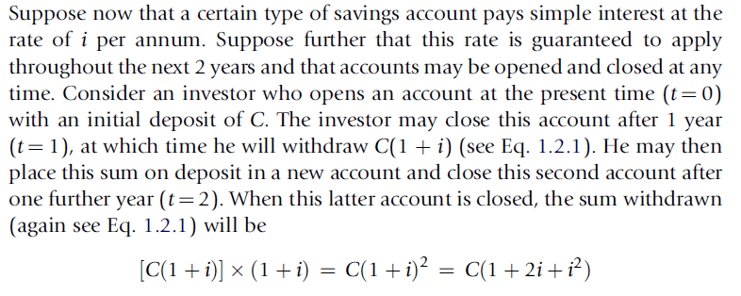
1.3 COMPOUND INTEREST

Slide 8
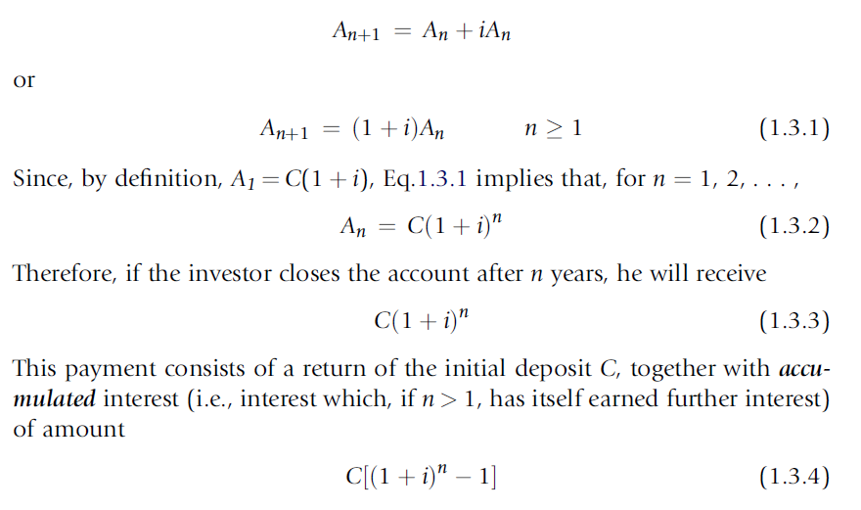
1.3 COMPOUND INTEREST

Slide 9
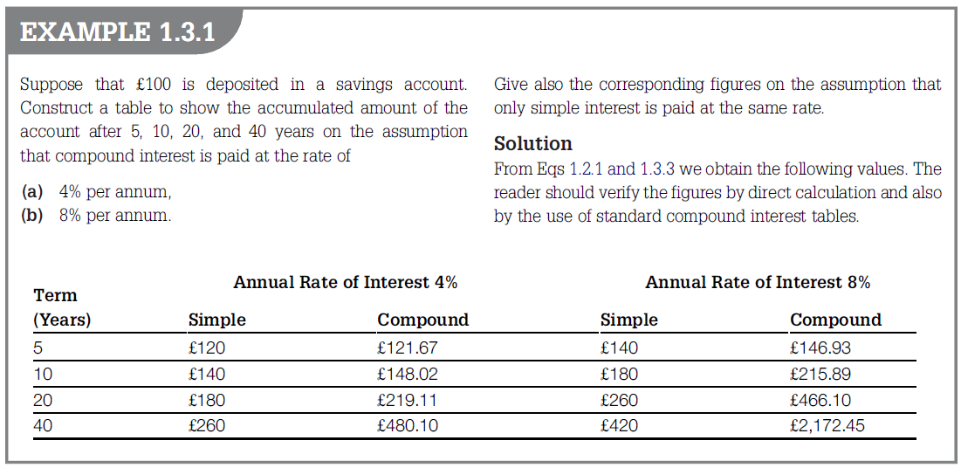

Slide 10
