Slide 1
ENCS 2110 Digital Electronics and Computer Organization Lab
Experiment No. 5 - Sequential Logic Circuits

Slide 2
Sequential Circuits
Any digital circuit could be classified as either a combinational or a sequential circuit.
Combinational logic circuits implement Boolean functions. Boolean functions are mappings of inputs to outputs. These circuits are functions of input only.
Sequential circuits are two-valued networks in which the outputs at any instant are dependent not only upon the inputs present at that instant, but also upon the history (sequence) of inputs.

Slide 3
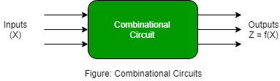
Combinational circuit
The output is only affected by the input

Slide 4
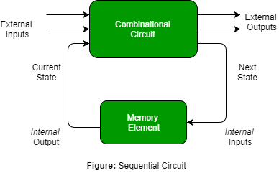
Sequential circuits
The outputs depend on a combination of both the present inputs as well as the previous outputs (Has a memory feedback component)

Slide 5
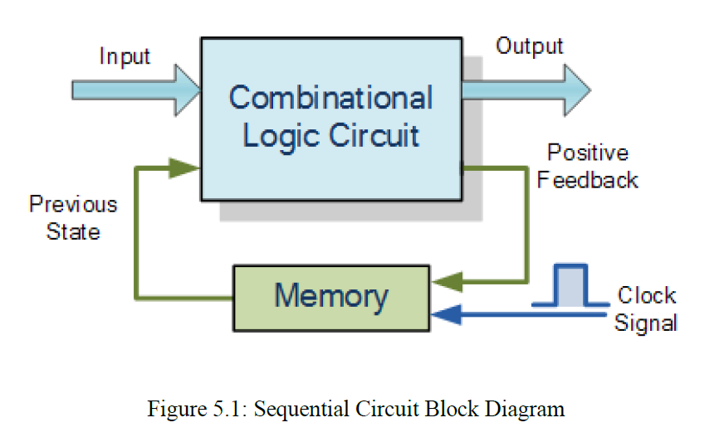
Combinational vs Sequential

Slide 6
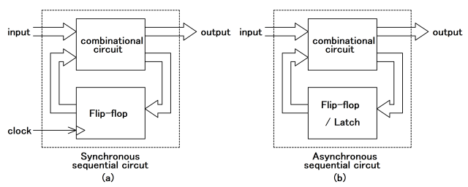
Latches
Latches form one class of flip-flops.
This class is characterized by the fact that the output changes' timing is not controlled.
Although latches are useful for storing binary information and for the design of asynchronous sequential circuits, they are not practical for use in synchronous sequential circuits. (why?)

Slide 7
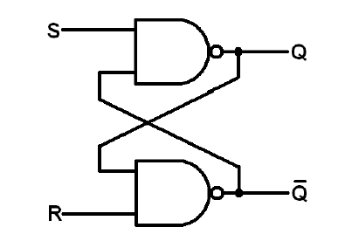
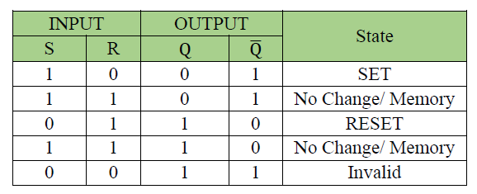
The SR (Set-Reset) Latch
The one with NAND gates as shown below.
Circuit is active low set/reset latch; that means the output Q goes to 1 when S (set) input is 0 and goes to 0 when R (Reset) input is 0.

Slide 8
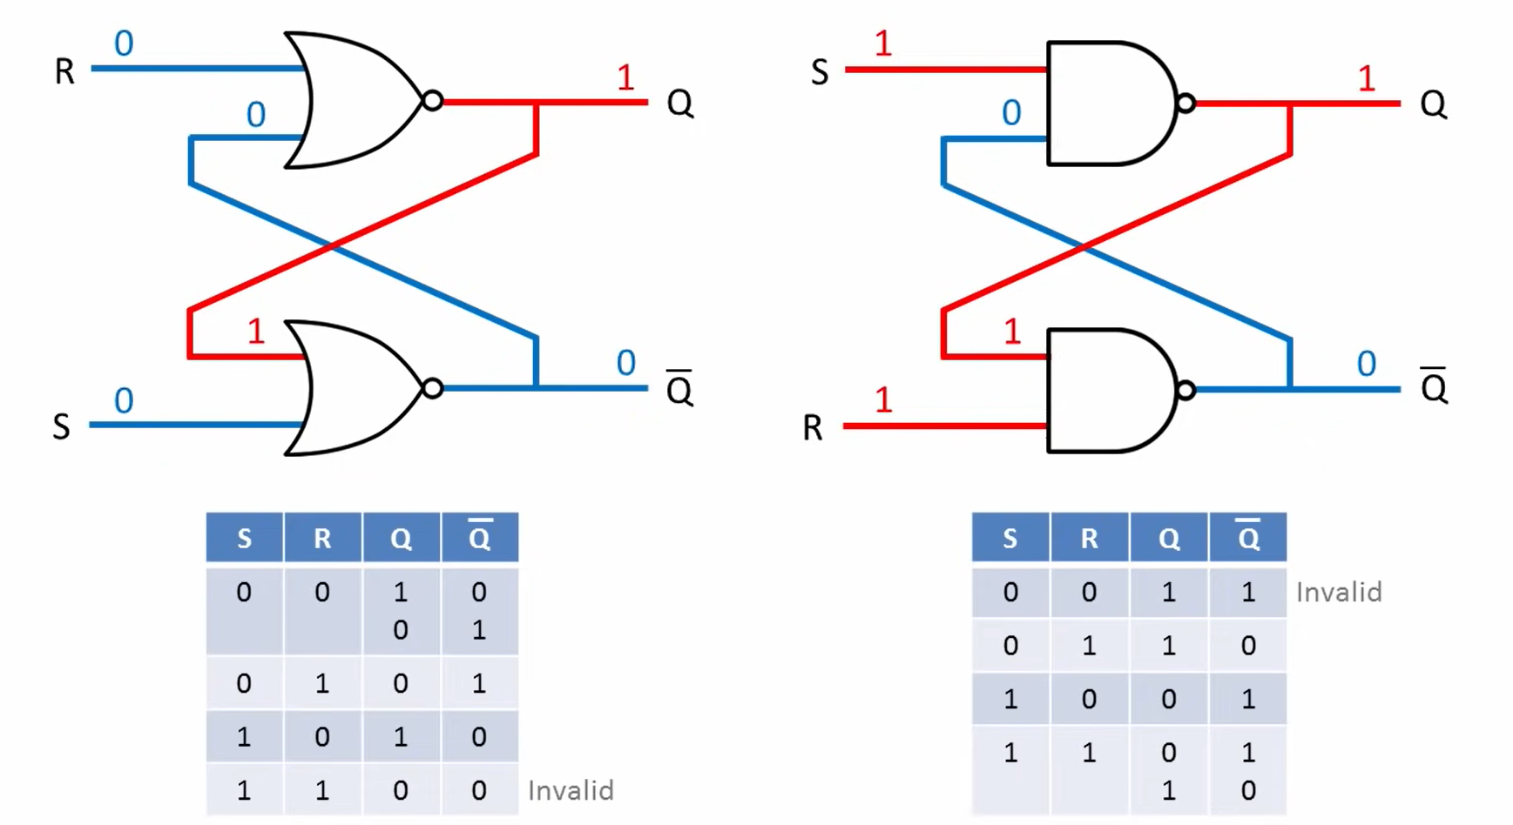
SR latch Active high vs Active low

Slide 9
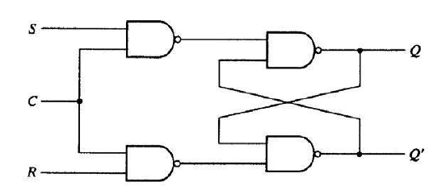
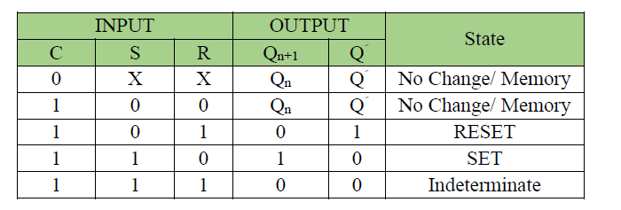
RS latch with control input
The RS latch with control input C .
If C=0 the output Q does not change regarding less the R and S values.
If C= 1 the circuit will work normally.

Slide 10
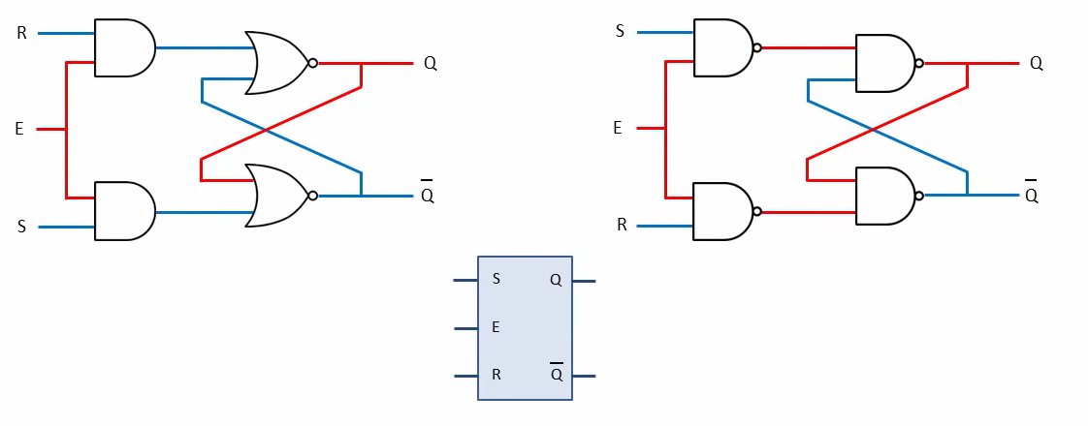
NAND vs NOR - RS latch

Slide 11
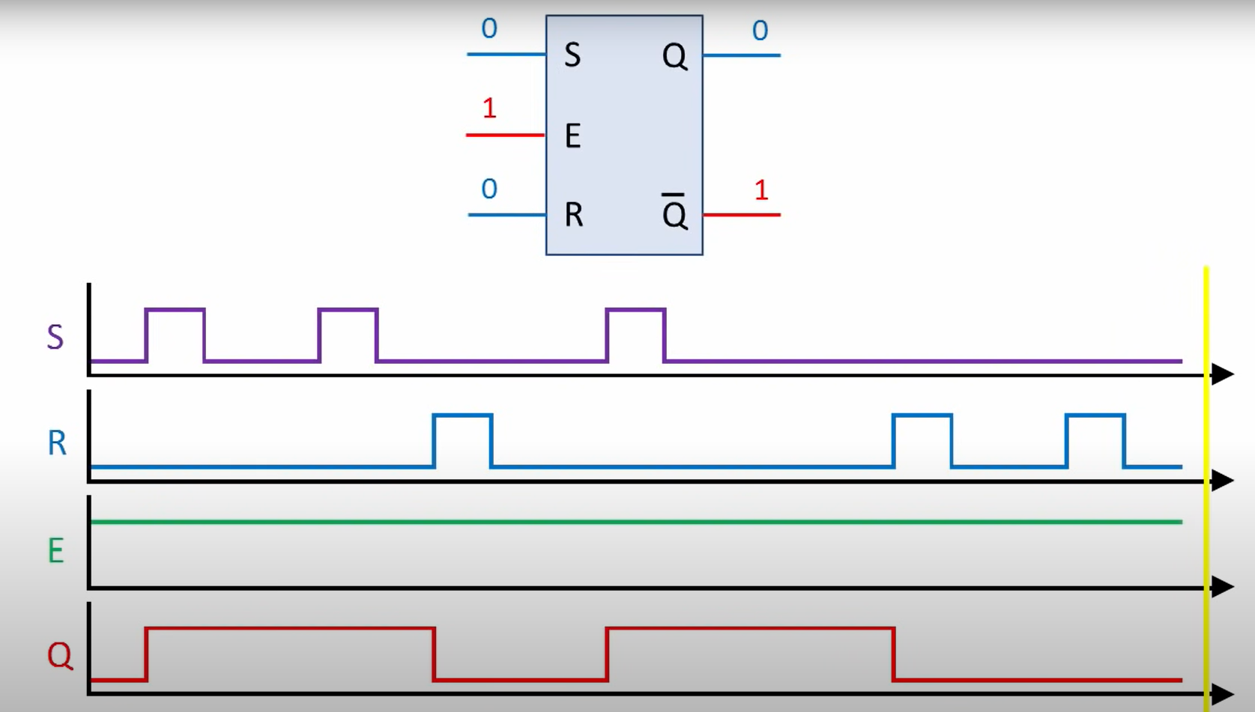
Example 1

Slide 12
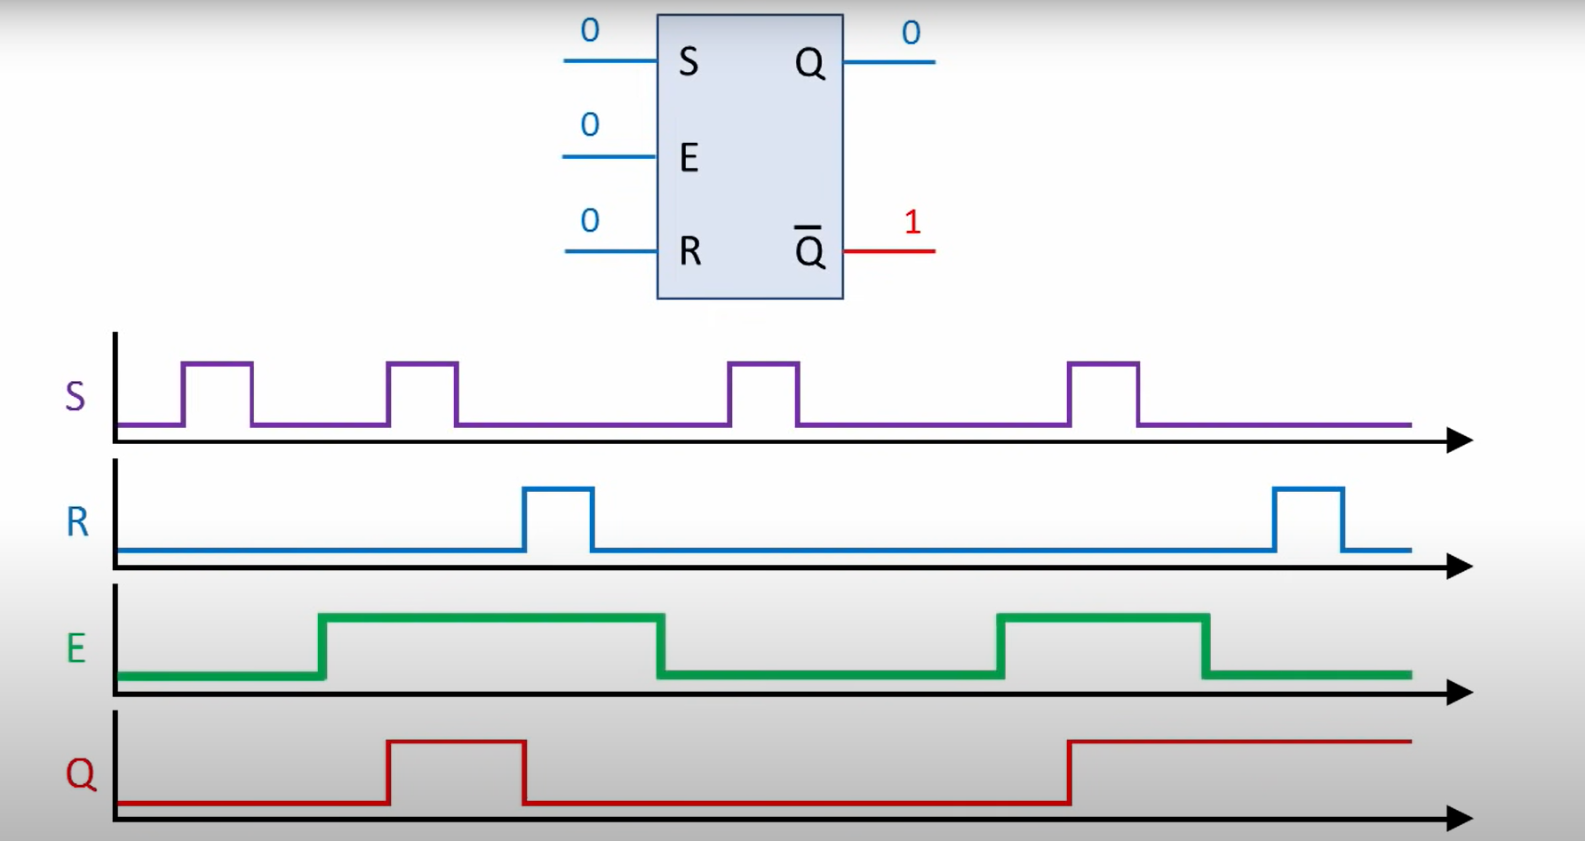
Example 2

Slide 13
Example 2

Slide 14
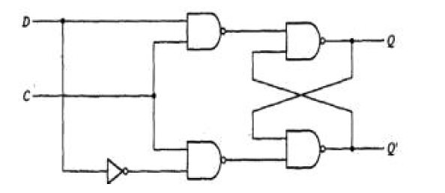
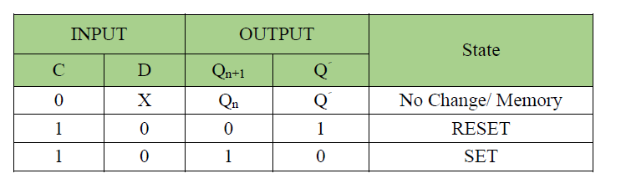
The D Latch
The D latch was developed to eliminate the undefined condition of the indeterminate state in the RS latch.

Slide 15
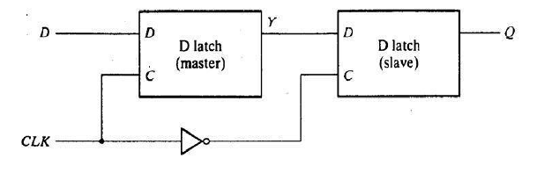
Flip-Flops
Like latches, flip-flops are also used for storing binary information.
The difference is: The output change in the flip-flop occurs only at the clock edge while in the latch it occurs at the clock level.
A flip-flop can be implemented using two separate latches

Slide 16
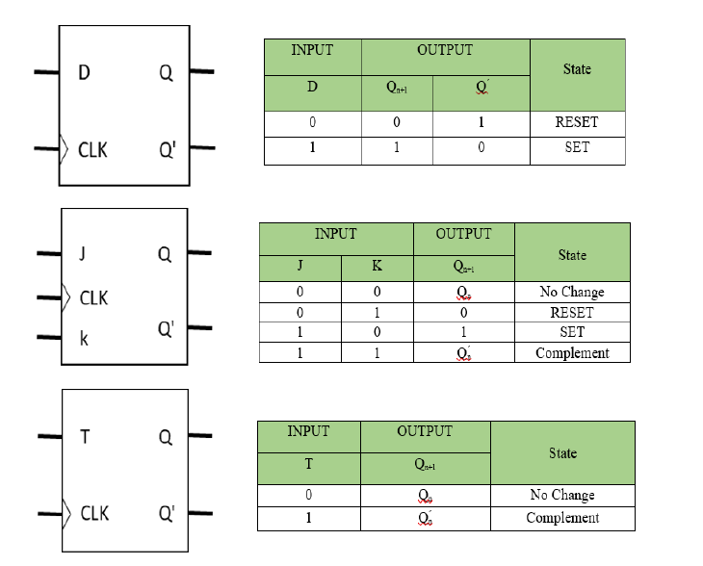
D, T, and JK flip flops.

Slide 17
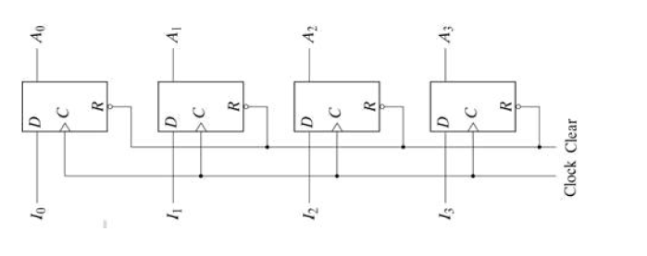
Registers
Digital systems use registers to hold binary entities. The register is a collection of flip flops; N-bit register consists of N flip-flops. (why not latches?)
The following shows simple 4-bit register implemented with D- flip flops. All the flip-flops are driven by a common clock, and all are reset simultaneously.

Slide 18
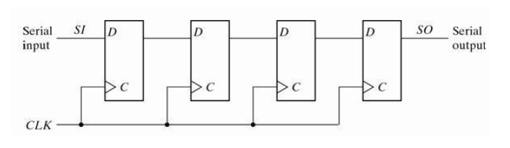
Shift registers
Are a group of flip-flops connected in a chain so that the output from one flip-flop becomes the input of the next flip-flop.

Slide 19
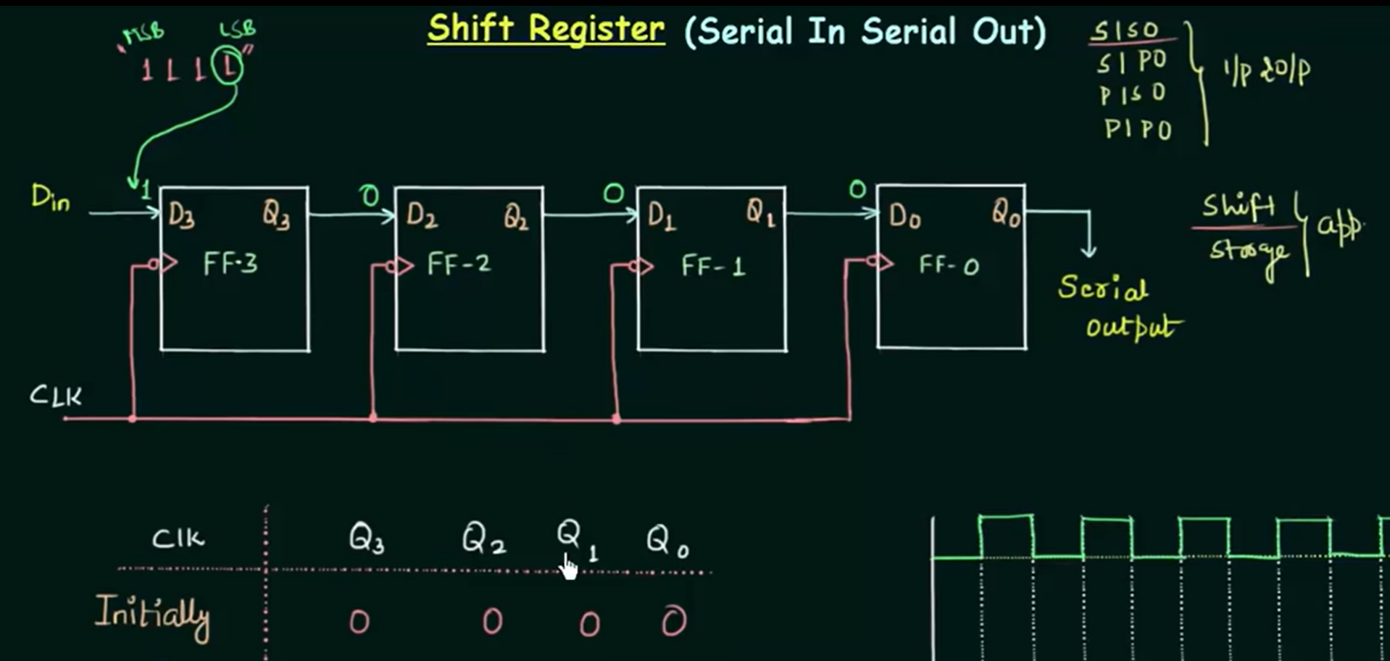
Source: https://www.youtube.com/watch?v=unorn9n-UpE

Slide 20
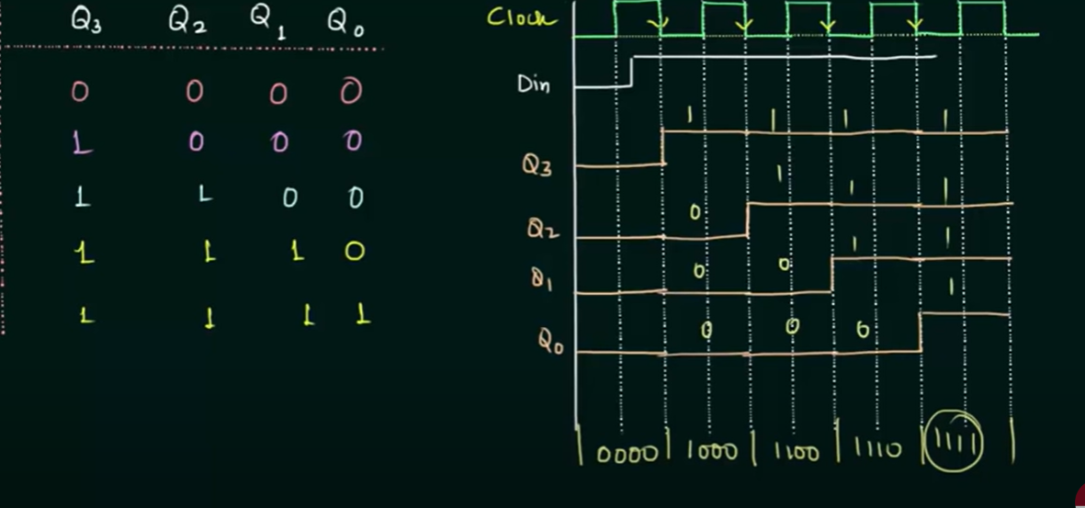

Slide 21
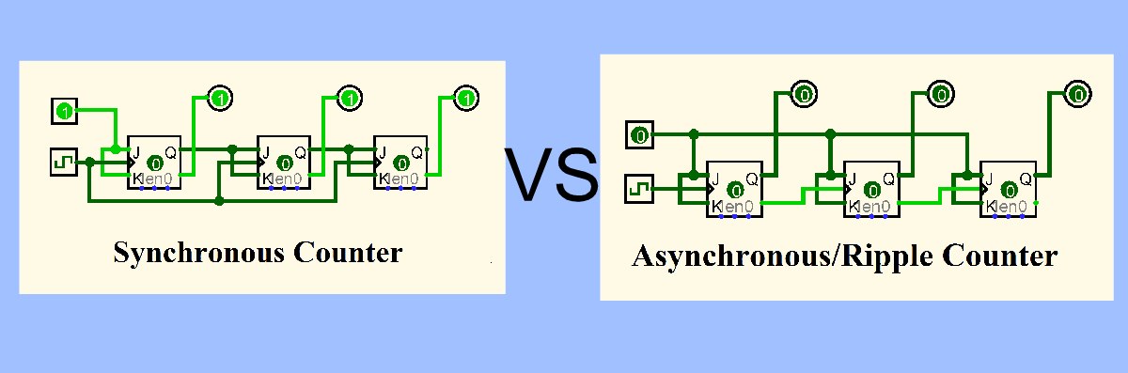
Counters
The counter is a special-purpose register; it is a register that goes through a prescribed sequence of states.
The counters are classified into two categories: Ripple and Synchronous counters.
In ripple counters, there is no common clock; the flip-flop output transition serves as a source for triggering other flip-flops. In synchronous counters, all flip flops receive a common clock

Slide 22
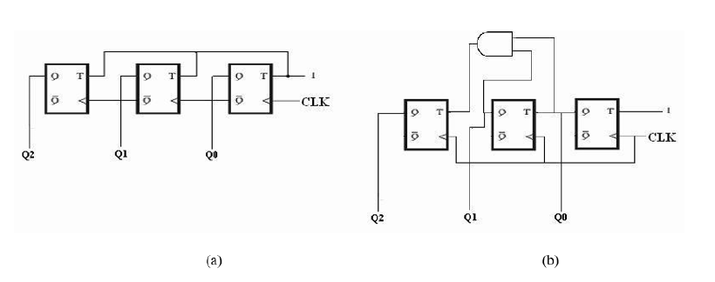
What are the types of A and B counters?

Slide 23
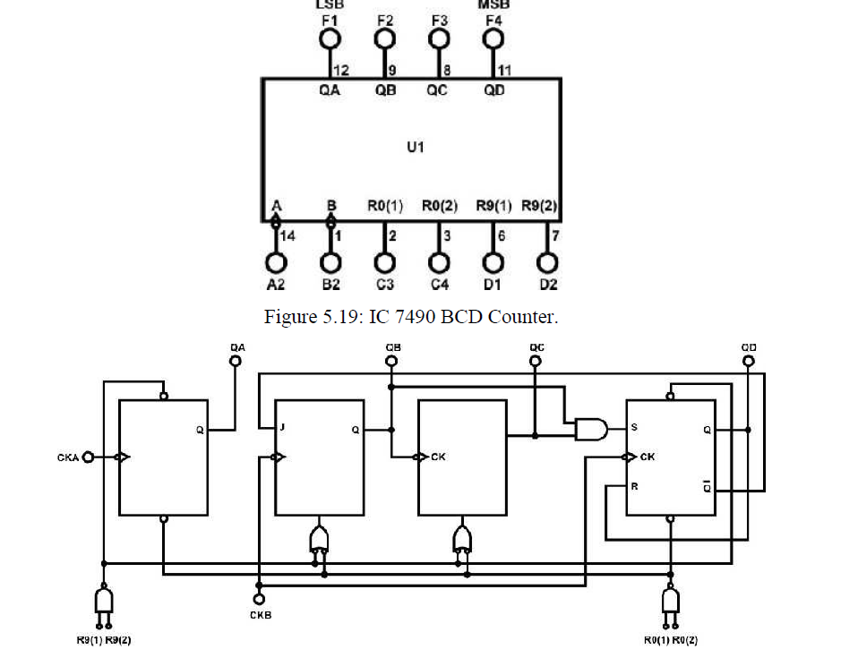
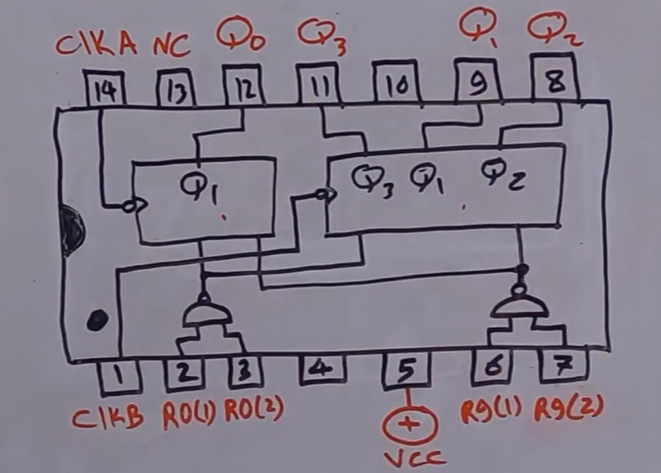
7490 IC

Slide 24
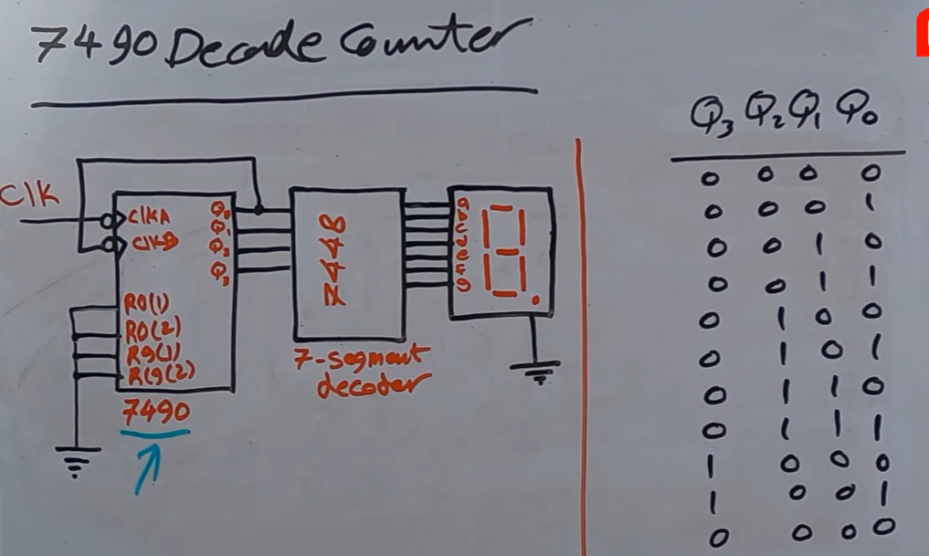
Counter using 7490 IC

Slide 25
Proteus software

Slide 26
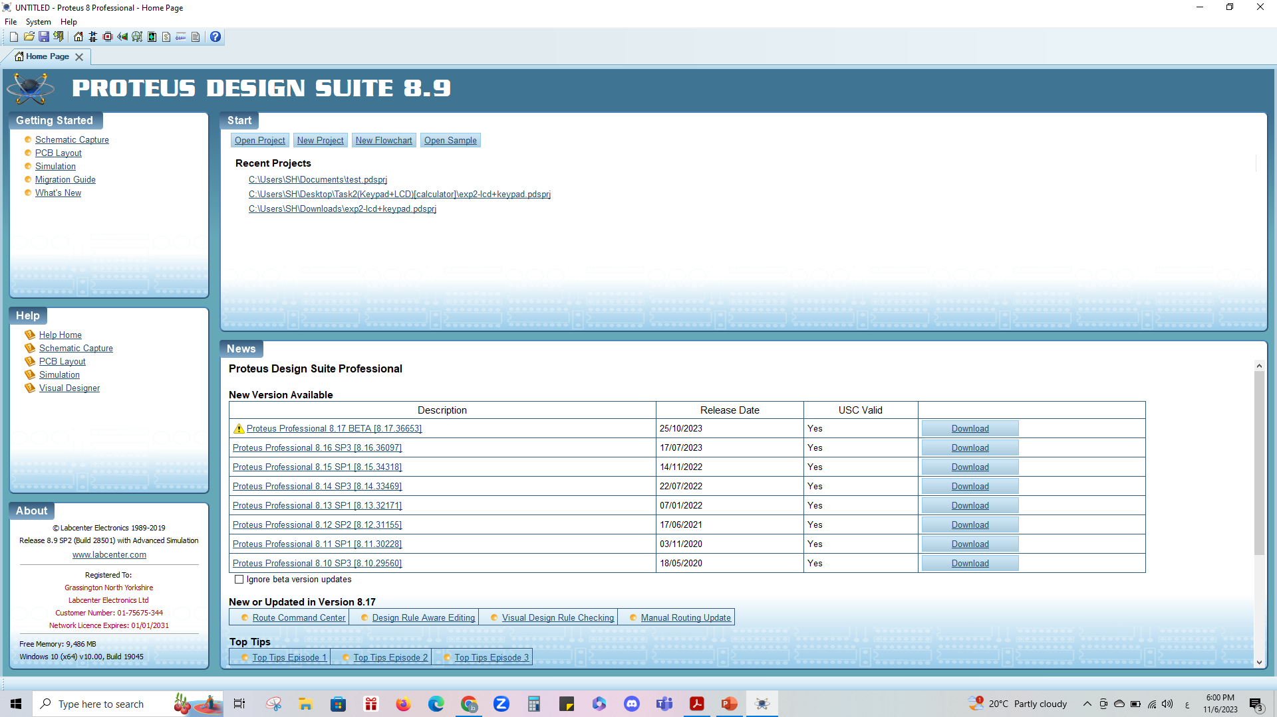
Proteus software: Starting page

Slide 27
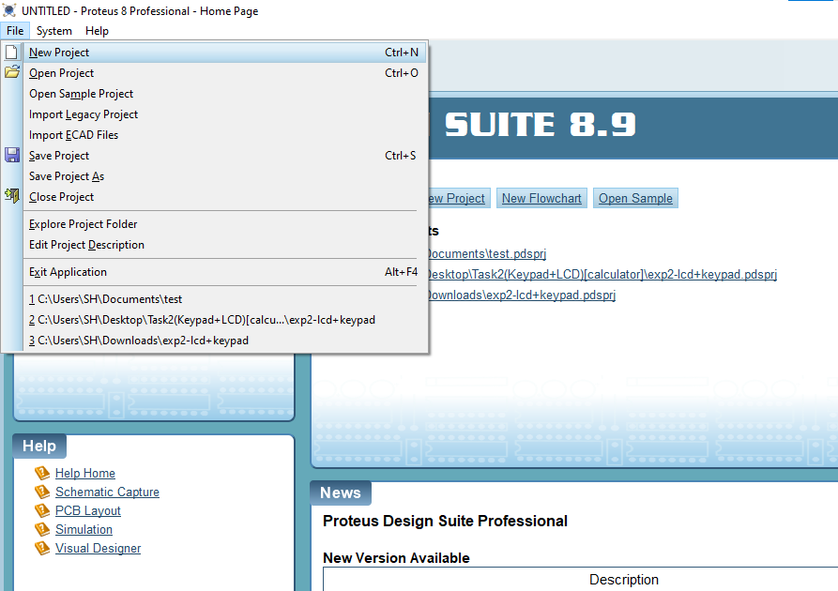
Proteus software: New project

Slide 28
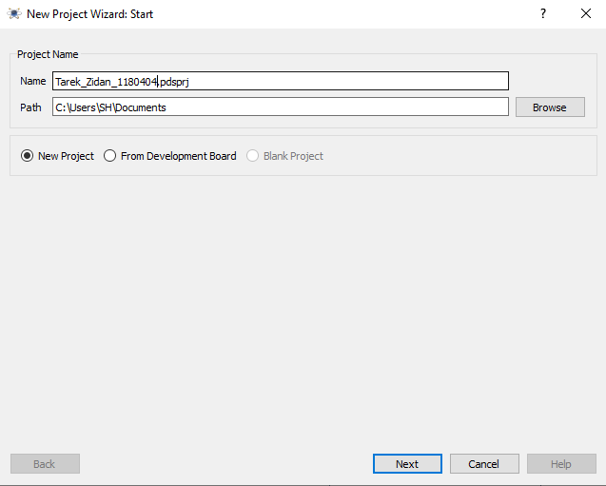
Proteus software: Name your project

Slide 29
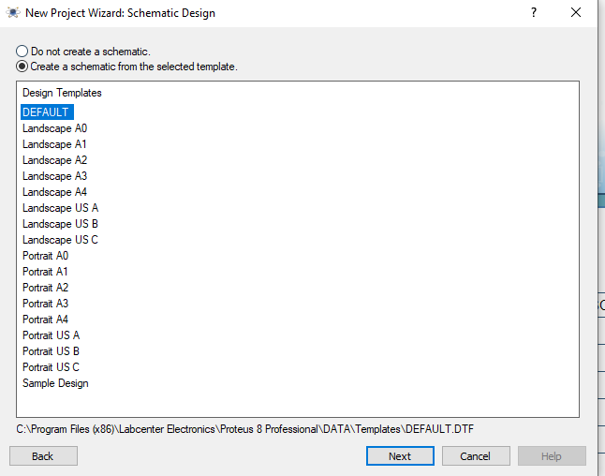
Proteus software: Create schematic (DEFAULT)

Slide 30
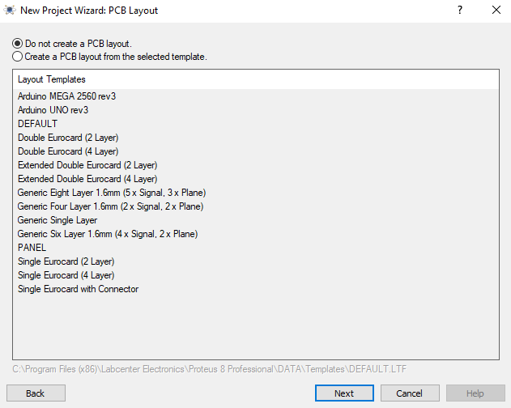
Proteus software: Do not create a PCB layout

Slide 31
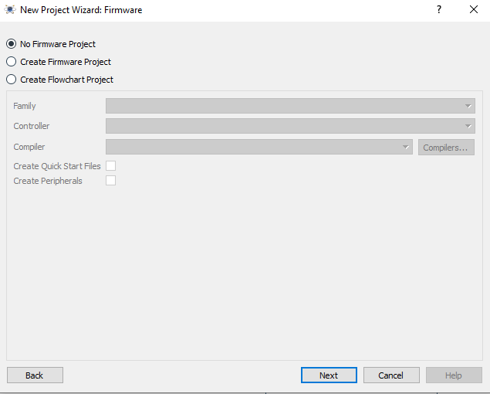
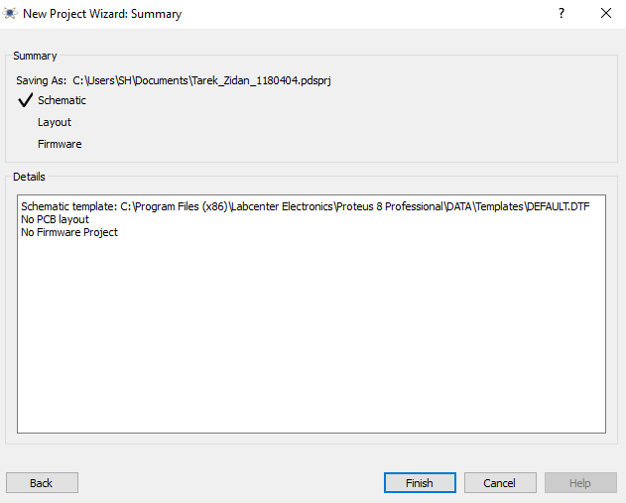
Proteus software: Finish setup

Slide 32
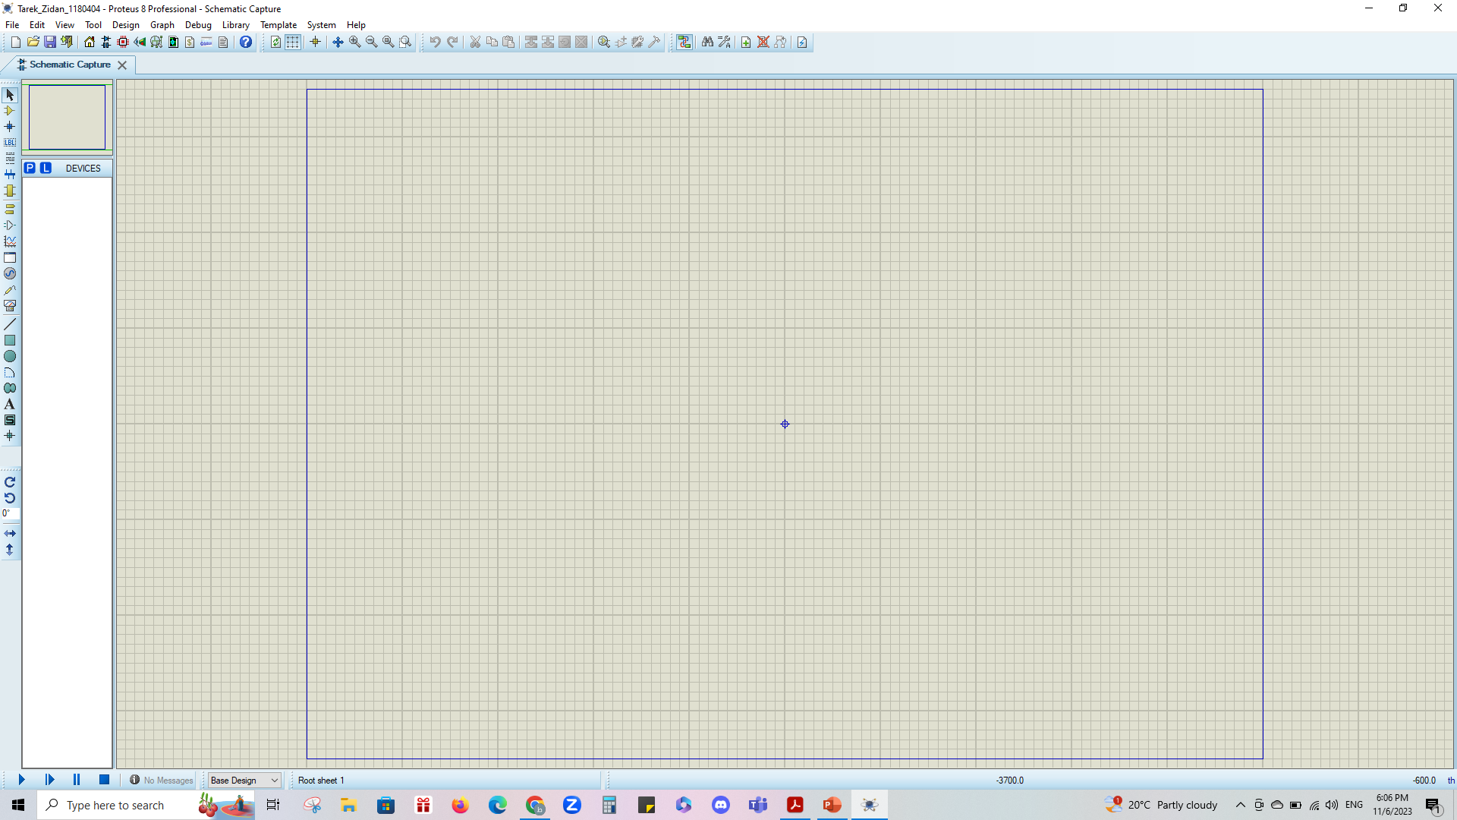
Proteus software: Working page

Slide 33
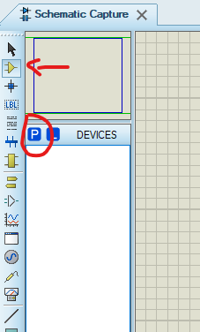
Proteus software: To get a component

Slide 34
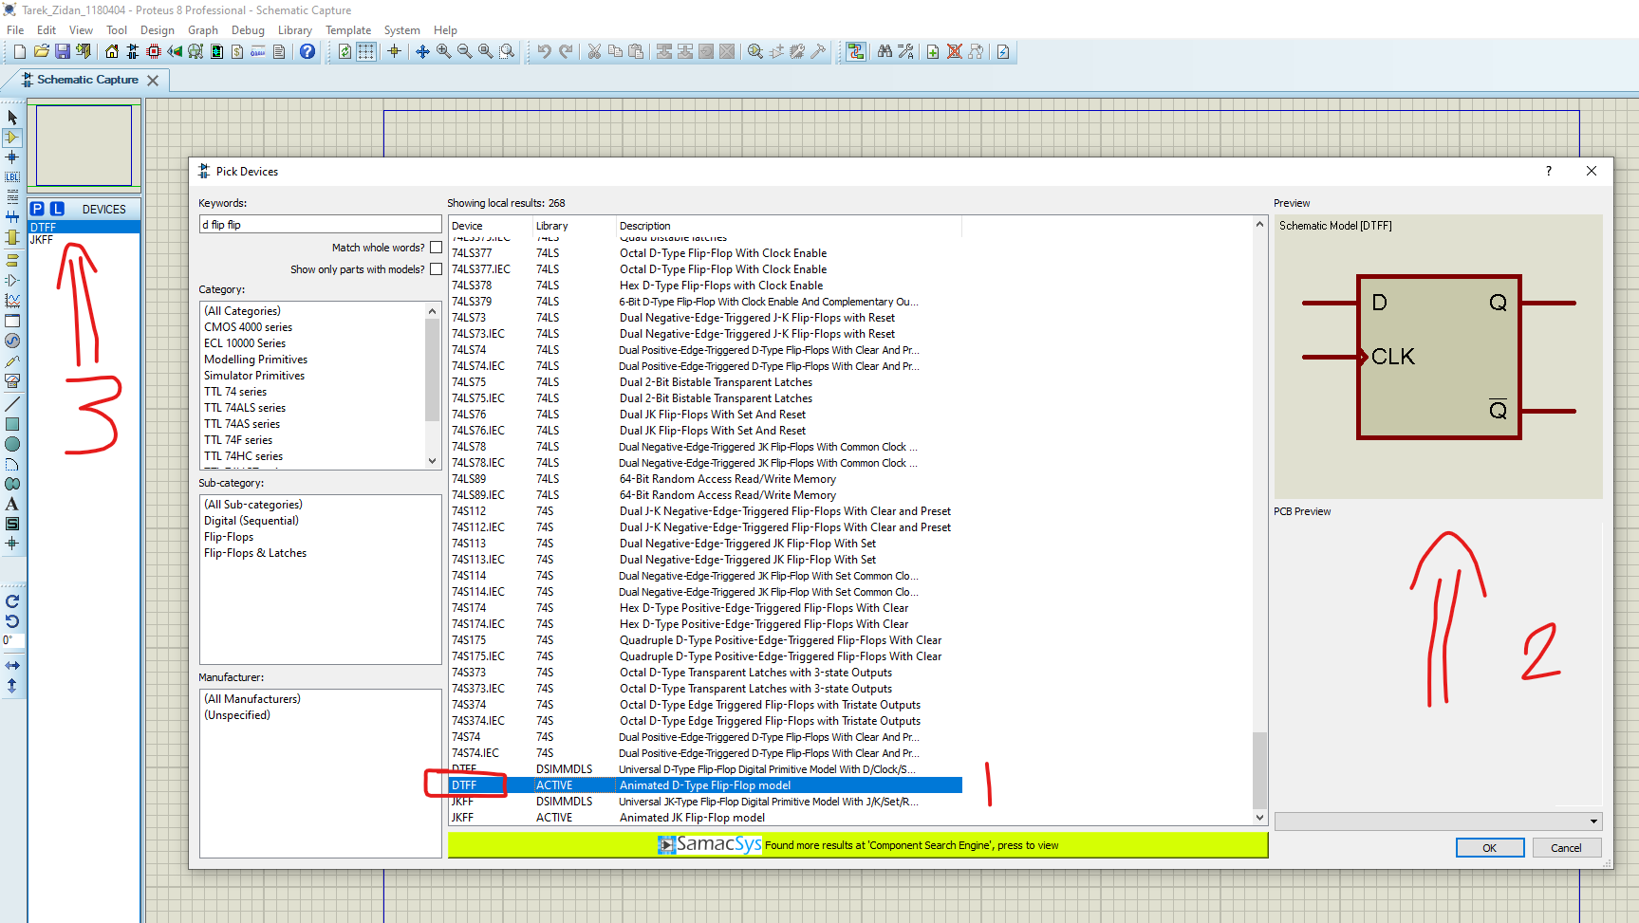
Proteus software: Choose component E.g.

Slide 35
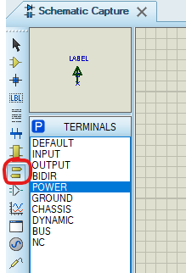
Proteus software: To get a Power (5v) or Ground (0v) when needed

Slide 36
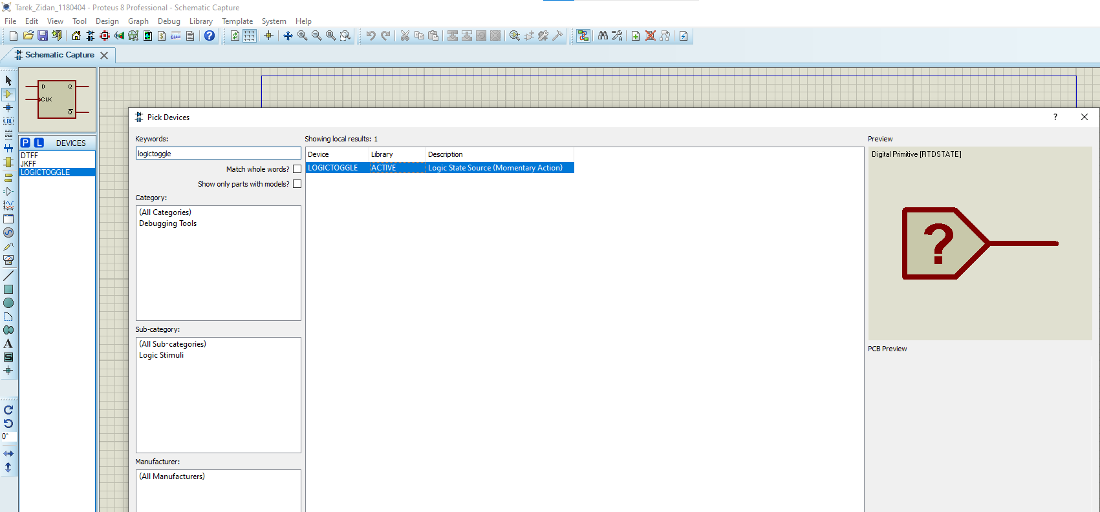
Proteus software: Input component

Slide 37
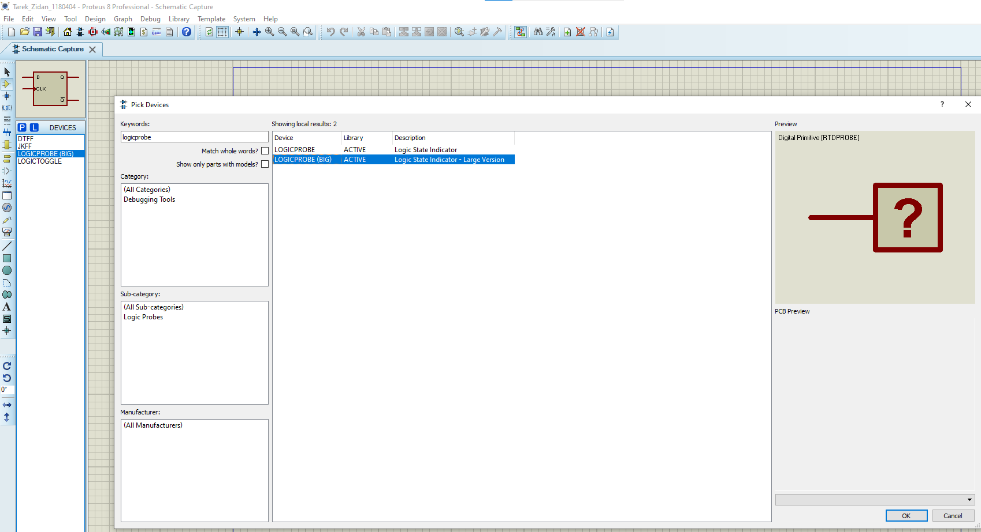
Proteus software: Output component

Slide 38
Examples

Slide 39
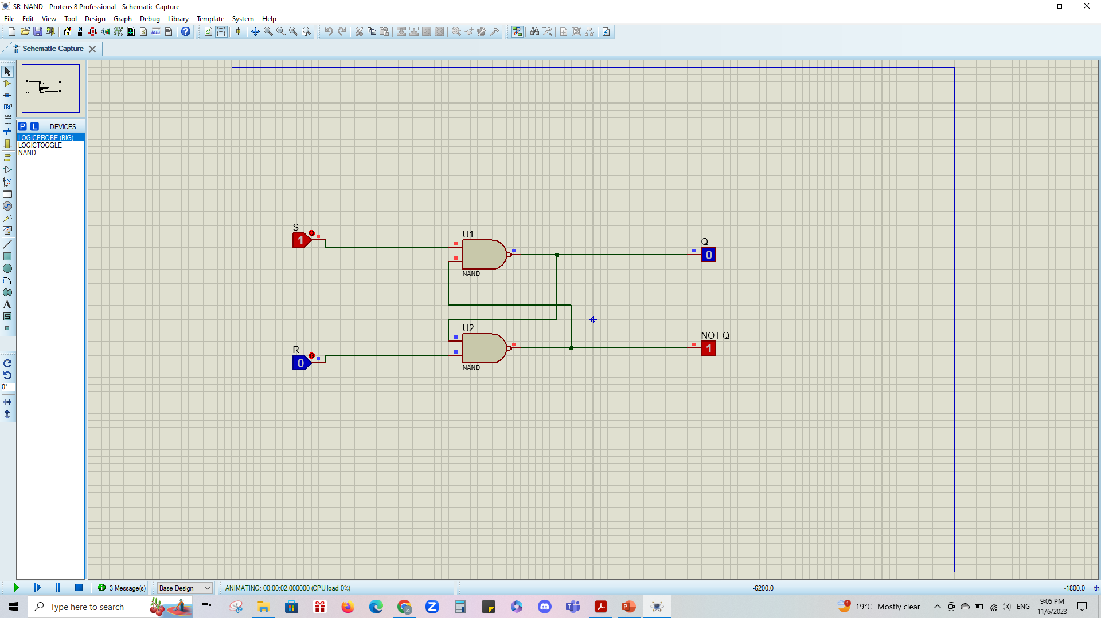
SR Latch - NAND

Slide 40
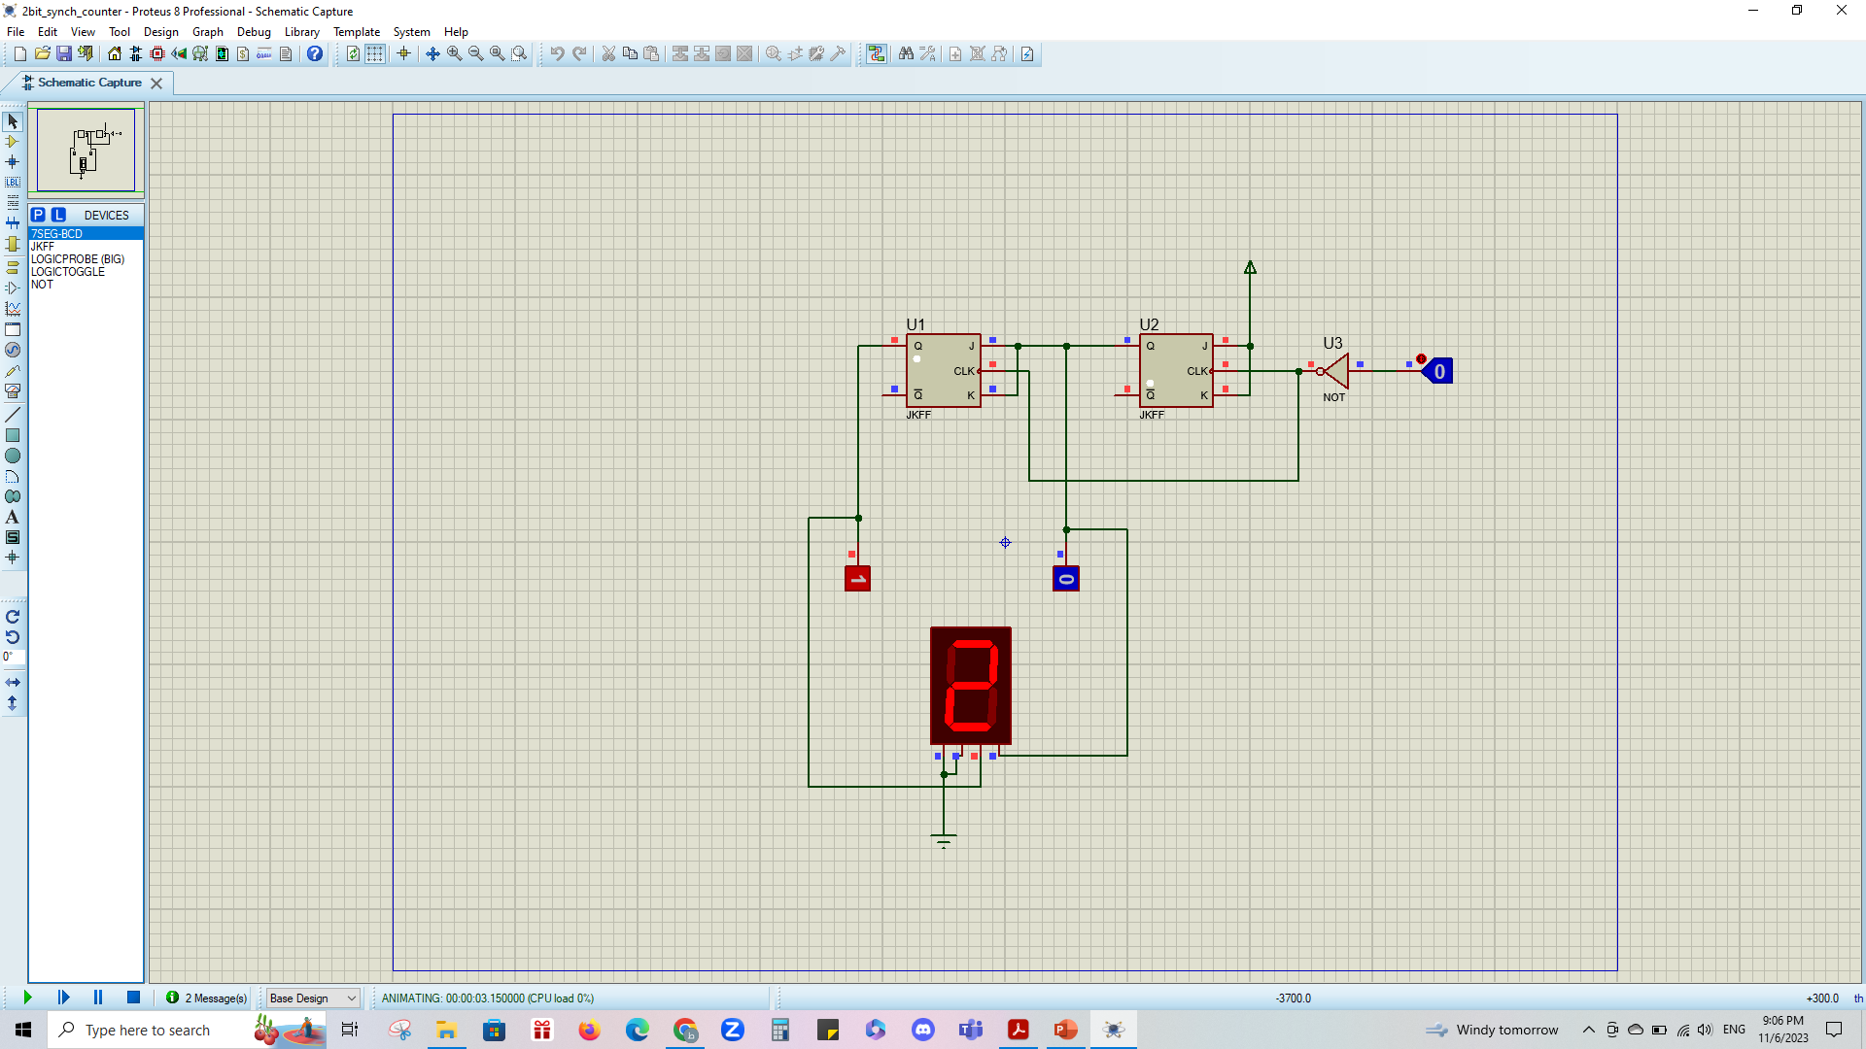
2-bit synchronous counter

Slide 41
What to do now?
1- Build SR latch using NAND and fill the table.
2- Build SR latch using NOR.
3- Build RS latch with control input using NAND and fill the table.
4- Build D latch from RS latch using NAND and fill the table.
5- Build JK latch with RS latch and fill the table (see Figure 5.13).
6- Build JK Flip-flop with master- slave RS latches and fill the table (See Figure 5.14) and note that you cany copy previous latches. (right click -> copy to clipboard -> paste from clipboard)

Slide 42
What to do now?
7- Build Shift Register with D Flip-Flops and fill the table (See figure 5.15).
8- Build 2-bit Synchronous Counter using JKFF and fill the table (See Figure 5.17).
9- Build 3-bit (divide-by-eight) Ripple Counter using JKFF and fill the table (See Figure 5.18).
10- Build BCD counter using IC 7490 and fill the table.

