Slide 1
Chapter 5 Loops

Slide 2
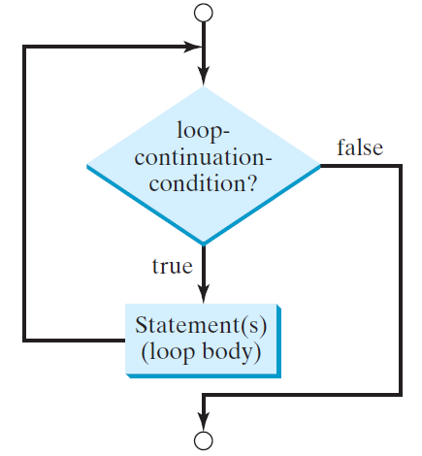
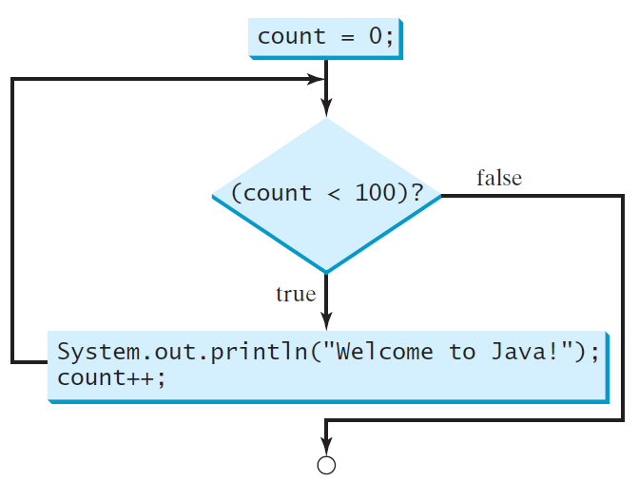
while Loop Flow Chart
int count = 0;
while (count < 100) {
System.out.println("Welcome to Java!");
count++;
}
while (loop-continuation-condition) {
// loop-body;
Statement(s);
}

Slide 3
Trace while Loop
animation
Initialize count
int count = 0;
while (count < 2) {
System.out.println("Welcome to Java!");
count++;
}

Slide 4
Problem: Repeat Addition Until Correct
Recall that Listing 3.1 AdditionQuiz.java gives a program that prompts the user to enter an answer for a question on addition of two single digits. Using a loop, you can now rewrite the program to let the user enter a new answer until it is correct.
RepeatAdditionQuiz
Run

Slide 5
import java.util.Scanner;
public class RepeatAdditionQuiz {
public static void main(String[] args) {
int number1 = (int)(Math.random() * 10);
int number2 = (int)(Math.random() * 10);
// Create a Scanner
Scanner input = new Scanner(System.in);
System.out.print( "What is " + number1 + " + " + number2 + "? ");
int answer = input.nextInt();
while (number1 + number2 != answer) {
System.out.print("Wrong answer. Try again. What is " +
number1 + " + " + number2 + "? ");
answer = input.nextInt();
}
System.out.println("You got it!");
}
}

Slide 6
Problem: An Advanced Math Learning Tool
The Math subtraction learning tool program generates just one question for each run. You can use a loop to generate questions repeatedly. This example gives a program that generates five questions and reports the number of the correct answers after a student answers all five questions.
SubtractionQuizLoop
Run

Slide 7
Ending a Loop with a Sentinel Value
You may use an input value to signify the end of the loop. Such a value is known as a sentinel value.
Scanner input = new Scanner(System.in);
// Read an initial data
System.out.print( "Enter an integer (the input ends if it is 0): ");
int data = input.nextInt();
// Keep reading data until the input is 0 int sum = 0;
while (data != 0) {
sum += data;
// Read the next data
System.out.print( "Enter an integer (the input ends if it is 0): ");
data = input.nextInt();
}
SentinelValue
Run

Slide 8
Caution
Don’t use floating-point values for equality checking in a loop control. Since floating-point values are approximations for some values, using them could result in imprecise counter values and inaccurate results. Consider the following code for computing 1 + 0.9 + 0.8 + ... + 0.1:
double item = 1; double sum = 0;
while (item != 0) { // No guarantee item will be 0
sum += item;
item -= 0.1;
}
System.out.println(sum);

Slide 9
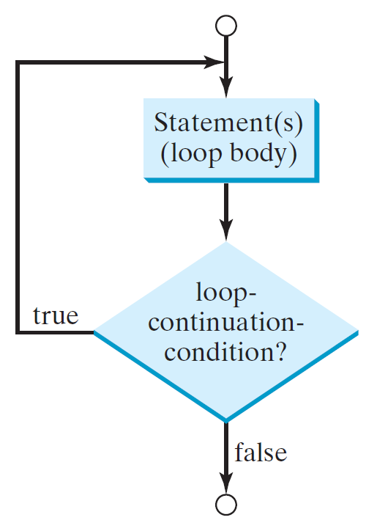
do-while Loop
do {
// Loop body;
Statement(s);
} while (loop-continuation-condition);

Slide 10
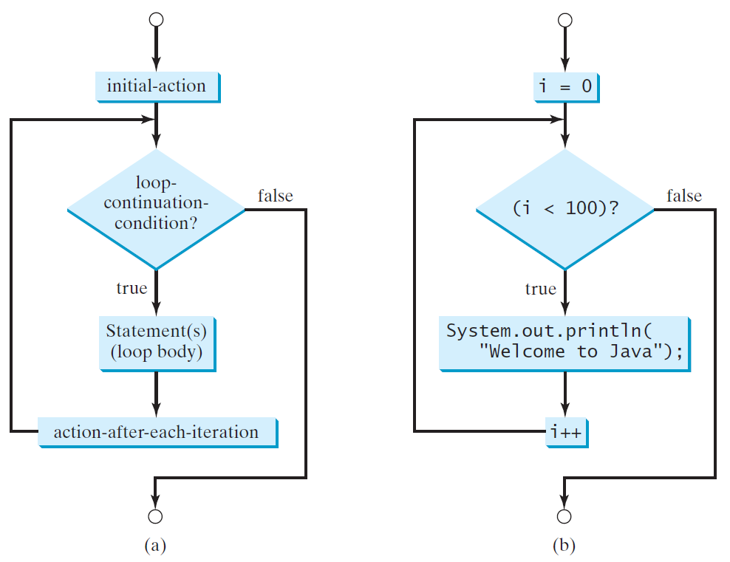
for Loops
for (initial-action; loop-continuation-condition; action-after-each-iteration) {
// loop body;
Statement(s);
}
int i;
for (i = 0; i < 100; i++) {
System.out.println(
"Welcome to Java!");
}

Slide 11
Trace for Loop
animation
Declare i
int i;
for (i = 0; i < 2; i++) {
System.out.println(
"Welcome to Java!");
}

Slide 12
Note
The initial-action in a for loop can be a list of zero or more comma-separated expressions. The action-after-each-iteration in a for loop can be a list of zero or more comma-separated statements. Therefore, the following two for loops are correct. They are rarely used in practice, however.
for (int i = 1; i < 100; System.out.println(i++));
for (int i = 0, j = 0; (i + j < 10); i++, j++) {
// Do something
}

Slide 13
Note
If the loop-continuation-condition in a for loop is omitted, it is implicitly true. Thus the statement given below in (a), which is an infinite loop, is correct. Nevertheless, it is better to use the equivalent loop in (b) to avoid confusion:

Slide 14
Caution
Adding a semicolon at the end of the for clause before the loop body is a common mistake, as shown below:
Logic Error
for (int i=0; i<10; i++);
{
System.out.println("i is " + i);
}

Slide 15
Caution, cont.
Similarly, the following loop is also wrong:
int i=0;
while (i < 10);
{
System.out.println("i is " + i);
i++;
}
In the case of the do loop, the following semicolon is needed to end the loop.
int i=0;
do {
System.out.println("i is " + i);
i++;
} while (i<10);
Logic Error
Correct

Slide 16
Problem: Finding the Greatest Common Divisor
Problem: Write a program that prompts the user to enter two positive integers and finds their greatest common divisor.
// Prompt the user to enter two integers
System.out.print("Enter first integer: ");
int n1 = input.nextInt();
System.out.print("Enter second integer: ");
int n2 = input.nextInt();
int gcd = 1;
int k = 2;
while (k <= n1 && k <= n2) {
if (n1 % k == 0 && n2 % k == 0)
gcd = k;
k++;
}
GreatestCommonDivisor
Run

Slide 17
Case Study: Converting Decimals to Hexadecimals
Hexadecimals are often used in computer systems programming (see Appendix F for an introduction to number systems). How do you convert a decimal number to a hexadecimal number? To convert a decimal number d to a hexadecimal number is to find the hexadecimal digits h_{n}, h_{n-1}, h_{n-2}, ... , h₂, h₁, and h₀ such that
These hexadecimal digits can be found by successively dividing d by 16 until the quotient is 0. The remainders are h₀, h₁, h₂, ... , h_{n-2}, h_{n-1}, and h_{n}.
Dec2Hex
Run

Slide 18
break

Slide 19
continue

Slide 20
Problem: Checking Palindrome
A string is a palindrome if it reads the same forward and backward. The words “mom,” “dad,” and “noon,” for instance, are all palindromes.
// Prompt the user to enter a string
System.out.print("Enter a string: ");
String s = input.nextLine();
// The index of the first character in the string
int low = 0;
// The index of the last character in the string
int high = s.length() - 1;
boolean isPalindrome = true;
while (low < high) {
if (s.charAt(low) != s.charAt(high)) {
isPalindrome = false;
break;
}
low++;
high--;
}
Palindrome
Run

Slide 21
Problem: Displaying Prime Numbers
Problem: Write a program that displays the first 50 prime numbers in five lines, each of which contains 10 numbers. An integer greater than 1 is prime if its only positive divisor is 1 or itself. For example, 2, 3, 5, and 7 are prime numbers, but 4, 6, 8, and 9 are not.
Solution: The problem can be broken into the following tasks:
For number = 2, 3, 4, 5, 6, ..., test whether the number is prime.
Determine whether a given number is prime.
Count the prime numbers.
Print each prime number, and print 10 numbers per line.
for (int divisor = 2; divisor <= number / 2; divisor++) {
if (number % divisor == 0) {
isPrime = false;
break;
}
}
PrimeNumber
Run

