Slide 1
Evaluating Serious Games
Framework and Methods

Slide 2
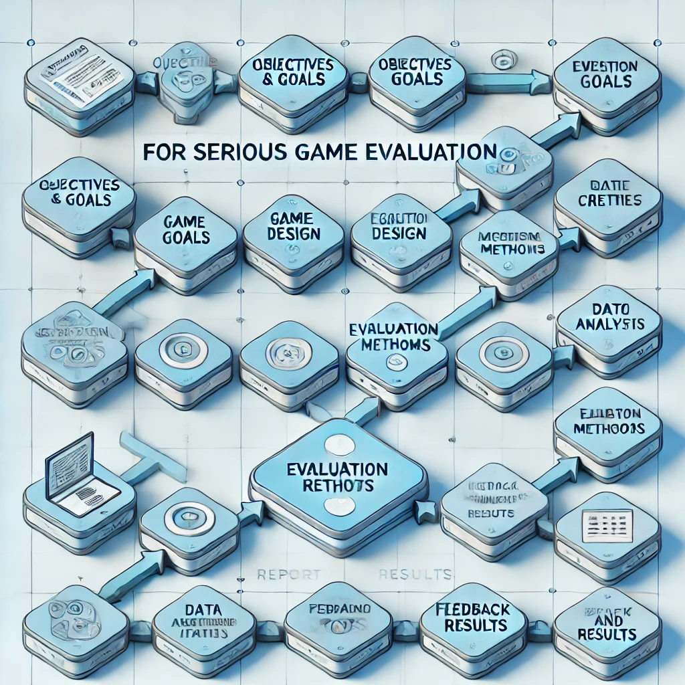

Slide 3
1. Define Learning Objectives and Outcomes
- Clarity of Objectives: Are educational goals clear?
- Relevance: Does the game content align with learning objectives?
- Knowledge or Skill Acquisition: Assess player’s knowledge/skills gained.

Slide 4
2. Engagement and Motivation
- User Engagement: Does the game hold attention?
- Intrinsic Motivation: Are elements motivating by nature?
- Feedback and Rewards: Is feedback constructive?

Slide 5
3. Usability and Accessibility
- Ease of Use: Is the interface intuitive?
- Adaptability: Can the game adjust to player skill levels?
- Accessibility: Is the game inclusive and device-compatible?

Slide 6
4. Game Mechanics and Educational Integration
- Relevance of Mechanics: Are gameplay elements relevant?
- Balance Fun and Learning: Does it combine education and entertainment?
- Assessment Integration: Are there checkpoints to gauge progress?

Slide 7
5. Effectiveness in Meeting Learning Goals
- Pre- and Post-Testing: Knowledge gained via testing.
- Transferability of Skills: Are skills applicable to real-world contexts?
- Learning Retention: Assess knowledge retention over time.

Slide 8
6. Player Feedback and Satisfaction
- Survey and Interviews: Gather direct player feedback.
- Engagement Metrics: Track time spent and repeat plays.
- Qualitative Feedback: Understand player enjoyment and challenges.

Slide 9
7. Technical Performance
- Stability and Bugs: Any technical issues?
- Platform Compatibility: Does it work on all intended platforms?
- Data Privacy and Security: Ensure compliance with privacy rules.

Slide 10
8. Long-Term Impact and Improvement
- Progress Tracking: Measure progress over time.
- Iterative Improvement: Use feedback to update and improve.
- Behavioral Change: Any measurable behavioral changes post-game?

Slide 11
Excercise
Evaluate the following Game:
Game URL

