Slide 1
Sports Nutrition Supplement: straight to the point with no Jargon
By Mohannad Kafri, PhD

Slide 2
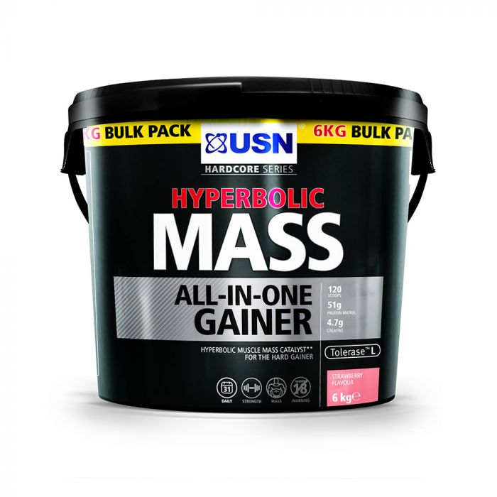
ALL-IN-ONE
Muscle gain
Provides micronutrients
Ergogenic aids
Branched Chain Amino Acids
May not contain effective doses
May contain Impurities
Maybe useful for beginners
Maybe expensive due to the presence of unproven ingredient
VERDICT
Can be useful although a high quality protein food such as milk is proven to improve muscle protein synthesis
Expensive !!!!!!!

Slide 3
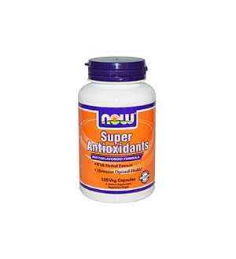
Anti-Oxidants
Remember HORMESIS?
Will it promote adaptations?
The Verdict
  Not enough evidence?
  Does it hamper exercise adaptations?

Slide 4
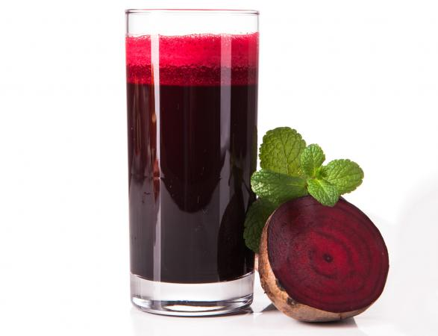
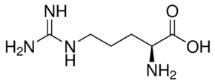
Increasing Blood Flow
Arginine
Beet Root/Beet Juice
Increase Nitric Oxide (NO)?
Why is it important in exercise?
Studies: not effective
Arginine Keto isocaproate / alpha ketogluterate
Verdict?
Consist of Nitrates..fate?
Studies: Effective in non-elite athletes
Side Effects, red urine!
Health concerns regarding Nitrosamines?

Slide 5

Reducing acidity
Increase synthesis of Carnosine
Reduces Lactic acid accumulation in muscle
Effective in short duration power activities
Side effects may include skin tingeling
Verdict: short power activities on regular bases only, reduce the dose no more than 2% till termination

Slide 6
Reducing Muscle Acidity
Sodium Bicarbonate
What does it do, how can it improve performance?
One for short duration high intensity exercise
Side effects includes nausea, vomiting
Verdict?

Slide 7
Branched Chain Amino Acids
What are they?
Varied evidence on reducing Muscle breakdown
Consuming BCAA may reduce other amino acid absorption
No clear evidence of benefit
Verdict?

Slide 8
Leucine
BCAA
  found in milk, dairy, meat, fish, poultry
Stimulate MPS
  Affect mTOR
Evidence-improved MPS, power, endurance
Side effects-none
Verdict?

Slide 9
Caffeine
Recent research suggested improved time trial
  Delays the feeling of fatigue and Pain
Anhydrous pill most effective
Beta-oxidation-incorrect
  Only spares glycogen
Side effects- varies per individual
Verdict?

Slide 10
Guarana
A South American shrub
Increase metabolic rate
Alertness
Stimulant
Evidence-not enough evidence but?
Side effect-as in caffeine
verdict?

Slide 11
Colostrum
Milk produced by cow in the first few days after calf birth
Rich in Immunoglobulin, IGF-I, Cytokines
May reduce URTI in athletes
Side effects-none
IGF-I and WADA-be very careful
Verdict?

Slide 12
Casein protein
Found in Milk
Slow absorption
Whey for immediate post exercise
Casien overnight
Side effect-none
Verdict?

Slide 13
Creatine
Refer to the previous slides
Creatine loading protocol
  0.3 g/kg BW for 5-7 days
  0.03 g/kg BW for one month (maintenance)

Slide 14
Taurine
Non-essential amino acid
  Synthesized in the body
Suggested to increase A.A transport to muscles
Studies-no evidence
Side effect-in very high doses > 3g it can be toxic
Verdict?

Slide 15
Dehydroepiandrosterone (DHEA)
Adrenal gland
Androgen-precursor for all steroid hormones in the body (Estrogen, Testosterone, etc..)
Studies-no clear benefit or improvement in muscle mass
Still consumed by many athletes
Side effect-gynecomastia, ↑Chol., Liver Cysts, different cancers, male characteristics in females
Verdict?

Slide 16
Phoromones
DHEA, androsterodione, norandrosterodione
Claims that
  It increases testosterone level hence?
Evdience-no clear evidence
Side effects as in DHEA
Banned by WADA
Verdict

Slide 17
Ephedrine
Ephedra (Ma Huang Plant)
Stimulant
  Norepinephrine & Adrenaline-↑ Metabolic rate
  Suppresses appetite
Effective with caffeine
Used in small doses as cold treatment
Side effect-tachycardia,↑BP, insomnia, irritability, nausea, stroke, MI, death
Banned by WADA
Verdict?

Slide 18
Fat burners
Herb mix
  Green tea extract
  Citrus aurantium extract
  Coloes forshkoli*
Side effect-can increase blood pressure*
Not enough evidence
verdict?

Slide 19
Green Tea extract
Evidence
  More weight loss in those who consumed it
  Not a huge caloric loss
  Only with exercise
Side effect-if in high doses similar to caffeince
Verdict?

Slide 20
Omega-3 fatty acid
Precursor for EPA & DHA
↓inflammation, ↓BP, ↑cell membrane fluidity
Study outcomes
  ↑lean body mass, ↑blood flow during exercise
  No benefit
Side effect-hemorrhage in high doses
Verdict?

Slide 21
Glucosamine
Amino sugar found in cartilage
Its presence ↑proteoglycan synthesis in cartilage cells
Suggested to repair damaged joints
Studies-no evidence
  Damage repair or pain reduction
Side effects-digestive system discomfort
Verdict?

Slide 22
Ginseng
Korean and Siberian
Adaptogen-it improves the body ability deal with stress
  Increases stamina
  Affect cortisol level (act on adrenal gland)
  Improved blood flow
Studies-Not much evidence
Side effect- ↑BP & Insomnia
Verdict?

Slide 23
Glycerol
Found in fats
Glycerol
  Increases water volume in inter and extracellular spaces
  Increased hydration and endurance
Studies suggest improved endurance with glycerol
Banned by WADA
Verdict?

Slide 24
References
Journal of the International Society of Sports Nutrition: https://jissn.biomedcentral.com/
Sports Supplements: Which nutritional supplements really work , by Anita Bean 2015

